Slide 1
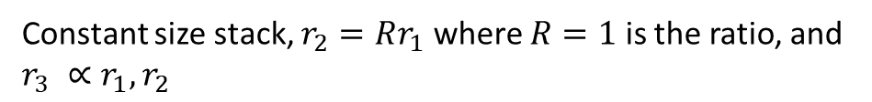
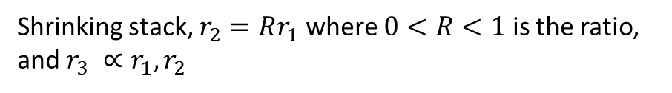
There are two vertebrae arrangements under consideration for the tentacle arm: shrinking stack, where each vertebrae is a scaled-down version of the previous (but otherwise similar), and constant size stack, where each vertebrae is identical. As both versions will be 3D printed, there is no specific manufacturing advantage to either. The differences in the design will arise from the path the tip traces maximum displacement on one side to the maximum displacement on the other.
I assume these problems are hard, although I have not attempted them myself. This is not an exam, and we don’t even need derivations, so long as the model is continuous, and the boundaries are clearly established. A computational implementation (preferably python, but so long as it can be translated, anything is acceptable) is also perfectly valid as a solution. Models do not need to be invertible, so long as a numerical method can solve it relatively quickly.
Shrinking stack, $r_{2}=Rr_{1}$ where $0<R<1$ is the ratio, and $r_{3} ∝r_{1}, r_{2}$
Constant size stack, $r_{2}=Rr_{1}$ where $R=1$ is the ratio, and $r_{3} ∝r_{1}, r_{2}$

Slide 2

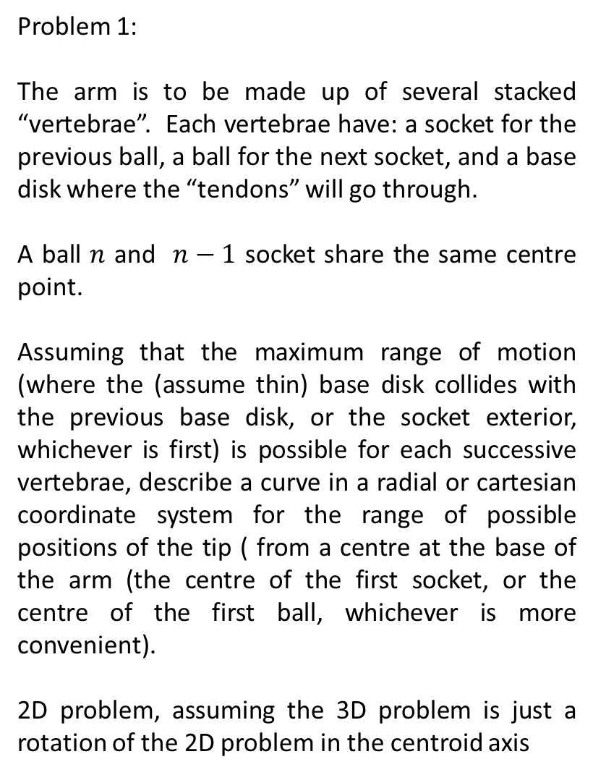

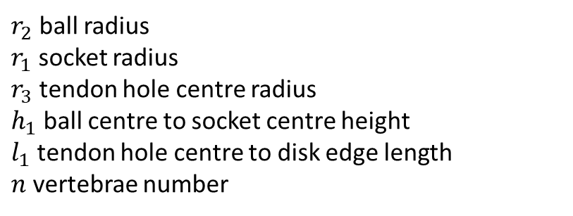



Problem 1:
The arm is to be made up of several stacked “vertebrae”. Each vertebrae have: a socket for the previous ball, a ball for the next socket, and a base disk where the “tendons” will go through.
A ball $n$ and $n−1$ socket share the same centre point.
Assuming that the maximum range of motion (where the (assume thin) base disk collides with the previous base disk, or the socket exterior, whichever is first) is possible for each successive vertebrae, describe a curve in a radial or cartesian coordinate system for the range of possible positions of the tip ( from a centre at the base of the arm (the centre of the first socket, or the centre of the first ball, whichever is more convenient).
2D problem, assuming the 3D problem is just a rotation of the 2D problem in the centroid axis
$$r_{2}$$
$$h_{1}$$
$$r_{1}$$
$$r_{3}$$
$$l_{1}$$
$r_{2}$ ball radius
$r_{1}$ socket radius
$r_{3}$ tendon hole centre radius
$h_{1}$ ball centre to socket centre height
$l_{1}$ tendon hole centre to disk edge length
$n$ vertebrae number

Slide 3



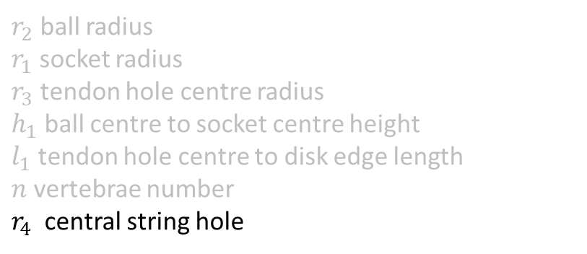



$$r_{4}$$
Problem 2:
At the end of the arm, there is a grabber that also uses a cable system to open and close. To use this, the cables must be passed through the centre of the arm so that their length does not change through movement of the arm alone.
Assuming that the cables have a radius of 0 (so the maximum deflection of each successive vertebrae is when the two central string hole circumferences coincide), what is the new limited range of motion?
$$r_{2}$$
$$h_{1}$$
$$r_{1}$$
$$r_{3}$$
$$l_{1}$$
$r_{2}$ ball radius
$r_{1}$ socket radius
$r_{3}$ tendon hole centre radius
$h_{1}$ ball centre to socket centre height
$l_{1}$ tendon hole centre to disk edge length
$n$ vertebrae number
$r_{4}$ central string hole

Slide 4



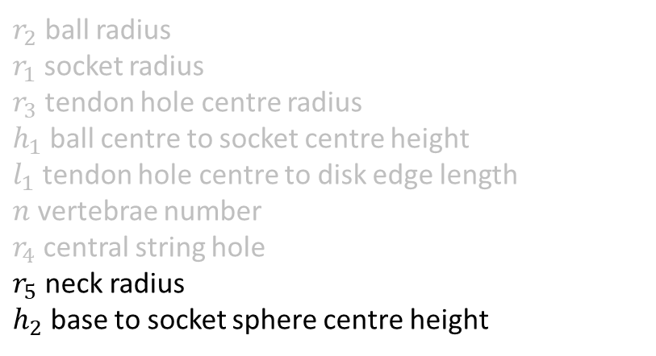





$$r_{4}$$
$$r_{2}$$
$$h_{1}$$
$$r_{5}$$
$r_{2}$ ball radius
$r_{1}$ socket radius
$r_{3}$ tendon hole centre radius
$h_{1}$ ball centre to socket centre height
$l_{1}$ tendon hole centre to disk edge length
$n$ vertebrae number
$r_{4}$ central string hole
$r_{5}$ neck radius
$h_{2}$ base to socket sphere centre height
$$r_{1}$$
$$h_{2}$$
$$l_{1}$$
$$r_{3}$$

Slide 5

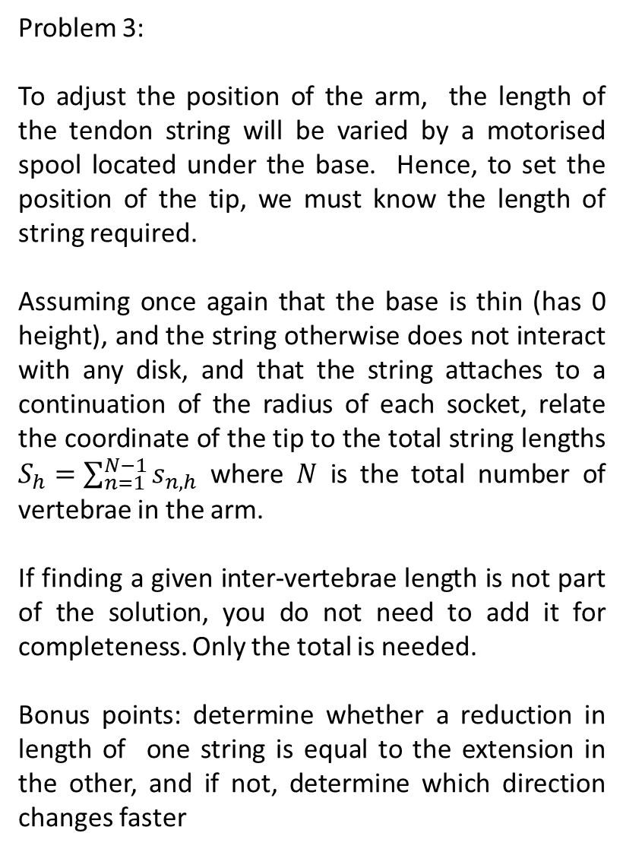

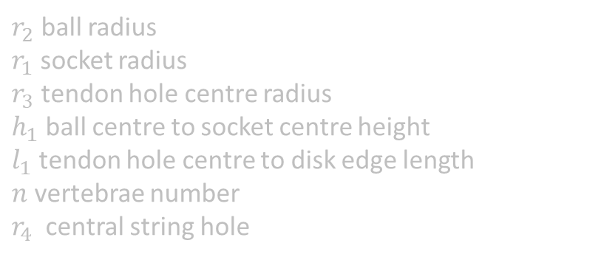



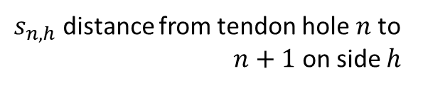

$$s_{3,l}$$
Problem 3:
To adjust the position of the arm, the length of the tendon string will be varied by a motorised spool located under the base. Hence, to set the position of the tip, we must know the length of string required.
Assuming once again that the base is thin (has 0 height), and the string otherwise does not interact with any disk, and that the string attaches to a continuation of the radius of each socket, relate the coordinate of the tip to the total string lengths $S_{h}=\sum_{n=1}^{N−1}{s_{n,h}}$ where $N$ is the total number of vertebrae in the arm.
If finding a given inter-vertebrae length is not part of the solution, you do not need to add it for completeness. Only the total is needed.
Bonus points: determine whether a reduction in length of one string is equal to the extension in the other, and if not, determine which direction changes faster
$$s_{2,l}$$
$$s_{3,r}$$
$$s_{1,l}$$
$$s_{2,r}$$
$$s_{1,r}$$
$s_{n, h}$ distance from tendon hole $n$ to $n+1$ on side $h$
$r_{2}$ ball radius
$r_{1}$ socket radius
$r_{3}$ tendon hole centre radius
$h_{1}$ ball centre to socket centre height
$l_{1}$ tendon hole centre to disk edge length
$n$ vertebrae number
$r_{4}$ central string hole

