Slide 1
ShiftGuard10 v7
Distribution-Shift Robust Image Classification
via WideResNet-40-10 with 3-Seed Ensemble
Aarnav gupta
Aarush singh
Kaushey
Prince Pathak
Sushant kumar
230547
230743
230014
230018
231062
Targeting Macro F1 > 0.95 · Tesla T4 GPU · AMP-Accelerated
IIT Kanpur · Group 8

Slide 2

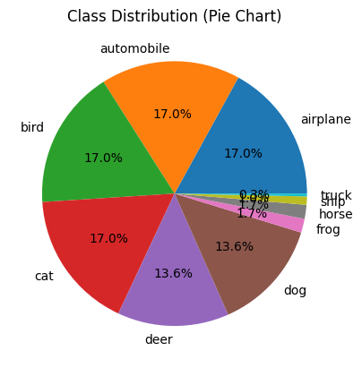
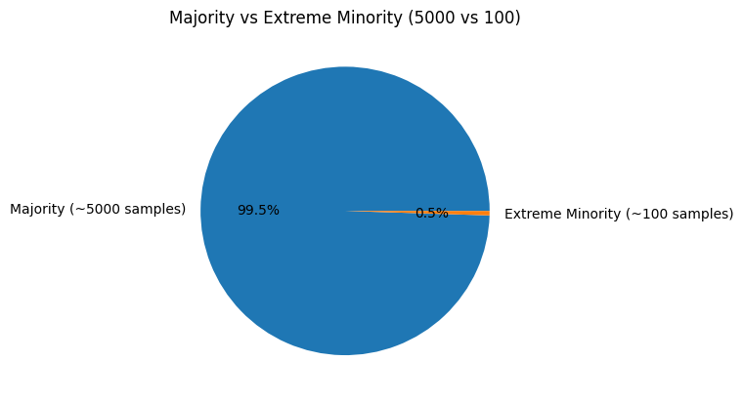
Exploratory Data Analysis (EDA)
10-Class Classification
Airplane, automobile, bird, cat, deer, dog, frog, horse, ship, truck — 32×32 RGB images in a CIFAR-style setup. Objective: maximize Macro F1.
Distribution Shift
Test images differ systematically from training images through augmentations, corruptions, and environmental changes — models must generalize.
Severe Class Imbalance
Majority classes have 5,000 samples; minority classes only 100. A brutal 50:1 ratio that standard cross-entropy completely fails to handle.

Slide 3
Dataset & Class Distribution
29,400
Total Training Images
10
Classes (CIFAR-style)
95/5
Train / Val Split
50:1
Imbalance Ratio
Class Distribution (Training Samples)
airplane
4,750
automobile
4,750
bird
4,750
cat
4,750
deer
3,800
dog
3,800
frog
475
horse
475
ship
285
truck
95
Sqrt-inverse frequency weighted sampler: wᵢ = 1/√Nᵢ ensures balanced mini-batches

Slide 4
Architecture: WideResNet-40-10
WRN-40-10 Specs
Network Block Architecture
Depth:
40 layers
Input 32×32×3
Conv 3×3 → 16 channels
Width Factor:
×10
WideBlock ×N → 160 ch (stride 1)
Parameters:
~54M
WideBlock ×N → 320 ch (stride 2)
Channels:
16→160→320→640
WideBlock ×N → 640 ch (stride 2)
Dropout:
p=0.3 (per block)
BN → ReLU → GlobalAvgPool
Head:
GlobalAvgPool + Linear
Linear Classifier → 10 classes
WideBlock: BN → ReLU → Conv3×3 → Dropout(0.3) → Conv3×3 + skip (1×1 proj)

Slide 5
Tackling Class Imbalance
A 3-Layer Defense Against the 50:1 Skew (Airplane/Truck)
01
Weighted Random Sampler
02
BalancedSoftmaxLoss
03
CutMix + MixUp
Data-level fix
Weight: wᵢ = 1/√Nᵢ
Sqrt-inverse frequency
Balanced mini-batches; replacement=True
Avoids extreme overfit on rare classes
Loss-level fix
Adds log(Nc / ΣNj) to logits pre-softmax
Shifts decision boundary toward minority classes
e.g. truck: −5.6 bias
Confidence-level fix
Prevents overconfident majority class predictions (Soft Labels)
MixUp: Linearly interpolates two images (pixel-by-pixel)
CutMix: Pastes a rectangular region from a shuffled image onto the current image
Label Smoothing ε=0.1
(Prevent overconfidence)

Slide 6
Augmentation Pipeline
Standard Augmentations
Standard Augmentations
★ Grey Cutout — Key Innovation
AutoAugment Optimised CIFAR-10 policy (25 sub-policies)
Invert, Rotate etc.
ColorJitter Brightness, contrast, saturation, hue
T.ColorJitter(brightness=0.05, contrast=0.05, saturation=0.05, hue=0.01)
Standard cutout fills with black. Our dataset has real 5–10px grey square artifacts. GreyCutout fills patches with the correctly normalized grey value:
GREY_FILL = [(0.5−μ)/σ] ≈ [0.035, 0.073, 0.205]
Batch-Level Mixing Strategy
25%
CutMix: Paste crop from shuffled image; labels mixed by area
25%
MixUp: Linear interpolate 2 images + distributions (α=0.4)
50%
Standard: BalancedSoftmaxLoss with label smoothing

Slide 7
Training Setup & Stochastic Weight Averaging
1
Optimiser
2
LR Schedule
SGD · Momentum 0.9 · Nesterov
5-epoch linear warmup from 0 → 0.1
Base LR: 0.1 · Weight Decay: 5×10⁻⁴
Cosine annealing epochs 5→300
Gradient clipping at norm = 1.0
Smooth decay prevents sharp transitions
AMP via GradScaler throughout
Minimum LR effectively reaches 0
3
SWA Activation
4
BN Recalculation
Starts at epoch 225 (75% of training)
After SWA weight averaging completes
Averages weights over final 75 epochs
BatchNorm stats recalculated on full
Cyclic SWALR = 0.01 · Anneal = 10
training set for averaged model
Seeks flatter, wider loss minima
Critical for distribution-shift robustness
SWA finds a broader, flatter loss landscape than the final SGD iterate → better calibration under distribution shift

Slide 8
Test-Time Augmentation & Ensemble Strategy
Per-Model TTA (×30)
3-Seed Ensemble
30 stochastic passes with full augmentation transform
Seeds {23, 71, 314} re-initialize model, optimizer,
sampler and all random states independently.
Diversity: different augmentation sequences,
weight initializations, and sampling orders.
1 clean pass weighted ×3 to anchor predictions
Combined: (Σ30 TTA passes + 3× clean) / 33
Seed 23
Best epoch: 185
F1: 0.9206
Applied to each of the 3 independent models
Seed 71
Best epoch: 165
F1: 0.8931
Total: 90 stochastic + 3 clean = 93 passes per image
Seed 314
Best epoch: 195
F1: 0.9146
P_model = (Σ³⁰ P_TTA + 3·P_clean) / 33
Final: avg(P₁, P₂, P₃) → argmax → submission

Slide 9
Results & Performance
Seed-by-Seed Breakdown
0.9206
Metric
Seed 23
Seed 71
Seed 314
Val F1 Score
0.9206
0.8931
0.9146
Best Single Seed F1
(Seed 23, Epoch 185)
Best Epoch
185
165
195
SWA Phase
✓ Active
✓ Active
✓ Active
> 0.95
TTA Rounds
30
30
30
Ensemble Target F1
Mean F1 across seeds: 0.9094 · Gap to target: 0.0406 · Expected closed by ensemble + TTA

Slide 10




Key Takeaways
ShiftGuard10 v7 — WideResNet-40-10 Ensemble System
Robustness is Everything
Dual Imbalance Defense Works
GreyCutout, SWA & TTA were decisive for handling distribution shift — not just raw model capacity.
WeightedSampler + BalancedSoftmaxLoss created compounded protection against the 50:1 skew.
Layered Strategy > Single Fix
Future: Push Beyond 0.95
Each component (SWA, TTA, ensemble, augmentation) addresses a specific failure mode.
Explore larger backbones, extended ensembles (5-seed), adaptive TTA, and EfficientNet-style heads.
IIT Kanpur · Group 8 | Aarnav Gupta · Aarush Singh · Kaushey · Prince · Sushant Kumar

