Slide 1

Loan Prediction
Sushil Kumar K

Slide 2
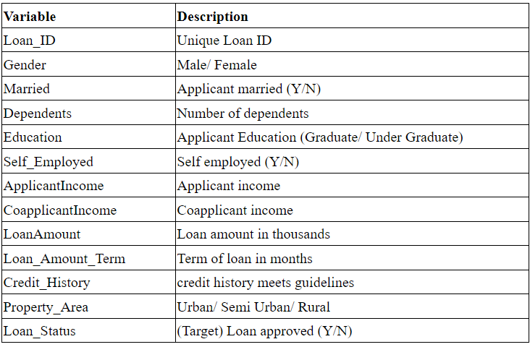
Introduction
Explain domain: This problem is of finance domain
Data:

Slide 3
Problem Formulation: Dream Housing Finance company deals in all kinds of home loans. They have a presence across all urban, semi-urban and rural areas. The customer first applies for a home loan and after that, the company validates the customer eligibility for the loan.
The company wants to automate the loan eligibility process (real-time) based on customer detail provided while filling out online application forms. These details are Gender, Marital Status, Education, number of Dependents, Income, Loan Amount, Credit History, and others.

Slide 4
The Problem
Describe the goal: To automate this process, they have provided a dataset to identify the customer segments that are eligible for loan amounts so that they can specifically target these customers.
Objectives of analytics & Data science problem: This is a Binary Classification problem in which we need to predict our Target label which is “Loan Status”.
Loan status can have two values: Yes or NO.
Yes: if the loan is approved
NO: if the loan is not approved

Slide 5
Timeline
Workflow and Timeline:
Understanding the problem statement-28.12.2022
About the dataset-28.12.2022
Load essential Python Libraries-29.12.2022
Load Training/Test datasets-29.12.2022
Data Preprocessing-29.12.2022
Exploratory data analysis (EDA).-30.12.2022
Feature Engineering.-30.12.2022
Build Machine Learning Model-30.12.2022
Make predictions on the test dataset-30.12.2022

Slide 6
Approach to Solution
Insights on Exploratory Data Analysis:
Univariate Analysis Observations
More Loans are approved Vs Rejected
Count of Male applicants is more than Female
Count of Married applicant is more than Non-married
Count of graduate is more than non-Graduate
Count of self-employed is less than that of Non-Self-employed
Maximum properties are located in Semiurban areas
Credit History is present for many applicants
The count of applicants with several dependents=0 is maximum.
Bivariate Analysis
Mean ApplicantIncome of 0 and 1 are almost the same (o: no,1: Yes)
Mean Co- ApplicantIncome of 1 is slightly more than 0 (o: no,1 Yes)
The mean value of Loan Amount applied by males (0) is slightly higher than Females(1).
If you are married then the loan amount requested is slightly higher than non-married
Male have higher Co-applicant income than females in all three property areas

Slide 7
Data preparation
Fill null values with mode
Next, we will be using Iterative imputer for filling missing values of LoanAmount and Loan_Amount_Term
So now as we have imputed all the missing values we go on to mapping the categorical variables with the integers.
Model building with techniques
Random forest classifier

Slide 8
Model Accuracy and Evaluation
Evaluate model accuracy and steps taken to improve accuracy:
55.7%
Again went for data cleaning
Conclusion
After the Final Submission of test data, my accuracy score was 55.7%.
Feature engineering helped me increase my accuracy.

