Slide 1
CUSTOMER RETENTION ANALYSIS
Submitted by :
Sushil Joshi

Slide 2
Table Of Contents :
1. What is customer retention?
2. Data analysis
3. Conclusion
4. Limitations of this work and Scope for Future Work
5. Acknowledgement

Slide 3
What is customer retention?
Simply put, customer retention rate is the ability of a company to retain its customers over a given period of time.
There are a number of actions and activities certain companies take to reduce churn and increase customer retention.
Focusing on customer retention is important because it not only looks at how good a company is at acquiring new customers but also how good they are at keeping those customers. While you may have the best acquisition process in the business, if your retention is terrible then it’s all worthless.

Slide 4
Problem statement:
E-retail factors for customer activation and retention: A case study from Indian e-commerce customers
Customer satisfaction has emerged as one of the most important factors that guarantee the success of online store; it has been posited as a key stimulant of purchase, repurchase intentions and customer loyalty. A comprehensive review of the literature, theories and models have been carried out to propose the models for customer activation and customer retention. Five major factors that contributed to the success of an e-commerce store have been identified as: service quality, system quality, information quality, trust and net benefit. The research furthermore investigated the factors that influence the online customers repeat purchase intention. The combination of both utilitarian value and hedonistic values are needed to affect the repeat purchase intention (loyalty) positively. The data is collected from the Indian online shoppers. Results indicate the e-retail success factors, which are very much critical for customer satisfaction.

Slide 5
Steps we have taken to analyze our data set are as follows:
First of all we have installed necessary libraries.
After that, imported our dataset.
Checked the shape of dataset
Checked the all column tittles.
Checked the data types.
Checked the Null Values.
Than we have plotted the Heat Map for checking the null values present in Dataset.
After that we have come to the Data Visualization part.

Slide 6
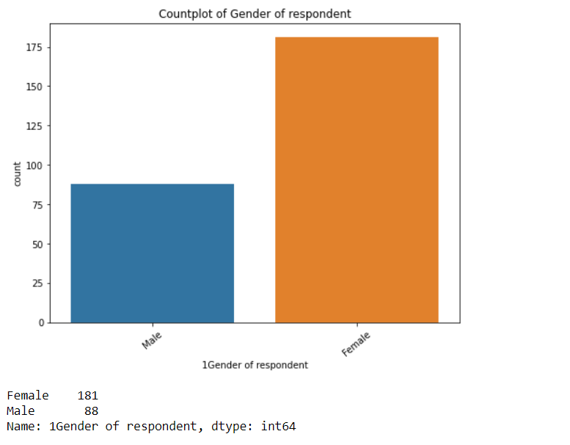
Data visualization
Observation:
Majority, 181 of the customers are Female whereas Male are 88.

Slide 7
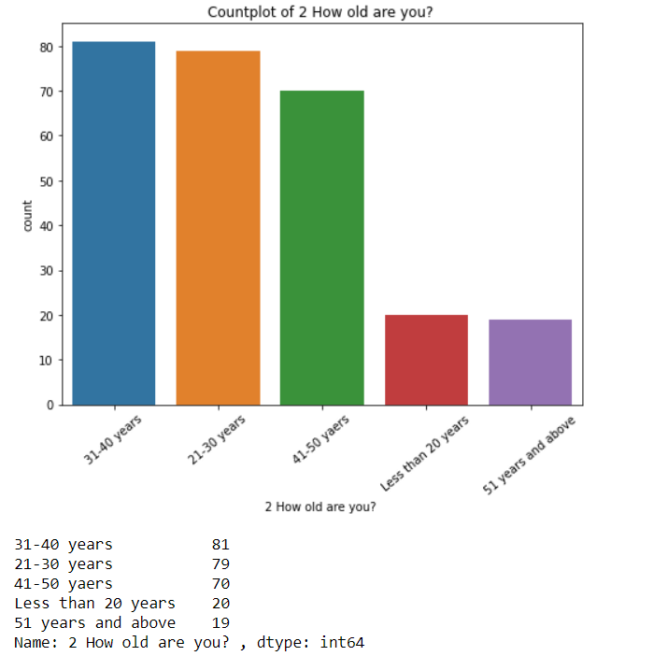
Observation:
Majority, 81 of the customers are from age group 31-40 years, 79 from 21-30 years, 70 from 41-50 years, 20 from les than 20 years and 19 from 51years and above.

Slide 8
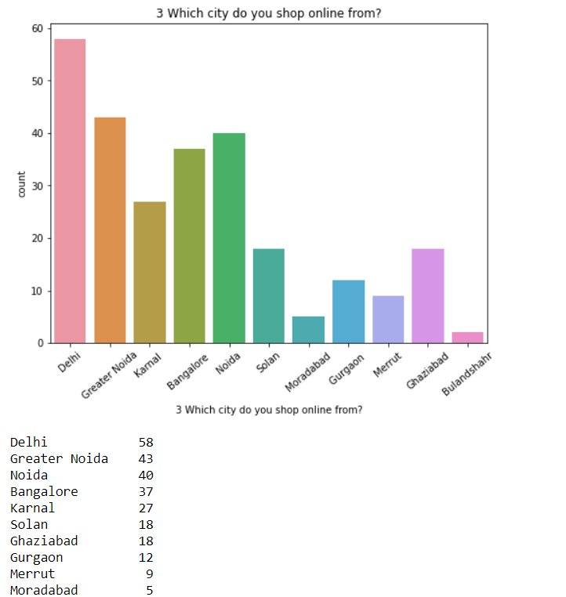
Observation:
Majority, 58 of the customers placed the order from Delhi city.

Slide 9
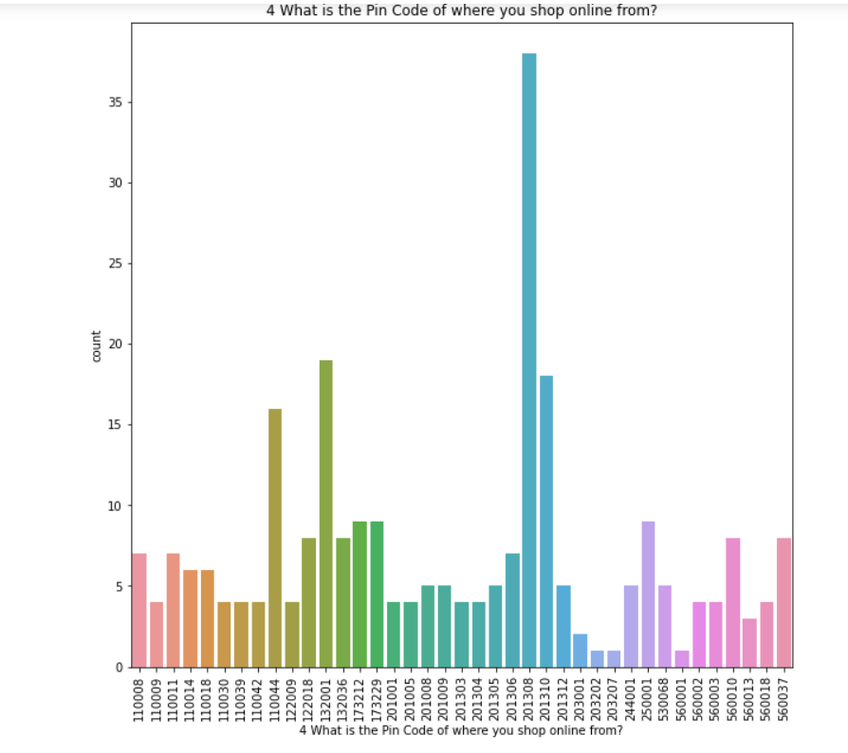
Observation:
Majority, 38 of the customers placed an order from the pincode 201308.

Slide 10
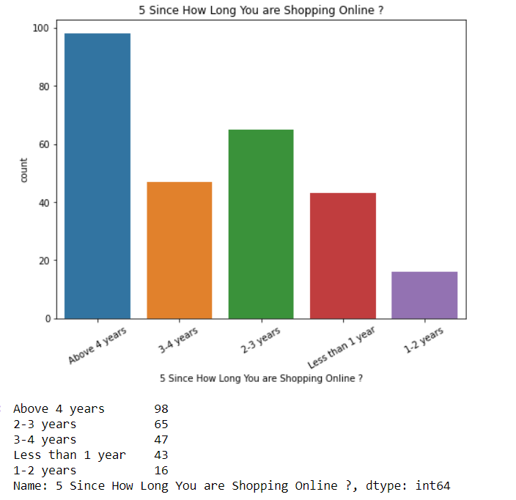
Observation:
Majority, 98 customers are shopping since above 4 years.

Slide 11
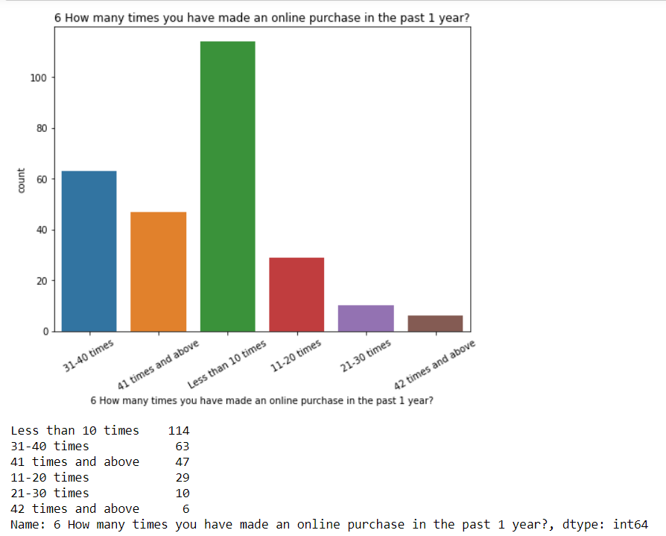
Observation:
Majority 114 of the customers have made less than 10 times online purchase in past 1 year

Slide 12
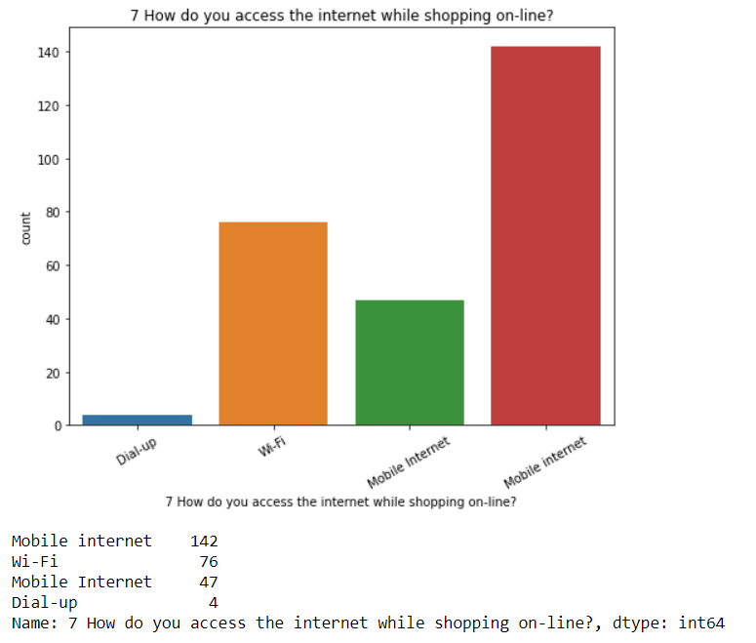
Observation:
Majority, 142 customers use Mobile internet while shopping online.

Slide 13
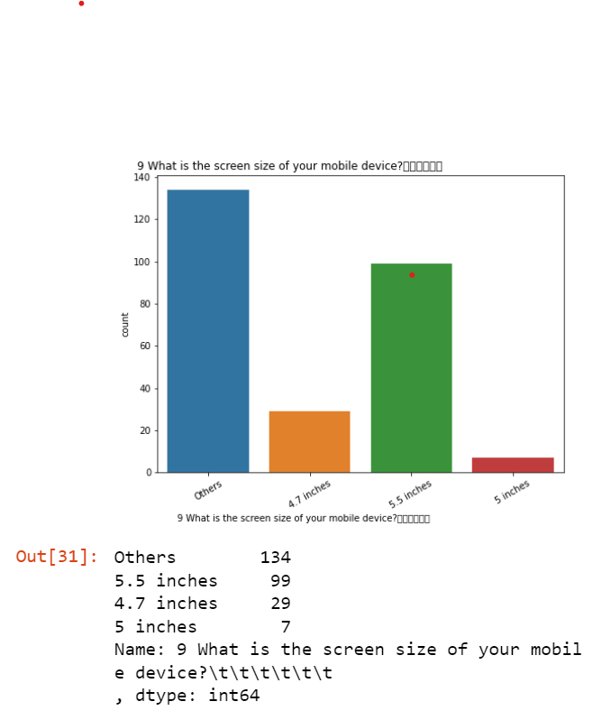
Observation:
Majority, 134 customers have other screen size of mobile.

Slide 14
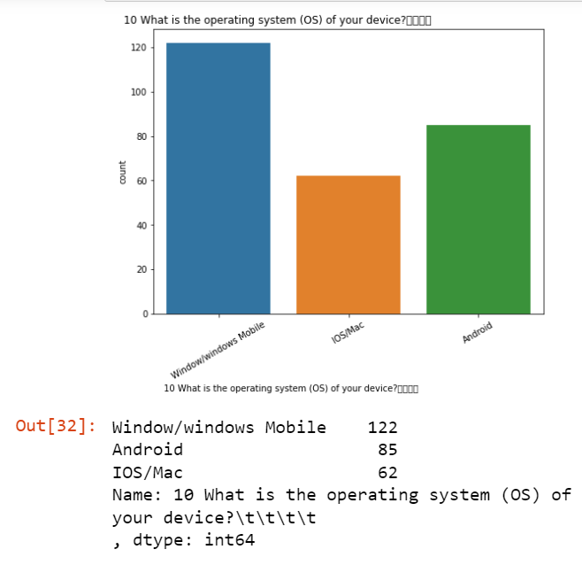
Observation:
Majority, 122 customers device operating system is Window/windows mobile

Slide 15
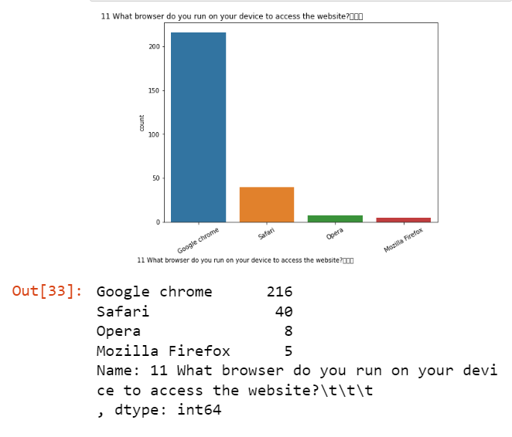
Observation:
Majority, 216 customers use Google chrome browser to access the website.

Slide 16
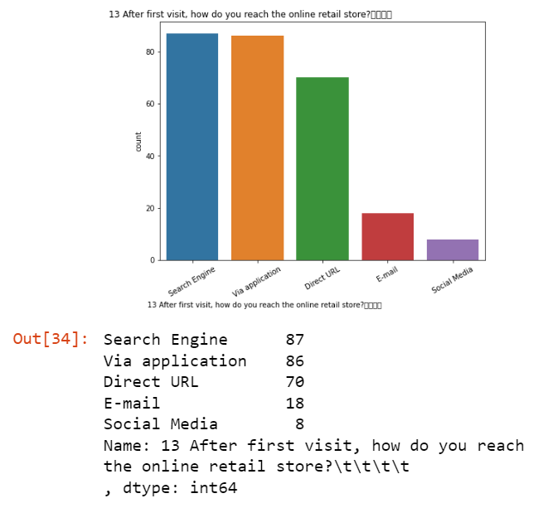
Observation:
majority 87 coustomers reach the online retail store using search engine.

Slide 17
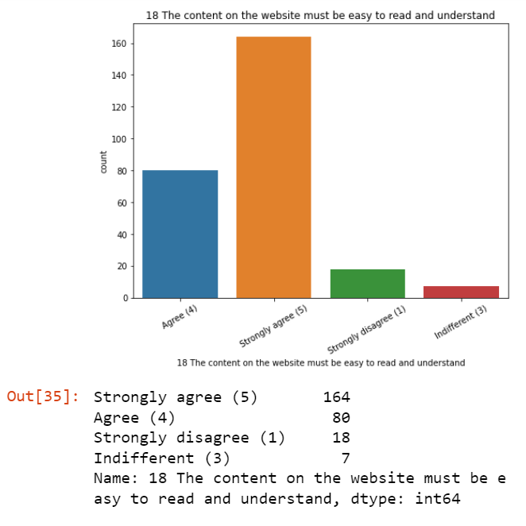
Observation:
Majority, 164 customers strongly agree that the content on the website must be easy to read and understand.

Slide 18
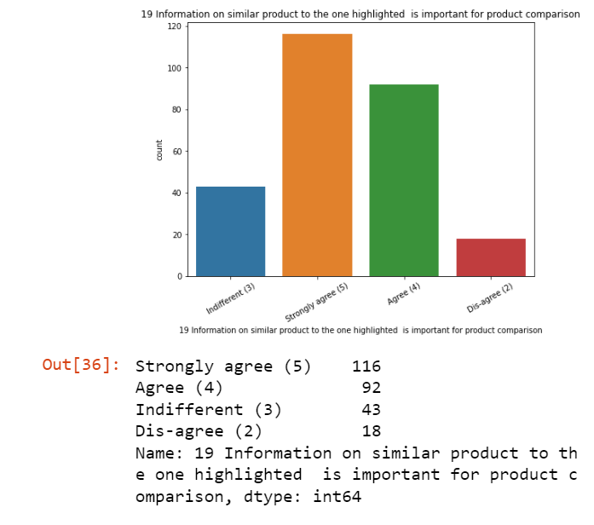
Observation:
Majority, 116 customers strongly agree that the Information on similar product to the one highlighted is important for product comparison.

Slide 19
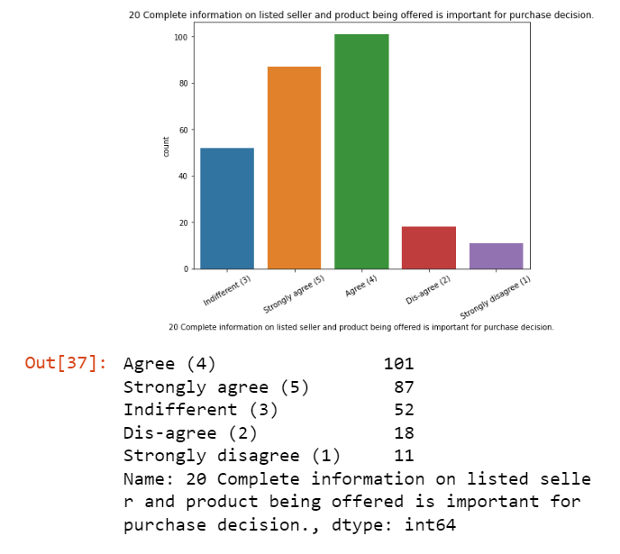
Observation:
Majority, 101 customers Agree that the Complete information on listed seller and product being offered is important for purchase decision.

Slide 20
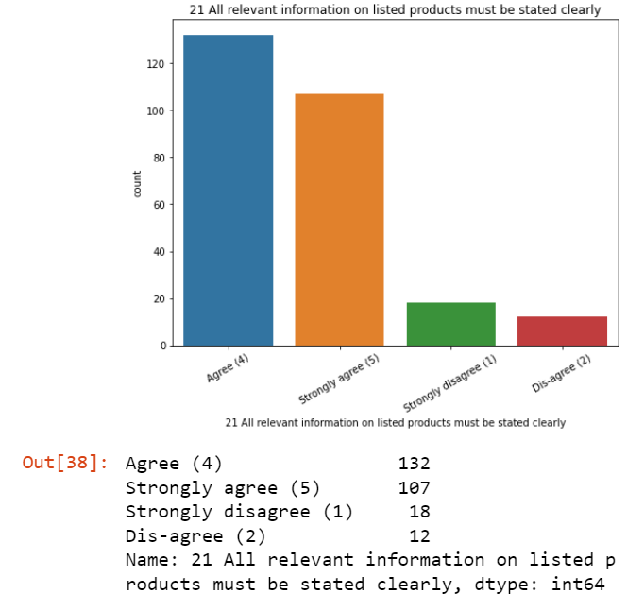
Observation:
Majority, 132 customers Agree that All relevant information on listed products must be stated clearly.

Slide 21
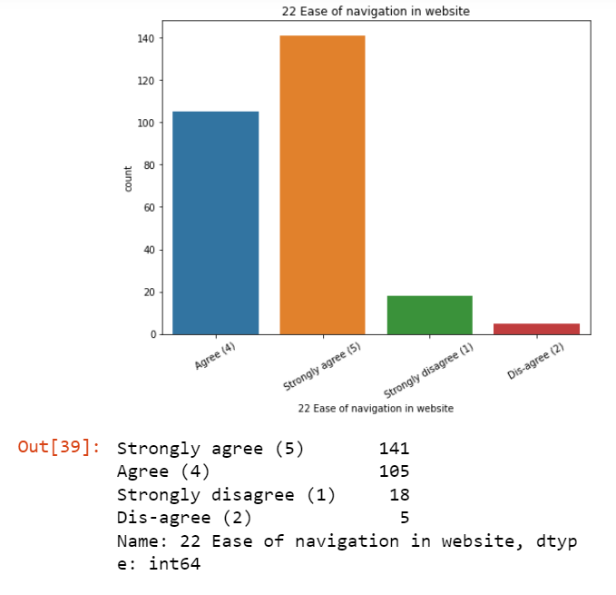
Observation:
Majority, 141 customers Strongly agree to Ease of navigation in website.

Slide 22
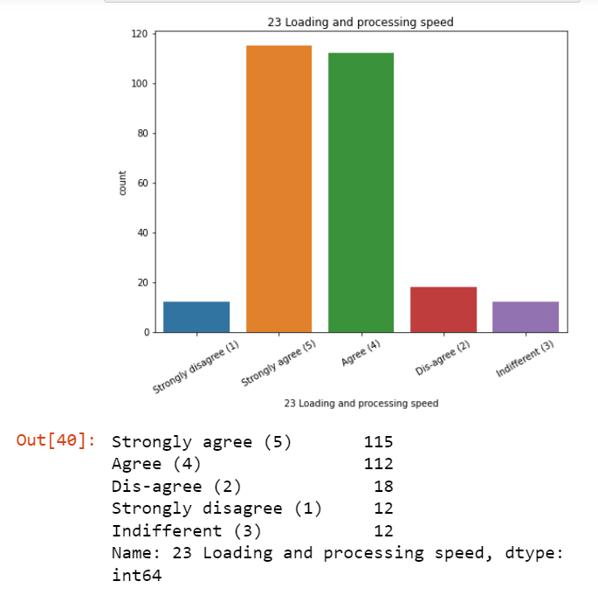
Observation:
Majority, 115 customers Strongly agree to Loading and processing speed.

Slide 23
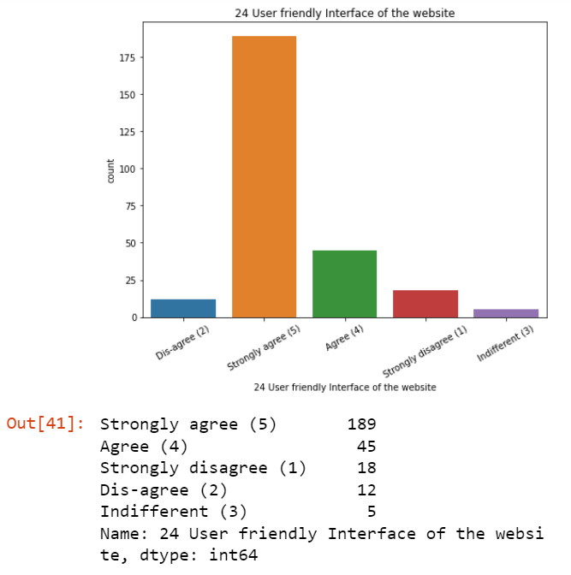
Observation:
Majority, 189 customers Strongly agree to User friendly Interface of the website.

Slide 24
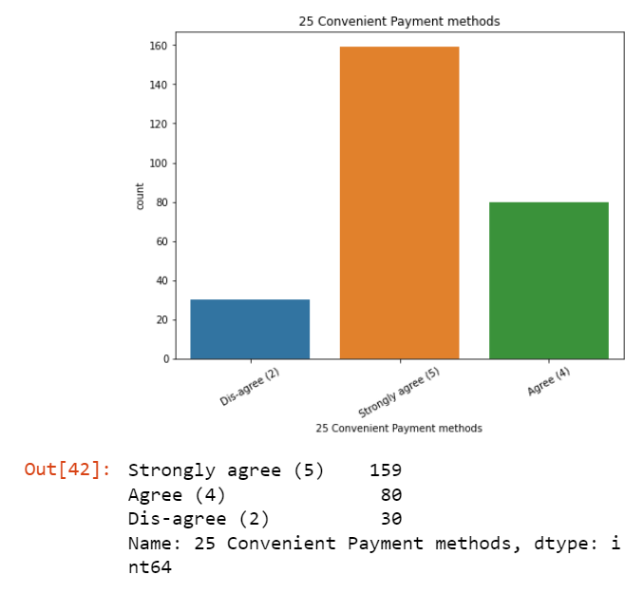
Observation:
Majority, 159 customers Strongly agree to Convenient Payment methods.

Slide 25
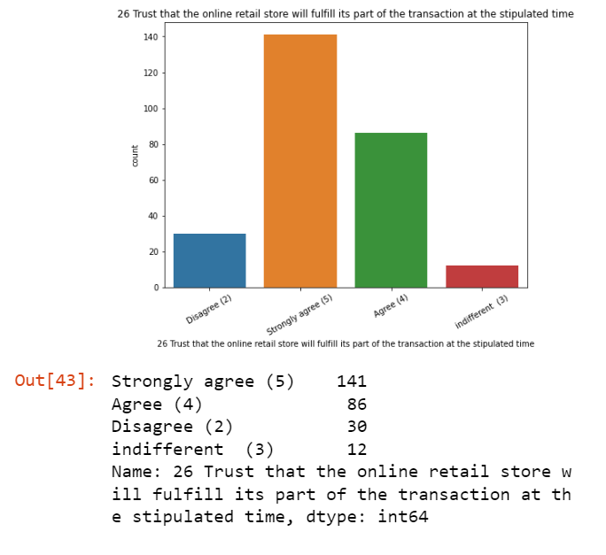
Observation:
Majority, 141 customers Strongly agree to Trust that the online retail store will fulfill its part of the transaction at the stipulated time.

Slide 26
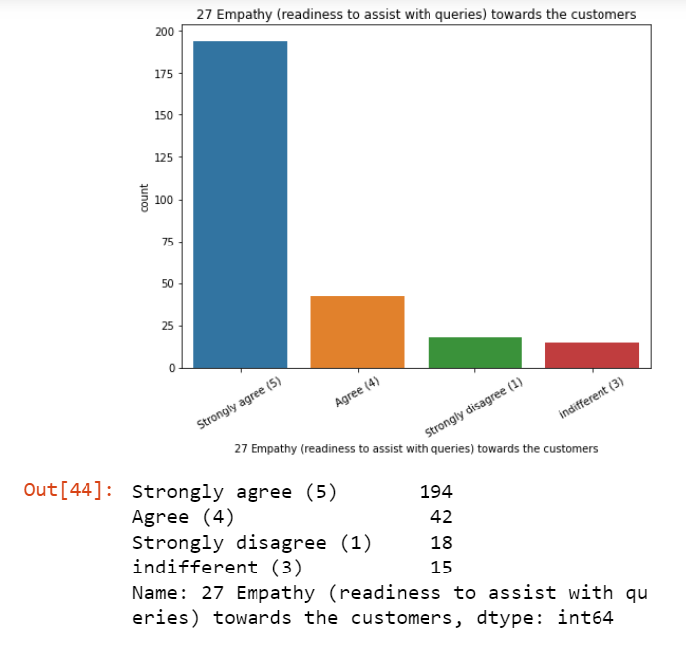
Observation:
Majority, 194 customers Strongly agree to Empathy (readiness to assist with queries) towards the customers.

Slide 27
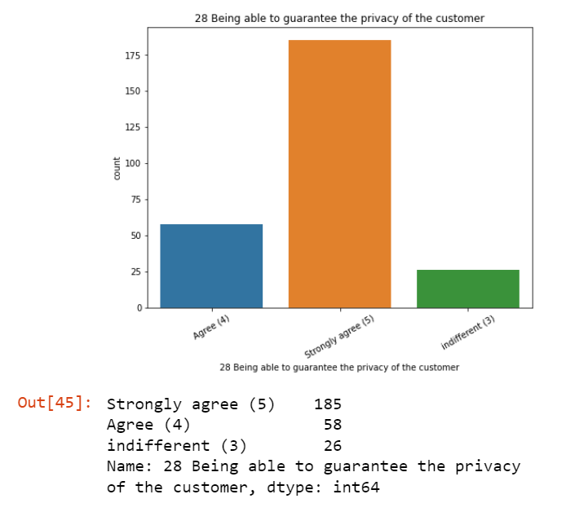
Observation:
Majority, 185 customers Strongly agree to Being able to guarantee the privacy of the customer.

Slide 28
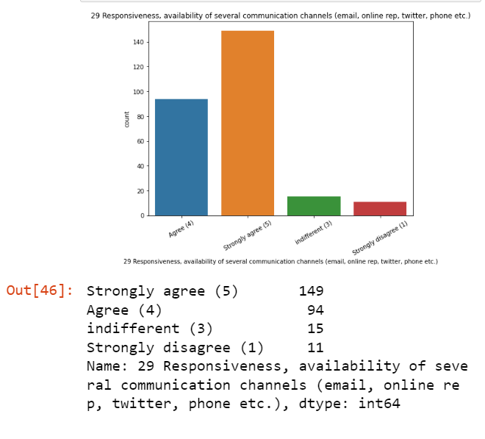
Observation:
Majority, 149 customers Strongly agree to Responsiveness, availability of several communication channels (email, online rep, twitter, phone etc.)

Slide 29
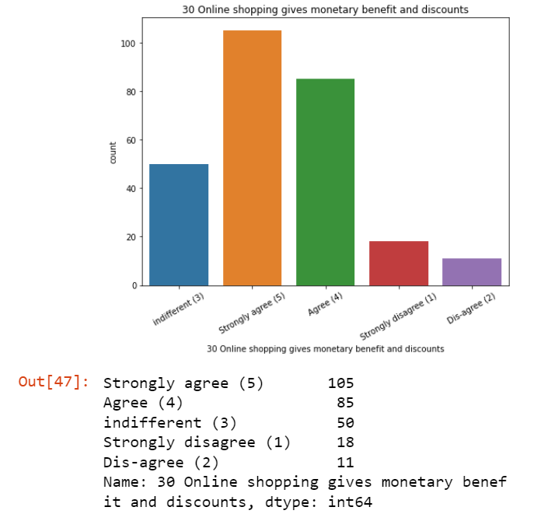
Observation:
Majority, 105 customers Strongly agree to Online shopping gives monetary benefit and discounts.

Slide 30
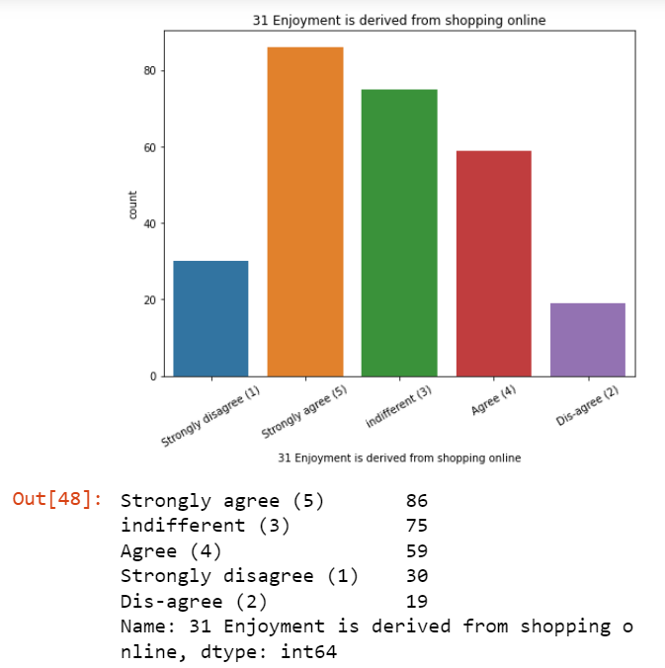
Observation:
Majority, 86 customers Strongly agree to Enjoyment is derived from shopping online.

Slide 31
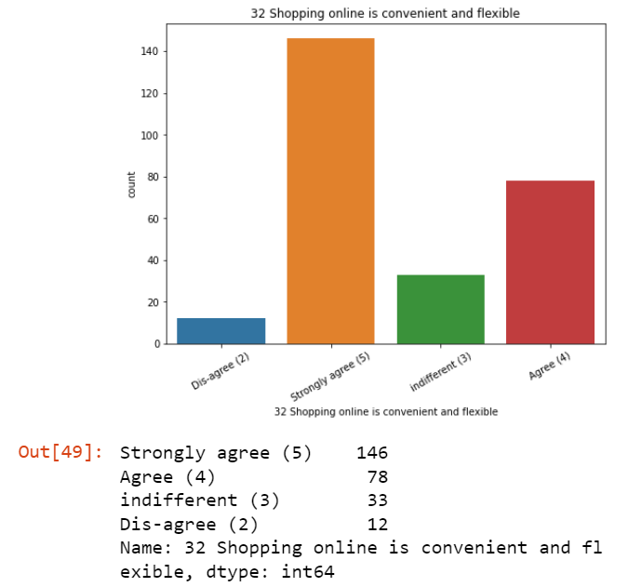
Observation:
Majority, 146 customers Strongly agree to Shopping online is convenient and flexible.

Slide 32
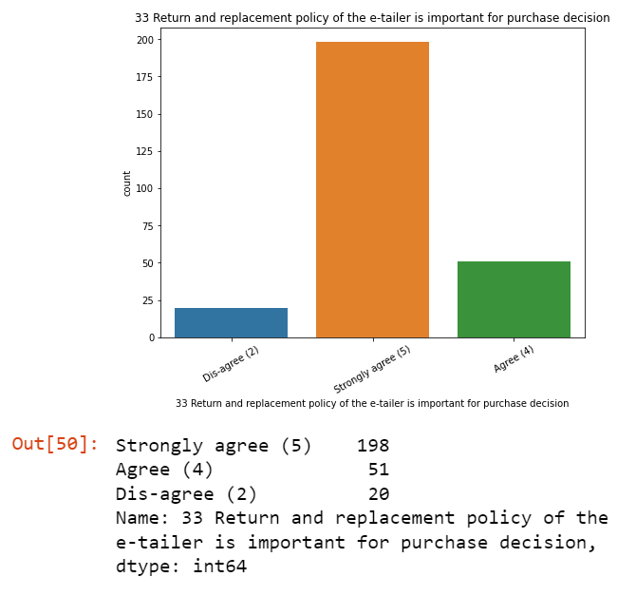
Observation:
Majority, 198 customers Strongly agree to Return and replacement policy of the e-tailer is important for purchase decision.

Slide 33
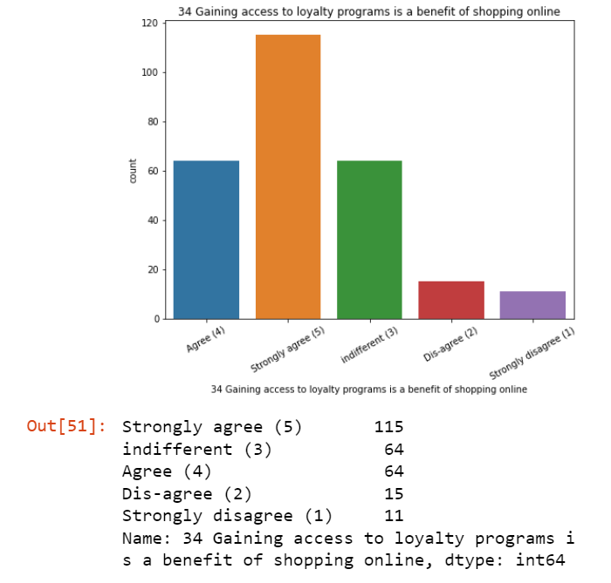
Observation:
Majority, 115 customers Strongly agree to Gaining access to loyalty programs is a benefit of shopping online.

Slide 34
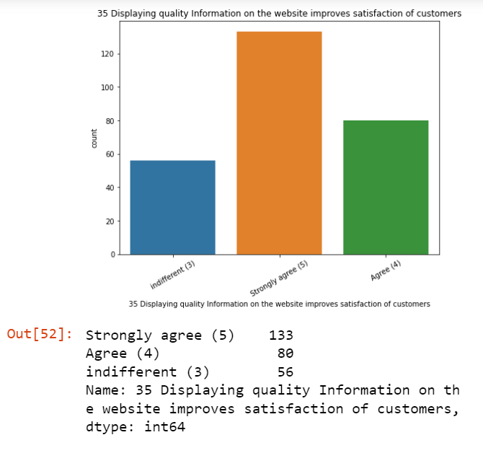
Observation:
Majority, 133 customers Strongly agree to Displaying quality Information on the website improves satisfaction of customers.

Slide 35
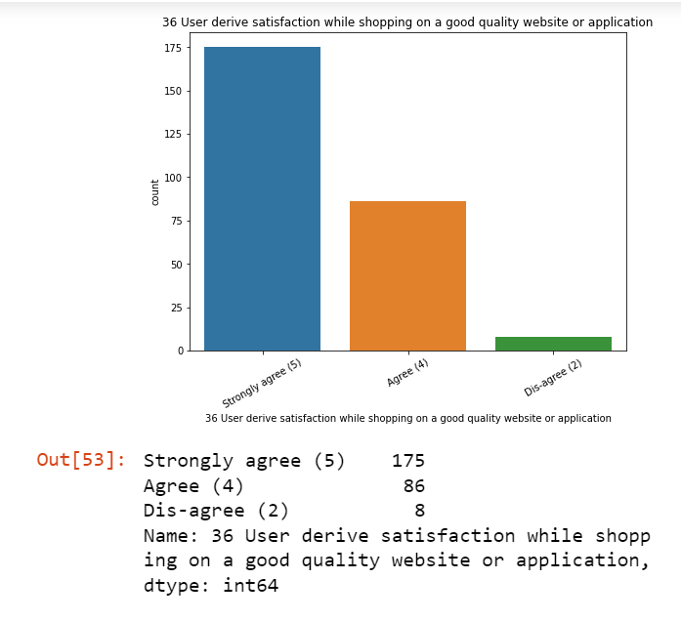
Observation:
Majority, 175 customers Strongly agree to User derive satisfaction while shopping on a good quality website or application.

Slide 36
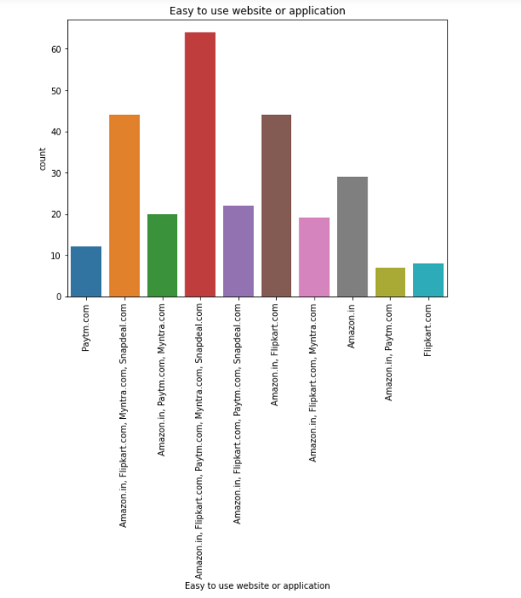
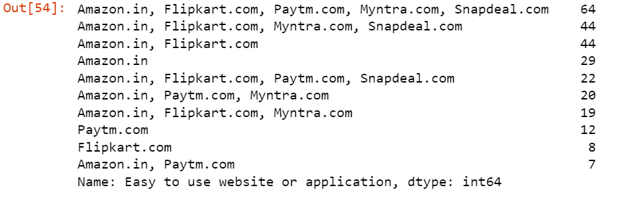
Observation:
Majority, 64 customers agree that Amazon.in, Flipkart.com, Paytm.com, Myntra.com, Snapdeal.com are Easy to use website or application.

Slide 37
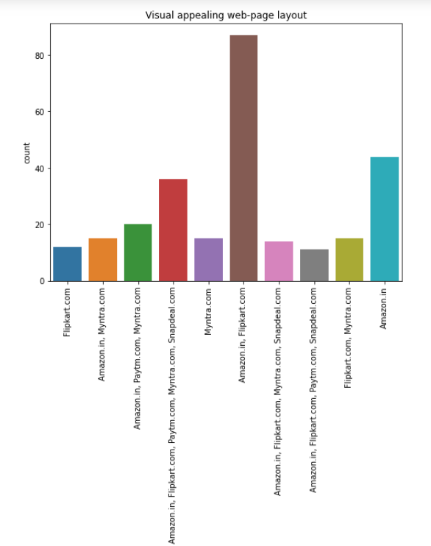
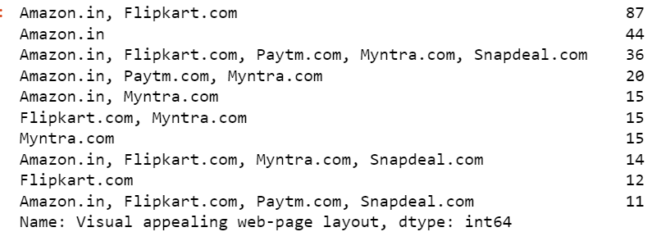
Observation:
Majority, 87 customers agree that Amazon.in, Flipkart.com have Visual appealing web-page layout.

Slide 38
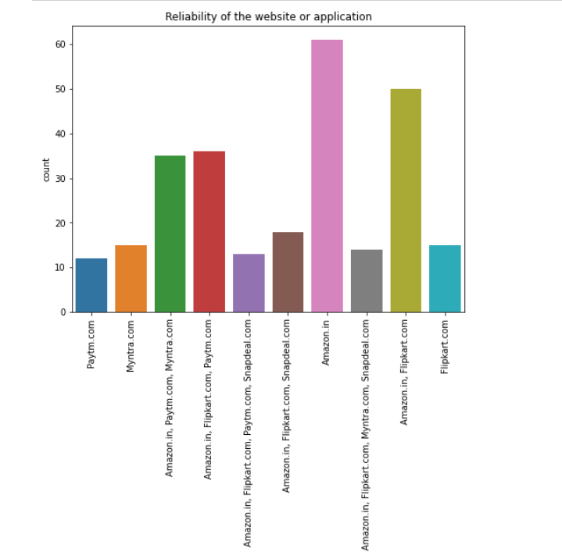
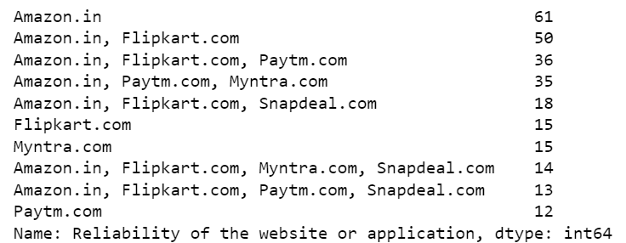
Observation:
Majority, 61 customers agree that Amazon.in Reliability of the website or application.

Slide 39
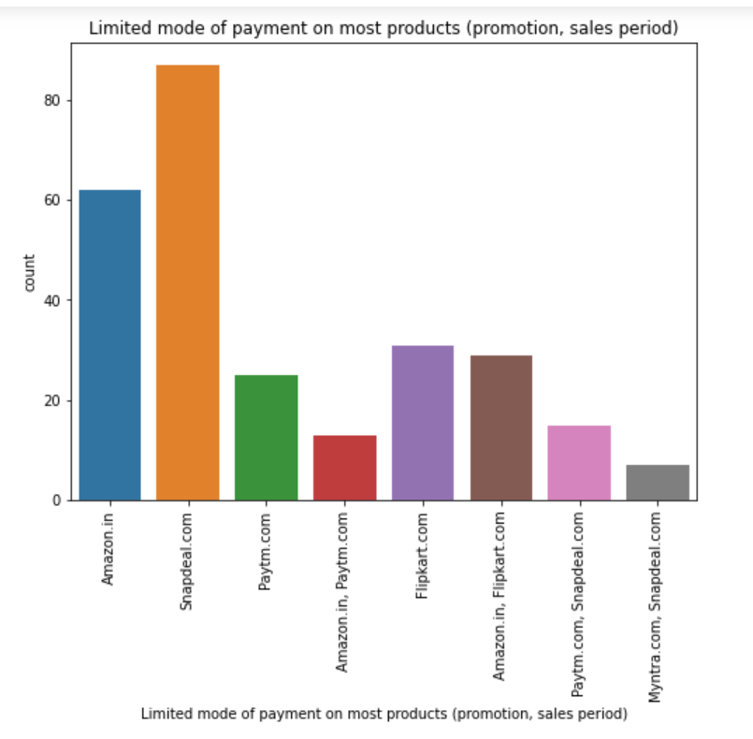
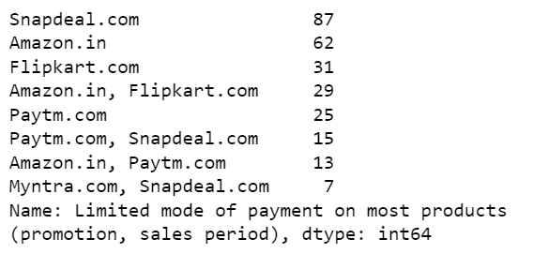
Observation:
Majority, 87 customers agree to snapdeal.com for Limited mode of payment on most products (promotion, sales period)

Slide 40
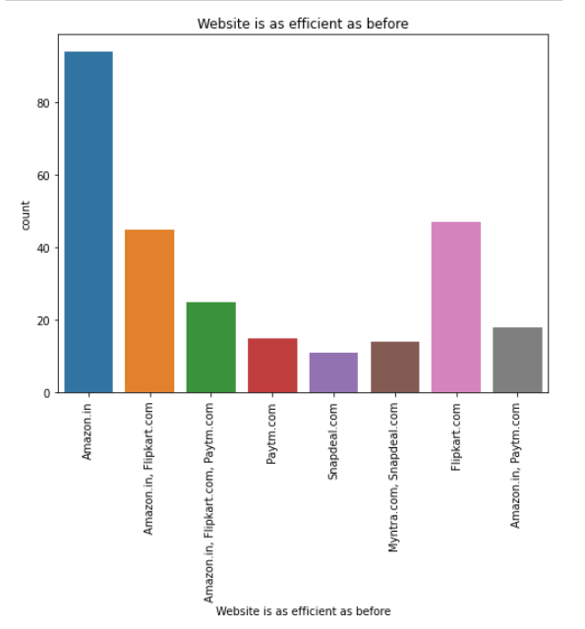
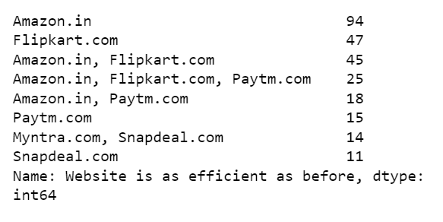
Observation:
Majority, 94 customers agree to Amazon.in that Website is as efficient as before.

Slide 41
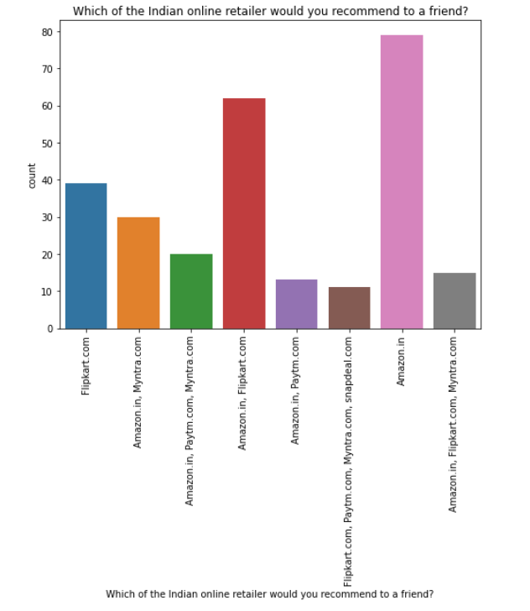
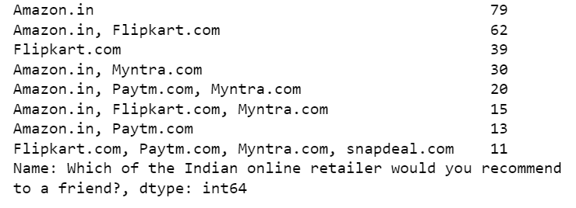
Observation:
Majority, 79 customers agree to Amazon.in to recommend to a friend.

Slide 42
Conclusion
Retention analysis is an integral part of your customer retention and marketing strategies. By taking full advantage of the data you collect by tracking customer behaviour, requesting feedback, and studying important metrics, you can decrease the churn rate, improve customer satisfaction, and boost your revenue.

Slide 43
Limitations of this work and Scope for Future Work
We are able to properly analyse the valuable feedback of the customers but given, the dataset was very small as it may result in bias understanding. If we are able to increase the feedbacks from more customers all over it would provide a great understanding of the strategies we will have to use to improve customer retention.

