Slide 1


VISVESVARAYA TECHNOLOGICAL UNIVERSITY
BELAGAVI-590018
SRI TARALABALU JAGADGURU INSTITUTE OF TECHNOLOGY RANEBENNUR-581115
Internship on Artificial intelligence and machine learning
BACHELOR OF ENGINEERING IN INFORMATION SCIENCE AND ENGINEERING
SUBMITTED BY
SUSHMA SURESH YAKKEGONDI(2SR22IS049)
GUIDE HEAD OF THE DEPARTMENT
MR. KARTHIK MORE DR. SAVITA R C
INTERNSHIP PROVIDER CO-ORDINATOR OF THE INTERNSHIP
DYASHIN TECHNOSOFT PVT LTD MR. MUKKUND BHAT M
2025-2026
DEPARTMENT OF INFORMATION SCIENCE AND ENGINEERING
SRI TARALABALU JAGADGURU INSTITUTE OF TECHNOLOGY RANEBENNUR-581115

Slide 2
ABOUT COMPANY
I am currently pursuing my internship at Dyashin Technosoft Private Limited, an IT services and software development company based in Bengaluru, specializing in digital transformation, AI-driven innovation, and engineering services.
Dyashin has developed innovative products and platforms including MediTrack, DSPristine, Sigo, and Shine Chat, along with training and placement initiatives through DSEdify.
The company has a global presence in India, USA, Australia, and UAE, follows quality standards with ISO 9001:2015 certification.
The company is led by directors Madan Kodagahalli and Dyamappa Praveen.
Subsidiaries: Includes DSEdify and DSJobby.

Slide 3
INTERNSHIP OVERVIEW
This internship focuses on Artificial Intelligence and Machine Learning (AIML) with hands-on experience in real-world projects, modern tools, data analysis techniques, and industry-oriented learning.
Key Learning Areas
Python Programming
Data Analysis (NumPy, Pandas)
Data Visualization
Machine Learning Algorithms
Model Training & Testing
AI Tools and Frameworks
Deep Learning

Slide 4
INTERNSHIP OBJECTIVES
To gain practical experience in Artificial Intelligence, Machine Learning, Python programming, data analysis, and AI-based project development using real-world technologies.
To improve technical, problem-solving, communication, and teamwork skills while understanding industry-oriented software development practices and career opportunities in AI and software development.

Slide 5
INTERNSHIP PROGRESS TIMELINE
Phase 1
Python Programming
Fundamentals (syntax, datatypes, loops, functions)
Try….except
Classes and Objects.
Phase 2
Python Libraries
Data handling( NumPy & Pandas)
Data visualization ( Matplotlib and Seaborn)
Data preprocessing and cleaning.
Phase 3
Machine Learning
Supervised and Unsupervised algorithm.
Scikit-learn(train & evaluate models)
Real-world datasets & prediction.
Phase 4
Deep learning
Models using tensorflow or keras.
Activation function, CNN, RNN.

Slide 6
Algorithms
Supervised Learning Algorithms
Linear Regression
predicting continuous values
Mean Squared Error, R-Squared
Logistic Regression
Predicting categorical probabilities.
Accuracy and Confusion Matrix
Decision Tree
Splitting data Hierarchically
Classification and Regression
Random Forest
Averaging multiple trees
ensemble, prevent overfitting
KNN
Distance based classification
Accuracy

Slide 7
Unsupervised Learning Algorithms
K-Means
Clustering model
Inertia metric, partitioning data
Hierarchical Clustering
Clustering model
Dendrogram, nested grouping data
DBSCAN
Density clustering, silhouette score, noise handling
PCA
Dimensionality reduction, variance metric, feature extraction
Apriori Algorithm
Association rule mining, support confidence, market basket analysis
XGBoost
supervised boosting model, accuracy metric, prediction tasks

Slide 8
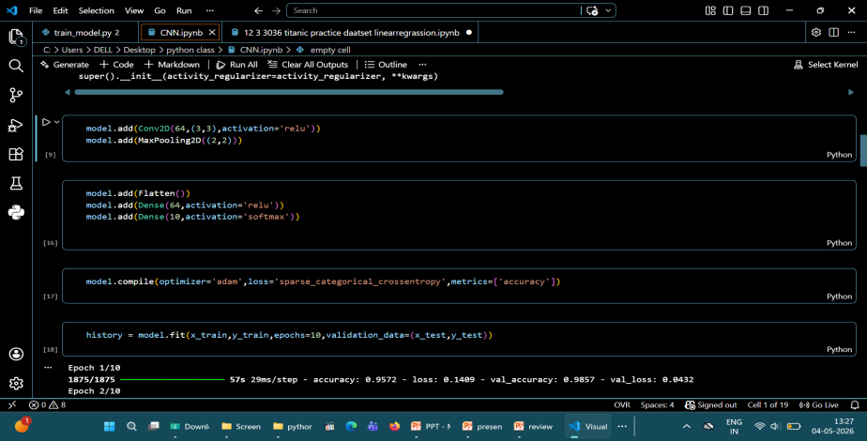
Deep Learning
Convolutional Neural Network
It is used for image and visual data processing.
It uses convolution layers to automatically extract features like edges and patterns.
Image classification, object detection, and vision tasks.

Slide 9
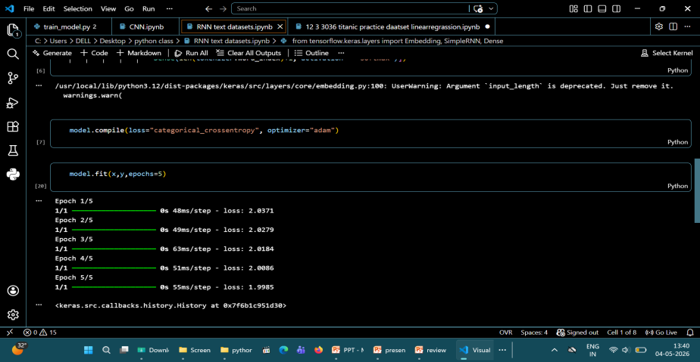
Recurrent Neural Network
Prediction may not be 100% accurate.
Depends heavily on quality of past data.
Requires technical skills and tools.
High initial setup cost.
Privacy and data security concerns.

Slide 10
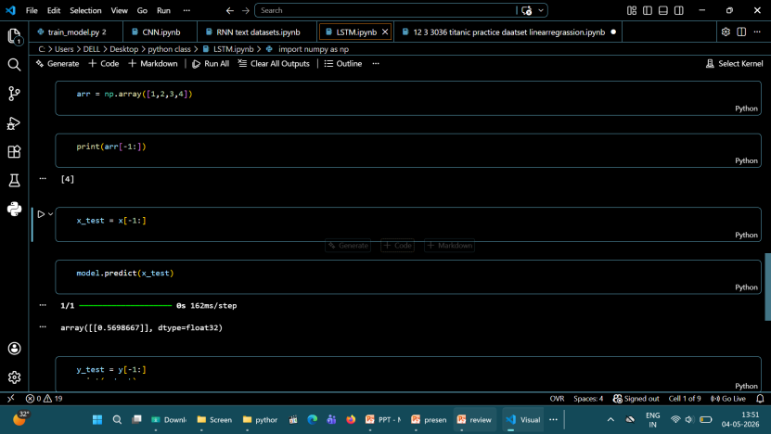
Long Short-Term Memory (LSTM)
LSTM is an advanced type of RNN.
It solves vanishing gradient and long-term memory issues.
Used for long sequence data like language translation

Slide 11
PROJECTS
Title: “ Invoice Fraud Detection & Financial Anomaly Monitoring ”
Problem Statement
Manual invoice verification is slow and may miss fraudulent transactions. Traditional systems cannot efficiently detect hidden financial anomalies. This project uses Machine Learning to automatically detect invoice fraud and improve financial security.

Slide 12
Technologies Used
Frontend
Backend
Machine Learning
React
Next.js
Tailwind CSS
TypeScript
Routes
Node.js
Python
scikit-learn
Pandas
NumPy

Slide 13
Algorithms Used
Fraud Detection
Anomaly Detection
Logistic Regression
Random Forest
Decision Tree
Gradient Boosting
Isolation Forest
DBSCAN
Z-Score

Slide 14
Methodology
Collect dataset
Clean and preprocess data
Split train and test data
Train ML models
Test model accuracy
Build frontend dashboard
Integrate backend APIs
Display fraud prediction results

Slide 15
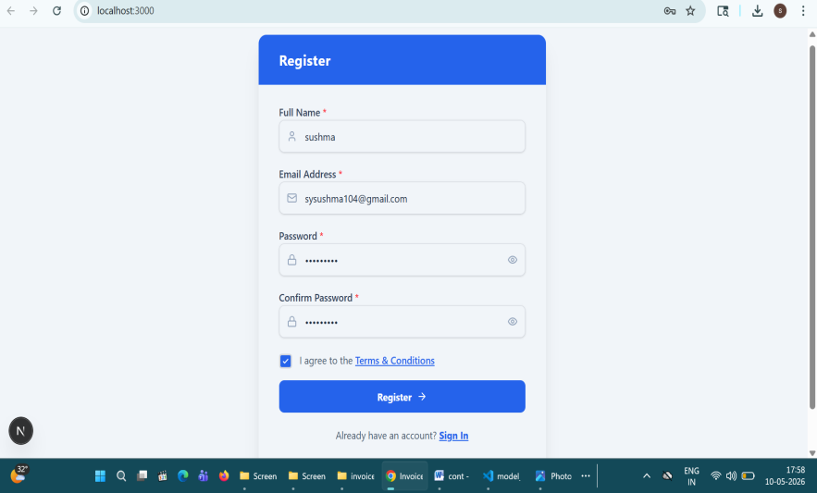
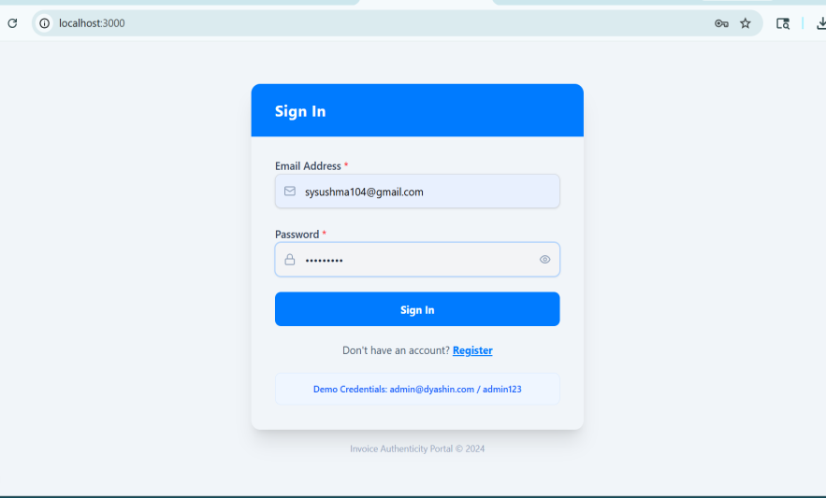
Result
1. Register Page
2. Login Page
Login page used for secure user authentication and account access
Registration page used for new user account creation and profile setup.

Slide 16
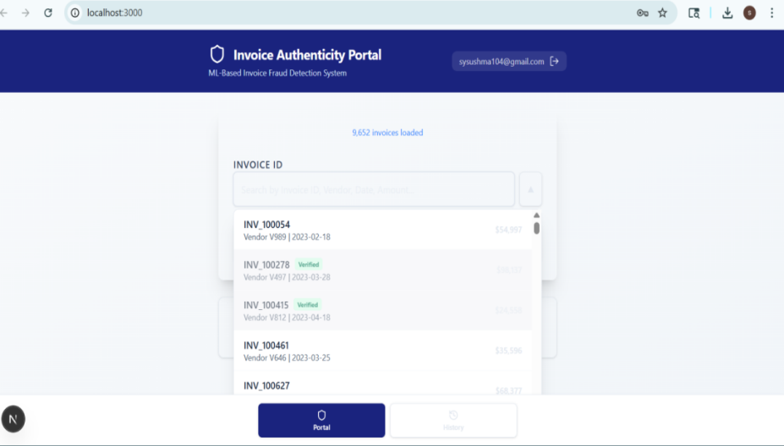

3. User Input
4. Input Details
Portal used to select invoice IDs for authenticity validation
User input form containing invoice details submitted for verification

Slide 17
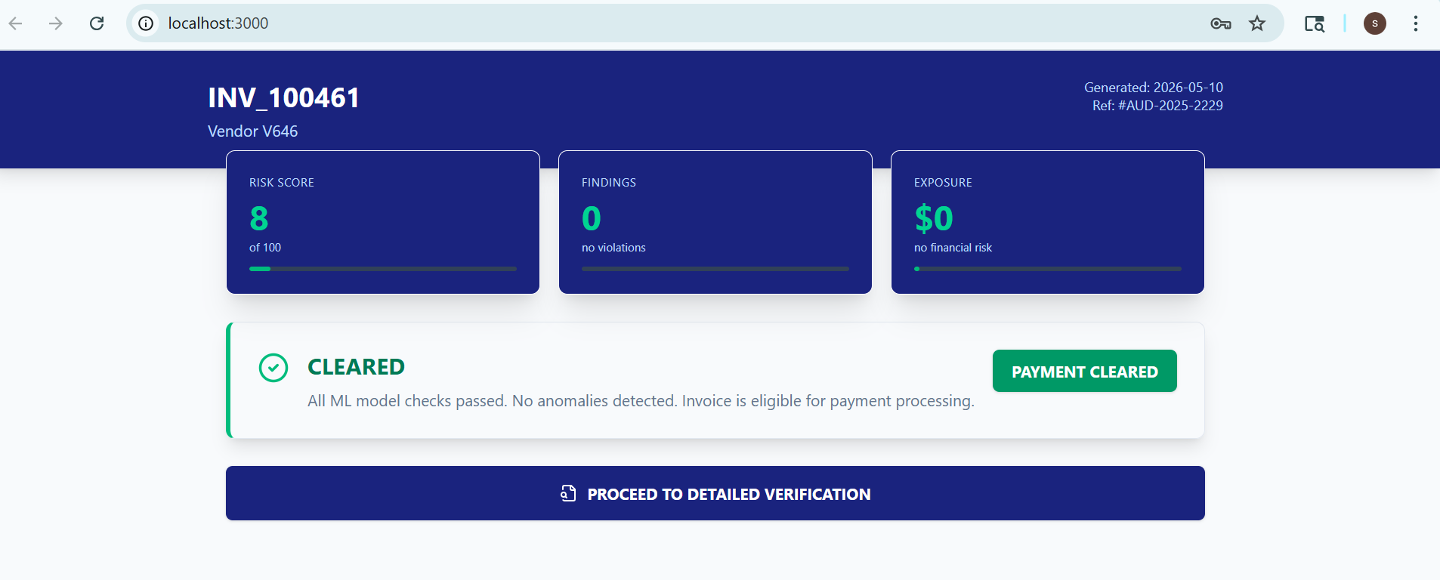
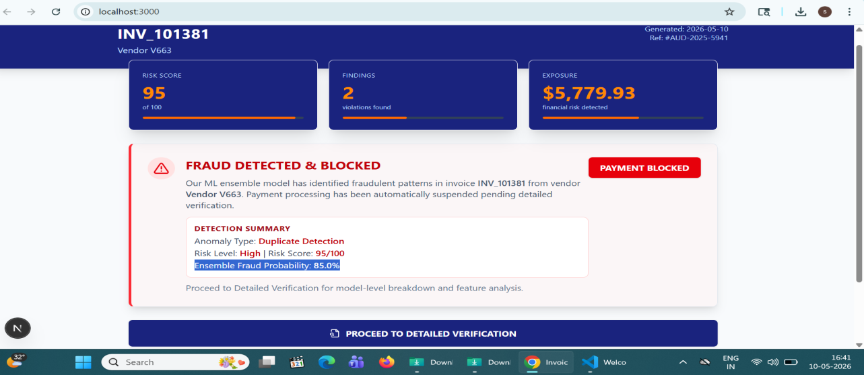
5. Safe Verification
6. High Risk Invoice
Risk Assessment Page displayed - Two possible outcomes:
LEGIT → "CLEARED" with low risk score, all checks passed
FRAUD → "FRAUD DETECTED & BLOCKED" with risk score, anomaly type, exposure

Slide 18
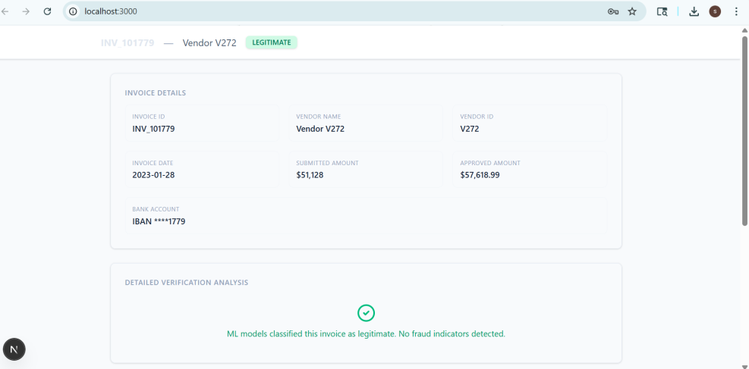
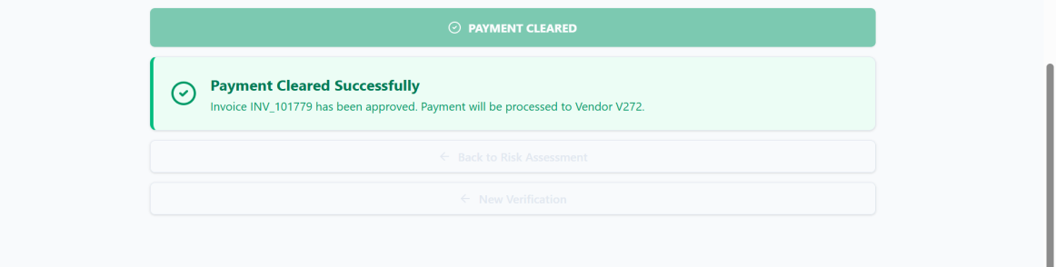
7. Verification Page for safe invoice
8. Payment Cleared
Detailed invoice verification page displaying complete authentication analysis.
Payment Cleared Notification

Slide 19
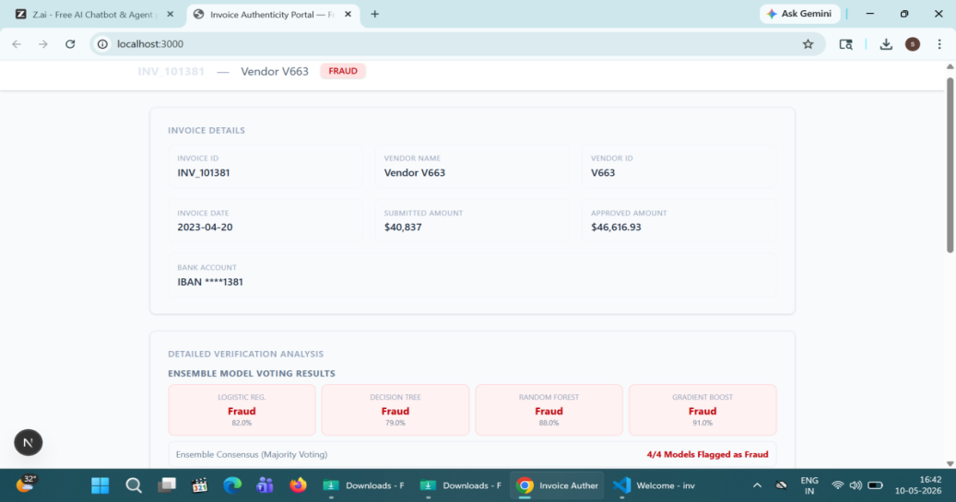
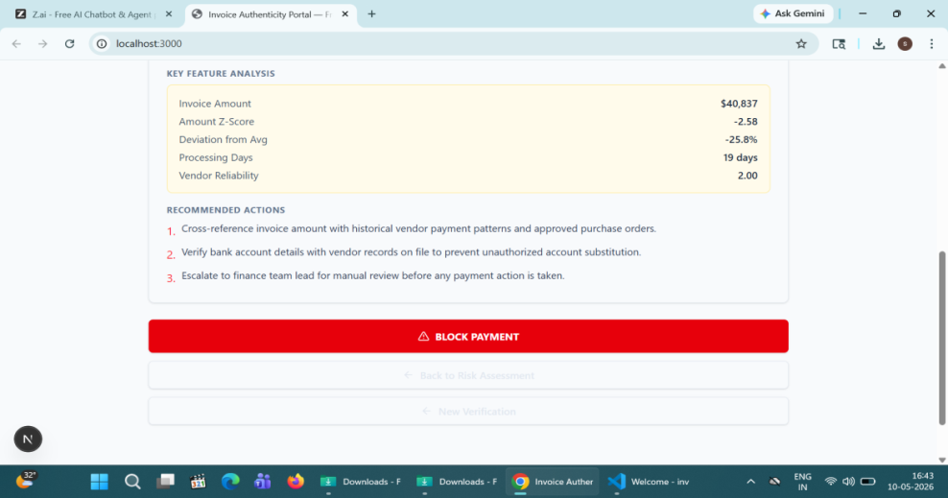
9. Proced with detailed verification
10. Fraud Analysis
View Invoice Details → ID, Vendor, Amounts, Bank Account, Status
View Key Feature Analysis → Invoice amount, processing days, vendor reliability, deviation scores.

Slide 20
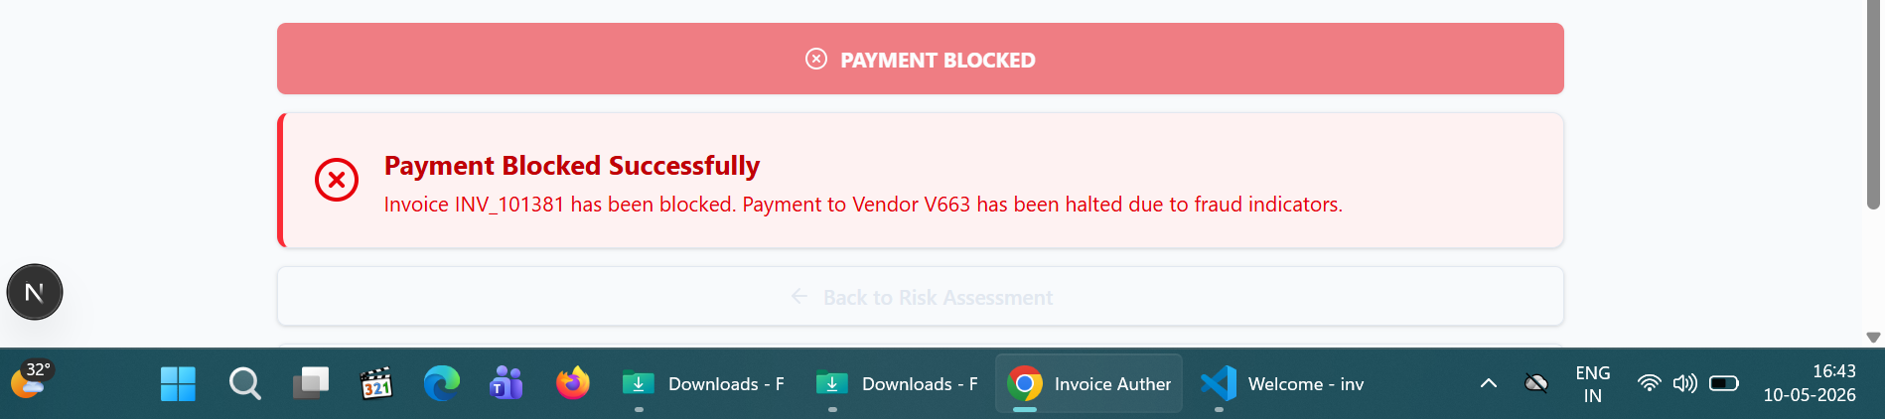
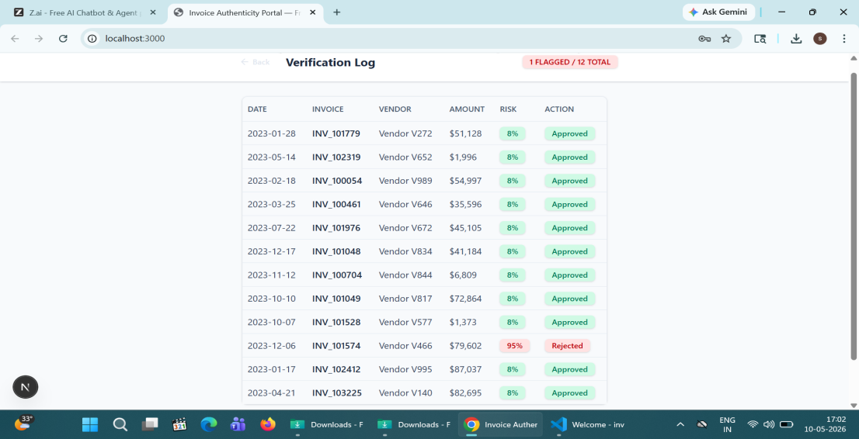
11. Block Alert
12. Verification Log
Switch to v tab → View all past verifications (Date, Invoice, Vendor, Amount, Risk %, Status)
Click any row → Re-opens that invoice’s Risk Assessment details
Click Logout → Session ended → Returns to Login screen

Slide 21
CONCLUSION
The Invoice Fraud Detection and Financial Anomaly Monitoring System successfully uses Machine Learning techniques to detect fraudulent invoices and suspicious financial activities automatically.
The project improves financial security, reduces manual verification effort, and provides faster and more accurate fraud detection through an intelligent dashboard system.

Slide 22
THANK YOU

