Slide 1
Connect four dots

Slide 2
Description :
Connect Four is a two player, turn based game, where each player align four game coins either horizontally, vertically or diagonally in the '7 \* 6' game board . This game is centuries old, Captain James Cook used to play it with his fellow officers on his long travels, and so it has also been called "Captain's Mistress". Game is also known as Four Up, lot Four, Find Four, Four in a Row, Four in a Line, Drop Four, and Gravi trips .

Slide 3
Rules:
- Before starting the game, players decide randomly which of them will be the beginner; moves are made alternatively, one by turn.
- Moves entails in placing new pieces on the board; pieces slide downwards from upper holes, falling down to the last row or piling up on the last piece introduced in the same column. So, in every turn the introduced piece may be placed at most on seven different squares.
- When you can connect four pieces vertically, horizontally or diagonally you win otherwise you lose.

Slide 4
Project flow :
Day 1:
Analysis on the project.
Day 2 :
Implementation of Board .
Day 3 :
Implementation of pieces on the board.
Day 4 :
Modification of code through colors etc.
Day 5 :
Execution and Presentation.

Slide 5
Technical Stack:
Languages used :
* Python
Tools Required :
* Any IDE like PyCharm , VS Code
* Git lab

Slide 6
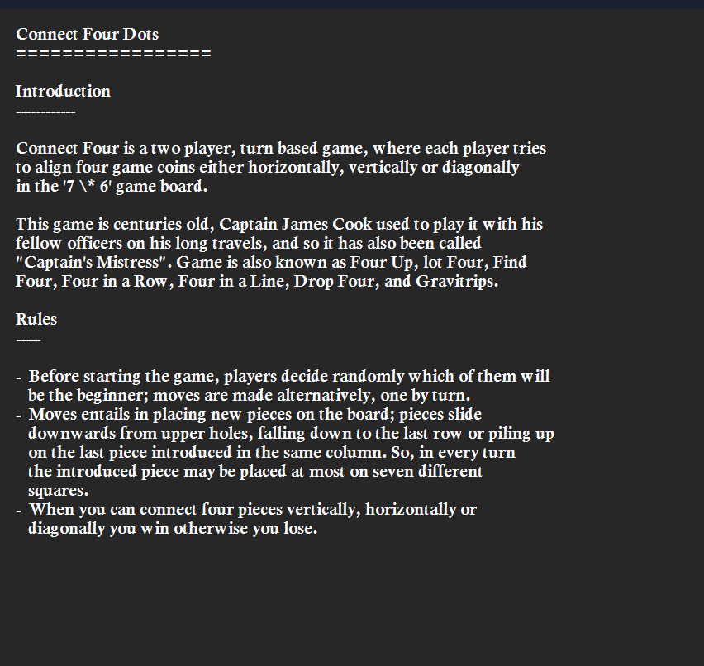
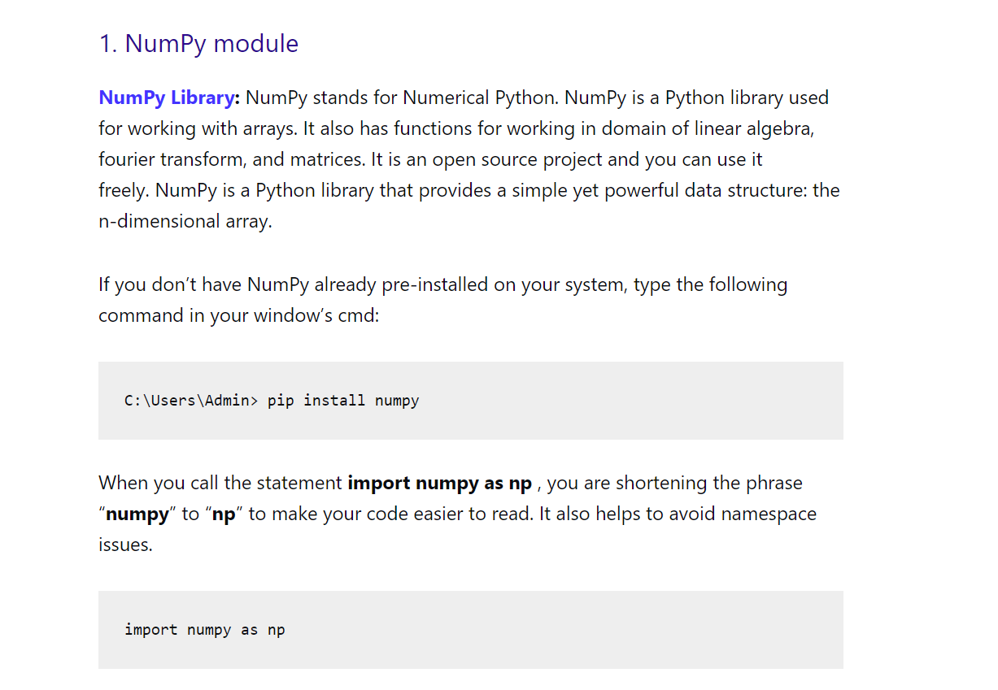
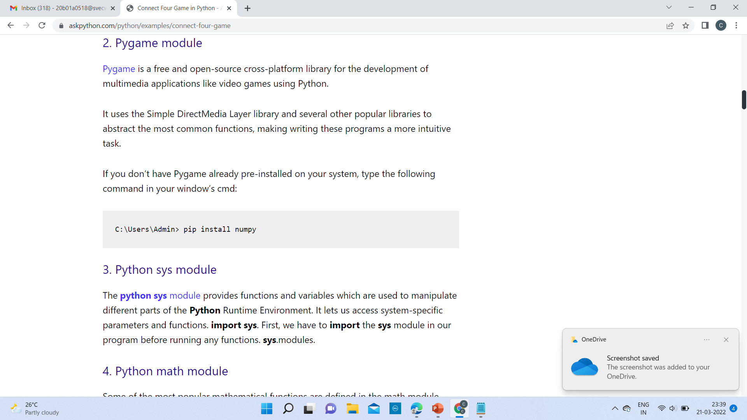
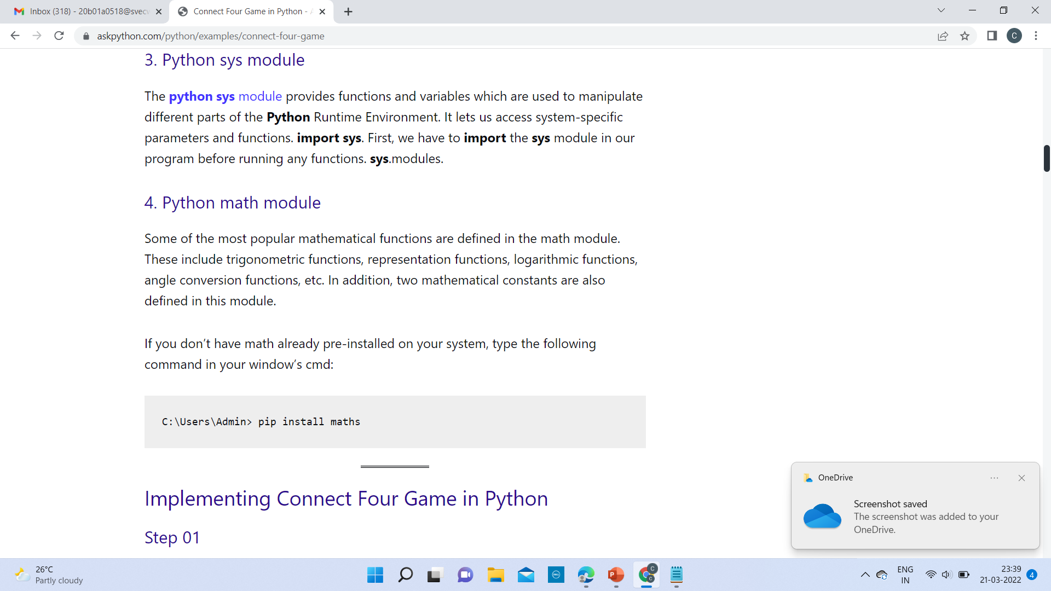
Updated screenshots:

