Slide 1
Day 2 : implementation of board and scope of players

Slide 2
Technical stack
Import the NumPy package as np. Then we will create a python function named create_board( ).
np.zeros( ) function is used to create a matrix full of zeroes. This function in Python can be used when you initialize the weights during the first iteration in TensorFlow and other statistic tasks. ((6,7)) are the dimensions. 6 rows and 7 columns. Then we just return that board.
We will begin writing the main game loop now. We’re going to create a loop as while not game_over. A while not loop repeatedly executes the body of the loop until the condition for loop termination is met. Our loop is going to run as long as this game_over variable is false. We will initialize the game_over as False. The only time its going to switch to true is if someone gets 4 circles in a row.
To increase the turn by 1 we will use turn += 1. To make it switch between player 1 and 2 alternatively, we use turn = turn % 2.

Slide 3
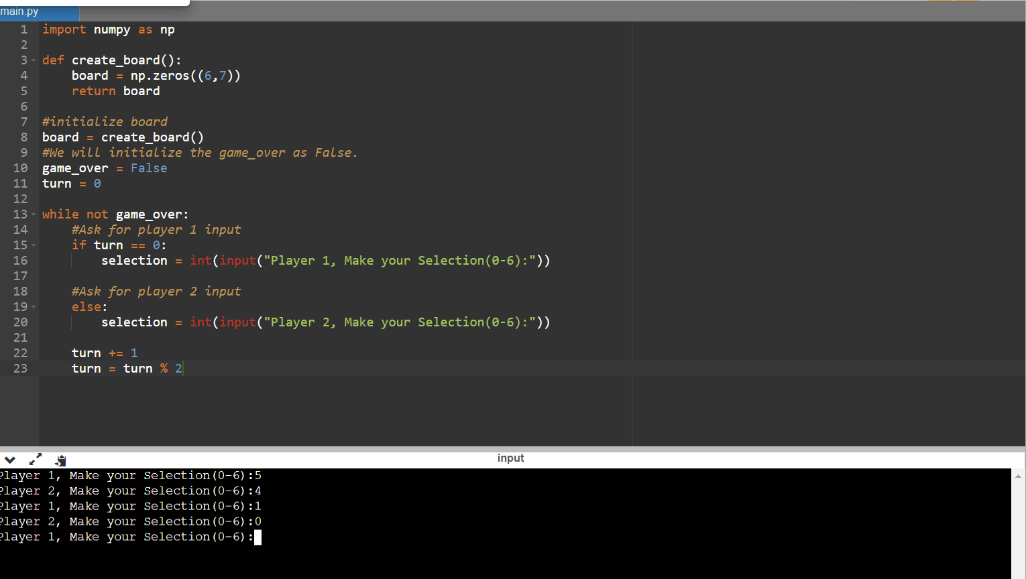

Slide 4
output

