Slide 1

Using Maxwell HPC
SUSTAIN CDT
Prof. Georgios Leontidis
Matthew Beddows
Dr. Aiden Durrant
georgios.leontidis@abdn.ac.uk
matbeddows@lincoln.ac.uk
aiden.durrant@abdn.ac.uk
University of Aberdeen

Slide 2
Today’s Session
Remind you of the HPC Basics
Infrastructure
Commands
Workflow
Hands on working examples
SLURM
Python / PyTorch GPU Acceleration

Slide 3
Maxwell
Overview
Maxwell is a Linux supercomputing cluster housed in the University of Aberdeen, Edward Wright Datacenter.
It is designed for running high computational workloads for simulation, modelling and training.
NOT a development environment.
NOT designed to host/interface model inference.
It is funded by University of Aberdeen and National Decommissioning Center and operated by external provider OCF.

Slide 4
Maxwell
Recourses Available
CPU (compute) Nodes:
11 x Compute Nodes
High Memory Nodes:
11 x High Memory Nodes
1 x Very High Memory Node (3TB)
GPU Nodes:
4 x 2080ti nodes (2 x 12GB RTX 2080ti per node)
4 x A100 nodes (3 x 80GB A100 per node)
1 Petabyte of tiered storage
Each user 1TB
HPC optimised software
Environment managers
Graphical Interface
Galaxy Server

Slide 5
Maxwell
Student Usage/Allocation
Each student as part of SUSTAIN will receive 3000 core hours as default.
If more is required, please consult with your supervisory team to purchase more credited hours.
Aberdeen HPC is costed at £0.10 per core/GPU hour.

Slide 6
Maxwell
Fair Use Policy
Be courteous of the duration for which run jobs, and how much resource you request.
If your job requires computation that is longer than 24 hours, you must handle it within the code/script.
Checkpointing
Save and Resume
Detection of resume checkpoint
Auto-Requeue SLURM

Slide 7
Carbon Usage
HPC Impact
The S in SUSTAIN is Sustainable, so we have to ensure our compute follows suit.
The Maxwell HPC fortunately employs a large amount of renewable energy from the Scottish power grid.
https://mlco2.github.io
For example,
A100 80GB GPU, 100 GPU hours, AWS, London Server = 15.5 Kg CO2 eq.

Slide 8
A. Basic Commands

Slide 9
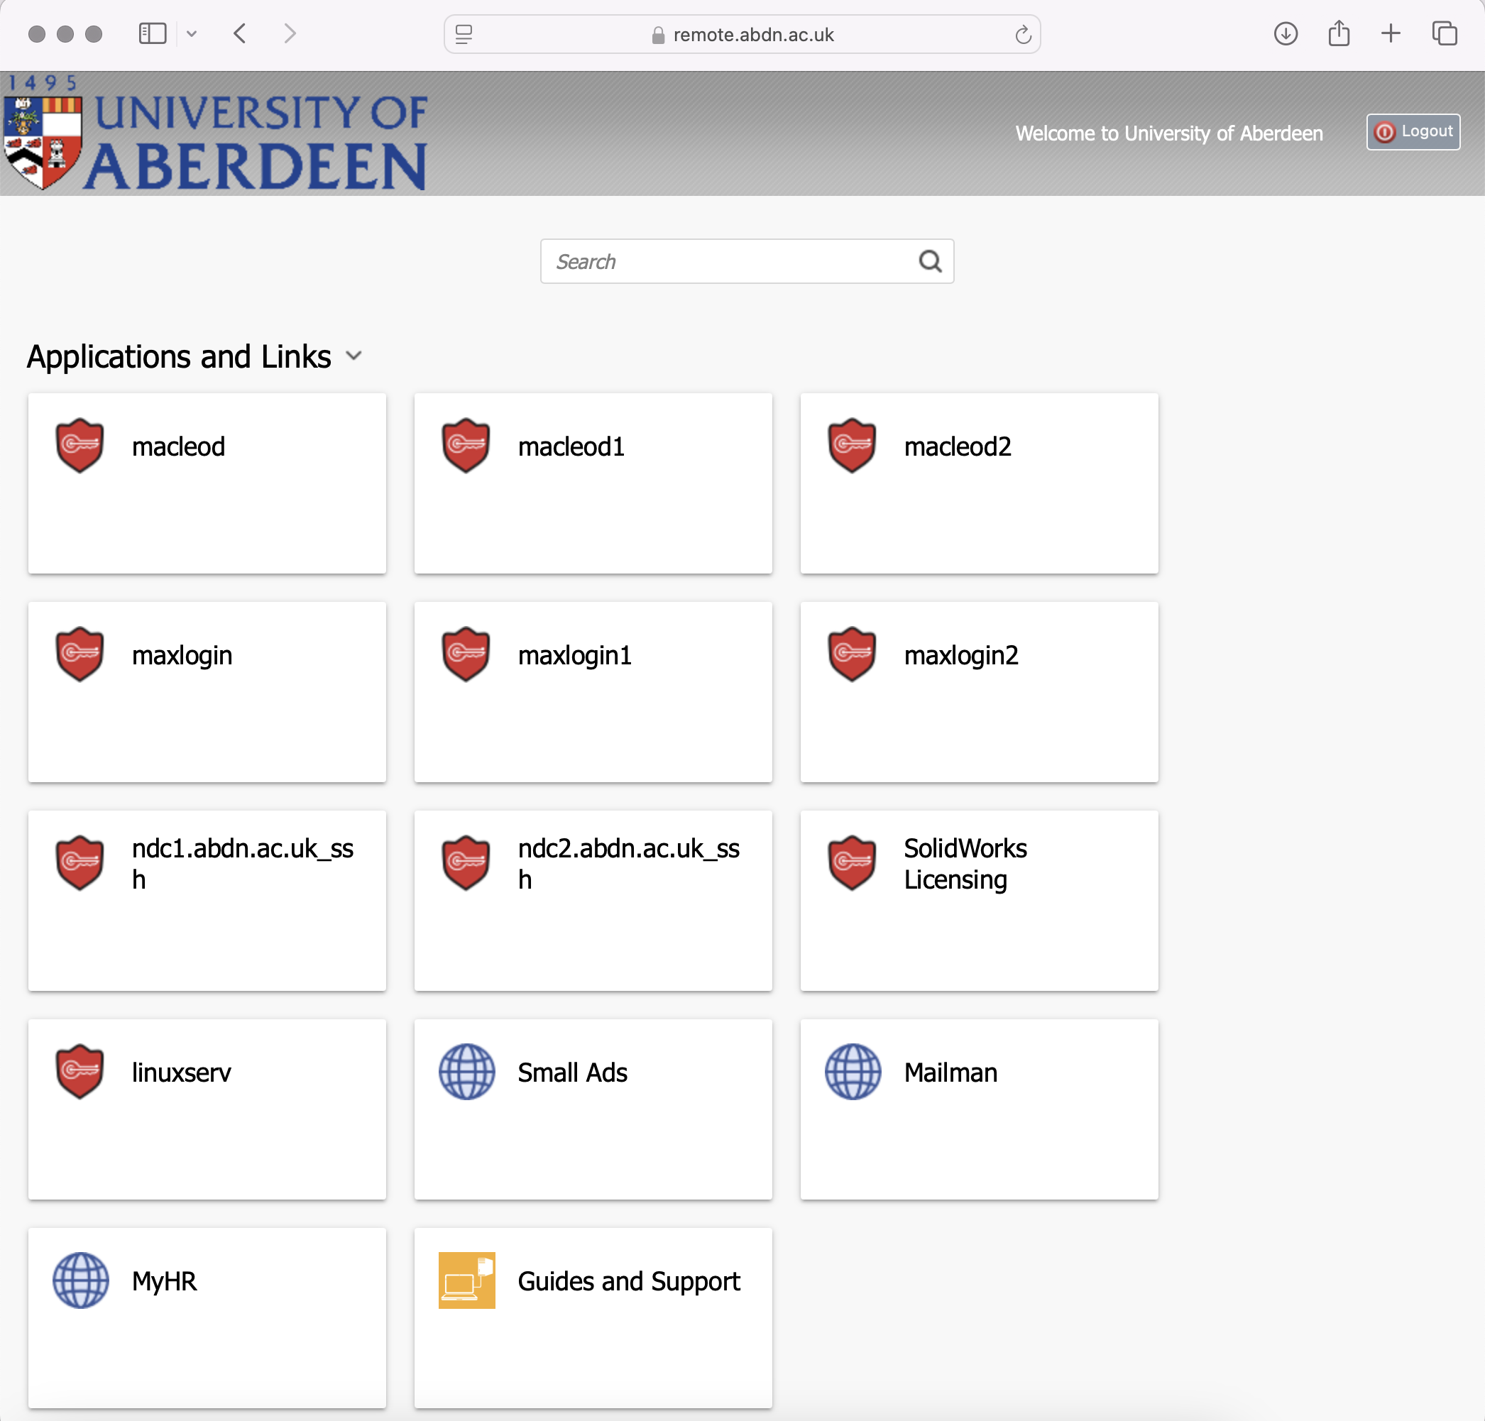
Accessing Maxwell
You should have been assigned a University of Aberdeen login
Head to:
https://remote.abdn.ac.uk
Use your Aberdeen Credentials and Log In

Slide 10
Accessing Maxwell
VPN, SSH, & SFTP
If at UoA the HPC services can be accessed via SSH when connected to the university network (not eduroam).
Connecting to the university network can be achieved via the f5 VPN if not using a managed device.
https://www.abdn.ac.uk/staffnet/working-here/it-services/remote-access.php
Maxwell login nodes:
Maxlogin1.abdn.ac.uk : port 22
Maxlogin2.abdn.ac.uk : port 22
MacLeod login nodes:
Macleod1.abdn.ac.uk : port 22
Macleod2.abdn.ac.uk : port 22

Slide 11
Using Maxwell
Directory Structure
Storage | HPC Backup and Restore Policy
Home Space | Data is backed up as follows: Daily backups kept for 14 days Weekly backups kept for 1 week Files can be restored as follows: To the path that folder/files came, or To a different specified HPC file path, or To a specified shared drive Restoration request process: Contact servicedesk@abdn.ac.uk
Shared scratch | Not backed up
Two key directories:
home
sharedscratch
Home:
Personal 50GB resilient, backed-up.
/uoa/home/<username>/
Sharedscratch:
1TB scratch space for working storage.
/uoa/scratch/users/<username>/

Slide 12
Using Maxwell
Data Management
Transferring of data is best done via SFTP (e.g. WinSCP)
All code, data, and outputs should be stored in sharedscratch.
home should be use only for small quantities of critical data.
It is recommended to use version control software for code management. (git - github/gitlab)
Maxwell storage is not optimised for speed rather for redundancy.
Preprocess prior if possible.
Store data in more efficient formats (i.e. HDF5)
Avoid multiple jobs accessing same data.
ALWAYS CHECK WHAT YOU ARE WRITING TO DISK BEFORE RUNNING!

Slide 13

GitHub
Data Management
Git can be used on Maxwell just like on your desktops.
Once we have navigated to our SharedScratch folder we can clone our repo into the folder using:
git clone <repository-url>

Slide 14
Exercise:
1. Log into Maxwell and get familiar with the Directory Structure.
2. Upload the Python code from the GitHub example repository to your sharedscratch/ directory
https://github.com/AidenDurrant/SUSTAIN-CDT-HPC-Introduction

Slide 15
B. Setting Up Your Environment

Slide 16
Using Maxwell
Software
Maxwell is pre-installed with a number of HPC optimised software.
A list of available software can be found at: https://www.abdn.ac.uk/it/documents-uni-only/Maxwell-Galaxy-Software.pdf
To utilize software when running a job simply load it via:
module load <name_of_software>
You can load multiple software packages, and unload via:
module unload <name_of_software>
To request any additions to the software list contact the digital research team.

Slide 17
Using Maxwell
Creating Environments (1/2)
In may cases it can be easier to install your own packages in a virtual environment
For data science workflows that employ Python or R, Anaconda is available.
Create personal environments.
Install any python packages and libraries via conda.
Manage different environments for different projects.

Slide 18
Using Maxwell
Creating Environments (2/2)
module load miniconda3
Conda init
source ~/.bashrc
conda create -n <your_env_name> python=3.12
Note: For first time installs you will be prompted to configure your shell, run the command `conda init bash` and then exit / close the terminal, ssh back into maxwell and load the miniconda3 module to continue.
conda activate <your_env_name>
conda install pytorch torchvision torchaudio cudatoolkit=11.7 -c pytorch
Note: The current installed version of cuda is 11.7 on maxwell.

Slide 19
Exercise:
1. Now create yourself a Conda environment
2. Install your necessary Python packages

Slide 20
SLURM
Workload Manager
SLURM is an open source, fault-tolerant, and highly scalable cluster management and job scheduling system for large and small Linux clusters.
SLURM Purpose:
Allocation of resources to users for some period of time.
Provides a framework for starting, executing, and monitoring work.
Manages a queue of pending work.
The short of it:
You interface with the home node, which in-turn communicates with compute nodes to execute your code.

Slide 21
SLURM
I want 3 GPU nodes
DATA
User 1
I want 2 CPU nodes
Resource
Not Available
Queue:
User 2
SLURM
Resource
Available
Queue:
I want 2 GPU nodes
User 3
User 3
User 3

Slide 22
Using Maxwell
Requesting Resource (1/3)
Unlike your standard desktop computer, you instead must submit a “job” for execution to the SLURM scheduler.
Some useful commands are as follows:
`sinfo` - Show summary information
`squeue` - Show job queue
`squeue -u <username>` - Show job queue for a specific user
`scontrol show partition a100_full` - Show gpu partition “a100_full” details
`scancel <job_ID>` - Cancel a job

Slide 23
Using Maxwell
#!/bin/bash
#SBATCH --nodes=1 # number of nodes
#SBATCH --cpus-per-task=12 # number of cores
#SBATCH --mem=32G # memory pool for all cores
#SBATCH --ntasks-per-node=1 # one job per node
#SBATCH --gres=gpu:2 # two gpus per node
#SBATCH --partition=a100_full
#SBATCH -o slurm.%j.out # STDOUT
#SBATCH -e slurm.%j.err # STDERR
#SBATCH --mail-type=ALL
#SBATCH --mail-user=<username>@abdn.ac.uk
module load anaconda3
source activate test
srun python example_script.py --epochs=25 --save /home/<username>/sharedscratch/
Requesting Resource (2/3)
To run a job (run your program) on Maxwell you must submit a script to the SLURM scheduler.
The SLURM script must contain 3 things:
Define the resource requirements for the job.
Activate the environment we created earlier.
Specify the script we wish to run.

Slide 24
Using Maxwell
Requesting Resource (3/3)
The partition specifies which compute nodes you will use, e.g. hmem, cgpu, a100, etc.
To submit the previous job script named `run_example.sh` to the Slurm scheduler we use the `sbatch` command:
sbatch run_example.sh
The job may run immediately or may take upto a few days to run depending on the number of existing jobs, you will receive an email notification if you use the SLURM command `email`.
To check the status of queued and running jobs, use the following:
squeue -u <username>
If you wish to cancel a job simply use:
scancel <job_ID>

Slide 25
Using Maxwell
SLURM Settings
SLURM arrays:
A slurm array batch job is similar to just running a ‘for’ loop over the sbatch script.
All runs have the same jobid with a predictable id as a suffix.
#SBATCH --array=1-10
srun python addone.py $SLURM_ARRAY_TASK_ID
#SBATCH Commands:
A full list can be found here: https://slurm.schedmd.com/sbatch.html

Slide 26
Using Maxwell
Monitoring Jobs
Monitoring jobs can most simply be achieved by printing the logs specified in the run script.
#SBATCH -o slurm.%j.out
#SBATCH -e slurm.%j.err
This produces two logs per submitted job:
STDOUT
STDERR
Many other web/cloud monitoring tools exist (ML focused):
Weights and Biases - https://wandb.ai
Neptune.ai - https://neptune.ai

Slide 27
Exercise:
1. Create a SLURM run script for the PyTorch example
2. Run the script using
1 GPU & 1 Node.

Slide 28
C. PyTorch ML Examples

Slide 29
Writing Performant Code
Distributed Computation
Using more than 1 GPU
When requesting more than 1 GPU ensure your code is configured to utilise the additional GPU’s
By default PyTorch will only use 1 GPU.
To use multiple GPUs on one node implement DataParallel.
https://pytorch.org/docs/stable/generated/torch.nn.DataParallel.html
Using more than 1 Node (Advanced)
When requesting more than 1 node ensure your code is written with distributed computation.
By default PyTorch will run separate processes on each node.
To use multiple nodes, ensure your code communicates across nodes.
https://pytorch.org/tutorials/intermediate/ddp_tutorial.html

Slide 30
Additional Resources
SLURM: https://slurm.schedmd.com/quickstart.html
Interactive Allocation: https://engaging-web.mit.edu/eofe-wiki/slurm/srun/
Jupyter Notebooks: https://nero-docs.stanford.edu/jupyter-slurm.html
ChatGPT for SLURM
University Information: https://www.abdn.ac.uk/research/digital-research/hpc-for-research-1097.php
Written Guide: https://github.com/AidenDurrant/abdn-hpc

Slide 31
Exercise:
1. Experiment with creating a small script that uses what we learnt today

Slide 32
Bonus Exercise:
1. Explore the use of cloud experiment trackers
(e.g. Neptune.ai or wandb.ai)

