Slide 1
ACTF: An Efficient Lossless Compression Algorithm for Time Series Floating Point Data
CSI3019 – ADVANCED DATA COMPRESSION TECHNIQUES
TEAM MEMBERS:
22MID0012 SUVATHI S
22MID0025 HARITHA R
22MID0308 SUJITHA T
22MID0319 SHRINIDHI K
22MID0339 RAKSHANA B

Slide 2
Abstract
Growth of time-series floating-point data in IoT, servers, finance, etc.
Challenge: Large storage, high transmission cost, and computation overhead.
Solution: ACTF (Adaptive Compression with Triple Features)
– a novel lossless compression algorithm.
Combines data preprocessing, new coding strategies, and feature refinement.
Achieves +12.25% compression ratio and +27.21% efficiency compared to Gorilla, Chimp, Chimp128.

Slide 3


Existing Methodology
Traditional Algorithms:
General compression (LZ4, Snappy, XZ, Brotli):
Fast but not specialized for time-series floating points.
Gorilla (Facebook): XOR-based, efficient but weak with trailing zeros.
Chimp / Chimp128:Improved Gorilla with better XOR and leading zeros handling.
Limitations:
Poor performance with long trailing zeros.
High redundancy in edge cases.
Limited adaptability to varied datasets.

Slide 4
Limitations of Existing Work
Trailing Zero Inefficiency
Both algorithms always output trailing zero fields (e.g., 6 bits in Gorilla), even when the trailing zero count is small or nearly zero—wastes bits.
Limited Handling of Leading Zeros
Fixed-length encoding for leading zeros (e.g., 5 bits in Gorilla) is not adaptive or efficient for datasets with frequent long zero runs.
Flag Structure Not Optimized
Shortest flag assigned to rare cases (exact value repeat), but most time-series values only partially repeat—opportunity for savings is missed.
Pattern Reuse is Limited
Only immediate previous value is used for compression; recurring XOR or center bit patterns beyond neighbor are ignored.
Struggles with High-Precision Data
On highly dynamic or high-precision data, savings are minimal due to lack of deeper pattern mining.

Slide 5
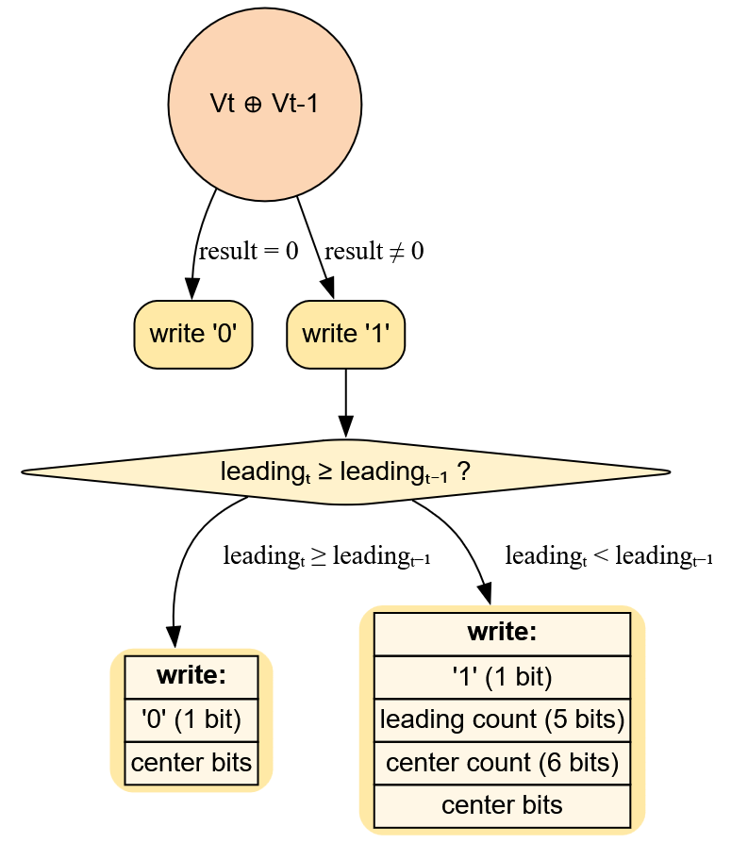
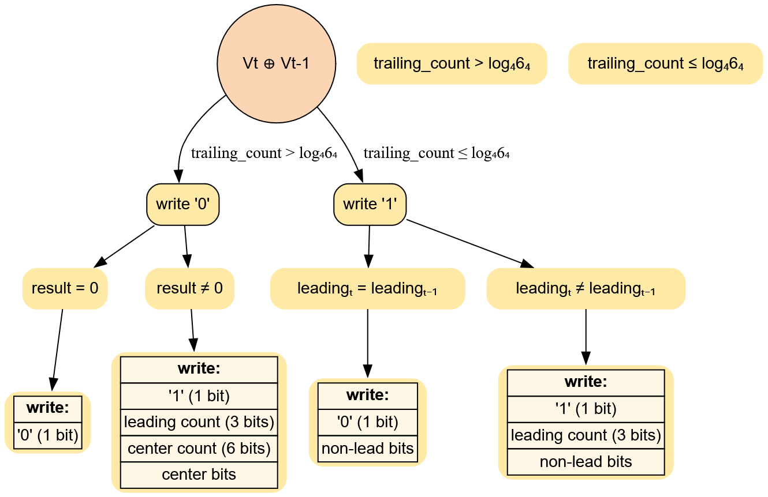
WORK FLOW OF EXISTING
GORILLA
CHIMP

Slide 6

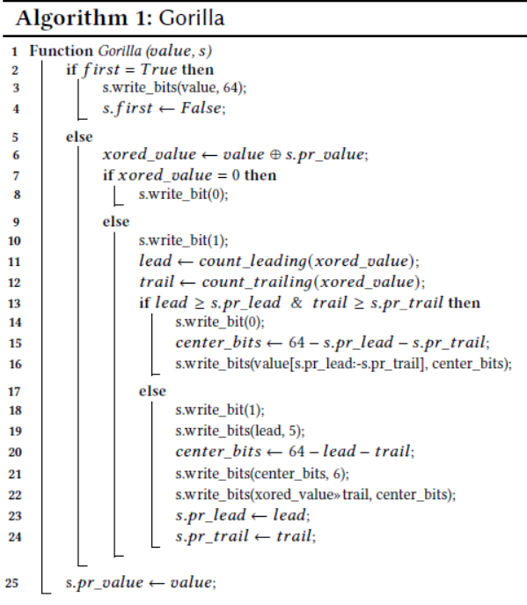


Algorithm of Gorilla

Slide 7
Example of Gorilla
1) IEEE-754 Bit Representation
729.9:
Binary (64 bits): 0100000010000110110011110011001100110011001100110011001100110011
Hex: 0x4086cf3333333333
731.3:
Binary (64 bits): 0100000010000110110110100110011001100110011001100110011001100110
Hex: 0x4086da6666666666
2) XOR of Values
XOR:
Binary (64 bits): 0000000000000000000101010101010101010101010101010101010101010101
Hex: 0x155555555555
Shows the differing bits between the two floats.

Slide 8
3. Leading/Trailing Zeros and Meaningful Bits
Leading Zeros: 19
Trailing Zeros: 0
Meaningful (center) bits: 64−19−0=45
Center bits extracted:101010101010101010101010101010101010101010101
4. Gorilla Encoder Actions
First Value (729.9):
Stored raw, 64 bits
Second Value (731.3):
XOR ≠ 0, so write control bit '1' (changed value)
Previous window doesn't fit, so write additional control bit '1' (new window)
Write leading zero count (10011), meaningful bits length minus 1 (101100)
Write 45 meaningful center bits (101010...)

Slide 9
5. Final Compressed Bitstream
First value: 64 bits
Second value: Control (11), leading (10011), length (101100), center bits (45 bits)
Total compressed stream length: 122 bits (vs 128 bits raw!)
6. Decoding/Verification
Decoded stream yields exactly 729.9 and 731.3 (lossless and bitwise accurate)
At A Glance:
Raw 2 floats: 128 bits
Gorilla compressed: 122 bits
Compression achieved!

Slide 10
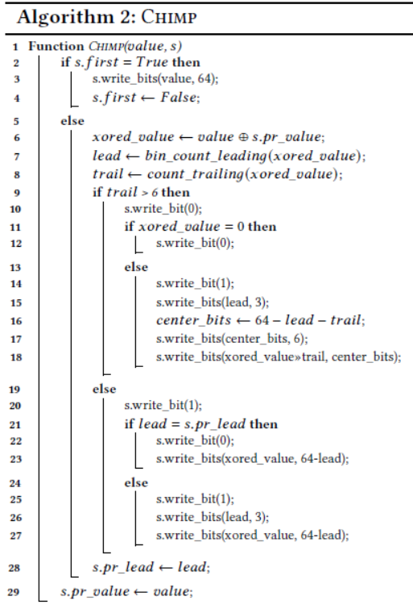
Algorithm of Chimp

Slide 11
Example Of Chimp
Initial State
pr_value: Undefined
pr_lead: Undefined
Timestamp 1 → Processing 729.9
Action: This is the first value, so it is stored uncompressed.
State Update:
pr_value = 729.9
s.first = False
Output: 01000000 10000110 11001111 00110011 00110011 00110011 00110011 00110011 (64 bits)
Timestamp 2 → Processing 731.3
Inputs:
value = 731.3
s.pr_value = 729.9
XOR Calculation (xored_value):
731.3 ⊕ 729.9 = 0000000000000000000101010101010101010101010101010101010101010101

Slide 12
Bit Counts:
lead = 19
trail = 0
Algorithm Path (Referencing Pseudo-Code):
s.first is False
trail > 6 ? → 0 > 6 → False → go to else (line 19)
Write bit: 1
lead == s.pr_lead ? → (19 == undefined) → False → go to else (line 24)
Write bit: 1
Write lead (19) in 3 bits → binary of 19 = 10011 → mapped/truncated → 100 (3 bits)
Write xored_value for (64 − lead) bits → (64 − 19 = 45 bits)
State Update:
s.pr_lead = 19
s.pr_value = 731.3
Output: 1 (flag)
+ 1 (flag)
+ 100 (lead, 3 bits)
+ [45 bits of XOR data]
Total = 50 bits

Slide 13
Proposed Methodology (ACTF)
Step 1: Data Preprocessing
Pre-check for equality and encode repeats with a special flag ('00'), skipping unnecessary calculations.
Step 2: Coding Category Expansion
Introduces new branches ('110', '111') for recurring center/XOR patterns, further saving space on repeating structures.
Step 3: Feature Representation Refinement
Uses shorter fields and adaptive bit allocation for leading/trailing zeros, fitted to dataset statistics (e.g., restrict L_count, T_count for relevant cases).
Step 4: Robust Edge-Case Handling
Optimizes long plateaus, recurring centers, and runs of zeros using custom flags and encoding, not present in Gorilla/Chimp.
Step 5: Achieved Improvements
Higher compression ratios and faster (de)compression, especially for sensor, IoT, and scientific time series.

Slide 14
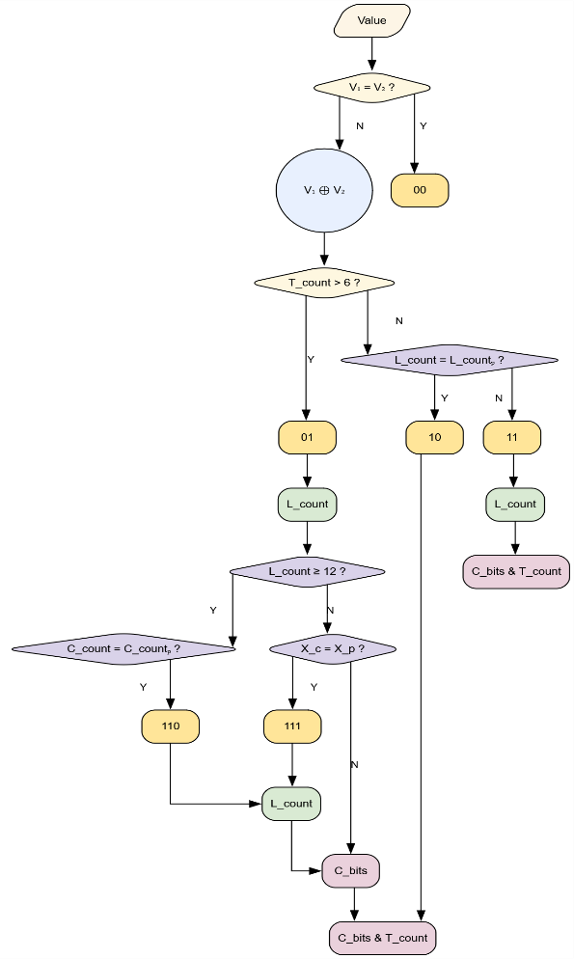
COMPRESSION WORKFLOW OF ACTF

Slide 15
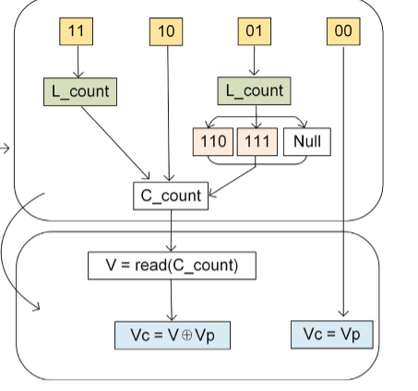
DECOMPRESSION OF ACTF

Slide 16
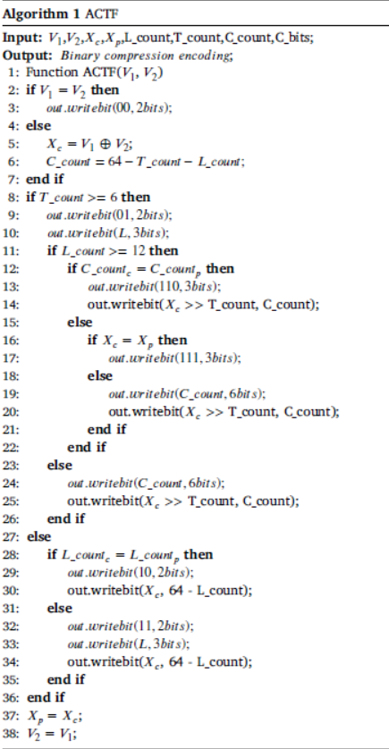
Alogorithm of ACTF :

Slide 17
Example Of ACTF :
Input Sequence: We’ll use two floating-point numbers for demonstration.
1. IEEE-754 64-bit Representations
V₁ (729.9): 01000000 10000110 11001111 00110011 00110011 00110011 00110011 00110011
V₂ (731.3): 01000000 10000110 11011010 01100110 01100110 01100110 01100110 01100110
Timestamp | Value (V)
1 | 729.9
2 | 731.3

Slide 18
2. Step-by-Step Compression (According to ACTF Algorithm)
Timestamp 1 → Processing V₁ = 729.9
Action: This is the first value, so it is stored uncompressed.
State Update: V₂ (previous value) ← 729.9
Output: 0100000010000110110011110011001100110011001100110011001100110011 (64 bits)
Timestamp 2 → Processing V₁ = 731.3
Inputs:
Current value (V₁) = 731.3
Previous value (V₂) = 729.9

Slide 19
Algorithm Path:
Line 2: V₁ == V₂ ? → No
Line 5: Compute XOR: Xc = V₁ ⊕ V₂
0100000010000110110011110011001100110011001100110011001100110011 (729.9)
⊕
0100000010000110110110100110011001100110011001100110011001100110 (731.3)=
0000000000000000000101010101010101010101010101010101010101010101 (Xc)
Calculate Counts for Xc:
L_count (leading zeros) = 19
T_count (trailing zeros) = 0
C_count (center bits) = 64 - 19 - 0 = 45

Slide 20
Branch Decision:
Line 8: T_count ≥ 6 ? → No (0 < 6)
Line 27: Proceed to else block
Line 28: L_count_c == L_count_p ? → First XOR → Assume False
Line 32: Write flag bits: ‘11’
Line 33: Write encoded L (3 bits): 19 → 101
Line 34: Write Xc’s significant bits: 45 bits (from position 19 onward)
State Update:
Xp ← current Xc
V₂ ← 731.3
L_count_p ← 19

Slide 21
Output Bitstream (for 2nd value):
Control bits: 11
Encoded L: 101
Center bits: 010101010101010101010101010101010101010101010
Total bits: 2 + 3 + 45 = 50 bits
Final ACTF Compressed Stream Summary :
First value (V₁ = 729.9): 64 bits
Second value (V₂ = 731.3): 50 bits
Total compressed length: 114 bits (vs 128 bits raw!)

Slide 22
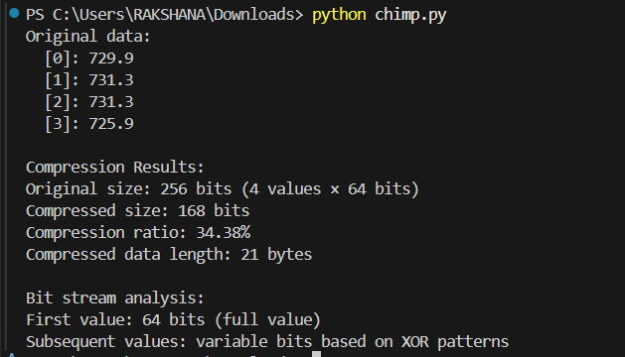
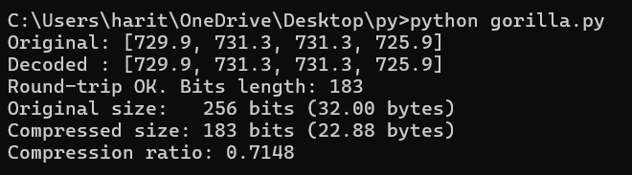
RESULT
Gorilla
Chimp

Slide 23
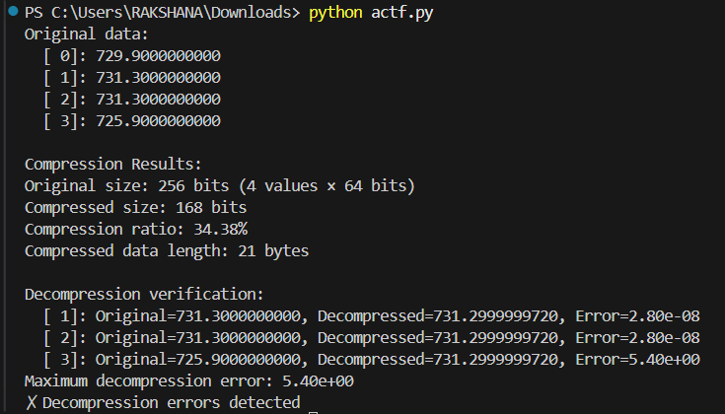
ACTF

Slide 24
CONCLUSION
The ACTF algorithm provides significantly better compression ratios and speed compared to existing techniques like Chimp and Gorilla for floating-point time series, as demonstrated in experimental studies.
Existing algorithms are fast but leave space savings on the table due to limited flag structures and underutilization of recurring patterns and zero runs.
ACTF introduces smarter preprocessing and new encoding branches, which efficiently handle repeated values and adaptive bit allocation.
As a result, ACTF offers lossless compression, faster (de)compression time, and greater space efficiency in real-world scenarios.
By directly addressing the limitations of Chimp and Gorilla, ACTF is shown to be a superior method for time series floating-point data compression.

