Slide 1
VEHICLE DETECTION AND COUNTING USING MATLAB.
SUYASH BHATT
170906140.
4th Year B. Tech Student,
Dept. of E&E,
MIT, MANIPAL-576104
Harshendra N. Shet K.
Asistant Professor(Senior scale)
Dept. of E&E,
MIT, MANIPAL-576104

Slide 2
Content
Introduction
Objectives
Methodology
Results and Conclusion
References

Slide 3
Introduction
In recent year, as a result of the increase in vehicle traffic, many problems have appeared. For example, traffic accidents, traffic congestion and so on. Traffic congestion has been a significantly challenging problem.Increase of preliminary transportation infrastructure e.g., more pavements, and widened road, have not been able to relieve city congestion.
While the Inductive loop detectors and laser sensors deployed all over the world are proving to be inefficient ,there was a need of a vision based system.The quality of data coming from them are richer and more complete compared to that of radars and lasers.
This project is aimed at counting and classifying vehicles from the dynamic data obtained from the camera installed at the highways.This method is much more feasible as cameras are much less disruptive to install compared to magnetic sensors.

Slide 4
Objectives
To input a video to identify and count number of vehicles passing on a road.
To study about background elimination ,frame difference ,background registration,object identification and image segmentation in matlab.

Slide 5
Methodology
Traffic surveillance system
Block diagram
Background registration
Foreground Detection
Image segmentation
Vehicle counting

Slide 6
Traffic surveillance
Detecting and tracking vehicles in video surveillance data is a very challenging problem in computer vision with important practical applications, such as traffic monitoring and analysis, congestion, accidents.
A system has been developed to detect and count objects efficiently.
Video surveillance for road vehicles is a key component for smooth and secure transportation systems.

Slide 7
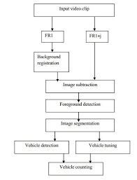
Block diagram
Fig1.1
ISSN 2349 9745

Slide 8
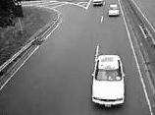
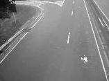
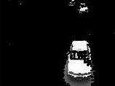
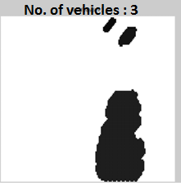
(a) Original Image
(b) Background Registered
(c) Foreground Detection
Fig 1.2
(d) Object Tracked

Slide 9
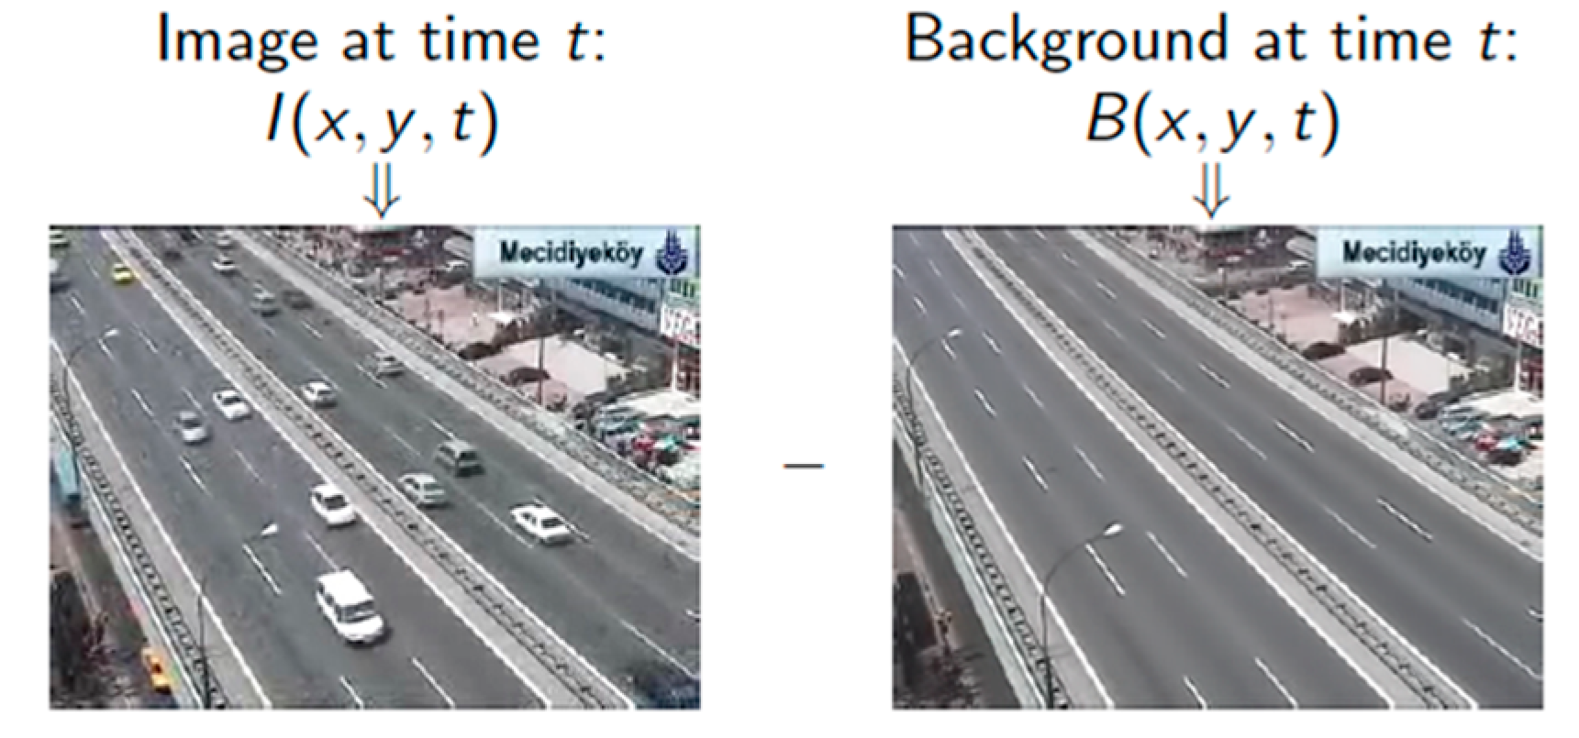
Background registration
Fig 1.3 courtesy :https://www.mdpi.com/1424-8220/17/7/1535

Slide 10
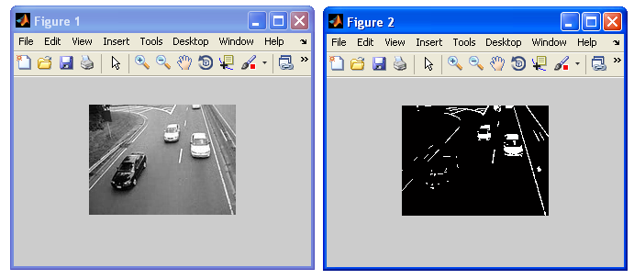
Foreground detection
Fig1.4 source: BogoToBogo

Slide 11
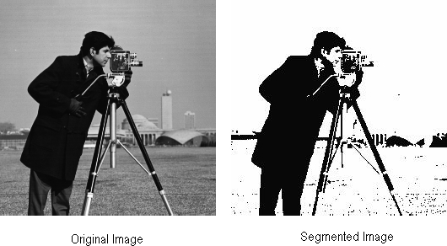
Image segmentation
In general, two steps are used in this study:
Segmentation to object regions of interest
In this step, regions which may contain unknown
objects have to be detected.
Focus on the extraction of suitable features and then extraction of objects.
Fig 1.5 Image segmentation

Slide 12
Vehicle counting
The tracked image forms the input image for counting. This image is scanned from top to bottom for detecting the presence of an object.
A variable named, count that keeps track of the number of vehicles is used for counting .
This concept is applied for the entire image and the final count of objects is present in variable count.
A fairly good accuracy of count is achieved by setting the value of number of frames.

Slide 13
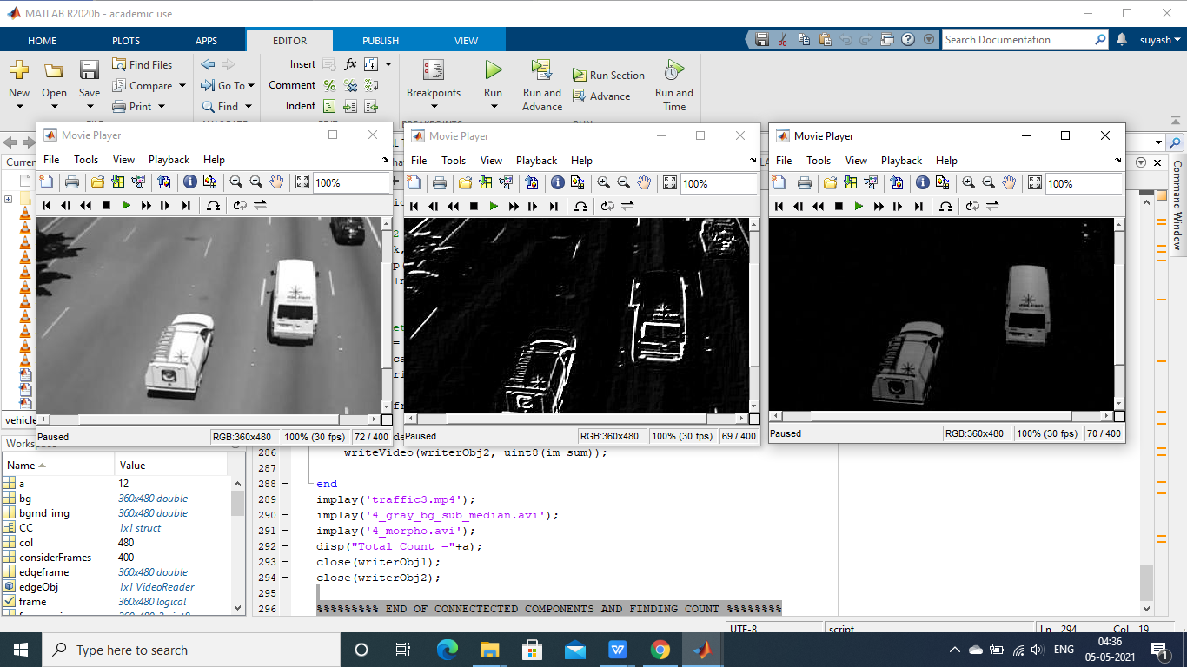
Results and Conclusion

Slide 14
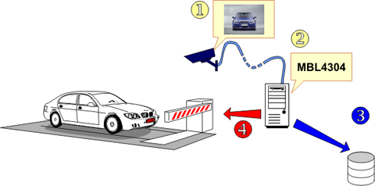
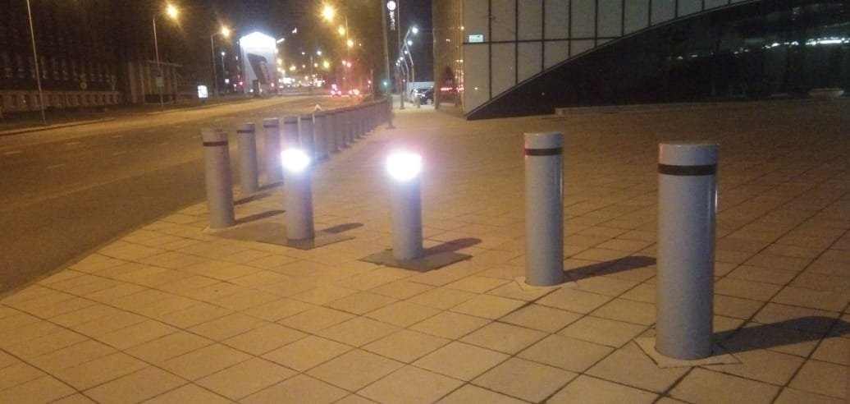
Application and future scope
Fig 1.6 Smart Car Parking
Fig 1.7 Barricades in the future

Slide 15
References
[1] Chen S. C., Shyu M. L. and Zhang C., ―An Intelligent Framework for Spatio-Temporal
Vehicle Tracking‖, 4th International IEEE Conference on Intelligent Transportation Systems,
Oakland,California, USA, Aug. 2001.
[2] Gupte S., Masoud O., Martin R. F. K. and Papanikolopoulos N. P.,―Detection and
Classification of Vehicles‖, In IEEE Transactions on Intelligent Transportation Systems, vol. 3,no. 1, March, 2002, pp. 37–47.
Books:
P.M.Daigavane and Dr. P.R.Bajaj , Real Time Vehicle Detection and Counting Method for
Unsupervised Traffic Video on Highways
Other references:
https://se.mathworks.com/matlabcentral/answers/387997-how-to-count-all-vehicles-in-matlab

Slide 16
Thank You

