Slide 1
Thorium : tHe new source of energy?

Slide 2
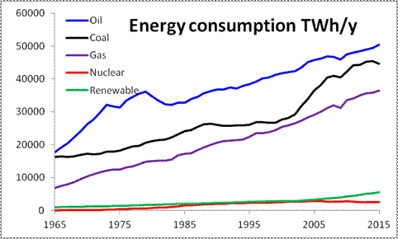
INtroduction
Energy consumption..
Renewable energy..
Environment.

Slide 3
A new primary energy source
By 2050, the world’s consumption (+ 2%/y) should reach 34 TW, of which 20 TW should come from new energy sources:
⇒ A major innovation is needed in order to replace the expected “decay” of the traditional energy sources!
This implies a strong R&D effort, which is the only hope to solve the energy problem on the long term. This R&D should not exclude any direction a priori!
  Renewables
  Nuclear (fission and fusion)
  Use of hydrogen
Can nuclear energy play a major role?
Nuclear energy has the potential to satisfy the demand for a long time (at least 15 centuries for fission, essentially infinite for fusion), and is obviously appealing from the point of view of atmospheric emissions.

Slide 4
WHICH TYPE OF NUCLEAR ENERGY?
Nuclear fusion energy: not yet proven to be practical. Conceptual level not reached (magnetic or inertial confinement?). ITER a step, hopefully in the right direction.
Nuclear fission energy: well understood, and the technology exists, with a long (≥ 50 years) experience, however, present scheme has its own problems:
Military proliferation (production and extraction of plutonium);
Possibility of accidents (Chernobyl [1986]; Three Mile island [1979]);
Waste management.
However, it is not given by Nature, that the way we use nuclear fission energy today is the only and best way to do it. One should rather ask the question:
Could nuclear fission be exploited in a way that is acceptable to Society?

Slide 5
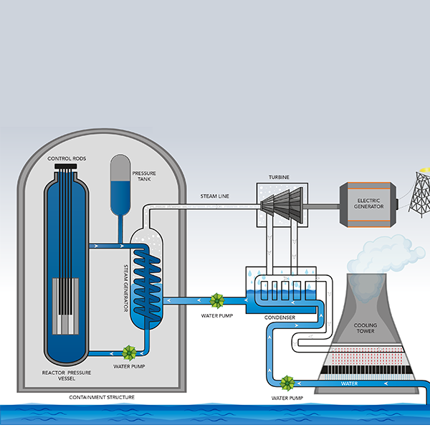
How a nuclear reactor works?

Slide 6
Thorium fuel cycle
Thorium cycle is a nuclear cycle that uses isotope of thorium 232 as fertile material.
In the reactor,Th is transmuted into fissile artificial U233 which is the nuclear fuel
Thorium cycle claims numerous potential advantage over Uranium cycle-
Thorium’s greater abundance,superior physical and nuclear properties,better resistance to nuclear weapons,plutonium and actinide production etc.

Slide 7

NUCLEAR REACTION WITH THORIUM
In the thorium cycle,fuel is formed when U 232 captures a Neutron(whether it’s a fast reactor or thermal reactor) to become Th233.This normally emits an electron and anti neutrino (v) by β-decay to become 233Pa.This then emits another electron and anti neutrino by a second β-decay to become U 233

Slide 8
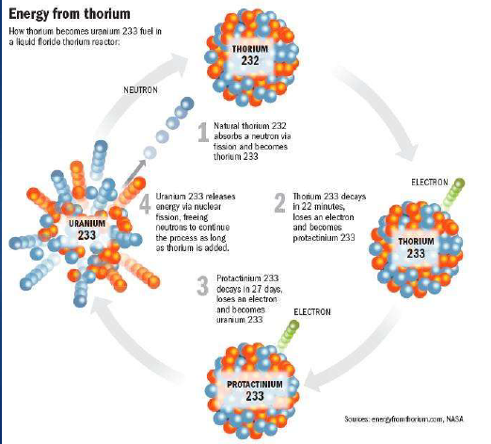
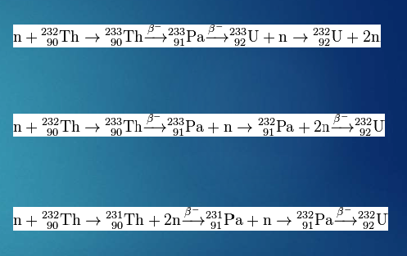
ENERGY FROM THORIUM

Slide 9
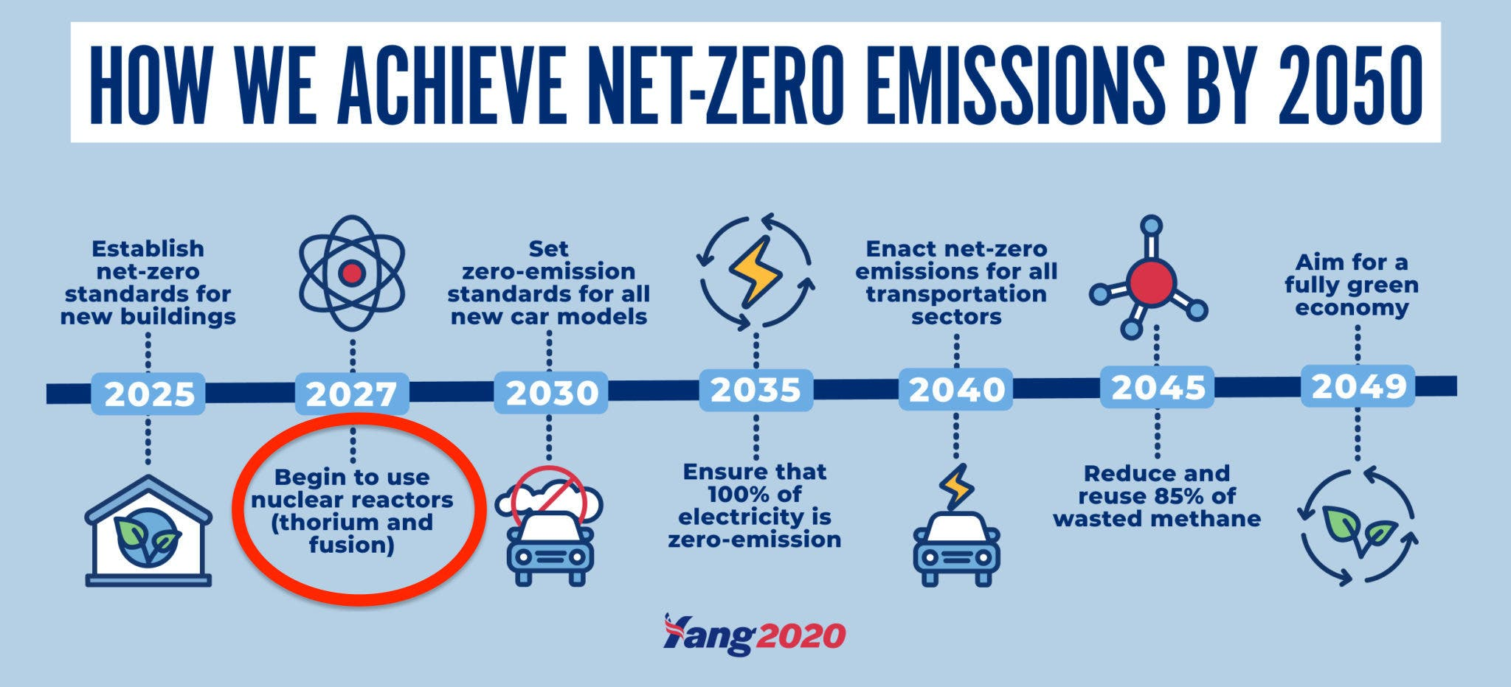
WHY DO WE NEED THORIUM?

Slide 10
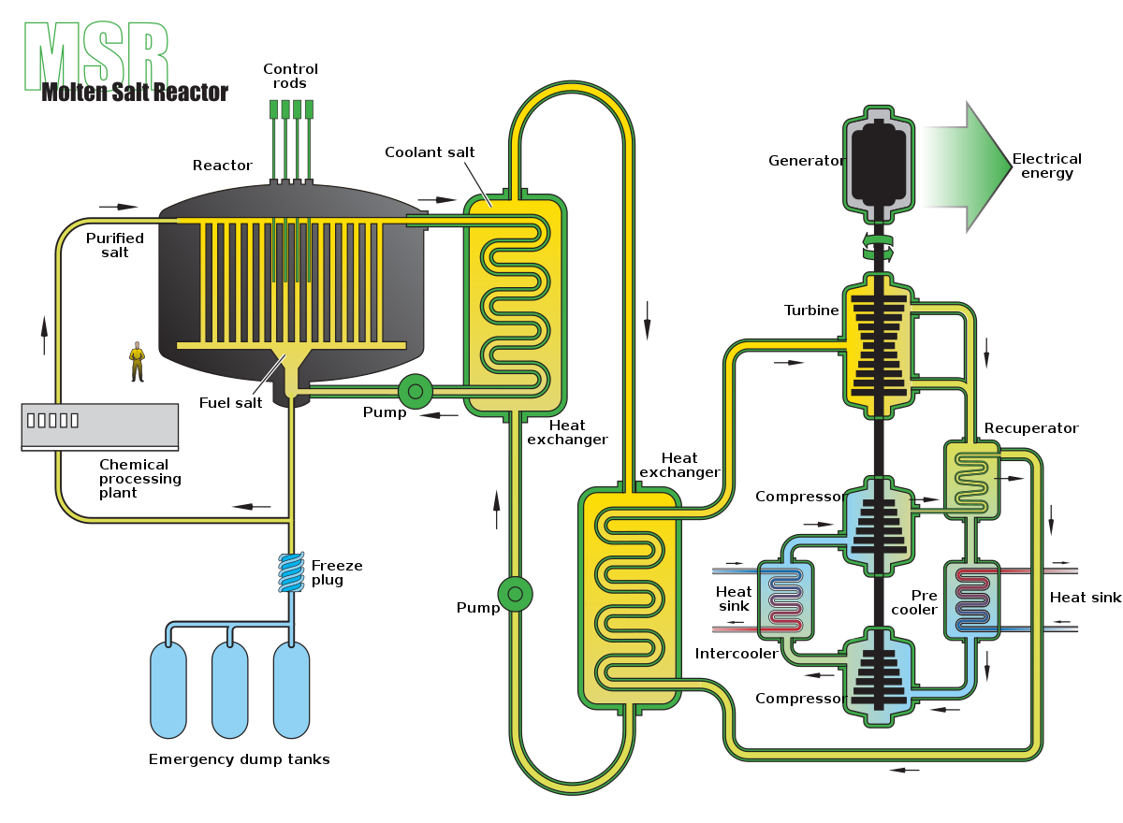
Molten salt reactors

Slide 11
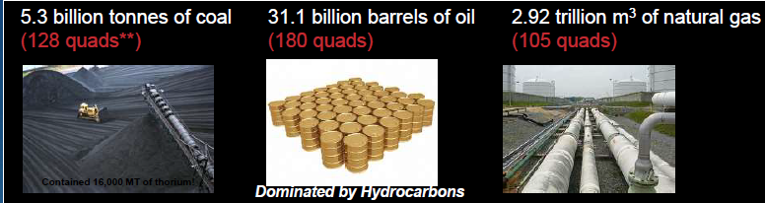
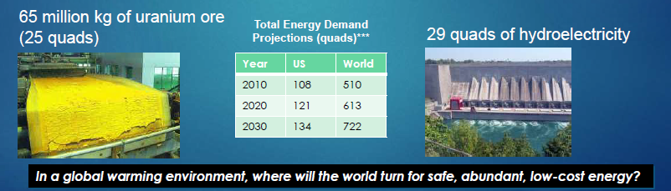
World energy consumption is rapidly escalating.Future energy consumption has been significantly underestimated.
In 2007 we consumed-

Slide 12
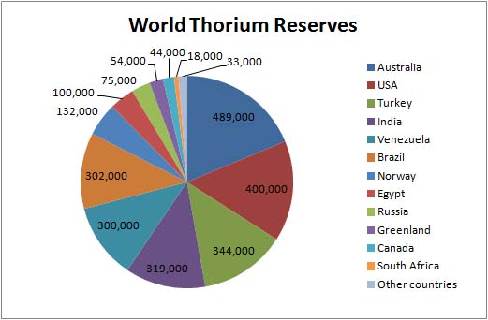
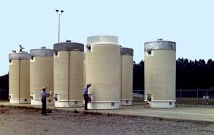
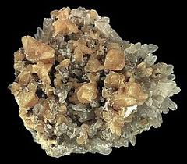
THORIUM FUEL SUPPLY
THORIUM IS ABUNDANT IN THE WORLD
ESTIMATED WORLD RESERVE OF 1.4M MT
INDIA has 20% of the World’s reserve

Slide 13
ENERGY COMPARISON
230 train cars (25,000 MT) of bituminous coal or,
600 train cars (66,000 MT) of brown coal,
=
or, 440 million cubic feet of natural gas (15% of a
125,000 cubic meter LNG tanker),
6 kg of fissile material in a liquid-fluoride
reactor has the energy equivalent (66,000
MW*hr electrical*) of:
or, 300 kg of enriched (3%) uranium in a
pressurized water reactor.

Slide 14
Advantages
Inherent Safety
Stable coolant-molten fluorides are chemically stable and impervious to radiation.
Low pressure operations
Leak resistance-due to low pressure operation, potential for large leaks greatly reduced.

Slide 15
Potential risks
India’s nuclear program compared to rest of the world.
No one knows what we are getting ourselves into.
Initial cost to setup is highly speculative.
Is it cost affective?
Stakes are high.

Slide 16
India’s three stage Nuclear Power program

Slide 17
COnclusion
Can renewables solve the energy crisis in the future?
We need more research and development.
Reducing the carbon footprint.
How much risk are we willing to take?
What choice do we have?

Slide 18
REFERENCES
[1] “Ministry of Power". Powermin.gov.in. Retrieved 22 August 2010.
[2] “Nuclear Power Plants in India”, Nuclear Power Corporation of India Limited
(NPCIL), retrieved 21 January 2011.
[3] "Projects under Construction". NPCIL. Retrieved 10 April 2014.
[4] "Nuclear Programme" (Press release). Press Information Bureau, Government of
India, Department of Atomic Energy.
[5] J. B. Gupta. “Power System Analysis”.

Slide 19
Thank you…

