Slide 1
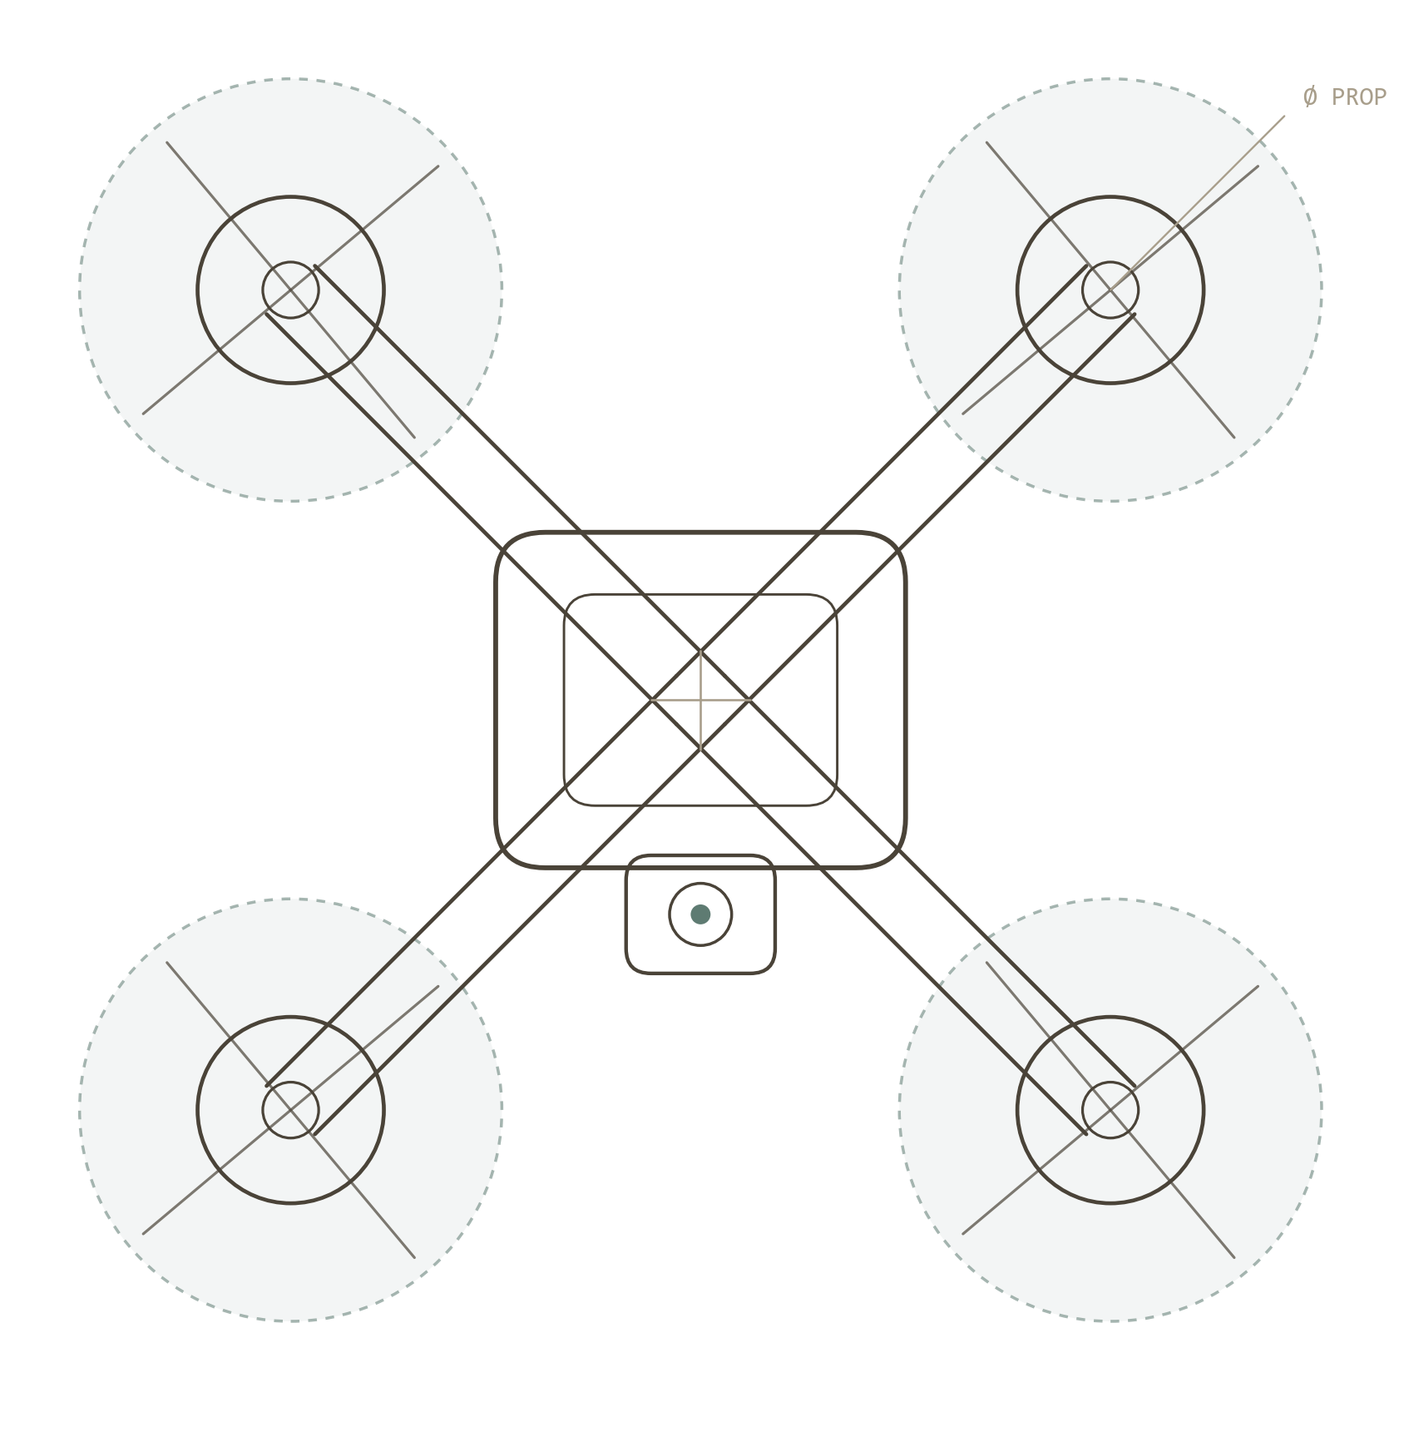

REV 1.1 / SITL-VERIFIED / 2026
AUTONOMOUS UAV / COMPANION-COMPUTER SAFETY
Drone Safety
System
Verified dispatch & failsafe arbitration for fully autonomous flight.
0.4 m
8 / 8
54
2
TERMINAL ACCURACY
ACCEPTANCE CHECKS
UNIT TESTS
PATENTS
github.com/SV-1411/drone

Slide 2
OVERVIEW
What this system is
A companion-computer stack that turns one network trigger into a complete autonomous mission — fly to a GPS target, hover, and return — with no pilot, and aviation-grade safety woven through every phase.
Trigger-to-flight
Verified commands
Arbitrated failsafes
Provable safety
POST a coordinate; the drone arms, takes off, navigates, hovers and returns on its own.
Every flight-mode change is confirmed from the autopilot's own telemetry, never assumed.
Battery, GPS, geofence & timeout hazards resolve to one debounced action.
A landing interlock makes it impossible to start a mission on an airborne drone.
DRONE SAFETY SYSTEM
02 / 24

Slide 3
MOTIVATION
Autonomy removes the operator who catches failures
• The autopilot can lie. A mode-change is reported accepted while the autopilot silently stays in its old mode — seen on real ArduCopter.
• No human is watching. In autonomous dispatch nobody notices a dropped command — and the same path carries emergency RTL/LAND.
• Missions can overlap. Treating mission N's end as license to start N+1 can arm a still-airborne aircraft — undefined & hazardous.
• Sensors glitch. One bad GPS sample, taken naively, triggers an instant land-in-place — over a road, water, or a crowd.
The core insight
“A command issued is not a command executed.”
So we treat the autopilot as untrusted: demand telemetry-confirmed proof of every transition — then guarantee the queue can never hand off an airborne drone.
DRONE SAFETY SYSTEM
03 / 24

Slide 4
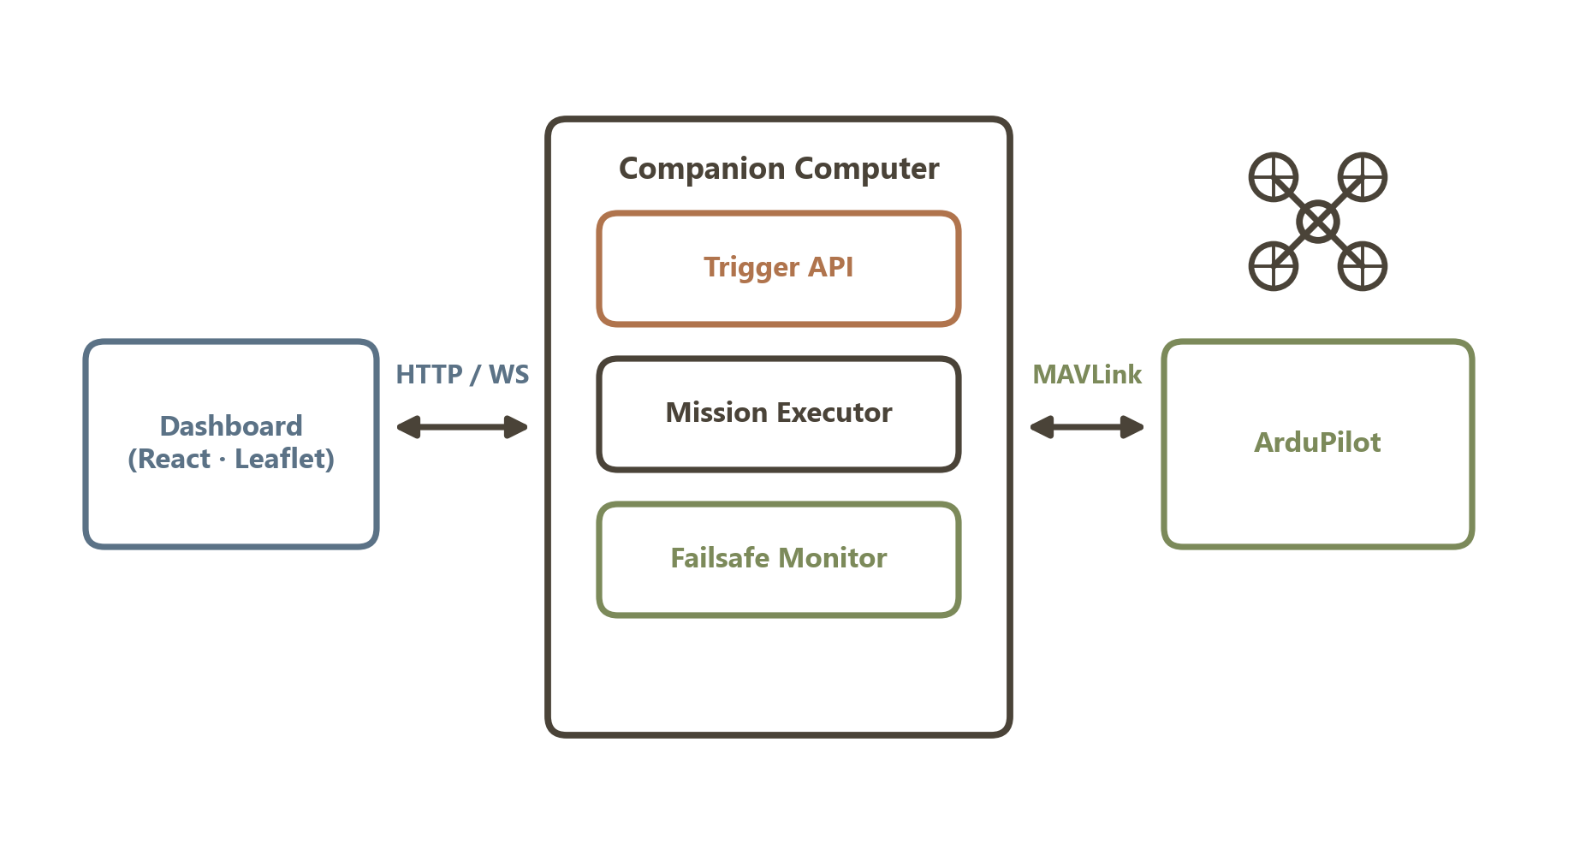
SYSTEM ARCHITECTURE
Four cleanly separated parts
• Trigger API — validate, queue, stream.
• Executor — the 12-state flight machine.
• Failsafe monitor — 1 Hz hazard arbiter.
• Dashboard — live Leaflet map.
Figure 1 · System architecture
DRONE SAFETY SYSTEM
04 / 24

Slide 5
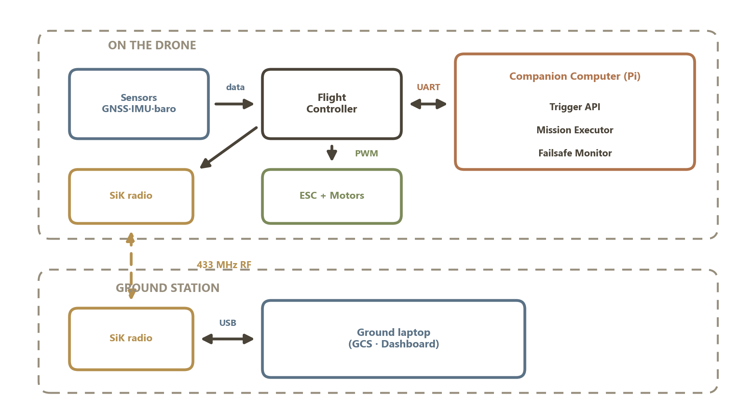
SYSTEM
The full system — hardware & software
• On the drone — sensors → flight controller → companion Pi → motors.
• Companion — runs the Trigger API, executor & failsafe.
• Link — SiK 433 MHz radio to the ground laptop.
• Ground — GCS / dashboard for monitoring & override.
Figure 2 · End-to-end system (drone + ground)
DRONE SAFETY SYSTEM
05 / 24

Slide 6
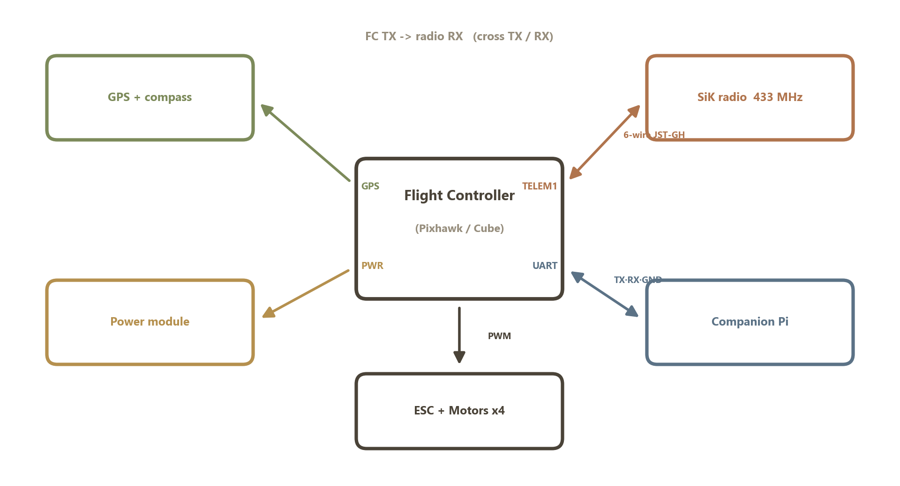
HARDWARE
How the radio & companion are wired in
• TELEM1 → SiK radio — 6-wire JST-GH; cross FC TX → radio RX.
• UART → Companion — TX·RX·GND; runs the autonomy stack.
• GPS & power — to their dedicated ports.
• MAIN OUT → ESCs — PWM to the four motors.
Figure · Flight-controller wiring (SiK 433 + companion)
DRONE SAFETY SYSTEM
06 / 24

Slide 7
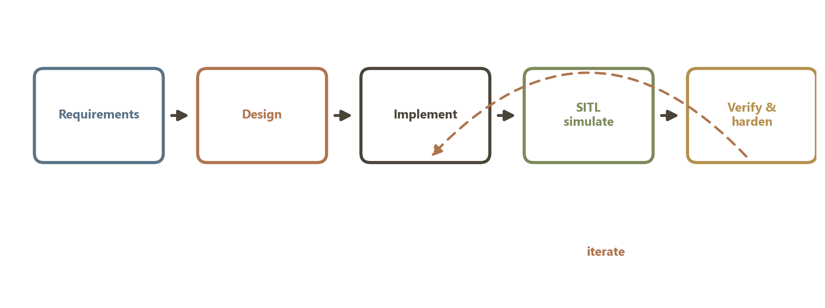
METHODOLOGY
How the system was built & proven
Figure 3 · Iterative, test-driven development method
• Test-driven — design → implement → simulate in SITL → verify with 37 unit + E2E tests → harden, repeat.
• Evidence-led — every safety claim is pinned by an automated test before it enters the patent drafts.
DRONE SAFETY SYSTEM
07 / 24

Slide 8
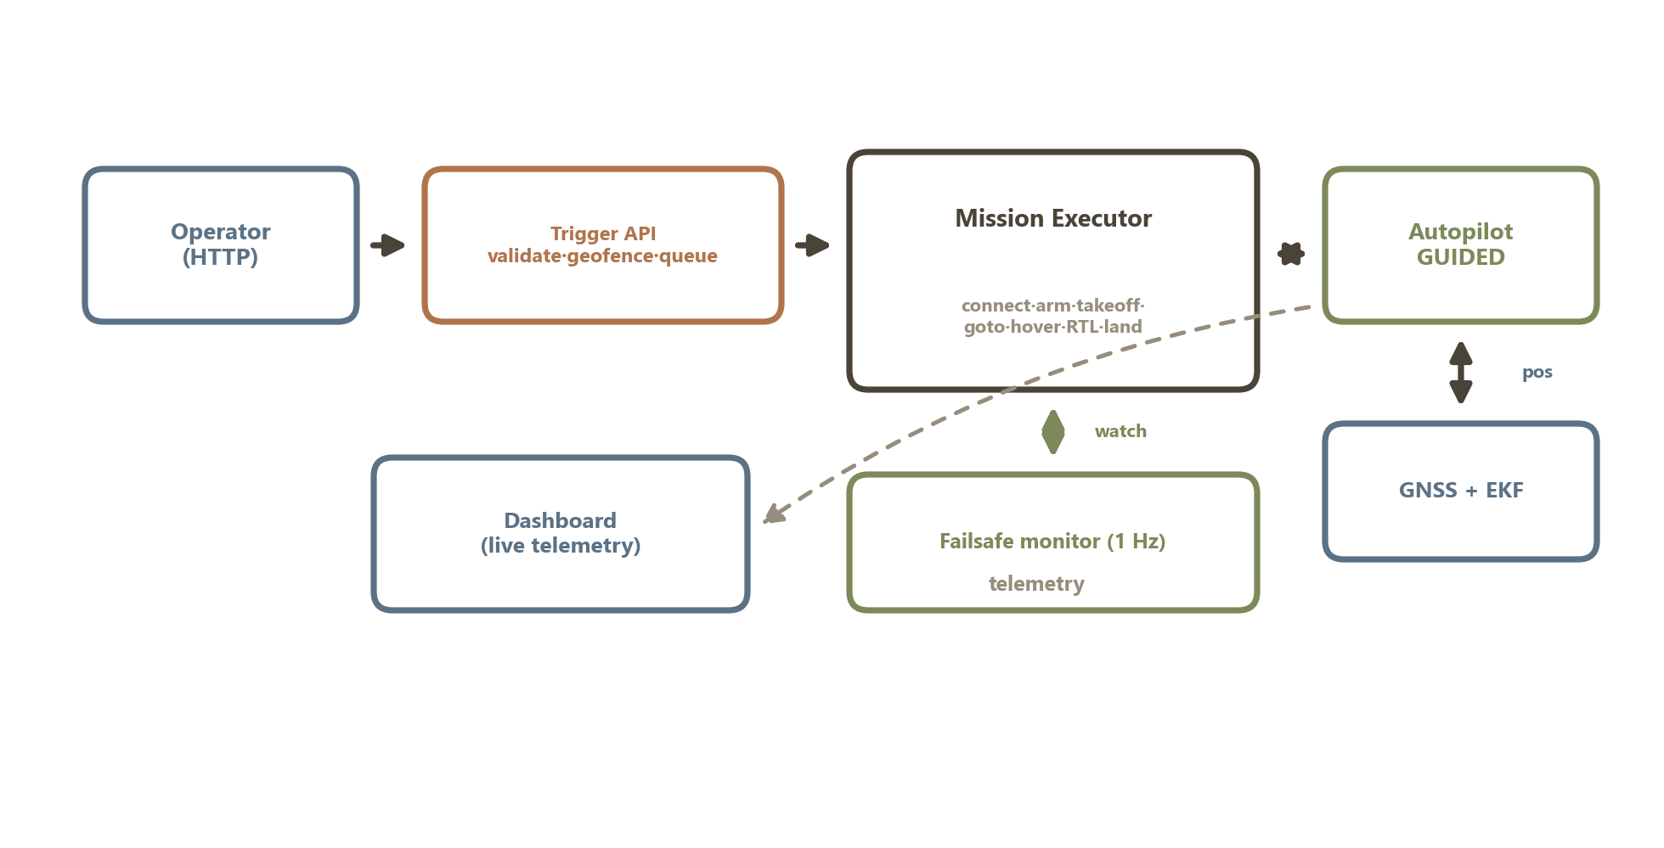
WORKING
End-to-end: how it all flows
• Input — operator POSTs a coordinate.
• Process — API validates & queues; executor flies the phases.
• Control — autopilot in GUIDED on GNSS-fused position.
• Feedback — live telemetry out; failsafe watches throughout.
Figure 4 · Working & data flow, input to flight
DRONE SAFETY SYSTEM
08 / 24

Slide 9
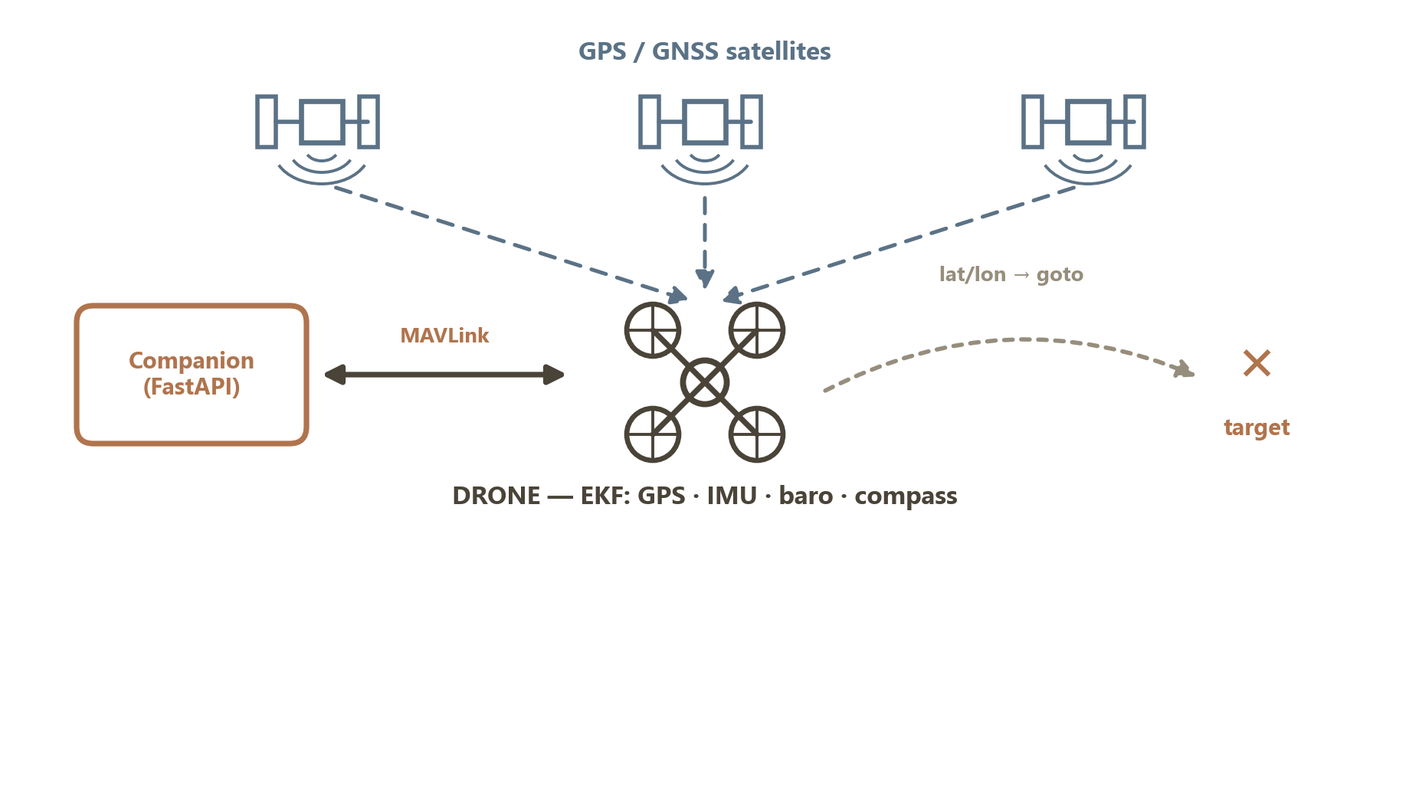
NAVIGATION
How it knows where it is: GPS, not cell towers
• Positioning — GNSS + IMU + baro + compass, fused onboard.
• Data link — MAVLink over radio / WiFi / LTE.
Figure 2 · Positioning by satellite GNSS + sensor fusion
Cell / 5G is only an optional link — never how the drone locates itself.
Positioning is satellite GNSS.
DRONE SAFETY SYSTEM
09 / 24

Slide 10
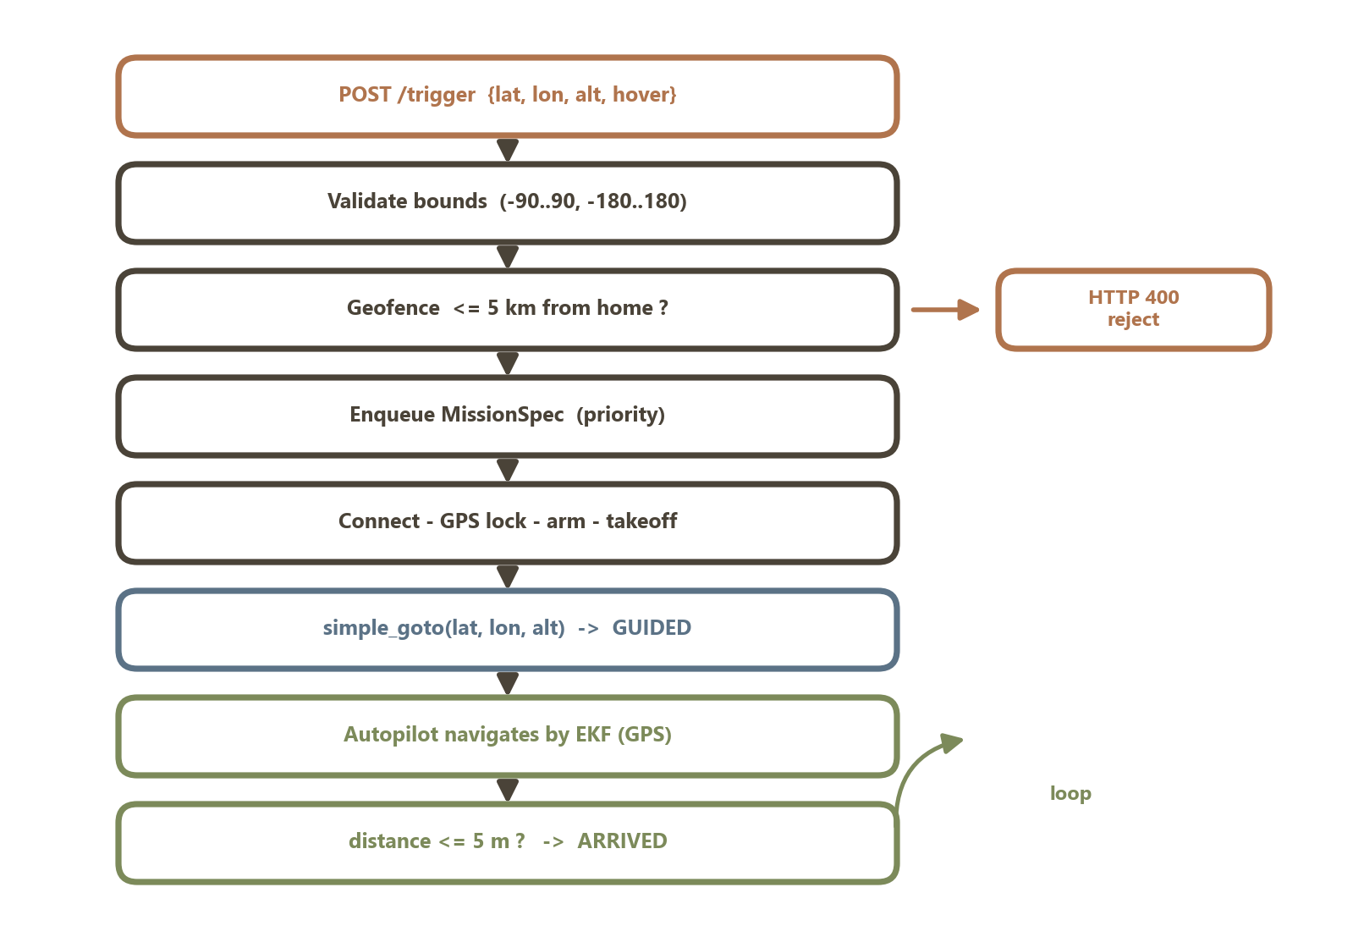
INPUT
How the drone receives coordinates
• Coordinate in — one POST with lat/lon (+ optional alt, hover).
• Checked twice — value bounds, then geofence vs home (else 400).
• Queued — as a MissionSpec; missions run strictly serially.
• Handed over — as a GUIDED-mode goto to the autopilot.
• Closed-loop — flies until within 5 m (haversine distance).
Figure 6 · From HTTP request to a navigated target
DRONE SAFETY SYSTEM
10 / 24

Slide 11
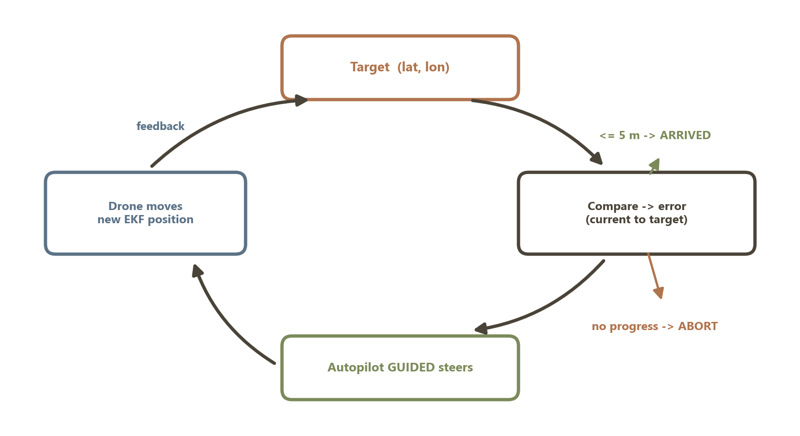
GUIDANCE
How it reaches the destination
• Closed loop — compares EKF position to target every second.
• Autopilot steers — GUIDED mode corrects continuously.
• Arrival — declared within 5 m tolerance (RTK → ~0.3 m).
• Stall guard — no progress in N s → abort the leg safely.
Figure 7 · The goto control loop
DRONE SAFETY SYSTEM
11 / 24

Slide 12
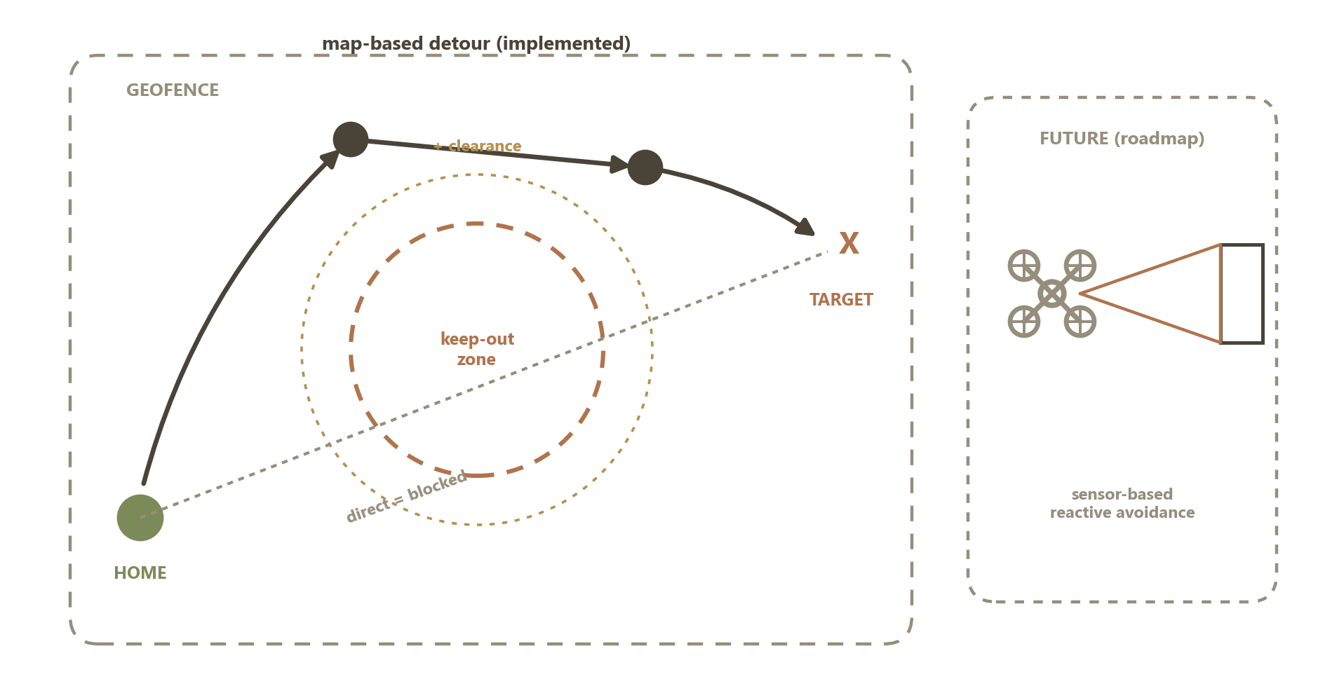
OBSTACLES
Obstacle avoidance — map-based, with a sensor roadmap
• Map-based avoidance — routes around configured keep-out zones (implemented, unit-tested).
• Detour planning — a blocked leg gets waypoints at a safe lateral offset.
• Altitude + geofence — flies above ground obstacles, inside a bounded area.
• Failsafe abort — battery / GPS / link → RTL or LAND.
• Roadmap — sensor-based reactive avoidance on Copter 4.x.
Figure 8 · Avoidance — implemented (map-based) + roadmap (sensors)
DRONE SAFETY SYSTEM
12 / 24

Slide 13
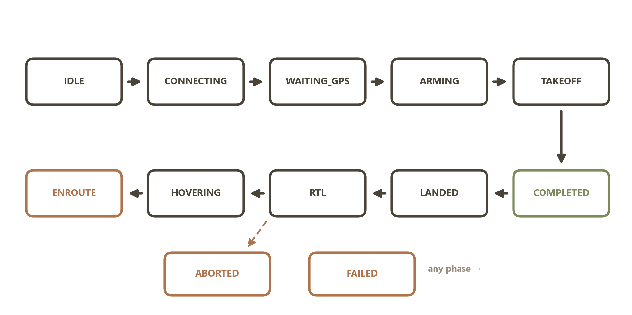
MISSION LIFECYCLE
A 12-state flight machine — every step logged
• Happy path — arm → take off → enroute → hover → RTL → land → done.
• Any phase can divert safely to ABORTED or FAILED.
• Abort blocks until disarm — never hand off an airborne drone.
Figure 3 · Mission state machine
DRONE SAFETY SYSTEM
13 / 24

Slide 14
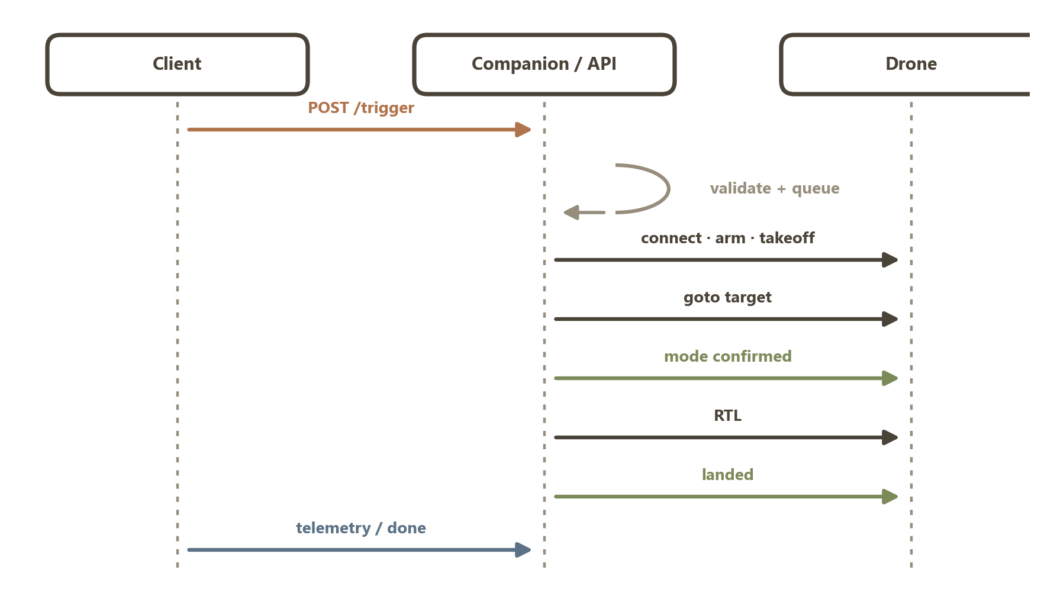
DISPATCH FLOW
From network trigger to touchdown
• 1 · Trigger — validated at the edge vs the geofence.
• 2 · Queue — bounded, strictly serial.
• 3 · Execute — connect, GPS lock, arm, climb.
• 4 · Verify — each mode change confirmed.
• 5 · Return — hover, RTL, land, log incident.
Figure 4 · Mission message sequence
DRONE SAFETY SYSTEM
14 / 24

Slide 15
INTELLECTUAL PROPERTY · PATENT 1
Verified flight-mode delivery + landing-interlocked dispatch
Treat the autopilot as untrusted; prove every command; never overlap missions.
• Confirmed setter — issue via high-level API, then re-issue as COMMAND_LONG / DO_SET_MODE and SET_MODE until telemetry confirms.
• Cross-action fallback — if RTL won't confirm, command LAND through the same verified routine, and vice versa.
• Abort guarantee — every abnormal exit blocks until the vehicle reports disarmed (or a 240 s bound).
• Pre-flight interlock — refuse to arm/take off while armed — violation becomes impossible, not just improbable.
• Edge geofence — reject out-of-fence targets & waypoints before flight.
8 claims · IPC B64U 10/13, G05D 1/00, G08G 5/00 · IPO Form 2 complete-specification draft
DRONE SAFETY SYSTEM
15 / 24

Slide 16
PATENT 1 · MECHANISM
The verified mode setter, in practice
# issue, then confirm from the autopilot's OWN telemetry
v.mode = target # 1) high-level setter
while now < deadline:
if v.mode.name == target: # confirmed!
return True
raw_set_mode(target) # 2) COMMAND_LONG
set_mode_send(target) # 3) SET_MODE
# emergency? if RTL fails, fall back to LAND
if not confirmed(action):
set_mode_confirmed(other) # cross-action
• Idempotent — redundant re-issue is harmless.
• Zero client trust — only telemetry confirms.
• Emergencies too — abort path as robust as nominal.
• Proven in SITL — silent-mode-reject bug mitigated.
DRONE SAFETY SYSTEM
16 / 24

Slide 17
INTELLECTUAL PROPERTY · PATENT 2
Debounced, severity-ordered failsafe arbitration
Many hazards, evaluated at 1 Hz, resolve to exactly one calm recovery action.
• Monotone severity — actions ordered NONE < RTL < LAND; a LAND demand is never downgraded.
• Debounced GPS — fires only after N consecutive bad samples (reset on recovery); a glitch never lands the drone.
• Mid-recovery escalation — a critical-battery LAND overrides an in-progress RTL.
• Fire-once discipline — each hazard emits one event per mission (re-fire only to escalate).
• Above firmware — layered on unmodified ArduPilot/PX4 failsafes.
8 claims · pinned by a 37-case unit suite · IPC G05D 1/00, B64D 45/00, B64U 2201/10
DRONE SAFETY SYSTEM
17 / 24

Slide 18
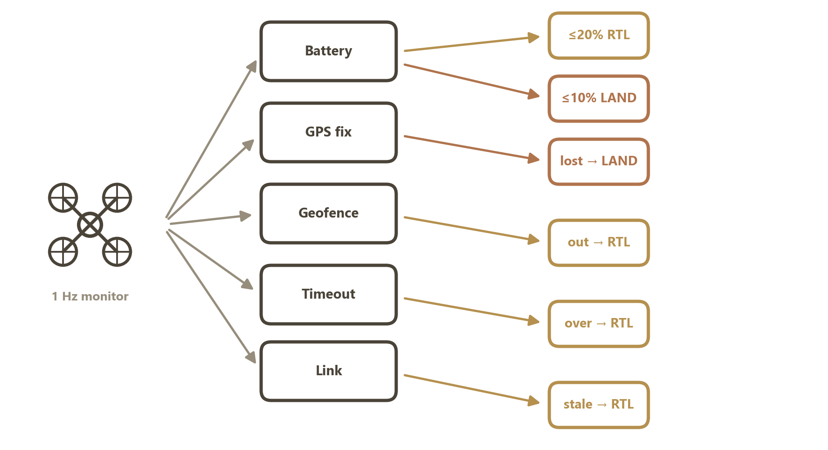
PATENT 2 · MECHANISM
The hazard tree: condition → threshold → action
• RTL — battery low, geofence, timeout, link loss.
• LAND — battery critical, GPS lost (can't navigate).
• Debounce — GPS needs N bad samples to fire.
Figure 5 · Failsafe decision tree
DRONE SAFETY SYSTEM
18 / 24

Slide 19
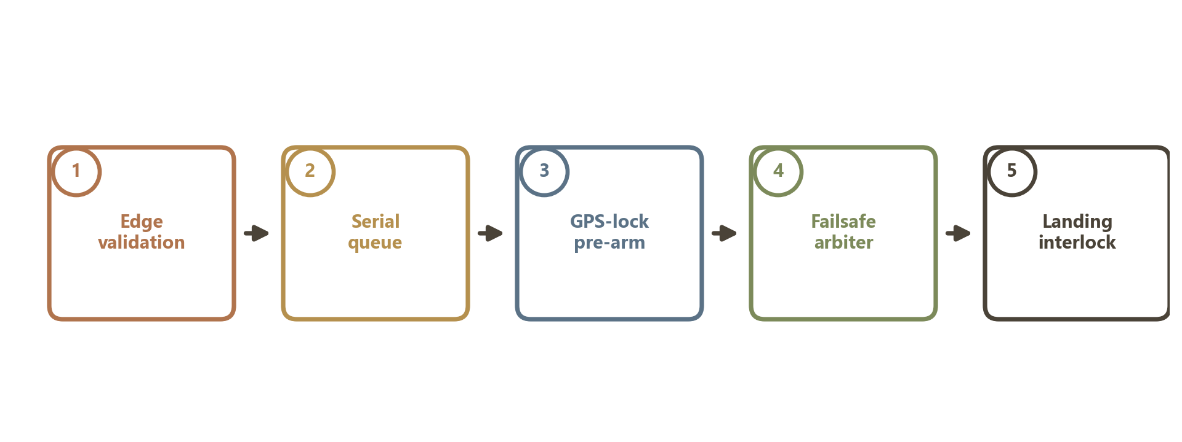
SAFETY MODEL
Five gates from network trigger to landing
Figure 6 · The five-gate safety interlock
The guarantee:
even if four gates fail, no mission ever starts against an airborne drone.
DRONE SAFETY SYSTEM
19 / 24

Slide 20
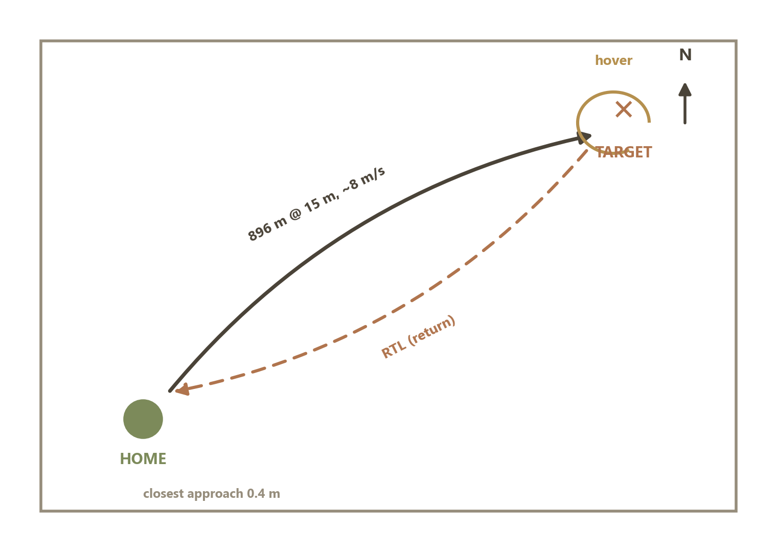
VALIDATION
Proven in software-in-the-loop
8 / 8
acceptance checks pass
0.4 m
terminal accuracy (5 m tol.)
37
safety unit tests, ms-fast
328 s
full autonomous mission
Figure 7 · Reconstructed flight path
DRONE SAFETY SYSTEM
20 / 24

Slide 21
ENGINEERING
Technology stack
Flight core
Service
Dashboard
Quality / ops
• Python 3.11
• DroneKit + pymavlink
• MAVLink protocol
• ArduPilot SITL
• FastAPI + Pydantic v2
• Uvicorn ASGI
• WebSocket telemetry
• SQLite store
• React 18 + Vite 5
• react-leaflet map
• Live path + log
• Follow-drone toggle
• 37 pytest tests
• E2E SITL acceptance
• Docker compose
• API-key + geofence
DRONE SAFETY SYSTEM
21 / 24

Slide 22
ROADMAP
Next steps & Claude Code integrations
Product hardening
Claude Code integrations
• Migrate off DroneKit → MAVSDK / ArduPilot 4.x.
• Failsafe-injection tests — scripted SITL cuts.
• Multi-leg routes — full waypoint list up front.
• RTK GPS for ~0.1 m real-world accuracy.
• /fly slash command — trigger → telemetry → cancel.
• Save-hook — auto-run unit tests on edits.
• GitHub Actions CI — run the safety suite per push.
• MCP telemetry server — query live state in chat.
DRONE SAFETY SYSTEM
22 / 24

Slide 23
FILING
Copyright vs. patent — what protects what
Copyright
Patent
Protects the expression — source code, docs, diagrams, the paper. Automatic on authorship; registration is cheap, fast, and yours to file now.
Protects the inventions — the verified setter, landing interlock, failsafe arbiter. Two IPO Form-2 drafts exist; needs a novelty search + a registered agent.
Recommended sequence
• Now — register copyright on the codebase + paper (immediate, low-cost).
• Then — run IPO InPASS / WIPO novelty search against both patent drafts.
• Then — file provisional patents via a registered agent before public disclosure.
DRONE SAFETY SYSTEM
23 / 24

Slide 24
Autonomous · Verified · Safe
Drone Safety System
A provable safety layer for autonomous UAV dispatch.
github.com/SV-1411/drone
Built with a companion-computer architecture · DroneKit · MAVLink · ArduPilot

