Slide 1

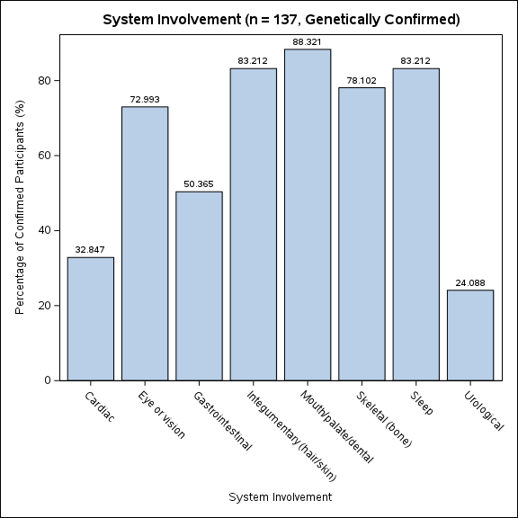
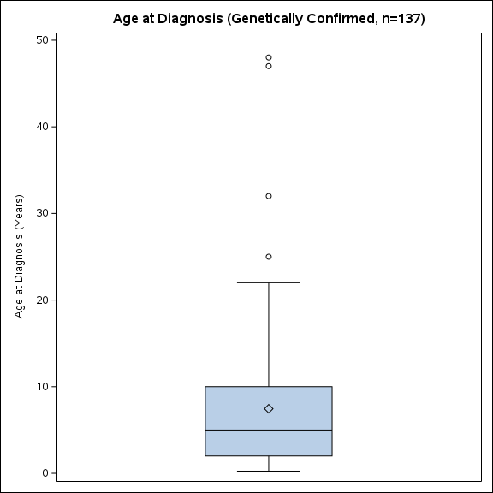
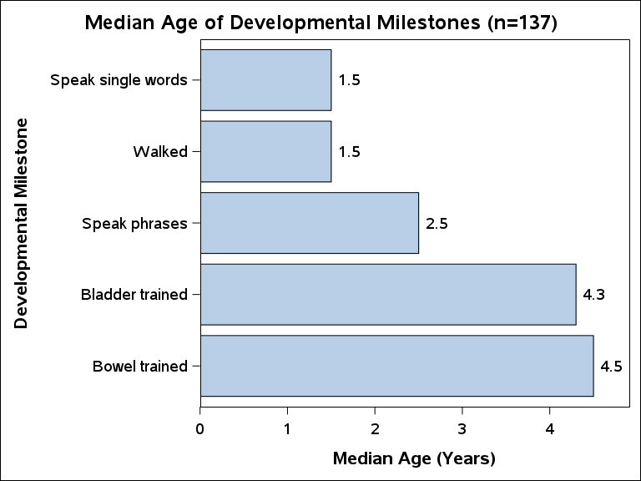
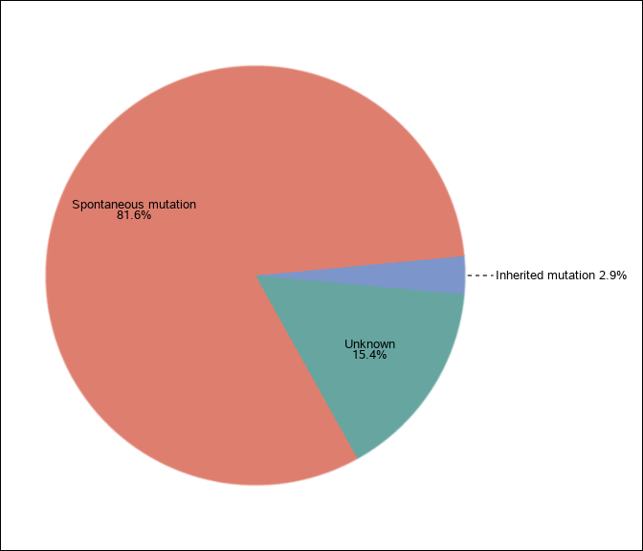
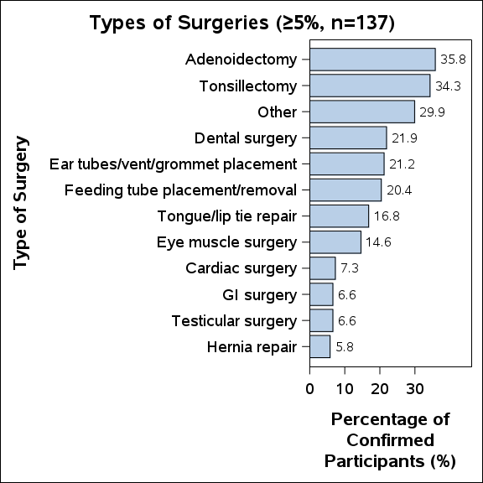
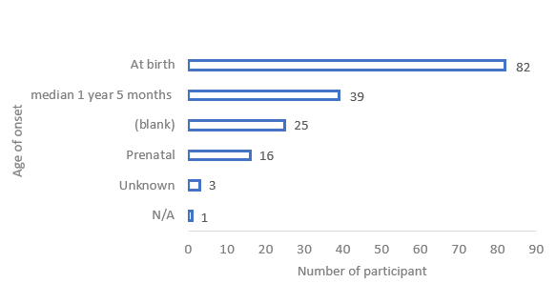
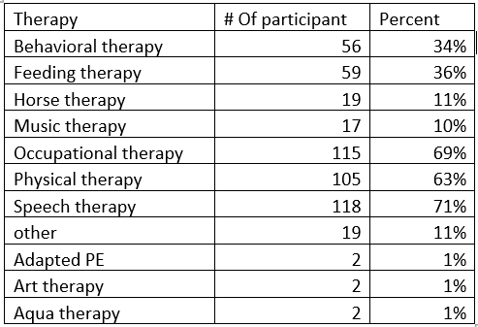
Seeing Wiedemann - Steiner Syndrome Through Caregivers’ Eyes: Global,
“Caregiver-Reported” Insights from the WDSTS Registry
Sarika Vemana, MS; Suhila Sawesi, PhD; Nadia Falah, MD
Background / Introduction
Wiedemann-Steiner syndrome (WDSTS; OMIM #605130) is a rare genetic neurodevelopmental disorder caused by heterozygous pathogenic variants in KMT2A (OMIM #159555) on chromosome 11q23 [1]. Initially described as “hairy elbow syndrome” due to hypertrichosis cubiti and developmental delay [2-4], WDSTS is now recognized as a multisystem condition characterized by short stature, distinctive facial features, intellectual disability, behavioral difficulties, and variable systemic involvement, including neurologic, gastrointestinal, musculoskeletal, cardiovascular, renal, and endocrine abnormalities [2-3]. The phenotypic spectrum is broad, contributing to frequent diagnostic delay; children with rare diseases often experience a 6-8 year gap before accurate diagnosis, often due to misrecognition of overlapping features. There is no curative therapy, and management relies on multidisciplinary care, including speech, occupational, and physical therapies, medical interventions, and supportive services [1-4]. Although survival into adulthood is generally favorable with appropriate care, caregiver-reported data remain limited. The international WDSTS Registry provides a unique opportunity to characterize demographic, genetic, systemic, and developmental patterns to improve early recognition, surveillance, and long-term care strategies.
Objective
“To characterize the demographic, genetic, systemic, and developmental features of genetically confirmed WDS-affected individuals using international registry data to improve early recognition and multidisciplinary care.”
Methods:
Data were obtained from the international WDSTS Registry, which integrates caregiver-reported surveys from the CoRDS Registry and the Wiedemann-Steiner Syndrome Foundation (WSS). Data collection began in June 2017, and all records were anonymized.
Survey responses were provided by patients or caregivers and included genetic testing, birth history, symptoms, development, therapies, treatments, education, and quality of life. Participation was voluntary and responses were self-reported.
All genetically confirmed individuals were included regardless of age, sex, or geographic location. Descriptive statistics (median, mean, frequencies, percentages) were calculated using SAS.
Symptoms not explicitly reported were assumed absent; therefore, reported frequencies may underestimate true prevalence.
Results/Implementation:
The dataset included 166 WDSTS diagnosed patients, with137 genetically confirmed individuals.
Figure 1:Median age of the diagnosis of patients with WDSTS per region.
The median age at diagnosis among genetically confirmed individuals (n=137) was approximately 5 years, with substantial variability and several late-diagnosis outliers extending into adulthood.
Median age at diagnosis was earlier in North America (4 years) compared to Europe (7 years), suggesting potential regional differences in recognition or access to genetic testing.
Figure 2: Distribution of mutation types for KMT2A confirmed individuals (n = 137)
The majority of genetically confirmed WDSTS cases were spontaneous mutations (81.7%), while inherited mutations were rare (2.9%), highlighting the predominance of de novo genetic events.
Figure 3: Age of First Symptom noticed for all patients (n = 166)
Most features were reported at birth (n=82), while many others were recognized in early childhood (median ~1.5 years), demonstrating early clinical manifestation with considerable variability in onset and phenotypic expression.
Figure 4: Prevalence of Systemic issues of WSS Patients
Figure 5: Median and mean age of milestones per number of participants
Developmental milestones demonstrate global delay, with median walking and single-word speech at 1.5 yrs, phrase speech at 2.5 yrs, and toileting milestones later at 4 - 4.5 yrs, highlighting persistent neurodevelopmental impact in genetically confirmed WDSTS.
Figure 6: Frequencies of the reasons that the participant had surgery
Table 1: Number and percentage of participants receiving therapies as reported in the registry as of October 2021.(n = 166)
Discussion:
WDSTS demonstrates substantial phenotypic variability, contributing to delayed recognition and inequities in diagnosis, particularly in regions with limited access to genetic testing and specialty care.
Genetic testing is critical for diagnosis, yet cost, insurance barriers, and limited provider familiarity with genetics remain major obstacles to timely identification.
Regional and age-related disparities were observed, including differences in diagnostic timing and quality of life, highlighting the need for improved surveillance, standardized assessments, and targeted support for adults with WDSTS.
Registry-based caregiver data provide valuable real-world insights, but variability in reporting, missing data, and a lack of genotype information limit genotype-phenotype correlations and precise prevalence estimates.
Limitation:
Lack of detailed genotype data: Although most participants were genetically confirmed, detailed KMT2A variant information (e.g., variant type, classification, molecular nomenclature) was not available. Caregiver-reported registries typically do not capture precise molecular findings, limiting genotype–phenotype correlation analyses.
Potential sample overlap with prior studies: Because registry participation is voluntary and international, some individuals may have been included in previous descriptive studies, and the proportion of overlap cannot be determined.
Incomplete or missing responses: As with most voluntary registries, not all participants answered every question, which may underestimate true symptom prevalence.
Reliance on caregiver-reported data: Information was self-reported and may lack clinical verification or standardized interpretation, particularly for complex genetic and medical details.
Conclusion:
The WDSTS Registry represents the largest caregiver-reported dataset for this condition and provides valuable insight into its multisystem involvement and developmental variability. Despite growing awareness, mild cases may remain undiagnosed, highlighting the need for improved recognition. Caregiver-reported data enhance understanding of the real-world clinical burden and support earlier diagnosis and coordinated management. These findings help define clinical benchmarks and inform future research and therapeutic development.
Bibliography
Jones WD, Dafou D, McEntagart M, et al. De novo mutations in MLL cause Wiedemann-Steiner syndrome. Am J Hum Genet. 2012;91(2):358-364. doi:10.1016/j.ajhg.2012.06.008
Edwards MJ, Crawford AE, Jammu V, Wise G. Hypertrichosis "cubiti" with facial asymmetry. Am J Med Genet. 1994;53(1):56-58. doi:10.1002/ajmg.1320530112
Flannery DB, Fink SM, Francis G, Gilman PA. Hypertrichosis cubiti. Am J Med Genet. 1989;32(4):482-483. doi:10.1002/ajmg.1320320410
MacDermot KD, Patton MA, Williams MJ, Winter RM. Hypertrichosis cubiti (hairy elbows) and short stature: a recognisable association. J Med Genet. 1989;26(6):382-385. doi:10.1136/jmg.26.6.382
Median Age at Diagnosis: 5 Years

