Slide 1
Padcon
Subsidiary of RWE
Producer of SupervisoryContolAndDataAcquisition-Systems and more general solar technology
Deployed in >20 countries
Recent project: Pavagada
  2GW capacity
  One of the biggest solar parks worldwide
  Covers an area of 53km²

Slide 2
Target
Development of a system for test- and integration of new hard- and software

Slide 3
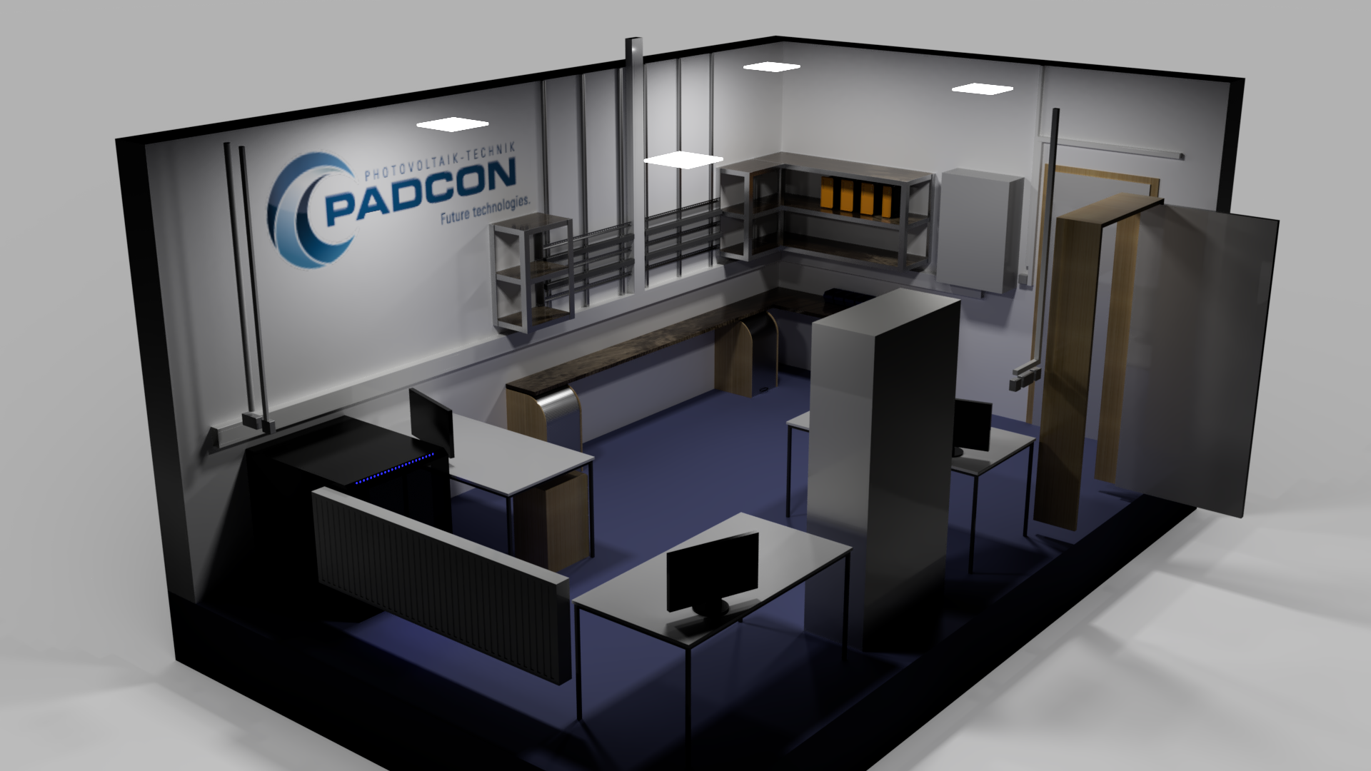

Slide 4


Slide 5
Technology stack
Programming Language: Python 3
  UI-Framework: PyQt5
  ORM: SQLAlchemy
  CV: OpenCV
Cross platform (Windows and Linux)

Slide 6
TUInventory
Features:
QR-Code generator
Visual barcode reader (EAN14, QR, ...)
Device management system
User management system
Inventory overview

Slide 7
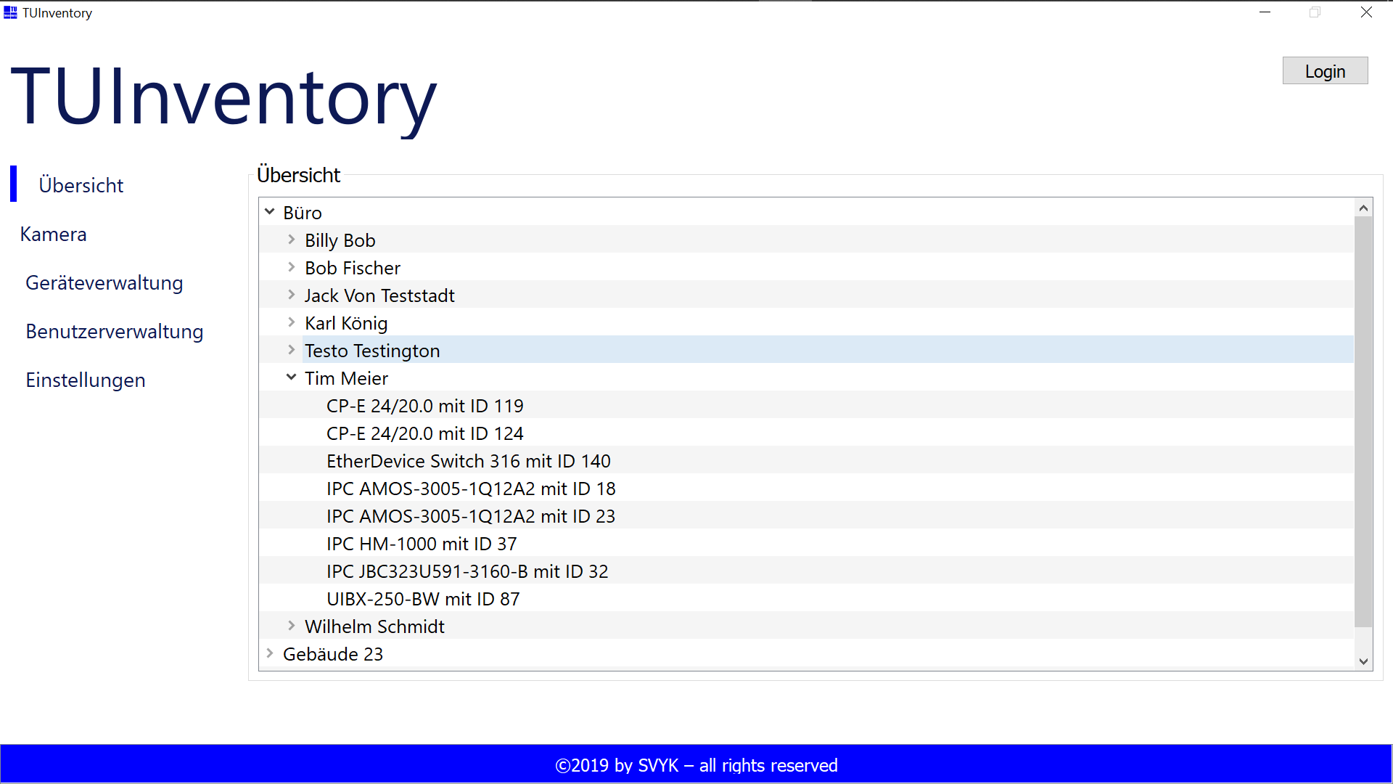

Slide 8
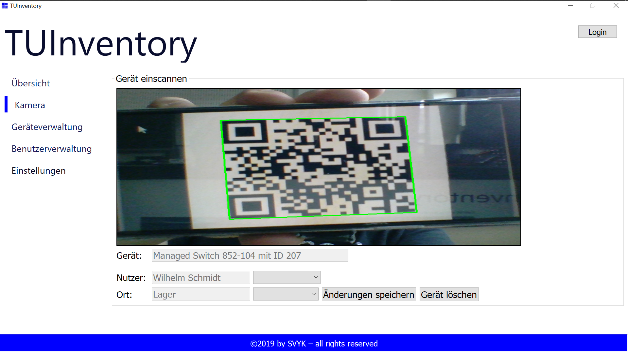

Slide 9
BENUTZERVERWALTUNG
I BIMS DER BILD

