Slide 1

Global Feed
Segunda sesión de practicas Proyecto Curso 2022-2023 2º Desarrollo de Aplicaciones Multiplataforma CENTRO SAN VALERO ZARAGOZA
Daniel González
Antonio De La Rosa
Hector Peiron

Slide 2

GlobalFeed (Idea)
GlobalFeed is an app where you can send messages and view messages from around the world.
No filters, no followers, and no following. Information from everyone to everyone.

Slide 3
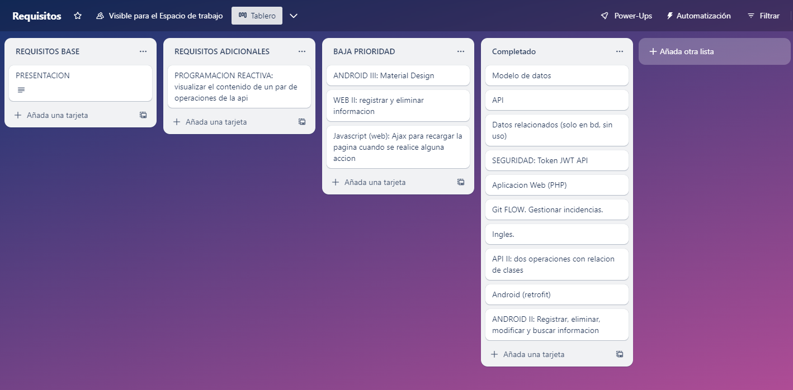
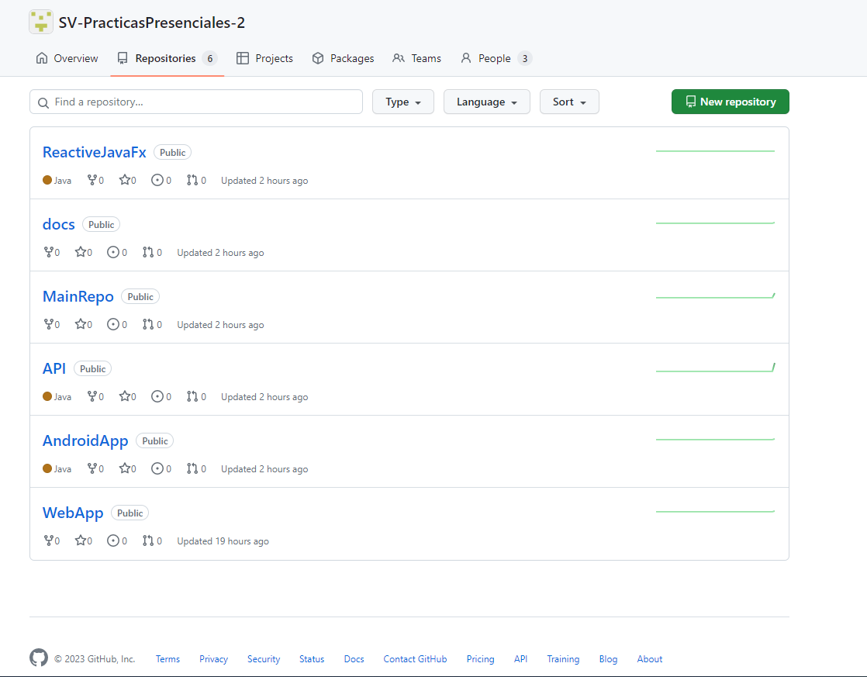
First steps of the project
As a task tracking and organization tool, we have used Trello. Additionally, we have used Github as a version control tool, utilizing the Gitflow methodology.

Slide 4
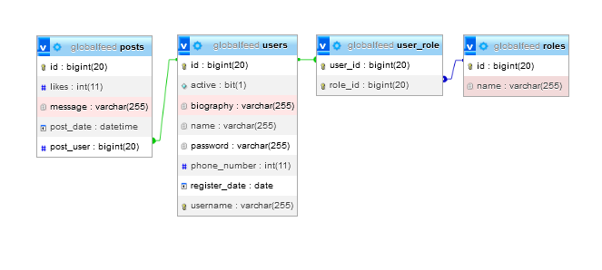
Entity-Relationship Diagram (ERD)

Slide 5
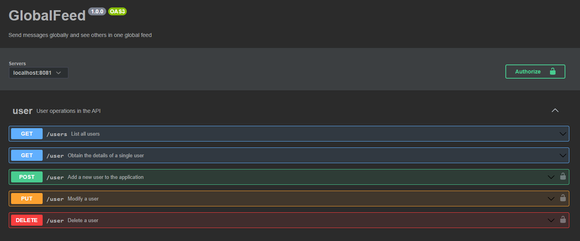
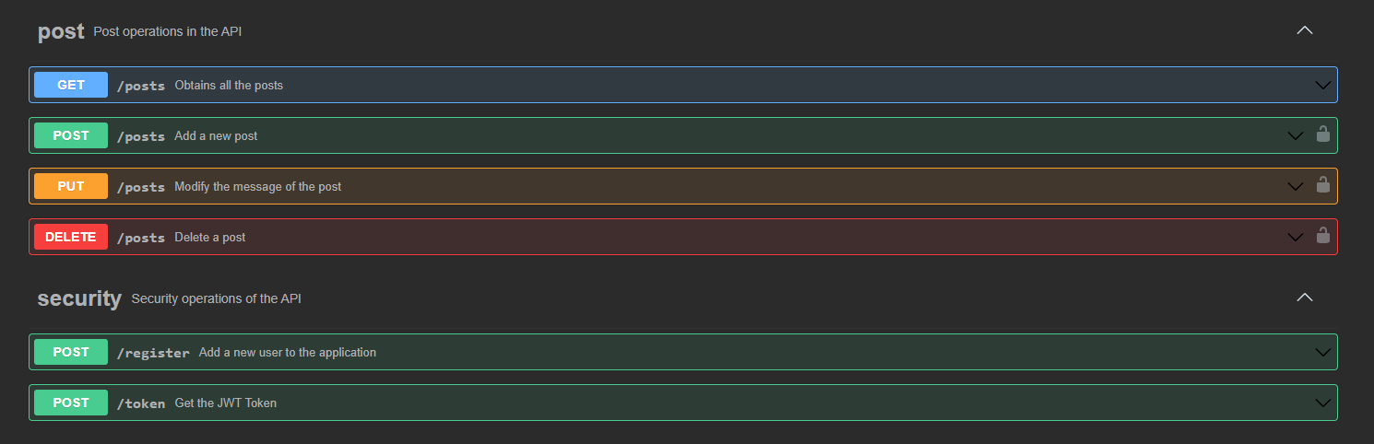
API (SpringBoot)

Slide 6
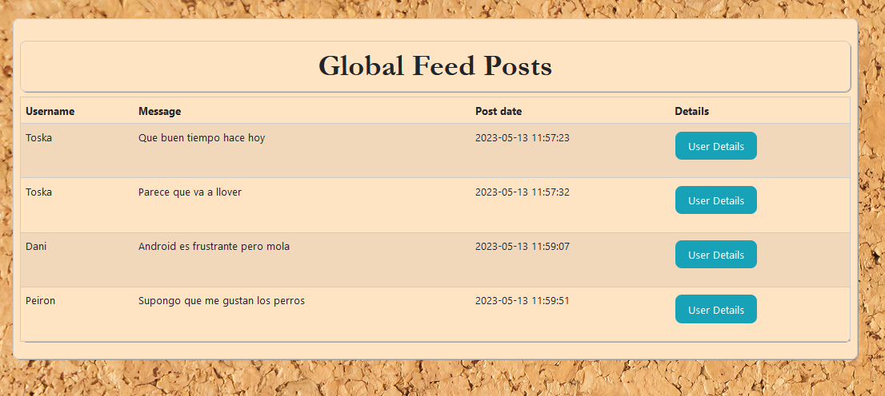
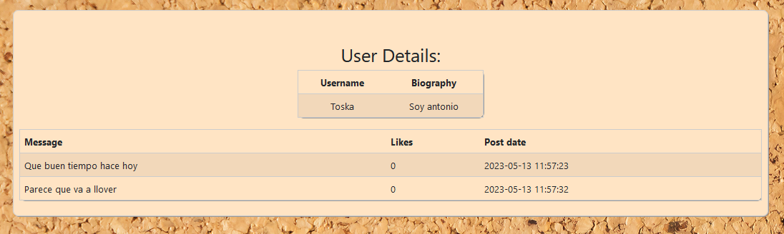
WEBAPP

Slide 7
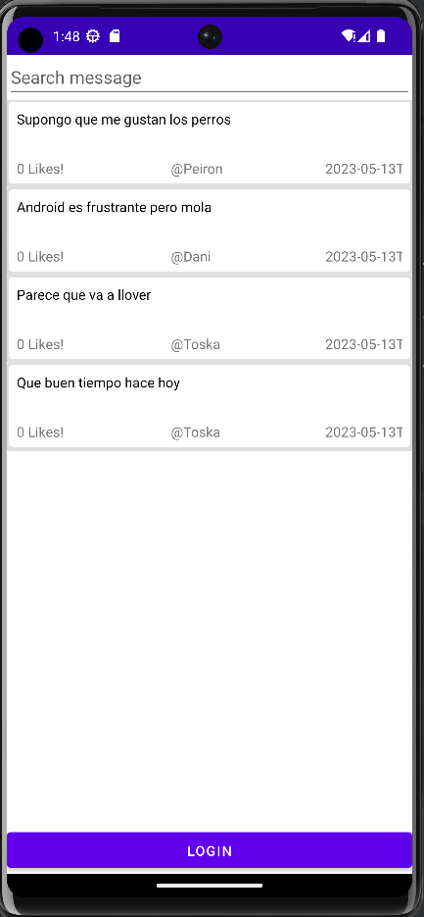
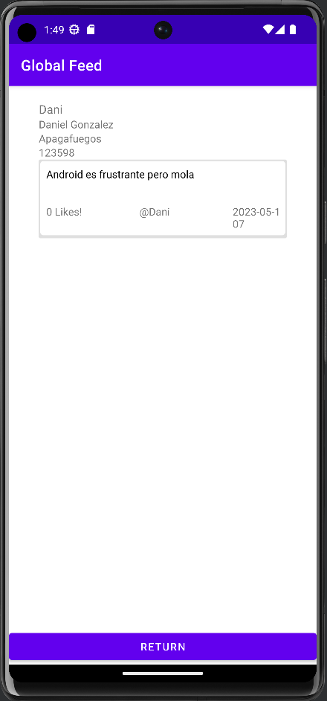
ANDROID

Slide 8
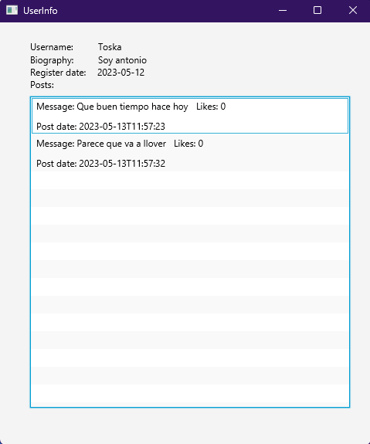
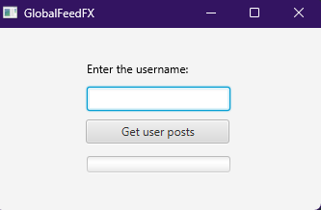
REACTIVE JAVA

Slide 9

Now let's see what the result is...

