Slide 1

Sectoral Insights on Global Economic Growth
Group 2
Krish Mukeshbhai Sonani
Ruthvik Reddy Dwaram
Prachi Rajendra Trivedi
Sivakumar Reddy Kesavareddy
Meet Pramod Sawaswat
Divyansh Singh
Surya Vamshi Sriperambudooru
Neelima Nandigam
Anoohya Alluri
Manisha Pandey

Slide 2

Introduction
Background:
Economic growth varies significantly across nations, with sectoral contributions evolving as economies develop. Understanding these patterns helps in predicting growth trajectories and policymaking.
Objectives:
Analyze trends in sectoral contributions to GDP and GNI across developed and developing countries.
Understand the role of agriculture, manufacturing, and services in economic transitions.
Use regression analysis to predict GNI based on key economic indicators.
Research Question:
How have sectoral contributions (agriculture, manufacturing, and services) to GDP changed over time in developed vs. developing economies, and what impact does this shift have on overall economic growth?

Slide 3
Dataset Overview
The dataset used in this analysis is a comprehensive collection of economic indicators compiled from multiple sources, including the World Bank and UN economic statistics databases.
It spans over 200+ countries and 51 years (1970–2021) and provides insights into the structural components of global economies.
Sectoral Contributions: Variables representing contributions of agriculture, manufacturing, and services to GDP.
Economic Indicators: Gross National Income (GNI) and Gross Domestic Product (GDP).
Trade metrics such as imports and exports.
There are 10,512 observations in our dataset with 26 attributes.

Slide 4
Methodology
Data collection and cleaning
Explorative Data Analysis (EDA)
Trend Analysis
Comparative Analysis
Sector contribution Analysis
Correlation Analysis
Regression Analysis
Tools Used – R ,ggplot and Excel

Slide 5
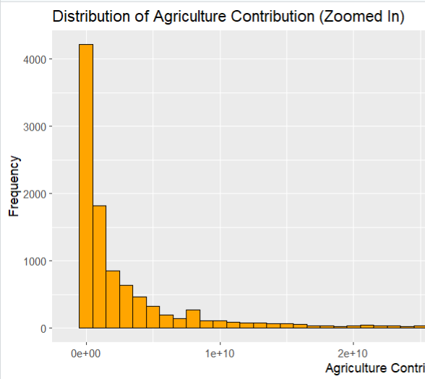
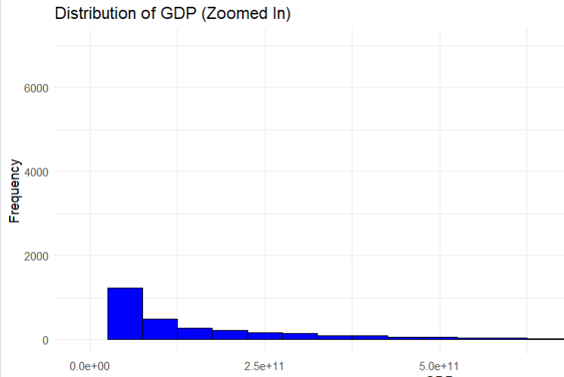
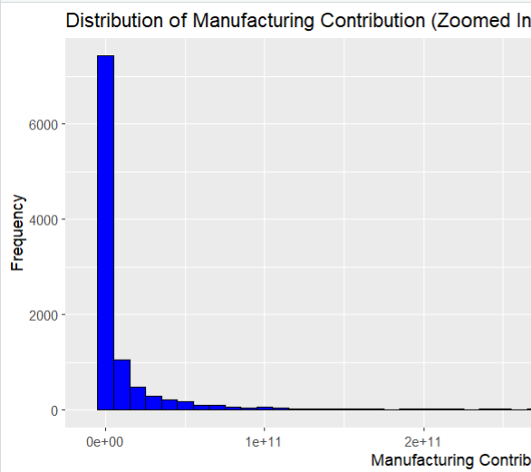
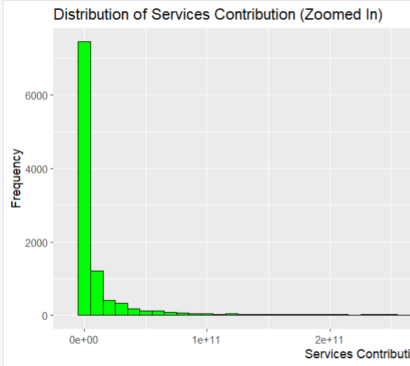
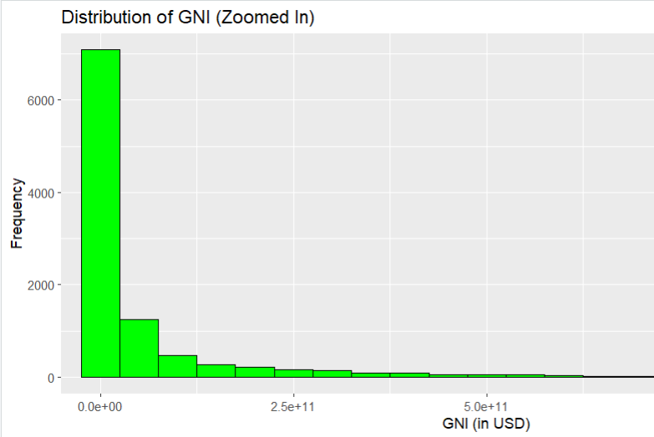
Sectoral Contributions Over Time (Trend Analysis)
GDP and GNI Distributions (Histograms):
The histograms for both GDP and GNI show a high concentration of countries with low values, with a long tail stretching to the right for countries with very high GDP and GNI. This distribution suggests a few countries have substantially larger economies compared to the rest.
Agriculture Contribution:
Most of the data lies at the lower end of the spectrum, indicating that most countries contribute relatively small amounts in agriculture compared to the highest values.
Services Contribution:
Services also follow a right-skewed distribution, with most countries contributing lower amounts.
Manufacturing Contribution:
Similar to the other sectors, manufacturing contributions are highly skewed, with a few industrialized nations contributing substantially larger amounts.

Slide 6
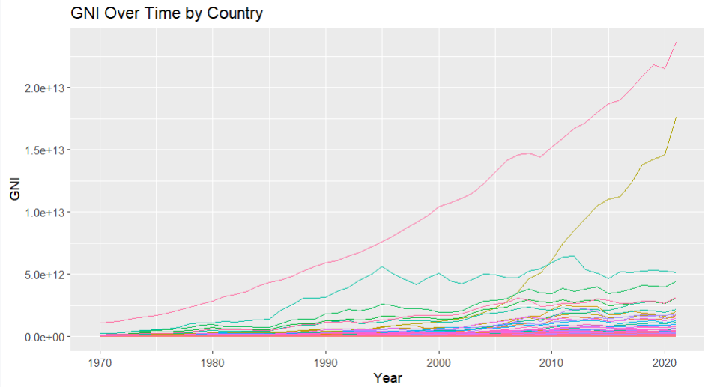
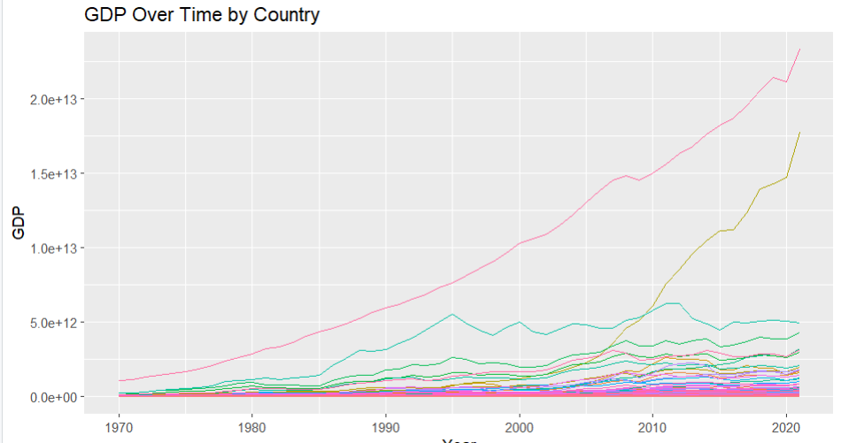
Time Series Plot for GDP and GNI
A time series plot of GDP and GNI over the years will give us a high-level view of economic growth over time.
Top Performers and Growth Trajectories:
The GDP graph clearly indicates that the United States (pink line) has maintained the highest GDP among countries over time, followed by China (yellow line), which shows exponential growth starting from the 1990s. This highlights the rapid economic development of China, particularly after adopting open-market policies in the late 20th century.
Emerging Economies:
Countries like India (light green line) and Brazil (dark green line) show steady upward trends but at a lower magnitude compared to the United States and China. This suggests consistent growth in emerging economies but at a slower pace due to structural and policy-related challenges.
Stability of Developed Economies:
The GDP of developed European nations, such as Germany (light blue line) and France (orange line), has grown steadily but does not exhibit the sharp upward trajectory seen in China. This reflects the maturity and slower growth typically observed in developed economies.

Slide 7
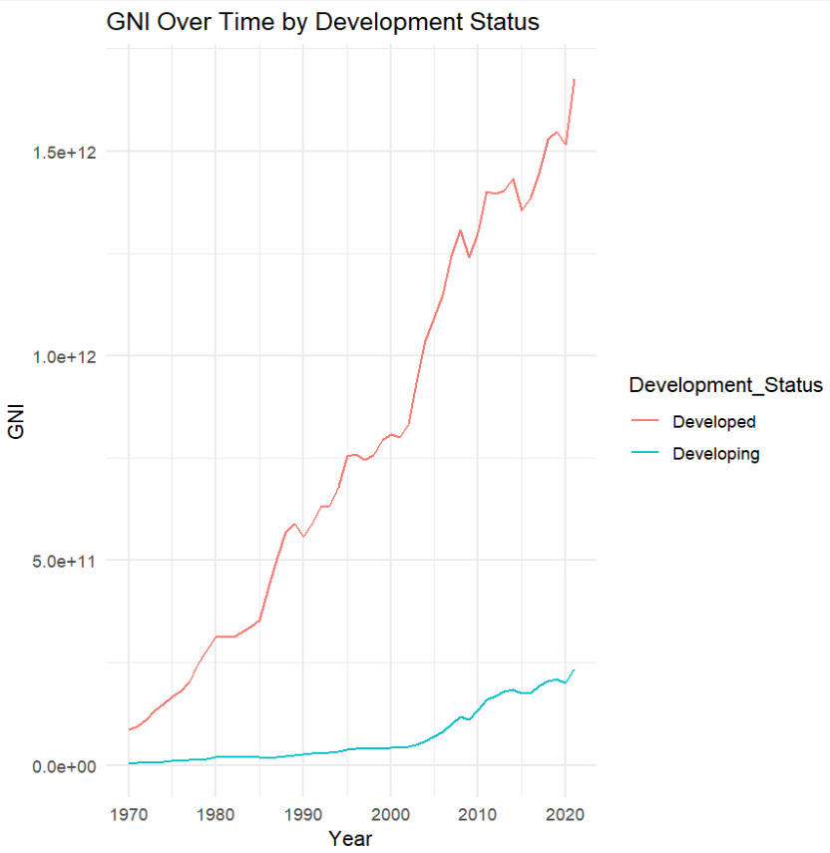
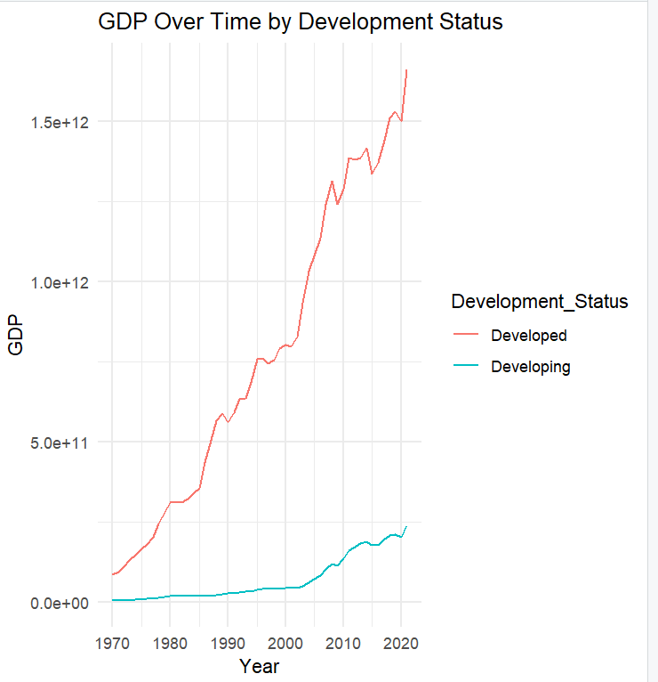
Developed vs Developing
As expected, the GDP and GNI of developed nations are significantly higher than that of developing countries.

Slide 8
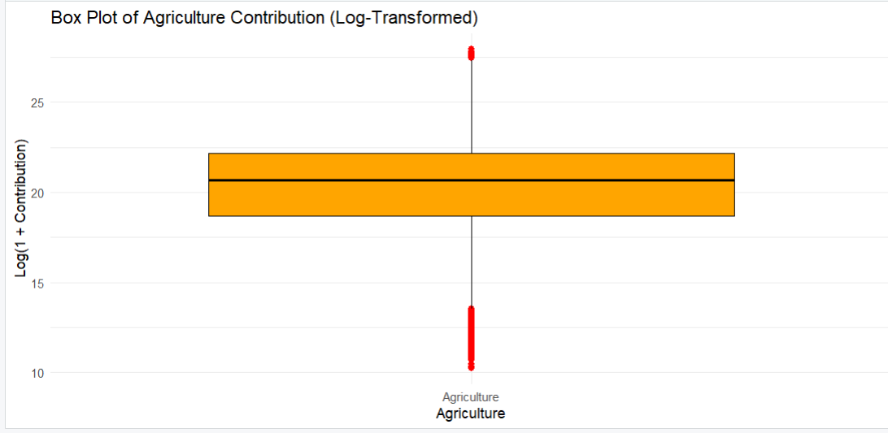
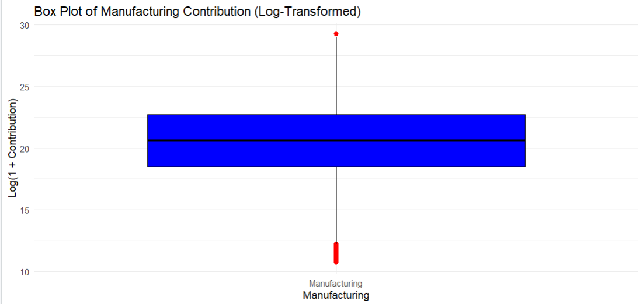
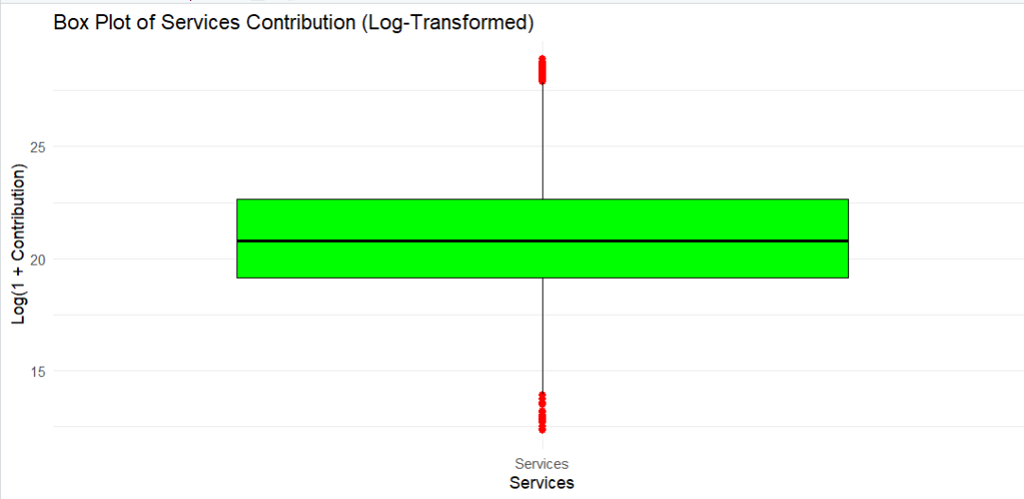
Box Plots
These box plots reveal sectoral differences and provide insights into economic diversification and development strategies globally.
Deeper Insights and Economic Implications
Developing vs. Developed Economies: The significant disparities in GDP, GNI, and sector contributions point to differences between developed and developing economies. Developing countries often have higher agricultural contributions and show more rapid growth, while developed economies display balanced contributions across sectors with steadier growth rates. This segmentation highlights the importance of economic diversification and structural transformation in driving sustainable development.
Sectoral Shifts: The data suggests that economies transition from agriculture to manufacturing and services as they grow. This shift typically aligns with higher productivity, better job opportunities, and greater resilience to economic downturns. Developing countries could potentially leverage this insight to prioritize industrial and service sector development, moving away from heavy reliance on agriculture.
Potential for Growth in Lower GDP Nations: The skewed GDP and GNI distributions indicate room for growth in lower-GDP countries if they can transition their economic structure towards high-value industries. Countries at the lower end of the GDP distribution may need policies that encourage investment in infrastructure, education, and technology adoption, enabling them to catch up with more developed nations.

Slide 9
Comparative Analysis (Developed vs. Developing Economies)
Objective: To examine sectoral contributions to GDP in developed and developing economies, highlighting structural differences and economic growth trends.
Key Findings:
Agriculture:
Developing countries initially relied heavily on agriculture (over 60% in the 1970s).
Agriculture's contribution has steadily declined to 10-20% by 2020 as these countries shifted towards industrialization.
In developed countries, agriculture's contribution is consistently below 10%.
Manufacturing:
Developed countries show a significant increase in manufacturing contributions, indicating industrial advancements.
Developing countries display slower but steady growth in manufacturing, reflecting ongoing industrialization.
Services:
The services sector dominates in developed economies, showing a strong upward trend and contributing the most to GDP.
In developing countries, services are growing but have not yet surpassed manufacturing in importance.

Slide 10
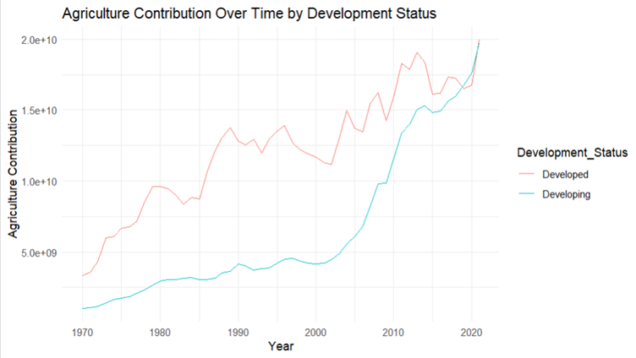
Visual Insights
Agriculture Over Time:
In Developed Countries:
Agriculture’s share is higher than in developing countries.
It rises initially, then levels off, showing a stable contribution as the economy matures.
In Developing Countries:
Agriculture is still a key part of the economy but grows slowly compared to developed nations.

Slide 11
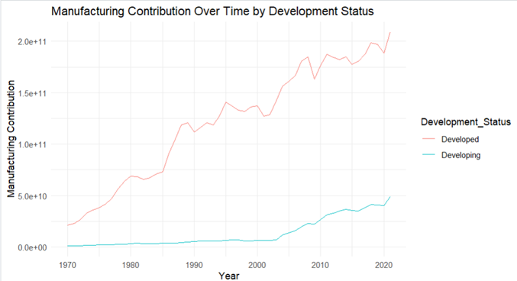
Manufacturing Over Time:
In Developed Countries:
There’s a big increase in manufacturing, showing strong industrial growth.
Developed nations rely more heavily on manufacturing as part of their economic strength.
In Developing Countries:
Manufacturing is growing, but at a slower pace, indicating they are still developing their industrial base.

Slide 12
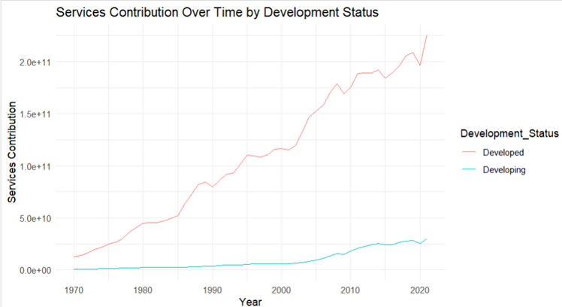
Services Over Time:
In Developed Countries:
Services are growing rapidly and play the biggest role in the economy, like finance, healthcare, and tech.
In Developing Countries:
Services are also increasing, but not as fast. They are not yet the main economic driver.

Slide 13
Sector-wise Contribution
What?
Calculated the percentage contributions of agriculture, manufacturing, and services to GDP and GNI.
Analyzed shifts in sectoral importance over time.
How?
Computed sectoral percentages for each year and country.
Plotted bar charts and line graphs to visualize sectoral contributions.
Why?
To quantify the relative importance of each sector and observe how their roles evolved over time.

Slide 14
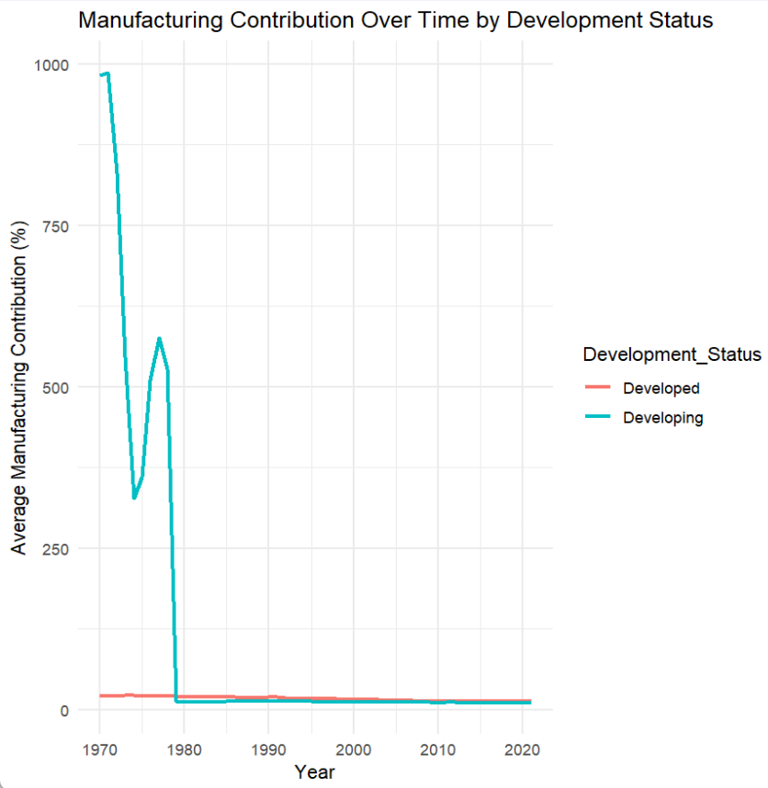
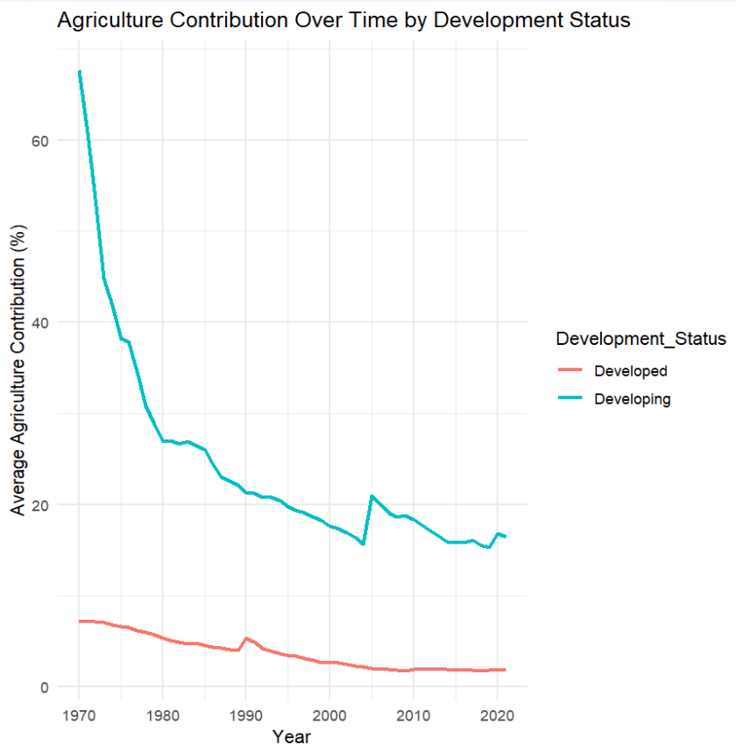
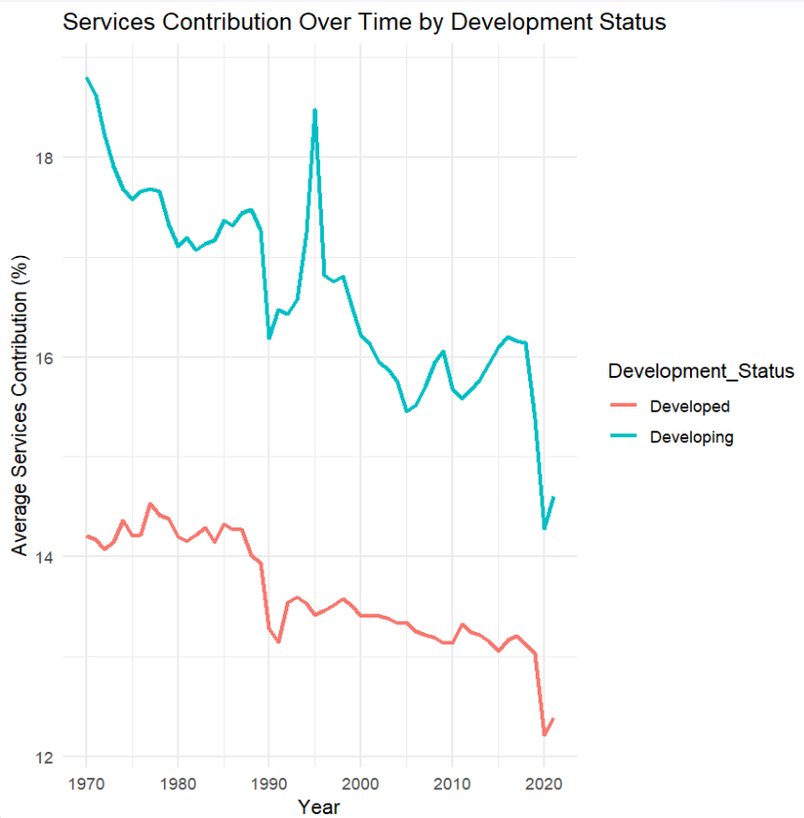
Results
Manufacturing showed steady contributions, particularly in developing economies.
Agriculture’s share declined globally, while services first grew significantly and later fell abruptly.

Slide 15
Correlation Analysis
What?
Analyzed relationships between GNI, GDP, and sectoral contributions to identify dependencies.
Visualized correlations using scatterplots and heatmaps.
How?
Calculated correlation coefficients for all variables using cor().
Created scatterplots to visualize pairwise relationships and Generated a heatmap to summarize.
Why?
To identify which variables were most strongly associated with GNI and GDP.

Slide 16
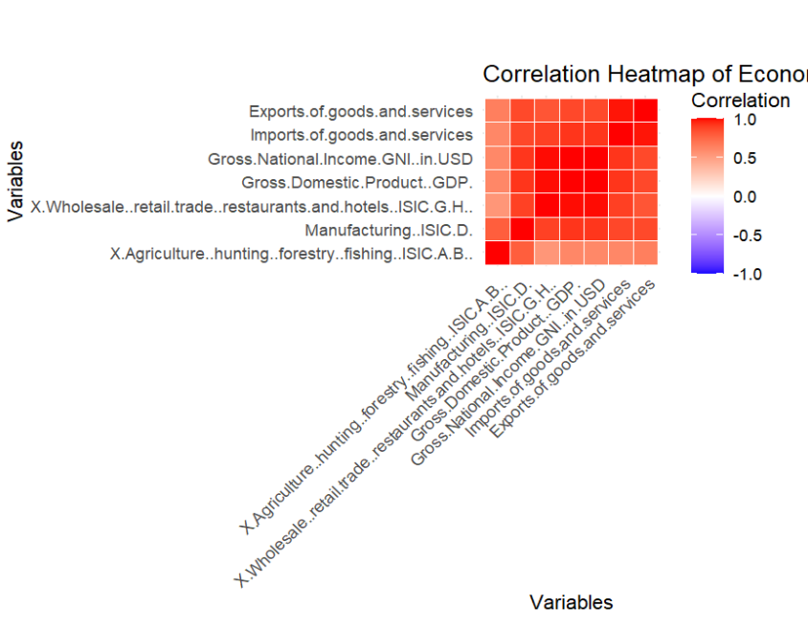
Results
Strong positive correlations between GNI and services contributions.
Weak correlations between GNI and agriculture, reflecting its diminishing importance.

Slide 17
Regression Analysis
Regression analysis is used to understand how key economic sectors, trade, and population influence Gross National Income (GNI). This helps quantify the contribution of each factor to overall economic performance.
Data Preparation:
Cleaned and transformed raw data to ensure accuracy and suitability for modeling.
Applied log transformations to relevant variables for normalization.
Model Training:
Built and trained the regression model using selected independent variables.
Split data into training and validation sets to evaluate performance.
Result Analysis:
Examined model coefficients to assess variable impact.
Interpreted R-squared and residuals to evaluate model fit.

Slide 18
Model Training
We started with a simple linear regression and then tried multiple regression when required.
log(GNI) = β0 + β1 log(Agriculture) + β2 log(Manufacturing) + β3 log(Trade/Services) + β4 (NetExports) + β5 Population + ϵ
The impact of each variable on GNI:
Predictor | Value | Comments
β1 | 0.05245 | indicates that an increase in agricultural activities is associated with higher GNI.
β2 | 0.2646 | highlights the critical role of manufacturing in driving GNI growth.
β3 | 0.6401 | The largest positive coefficient demonstrates its substantial impact on GNI.
β4 | 2.917e-13 | showing a relatively less contribution
β5 | 3.035e-10 | indicating a link between larger populations and higher GNI.

Slide 19
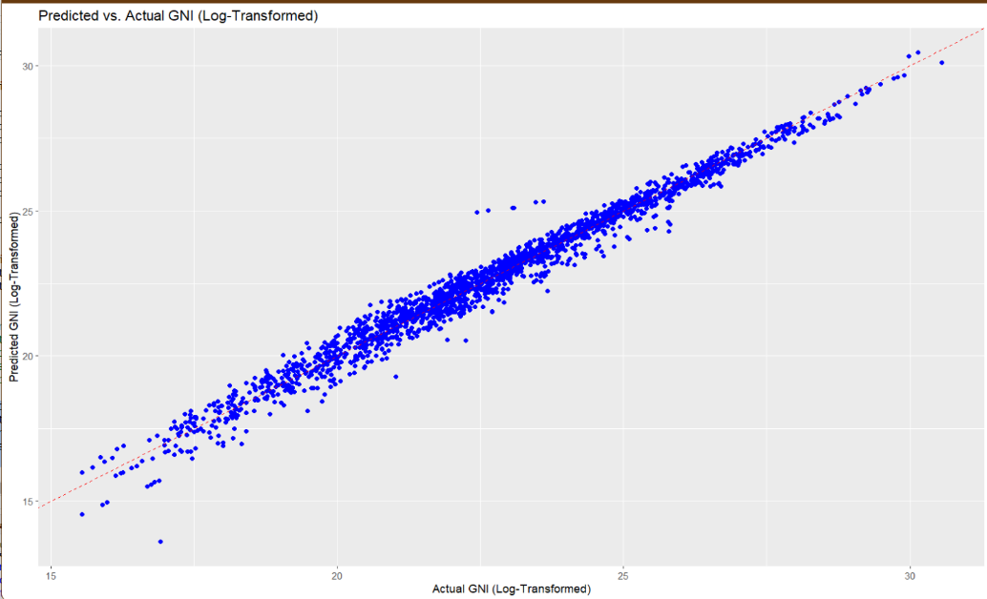
Model Evaluation
The scatter points align closely along the red dashed diagonal line (representing perfect prediction).
The proximity of points to this line suggests that the model performs well in predicting GNI
Metric | Value | Comment
R-squared | 0.9774 | indicates that 97.74% of the variance in GNI is explained by the model.
MSE, RMSE | 0.1657, 0.4072 | low, reflecting high model accuracy.
RSE(Residual Standard Error) | 0.3913 | average deviation of the observed GNI from the model's predictions.

Slide 20
Analysis Summary
1. Significance of Predictors:
Agriculture (p < 2e-16): Highly significant.
Manufacturing (p < 2e-16): Highly significant.
Wholesale/Retail Trade (p < 2e-16): Highly significant.
Net Exports (p = 0.128): Marginal significance.
Population (p = 9.65e-15): Highly significant.
We can remove Net Exports as it may not contribute significantly to the model.
2. Insights:
This regression model effectively explains GNI using key economic indicators with high accuracy.
Most variables show strong contributions, while Net Exports is less impactful. It requires further exploration or justification for its inclusion.
The low RMSE and MAPE values indicate the model is reliable for prediction.
The scatter plot validates the linear relationship between actual and predicted GNI values

Slide 21

Conclusion
Services dominate GNI only after economies cross a $10,000 per capita threshold, leading to exponential growth in developed countries.
Agriculture acts as a stabilizing force in developing nations during global economic crises.
Positive trade balances significantly amplify manufacturing-driven growth in developing economies.
Population growth boosts GNI in developing economies but adds little to developed ones, shifting focus to productivity gains.
Transitioning from manufacturing to services temporarily slows economic growth, but recovery in the service phase is explosive.
Developed economies thrive on internal consumption, while developing economies are trade-dependent for sustained growth.

