Slide 1


Dermaviz
A comprehensive research suite for integrated phenotyping, genotyping, and 3D modeling for NF1 patients
Dermaviz
SVAI Second Hackathon for NF
15 Sept 2019

Slide 2
Opportunity
The heterogeneity of NF1 is not understood
Rich NF1 datasets are not linked to comprehensive associated phenotypic data
Large sample size of linked genotype-phenotype data needed to understand heterogeneity and subtypes of disease
Dermaviz
SVAI Second Hackathon for NF
15 Sept 2019

Slide 3
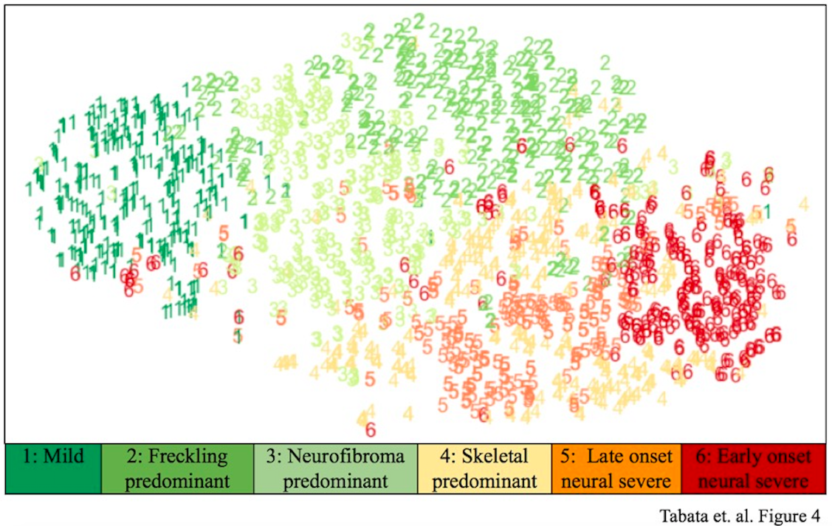
Analysis of CTF survey data reveals possible phenotypic clusters → genetic correlation needed
Dermaviz
SVAI Second Hackathon for NF
15 Sept 2019

Slide 4
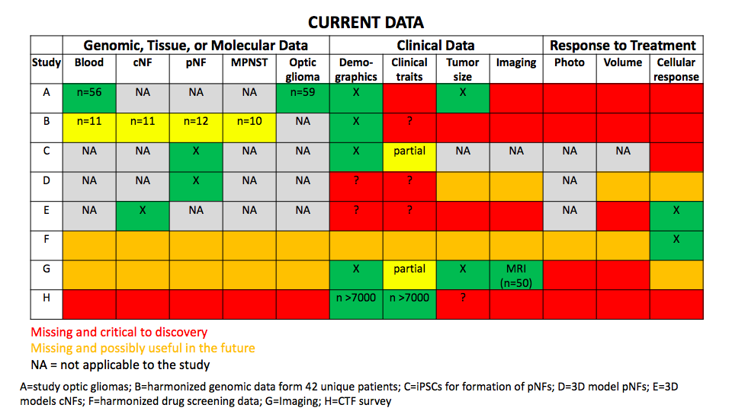

Slide 5
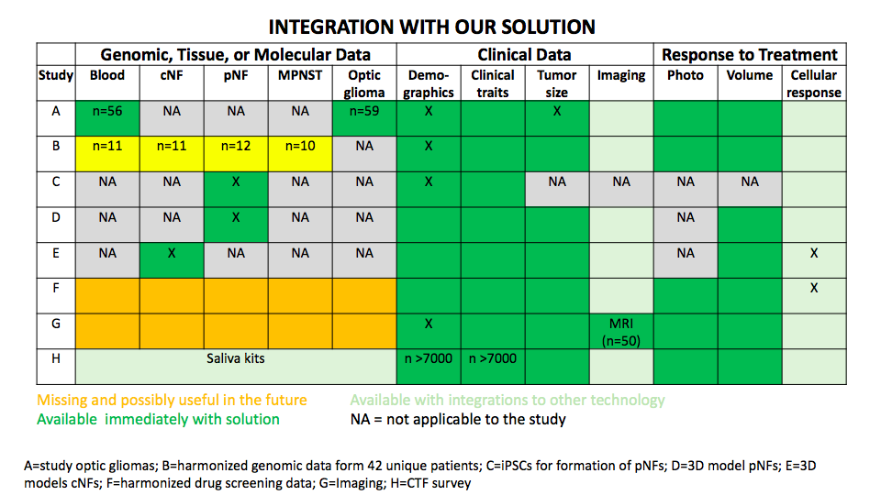

Slide 6
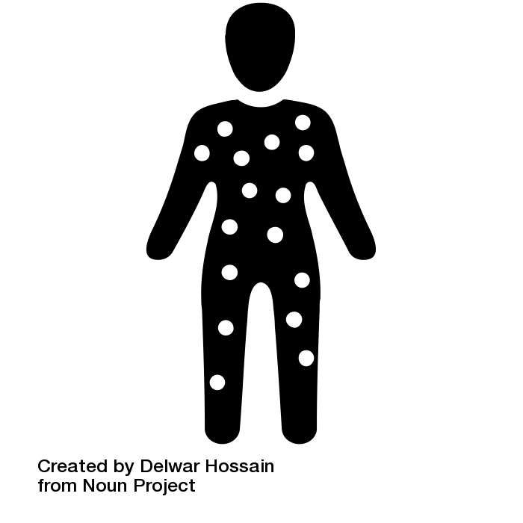


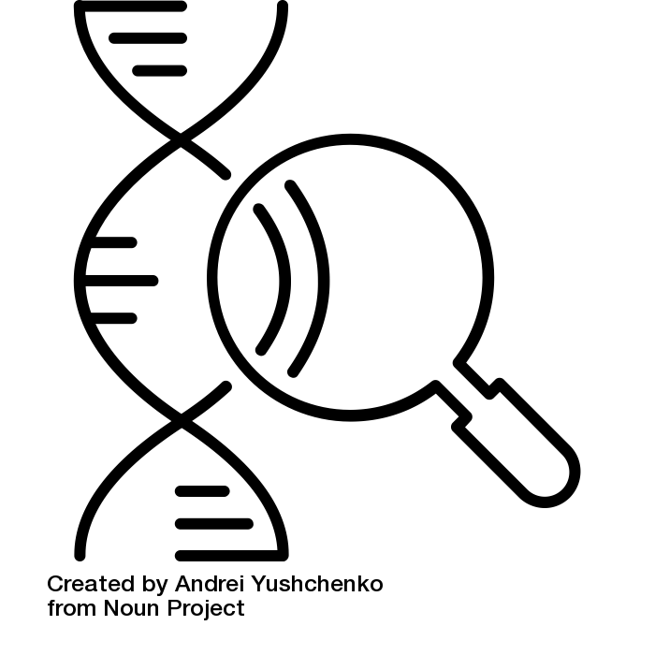
Solution
Mobile app generates high-res 3D model of NF1 patient
Rapidly collect thousands of 3D images of NF1 patients’ skin
Store in HIPAA-compliant cloud server for phenotypic visualization and ML
Genotype-phenotype integration
Dermaviz
SVAI Second Hackathon for NF
15 Sept 2019

Slide 7
Use Cases
Increase utility of currently available datasets
Understand disease heterogeneity/subtypes
Obtain prognostic information on who might need treatment
Capture natural history of NF1
Measure cutaneous tumor burden over time
Track response to future therapies
Identify pathways that modulate number of neurofibromas -> drug targets
Extrapolate to any rare cutaneous disease
Gorlin’s, dysplastic nevus syndrome, phakomatosis pigmentokeratotica, tuberous sclerosis, RAS-opathies, etc.
Dermaviz
SVAI Second Hackathon for NF
15 Sept 2019

Slide 8
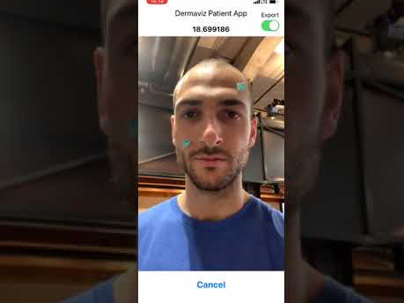
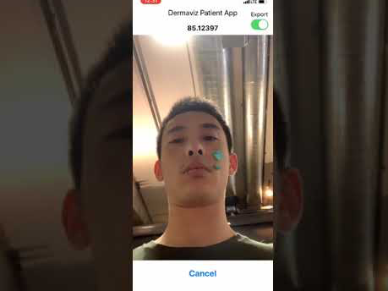
Demo
DermaViz
Dermaviz
15 Sept 2019
SVAI Second Hackathon for NF
15 Sept 2019
SVAI Second Hackathon for NF

Slide 9
Next steps
Expand to the rest of the body
Human in the loop characterization to label training data for automated lesion count, volume burden, and classification
Implement dermatologist portal for access to 3D models
DermaViz
SVAI Second Hackathon for NF
15 Sept 2019

Slide 10
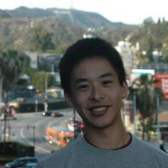
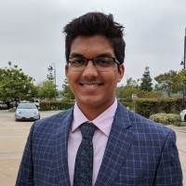
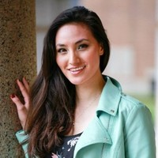

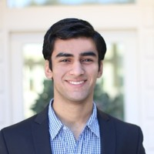
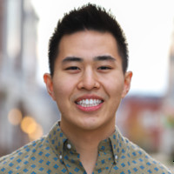
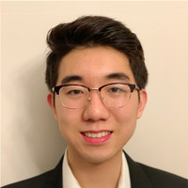
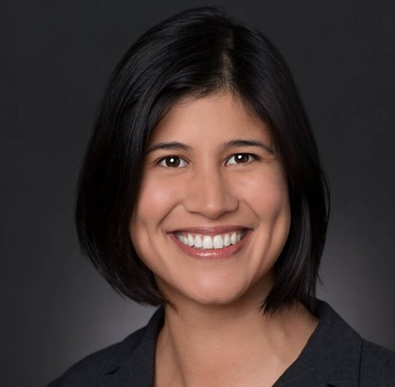
OUR TEAM
Warren Chan
wchan28@stanford.edu
Rushil Srivastava
rushils@stanford.edu
Mika Tabata
mikatabata@stanford.edu
Bellus3D
bellus3D.com
Neekon Saadat
neekonsu@gmail.com
Nam Nguyen
quocnam314@gmail.com
Michael Yan
yanm@stanford.edu
Kavita Sarin
ksarin@stanford.edu
github.com/SVAI/Dermaviz
Dermaviz
SVAI Second Hackathon for NF
15 Sept 2019

