Slide 1
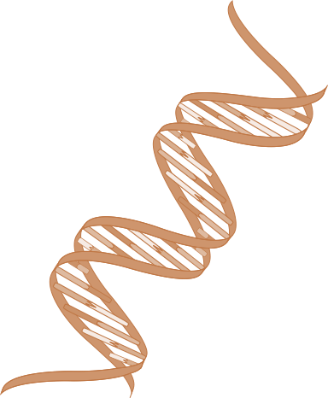
codeOmics

Slide 2

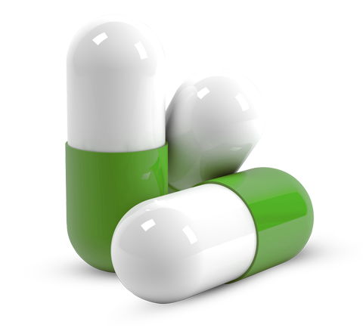
What do we want to achieve?
precision phenotyping . tcga . gene ontology . drug biomarker
treat
understand
Notes:
Goals:
1) Help bill understand his disease
2) Improve treatment

Slide 3
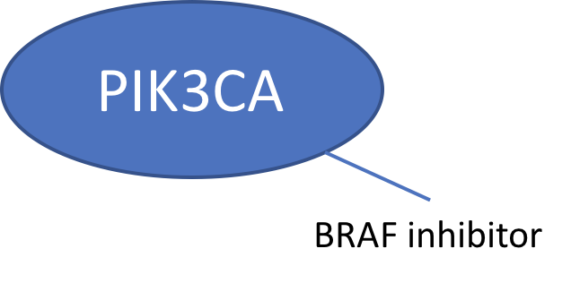
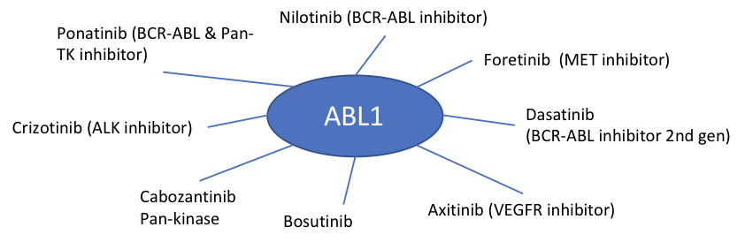
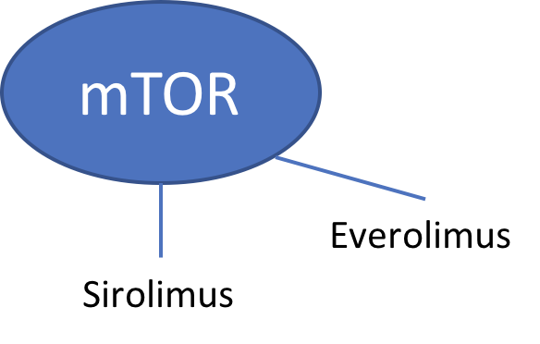
Biomarkers to Precision Drugs

Slide 4
Pipeline
Functional Pathways
Drug - Gene Interactions
Bill’s Genetic Data
SNPs
Gene Mutations
Functional Groups
Dashboard
Similar Patients
Similar & Unique Mutations
Affected Functional Pathways
Personalized Treatment Options
TCGA Patient Data
Gene Mutations
Functional Groups
Notes:
Goals: 1) Help Bill Understand His Disease 2) Improve treatment

Slide 5
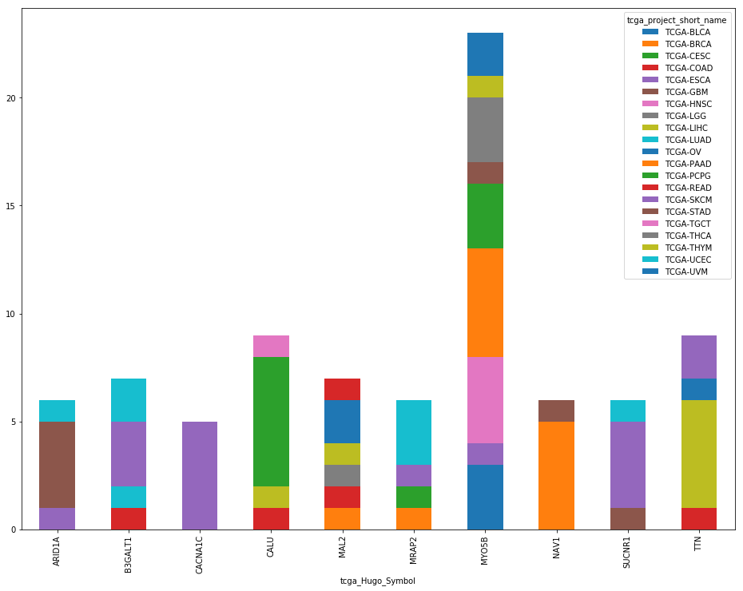
From Bill’s cancer mutations to TCGA
SNPs that are present in Bill’s cancer and are also present in specific cancer subtypes

Slide 6
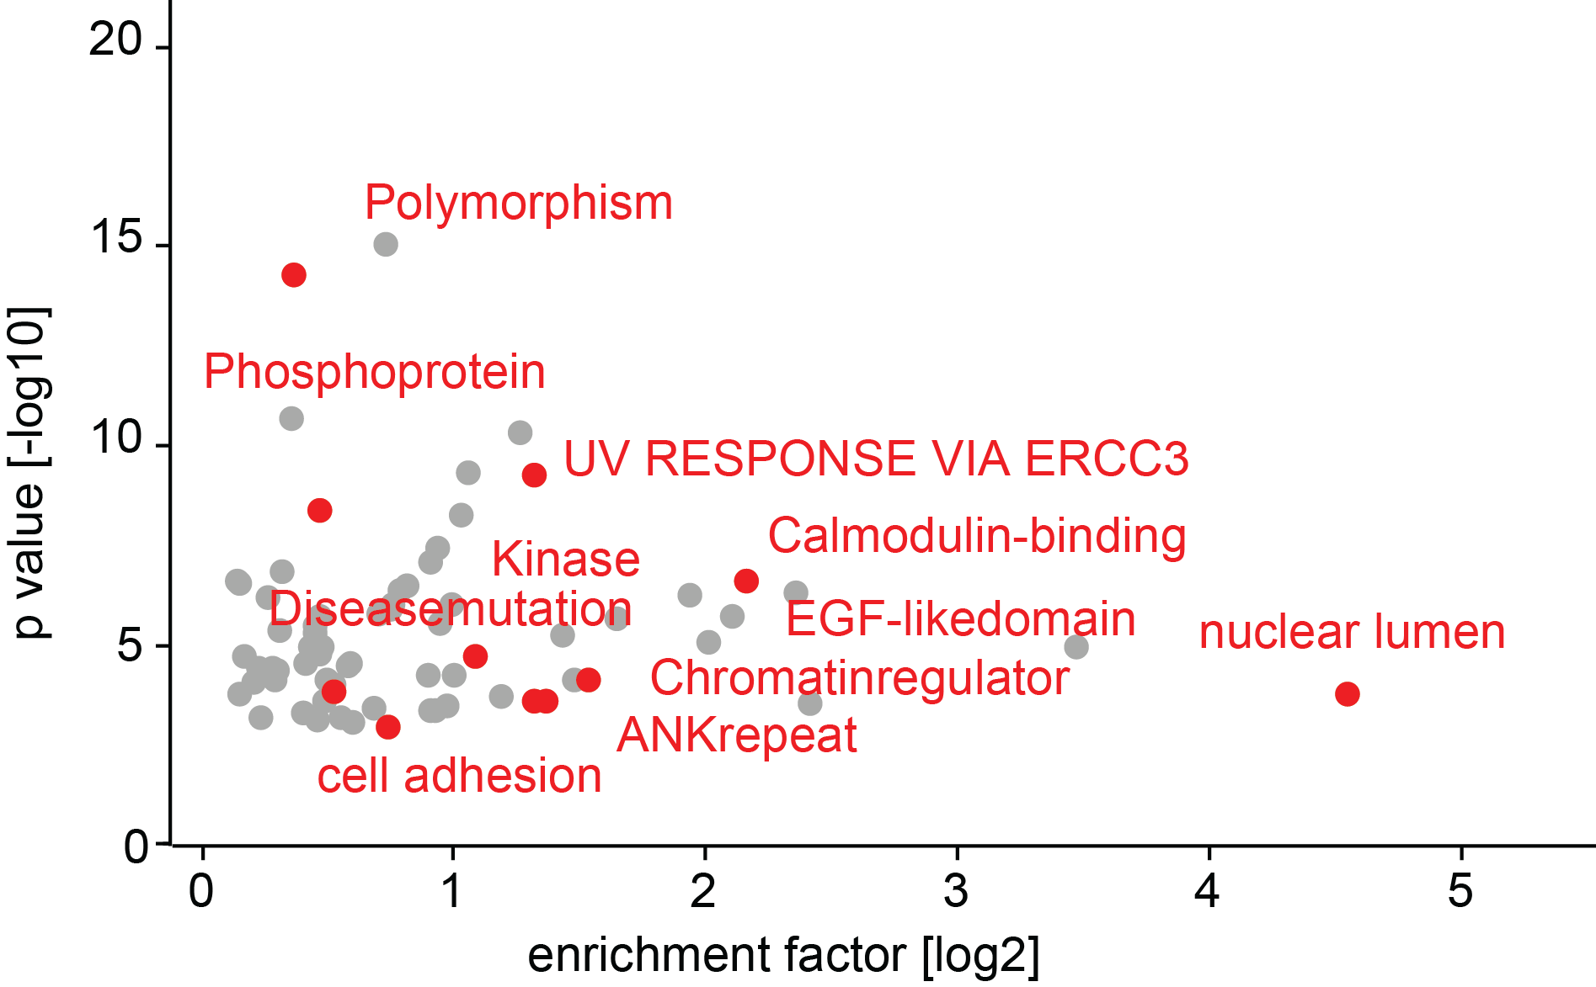
What Pathways are significantly under / over represented in Bill’s tumor?
missense mutations → genes
genes → pathways
Bill’s → tcga
Fisher’s test

Slide 7
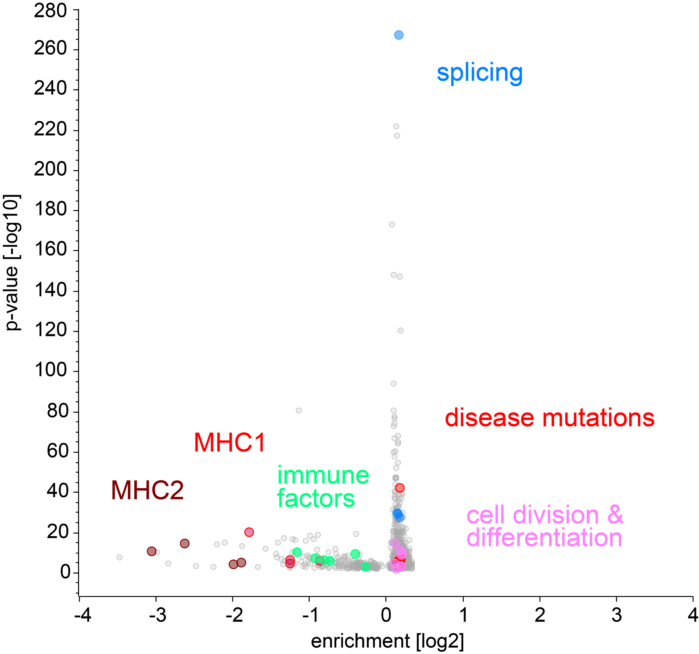
What Pathways are significantly under / over represented in Bill’s tumor?
missense mutations → genes
genes → pathways
depleted
enriched
TAP binding (GO: antigen processing and presentation)
Fisher’s test

Slide 8
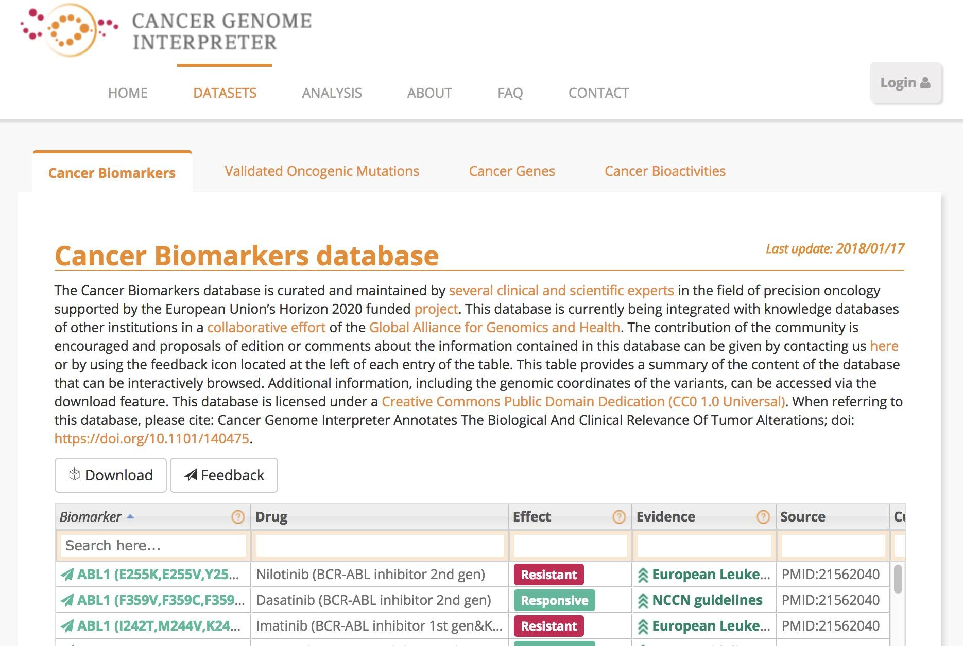
Biomarkers to Precision Drugs
specific mutations → response to drug therapy / drug resistance to drug therapy
Drug effect
Mutation

Slide 9
Biomarkers to Precision Drugs

