Slide 1
Gene Expression Visualization (GEViz)
Navi Tansaraviput
Natnicha Vanitchanant
Thanapat Worasaran
Maytas Monsereenusorn

Slide 2

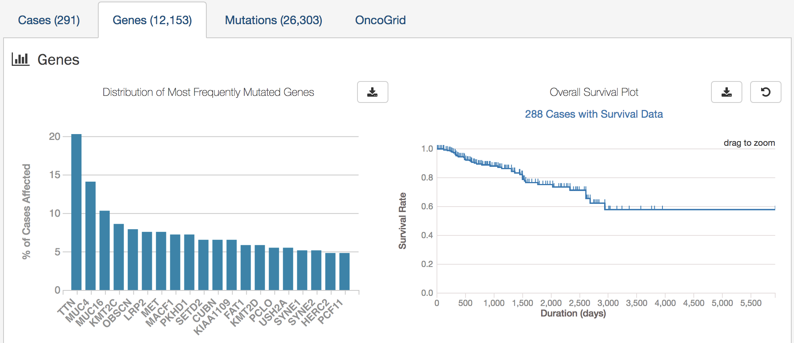
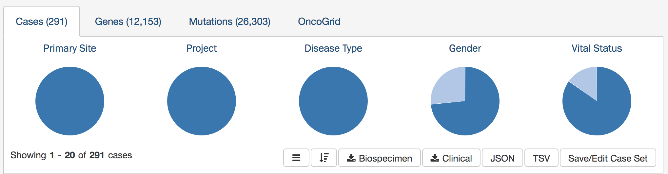
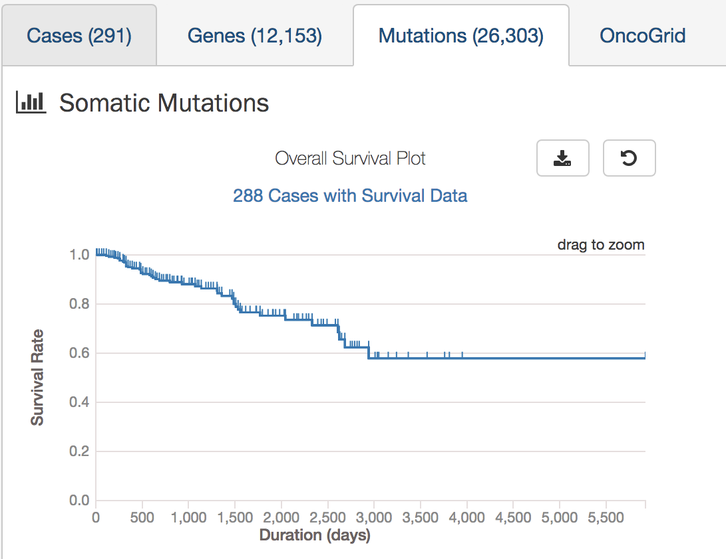
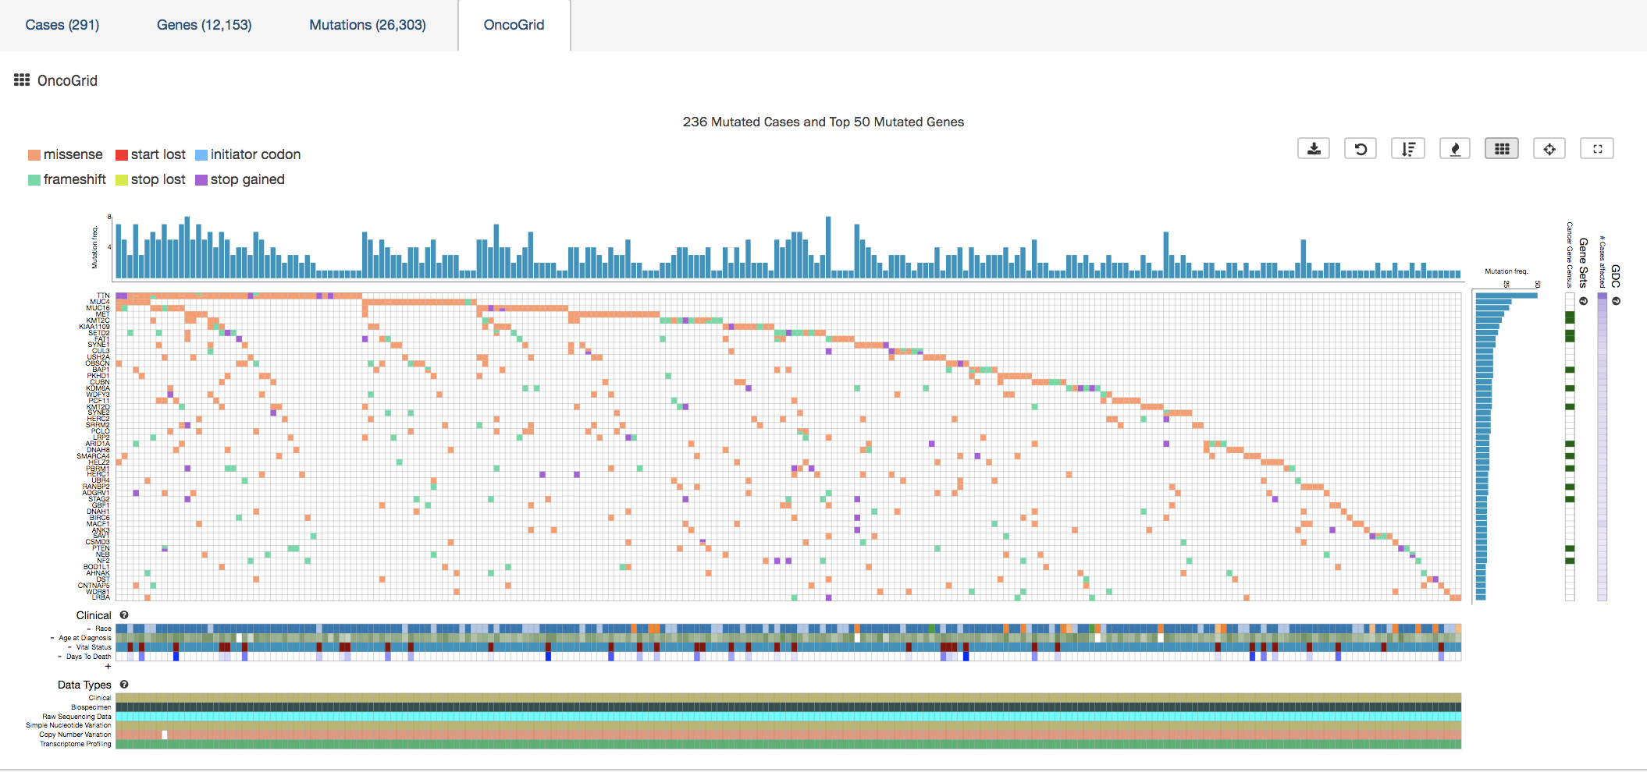
Problem Statement
GDC data portal is very useful, but has limited visualization available
Less freedom in choosing inputs, limited in color by field and no visualization for gene expression
Goal: visualize gene expression data

Slide 3




Methods
Extract data from tables in isb-cgc using BigQuery (study name = KIRP)
mRNA data from tcga_201607_beta.mRNA_UNC_HiSeq_RSEM
Patients clinical data from tcga_201607_beta.Clinical_data
Visualize gene expression data in ipython notebook
Distribution of gene expression across patients for a particular gene
Correlation of gene expression for 2 genes
Color plots by any chosen clinical data field (i.e. gender, tumor type)

Slide 4
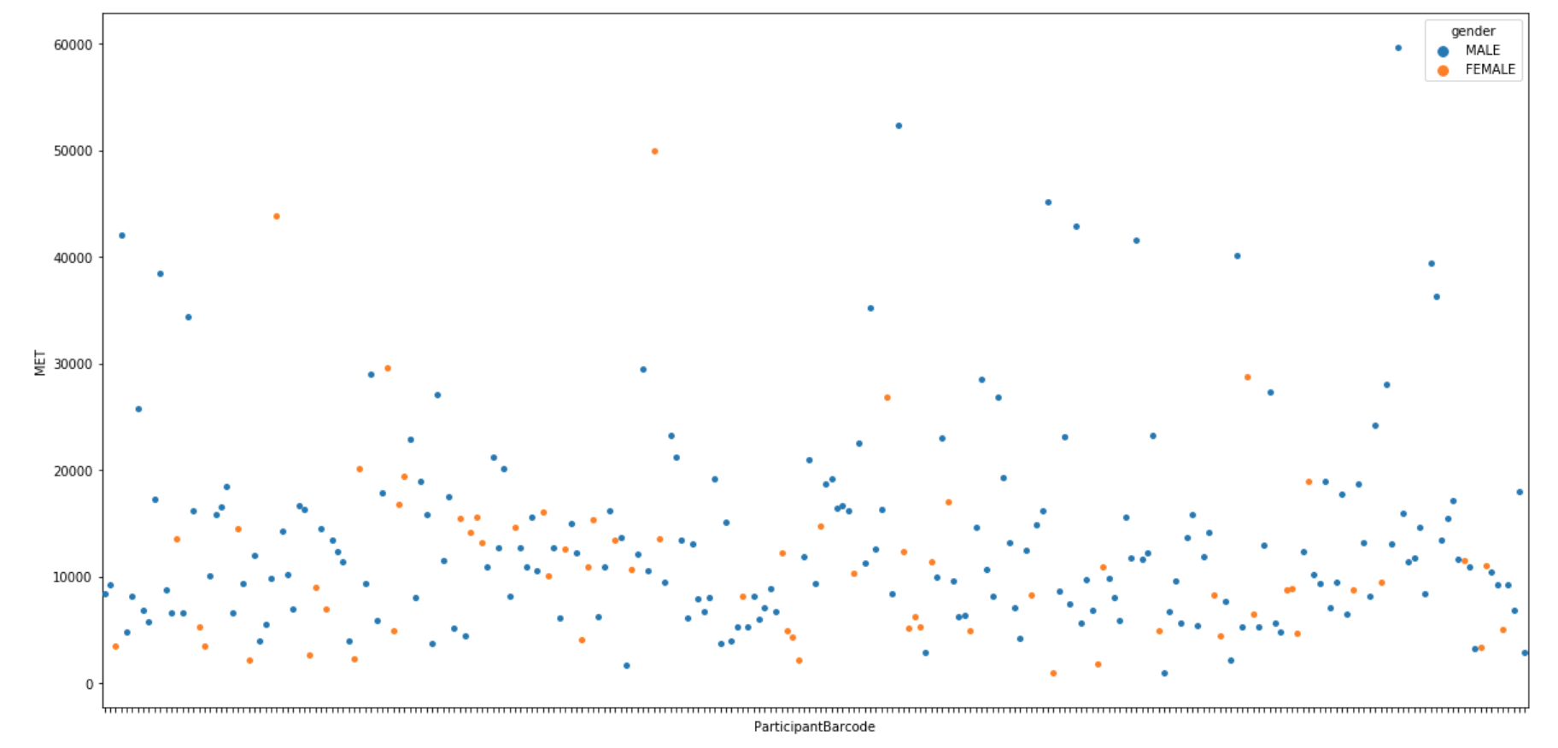
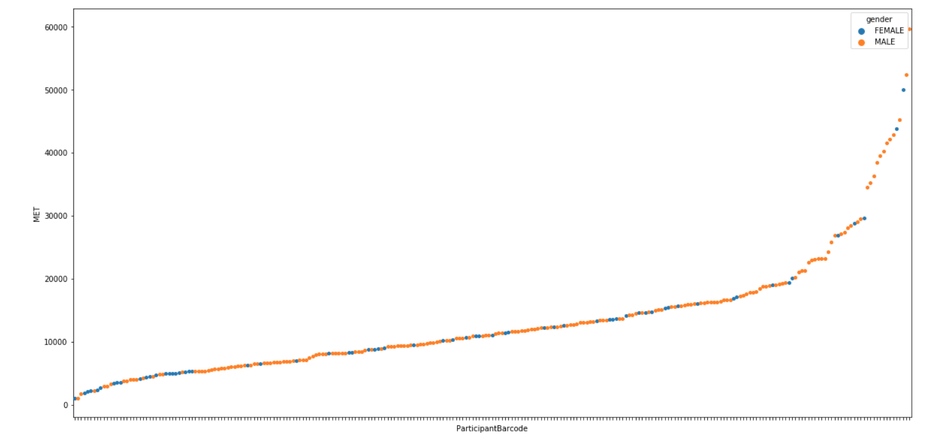
Gene expression by patient colored by gender
Input: MET
count 257.000000 mean 13270.533349 std 9503.889011 min 1023.173800 25% 6894.579800 50% 11057.759900 75% 16155.091600 max 59641.815200 Name: MET, dtype: float64

Slide 5
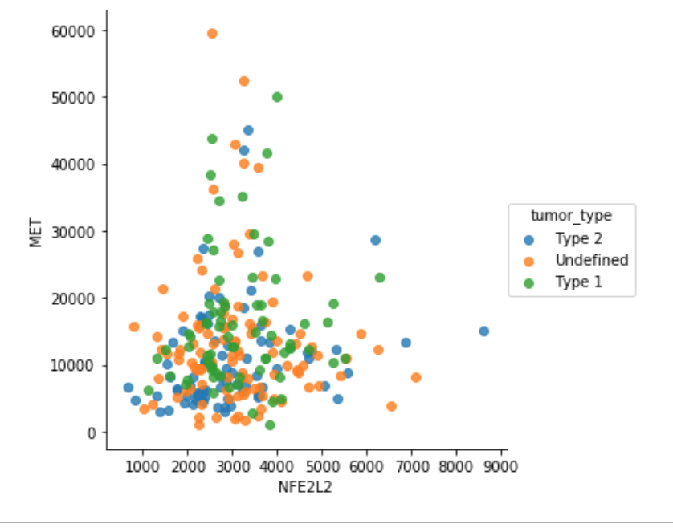
Compare 2 genes colored by tumor type
Input: MET and NFE2L2
Alterations in the MET pathway were associated with type 1, and activation of the NRF2-ARE pathway was associated with type 2¹
¹Cancer Genome Atlas Research Network. Comprehensive molecular characterization of papillary renal-cell carcinoma. New England Journal of Medicine. 2016 Jan 14;374(2):135-45.

Slide 6
Future Directions
iPython notebook can be extended and used by other researchers
Calculate separate statistics for subgroups (ex. Tumor type)
GUI to support easy choosing of gene symbol, visualization type, color by clinical data parameter, etc.
Compare Bill’s gene expression data to other patients in the TCGA database
Calculate correlation for every possible pair of genes

Slide 7
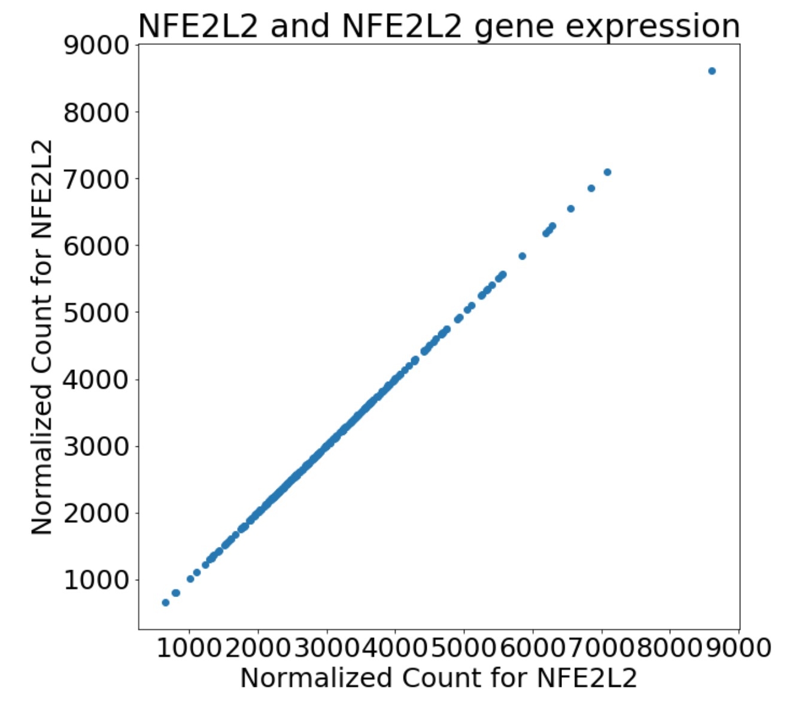
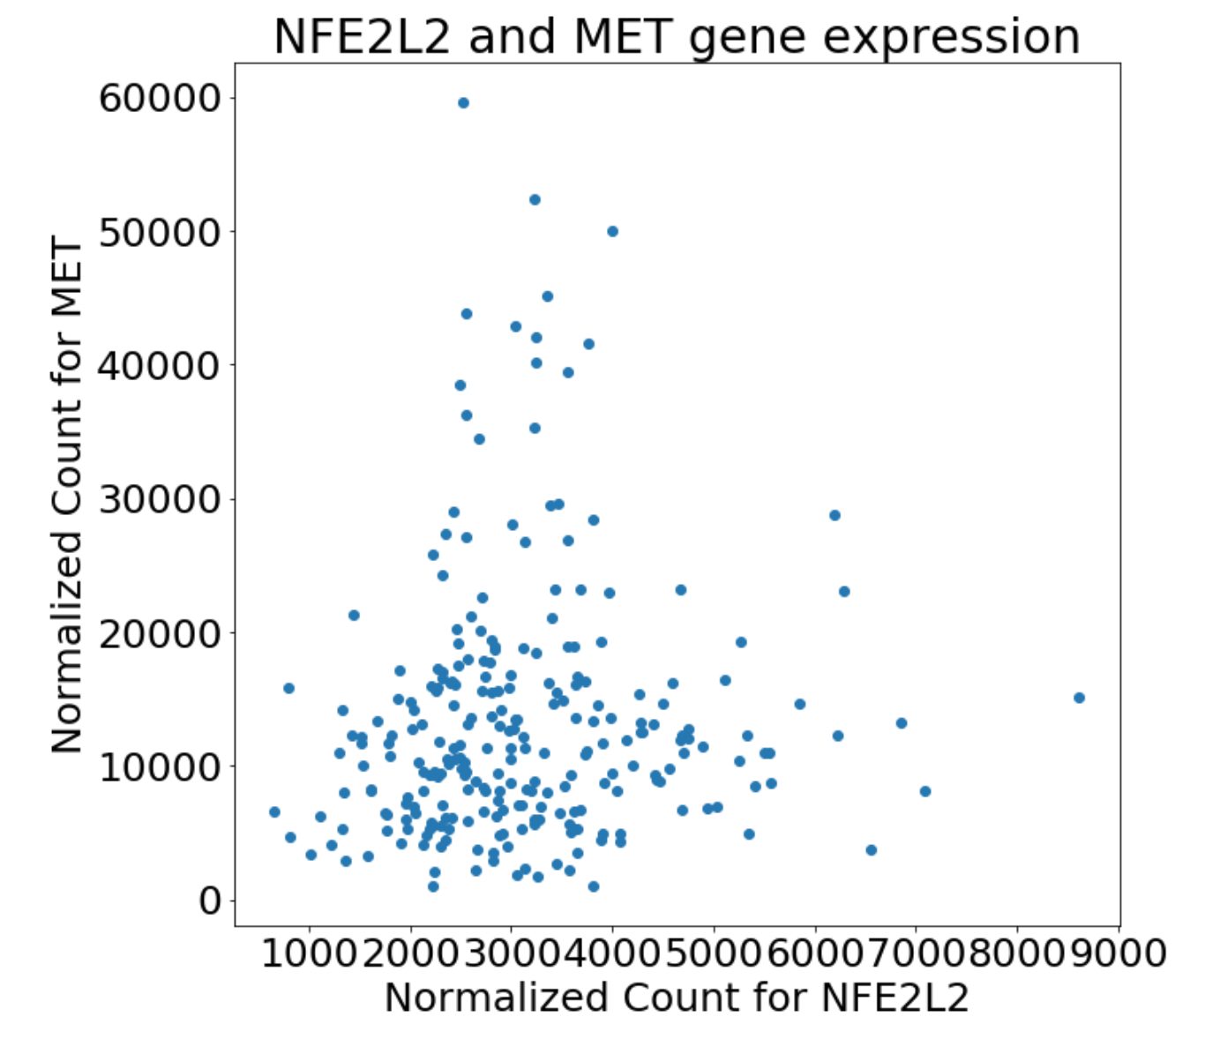
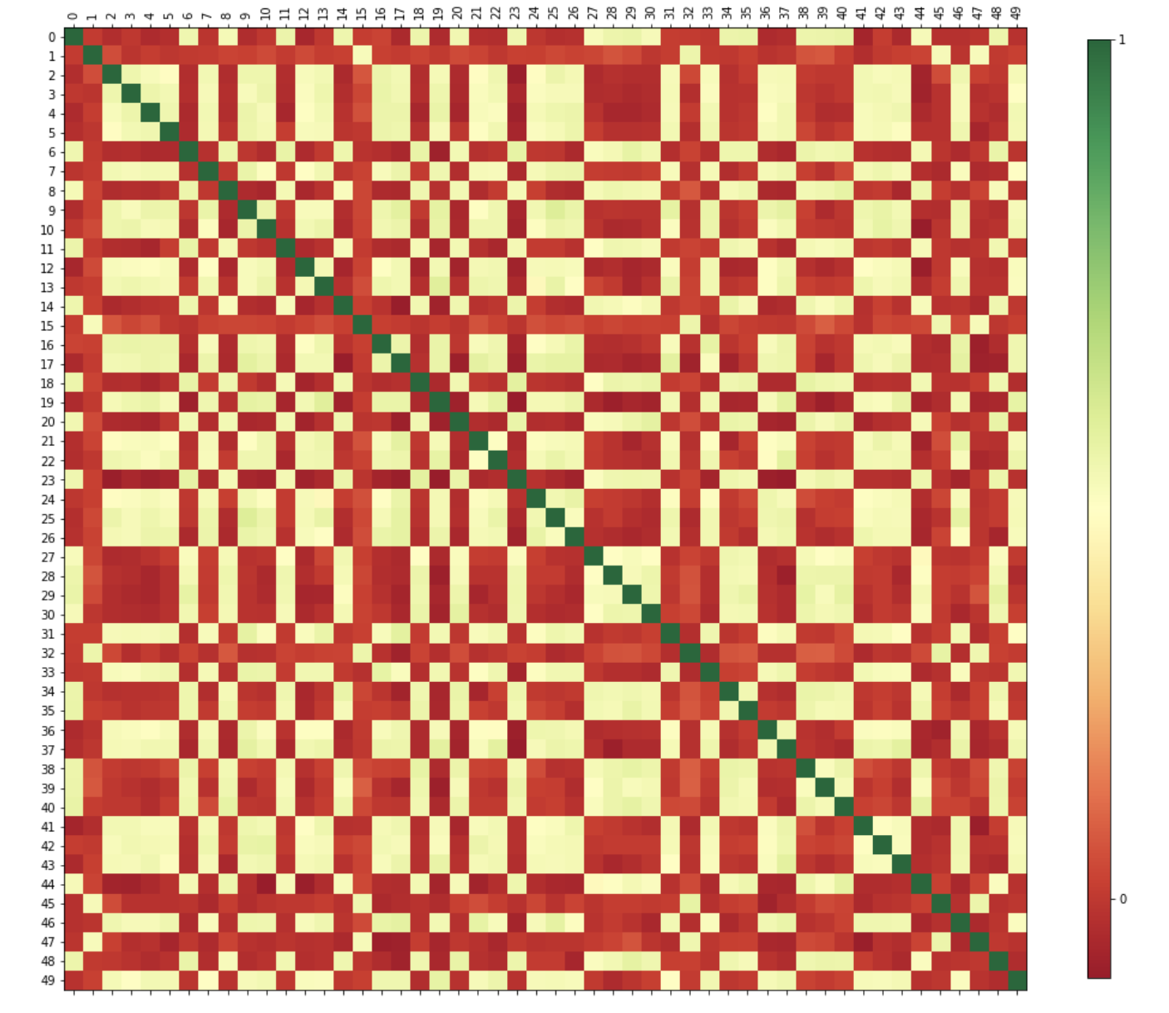
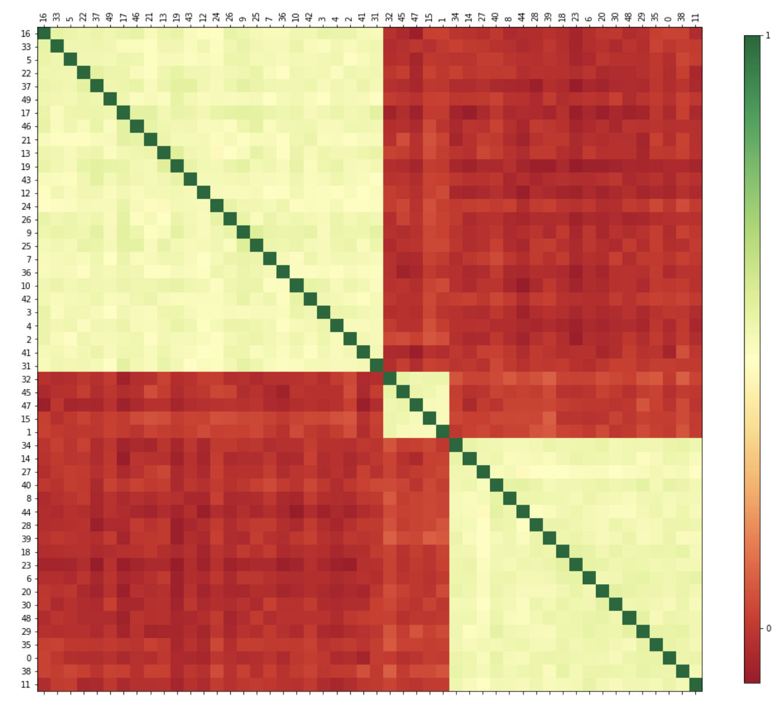
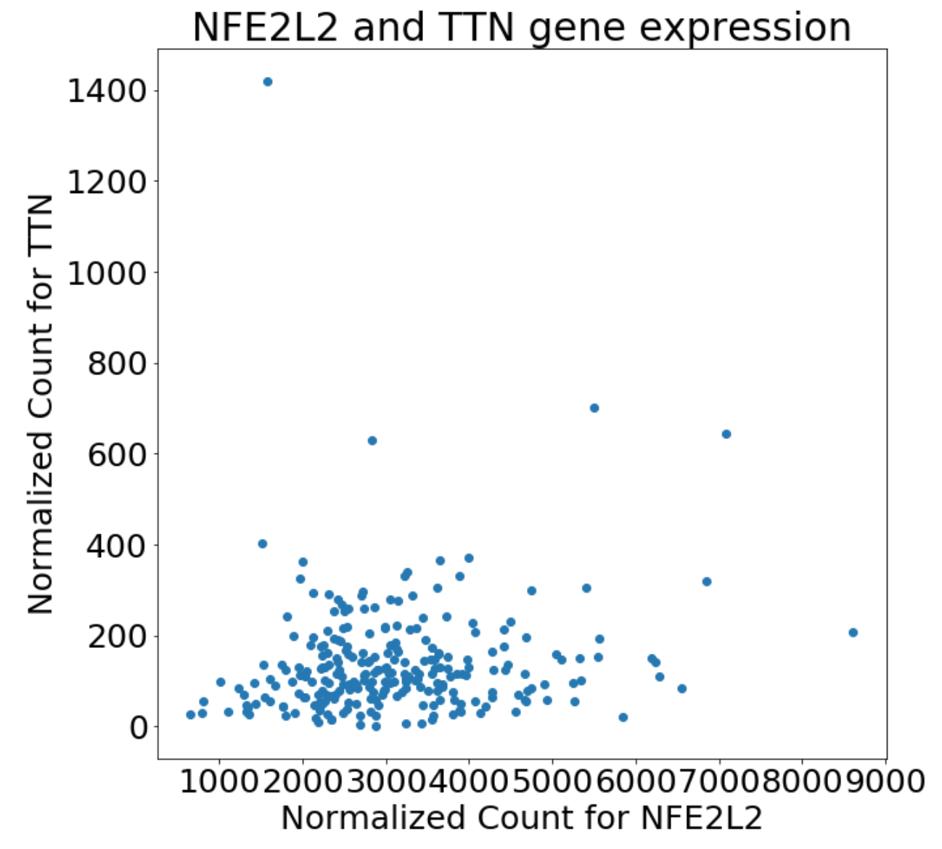
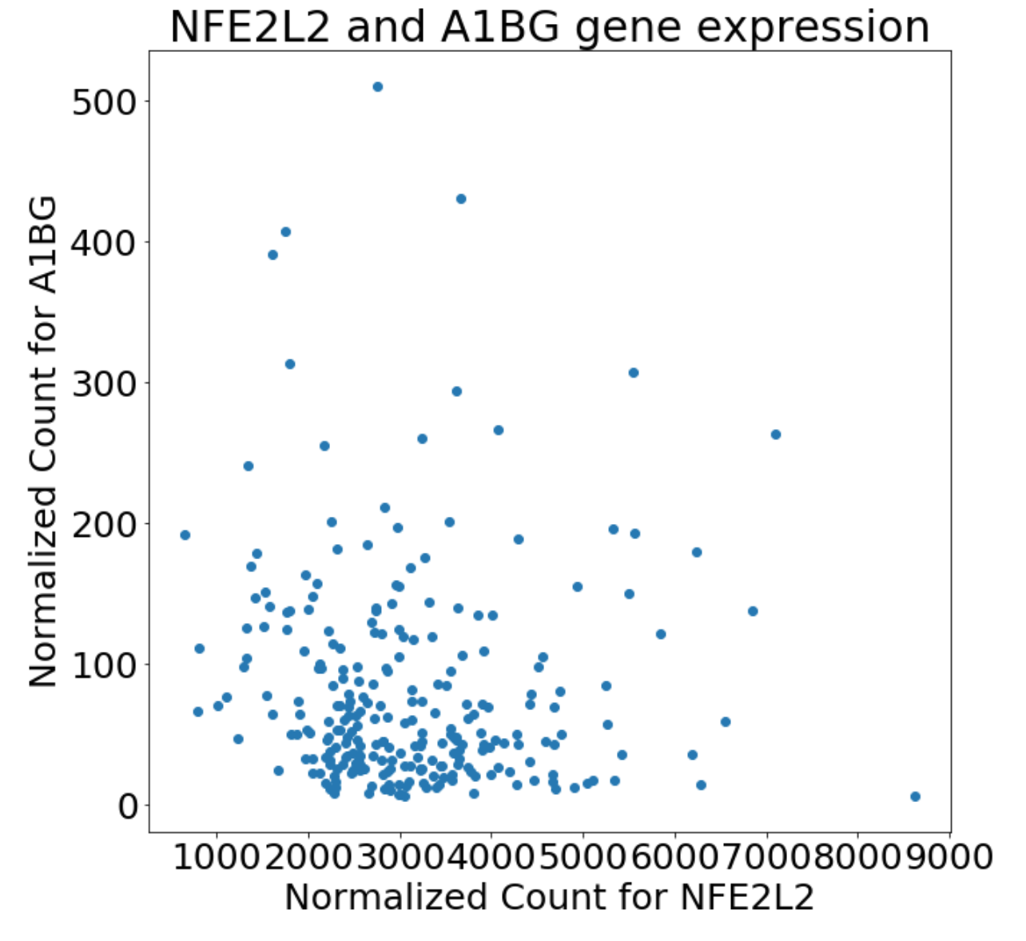
Correlations Between Genes
All mutations in the tumour caused by (hopefully) small number of driver mutations
Passenger mutation that came from the same driver mutations should have correlation in gene expression
By calculating correlations between all gene pairs and clustering them, we should be able to identify the number of driver gene in the tumour
Correlation Matrix Clustering (example)
https://github.com/TheLoneNut/CorrelationMatrixClustering/blob/master/CorrelationMatrixClustering.ipynb
Notes:
All mutations in the tumour cuased by driver mutations
The driver mutation then induce the subsequent mutations called passenger mutation. The mutations that have the same driver mutation will have higher correlation than one that have different driver mutation
We calculated the correlations between all gene pairs
We then cluster the genes that have correlations - hopefully will be able to identify how many driver genes in the tumour

Slide 8
Appendix
Github repo: https://github.com/SVAI/geviz
TCGA gene expression pipeline: https://docs.gdc.cancer.gov/Data/Bioinformatics_Pipelines/Expression_mRNA_Pipeline/

