Slide 1
UNIT-IV
Structures

Slide 2
Structure is a collection of data items of different data types.
The structure members are accessed by using dot operator(.) and for pointers(→)
Ex: struct student
{ int rollno;
char name[20];
float attendance;
} s1;
Where struct is a keyword, student is the structure tag name and s1 is a structure variable or identifier.

Slide 3
The structure mechanism provides a means to combine variables of different types.
Syntax: struct <tag-name>
{ member-1;
member-2; …………
member-n;
};
Every member has its own memory.

Slide 4
Structure is a derived data type.
Structure is a collection of data items of different data types.
Structure is a derived data type in which each element may have different data types.

Slide 5
Feature of structures
It permits different data items.
Array of structure is possible.
Pointer to a structure is possible.
Nested structure is possible.
Self referential structure is possible.
Structures can be passed as arguments.
The members can be accessed and manipulated.
Union can be a member of a structure.

Slide 6
Initializing structures-example
#include<stdio.h>
main()
{
struct student
{
int rollno;
char name[20];
float attend;
} s={ 1250,”surya”,99.50};
printf (“%d%s%f”, s.rollno, s.name, s.attdnd);
getch();
}

Slide 7
WAP TO FIND OUT THE STUDENTS MARKS TOTAL,AVG BY USING STRUCTURES
struct student
{ char name[20];
char branch[10];
int rollno;
int a,b,c,d,e,f,g,total;
float avg;
} s1;
void main()
{ clrscr();
printf("\n Enter Student Name:");
scanf("%s",s1.name);
printf("\n Enter roll Number:");
scanf("%d",&s1.rollno);
printf("\n Enter branch:");
scanf("%s",&s1.branch);
printf("\n Enter the marks of the student");
scanf("%d%d%d%d%d%d%d",&s1.a,&s1.b,&s1.c,&s1.d,&s1.e,&s1.f,&s1.g);
s1.total = s1.a+s1.b+s1.c+s1.d+s1.e+s1.f+s1.g;
s1.avg=s1.total/6;
printf("\n Name of the student:%s\n",s1.name);
printf("\n Roll No: %d Branch :%s\n",s1.rollno,s1.branch);
printf("\n Total Marks:%d \n",s1.total);
printf("\n Average:%f\n",s1.avg);
getch();
}

Slide 8
Structures
Structures are collections of different data types and related variables under one name.
Unlike arrays, structures can store variables of many different types.

Slide 9
structure definition
keyword struct: tells the compiler you are defining a struct
struct student {
  char firstName[10];
  char lastName[10];
  int exam1;
  int exam2;
  int final;
};
structure tag: used to name the structure definition
members of the structure
don't forget the semi-colon

Slide 10
declaring struct variables
Once the struct is defined, we can declare variables of our new type.
struct student currentStudent, class[50];
keyword
struct
struct
tag
variable to hold one student record
array to hold 50 student records

Slide 11
alternative definition / declaration
struct student {
  char firstName[10];
  char lastName[10];
  int exam1;
  int exam2;
  int final;
} currentStudent, class[50];
struct student {
  char firstName[10];
  char lastName[10];
  int exam1;
  int exam2;
  int final;
};
struct student currentStudent, class[50];
these do the same thing

Slide 12
What is the amount of memory to be allocated for this program?
struct time
{
int second;
int minute;
int hour;
} t1;
Ans) 6 bytes.

Slide 13
How is a member of a structure accessed?
Each member of a structure variable can be accessed using the structure member operator dot(.)
Format: structure_variable.member_variable
s.rollno
s.name

Slide 14
Nested structure
If a structure contains one or more structures as its members it is known as nested structure.
Ex: struct date
{
int day;
char month[10];
}
struct person
{
int age;
char name[10];
};

Slide 15
Write a program to find the size of the structure
#include<stdio.h>
#include<conio.h>
struct student
{
char name;
int id;
float avge;
};
void main()
{
struct student stud;
clrscr();
printf("Enter name , id and avge of student\n");
scanf("%s%d%f",&stud.name,&stud.id,&stud.avge);
printf("name of the student:%s\n",stud.name);
printf("Id of the student:%d\n",stud.id);
printf("Average of the student:%f\n",stud.avge);
printf("Size of a structure variable is:%d Bytes \n",sizeof(stud));
getch();
}

Slide 16
typedef
It is a user defined data type.
It is defined using the keyword typedef and the syntax is:
typedef struct student Student;
defines a new type “Student” as a synonym for type struct student.
The keyword typedef provides a mechanism for creating synonyms (or aliases) for previously defined data types.

Slide 17
typedef
C provides a facility called typedef for creating new data types.
The typedef feature is particularly convenient when defining structures since it eliminates the need to repeatedly write struct tag whenever a structure is referenced.
It is usually good programming practice to associate a tag name with a structure type.
It is convenient for further declarations and for documentation.

Slide 18
typedef (cont)
You can combine the typedef statement with the struct definition. For example:
typedef struct {
  char firstName[10];
  char lastName[10];
  int exam1;
  int exam2;
  int final;
  } Student;
note: We avoid the need for a typedef tag.
would define the struct and make Student an alias for the newly defined type.

Slide 19
Initializing typedef-example
#include<stdio.h>
main()
{ typedef student
{
int rollno;
char name[20];
float attend;
} s={ 1250,”suryakiran”,99.50};
printf(“%d%s%f”,s.rollno,s.name,s.attdnd);
getch();
}

Slide 20
#include <stdio.h>
struct student
{
char firstName[10];
char lastName[10];
int exam1;
int exam2;
int final;
};
int main ()
{
struct student currentStudent;
float average;
printf("Enter your first name: ");
scanf ("%s", currentStudent.firstName);
printf("Enter your last name: ");
scanf ("%s", currentStudent.lastName);
printf("First exam score: ");
scanf ("%d", &currentStudent.exam1);
printf("Second exam score: ");
scanf ("%d", &currentStudent.exam2);
printf("Final exam score: ");
scanf ("%d", &currentStudent.final); /*final has double the weight of either exam*/
average = (float)(currentStudent.exam1 + currentStudent.exam2 + currentStudent.final*2)/4.0;
printf ("Thanks %s %s, you have received a %.2f in this class.\n",
currentStudent.firstName, currentStudent.lastName, average);
getch();
}

Slide 21
Enumeration
Enumeration is a user-defined data type.
It is defined using the keyword enum.
Set of integer constants represented by identifiers.
The tag_name is not used directly. The names in the braces are symbolic constants that take on integer values from zero through n.
Enumeration constants are like symbolic constants whose values are automatically set
    Values start at 0 and are incremented by 1
    Values can be set explicitly with =
    Need unique constant names
Syntax is:
  enum tag_name {name_0, …, name_n} ;

Slide 22
As an example, the statement:
  enum colors { red, yellow, green } ;
creates three constants. red is assigned the value 0, yellow is assigned 1 and green is assigned 2.
  Example:
    enum Months { JAN = 1, FEB, MAR, APR, MAY, JUN, JUL, AUG, SEP, OCT, NOV, DEC};
    Creates a new type enum Months in which the identifiers are set to the integers 1 to 12
  Enumeration variables can only assume their enumeration constant values (not the integer representations)

Slide 23
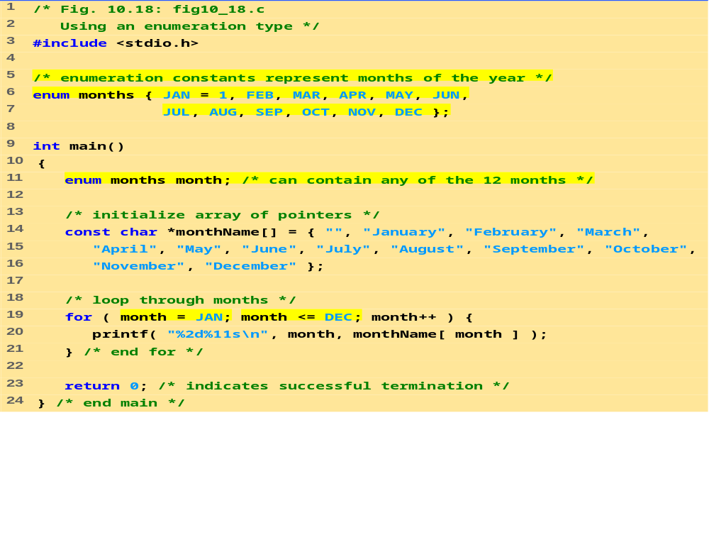

Slide 24
/* This program uses enumerated data types to access the elements of an array */
#include <stdio.h>
int main( )
{
int march[5][7]={{0,0,1,2,3,4,5},{6,7,8,9,10,11,12},
{13,14,15,16,17,18,19},{20,21,22,23,24,25,26},
{27,28,29,30,31,0,0}};
enum days {Sunday, monday, Tuesday,
wednesday, Thursday, Friday, Saturday};
enum week {week_one, week_two, week_three,
week_four, week_five};
clrscr();
printf ("Monday the third week of March is March %d\n",
march [week_three] [monday] );
getch();
}

Slide 25
Passing structs to functions
You can pass entire structs to function.
A function may pass a structure as an argument .
Passing structures to functions
  Pass entire structure
    Or, pass individual members
  Both pass call by value
To pass structures call-by-reference
  Pass its address
  Pass reference to it
To pass arrays call-by-value
  Create a structure with the array as a member
  Pass the structure

Slide 26
Wac-pgm to find out the details of student using function in structures
struct student
{
name char[30];
marks float;
}
main ( )
{ struct student student1;
student1 = read_student ( )
print_student( student1);
read_student_p(student1);
print_student (student1);
}

Slide 27
struct student read_student( )
{
struct student student2;
gets(student2.name);
scanf(“%d”,&student2.marks);
return (student2);
}
void print_student (struct student student2)
{
printf( “name is %s\n”, student2.name);
printf( “marks are%d\n”, student2.marks);
}
void read_student_p(struct student student2)
{
gets(student2.name);
scanf(“%d”,&student2.marks);
}

Slide 28
Array of structures
A group of structures may be organized in an array resulting in an array of structures.
Each element in the array is a structures.
Ex: struct person
{ char name[10];
int age;
};
structure person emp[10];
each structure variable emp[0],emp[1]…emp[9] contains structure as its value.
The members are accessed as emp[0].age,emp[1].age
……..emp[9].age

Slide 29
WA C-PGM TO FIND OUT STUDENT DETAILS USING ARRAYS IN STRUCTURES
#include< stdio.h >
Struct address
{
plot char [30], struc char[30];
city char[30]
}
struct student
{
name char[30];
marks float;
struct address adr;
}

Slide 30
void main ( )
{ struct student student1;
struct student class[20];
class[1].marks = 70;
class[1].name = “ Anil “;
class[1].adr.plot = “7 ”;
class[1].adr.street = “ Mg Road”;
class[1].adr.city = “mumbai”;
printf( “ Marks are %d\n”, class[1].marks);
printf( “ name are %s\n”, class[1].name);
printf( “ adr.plot is %s\n”, class[1].adr.plot);
printf( “ adr.street is %s\n”, class[1].adr.stret);
printf( “ adr.city is %s\n”, class[1].adr.city);
}

Slide 31
Pointer to a structures
A pointer to a structure is similar to a pointer to an ordinary variable.
It is created in the same way as a pointer to an ordinary variable is created.
struct person *sp;
Where sp is a pointer variable pointing to a structure person. This pointer must be initialized statistically or dynamically.

Slide 32
Accessing Members of Structures
Accessing structure members
  Dot operator (.) used with structure variables
    card myCard;
    printf( "%s", myCard.suit );
  Arrow operator (->) used with pointers to structure variables
    card *myCardPtr = &myCard;
    printf( "%s", myCardPtr->suit );
  myCardPtr->suit is equivalent to
    ( *myCardPtr ).suit

Slide 33
Ex: struct person
{ int age;
char name[10];
};
struct person s,*sp1,*sp2;
sp1=&s; /* static allocation */
sp2=(struct person*)malloc(sizeof(s));
/* dynamic allocation */
The individual members can be accessed as (*sp1).name (*sp1).age
(*sp2).name (*sp2).age
The & and . have same precedence, to avoid this one we are using -->
sp1->name sp1->age
sp2->name sp2->age

Slide 34
Wap to find student details using pointers in structures
struct student
{ char name[30];
float marks;
} ;
main ( )
{ struct student *student1;
struct student student2;
char s1[30];
float f;
student1 = &student2;
scanf (“%s”, name);
scanf (“ %f”, & f);
*student1.name = s1; \\ J student1-> name = f;
*student2.marks = f; \\ K student1-> marks = s1;
printf (“ Name is %s \n”, *student1.name);
printf (“ Marks are %f \n”, *student2.marks);
}

Slide 35
WAP TO FIND DETAILS USING POINTERS IN STRUCTURES
#include <stdio.h>
struct personal /* Create a struct but don’t reserve space.*/
{
long id;
float gpa;
};
struct identity /* Create a second struct that includes the first one.*/
{
char name[30];
struct personal person;
};
int main ( )
{
struct identity js = {“surya kiran"}, *ptr = &js ;
js.person.id = 123456789 ;
js.person.gpa = 3.4 ;
clrscr();
printf ("%s %ld %f\n", js.name, js.person.id,js.person.gpa);
printf ("%s %ld %f\n", ptr->name, ptr->person.id, ptr->person.gpa);
getch();
}

Slide 36
WAP TO FIND BANK TRANSACTION USING FUNCTION, STRUCTURE POINTERS
#include<stdio.h>
#include<conio.h>
#include<process.h>
struct bank
{
char name[20];
int acno;
float bal;
};
void deposit(struct bank *);
void withdrawl(struct bank *);
void balenq(struct bank *);
void main()
{
struct bank cust;
int choice;
system("cls");
cust.bal=0;

Slide 37
printf("Enter name ,acno of the customer\n");
scanf("%s %d",&cust.name,&cust.acno);
while(1)
{
printf("Bank Transactions \n");
printf("1. Deposit 2. Balance Enquiry 3. Withdrawl 4. Exit\n");
printf("Enter ur choice\n");
scanf("%d",&choice);
switch(choice)
{
case 1: deposit(&cust); break;
case 2: balenq(&cust); break;
case 3: withdrawl(&cust); break;
default:
return;
}
}
getch();
}

Slide 38
void deposit(struct bank *cust)
{
float amt;
printf("Enter amount to be deposited\n");
scanf("%f",&amt);
cust->bal+=amt;
}
void withdrawl(struct bank *cust)
{
float amt;
printf("Enter amount to be withdrawn\n");
scanf("%f",&amt);
if(cust->bal-amt>=500)
cust->bal-=amt;
else
printf("INVALID TRANSACTION\n");
}
void balenq(struct bank *cust)
{
printf("Name %s\n",cust->name);
printf("A/c No: %d\n",cust->acno);
printf("Balance Left:%f\n",cust->bal);
}

Slide 39
Self-Referential Structures
A structure with a member field that points to the same structure type i.e. to include a pointer as a member to the parent structure type.
We do this in order to have any number of such structures nested together.
Two structures that refer to each other are known as self referential structures.

Slide 40
typedef struct node
{ int numb;
char name[20]; /* numb and name are data items for this node*/
struct node *next; /* next is a pointer to the next node */
};
Each node consists of three data items are a numb, a name and pointer that references the next node within the list. (list is a set of nodes).
The pointer variable next is called a link.
Each structure is linked to succeeding structure by way of the pointer member next.
numb
name
next
Fig:A structure node

Slide 41
The pointer “next” contains either an address of the location in memory of the successor node element or NULL.
The NULL is used to denote the end of the list.
Self-Referential structures are very frequently used in DS such as linked lists and trees.

Slide 42
#include< stdio.h >
void main()
{ struct node
{ int numb;
char name[20];
struct node *next;
};
struct node n1,n2,n3;
n1.numb=10; strcpy(n1.name,”ganga”);
n2.numb=10; strcpy(n2.name,”yamuna”);
n3.numb=10; strcpy(n3.name,”saraswathi”);

Slide 43
n1.next=&n2;
n2.next=&n3;
n3.next=NULL;
printf(“\n %d=%s”,n1.next->numb,n1.next->name);
printf(“\n %d=%s”,n1.next->numb,n1.next->next->name);
getch();
}
Output
20=yamuna
30=saraswathi

