Slide 1
Arrays
It is a collection of homogeneous elements and shared by the common name.
An array is a group of contiguous or related data items that share a common name.
Arrays are used when programs have to handle large amount of data.
Arrays elements are stored in sequential memory locations and each value is stored at a specific position
Position is called a index or superscript. Base index = 0.

Slide 2
Array elements are stored in sequential memory location based on row major order.
The total memory required for an array is sizeof(data type)*sizeof array.
The maximum no.of dimension an array can have in C-Language is compiler dependant.
The amount of storage required for holding elements of the array depends on datatype and size

Slide 3
If the array with more number of values than the array size is compiler error message i.e. too many initial values.
If the array with less number of values than the array size is set to be 0’s.
Arrays are fixed length.
Length is specified at create time.
There are three types arrays
  ONE DIMENSIONAL ARRAYS(VECTOR) Eg: int A[2]
  TWO DIMENSIONAL ARRAYS(SCALAR) Eg: int A[2][2]
  MULTI DIMENSIONAL ARRAYS Eg: int A[3][3]

Slide 4
Basic Terminology
An array is a form of ordered list.
A list is composed of elements.
Elements in a list have a common name.
The list as a whole is referenced through the common name.
List is homogeneous, that is, list elements are of the same type — the base type.
Elements of a list are referenced by subscripting (indexing) the common name.
Notes:
CS1101X Programming Methodology

Slide 5
An array is a contiguous block of list of data in memory. Each element of the list must be the same type and use exactly the same number of bytes of memory for storage.
Because of these properties, arrays allow efficient access of the data by its position (or index) in the array. The address of any element can be computed by knowing three facts:
1)The address of the first element of the array.
2)The number of bytes in each element
3)The index of the element

Slide 6
Arrays
An array can be viewed as a set of indexed variables with the same name.
Declared using the [] notation to indicate the range/size of the array
Elements are indexed using the [] notation, ranging from 0 to one less than the bound
int a[5], i;
for(i=0;i<5;i++)
{
a[i]=i;
}
a[0]
a[1]
a[2]
a[3]
a[4]
i

Slide 7
Arrays - Introduction
0
1201
1
1202
index
2
1203
3
1204
values
4
1205
5
1206
6
1207

Slide 8
WAP to generate Fibonacci series using arrays
#include< stdio.h >
main()
{
int fib[20],i,n;
clrscr();
printf("Enter n:");
scanf("%d", &n);
fib[0]=0; fib[1]=1;
for(i=2;i<n;i++)
{
fib[i]=fib[i-2]+fib[i-1];
}
for(i=0;i<n; i++)
{
printf("\n %d", fib[i]);
}
getch();
}

Slide 9
Arrays – Initializing at Declaration
Arrays can also be initialised like standard variables at the time of their declaration.
  Type arrayname[] = {list of values};
Example:
    int students[] = {55, 69, 70, 30, 80};
Creates and initializes the array of integers of length 5.

Slide 10
Two Dimensional Arrays
Two dimensional arrays allows us to store data that are recorded in table.
Table contains 12 items, we can think of this as a matrix consisting of 4 rows and 3 columns.
 | Item1 | Item2 | Item3
Salesgirl #1 | 10 | 15 | 30
Salesgirl #2 | 14 | 30 | 33
Salesgirl #3 | 200 | 32 | 1
Salesgirl #4 | 10 | 200 | 4
Sold
Person

Slide 11
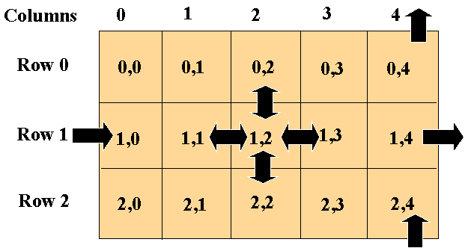
Matrix Representation
Matrix multiplication is possible first matrix columns=second matrix rows

Slide 12
2D arrays manipulations
Declaration:
  int myArray [][];
Creation:
  myArray = new int[3][3]; // OR
  int myArray [][] = int[3][3];
Initialisation:
  Single Value;
    myArray[0][0] = 10;
  Multiple values:
    int tableA[3][3] = {{10, 15, 30}, {14, 30, 33}};
    int tableA[][] = {{10, 15, 30}, {14, 30, 33}};

Slide 13
Try: Write a program to Add to Matrix
Define 2 dimensional matrix variables:
  Say: int a[][], b[][];
Define their size to be 2x2
Initialise like some values
Create a matrix c to storage sum value
  c[0][0] = a[0][0] + b[0][0]
Print the contents of result matrix.

Slide 14
#include<stdio.h> /* MATRIX ADDITION */
main()
{
int a[3][3],b[3][3],c[3][3],i,j; clrscr();
printf("Enter A-Mtrix Elements:");
for(i=0;i<3;i++)
{
for(j=0;j<3;j++)
{
scanf("%d", &a[i][j]);
}
}
printf("Enter B-Matrix Elements:");
for(i=0;i<3;i++)
{
for(j=0;j<3;j++)
{
scanf("%d", &b[i][j]);
}
}
printf("Matrix Addition");
for(i=0;i<3;i++)
{
for(j=0;j<3;j++)
{
c[i][j]=a[i][j]+b[i][j];
printf("\n%d", c[i][j]);
}
}
getch();
}

Slide 15
Arrays
An array can be viewed as a set of indexed variables with the same name.
Declared using the [] notation to indicate the range/size of the array
Elements are indexed using the [] notation, ranging from 0 to one less than the bound
The elements of an array are accessed by an index number that allows random access.
  Advantages: very fast access time, fast write time.
  Disadvantage: Unacceptable memory consumption

Slide 16
6.9 Multiple-Subscripted Arrays
Initialization
  int b[ 2 ][ 2 ] = { { 1, 2 }, { 3, 4 } };
  Initializers grouped by row in braces
  If not enough, unspecified elements set to zero
    int b[ 2 ][ 2 ] = { { 1 }, { 3, 4 } };
Referencing elements
  Specify row, then column
    printf( "%d", b[ 0 ][ 1 ] );
1 2
3 4
1 0
3 4

Slide 17
Multiple-Subscripted Arrays
Multiple subscripted arrays
  Tables with rows and columns (m by n array)
  Like matrices: specify row, then column
Column 0
Column 1
Column 2
Column 3
Row 0
a[ 0 ][ 0] ]
a[ 0 ][ 1] ]
a[ 0 ][ 2] ]
a[ 0 ][ 3] ]
Row 1
a[ 1 ][ 0] ]
a[ 1 ][ 1] ]
a[ 1 ][ 2] ]
a[ 1 ][ 3] ]
Row 2
a[ 2 ][ 0]
a[ 2 ][ 1]
a[ 2 ][ 2]
a[ 2 ][ 3]
Column subscript
Array name
Row subscript

Slide 18
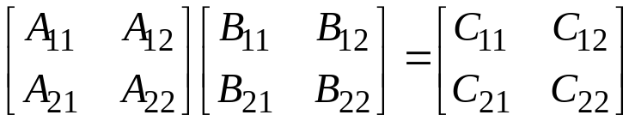
Matrix Multiplication Algorithms:
When multiplying two 2 × 2 matrices [A_{ij}] and [B_{ij}]
The resulting matrix [C_{ij}] is computed by the equations
C₁₁ = A₁₁ B₁₁ + A₁₂ B₂₁
C₁₂ = A₁₁ B₁₂ + A₁₂ B₂₂
C₂₁ = A₂₁ B₁₁ + A₂₂ B₂₁
C₂₂ = A₂₁ B₁₂ + A₂₂ B₂₂
When the size of the matrices are n × n, the amount of computation is O(n³), because there are n² entries in the product matrix where each require O(n) time to compute.

Slide 19
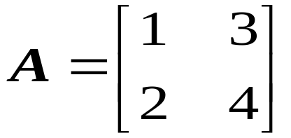
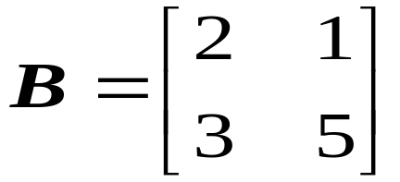
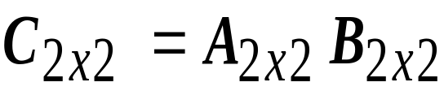
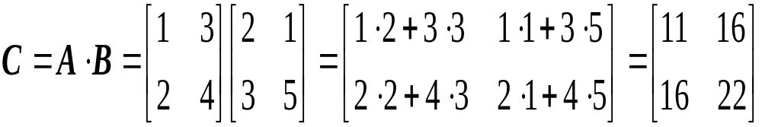
Example - Matrix Multiplication

Slide 20
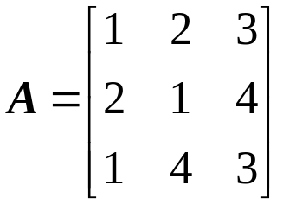
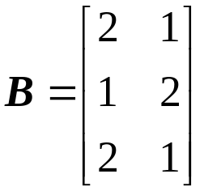
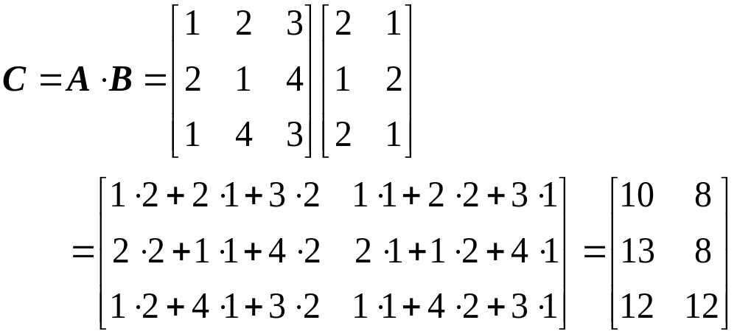

Matrix multiplication is possible when first matrix columns=second matrix rows AND size of the matrix will be get first matrix rows by second matrix columns

Slide 21
#include< stdio.h >
main()
{ int i, j, k, a[2][2],b[2][2],c[2][2];
clrscr();
printf("Enter A-Matrix elements:");
for(i=0;i<2;i++)
{
for(j=0;j<2;j++)
{
scanf("%d", &a[i][j]);
}
}
printf("Enter B-Matrix Elements:");

Slide 22
for(i=0;i<2;i++)
{
for(j=0;j<2;j++)
{
scanf("%d", &b[i][j]);
}
}
printf("Matrix Multiplication");
for(i=0;i<2;i++)
{
for(j=0;j<2;j++)
{
c[i][j]=0;
for(k=0;k<2;k++)
{
c[i][j]=c[i][j]+a[i][k]*b[k][j];
}
printf("%4d", c[i][j]);
}printf(“\n”);
}
getch();
}

Slide 23
Memory Performance
Implementations of Matrix Multiplication
  Multiple ways to nest loops
/* ijk */
for (i=0; i<n; i++) {
for (j=0; j<n; j++) {
sum = 0.0;
for (k=0; k<n; k++)
sum += a[i][k] * b[k][j];
c[i][j] = sum;
}
}
/* jik */
for (j=0; j<n; j++) {
for (i=0; i<n; i++) {
sum = 0.0;
for (k=0; k<n; k++)
sum += a[i][k] * b[k][j];
c[i][j] = sum;
}
}

Slide 24
Arrays as Function Parameters
int sum(int a[ ], int n)
{
int i,s;
for(i=0,sum=0;i<n; i++)
s+=a[n];
return s;
}
int main()
{
int i, c[100];
for(i=0;i<100;i++)
c[i]=i;
printf("The total is %d\n", sum(c,100));
return 0;
}

Slide 25
/* find the largest number in an array */
#include<stdio.h>
#define MAXSIZE 100
main()
{
int n,i,max=0,elements[MAXSIZE];
printf(“enter the no of elements”);
scanf(“%d”,&n);
for(i=0, i<n, i++)
{
printf(“enter value for element %d:”,i);
scanf(%d”,&elements);
}
for(i=0;i<n;i++)
{
if(max<elements[i])
max=elements[i];
}
printf(the maximum is %d”,max);
}

Slide 26
#include< stdio.h >
void creat(int[],int); /* WAP TO SORT THE GIVEN NUMBNERS IN ARRYAS USING FUNCTIONS*/
void sort(int[],int);
main()
{ int i, a[5]; clrscr();
creat(a,5);
printf("\n input array:");
for(i=0;i<5;i++)
printf("%d\t",a[i]);
sort(a,5);
printf("\n sorted array:");
for(i=0;i<5;i++)
printf("%d\t", a[i]);
}
void creat(int a[],int n)
{ int i;
printf("Enter values:");
for(i=0;i<n; i++)
scanf("%d", &a[i]);
}
void sort(int a[],int n)
{ int i, j, temp;
for(i=0;i<n; i++)
for(j=i+1;j<n; j++)
if(a[i]>a[j])
{ temp=a[i];
a[i]=a[j];
a[j]=temp;
}
}

