Slide 1
— Chapter 3 —
Data Warehousing and OLAP Technology:
An Overview

Slide 2
Chapter 3: Data Warehousing and OLAP Technology: An Overview
Data warehouse
Multi-dimensional data model
Data warehouse architecture
Data warehouse implementation
From data warehousing to data mining

Slide 3
What is Data Warehouse?
Defined in many different ways
  A decision support database that is maintained separately from the organization’s operational database
  Support information processing by providing a solid platform of consolidated, historical data for analysis.
“A data warehouse is a subject-oriented, integrated, time-variant, and nonvolatile collection of data in support of management’s decision-making process.”—W. H. Inmon
Data warehousing:
  The process of constructing and using data warehouses

Slide 4
Data Warehouse—Subject-Oriented
Organized around major subjects, such as customer, product, sales
Focusing on the modeling and analysis of data for decision makers, not on daily operations or transaction processing
Provide a simple and concise view around particular subject issues by excluding data that are not useful in the decision support process

Slide 5
Data Warehouse—Integrated
Constructed by integrating multiple, heterogeneous data sources
  relational databases, flat files, on-line transaction records
Data cleaning and data integration techniques are applied.
  Ensure consistency in naming conventions, encoding structures, attribute measures, etc. among different data sources
    E.g., Hotel price: currency, tax, breakfast covered, etc.
  When data is moved to the warehouse, it is converted.

Slide 6
Data Warehouse—Time Variant
The time horizon for the data warehouse is significantly longer than that of operational systems
  Operational database: current value data
  Data warehouse data: provide information from a historical perspective (e.g., past 30-40 years)
Every key structure in the data warehouse
  Contains an element of time, explicitly or implicitly

Slide 7
Data Warehouse—Nonvolatile
A physically separate store of data transformed from the operational environment
Operational update of data does not occur in the data warehouse environment
  Does not require transaction processing, recovery, and concurrency control mechanisms
  Requires only two operations in data accessing:
    initial loading of data and access of data

Slide 8
Data Warehouse vs. Operational DBMS
OLTP (on-line transaction processing)
  Major task of traditional relational DBMS
  Day-to-day operations: purchasing, inventory, banking, manufacturing, payroll, registration, accounting, etc.
OLAP (on-line analytical processing)
  Major task of data warehouse system
  Data analysis and decision making
Distinct features (OLTP vs. OLAP):
  User and system orientation: customer vs. market
  Data contents: current, detailed vs. historical, consolidated
  Database design: ER + application vs. star + subject
  View: current, local vs. evolutionary, integrated
  Access patterns: update vs. read-only but complex queries

Slide 9

OLTP vs. OLAP

Slide 10
Chapter 3: Data Warehousing and OLAP Technology: An Overview
What is a data warehouse?
A multi-dimensional data model
Data warehouse architecture
Data warehouse implementation
From data warehousing to data mining

Slide 11
MULTI-DIMENSIONAL DATA MODEL
1

Slide 12
MULTI-DIMENSIONAL DATA MODEL(MDDM)
Introduction to MDDM.
Components of MDDM.
Data Cube
Types of MDDM.
[A]. Star Schema Model.
[B]. Snow Flake Schema Model.
[C]. Fact Constellations.
5. OLAP Operations.

Slide 13




INTRODUCTION MDDM
The Dimensional Model was Developed for Implementing data warehouse and data marts.
MDDM provide both a mechanism to store data and a way for business analysis.

Slide 14





COMPONENT OF MDDM
The two primary components of dimensional model are Dimensions and Facts.
Dimensions:- Text Attributes
Facts:- Numeric attributes

Slide 15
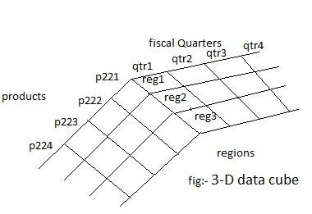
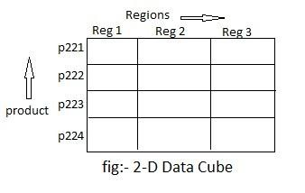
Data Cube
When data is grouped or combined together in
multidimensional matrices called Data Cubes.
In Two Dimension :- Row & Column
e.g:-Rows-Products & Columns-Regions.
In Three Dimension:- regions, products and financial
quarters.

Slide 16
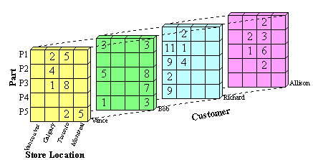

Slide 17
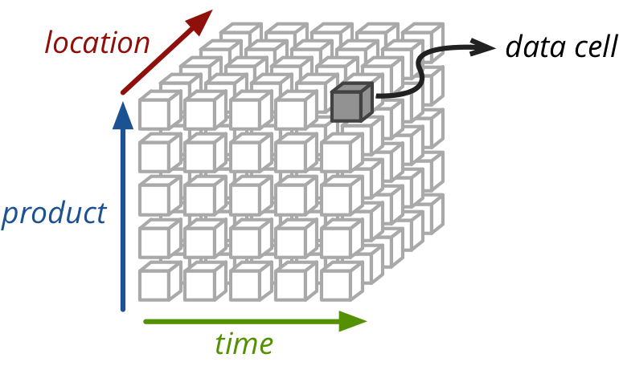

Slide 18
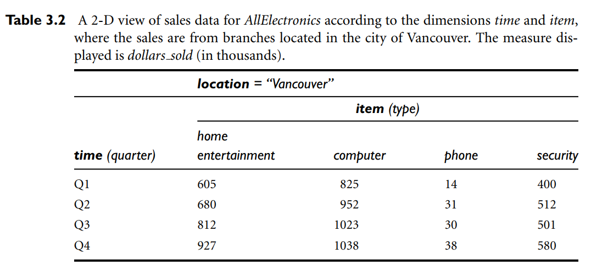
E.g: 2-D Data Model

Slide 19
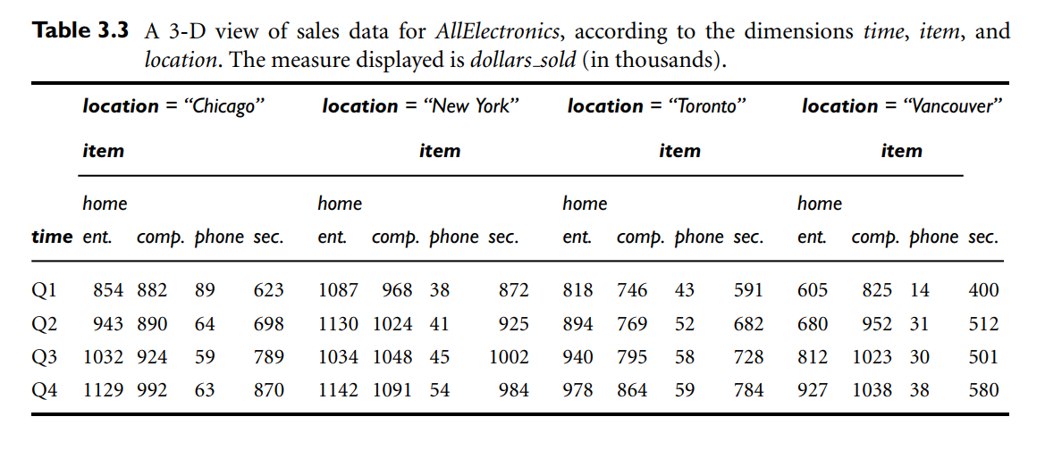
E.g: Multidimensional (3-D) Data Model

Slide 20
The MDDM involve two types of tables:-
1. Dimension Table: -
Consists of tuple of attributes of dimension.
It is Simple Primary Key.
2. Fact Table:-
A Fact table has tuples of numeric attributes, one per a recorded fact.
It is Foreign key reference to dimension tables.

Slide 21


TYPES OF MDDM
[A]. Star Schema Model.
[B]. Snow Flake Schema Model.
[C]. Fact Constellations.

Slide 22
STAR SCHEMA MODEL
It is also known as Star Join Schema.
It is the simplest style of data warehouse schema.
It is called a Star Schema because the entity relationship diagram of this Schema resembles a star, with points radiating from central table.
A star query is a join between a fact table and a no. of
dimension table.
Each dimension table is joined to the fact table using primary key to foreign key join but dimension table are not joined to each other.
A typical fact table contain key and measure.

Slide 23
Example of Star Schema:-
Time
Time_key
Day
Day of Week
Month
Quarter
Year
Item
Item_key
Item_name
Brand
Types
Suppiler_types
Sales Fact Table
Time_key
Item_key
Branch_Key
Location_key
Unit_sold
Dollar_sold
Average_sales
Location
Location_key
Street
City
State
1 Country
Branch
Branch_Key
Branch_name
Branch type
1
Measure
Fig.:-Star Schema model

Slide 24
SNOW FLAKE SCHEMA
It is slightly different from a star schema in which the dimensional tables from a star schema are organized into a hierarchy by normalizing them.
The Snow Flake Schema is represented by centralized fact table which are connected to multiple dimensions.
The Snow Flaking effecting only affecting the dimension tables and not the fact tables.

Slide 25
Example of Snow Flake Schema:-
Time
Time_key
Day
Day of Week
Month
Quarter
Year
Sales Fact Table
Time_key
Item_key
Branch_Key
Location_key
Unit_sold
Dollar_sold
Average_sales
Item
Item_key
Item_name
Brand
Types
Suppiler_types
Supplier
Supplier_key
Supplier_type
Location
Location_key
Street
City _key
Branch
Branch_Key
Branch_name
Branch type
City
City_key
City
State
Country
Fig.:-Snow Flake Schema model
14
Measures

Slide 26
Benefits of Snow flaking:-
It is Easier to implement a snow flak Schema when a multidimensional is added to the typically normalized tables.
A Snow flake schema can reflect the same data to the database.
Difference b/w Star schema and Snow Flake:-
Star Schema Snow Flake
Star Schema dimension are De normalized with each dimension being represented in single table.
Snow flake Schema dimension are normalized
into multiple related tables.
15

Slide 27
FACT CONSTELLATIONS
It is set of fact tables that share some dimensions tables.
It limits the possible queries for the data warehouse.
Fact Table- 1
Product
Quarter
Region
Revenue
Dimension Table
Product No.
Product Name
Product Design
Product Style
Product Line
Fact Table- 2
Product
Future Quarter
Region
Projected
Revenue
Business Result
Product
Fig.:-Fact Constellations
Business 16
Forecast

Slide 28
Cube Definition Syntax in DMQL
Cube Definition (Fact Table)
  define cube <cube_name> [<dimension_list>]: <measure_list>
Dimension Definition (Dimension Table)
  define dimension <dimension_name> as (<attribute_or_subdimension_list>)
Special Case (Shared Dimension Tables)
  First time as “cube definition”
  define dimension <dimension_name> as <dimension_name_first_time> in cube <cube_name_first_time>

Slide 29
Defining Star Schema in DMQL
define cube sales_star [time, item, branch, location]:
    dollars_sold = sum(sales_in_dollars), avg_sales = avg(sales_in_dollars), units_sold = count(*)
define dimension time as (time_key, day, day_of_week, month, quarter, year)
define dimension item as (item_key, item_name, brand, type, supplier_type)
define dimension branch as (branch_key, branch_name, branch_type)
define dimension location as (location_key, street, city, province_or_state, country)

Slide 30
Defining Snowflake Schema in DMQL
define cube sales_snowflake [time, item, branch, location]:
    dollars_sold = sum(sales_in_dollars), avg_sales = avg(sales_in_dollars), units_sold = count(*)
define dimension time as (time_key, day, day_of_week, month, quarter, year)
define dimension item as (item_key, item_name, brand, type, supplier(supplier_key, supplier_type))
define dimension branch as (branch_key, branch_name, branch_type)
define dimension location as (location_key, street, city(city_key, province_or_state, country))

Slide 31
Defining Fact Constellation in DMQL
define cube sales [time, item, branch, location]:
    dollars_sold = sum(sales_in_dollars), avg_sales = avg(sales_in_dollars), units_sold = count(*)
define dimension time as (time_key, day, day_of_week, month, quarter, year)
define dimension item as (item_key, item_name, brand, type, supplier_type)
define dimension branch as (branch_key, branch_name, branch_type)
define dimension location as (location_key, street, city, province_or_state, country)
define cube shipping [time, item, shipper, from_location, to_location]:
    dollar_cost = sum(cost_in_dollars), unit_shipped = count(*)
define dimension time as time in cube sales
define dimension item as item in cube sales
define dimension shipper as (shipper_key, shipper_name, location as location in cube sales, shipper_type)
define dimension from_location as location in cube sales
define dimension to_location as location in cube sales

Slide 32
Multidimensional Data
Sales volume as a function of product, month, and region
Dimensions: Product, Location, Time
Hierarchical summarization paths
Region
Industry Region Year
Category Country Quarter
Product City Month Week
Office Day
Product
Month

Slide 33
OLAP Operations
List of OLAP Operations:
Roll up (drill-up)
Drill down (roll-down)
Slicing
Dicing
Pivot (rotate)

Slide 34
Roll-up (Drill-up)
Roll-up performs aggregation on a data cube in any of the following ways −
By climbing up a concept hierarchy for a dimension
By dimension reduction

Slide 35
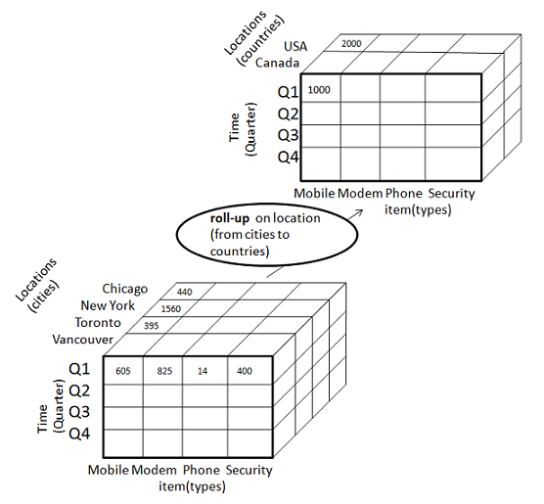
Example:

Slide 36
Drill-Down (Roll-Down)
Drill-down is the reverse operation of roll-up. It is performed by either of the following ways −
By stepping down a concept hierarchy for a dimension
By introducing a new dimension.

Slide 37
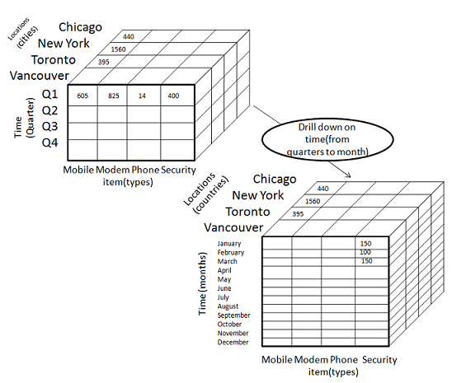
Example:

Slide 38
Slicing
The slice operation selects one particular dimension from a given cube and provides a new view.

Slide 39
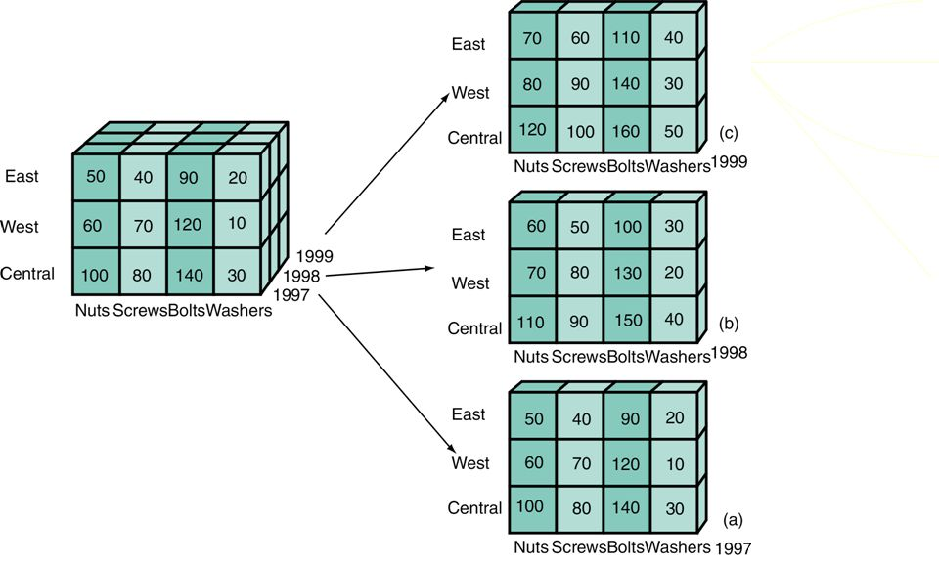
Example-Slicing

Slide 40
Dicing
Dice selects two or more dimensions from a given cube and provides a new sub-cube.

Slide 41
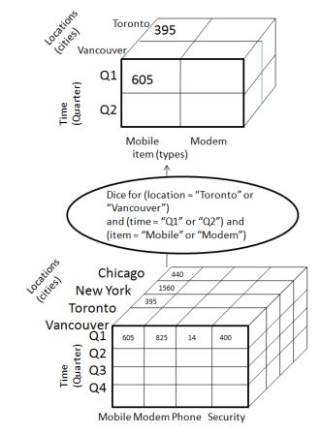
Example-Dicing

Slide 42
Pivot (Rotate)
The pivot operation is also known as rotation. It rotates the data axes in view in order to provide an alternative presentation of data

Slide 43
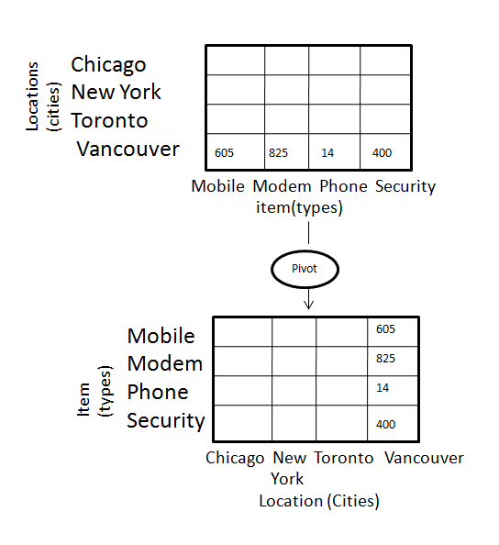
Example:

Slide 44
Chapter 3: Data Warehousing and OLAP Technology: An Overview
What is a data warehouse?
A multi-dimensional data model
Data warehouse architecture
Data warehouse implementation
From data warehousing to data mining

Slide 45
Design of Data Warehouse: A Business Analysis Framework
Four views regarding the design of a data warehouse
  Top-down view
    allows selection of the relevant information necessary for the data warehouse
  Data source view
    exposes the information being captured, stored, and managed by operational systems
  Data warehouse view
    consists of fact tables and dimension tables
  Business query view
    sees the perspectives of data in the warehouse from the view of end-user

Slide 46
Data Warehouse Design Process
Top-down, bottom-up approaches or a combination of both
  Top-down: Starts with overall design and planning (mature)
  Bottom-up: Starts with experiments and prototypes (rapid)
From software engineering point of view
  Waterfall: structured and systematic analysis at each step before proceeding to the next
  Spiral: rapid generation of increasingly functional systems, short turn around time, quick turn around
Typical data warehouse design process
  Choose a business process to model, e.g., orders, invoices, etc.
  Choose the dimensions that will apply to each fact table record
  Choose the measure that will populate each fact table record

Slide 47
Data Warehouse: A Multi-Tiered Architecture
Monitor
&
Integrator
OLAP Server
Other
sources
Metadata
Analysis
Query
Reports
Data mining
Operational
DBs
Extract
Transform
Load
Refresh
Data
Warehouse
Serve
Data Marts
Data Sources
Data Storage
OLAP Engine
Front-End Tools

Slide 48
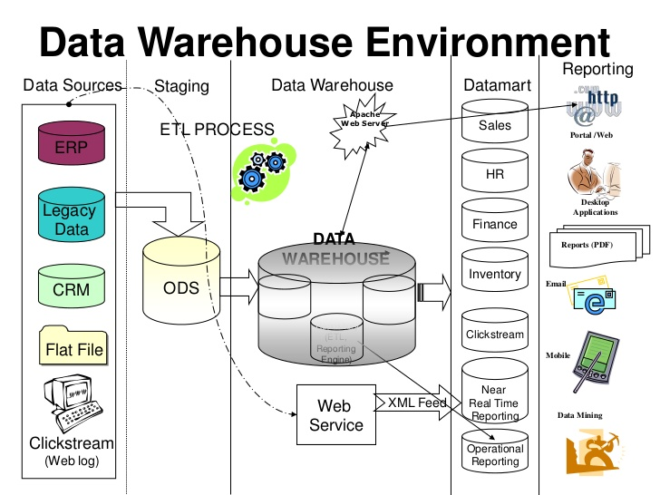

Slide 49
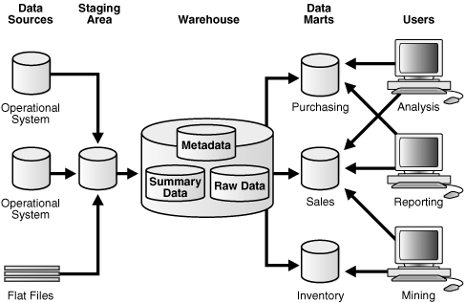

Slide 50
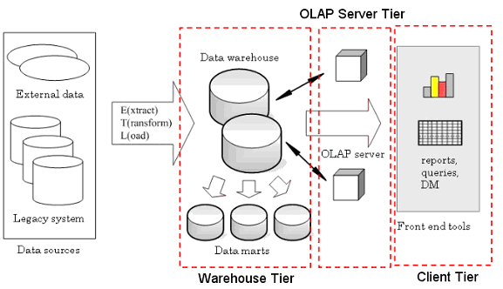

Slide 51
Three Data Warehouse Models
Enterprise warehouse
  collects all of the information about subjects spanning the entire organization
Data Mart
  a subset of corporate-wide data that is of value to a specific groups of users. Its scope is confined to specific, selected groups, such as marketing data mart
Virtual warehouse
  A set of views over operational databases
  Only some of the possible summary views may be materialized

Slide 52
Data Warehouse Back-End Tools and Utilities
Data extraction
  get data from multiple, heterogeneous, and external sources
Data cleaning
  detect errors in the data and rectify them when possible
Data transformation
  convert data from legacy or host format to warehouse format
Load
  sort, summarize, consolidate, compute views, check integrity, and build indicies and partitions
Refresh
  propagate the updates from the data sources to the warehouse

Slide 53
Metadata Repository
Meta data is the data defining warehouse objects. It stores:
Description of the structure of the data warehouse
  schema, view, dimensions, hierarchies, derived data defn, data mart locations and contents
Operational meta-data
  data lineage (history of migrated data and transformation path), currency of data (active, archived, or purged), monitoring information (warehouse usage statistics, error reports, audit trails)
The algorithms used for summarization
The mapping from operational environment to the data warehouse
Data related to system performance
  warehouse schema, view and derived data definitions
Business data
  business terms and definitions, ownership of data, charging policies

Slide 54
OLAP Server Architectures
Relational OLAP (ROLAP)
  Use relational or extended-relational DBMS to store and manage warehouse data and OLAP middle ware
  Include optimization of DBMS backend, implementation of aggregation navigation logic, and additional tools and services
  Greater scalability
Multidimensional OLAP (MOLAP)
  Sparse array-based multidimensional storage engine
  Fast indexing to pre-computed summarized data
Hybrid OLAP (HOLAP) (e.g., Microsoft SQL Server)
  Flexibility, e.g., low level: relational, high-level: array

Slide 55
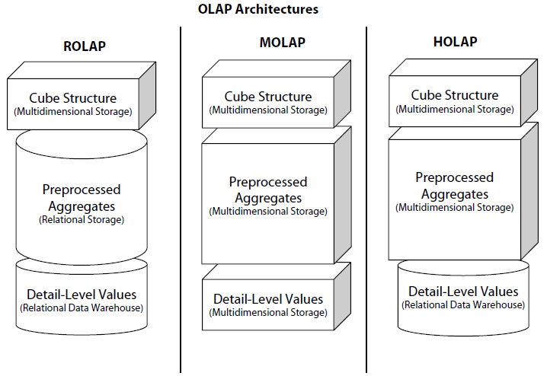

Slide 56
Chapter 3: Data Warehousing and OLAP Technology: An Overview
What is a data warehouse?
A multi-dimensional data model
Data warehouse architecture
Data warehouse implementation
From data warehousing to data mining

Slide 57
Data Warehouse Implementation
Data Warehouse Implementation is having the following techniques:
1) Efficient data cube computation.
2) Compute cube operation.
3) Indexing OLAP data: bitmap index.
4) Indexing OLAP data: join indices.
5) Efficient processing OLAP queries.

Slide 58
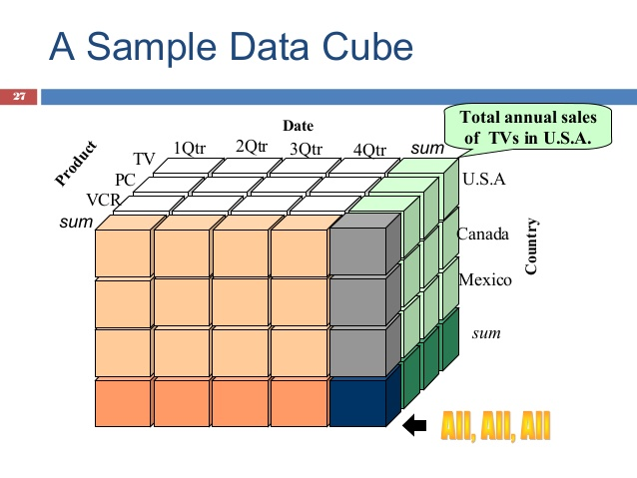

Slide 59
1) Efficient data cube computation
Data cube can be viewed as a lattice of cuboids. The bottom-most cuboids is the base cuboids.
The top-most cuboids (apex) contains only one cell.
.

Slide 60
0-D(apex) cuboid
all
product
date
country
1-D cuboids
product,date
product,country
date, country
2-D cuboids
3-D(base) cuboid
product, date, country

Slide 61
2) Compute Cube Operation
Cube definition and computation in DMQL
    define cube sales[item, city, year]: sum(sales_in_dollars)
    compute cube sales
Transform it into a SQL-like language
SELECT item, city, year, SUM (amount)
    FROM SALES
    CUBE BY item, city, year

Slide 62
3) Indexing OLAP data: bitmap index
Index on a particular column
Each value in the column has a bit vector: bit-op is fast
The length of the bit vector: # of records in the base table
The i-th bit is set if the i-th row of the base table has the value for the indexed column
not suitable for high cardinality domains
Base table
Index on Region Index on Type
RecI | D Asia | Europe | America
1 | 1 | 0 | 0
2 | 0 | 1 | 0
3 | 1 | 0 | 0
4 | 0 | 0 | 1
5 | 0 | 1 | 0
RecID | Retail | Dealer
1 | 1 | 0
2 3 | 0 0 | 1 1
4 | 1 | 0
5 | 0 | 1
Cust | Region | Type
C1 | Asia | Retail
C2 | Europe | Dealer
C3 | Asia | Dealer
C4 | America | Retail
C5 | Europe | Dealer

Slide 63
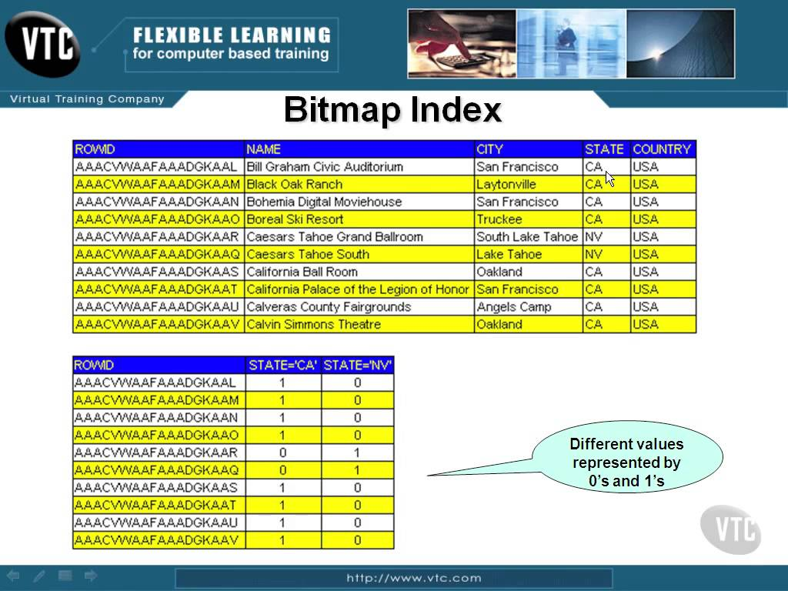

Slide 64
4) Indexing OLAP data: join indices
Traditional indices map the values to a list of record ids
  It materializes relational join in JI file and speeds up relational join — a rather costly operation
In data warehouses, join index relates the values of the dimensions of a start schema to rows in the fact table.
  E.g. fact table: Sales and two dimensions city and product
    A join index on city maintains for each distinct city a list of R-IDs of the tuples recording the Sales in the city
  Join indices can span multiple dimensions

Slide 65



Slide 66

○ Determine which operations should be performed on the available cuboids:
transform drill, roll, etc. into corresponding SQL and/or
OLAP operations, e.g. dice = selection + projection
○ Determine to which materialized cuboids(s) the relevant operations should be applied.

Slide 67
Advantages & Disadvantages of
Data warehousing
Integrating data from multiple sources .
Performing new types of analysis.
Reducing cost to access historical data.
Disadvantages:
The data warehouse can be costly to maintain and that becomes a problem if the warehouse is under utilled.

Slide 68
Chapter 3: Data Warehousing and OLAP Technology: An Overview
What is a data warehouse?
A multi-dimensional data model
Data warehouse architecture
Data warehouse implementation
From data warehousing to data mining

Slide 69
Data Warehouse Usage
Three kinds of data warehouse applications
  Information processing
    supports querying, basic statistical analysis, and reporting using crosstabs, tables, charts and graphs
  Analytical processing
    multidimensional analysis of data warehouse data
    supports basic OLAP operations, slice-dice, drilling, pivoting
  Data mining
    knowledge discovery from hidden patterns
    supports associations, constructing analytical models, performing classification and prediction, and presenting the mining results using visualization tools

Slide 70
From On-Line Analytical Processing (OLAP) to On Line Analytical Mining (OLAM)
Why online analytical mining?
  High quality of data in data warehouses
    DW contains integrated, consistent, cleaned data
  Available information processing structure surrounding data warehouses
    ODBC, OLEDB, Web accessing, service facilities, reporting and OLAP tools
  OLAP-based exploratory data analysis
    Mining with drilling, dicing, pivoting, etc.
  On-line selection of data mining functions
    Integration and swapping of multiple mining functions, algorithms, and tasks

Slide 71
An OLAM System Architecture
Mining query
Mining result
Layer4
User Interface
User GUI API
OLAM
Engine
OLAP
Engine
Layer3
OLAP/OLAM
Data Cube API
Layer2
MDDB
MDDB
Meta Data
Filtering&Integration
Database API
Filtering
Layer1
Data Repository
Data cleaning
Data
Warehouse
Databases
Data integration

Slide 72
Chapter 3: Data Warehousing and OLAP Technology: An Overview
What is a data warehouse?
A multi-dimensional data model
Data warehouse architecture
Data warehouse implementation
From data warehousing to data mining
Summary

Slide 73
Summary: Data Warehouse and OLAP Technology
Why data warehousing?
A multi-dimensional model of a data warehouse
  Star schema, snowflake schema, fact constellations
  A data cube consists of dimensions & measures
OLAP operations: drilling, rolling, slicing, dicing and pivoting
Data warehouse architecture
OLAP servers: ROLAP, MOLAP, HOLAP
Efficient computation of data cubes
  Indexing OALP data: Bitmap index and join index
  OLAP query processing
From OLAP to OLAM (on-line analytical mining)

