Slide 1
Data Mining:
Concepts and Techniques
— Chapter 4 —

Slide 2
Chapter 4: Data Cube Computation and Data Generalization
Efficient Computation of Data Cubes
Further Development of Data Cube & OLAP Technology
Attribute-Oriented Induction ─ An Alternative Data Generalization Method

Slide 3
Efficient Computation of Data Cubes
Preliminary cube computation tricks (Agarwal et al.’96)
Computing full/iceberg cubes: 3 methodologies
  Top-Down: Multi-Way array aggregation (Zhao, Deshpande & Naughton, SIGMOD’97)
  Bottom-Up:
    Bottom-up computation: BUC (Beyer & Ramarkrishnan, SIGMOD’99)
    H-cubing technique (Han, Pei, Dong & Wang: SIGMOD’01)
  Integrating Top-Down and Bottom-Up:
    Star-cubing algorithm (Xin, Han, Li & Wah: VLDB’03)
High-dimensional OLAP: A Minimal Cubing Approach (Li, et al. VLDB’04)
Computing alternative kinds of cubes:
  Partial cube, closed cube, approximate cube, etc.

Slide 4
Preliminary Tricks (Agarwal et al. VLDB’96)
Sorting, hashing, and grouping operations are applied to the dimension attributes in order to reorder and cluster related tuples
Aggregates may be computed from previously computed aggregates, rather than from the base fact table
  Smallest-child: computing a cuboid from the smallest, previously computed cuboid
  Cache-results: caching results of a cuboid from which other cuboids are computed to reduce disk I/Os
  Amortize-scans: computing as many as possible cuboids at the same time to amortize disk reads
  Share-sorts: sharing sorting costs cross multiple cuboids when sort-based method is used
  Share-partitions: sharing the partitioning cost across multiple cuboids when hash-based algorithms are used

Slide 5
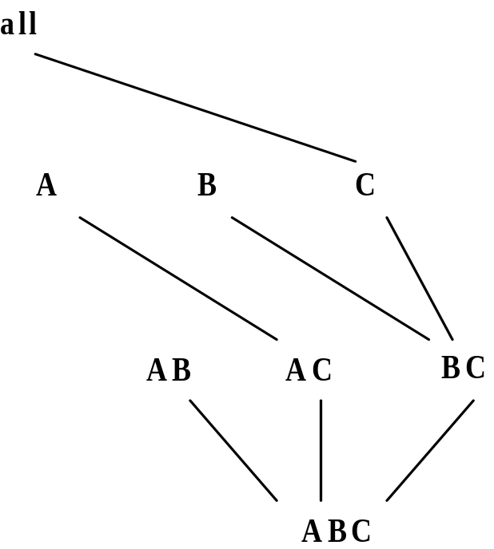
Multi-Way Array Aggregation
Array-based “bottom-up” algorithm
Using multi-dimensional chunks
No direct tuple comparisons
Simultaneous aggregation on multiple dimensions
Intermediate aggregate values are re-used for computing ancestor cuboids
Cannot do Apriori pruning: No iceberg optimization

Slide 6
Multi-way Array Aggregation for Cube Computation (MOLAP)
Partition arrays into chunks (a small subcube which fits in memory).
Compressed sparse array addressing: (chunk_id, offset)
Compute aggregates in “multiway” by visiting cube cells in the order which minimizes the # of times to visit each cell, and reduces memory access and storage cost.
C
c3
61
62
63
64
c2
45
46
47
48
c1
29
30
31
32
What is the best traversing order to do multi-way aggregation?
c 0
B
60
b3
13
14
15
16
44
9
28
56
b2
B
40
24
52
b1
5
36
20
b0
1
2
3
4
a0
a1
a2
a3
A

Slide 7
Multi-way Array Aggregation for Cube Computation
C
c3
61
62
63
64
c2
45
46
47
48
c1
29
30
31
32
c 0
B
60
b3
13
14
15
16
44
B
9
28
56
b2
40
5
24
52
b1
36
20
b0
1
2
3
4
a0
a1
a2
a3
A

Slide 8
Multi-way Array Aggregation for Cube Computation
C
c3
61
62
63
64
c2
45
46
47
48
c1
29
30
31
32
c 0
B
60
b3
13
14
15
16
44
B
9
28
56
b2
40
5
24
52
b1
36
20
b0
1
2
3
4
a0
a1
a2
a3
A

Slide 9
Multi-Way Array Aggregation for Cube Computation (Cont.)
Method: the planes should be sorted and computed according to their size in ascending order
  Idea: keep the smallest plane in the main memory, fetch and compute only one chunk at a time for the largest plane
Limitation of the method: computing well only for a small number of dimensions
  If there are a large number of dimensions, “top-down” computation and iceberg cube computation methods can be explored

Slide 10
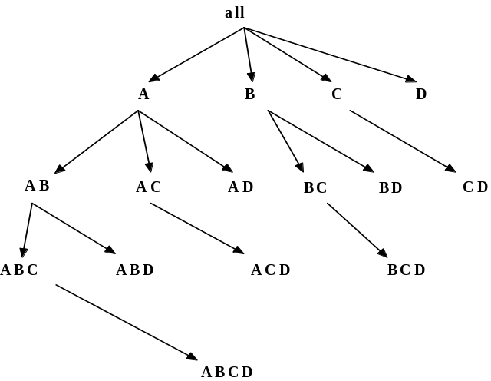
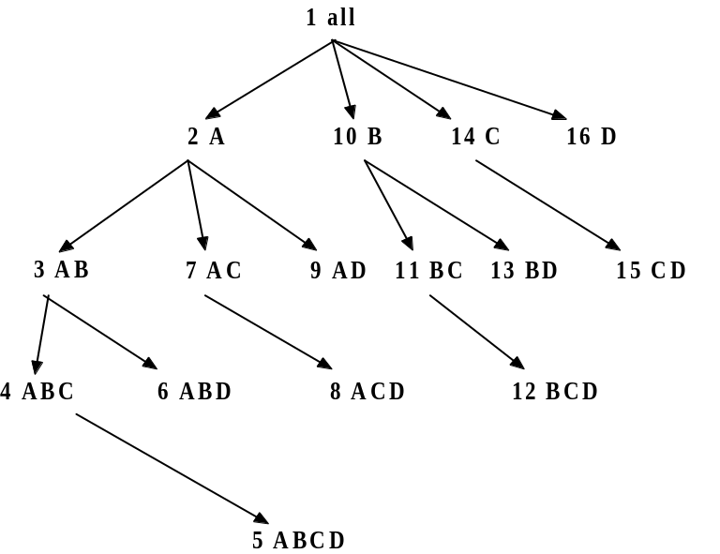
Bottom-Up Computation (BUC)
BUC (Beyer & Ramakrishnan, SIGMOD’99)
Bottom-up cube computation
  (Note: top-down in our view!)
Divides dimensions into partitions and facilitates iceberg pruning
  If a partition does not satisfy min_sup, its descendants can be pruned
  If minsup = 1 ⇒ compute full CUBE!
No simultaneous aggregation

Slide 11

BUC: Partitioning
Usually, entire data set can’t fit in main memory
Sort distinct values, partition into blocks that fit
Continue processing
Optimizations
  Partitioning
    External Sorting, Hashing, Counting Sort
  Ordering dimensions to encourage pruning
    Cardinality, Skew, Correlation
  Collapsing duplicates
    Can’t do holistic aggregates anymore!

Slide 12
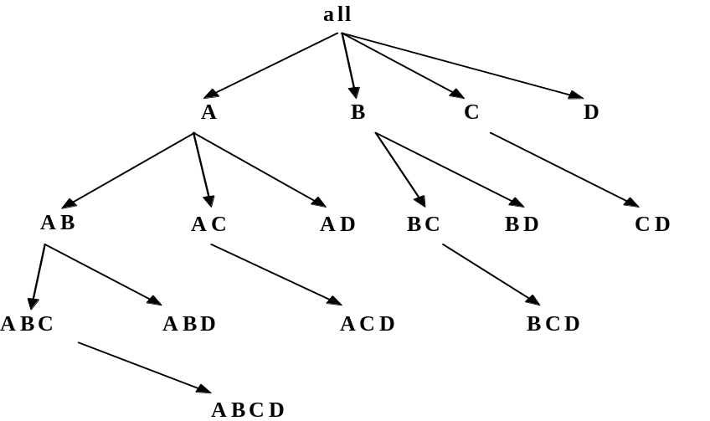
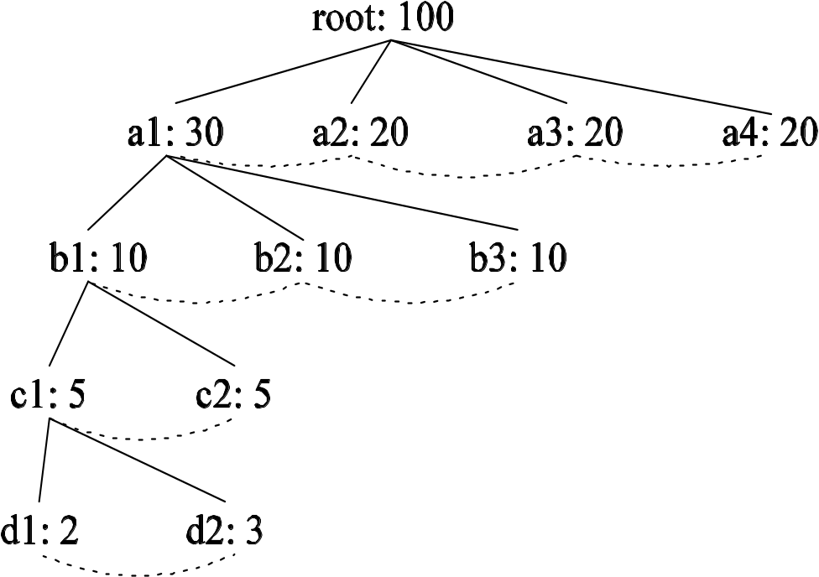
H-Cubing: Using H-Tree Structure
Bottom-up computation
Exploring an H-tree structure
If the current computation of an H-tree cannot pass min_sup, do not proceed further (pruning)
No simultaneous aggregation

Slide 13
H-tree: A Prefix Hyper-tree
Attr. Val. | Quant-Info | Side-link
Edu | Sum:2285 …
Hhd | …
Bus | …
… | …
Jan | …
Feb | …
… | …
Tor | …
Van | …
Mon | …
… | …
root
Header
table
hhd
bus
edu
Jan
Mar
Jan
Feb
Tor
Van
Tor
Mon
Month | City | Cust_grp | Prod | Cost | Price
Jan | Tor | Edu | Printer | 500 | 485
Jan | Tor | Hhd | TV | 800 | 1200
Jan | Tor | Edu | Camera | 1160 | 1280
Feb | Mon | Bus | Laptop | 1500 | 2500
Mar | Van | Edu | HD | 540 | 520
… | … | … | … | … | …
Quant-Info
Sum: 1765 Cnt: 2
bins
Q.I.
Q.I.
Q.I.

Slide 14
H-Cubing: Computing Cells Involving Dimension City
Attr. Val. | Q.I. | Side-link
Edu | …
Hhd | …
Bus | …
… | …
Jan | …
Feb | …
… | …
From (*, *, Tor) to (*, Jan, Tor)
Header
Table
H_{Tor}
root
Edu.
Hhd.
Bus.
Attr. Val. | Quant-Info | Side-link
Edu | Sum:2285 …
Hhd | …
Bus | …
… | …
Jan | …
Feb | …
… | …
Tor | …
Van | …
Mon | …
… | …
Jan.
Mar.
Jan.
Feb.
Tor.
Van.
Tor.
Mon.
Quant-Info
Sum: 1765 Cnt: 2
bins
Q.I.
Q.I.
Q.I.

Slide 15
Computing Cells Involving Month But No City
Roll up quant-info
Compute cells involving month but no city
root
Edu.
Hhd.
Bus.
Attr. Val. | Quant-Info | Side-link
Edu. | Sum:2285 …
Hhd. | …
Bus. | …
… | …
Jan. | …
Feb. | …
Mar. | …
… | …
Tor. | …
Van. | …
Mont. | …
… | …
Jan.
Mar.
Jan.
Feb.
Q.I.
Q.I.
Q.I.
Q.I.
Tor.
Van.
Tor.
Mont.
Top-k OK mark: if Q.I. in a child passes top-k avg threshold, so does its parents. No binning is needed!

Slide 16
Computing Cells Involving Only Cust_grp
root
Check header table directly
hhd
bus
edu
Attr. Val. | Quant-Info | Side-link
Edu | Sum:2285 …
Hhd | …
Bus | …
… | …
Jan | …
Feb | …
Mar | …
… | …
Tor | …
Van | …
Mon | …
… | …
Jan
Mar
Jan
Feb
Q.I.
Q.I.
Q.I.
Q.I.
Tor
Van
Tor
Mon

Slide 17
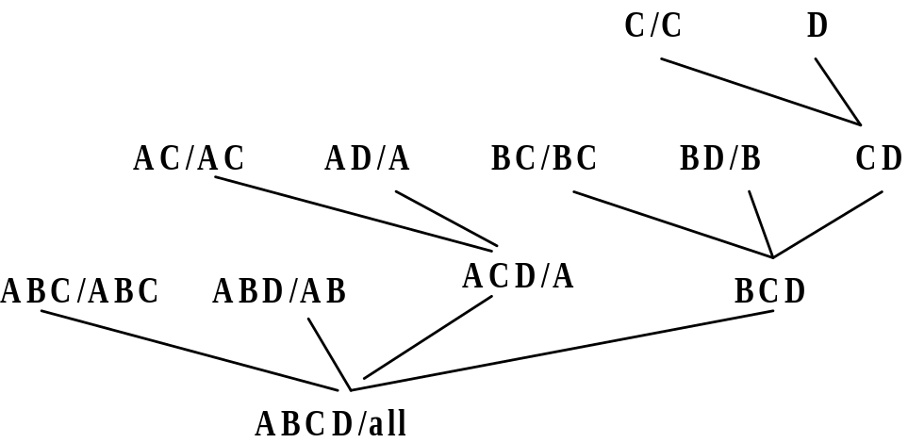
Star-Cubing: An Integrating Method
Integrate the top-down and bottom-up methods
Explore shared dimensions
  E.g., dimension A is the shared dimension of ACD and AD
  ABD/AB means cuboid ABD has shared dimensions AB
Allows for shared computations
  e.g., cuboid AB is computed simultaneously as ABD
Aggregate in a top-down manner but with the bottom-up sub-layer underneath which will allow Apriori pruning
Shared dimensions grow in bottom-up fashion

Slide 18
Iceberg Pruning in Shared Dimensions
Anti-monotonic property of shared dimensions
  If the measure is anti-monotonic, and if the aggregate value on a shared dimension does not satisfy the iceberg condition, then all the cells extended from this shared dimension cannot satisfy the condition either
Intuition: if we can compute the shared dimensions before the actual cuboid, we can use them to do Apriori pruning
Problem: how to prune while still aggregate simultaneously on multiple dimensions?

Slide 19
Cell Trees
Use a tree structure similar to H-tree to represent cuboids
Collapses common prefixes to save memory
Keep count at node
Traverse the tree to retrieve a particular tuple

Slide 20
Star Attributes and Star Nodes
Intuition: If a single-dimensional aggregate on an attribute value p does not satisfy the iceberg condition, it is useless to distinguish them during the iceberg computation
  E.g., b₂, b₃, b₄, c₁, c₂, c₄, d₁, d₂, d₃
Solution: Replace such attributes by a *. Such attributes are star attributes, and the corresponding nodes in the cell tree are star nodes
A | B | C | D | Count
a1 | b1 | c1 | d1 | 1
a1 | b1 | c4 | d3 | 1
a1 | b2 | c2 | d2 | 1
a2 | b3 | c3 | d4 | 1
a2 | b4 | c3 | d4 | 1

Slide 21
Example: Star Reduction
Suppose minsup = 2
Perform one-dimensional aggregation. Replace attribute values whose count < 2 with *. And collapse all *’s together
Resulting table has all such attributes replaced with the star-attribute
With regards to the iceberg computation, this new table is a loseless compression of the original table
A | B | C | D | Count
a1 | b1 | * | * | 1
a1 | b1 | * | * | 1
a1 | * | * | * | 1
a2 | * | c3 | d4 | 1
a2 | * | c3 | d4 | 1
A | B | C | D | Count
a1 | b1 | * | * | 2
a1 | * | * | * | 1
a2 | * | c3 | d4 | 2

Slide 22
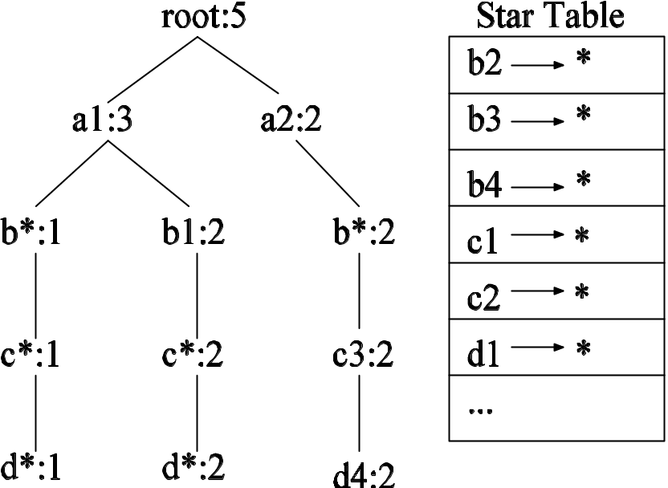
Star Tree
Given the new compressed table, it is possible to construct the corresponding cell tree—called star tree
Keep a star table at the side for easy lookup of star attributes
The star tree is a loseless compression of the original cell tree

Slide 23
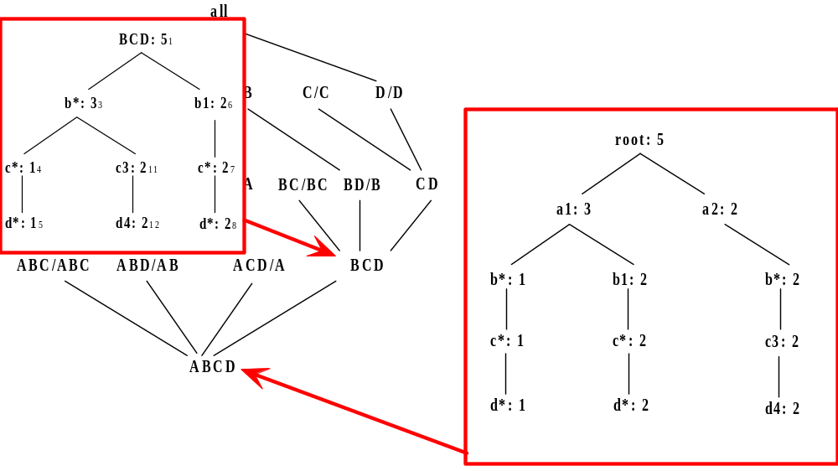
Star-Cubing Algorithm—DFS on Lattice Tree

Slide 24
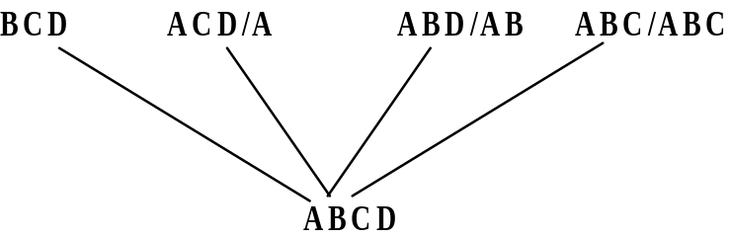
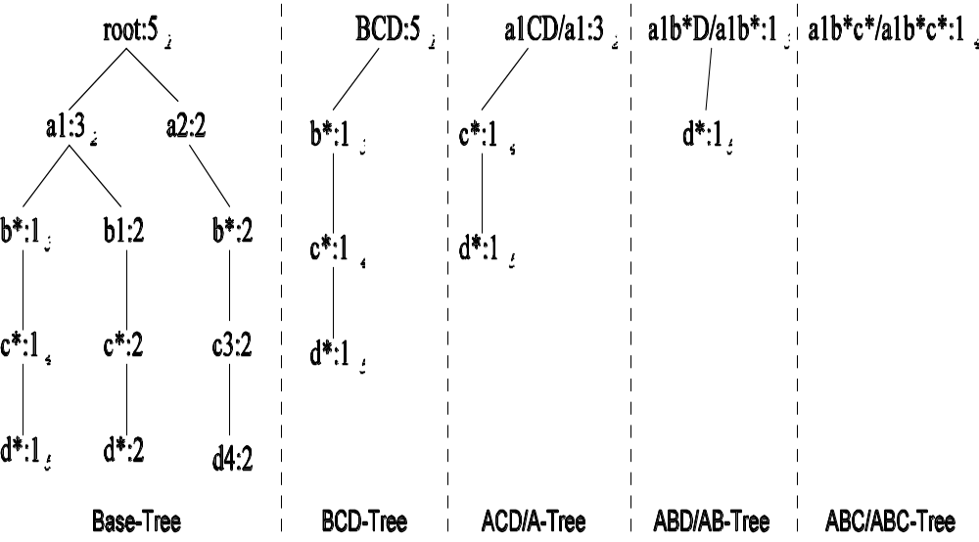
Multi-Way Aggregation

Slide 25
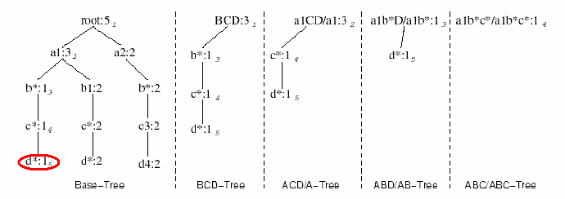
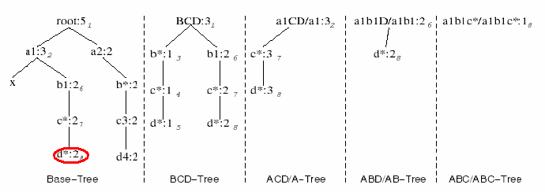
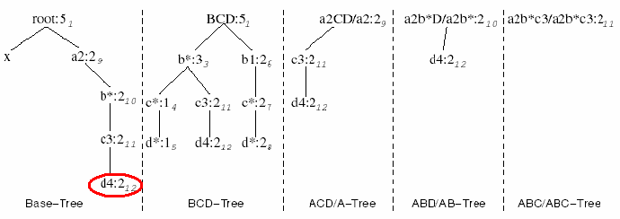
Star-Cubing Algorithm—DFS on Star-Tree

Slide 26
Multi-Way Star-Tree Aggregation
Start depth-first search at the root of the base star tree
At each new node in the DFS, create corresponding star tree that are descendents of the current tree according to the integrated traversal ordering
  E.g., in the base tree, when DFS reaches a1, the ACD/A tree is created
  When DFS reaches b*, the ABD/AD tree is created
The counts in the base tree are carried over to the new trees
Notes:
Refer to the aggregation diagram.

Slide 27
Multi-Way Aggregation (2)
When DFS reaches a leaf node (e.g., d*), start backtracking
On every backtracking branch, the count in the corresponding trees are output, the tree is destroyed, and the node in the base tree is destroyed
Example
  When traversing from d* back to c*, the a1b*c*/a1b*c* tree is output and destroyed
  When traversing from c* back to b*, the a1b*D/a1b* tree is output and destroyed
  When at b*, jump to b1 and repeat similar process

Slide 28
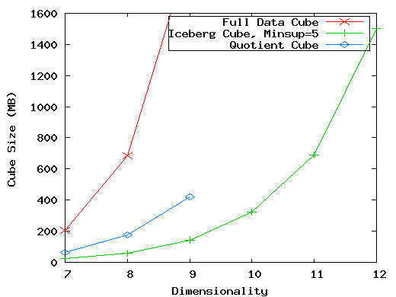
The Curse of Dimensionality
None of the previous cubing method can handle high dimensionality!
A database of 600k tuples. Each dimension has cardinality of 100 and zipf of 2.

Slide 29
Motivation of High-D OLAP
Challenge to current cubing methods:
  The “curse of dimensionality’’ problem
  Iceberg cube and compressed cubes: only delay the inevitable explosion
  Full materialization: still significant overhead in accessing results on disk
High-D OLAP is needed in applications
  Science and engineering analysis
  Bio-data analysis: thousands of genes
  Statistical surveys: hundreds of variables

Slide 30
Fast High-D OLAP with Minimal Cubing
Observation: OLAP occurs only on a small subset of dimensions at a time
Semi-Online Computational Model
  Partition the set of dimensions into shell fragments
  Compute data cubes for each shell fragment while retaining inverted indices or value-list indices
  Given the pre-computed fragment cubes, dynamically compute cube cells of the high-dimensional data cube online

Slide 31
Properties of Proposed Method
Partitions the data vertically
Reduces high-dimensional cube into a set of lower dimensional cubes
Online re-construction of original high-dimensional space
Lossless reduction
Offers tradeoffs between the amount of pre-processing and the speed of online computation

Slide 32
Example Computation
Let the cube aggregation function be count
Divide the 5 dimensions into 2 shell fragments:
  (A, B, C) and (D, E)
tid | A | B | C | D | E
1 | a1 | b1 | c1 | d1 | e1
2 | a1 | b2 | c1 | d2 | e1
3 | a1 | b2 | c1 | d1 | e2
4 | a2 | b1 | c1 | d1 | e2
5 | a2 | b1 | c1 | d1 | e3

Slide 33
1-D Inverted Indices
Build traditional invert index or RID list
Attribute Value | TID List | List Size
a1 | 1 2 3 | 3
a2 | 4 5 | 2
b1 | 1 4 5 | 3
b2 | 2 3 | 2
c1 | 1 2 3 4 5 | 5
d1 | 1 3 4 5 | 4
d2 | 2 | 1
e1 | 1 2 | 2
e2 | 3 4 | 2
e3 | 5 | 1

Slide 34


Shell Fragment Cubes
Generalize the 1-D inverted indices to multi-dimensional ones in the data cube sense
Cell | Intersection | TID List | List Size
a1 b1 | 1 2 3 1 4 5 | 1 | 1
a1 b2 | 1 2 3 2 3 | 2 3 | 2
a2 b1 | 4 5 1 4 5 | 4 5 | 2
a2 b2 | 4 5 2 3 |  | 0

Slide 35
Shell Fragment Cubes (2)
Compute all cuboids for data cubes ABC and DE while retaining the inverted indices
For example, shell fragment cube ABC contains 7 cuboids:
  A, B, C
  AB, AC, BC
  ABC
This completes the offline computation stage

Slide 36
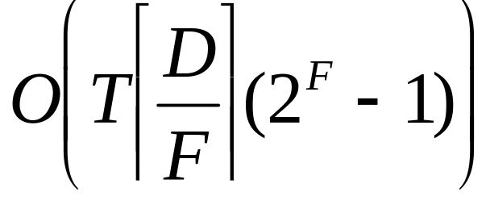
Shell Fragment Cubes (3)
Given a database of T tuples, D dimensions, and F shell fragment size, the fragment cubes’ space requirement is:
For F < 5, the growth is sub-linear.

Slide 37
Shell Fragment Cubes (4)
Shell fragments do not have to be disjoint
Fragment groupings can be arbitrary to allow for maximum online performance
  Known common combinations (e.g.,<city, state>) should be grouped together.
Shell fragment sizes can be adjusted for optimal balance between offline and online computation

Slide 38
ID_Measure Table
If measures other than count are present, store in ID_measure table separate from the shell fragments
tid | count | sum
1 | 5 | 70
2 | 3 | 10
3 | 8 | 20
4 | 5 | 40
5 | 2 | 30

Slide 39
The Frag-Shells Algorithm
Partition set of dimension (A₁,…,A_{n}) into a set of k fragments (P₁,…,P_{k}).
Scan base table once and do the following
insert <tid, measure> into ID_measure table.
for each attribute value a_{i} of each dimension A_{i}
build inverted index entry <a_{i}, tidlist>
For each fragment partition P_{i}
build local fragment cube S_{i} by intersecting tid-lists in bottom- up fashion.

Slide 40
Frag-Shells (2)
Dimensions
D Cuboid
EF Cuboid
A | B | C | D | E | F | …
DE Cuboid
Cell | Tuple-ID List
d1 e1 | {1, 3, 8, 9}
d1 e2 | {2, 4, 6, 7}
d2 e1 | {5, 10}
… | …
ABC
Cube
DEF
Cube

Slide 41


Online Query Computation
A query has the general form
Each a_{i} has 3 possible values
  Instantiated value
  Aggregate * function
  Inquire ? function
For example, returns a 2-D data cube.

Slide 42
Online Query Computation (2)
Given the fragment cubes, process a query as follows
  Divide the query into fragment, same as the shell
  Fetch the corresponding TID list for each fragment from the fragment cube
  Intersect the TID lists from each fragment to construct instantiated base table
  Compute the data cube using the base table with any cubing algorithm

Slide 43
Online Query Computation (3)
A | B | C | D | E | F | G | H | I | J | K | L | M | N | …
Instantiated
Base Table
Online
Cube

Slide 44
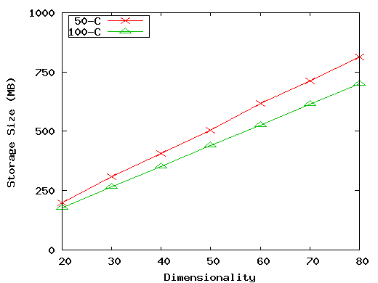
Experiment: Size vs. Dimensionality (50 and 100 cardinality)
(50-C): 10⁶ tuples, 0 skew, 50 cardinality, fragment size 3.
(100-C): 10⁶ tuples, 2 skew, 100 cardinality, fragment size 2.

Slide 45
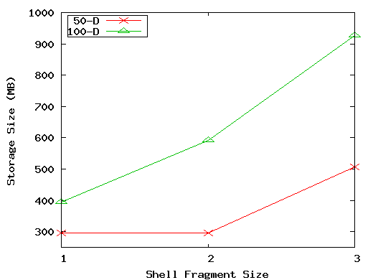
Experiment: Size vs. Shell-Fragment Size
(50-D): 10⁶ tuples, 50 dimensions, 0 skew, 50 cardinality.
(100-D): 10⁶ tuples, 100 dimensions, 2 skew, 25 cardinality.

Slide 46
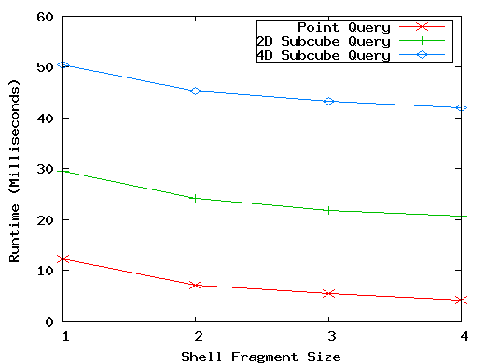
Experiment: Run-time vs. Shell-Fragment Size
10⁶ tuples, 20 dimensions, 10 cardinality, skew 1, fragment size 3, 3 instantiated dimensions.

Slide 47
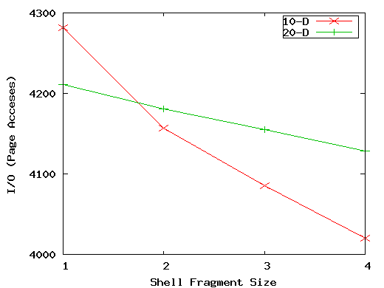
Experiment: I/O vs. Shell-Fragment Size
(10-D): 10⁶ tuples, 10 dimensions, 10 cardinalty, 0 skew, 4 inst., 4 query.
(20-D): 10⁶ tuples, 20 dimensions, 10 cardinalty, 1 skew, 3 inst., 4 query.

Slide 48
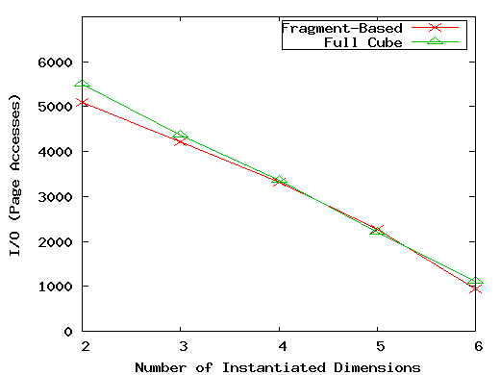
Experiment: I/O vs. # of Instantiated Dimensions
10⁶ tuples, 10 dimensions, 10 cardinalty, 0 skew, fragment size 1, 7 total relevant dimensions.

Slide 49
Experiments on Real World Data
UCI Forest CoverType data set
  54 dimensions, 581K tuples
  Shell fragments of size 2 took 33 seconds and 325MB to compute
  3-D subquery with 1 instantiate D: 85ms~1.4 sec.
Longitudinal Study of Vocational Rehab. Data
  24 dimensions, 8818 tuples
  Shell fragments of size 3 took 0.9 seconds and 60MB to compute
  5-D query with 0 instantiated D: 227ms~2.6 sec.

Slide 50
Comparisons to Related Work
[Harinarayan96] computes low-dimensional cuboids by further aggregation of high-dimensional cuboids. Opposite of our method’s direction.
Inverted indexing structures [Witten99] focus on single dimensional data or multi-dimensional data with no aggregation.
Tree-stripping [Berchtold00] uses similar vertical partitioning of database but no aggregation.

Slide 51
Further Implementation Considerations
Incremental Update:
  Append more TIDs to inverted list
  Add <tid: measure> to ID_measure table
Incremental adding new dimensions
  Form new inverted list and add new fragments
Bitmap indexing
  May further improve space usage and speed
Inverted index compression
  Store as d-gaps
  Explore more IR compression methods

Slide 52
Computing Cubes with Non-Antimonotonic Iceberg Conditions
Most cubing algorithms cannot compute cubes with non-antimonotonic iceberg conditions efficiently
Example
    CREATE CUBE Sales_Iceberg AS
    SELECT month, city, cust_grp,
    AVG(price), COUNT(*)
    FROM Sales_Infor
    CUBEBY month, city, cust_grp
    HAVING AVG(price) >= 800 AND
    COUNT(*) >= 50
Needs to study how to push constraint into the cubing process

Slide 53
Non-Anti-Monotonic Iceberg Condition
Anti-monotonic: if a process fails a condition, continue processing will still fail
The cubing query with avg is non-anti-monotonic!
  (Mar, *, *, 600, 1800) fails the HAVING clause
  (Mar, *, Bus, 1300, 360) passes the clause
Month | City | Cust_grp | Prod | Cost | Price
Jan | Tor | Edu | Printer | 500 | 485
Jan | Tor | Hld | TV | 800 | 1200
Jan | Tor | Edu | Camera | 1160 | 1280
Feb | Mon | Bus | Laptop | 1500 | 2500
Mar | Van | Edu | HD | 540 | 520
… | … | … | … | … | …
CREATE CUBE Sales_Iceberg AS
SELECT month, city, cust_grp,
AVG(price), COUNT(*)
FROM Sales_Infor
CUBEBY month, city, cust_grp
HAVING AVG(price) >= 800 AND
COUNT(*) >= 50

Slide 54
From Average to Top-k Average
Let (*, Van, *) cover 1,000 records
  Avg(price) is the average price of those 1000 sales
  Avg⁵⁰(price) is the average price of the top-50 sales (top-50 according to the sales price
Top-k average is anti-monotonic
  The top 50 sales in Van. is with avg(price) <= 800 → the top 50 deals in Van. during Feb. must be with avg(price) <= 800
Month | City | Cust_grp | Prod | Cost | Price
… | … | … | … | … | …

Slide 55
Binning for Top-k Average
Computing top-k avg is costly with large k
Binning idea
  Avg⁵⁰(c) >= 800
  Large value collapsing: use a sum and a count to summarize records with measure >= 800
    If count>=800, no need to check “small” records
  Small value binning: a group of bins
    One bin covers a range, e.g., 600~800, 400~600, etc.
    Register a sum and a count for each bin

Slide 56
Computing Approximate top-k average
Suppose for (*, Van, *), we have
Approximate avg⁵⁰()=
(28000+10600+600*15)/50=952
Range | Sum | Count
Over 800 | 28000 | 20
600~800 | 10600 | 15
400~600 | 15200 | 30
… | … | …
Top 50
The cell may pass the HAVING clause
Month | City | Cust_grp | Prod | Cost | Price
… | … | … | … | … | …

Slide 57
Weakened Conditions Facilitate Pushing
Accumulate quant-info for cells to compute average iceberg cubes efficiently
  Three pieces: sum, count, top-k bins
  Use top-k bins to estimate/prune descendants
  Use sum and count to consolidate current cell
weakest
strongest
Approximate avg⁵⁰() Anti-monotonic, can be computed efficiently |  | real avg⁵⁰() Anti-monotonic, but computationally costly |  | avg() Not anti-monotonic

Slide 58
Computing Iceberg Cubes with Other Complex Measures
Computing other complex measures
  Key point: find a function which is weaker but ensures certain anti-monotonicity
Examples
  Avg() ≤ v: avg_{k}(c) ≤ v (bottom-k avg)
  Avg() ≥ v only (no count): max(price) ≥ v
  Sum(profit) (profit can be negative):
    p_sum(c) ≥ v if p_count(c) ≥ k; or otherwise, sum^{k}(c) ≥ v
  Others: conjunctions of multiple conditions

Slide 59
Compressed Cubes: Condensed or Closed Cubes
W. Wang, H. Lu, J. Feng, J. X. Yu, Condensed Cube: An Effective Approach to Reducing Data Cube Size, ICDE’02.
Icerberg cube cannot solve all the problems
  Suppose 100 dimensions, only 1 base cell with count = 10. How many aggregate (non-base) cells if count >= 10?
Condensed cube
  Only need to store one cell (a₁, a₂, …, a₁₀₀, 10), which represents all the corresponding aggregate cells
  Adv.
    Fully precomputed cube without compression
  Efficient computation of the minimal condensed cube
Closed cube
  Dong Xin, Jiawei Han, Zheng Shao, and Hongyan Liu, “C-Cubing: Efficient Computation of Closed Cubes by Aggregation-Based Checking”, ICDE'06.

Slide 60
Chapter 4: Data Cube Computation and Data Generalization
Efficient Computation of Data Cubes
Further Development of Data Cube & OLAP Technology
Attribute-Oriented Induction ─ An Alternative Data Generalization Method

Slide 61
Further Development of Data Cube & OLAP Technology
There are 3 major enhancements in the data cube technology. They are:
Discovery-Driven Exploration of Data Cubes
Multi-Feature Cubes
Constrained Gradient Analysis

Slide 62
1. Discovery-Driven Exploration of Data Cubes
Discovery-driven exploration of data cubes, where anomalies in the data are automatically detected and marked for the user with visual indications.
Discovery-driven (Sarawagi, 1998-Research Paper)
  Effective navigation of large OLAP data cubes
  pre-compute measures indicating exceptions, guide user in the data analysis, at all levels of aggregation
  Exception: significantly different from the value anticipated, based on a statistical model
  Visual Indications such as background color are used to reflect the degree of exception of each cell

Slide 63
Kinds of Exceptions and their Computation
Three measures are used as exception indicators to help identify data anomalies. These measures indicate the degree of surprise that the quantity in a cell holds, with respect to its expected value.
SelfExp: It indicates the degree of surprise of cell relative to other cells at same level of aggregation
InExp: Degree of surprise beneath the cell
PathExp: Degree of surprise beneath cell for each drill-down path

Slide 64

Example: Discovery-Driven Data Cubes

Slide 65
Example: Discovery-Driven Data Cubes
The background color of each cell is based on its SelfExp value.
In addition, a box is drawn around each cell, where the thickness and color of the box are based on its InExp value.
Thick boxes indicate high InExp values. In both cases, the darker the color, the greater the degree of exception.
For example, the dark, thick boxes for sales during July, August, and September signal the user to explore the lower-level aggregations of these cells by drilling down (PathExp).

Slide 66

Example: Discovery-Driven Data Cubes

Slide 67

Example: Discovery-Driven Data Cubes

Slide 68
2. Multi-Feature Cubes
Multi-feature cubes (Ross - IEEE 1998 Research Paper): Compute complex queries involving multiple dependent groups at multiple levels.
Eg.1: Grouping by all subsets of {item, region, month}, find the maximum price in 1997 for each group, and the total sales among all maximum price tuples
    select item, region, month, max(price), sum(R.sales)
    from purchases
    where year = 1997
    cube by item, region, month: R
    such that R.price = max(price)

Slide 69
Multi-Feature Cubes
Eg.2: Complex Query - Grouping by all subsets of (item, region, month),
Find the maximum price in 2004 for each group. Among the maximum price tuples, Find the minimum and maximum item shelf lives.
Also find the fraction of the total sales due to tuples that have minimum shelf life within the set of all maximum price tuples.
Also find the fraction of the total sales due to tuples that have maximum shelf life within the set of all maximum price tuples.

Slide 70
Multi-Feature Cubes
DMQL Query for Eg.2:
select item, region, month, max(price), min(R1.shelf), max(R1.shelf), sum(R1.sales), sum(R2.sales), sum(R3.sales)
from Purchases
where year = 2004
cube by item, region, month: R1, R2, R3
such that R1.price = max(price) and
R2 in R1 and R2.shelf = min(R1.shelf) and R3 in R1 and R3.shelf = max(R1.shelf)

Slide 71
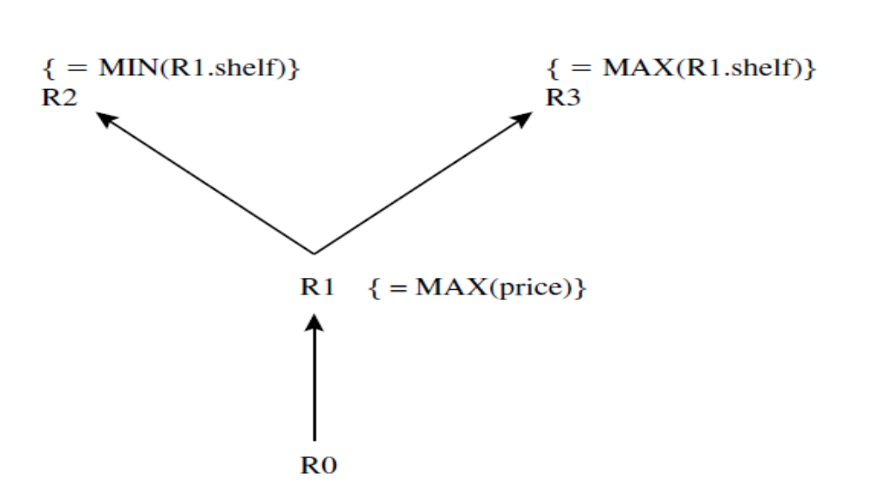
Multi-Feature Cube Graph

Slide 72
3. Constrained Gradient Analysis
Analysis of changes of sophisticated measures in multi-dimensional spaces
  Query: changes of average house price in Vancouver in 2000 comparing against 1999
  Answer: Apartments in West went down 20%, houses in Metrotown went up 10%

Slide 73
Constrained Gradients in Data Cubes
Significantly more expressive than association rules
  Capture trends in user-specified measures
Serious challenges
  Many trivial cells in a cube → “significance constraint” is to trim/hide trivial(Minor) cells
  Numerate pairs of cells → “probe constraint” to select a subset of cells to examine
  Only interesting changes wanted→ “gradient constraint” to capture significant changes

Slide 74
MD Constrained Gradient Mining
Significance constraint C_{sig}: (cnt≥100)
Probe constraint C_{prb:} (city=“Van”, cust_grp=“busi”, prod_grp=“*”)
Gradient constraint C_{grad}(c_{g}, c_{p}): (avg_price(c_{g})/avg_price(c_{p})≥1.2)
(c3, c2) satisfies C_{grad}!
Dimensions |  |  |  |  | Measures
cid | Yr | City | Cst_grp | Prd_grp | Cnt | Avg_price
c1 | 00 | Van | Busi | PC | 300 | 2100
c2 | * | Van | Busi | PC | 2800 | 1800
c3 | * | Tor | Busi | PC | 7900 | 2350
c4 | * | * | busi | PC | 58600 | 2250

Slide 75
Chapter 4: Data Cube Computation and Data Generalization
Efficient Computation of Data Cubes
Further Development of Data Cube & OLAP Technology
Attribute-Oriented Induction ─ An Alternative Data Generalization Method

Slide 76
What is Concept Description?
Descriptive vs. predictive data mining
  Descriptive mining: describes concepts or task-relevant data sets in concise, summarative, informative, discriminative forms
  Predictive mining: Based on data and analysis, constructs models for the database, and predicts the trend and properties of unknown data
Concept description:
  Characterization: provides a concise and succinct summarization of the given collection of data
  Comparison: provides descriptions comparing two or more collections of data

Slide 77
Data Generalization and Summarization-based Characterization
Data generalization
  A process which abstracts a large set of task-relevant data in a database from a low conceptual levels to higher ones.
  Approaches:
    Data cube approach(OLAP approach)
    Attribute-oriented induction approach
1
2
3
4
Conceptual levels
5

Slide 78
Concept Description vs. OLAP
Similarity:
  Data generalization
  Presentation of data summarization at multiple levels of abstraction.
  Interactive drilling, pivoting, slicing and dicing.
Differences:
  Can handle complex data types of the attributes and their aggregations
  Automated desired level allocation.
  Sophisticated typing on dimensions and measures.

Slide 79
Attribute-Oriented Induction
Proposed in 1989 (KDD ‘89 workshop)
Not confined to categorical data nor particular measures
How it is done?
  Collect the task-relevant data (initial relation) using a relational database query
  Perform generalization by attribute removal or attribute generalization
  Apply aggregation by merging identical, generalized tuples and accumulating their respective counts
  Interactive presentation with users

Slide 80
Basic Principles of Attribute-Oriented Induction
Data focusing: task-relevant data, including dimensions, and the result is the initial relation
Attribute-removal: remove attribute A if there is a large set of distinct values for A but (1) there is no generalization operator on A, or (2) A’s higher level concepts are expressed in terms of other attributes
Attribute-generalization: If there is a large set of distinct values for A, and there exists a set of generalization operators on A, then select an operator and generalize A
Attribute-threshold control: typical 2-8, specified/default

Slide 81
Attribute-Oriented Induction: Basic Algorithm
InitialRel: Query processing of task-relevant data, deriving the initial relation.
PreGen: Based on the analysis of the number of distinct values in each attribute, determine generalization plan for each attribute: removal? or how high to generalize?
PrimeGen: Based on the PreGen plan, perform generalization to the right level to derive a “prime generalized relation”, accumulating the counts.
Presentation: User interaction: (1) adjust levels by drilling, (2) pivoting, (3) mapping into rules, cross tabs, visualization presentations.

Slide 82
Example
DMQL: Describe general characteristics of graduate students in the Big-University database
  use Big_University_DB
  mine characteristics as “Science_Students”
  in relevance to name, gender, major, birth_place, birth_date, residence, phone#, gpa
  from student
  where status in “graduate”
Corresponding SQL statement:
  Select name, gender, major, birth_place, birth_date, residence, phone#, gpa
  from student
  where status in {“Msc”, “MBA”, “PhD” }

Slide 83



Class Characterization: An Example
Initial Relation
Prime Generalized Relation

Slide 84
Presentation of Generalized Results
Generalized relation:
  Relations where some or all attributes are generalized, with counts or other aggregation values accumulated.
Cross tabulation:
  Mapping results into cross tabulation form (similar to contingency tables).
  Visualization techniques:
  Pie charts, bar charts, curves, cubes, and other visual forms.
Quantitative characteristic rules:
  Mapping generalized result into characteristic rules with quantitative information associated with it, e.g.,

Slide 85
Mining Class Comparisons
Comparison: Comparing two or more classes
Method:
  Partition the set of relevant data into the target class and the contrasting class(es)
  Generalize both classes to the same high level concepts
  Compare tuples with the same high level descriptions
  Present for every tuple its description and two measures
    support - distribution within single class
    comparison - distribution between classes
  Highlight the tuples with strong discriminant features
Relevance Analysis:
  Find attributes (features) which best distinguish different classes

Slide 86
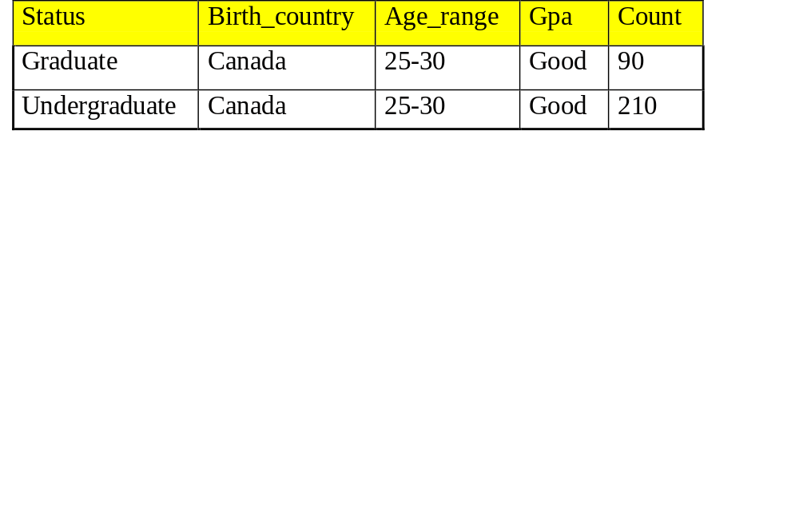
Example: Quantitative Discriminant Rule
Count distribution between graduate and undergraduate students for a generalized tuple
Quantitative discriminant rule
  where 90/(90 + 210) = 30%

Slide 87
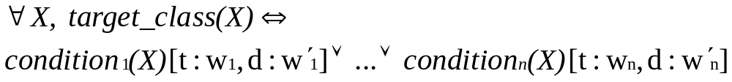
Class Description
Quantitative characteristic rule
  necessary
Quantitative discriminant rule
  sufficient
Quantitative description rule
  necessary and sufficient

Slide 88
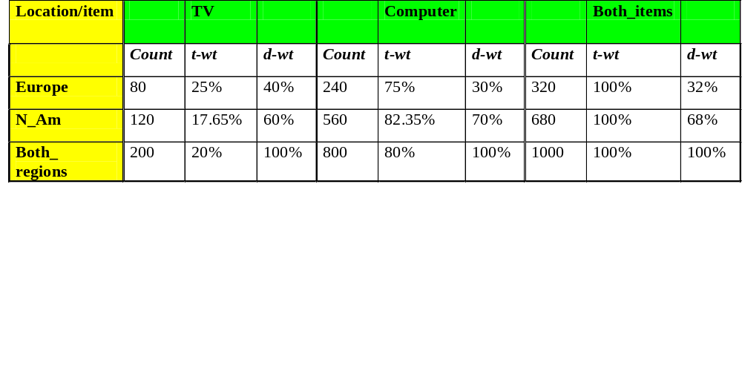
Example: Quantitative Description Rule
Crosstab showing associated t-weight, d-weight values and total number (in thousands) of TVs and computers sold at AllElectronics in 1998
Quantitative description rule for target class Europe

Slide 89
Summary
Efficient algorithms for computing data cubes
  Multiway array aggregation
  BUC
  H-cubing
  Star-cubing
  High-D OLAP by minimal cubing
Further development of data cube technology
  Discovery-drive cube
  Multi-feature cubes
  Cube-gradient analysis
Another generalization approach: Attribute-Oriented Induction

