Slide 1
Data Mining:
Concepts and Techniques
— Chapter 1 —
— Introduction —

Slide 2
Why Data Mining?
The Explosive Growth of Data: from terabytes to petabytes
  Data collection and data availability
    Automated data collection tools, database systems, Web, computerized society
  Major sources of abundant data
    Business: Web, e-commerce, transactions, stocks, …
    Science: Remote sensing, bioinformatics, scientific simulation, …
    Society and everyone: news, digital cameras, YouTube
We are drowning in data, but starving for knowledge!
“Necessity is the mother of invention”—Data mining—Automated analysis of massive data sets

Slide 3
Evolution of Sciences
Before 1600, empirical science
1600-1950s, theoretical science
  Each discipline has grown a theoretical component. Theoretical models often motivate experiments and generalize our understanding.
1950s-1990s, computational science
  Over the last 50 years, most disciplines have grown a third, computational branch (e.g. empirical, theoretical, and computational ecology, or physics, or linguistics.)
  Computational Science traditionally meant simulation. It grew out of our inability to find closed-form solutions for complex mathematical models.
1990-now, data science
  The flood of data from new scientific instruments and simulations
  The ability to economically store and manage petabytes of data online
  The Internet and computing Grid that makes all these archives universally accessible
  Scientific info. management, acquisition, organization, query, and visualization tasks scale almost linearly with data volumes. Data mining is a major new challenge!
Jim Gray and Alex Szalay, The World Wide Telescope: An Archetype for Online Science, Comm. ACM, 45(11): 50-54, Nov. 2002

Slide 4
Evolution of Database Technology
1960s:
  Data collection, database creation, and network DBMS
1970s:
  Relational data model, relational DBMS implementation
1980s:
  RDBMS, advanced data models (extended-relational, OO, deductive, etc.)
  Application-oriented DBMS (spatial, scientific, engineering, etc.)
1990s:
  Data mining, data warehousing, multimedia databases, and Web databases
2000s
  Stream data management and mining
  Data mining and its applications
  Web technology (XML, data integration) and global information systems

Slide 5


What Is Data Mining?
Data mining (knowledge discovery from data)
  Extraction of interesting (non-trivial, implicit, previously unknown and potentially useful) patterns or knowledge from huge amount of data
  Data mining: a misnomer?
Alternative names
  Knowledge discovery (mining) in databases (KDD), knowledge extraction, data/pattern analysis, data archeology, data dredging, information harvesting, business intelligence, etc.
Watch out: Is everything “data mining”?
  Simple search and query processing
  (Deductive) expert systems

Slide 6
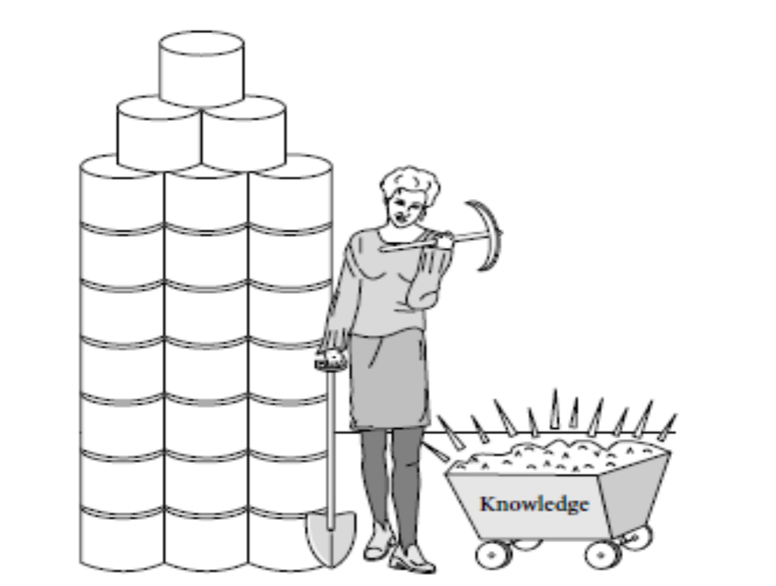
Knowledge Discovery from Data (KDD)

Slide 7
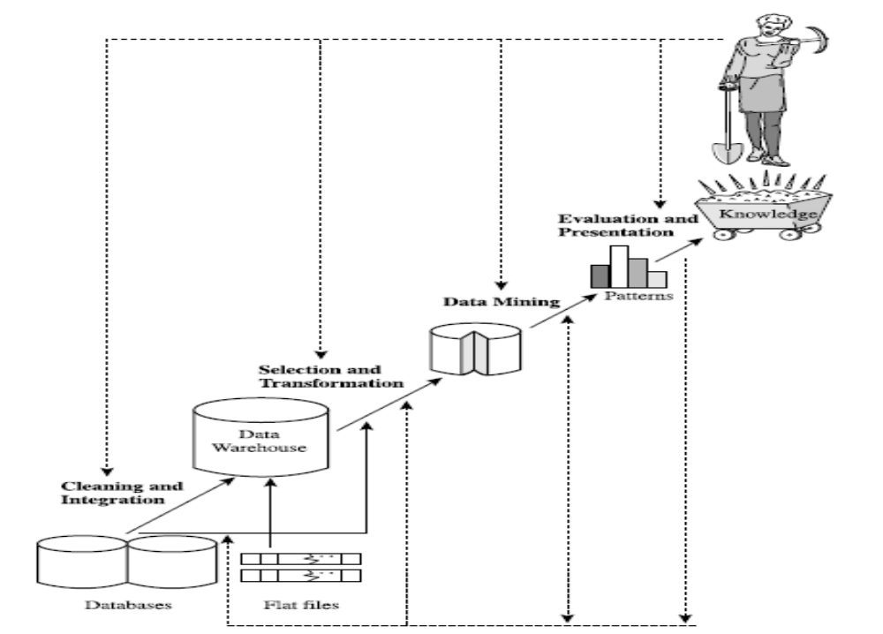

Slide 8
Steps in KDD
There are 7 steps in KDD.
Data Cleaning
Data Integration
Data Selection
Data Transformation
Data Mining
Pattern Evaluation
Knowledge Presentation

Slide 9
Data Cleaning: To remove noise, redundant and
inconsistent data.
2. Data Integration: where multiple data sources
may be combined.
After these 2 steps generally the data will be stored in data warehouse.

Slide 10
3. Data Selection: where data relevant to the
analysis task are retrieved from the database.
4. Data Transformation: where data are
transformed or consolidated into forms
appropriate for mining by performing summary or
aggregation operations.
Sometimes data transformation phase is performed before the data selection.
All these first 4 steps comes under data preprocessing. Where the data is prepared for mining.

Slide 11
5. Data Mining: An essential process where
intelligent methods are applied in order to extract
data patterns.
6. Pattern Evaluation: To identify the truly
interesting patterns representing knowledge
based on some interestingness measures.
7. Knowledge Presentation: where visualization and
knowledge representation techniques are used to
present the mined knowledge to the user

Slide 12
Generally that knowledge which we got from the final step of KDD, will be stored in the knowledge base by the user.

Slide 13
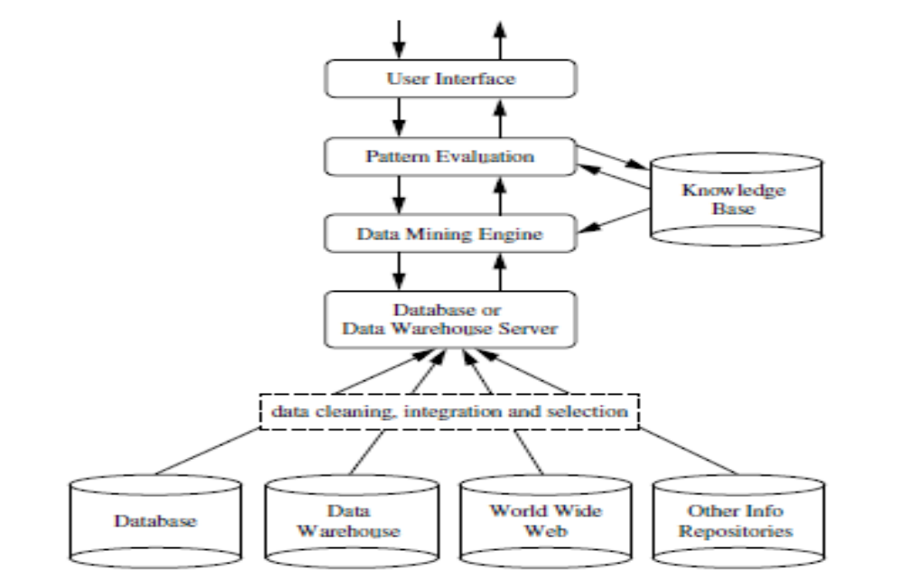
Architecture of Typical data mining system

Slide 14
Data Mining and Business Intelligence
Increasing potential
to support
business decisions
End User
Decision Making
Data Presentation
Business
Analyst
Visualization Techniques
Data Mining
Data
Analyst
Information Discovery
Data Exploration
Statistical Summary, Querying, and Reporting
Data Preprocessing/Integration, Data Warehouses
Data Sources
DBA
Paper, Files, Web documents, Scientific experiments, Database Systems

Slide 15
Data Mining: On What Kinds of Data?
Database-oriented data sets and applications
  Relational database, data warehouse, transactional database
Advanced data sets and advanced applications
  Data streams and sensor data
  Time-series data, temporal data, sequence data (incl. bio-sequences)
  Structure data, graphs, social networks and multi-linked data
  Object-relational databases
  Heterogeneous databases and legacy databases
  Spatial data and spatiotemporal data
  Multimedia database
  Text databases
  The World-Wide Web

Slide 16
What is (not) Data Mining?
What is not Data Mining?
  Look up phone number in phone directory
  Query a Web search engine for information about “Amazon”
What is Data Mining?
  Certain names are more prevalent in certain US locations (O’Brien, O’Rurke, O’Reilly… in Boston area)
  Group together similar documents returned by search engine according to their context (e.g. Amazon rainforest, Amazon.com,)

Slide 17
Query Examples
Database
Data Mining
Find all credit applicants with last name of Smith.
        Find all customers who have purchased milk
  Identify customers who have purchased more than $10,000 in the last month.
  Find all credit applicants who are poor credit risks. (classification)
        Identify customers with similar buying habits. (Clustering)
        Find all items which are frequently purchased with milk. (association rules)

Slide 18
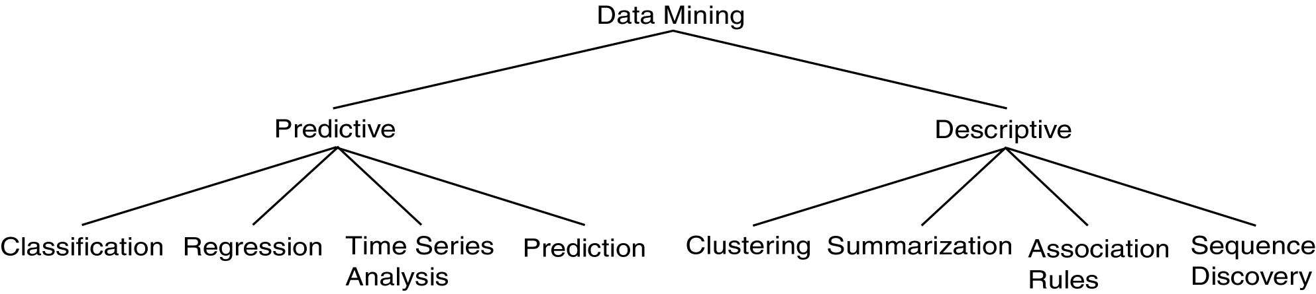
Data Mining Tasks

Slide 19
Data Mining Functionalities/Techniques
Concept/Class Description: Characterization and Discrimination
Mining Frequent Patterns, Associations and correlations
Classification and Prediction
Cluster Analysis
Outlier Analysis
Evolution Analysis

Slide 20
Concept/Class Description
Data can be associated with classes or concepts.
For example, in the D-Mart store, classes of items for sale include computers and TVs, and concepts of customers include bigSpenders and budgetSpenders.
This can be useful to describe individual classes and concepts in summarized, brief, and in detailed terms. Such descriptions of a class or a concept are called concept/class descriptions.

Slide 21
Concept/Class Description
These descriptions can be derived via
Data Characterization
Data Discrimination

Slide 22
Data Characterization
Data characterization is a summarization of the characteristics of a target class of data.
Example: The characteristics of customers who spend more than 75,000/- a year at D-Mart. The result can be a general profile such as age, employment status or credit ratings.

Slide 23
Data Discrimination
Data discrimination is a comparison of the characteristics of target class data with the characteristics of different classes data.
Example: Compare two groups of Reliance Digital Store customers, such as those who shop for computer products regularly versus those who rarely shop for computer products.
  The resulting description provides a general comparative profile of the customers, such as 80% of the customers who frequently purchase computer products are between 20 and 40 years old and have a degree
  Whereas 60% of the customers who infrequently buy such products are either seniors or teenagers, and have no degree.

Slide 24
Mining Frequent Patterns, Associations and correlations
Frequent patterns, as the name suggests, are patterns that occur frequently in data.
There are many kinds of frequent patterns, including itemsets, subsequences.
A frequent itemset typically refers to a set of items that frequently appear together in a transactional data set, such as milk and bread.
A frequently occurring subsequence, such as the pattern that customers tend to purchase first a PC, followed by a digital camera, and then a memory card, is a frequent sequential pattern.

Slide 25
Mining Frequent Patterns, Associations and correlations
Mining frequent patterns leads to the discovery of interesting associations and correlations within data.
Association Analysis: from marketing perspective, determining which items are frequently purchased together within the same transaction.
Example: An example is mined from the Reliance Mart transactional database.
buys (X, “Computers”) ➔ buys (X, “software”) [Support = 1%, confidence = 50% ]

Slide 26
X represents Customer
Confidence = 50% , if a customer buys a computer there is a 50% chance that he/she will buy software as well.
Support = 1%, means that 1% of all the transactions under analysis showed that computer and software were purchased together.
Another example:
Age (X, 20…29) ^ income (X, 20K-29K) ➔ buys(X, “Laptop”) [Support = 2%, confidence = 60% ]

Slide 27
Classification and Prediction
Classification is the process of finding a model that describes and distinguishes data classes for the purpose of being able to use the model to predict the class of objects.
Classification model can be represented in various forms such as
        IF-THEN Rules
        A decision tree
        Neural network

Slide 28
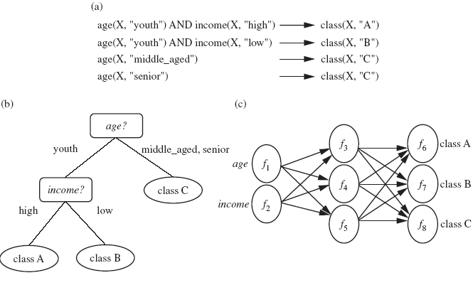
Classification Model

Slide 29
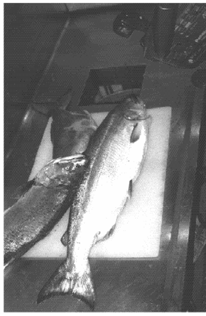
An Example
Features (to distinguish):
Length
Width

Slide 30
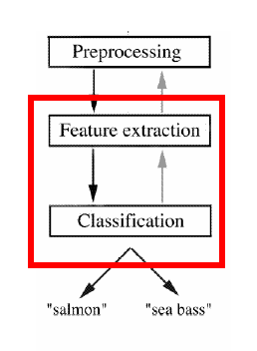
An Example (continued)
Preprocessing: Images of different fishes are isolated from one another and from background;
Feature extraction: The information of a single fish is then sent to a feature extractor, that measure certain “features” or “properties”;
Classification: The values of these features are passed to a classifier that evaluates the evidence presented, and build a model to discriminate between the two species

Slide 31
An Example (continued)
Domain knowledge:
  A sea bass is generally longer than a salmon
Related feature: (or attribute)
  Length
Training the classifier:
  Some examples are provided to the classifier in this form: <fish_length, fish_name>
  These examples are called training examples
  The classifier learns itself from the training examples, how to distinguish Salmon from Bass based on the fish_length

Slide 32
Cluster Analysis
Cluster analysis or clustering is the task of grouping a set of objects in such a way that objects in the same group (called a cluster) are more similar to each other than to those in other groups (clusters).
Example: Cluster analysis can be performed on
D-Mart (Main Outlet) customer data in order to identify similar area of customers. These clusters may represent individual target areas used for business expansion.
The figure on next slide shows a 2-D plot of customers with respect to customer locations in Tirupati City.

Slide 33
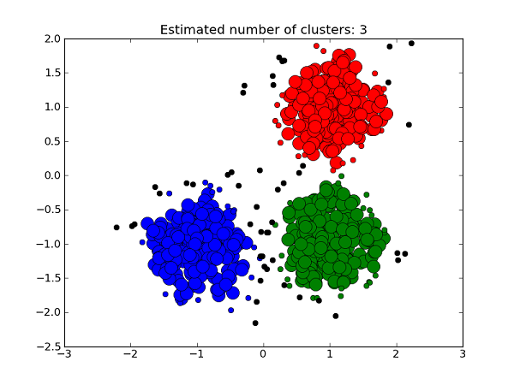
Cluster Analysis

Slide 34
Outlier Analysis
Outlier Analysis : A database may contain data objects that do not fulfill with the model of the data. These data objects are outliers.
Example:
1. Fraud Detection in Internet Banking & Credit Cards.
2. Login Alerts in Gmail, fb etc due to login access in new
devices.

Slide 35
Evolution Analysis
Evolution Analysis: Data evolution analysis describes and models regularities or trends for objects whose behavior changes over time.
Example: Time-series data. If the stock market data (time-series) of the last several years available from the National Stock exchange and one would like to invest in shares of high tech industrial companies.
  A data mining study of stock exchange data may identify stock evolution regularities for overall stocks and for the stocks of particular companies. Such regularities may help predict future trends in stock market prices, contributing to one’s decision making regarding stock investments.

Slide 36
Classification of Data Mining Systems:
Confluence of Multiple Disciplines
Database
Technology
Statistics
Machine
Learning
Data Mining
Visualization
Pattern
Recognition
Other
Disciplines
Algorithm

Slide 37
Data Mining: Classification Schemes
Different views lead to different classifications
  Data view: Kinds of data to be mined
  Knowledge view: Kinds of knowledge to be discovered
  Method view: Kinds of techniques utilized
  Application view: Kinds of applications adapted

Slide 38
Multi-Dimensional View of Data Mining
Data to be mined
  Relational, data warehouse, transactional, stream, object-oriented/relational, active, spatial, time-series, text, multi-media, heterogeneous, legacy, WWW
Knowledge to be mined
  Characterization, discrimination, association, classification, clustering, trend/deviation, outlier analysis, etc.
  Multiple/integrated functions and mining at multiple levels
Techniques/Methods utilized
  Database-oriented, data warehouse (OLAP), machine learning, statistics, visualization, etc.
Applications adapted
  Retail, telecommunication, banking, fraud analysis, bio-data mining, stock market analysis, text mining, Web mining, DNA Mining etc.

Slide 39
Why Data Mining Query Language?
Automated vs. query-driven?
  Finding all the patterns autonomously in a database?—unrealistic because the patterns could be too many but uninteresting
Data mining should be an interactive process
  User directs what to be mined
Users must be provided with a set of primitives to be used to communicate with the data mining system
Incorporating these primitives in a data mining query language
  More flexible user interaction through interactive GUI.
  Foundation for design of graphical user interface

Slide 40
Data Mining Task Primitives
Primitive 1: Task-relevant data
  Database or data warehouse name
  Database tables or data warehouse cubes
  Condition for data selection
  Relevant attributes or dimensions
  Data grouping criteria
Primitive 2: Type of knowledge to be mined
  Characterization, discrimination, association, classification, prediction, clustering, outlier analysis, other data mining tasks
Primitive 3: Background knowledge
Primitive 4: Pattern interestingness measurements
Primitive 5: Visualization/presentation of discovered patterns

Slide 41
Primitive 3: Background Knowledge
A typical kind of background knowledge: Concept hierarchies
Schema hierarchy
  E.g., street < city < state < country
Set-grouping hierarchy
  E.g., {20-39} = young, {40-59} = middle_aged
Operation-derived hierarchy
    login-name < department < university < country

Slide 42
Primitive 4: Pattern Interestingness Measure
Simplicity
  e.g., (association) rule length, (decision) tree size
Certainty
  e.g., confidence, P(A|B) = #(A and B)/ #(B), classification reliability or accuracy, certainty factor, rule strength, rule quality, discriminating weight, etc.
Utility
  potential usefulness, e.g., support (association), noise threshold (description)

Slide 43
Primitive 5: Presentation of Discovered Patterns
Different backgrounds/usages may require different forms of representation
  E.g., rules, tables, crosstabs, pie/bar chart, etc.
Concept hierarchy is also important
  Discovered knowledge might be more understandable when represented at high level of abstraction
  Interactive drill up/down, pivoting, slicing and dicing provide different perspectives to data
Different kinds of knowledge require different representation: association, classification, clustering, etc.

Slide 44
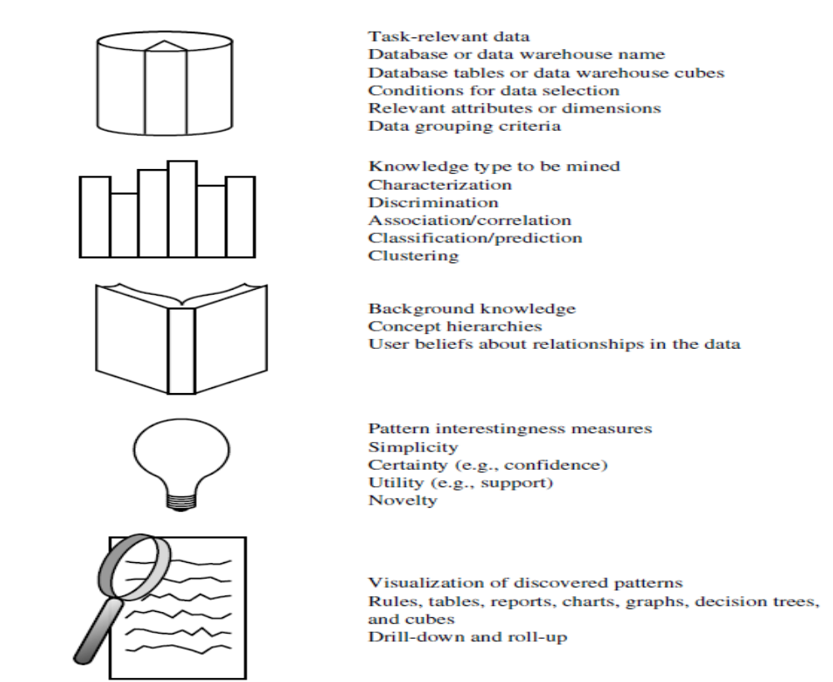

Slide 45
DMQL—A Data Mining Query Language
Motivation
  A DMQL can provide the ability to provide interactive data mining
  But, there is no standard DMQL up to now.
Design
  DMQL is designed with the primitives described earlier.
  In general, data mining tools are easily handled by easy GUI rather than DMQL.

Slide 46
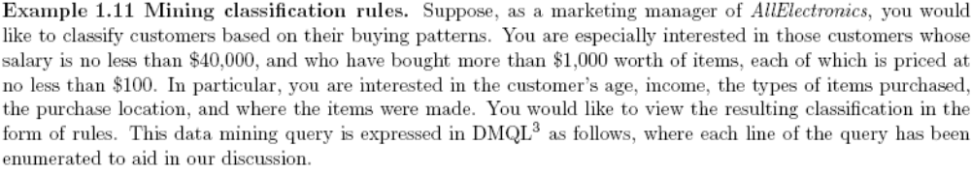
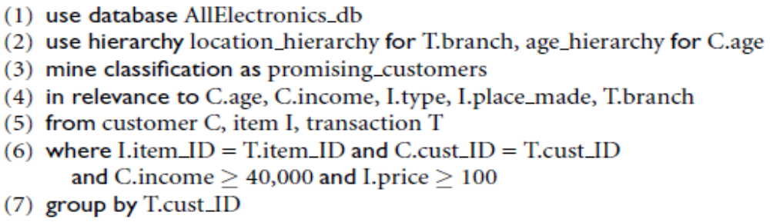
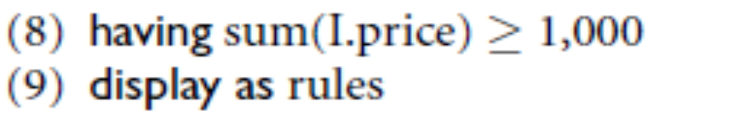
An Example Query in DMQL

Slide 47
DMQL Query Explanation
There are total 9 lines in that syntax.
Line 1 & Lines 4 to 8 represent task relevant data primitive.
Line 2 represents the background knowledge primitive.
Line 3 represents the kind of knowledge to be mined primitive.
Line 9 represents the visualization of discovered patterns primitive.

Slide 48
Other Data Mining Languages & Tools
Association rule language specifications
  MSQL
  MineRule
  Query flocks based on Datalog syntax
OLEDB for DM (Microsoft’2000) and recently DMX (Microsoft SQL Server for Business Intelligence 2012)
  Based on OLE, OLE DB, OLE DB for OLAP, C#
  Integrating DBMS, data warehouse and data mining
DMML (Data Mining Mark-up Language) by DMG (www.dmg.org)
  Providing a platform and process structure for effective data mining
  Most of the data mining tools are used for business intelligence.

Slide 49
Integration of a Data Mining System with a Database or Data Warehouse System
There are different possible data integration schemas are:
No coupling
Loose coupling
Semi tight coupling
Tight coupling

Slide 50
No Coupling:
No coupling means that a DM system will not utilize any function of a DB or DW system. It may fetch data from a particular source (such as a file system), process data using some data mining algorithms, and then store the mining results in another file.

Slide 51
Loose coupling:
Loose coupling means that a DM system will use some facilities of a DB or DW system, fetching data from a data repository managed by these systems, performing data mining, and then storing the mining results either in a file or in a designated place in a database or data Warehouse.

Slide 52
Semi tight coupling:
Semi tight coupling means that besides linking a DM system to a DB/DW system, efficient implementations of a few essential data mining primitives can be provided in the DB/DW system.

Slide 53
Tight coupling:
Tight coupling means that a DM system is smoothly integrated into the DB/DW system. The data mining subsystem is treated as one functional component of information system.

Slide 54
Major Issues in Data Mining
Major issues in data mining regarding
Mining methodology & user interaction,
Performance & Scalability,
Diversity of data types,
Applications and social impacts.

Slide 55
Major Issues in Data Mining
Mining methodology and user interaction
  Mining different kinds of knowledge in databases
  Interactive mining of knowledge at multiple levels of abstraction
  Incorporation of background knowledge
  Data mining query languages and ad-hoc data mining
  Expression and visualization of data mining results
  Handling noise and incomplete data
  Pattern evaluation: the interestingness problem

Slide 56
Major Issues in Data Mining
Performance and scalability
  Efficiency and scalability of data mining algorithms
  Parallel, distributed and incremental mining methods

Slide 57
Major Issues in Data Mining
Issues relating to the diversity of data types
  Handling relational and complex types of data
  Mining information from heterogeneous databases and global information systems (WWW).

Slide 58
Major Issues in Data Mining
Issues related to applications and social impacts
  Application of discovered knowledge
    Domain-specific data mining tools
  Integration of the discovered knowledge with existing knowledge: A knowledge fusion problem
  Protection of data security, integrity, and privacy

