Slide 1
Data Mining:
Concepts and Techniques
— Chapter 2 —
— Data Preprocessing —

Slide 2
Chapter 2: Data Preprocessing
Need for Preprocessing the Data
Data cleaning
Data integration and transformation
Data reduction
Discretization and concept hierarchy generation

Slide 3
Need for Preprocessing the Data
Data in the real world is messy
  incomplete: lacking attribute values, lacking certain attributes of interest, or containing only aggregate data
    e.g., occupation=“ ”
  noisy: containing errors or outliers
    e.g., Salary=“-10,000”
  inconsistent: containing discrepancies in codes or names
    e.g., Age=“42” Birthday=“03/07/1997”
    e.g., Was rating “1,2,3”, now rating “A, B, C”
    e.g., discrepancy between duplicate records

Slide 4
Why Is Data Messy?
Incomplete data may come from
  “Not applicable” data value when collected
  Different considerations between the time when the data was collected and when it is analyzed.
  Human/hardware/software problems
Noisy data (incorrect values) may come from
  Faulty data collection instruments
  Human or computer error at data entry
  Errors in data transmission
Inconsistent data may come from
  Different data sources
  Functional dependency violation (e.g., modify some linked data)
Duplicate records also need data cleaning

Slide 5
Why Is Data Preprocessing Important?
No quality data, no quality mining results!
  Quality decisions must be based on quality data
    e.g., duplicate or missing data may cause incorrect or even misleading statistics.
  Data warehouse needs consistent integration of quality data
Data extraction, cleaning, and transformation comprises the majority of the work of building a data warehouse

Slide 6
Multi-Dimensional Measure of Data Quality
A well-accepted multidimensional view:
  Accuracy
  Completeness
  Consistency
  Timeliness
  Believability
  Value added
  Interpretability
  Accessibility

Slide 7
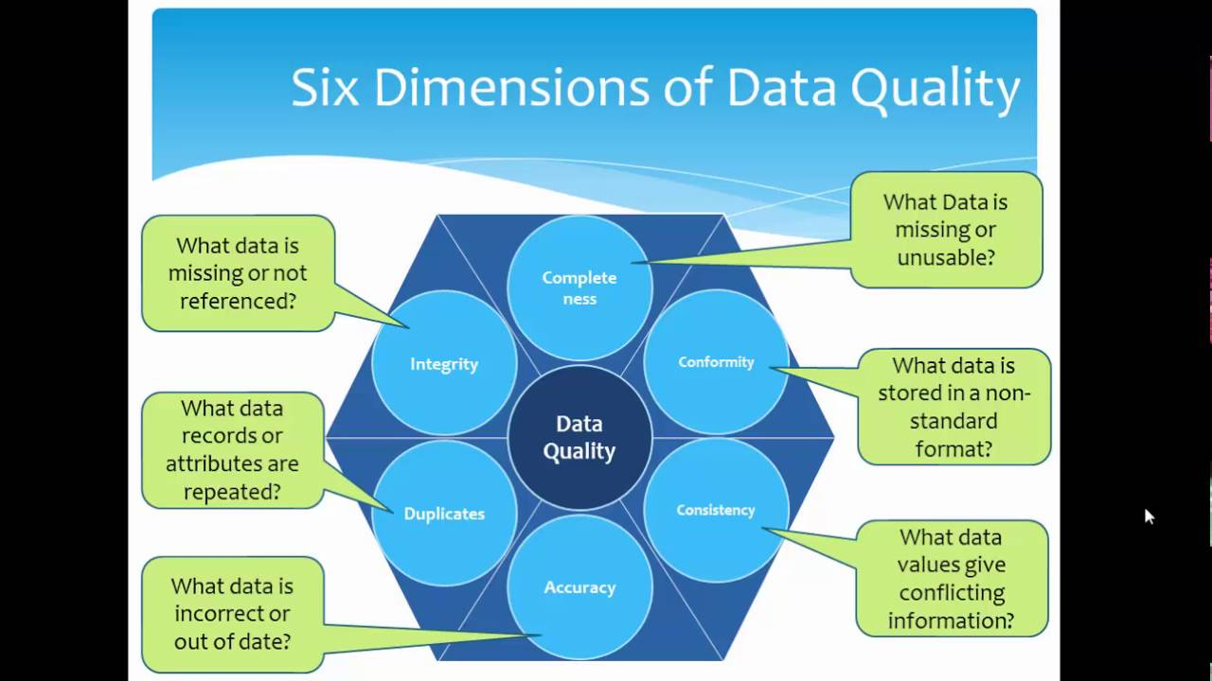
Data Quality Engineering

Slide 8
Major Tasks in Data Preprocessing
Data cleaning
  Fill in missing values, smooth noisy data, identify or remove outliers, and resolve inconsistencies
Data integration
  Integration of multiple databases, data cubes, or files
Data transformation
  Normalization and aggregation
Data reduction
  Obtains reduced representation in volume but produces the same or similar analytical results
Data discretization
  Part of data reduction but with particular importance, especially for numerical data

Slide 9

Forms of Data Preprocessing

Slide 10
Chapter 2: Data Preprocessing
Need for Preprocessing the Data
Data cleaning
Data integration and transformation
Data reduction
Discretization and concept hierarchy generation

Slide 11
Data Cleaning
Importance
  “Data cleaning is one of the three biggest problems in data warehousing”—Ralph Kimball
  “Data cleaning is the number one problem in data warehousing”—DCI survey
Data cleaning tasks
  Fill in missing values
  Identify outliers and smooth out noisy data
  Correct inconsistent data
  Resolve redundancy caused by data integration

Slide 12
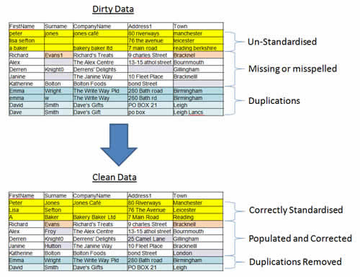
Real-Time Example

Slide 13
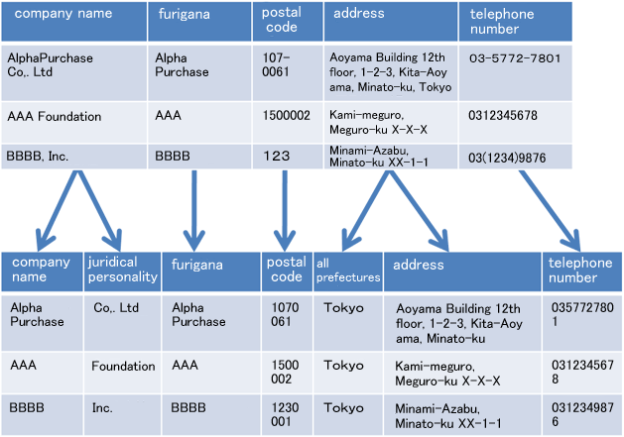
Real-Time Example

Slide 14
Missing Data
Data is not always available
  E.g., many tuples have no recorded value for several attributes, such as customer income in sales data
Missing data may be due to
  equipment malfunction
  inconsistent with other recorded data and thus deleted
  data not entered due to misunderstanding
  certain data may not be considered important at the time of entry
  not register history or changes of the data
Missing data may need to be inferred.

Slide 15
How to Handle Missing Data?
Ignore the tuple: usually done when class label is missing (assuming the tasks in classification—not effective when the percentage of missing values per attribute varies considerably.
Fill in the missing value manually: tedious + infeasible?
Fill in it automatically with
  a global constant : e.g., “unknown”, a new class?!
  the attribute mean
  the attribute mean for all samples belonging to the same class: smarter

Slide 16
Noisy Data
Noise: random error or variance in a measured variable
Incorrect attribute values may due to
  faulty data collection instruments
  data entry problems
  data transmission problems
  technology limitation
  inconsistency in naming convention
Other data problems which requires data cleaning
  duplicate records
  incomplete data
  inconsistent data

Slide 17
How to Handle Noisy Data?
Binning
  first sort data and partition into (equal-frequency) bins
  then one can smooth by bin means, smooth by bin median, smooth by bin boundaries, etc.
Regression
  smooth by fitting the data into regression functions
Clustering
  detect and remove outliers
Combined computer and human inspection
  detect suspicious values and check by human (e.g., deal with possible outliers)

Slide 18
Simple Discretization Methods: Binning
Equal-width (distance) partitioning
  Divides the range into N intervals of equal size: uniform grid
  if A and B are the lowest and highest values of the attribute, the width of intervals will be: W = (B –A)/N.
  The most straightforward, but outliers may dominate presentation
  Skewed data is not handled well
Equal-depth (frequency) partitioning
  Divides the range into N intervals, each containing approximately same number of samples
  Good data scaling
  Managing categorical attributes can be tricky

Slide 19
Binning Methods for Data Smoothing
Sorted data for price (in dollars): 4, 8, 9, 15, 21, 21, 24, 25, 26, 28, 29, 34
* Partition into equal-frequency (equi-depth) bins:
- Bin 1: 4, 8, 9, 15
- Bin 2: 21, 21, 24, 25
- Bin 3: 26, 28, 29, 34
* Smoothing by bin means:
- Bin 1: 9, 9, 9, 9
- Bin 2: 23, 23, 23, 23
- Bin 3: 29, 29, 29, 29
* Smoothing by bin boundaries:
- Bin 1: 4, 4, 4, 15
- Bin 2: 21, 21, 25, 25
- Bin 3: 26, 26, 26, 34

Slide 20
Regression
y
Y1
Y1’
y = x + 1
X1
x

Slide 21
Cluster Analysis

Slide 22
Data Cleaning as a Process
Data discrepancy detection
  Use metadata (e.g., domain, range, dependency, distribution)
  Check field overloading
  Check uniqueness rule, consecutive rule and null rule
  Use commercial tools
    Data scrubbing: use simple domain knowledge (e.g., postal code, spell-check) to detect errors and make corrections
    Data auditing: by analyzing data to discover rules and relationship to detect violators (e.g., correlation and clustering to find outliers)
    Open Refine Tool: Developed by Google, for dealing with messy data.
Data migration and integration
  Data migration tools: allow transformations to be specified
  ETL (Extraction/Transformation/Loading) tools: allow users to specify transformations through a graphical user interface. Open Refine Tool is a ETL based Tool.

Slide 23
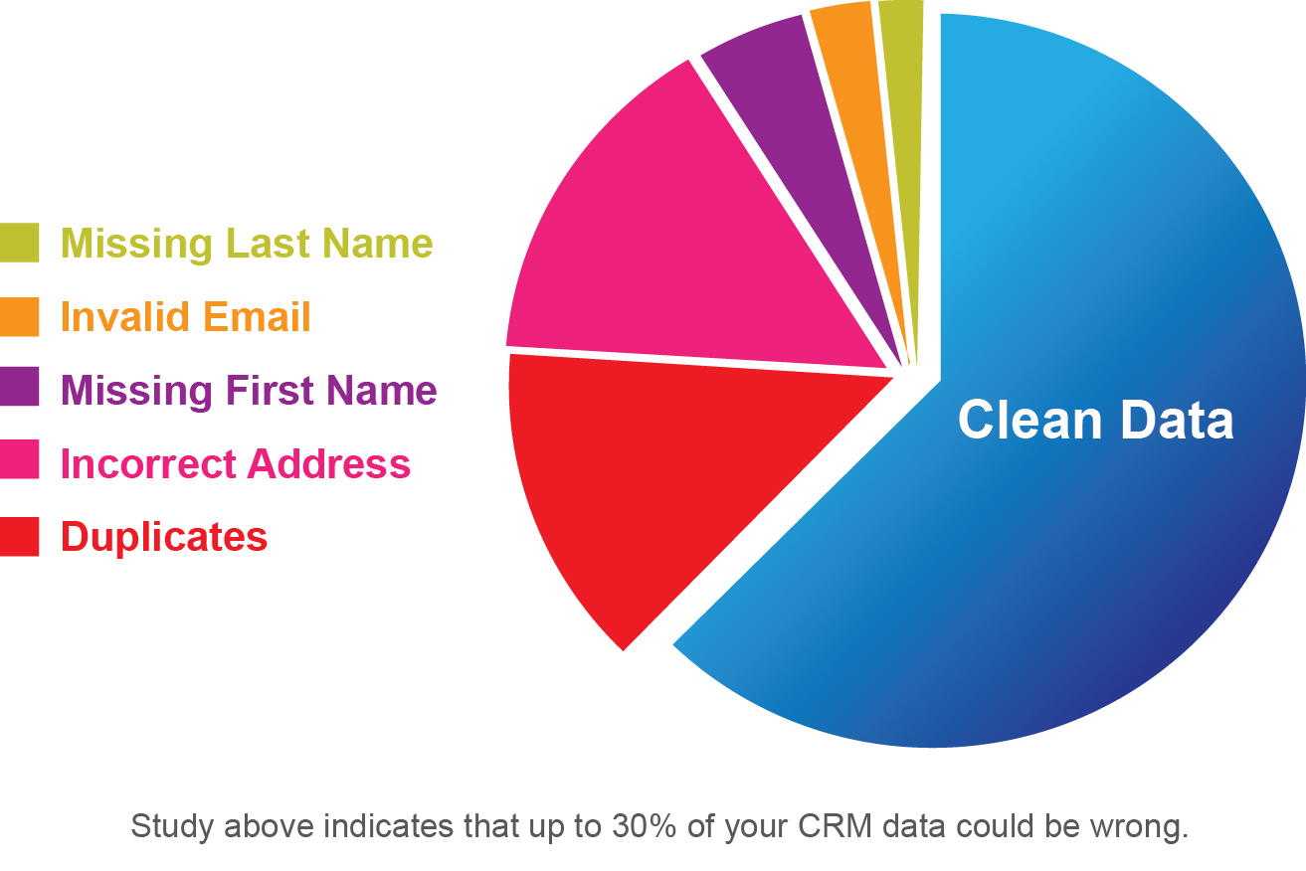
Survey-Statistics

Slide 24
Chapter 2: Data Preprocessing
Need for Preprocessing the Data
Data cleaning
Data integration and transformation
Data reduction
Discretization and concept hierarchy generation

Slide 25
Data Integration
Data integration:
  Combines data from multiple sources into a coherent store as Data Warehouse.
Schema integration: e.g., A.cust-id ≡ B.cust-#
  Integrate metadata from different sources
Entity identification problem:
  Identify real world entities from multiple data sources, e.g., Bill Clinton = William Clinton
Detecting and resolving data value conflicts
  For the same real world entity, attribute values from different sources are different
  Possible reasons: different representations, different scales, e.g., metric vs. British units

Slide 26
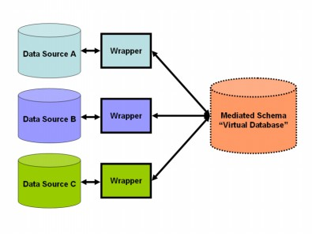

Slide 27
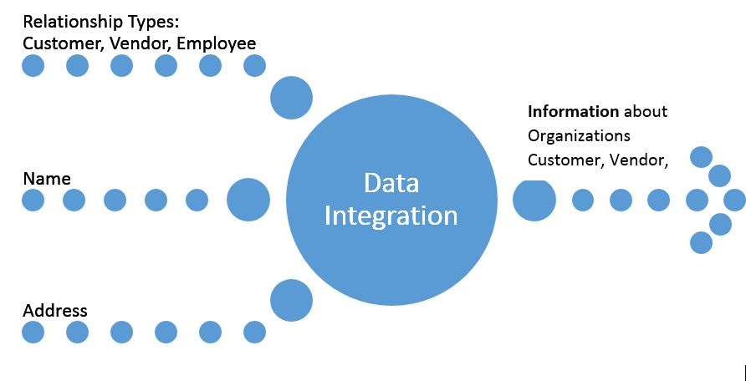
Example

Slide 28
Handling Redundancy in Data Integration
Redundant data occur often when integration of multiple databases
  Object identification: The same attribute or object may have different names in different databases
  Derivable data: One attribute may be a “derived” attribute in another table, e.g., annual revenue
Redundant attributes may be able to be detected by correlation analysis
Careful integration of the data from multiple sources may help reduce/avoid redundancies and inconsistencies and improve mining speed and quality

Slide 29
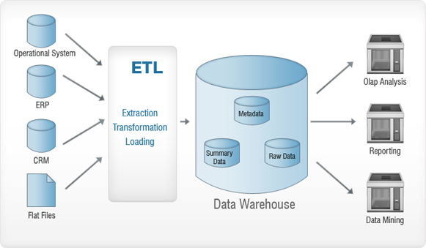

Slide 30
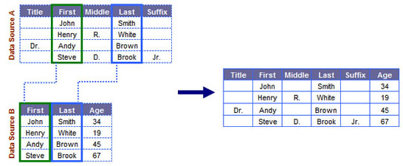

Slide 31

Correlation Analysis (Categorical Data)
Χ² (chi-square) test
The larger the Χ² value, the more likely the variables are related
The cells that contribute the most to the Χ² value are those whose actual count is very different from the expected count

Slide 32
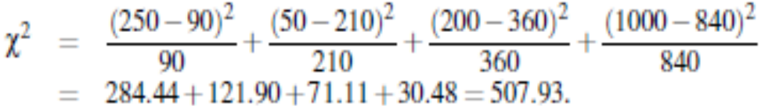
Chi-Square Calculation: An Example
Χ² (chi-square) calculation (numbers in parenthesis are expected counts calculated based on the data distribution)
It shows that like_science_fiction and Male are correlated in the group.
 | Male | Female | Sum (row)
Like science fiction | 250(90) | 200(360) | 450
Not like science fiction | 50(210) | 1000(840) | 1050
Sum(col.) | 300 | 1200 | 1500

Slide 33
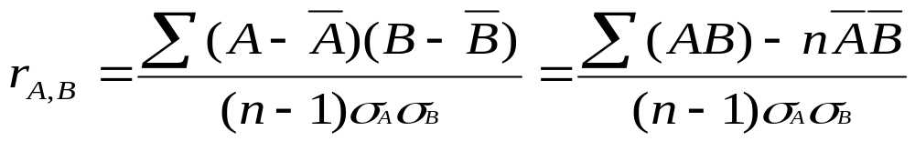


Correlation Analysis (Numerical Data)
Correlation coefficient (also called Pearson’s product moment coefficient)
  where n is the number of tuples, and are the respective means of A and B, σ_{A} and σ_{B} are the respective standard deviation of A and B, and Σ(AB) is the sum of the AB cross-product.
If r_{A,B} > 0, A and B are positively correlated, then it is stronger correlation.
r_{A,B} = 0; A and B are independent.
r_{A,B} < 0; A and B are negatively correlated (Weaker Correlation).

Slide 34
Data Transformation
Data Transformation involves following techniques:
Smoothing
Aggregation
Generalization
Attribute/feature construction
Normalization

Slide 35
Smoothing: which works to remove noise from the data. Such techniques include binning, regression, and clustering.
Aggregation: where summary or aggregation operations are applied to the data. For example, the daily sales data may be aggregated so as to compute monthly and annual total amounts.

Slide 36
Generalization: where low-level data are replaced by higher-level concepts through the use of concept hierarchies. For example, categorical attributes, like street, can be generalized to higher-level concepts, like city or country.
Similarly, values for numerical attributes, like age, may be mapped to higher-level concepts, like youth, middle-aged, and senior.

Slide 37
Attribute/feature-construction:New attributes are constructed from the given attributes and added in order to help improve the accuracy and understanding of structure in high-dimensional data.
For example, we may wish to add the attribute area based on the attributes height and width. By combining attributes, attribute construction can discover missing information about the relationships between data attributes that can be useful for knowledge discovery.

Slide 38
Normalization: Numerical Data will be scaled to fall within a small, specified range, such as -1.0 to 1.0, or 0.0 to 1.0.
There are 3 methods for normalization. They are:
  min-max normalization
  z-score normalization
  normalization by decimal scaling

Slide 39





Data Transformation: Normalization
Min-max normalization: to [new_min_{A}, new_max_{A}]
  Ex. Let income range $12,000 to $98,000 normalized to [0.0, 1.0]. Then $73,600 is mapped as
Z-score normalization (μ: mean, σ: standard deviation):
  Ex. Let μ = 54,000, σ = 16,000. Then
Normalization by decimal scaling
Where j is the smallest integer such that Max(|ν’|) < 1

Slide 40
Chapter 2: Data Preprocessing
Need for Preprocessing the Data
Data cleaning
Data integration and transformation
Data reduction
Discretization and concept hierarchy generation

Slide 41
Data Reduction Strategies
Why data reduction?
  A database/data warehouse may store terabytes of data
  Complex data analysis/mining may take a very long time to run on the complete data set
Data reduction
  Obtain a reduced representation of the data set that is much smaller in volume but yet produce the same (or almost the same) analytical results
Data reduction strategies
  Data cube aggregation:
  Dimensionality reduction
  Data Compression
  Numerosity reduction
  Discretization and concept hierarchy generation

Slide 42
1. Data cube aggregation: where aggregation operations are applied to the data in the
construction of a data cube.
2. Attribute subset selection: where irrelevant, weakly relevant, or redundant attributes
or dimensions may be detected and removed.
3. Dimensionality reduction: where encoding mechanisms are used to reduce the data
set size.

Slide 43
4. Numerosity reduction: where the data are replaced or estimated by alternative, smaller data representations such as parametric models (which need store only the model parameters instead of the actual data) or nonparametric methods such as clustering, sampling, and the use of histograms.

Slide 44
5. Discretization and concept hierarchy:
where raw data values for attributes are replaced by ranges or higher conceptual levels. Data discretization is a form of numerosity reduction that is very useful for the automatic generation of concept hierarchies.

Slide 45
Data Cube Aggregation
The lowest level of a data cube (base cuboid)
  The aggregated data for an individual entity of interest
Multiple levels of aggregation in data cubes
  Further reduce the size of data to deal with
Reference appropriate levels
  Use the smallest representation which is enough to solve the task
Queries regarding aggregated information should be answered using data cube, when possible

Slide 46
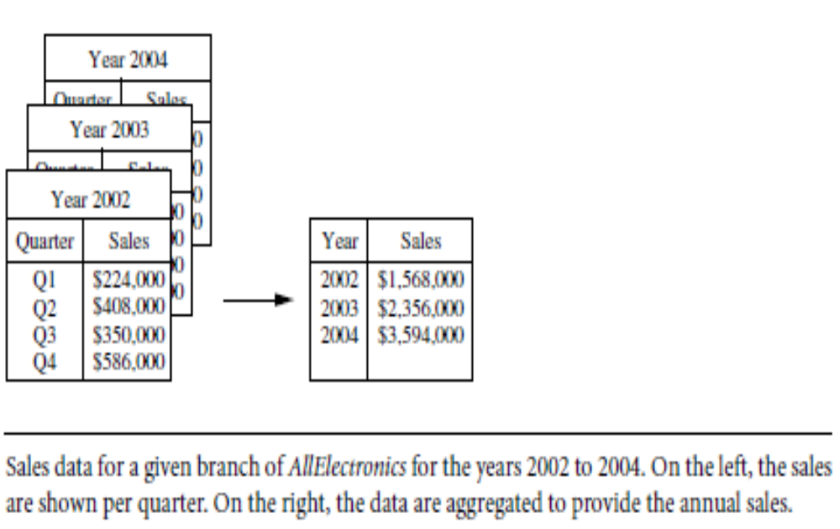
Example

Slide 47
Attribute Subset Selection
Feature selection (i.e., attribute subset selection):
  Select a minimum set of features such that the probability distribution of different classes given the values for those features is as close as possible to the original distribution given the values of all features
Some of the methods for attribute subset selection are:
  Step-wise forward selection
  Step-wise backward elimination
  Decision-tree induction

Slide 48
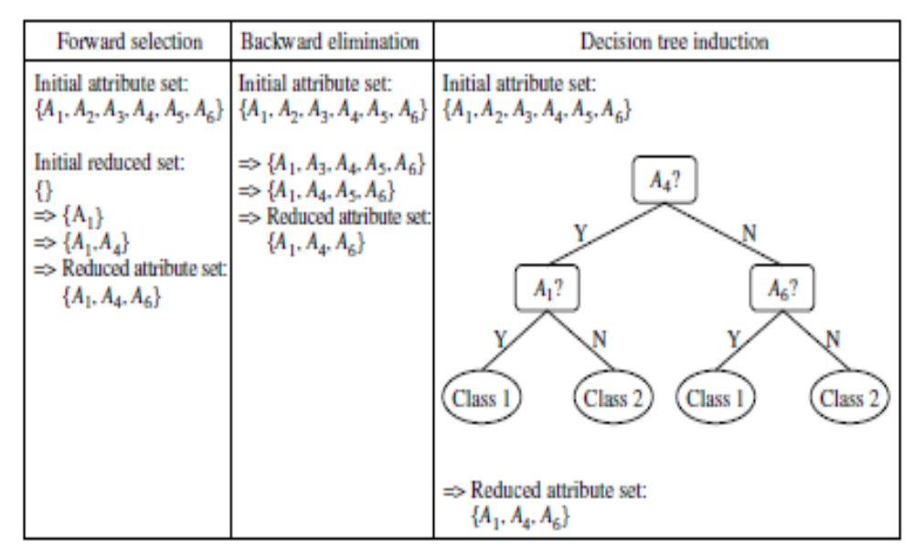
Example

Slide 49
Example of Decision Tree Induction
Initial attribute set:
{A1, A2, A3, A4, A5, A6}
A4 ?
A1?
A6?
Class 1
Class 2
Class 1
Class 2
>
Reduced attribute set: {A1, A4, A6}

Slide 50
Data Compression
String compression
  There are extensive theories and well-tuned algorithms
  Typically lossless
  But only limited manipulation is possible without expansion
Audio/video compression
  Typically lossy compression, with progressive refinement
  Sometimes small fragments of signal can be reconstructed without reconstructing the whole

Slide 51
Dimensionality Reduction:
Wavelet Transformation
Haar2
Daubechie4
Discrete wavelet transform (DWT): linear signal processing, multi-resolutional analysis
Compressed approximation: store only a small fraction of the strongest of the wavelet coefficients
Similar to discrete Fourier transform (DFT), but better lossy compression, localized in space
Method:
  Length, L, must be an integer power of 2 (padding with 0’s, when necessary)
  Each transform has 2 functions: smoothing, difference
  Applies to pairs of data, resulting in two set of data of length L/2
  Applies two functions recursively, until reaches the desired length

Slide 52

DWT for Image Compression
Image
Low Pass High Pass
Low Pass High Pass
Low Pass High Pass

Slide 53
Numerosity Reduction
Reduce data volume by choosing alternative, smaller forms of data representation
Parametric methods
  Assume the data fits some model, estimate model parameters, store only the parameters, and discard the data (except possible outliers)
  Example: Log-linear models—obtain value at a point in m-D space as the product on appropriate marginal subspaces
Non-parametric methods
  Do not assume models
  Major families: histograms, clustering, sampling

Slide 54

Data Reduction Method (1): Histograms
Divide data into buckets and store average (sum) for each bucket
Partitioning rules:
  Equal-width: equal bucket range
  Equal-frequency (or equal-depth)
  V-optimal: with the least histogram variance (weighted sum of the original values that each bucket represents)
  MaxDiff: set bucket boundary between each pair for pairs have the β–1 largest differences

Slide 55
Data Reduction Method (2): Clustering
Partition data set into clusters based on similarity, and store cluster representation (e.g., centroid and diameter) only
Can be very effective if data is clustered but not if data is “smeared”
Can have hierarchical clustering and be stored in multi-dimensional index tree structures
There are many choices of clustering definitions and clustering algorithms
Cluster analysis will be studied in depth in Chapter 7

Slide 56
Data Reduction Method (3): Sampling
Sampling: obtaining a small sample s to represent the whole data set N
Allow a mining algorithm to run in complexity that is potentially sub-linear to the size of the data
Choose a representative subset of the data
  Simple random sampling may have very poor performance in the presence of skew
Develop adaptive sampling methods
  Stratified sampling:
    Approximate the percentage of each class (or subpopulation of interest) in the overall database
    Used in conjunction with skewed data

Slide 57
Sampling: with or without Replacement
SRSWOR
(simple random
sample without
replacement)
SRSWR
Raw Data

Slide 58
Sampling: Cluster Sampling
Raw Data
Cluster Sample

Slide 59
Chapter 2: Data Preprocessing
Need for Preprocessing the Data
Data cleaning
Data integration and transformation
Data reduction
Discretization and concept hierarchy generation

Slide 60
Discretization
Three types of attributes:
  Nominal — values from an unordered set, e.g., color, profession
  Ordinal — values from an ordered set, e.g., military or academic rank
  Continuous — real numbers, e.g., integer or real numbers
Discretization:
  Divide the range of a continuous attribute into intervals
  Some classification algorithms only accept categorical attributes.
  Reduce data size by discretization
  Prepare for further analysis

Slide 61
Discretization and Concept Hierarchy
Discretization
  Reduce the number of values for a given continuous attribute by dividing the range of the attribute into intervals
  Interval labels can then be used to replace actual data values
  Supervised vs. unsupervised
  Split (top-down) vs. merge (bottom-up)
  Discretization can be performed recursively on an attribute
Concept hierarchy formation
  Recursively reduce the data by collecting and replacing low level concepts (such as numeric values for age) by higher level concepts (such as young, middle-aged, or senior)

Slide 62
Discretization and Concept Hierarchy Generation for Numeric Data
Typical methods: All the methods can be applied recursively
  Binning (covered above)
    Top-down split, unsupervised,
  Histogram analysis (covered above)
    Top-down split, unsupervised
  Clustering analysis (covered above)
    Either top-down split or bottom-up merge, unsupervised

Slide 63
Segmentation by Natural Partitioning
A simply rule can be used to segment numeric data into relatively uniform, “natural” intervals.
  If an interval covers 3, 6, 7 or 9 distinct values at the most significant digit, partition the range into 3 equi-width intervals
  If it covers 2, 4, or 8 distinct values at the most significant digit, partition the range into 4 intervals
  If it covers 1, 5, or 10 distinct values at the most significant digit, partition the range into 5 intervals

Slide 64
Example
count
Step 1:
-$351 -$159 profit $1,838 $4,700
Min Low (i.e, 5%-tile) High(i.e, 95%-0 tile) Max
Step 2:
msd=1,000 Low=-$1,000 High=$2,000
Step 3:
(-$1,000 - $2,000)
(-$1,000 - 0)
(0 -$ 1,000)
($1,000 - $2,000)
Step 4:
(-$400 -$5,000)
(-$400 - 0)
(0 - $1,000)
($1,000 - $2, 000)
($2,000 - $5, 000)
(-$400 -
-$300)
(0 -
$200)
($1,000 -
$1,200)
($2,000 -
$3,000)
($200 -
$400)
($1,200 -
$1,400)
(-$300 -
-$200)
($3,000 -
$4,000)
($400 -
$600)
($1,400 -
$1,600)
(-$200 -
-$100)
($4,000 -
$5,000)
($600 -
$800)
($1,600 -
$1,800)
($1,800 -
$2,000)
(-$100 -
0)
($800 -
$1,000)

Slide 65
Concept Hierarchy Generation for Categorical Data
Specification of a partial/total ordering of attributes explicitly at the schema level by users or experts
  street < city < state < country
Specification of a hierarchy for a set of values by explicit data grouping
  {Urbana, Champaign, Chicago} < Illinois
Specification of only a partial set of attributes
  E.g., only street < city, not others
Automatic generation of hierarchies (or attribute levels) by the analysis of the number of distinct values
  E.g., for a set of attributes: {street, city, state, country}

Slide 66
Automatic Concept Hierarchy Generation
Some hierarchies can be automatically generated based on the analysis of the number of distinct values per attribute in the data set
  The attribute with the most distinct values is placed at the lowest level of the hierarchy
  Exceptions, e.g., weekday, month, quarter, year
country
15 distinct values
province_or_ state
365 distinct values
city
3567 distinct values
street
674,339 distinct values

