Slide 1
GROW ETL Collaboration – Governance Meeting
SX/ETL3 – Feb 2024

Slide 2
Key Decisions/Discussion Points
GROW – ETL Governance Updates – Feb’24
Stream | Description
Resource allocation | Demands to be provided for all associates for next three months Details on seven new resources shared for Adnoc; awaiting confirmation of their demands. Demands to be fulfilled for 3 more data scientists role for Adnoc.
Resource Availability - WinGD | Prince allocation is assigned to Pauline in March. Pauline shares DSR with commendable progress in the completing the tasks shared by Fedrick. Mandar needs a release from GROW DT; KT initiated to Gokul
Task Allocation | Shital's utilization on technical consulting and SoW
Onsite Opportunity | Advance notification to be provided regarding onsite opportunities for the associates.

Slide 3
Overall Status
GROW – ETL Governance Updates – Feb’24
# | Project Name | Project Manager from ETL | SPOC from GROW | Overall Project Status | Comments
1 | Solution Ecosystem( DS & DE) | Swetha | Deepa Velankar |  | Centrifugal Compressor - Completed Surge detection | 15th Feb Collaboration with IIT-R for synthetic sensor data gen – SOW done | 5 Feb RUL(Remaining useful life) - Literature review | 12th Feb, exploring physics-based concepts to enhance health indicators – in progress LLM's -Implementation of basic version of information extraction from pdf and response generation completed. | 19 Feb
2 | Solution Ecosystem( DE) | Swetha | Deepa Velankar |  | Support on PPGPL phase 2 design | 6 Feb Integration of Asset Templates on edge solution | 9 Feb Feature and prediction schema definition V2 | 16 Feb PCH pipeline set up in Databricks | 19 Feb HPE High frequency flow setup, script update and deployment | 21 Feb IoTEdge PoC for KPI calculation and at scale deployment | 21 Feb Enabling "DT in a Box" solution for BCW event | 26 Feb
3 | WinGD | Swetha | Deepa Velankar |  | QuestDB maintenance and upgrade| 5th Feb FastAPI for AD plots and data preprocessing script | 6th Feb Failure table data migration | 19 Feb Data ingestion of Detection of event signals | 22nd Feb Bmep for User Rating | In-progress

Slide 4
Overall Status
GROW – ETL Governance Updates – Feb’24
# | Project Name | Project Manager from ETL | SPOC from GROW | Overall Project Status | Comments
4 | PPGPL | Swetha | Deepa Velankar |  | Developed logic for C-suite analysis and failure causes, enhanced back-end for anomaly/threshold tracking for common causes of failure, and updated front-end for to reflect the same – Feb 12 Collaborated Team effort to successfully support and get a green flag in Product Compliance Check. The team received appreciation for the same from customer end – Feb 9 Provided anomaly reports and performed cost optimization of resources being used for the monitoring of Pump and Gas turbine operations – Feb 20
5 | KSB | Manju | Deepa Velankar |  | Data Summary on the overall data shared by customer | Feb 8 Analysis on the data received on Cavitation and Coupling from Customer | Feb 12 Expecting cavitation data (Low Cavitation, Medium Cavitation, High Cavitation data) from customer to start data modelling tasks on cavitation. Modelling activity started for cavitation and coupling.| Feb 22 Base API Code is up and running on the webapp. | Feb 20 Creation of users for accessing UI in AD is completed. | Feb 21 Demonstration of user interface to the customer on 23rd | Feb 23 Activities for data availability in cosmos is started | Feb 23
6 | JSW | Swetha | Deepa Velankar |  | Need enhanced data collection from JSW for robust analysis: 5 samples post-bearing replacement, mid-life, and end-of-life | Feb 12

Slide 5
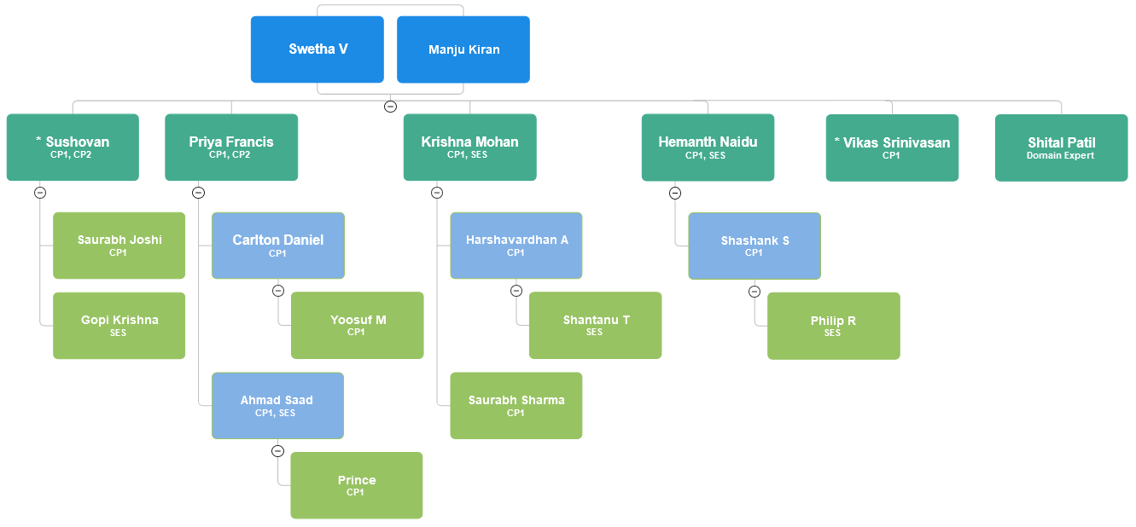
Data Science Team
GROW – ETL Governance Updates – Jan’24
CP – Customer Project
SES – Solution Ecosystem
Project Manager
Solution Architect
Specialist
Developers

Slide 6
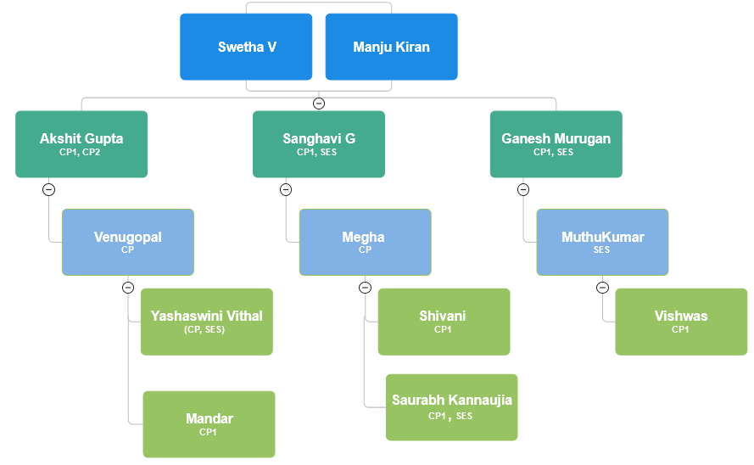
Data Engineering Team
GROW – ETL Governance Updates – Jan’24
CP – Customer Project
SES – Solution Ecosystem
Project Manager
Solution Architect
Specialist
Developers

Slide 7
GROW – ETL Governance Updates – Feb’24
Project Name: Solution Ecosystem
# Head count | #Datascience | # Data Engineering
9 | 6 | 0
Date(as on today) | Scope | Overall status | Time
29-Feb-2024
Project Scope
To enable and create a Unified Digital Enterprise by providing Digital twin solution/Template for various components.
Highlights
Centrifugal Compressor – Completed Surge detection | 15th Feb
Steam turbines - Analyzed first-phase simulation data for steam turbines, conducted EDA, and provided feedback to the simulation team | 12th Feb
Exploratory Task
Collaboration with IIT-R for synthetic sensor data gen – SOW done | 5 Feb
RUL(Remaining useful life) - Literature review | 12th Feb, exploring physics-based concepts to enhance health indicators – in progress
LLM's -Implementation of basic version of information extraction from pdf and response generation completed. | 19 Feb
Phase analysis EDA done on vibration dataset(adugodi test bench dataset) | 12 Feb
Key Next Steps
Centrifugal compressor - blade crack detection in progress, High level KPI development, Artesis, Faraday (Devices connected to motor to detect faults) data analysis.
Using Phase analysis to detect the faults in assets
Develop fault detection algo for heat exchanger
Steam turbine asset template- 2nd phase of data yet to be recieved
Motor -loose winding fault, loose rotor bar faults – on hold
LLM’s - Discuss with backend team for the integration.
Condensate pump template development - literature review and fault detection algorithms.
Research to create a robust rule-based vibration algorithm for different faults.
Key Risks/Measures:

Slide 8
GROW – ETL Governance Updates – Feb’24
Project Name: Solution Ecosystem – Data Engineering
# Head count | #Datascience | # Data Engineering
3 | 0 | 3
Date(as on today) | Scope | Overall status | Time
29-Feb-2024
Project Scope:
To enable and create a Unified Digital Enterprise by providing Digital twin solution/Template for various components.
Highlights
Support on PPGPL phase 2 design | 6 Feb
Integration of Asset Templates on edge solution | 9 Feb
Feature and prediction schema definition V2 | 16 Feb
PCH pipeline set up in Databricks | 19 Feb
HPE High frequency flow setup, script update and deployment | 21 Feb
IoTEdge PoC for KPI calculation and at scale deployment | 21 Feb
Enabling "DT in a Box" solution for BCW event | 26 Feb
Key Next Steps
Design and Implementation of RUL and KPI flows
Enabling MLOps pipeline on edge solution
IoT Edge, next set of tasks, if any
KPI Catalog designing
Key Risks/Measures
NA

Slide 9
GROW – ETL Governance Updates – Feb’24
Project Name: WinGD – Customer Project
# Head count | #Datascience | # Data Engineering | #Python Developer
4 | 1 | 2 | 1
Date(as on today) | Scope | Overall status | Time
31-Jan-2024
Project Scope
To create an anomaly detection model for Engine type 12X92DF along with reports and visualizations and to automate E2E pipeline for scheduled data download and inferencing.
Highlights
QuestDB Maintenance and Upgrade and Resumed Scheduler for fresh data download and processing| 5th Feb
Fast API for data pre-processing script | 06th Feb
Failure table Data Migration| 19th Feb
Data ingestion of Detection of event signals in PostgresDB table | 22nd Feb
Detection of Event Signals from Quest DB inferencing tables | 22nd Feb
Rename Outfile | 22nd Feb
Fast API for anomaly detection plots | 27th Feb
Failure table ingestion for dump migration for 12x92DF & 10x92DF vessel |15th March
Bmep for user Rating | In-progress
Key Next Steps
Close gaps in data
FastAPI for Anomaly Incidents
Failure table ingestion for all engines(3)
Anomaly Detection Webapp finalization
Resolve the existing issues in ACR topic
Key Risks/Measures
Debugging issues in ACR

Slide 10
GROW – ETL Governance Updates – Feb’24
Project Name: PPGPL – Customer Project
# Head count | #Datascience | # Data Engineering | #Front-end
5 | 2 | 2 | 1
Date(as on today) | Scope | Overall status | Time
29-Feb-2024
Project Scope
To enable and to create a Unified Digital Enterprise by providing Digital twin solution for Gas Turbines, Motor Pump and Cooling Tower Fan
Highlights
C-Suite and Common Causes of Failure:-| Feb 16
DS:- Main logic for C-suite and common causes of failure.
DE:- Back-end engineering changes to show the anomaly and threshold changes for common causes of failure. Additionally, APIs were introduced to compute the OE of all 3 assets and some other minor changes concerning front-end team requirements.
Front end:- Threshold display for engineering and operational insights was introduced along with some other minor changes.
Audit support:-| Feb 8
DS,DE, & Frontend: Supported in preparation and execution of the audit process. Got a green flag for the delivery of our project.
Anomaly reports for the Pump and Gas turbine delivered along with cost optimization concerning the resources used.
Key Next Steps
Phase 2B proposal to be delivered to the customer.
DS team will work on the pump cavitation ML model development.
DE support to re-deploy the pump cavitation model.
Key Risks/Measures
Dependencies with the simulation team to deliver fault models for the impeller cavitation and water hammer effect.

Slide 11
GROW – ETL Governance Updates – Feb’24
Project Name: KSB – Customer Project
# Head count | #Datascience | # Data Engineering
4 | 3 | 1
Date (as on today) | Scope | Overall status | Time
22-feb-2024
Project Scope:
To enable and to create proof of value (PoV) predictive maintenance solution for KSB's centrifugal pump and supporting facilities
Highlights
Data Summary on the overall data shared by customer | Feb 8
Analysis on the data received on Cavitation and Coupling from Customer | Feb 12
Expecting cavitation data (Low Cavitation, Medium Cavitation, High Cavitation data) from customer to start data modelling tasks on cavitation.
Modelling activity started for cavitation and coupling on the existing data| Feb 22
Base API Code is up and running on the webapp. | Feb 20
Creation of users for accessing UI in AD is completed. | Feb 21
Demonstration of user interface to the customer on 23rd | Feb 23
Activities for data availability in cosmos is started | Feb 23
Key Next Steps
Data analysis and AI ML model development for Cavitation and Coupling faults in KSB's centrifugal pump.
Data pipeline development for Cavitation and Coupling faults in KSB's centrifugal pump.
Key Risks/Measures
Simulation effort , timeline and approach yet to be finalized ( cavitation )
Data Collection & scope changes from customer can lead to delays
Data schema format confirmation from customer is pending.
Data ingestion mechanism confirmation is required.

Slide 12
GROW – ETL Governance Updates – Feb’24
Project Name: JSW – Customer Project
# Head count | #Datascience | # Data Engineering
3 | 2 | 1
Date(as on today) | Scope | Overall status | Time
31-Jan-2024
Project Scope:
Predicting roughing mill faults and avoid failure of the universal cross bearing ,and other connected state of lubrication and lubrication failure
Highlights
Data Science review identified existing analysis as inconclusive. Action required: Acquire detailed JSW data at critical bearing lifecycle stages.Specifics: Collect sets of 5 data samples after bearing installation, at mid-life, and before expected end-of-life. |Feb 12
Key Next Steps
New Sample Data Collection
Synthetic Data Generation
Machine Learning Model Development
Failure Prediction
Meta Model Deployment
Lubrication Timing Prediction:
Key Risks/Measures
Collect high-quality samples from JSW to discern patterns confirming if current sensors can detect failure with 60% accuracy.
Created high-frequency data by simulation team from existing low-frequency records, test with customer-defined set points at pre-failure, failure, and post-failure stages and validate the abnormalities if any.

