Slide 1




IndAIGenious

Slide 2



IndAIGenious
Functional view representing IndAIGenious in a multi-site scenario
SITES
Gen ai assistant
PERSONA
Plant 1
Data Platform
IndAIGenious
Asset tags
Maintenance history
Inventory details
Plant Head
Predictive Failure Assessment
Plant 2
Condition Monitoring Failure Assessment
Shift Manager
Asset tags
Maintenance history
Inventory details
Inventory Recommendations
Resolution and Technician Recommendations
Operator
.
.
.
Technician Assistant
Lead Technician
Plant N
Centralised knowledge base
Technician
Workflow Integrations
Asset tags
Maintenance history
Inventory details`
Core Module
Maintenance Lead
2

Slide 3
IndAIGenious
Detailed View: Key Building Blocks of IndAIGenious
IndAIGenious – Building Blocks
IndAIGenious
Modules
Predictive Failure Assessment
Condition Monitoring failure assessment
Inventory recommendations
Resolution and Technician Recommendations
Technician Assistant
Centralized Knowledge base
Workflow Integrations
Security and Governance
Services
Model deployment and monitoring
Responsible and XAI *
Endpoint Management
Usage tracking
Feedback loop
Lifecycle Management
Models
OEM
Open Source
Orchestration
Agents
Prompt Engineering
Kowledge Base
Embedding store
Vector DB
Knowledge Graph
Document DB
Domain artefacts
Embeddings
Embedding models
Embedding vectors
Data Platform *
Medallion architecture
Active Metadata
Data Quality
Validations
Transcribe & Transcript
Structured, Semi structured, Unstructured
Lineage and Catalog
* Optional
3

Slide 4
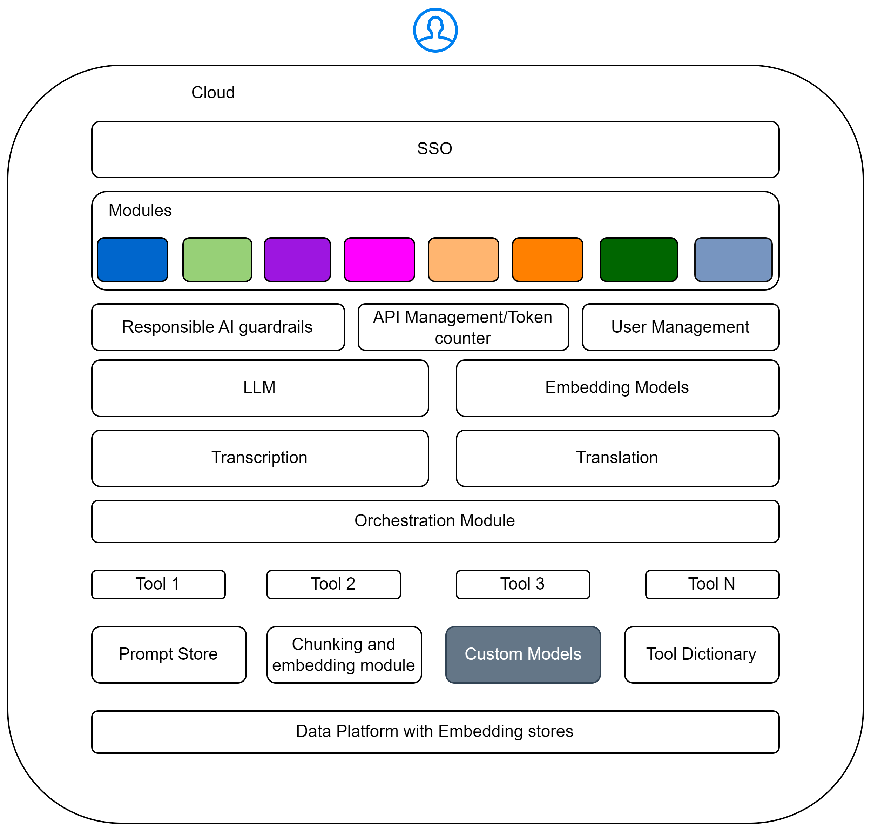








IndAIGenious
Building Blocks
Predictive Failure Assessment**
Condition Monitoring Failure Assessment**
Inventory Recommendations
Resolution and Technician Recommendations
Technician Assistant
Centralized Knowledge base
Workflow Integrations*
Core Module
Custom Models**
*Will require customization
** Supports BYOM
4

Slide 5
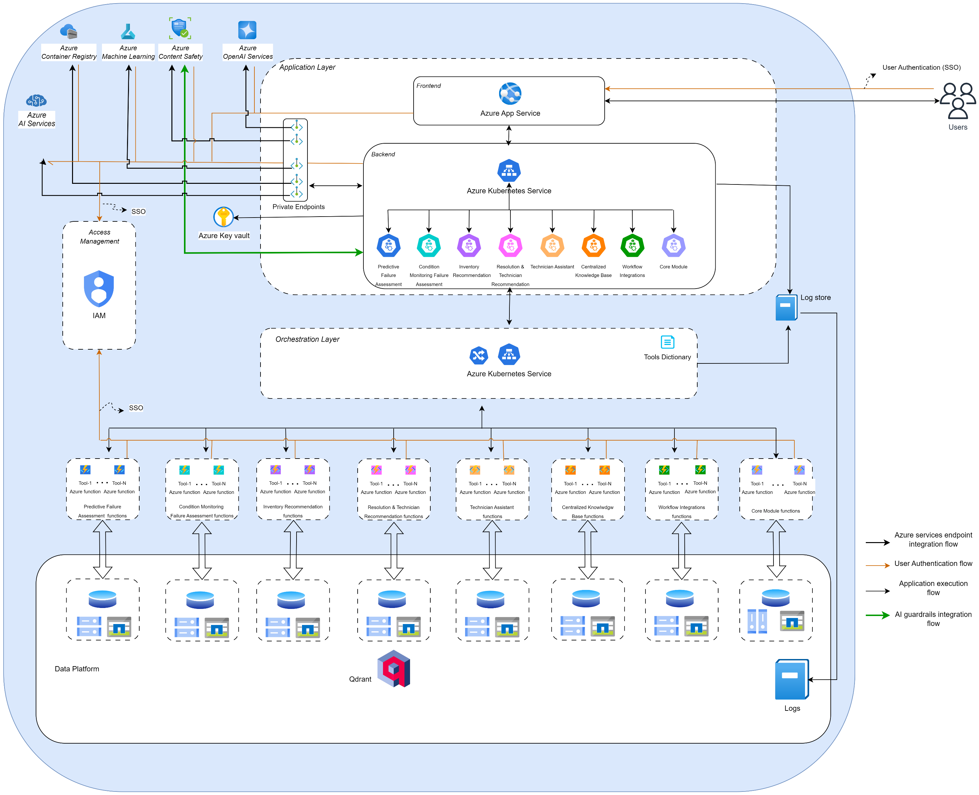
IndAIGenious
Architecture
5

Slide 6
IndAIGenious
Components
Building Block | Component | Purpose
Security and Governance | IAM (Identity and Access Management) | The module is responsible for managing user access and permissions for IndAIGenious modules. Key features include: Access Control: Manages user roles and permissions based on predefined personas and access rights. Data Privacy and Security: Ensures robust data privacy and security tailored to individual user roles and access levels. This module ensures a secure and streamlined user management process while maintaining compliance with data protection standards.
Application Layer | Azure Kubernetes Service | Execution Environment This is the platform where IndAIGenious modules operate, enabling the deployment and execution of scalable, containerized applications.
 | Azure App Service | The Frontend Hosting component serves as the interface layer for IndAIGenious modules. It provides an intuitive and accessible user interface designed for end-users. Key features include: User Interaction: Enables seamless interaction with the platform through a well-designed, responsive interface. Accessibility: Ensures end-users can efficiently access and navigate the functionalities offered by the IndAIGenious modules. Integration: Acts as a gateway to the backend services, delivering a cohesive and streamlined experience. This component is critical for delivering a user-centric approach to leveraging the capabilities of IndAIGenious modules.
 | Core Module | Enables users to easily access and configure the IndAIGenious modules according to their needs. Provides tools for managing configurations, monitoring usage, and interacting with individual modules independently. Features a Self-Service Unit that simplifies operations by offering: Single-Click Deployment: Streamlines the deployment process. Automated Subscription Checks: Ensures subscriptions are validated and up to date without manual intervention.
6

Slide 7
IndAIGenious
Components
Building Block | Component | Purpose
Application Layer | Azure Container Registry | This component is responsible for storing module images utilized by the IndAIGenious modules. It ensures reliable and efficient access to the container images required for deploying and running the modules.
Monitoring and Logging | Log Store | The Centralized Log Storage serves as a unified repository for logs generated by various IndAIGenious modules. Key functionalities include: Monitoring: Facilitates real-time observation of system activities across modules. Troubleshooting: Provides detailed logs to diagnose and resolve issues effectively. Audit and Compliance: Maintains a comprehensive log history for audit and compliance purposes. This centralized storage ensures seamless log management and improves operational efficiency.
Models, Embeddings | Azure Machine Learning | This component provides the environment and tools necessary for onboarding Large Language Models (LLMs) onto managed compute infrastructure or leveraging Model as a Service (MaaS). Key features include: LLM Onboarding: Simplifies the deployment of pre-trained LLMs onto managed compute platforms, ensuring scalability and ease of use. Custom Model Development: Offers a robust platform for developing, training, and deploying custom models tailored to specific requirements. Flexibility and Integration: Supports a variety of machine learning workflows, making it adaptable for diverse use cases. This platform accelerates the integration of LLMs and empowers users to create bespoke AI solutions.
 | Azure OpenAI Services | Access to advanced language models like GPT-4,GPT-4o etc. for generative AI applications.
6

Slide 8
IndAIGenious
Components
Building Block | Component | Purpose
Orchestration | Tools Dictionary | The Tools Dictionary stores detailed information about the various tools available within the IndAIGenious modules. Key functionalities include: Centralized Repository: Acts as a single source of truth for all tools offered by the modules. Easy Lookup: Enables efficient search and retrieval of information for seamless integration. Component Integration: Facilitates smooth interaction between different components by providing consistent and accessible service data. This dictionary ensures streamlined access to tools and services, enhancing the modularity and usability of the platform.
Transcribe & Transcript | Azure AI services | IndAIGenious modules uses Azure AI services for transcription and translations.
Security and Governance | Azure Content Safety | The IndAIGenious modules ensure that all generated or processed content remains compliant with safety policies. This is achieved through a combination of automated mechanisms, real-time content filtering, and continuous monitoring to detect and prevent harmful, inappropriate, or unethical material.
 | Azure Key Vault | Secures sensitive information, such as secrets, API keys, and certificates, which the application accesses through Private Endpoints for secure communication.
Data Platform | Data Platform | The data platforms collect, store, and manage the data required for each module. These platforms are designed to efficiently handle large volumes of data, ensuring that the necessary information is readily available and well-organized for processing within the respective modules. These data platforms ensure seamless integration and efficient data flow across the system.
6

Slide 9
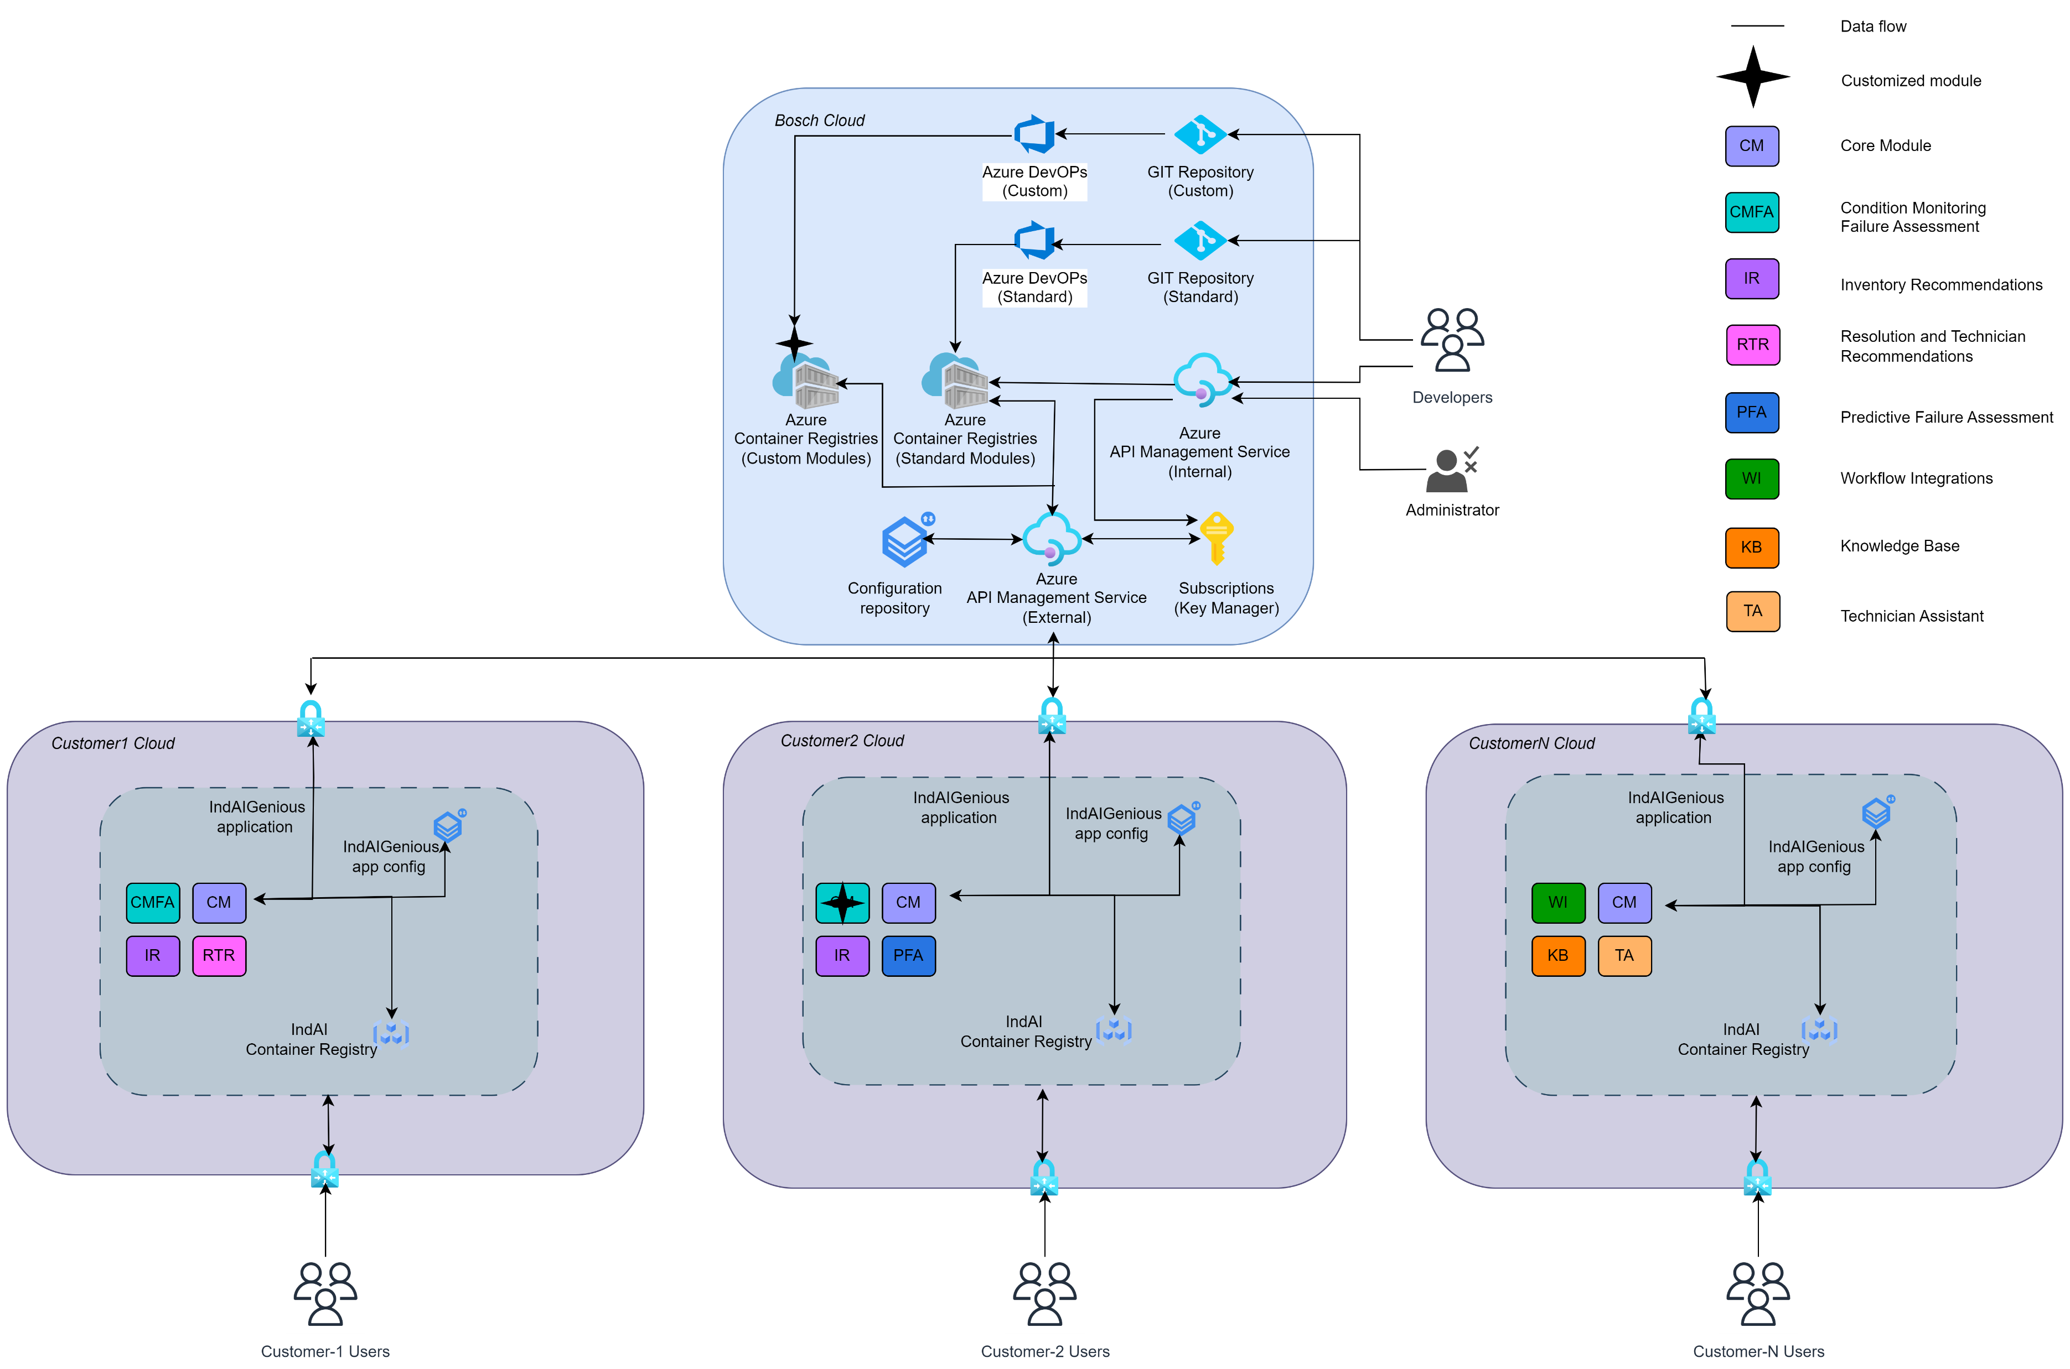
IndAIGenious
Deployment Architecture
7

Slide 10
IndAIGenious
Components
Cloud | Component | Purpose
Bosch | Azure DevOps and GIT Repository | Azure DevOps and Git are utilized for version control and continuous integration/continuous deployment (CI/CD) pipeline management for the IndAIGenious modules. These tools facilitate efficient code management, streamlined deployment processes, and maintain consistency across the development lifecycle. Key aspects include: Version Control: Git is used to manage the application’s codebase, enabling version tracking and collaboration across development teams. CI/CD Pipeline: Azure DevOps is responsible for automating the build, testing, and deployment of the IndAIGenious modules, ensuring faster release cycles and consistent delivery of updates. Codebase and Artifacts: The application’s codebase, along with deployment artifacts, are stored and managed within Azure DevOps and Git repositories. Separate Repositories: Distinct repositories are maintained for Custom Modules and Standard Modules to ensure proper segregation and version management for each module type. This system provides a robust infrastructure for maintaining and deploying the IndAIGenious modules while ensuring code quality and reliability.
 | Subscriptions (Key Manager) | The subscription management system ensures secure access to the IndAIGenious modules, allowing only authorized customers to interact with the modules. This system also tracks the module versions that customers have subscribed to, enabling version-specific access control. Key features include: Secure Access Control: Ensures that only authorized customers can access the modules, protecting against unauthorized usage. Version Tracking: Stores information about the specific module versions that customers have subscribed to, allowing for version-specific module access. Customer Subscription Management: Allows for the management of customer subscriptions, including the ability to update, renew, or revoke access to modules based on subscription status. This ensures secure and controlled access to the IndAIGenious modules, aligned with customer subscriptions and versioning requirements.
8

Slide 11
IndAIGenious
Components
Cloud | Component | Purpose
Bosch | Azure Container Registry (ACR) | This system is responsible for storing the module images of the IndAIGenious modules, ensuring they are readily accessible across different customer environments. Once the standard module images are built, they are pushed to a centralized container registry. Customer-specific module images are pushed to a separate, dedicated registry with access controls tailored to each customer's requirements. Key components include: Centralized Registry for Standard Images: Standard module images are stored in a centralized registry, making them accessible across all customer environments. Custom Container Registry for Customer-Specific Images: Customer-specific module images are stored in separate, isolated registries, ensuring that each customer has access only to their designated images. Access Control: Access to the customer-specific images is managed via tailored access controls, ensuring that only authorized customers can retrieve their corresponding module images. This approach ensures efficient, secure, and scalable management of module images across different customer environments.
 | Azure API Management Service (Internal and External) | The API management services are designed to handle both internal and external APIs, ensuring secure and efficient interactions within Bosch Cloud and with external clients. Internal API Management Service The Internal API Management Service is used for managing internal APIs, which are accessed exclusively within Bosch Cloud or by authorized Bosch components. This service ensures secure and efficient communication between internal systems. Key features: Internal Access Control: APIs are restricted to authorized Bosch components, ensuring secure internal communication. Service Integration: Facilitates seamless integration between various Bosch services and components within the Bosch Cloud. External API Management Service The External API Management Service manages customer-facing APIs, providing a secure mechanism for external clients (in customer clouds) to interact with Bosch's API services. This service is designed to offer secure access, rate limiting, and monitoring for external interactions. Key features: External Client Access: Allows external clients to securely access Bosch’s API services. Security & Access Control: Ensures that only authorized external clients can interact with Bosch APIs, implementing proper authentication and authorization mechanisms. API Rate Limiting and Monitoring: Provides rate limiting and monitoring features to ensure optimal performance and security for customer-facing APIs. These services help maintain a secure, efficient, and scalable API ecosystem, ensuring proper access management both internally and externally.
8

Slide 12
IndAIGenious
Components
Cloud | Component | Purpose
Bosch | Configuration Repository | This system contains configuration files and scripts that manage the configuration settings for various components of the IndAIGenious modules. It also tracks the version information of the components currently in use by the customer, ensuring that each deployment is properly configured and versioned. Key features include: Configuration Files and Scripts: Stores and manages configuration files and scripts to customize and control the settings of various components within the IndAIGenious modules. Version Tracking: Maintains detailed version information for the components in use, ensuring that the correct versions are deployed and accessible to the customer. Customer-Specific Configurations: Allows for the management of customer-specific configurations, ensuring that each customer has the appropriate settings tailored to their environment. This system ensures that all components are properly configured and versioned, streamlining deployment and maintenance across different customer environments.
Customer | Self-Service Module | Self-Service Unit that simplifies operations by offering: Single-Click Deployment: Streamlines the deployment process. Automated Subscription Checks: Ensures subscriptions are validated and up to date without manual intervention.
 | IndAIGenious Container Registry | This system stores application-specific containers that are required for the deployment of IndAIGenious modules. It ensures that all necessary containers are available for seamless and efficient deployment across customer environment.
 | IndAIGenious Application | Know-it-all Gen AI powered assistant to aid Industrial plants for key stakeholders involved in Manufacturing process
 | IndAIGenious Application Configuration | This system stores application-specific configurations that are required for the deployment of IndAIGenious modules. It ensures that all necessary configurations are available for seamless and efficient deployment across customer environment. Key features include: Application-Specific Configurations: Stores configurations tailored to the requirements of each IndAIGenious module, ensuring correct setup and operation during deployment. Deployment Readiness: Ensures that all configuration files and container images are prepped and accessible for deployment, facilitating a smooth roll-out process across customer environment.
8

Slide 13
Thank You

