Slide 1

PROOF BEFORE PROFIT
An abstention-first, defined-risk options agent
Notes:
Open with one sentence: AlphaLedger is the options agent that can prove why it refused a trade, not only explain one it planned.
[Sources]
- Local generated asset: assets/alphaledger-cover.png

Slide 2
THE TRUST GAP
Prediction is easy to demo. Refusal is hard to prove.
Options turn one stale quote or understated debit into a different risk.
1
Are both quotes, Greeks, and liquidity valid?
But a real user still needs to know:
2
Was maximum loss recomputed from the legs?
3
Can the model veto without authorizing?
AXIOMWEAVE ALPHALEDGER
02
Notes:
Frame the problem around options risk, not market prediction. The live hub exposes the Options Alpha Agents track; our entry focuses on the deterministic control surface an AI options agent needs.
[Sources]
- https://lablab.ai/ai-hackathons/alpaca-ai-trading-agents-hackathon
- https://docs.alpaca.markets/us/docs/paper-trading

Slide 3
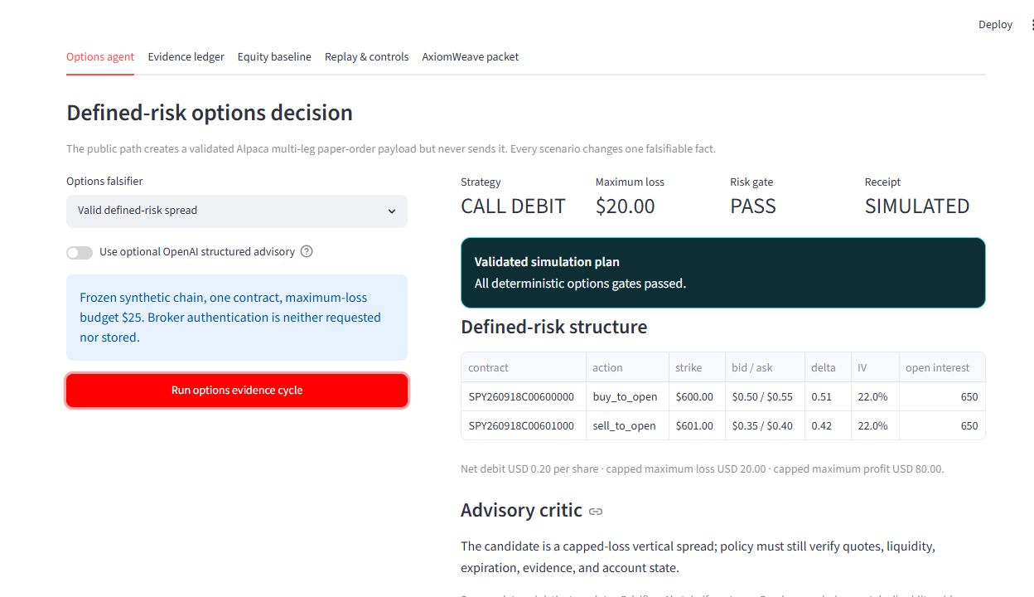
THE PRODUCT
AlphaLedger turns every decision into a falsifiable receipt
1
Name both option legs
2
Recompute capped loss
3
Gate before a plan
The public demo is simulation-only and requests no credentials.
AXIOMWEAVE ALPHALEDGER
03
Notes:
Show the working screen. Read the four outputs: CALL DEBIT, $20 maximum loss, PASS, SIMULATED. Point to the two legs and state that no broker request was made.
[Sources]
- Local browser-verified screenshot: artifacts/options-dashboard-pass.png

Slide 4
HOW IT WORKS
One governed loop keeps AI advisory
OBSERVE
PROPOSE
ADVISE
RECOMPUTE
PLAN / ABSTAIN
LEDGER
complete typed data
capped spread
structured veto
quote economics
paper shape
hash chain
The adviser may veto. Only quote-derived deterministic policy can permit a plan.
The public path validates Alpaca’s multi-leg order shape but never sends it.
AXIOMWEAVE ALPHALEDGER
04
Notes:
The data reader now retrieves complete contracts and snapshot pages using unchanged filters. It rejects duplicate symbols, repeated tokens, transport errors, incomplete pages, or exceeded page/record/time budgets. AI remains optional and veto-only.
[Sources]
- src/alphaledger/alpaca_readonly.py
- https://docs.alpaca.markets/us/reference/get-options-contracts
- https://docs.alpaca.markets/us/reference/optionchain

Slide 5
THE 30-SECOND DEMO
Change one fact; the same candidate stops
12 s
900 s
evidence age
evidence age
PASS
ABSTAIN
simulated receipt
rejection receipt
AXIOMWEAVE ALPHALEDGER
05
Notes:
This is the centerpiece. Run the valid option spread, then switch only evidence age. At 900 seconds both contracts cross the 180-second hard stop, no multi-leg payload exists, and the abstention is ledgered.
[Sources]
- Local source: app.py
- Local source: tests/test_options.py

Slide 6
CLOCK + RISK CONTROLS
Six controls outrank every model score
01
paper only; exact account and one writer
02
complete, fresh data with valid Greeks
MODEL
03
10:20–14:30 ET; one attempt per day
veto only
04
$250 plan / $500 day / $1k total loss caps
POLICY
05
45-minute hold; +25% / −20% exit triggers
execution authority
06
Thu 15:45 ET flat; EOD Thursday equity scored
AXIOMWEAVE ALPHALEDGER
06
Notes:
Frozen competition policy: new SPY call/put debit-spread entries Monday through Thursday, 10:20–14:30 ET, at most one attempt per session. Maximum planned loss $250, daily drawdown stop $500, total drawdown stop $1,000, maximum hold 45 minutes, +25% take-profit and -20% stop-loss triggers. These are controller rules, not guarantees that a fill or exit is available. Default force-flat Thursday September 3 at 15:45 ET. Organizer scoring basis is total equity as of EOD Thursday, including Thursday-expiry exercise and assignment. Policy and executor hashes were unchanged by the pagination repair.
[Sources]
- src/alphaledger/competition.py
- src/alphaledger/competition_runner.py
- evidence/competition-window-decision.json
- evidence/incidents/2026-08-31-options-pagination.json

Slide 7
EVALUATION HONESTY
The evidence ceiling is visible, not buried
C0
C1
C2
C3
C4
C5
C6
C1 · mechanics on frozen synthetic + Alpaca-shaped inputs
102 tests pass
≠
options alpha proven
No tested signal cleared its held-out promotion gate
AXIOMWEAVE ALPHALEDGER
07
Notes:
102 local tests passed on August 31. The same suite on the VM passed 101 and skipped the Windows-only PowerShell test. This is C1 mechanics, not alpha. A 60-day five-minute study had only 16 held-out fallback observations; mean directional proxy 2.068468 bps did not exceed standard error 2.281778 bps, and minus-5-bps stress was negative. The hourly candidate failed untouched test. No tested strategy earned promotion. Authenticated current paper operations are C2 observations, not future performance.
[Sources]
- evidence/verification-receipt.json
- evidence/signal-benchmark-receipt.json
- evidence/hourly-regime-benchmark-receipt.json
- evidence/incidents/2026-08-31-options-pagination.json

Slide 8
INCIDENT • AUGUST 31
An incomplete catalog stopped new entries
MEASURED TIMELINE · PT
REPAIR + EVIDENCE
07:21:58 First fault
07:33:59 Detected
07:58:38 Verified
36m 40s Elapsed
1,041 contracts. Two pages.
Complete bounded retrieval; no silent truncation.
NO
102 local tests passed
ORDERS
VM: 101 passed; one Windows-only skip.
through recovery
State and policy preserved
No orders or loss observed through recovery.
AXIOMWEAVE ALPHALEDGER
08
Notes:
On August 31 the first logged options-data failure was 07:21:58 Pacific. The hourly monitor detected repeated errors at 07:33:59 and reproduced incomplete pagination at 07:35:11. Repair verification completed at 07:58:38, 36 minutes 40 seconds after first failure. Service pause was 19.44 seconds. Complete two-page retrieval returned 1,041 contracts. The first post-restart cycle was a valid neutral-signal abstention. No orders, positions, or account loss were observed through recovery; forgone profitable opportunity is unknown. This is an incident report, not final competition performance.
[Sources]
- docs/INCIDENT_2026-08-31_PAGINATION.md
- evidence/incidents/2026-08-31-options-pagination.json
- evidence/public-operation-status.json
- https://docs.alpaca.markets/us/reference/get-options-contracts

Slide 9
BUSINESS VALUE
A trust layer for AI options workflows
WHO IT COULD SERVE
WHAT WE OFFER
Brokerages
Fintech platforms
Wealth tools
Agent developers
Quote-derived provenance
Why these legs, economics, and outcome?
PAPER
Fail-closed planning
first
No model-direct path to a broker payload.
proof before scale
Audit-ready replay
Passes and abstentions share one ledger.
AXIOMWEAVE ALPHALEDGER
09
Notes:
These are prospective users and product hypotheses, not established customers or willingness-to-pay evidence. The public demo is credential-free. The private paper runner is separately activated with exact-account and risk gates.
[Sources]
- docs/ONE_PAGE_WRITEUP.md
- README.md

Slide 10
TRUST BEGINS WITH
the option trade an agent refuses.
NEXT
Try the public demo: 34.27.11.180
AxiomWeave
AlphaLedger
Inspect the receipts, including our failure
Proof before profit
Reconcile Thursday EOD before final submission
AXIOMWEAVE ALPHALEDGER
10
Notes:
Invite judges to inspect the public demo and code, including the preserved failure. Final results must use reconciled Thursday EOD equity, not the interim recovery snapshot. The final video and LabLab submission remain owner-reviewed actions. No probability of winning is established.
[Sources]
- docs/SUBMISSION_WALKTHROUGH.md
- docs/RESOURCE_UPDATE_CHECKLIST.md
- evidence/competition-window-decision.json
- http://34.27.11.180
- https://github.com/SVG-campus/axiomweave-alphaledger

