Slide 1
Interacting with SPFx Web Parts in Modern Pages

Slide 2

Interacting with SPFx Web Parts in Modern Pages
Adding client-side web parts to modern pages
Introducing the new reactive property pane
Validating local SPFx development environment
Notes:
In this unit, you'll learn how to interact with Framework-based client-side web parts in a SharePoint Online modern site collection.

Slide 3
SharePoint client-side web parts
Configurable, reusable, purpose-built components
Add functionality to SharePoint experiences
Web Parts
Framework for connecting related components
Context aware parts
Notes:
Client-side web parts, built using the SharePoint Framework, are the cornerstone of the vision for innovating, extending and customizing the SharePoint modern experience.
They are configurable, reusable and purpose-built components that page designers and site owns can use to create unique experiences for their users.
Client-side web parts are built using the SharePoint Framework that provide additional capabilities, including access to Microsoft Graph for incorporating personal and organizational information into page experiences.
Web parts are also context aware, in the sense that they have access to contextual information about the current page. For instance, at runtime, the web part can get information about the current user and the current page and site the web part is currently running in.
Client-side web parts are flexible as well! Developers can use them to create single page applications (SPAs) as single page app pages, the basis for Microsoft Teams tabs and personal apps, and even as the host for Office Add-ins.

Slide 4
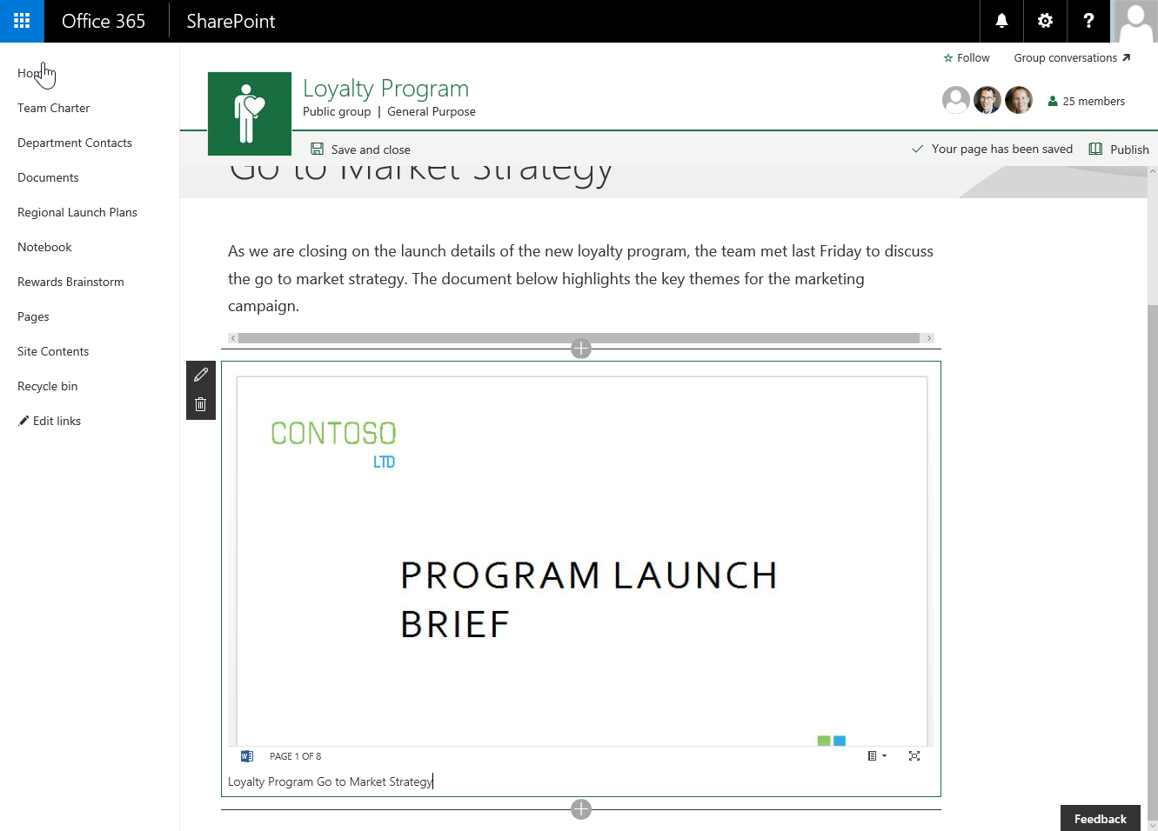
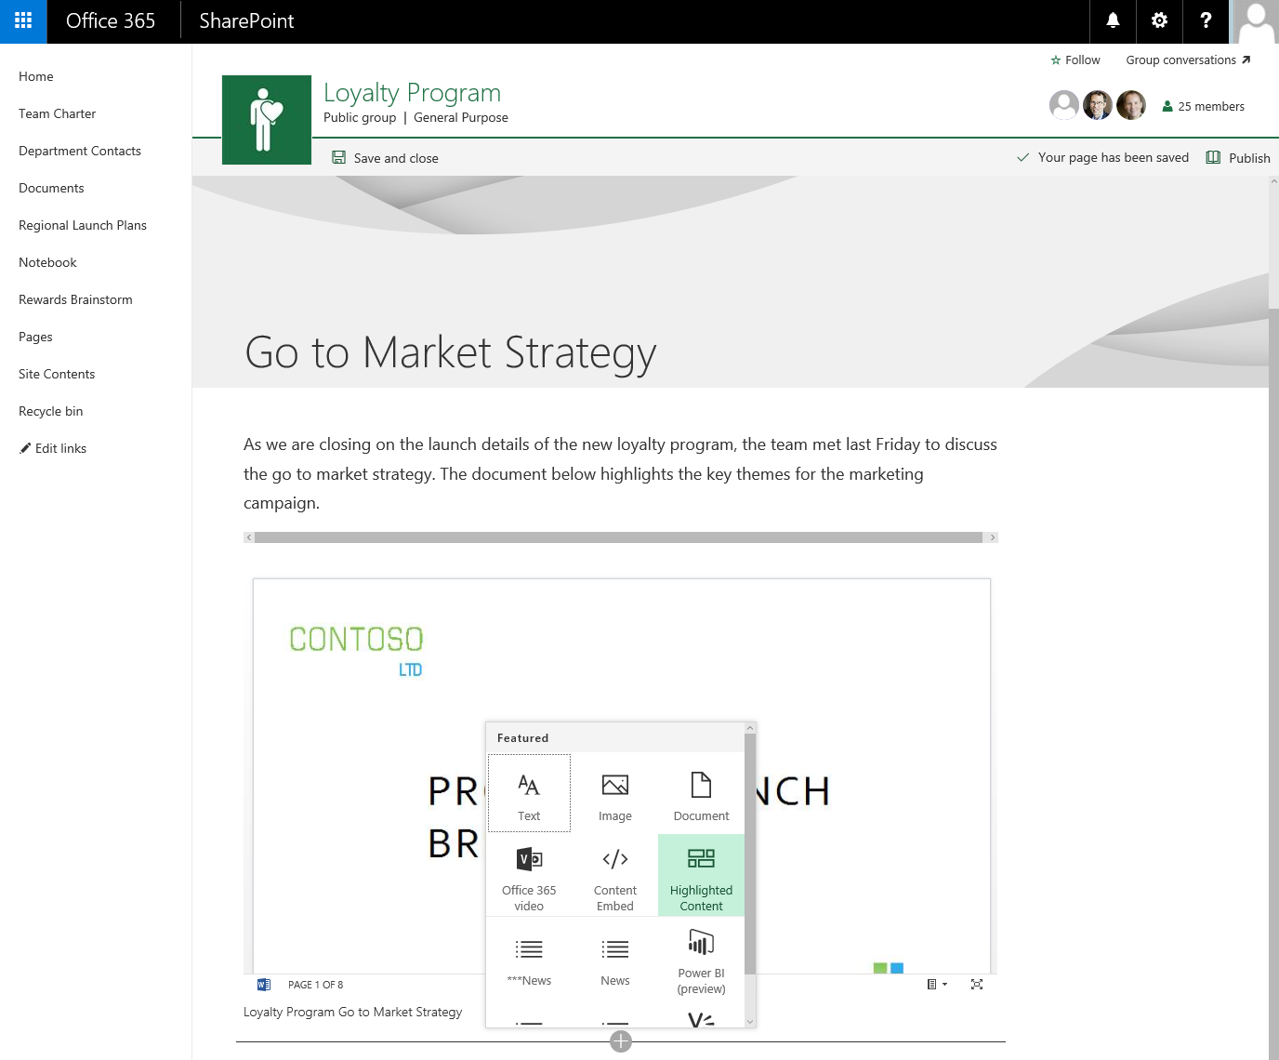
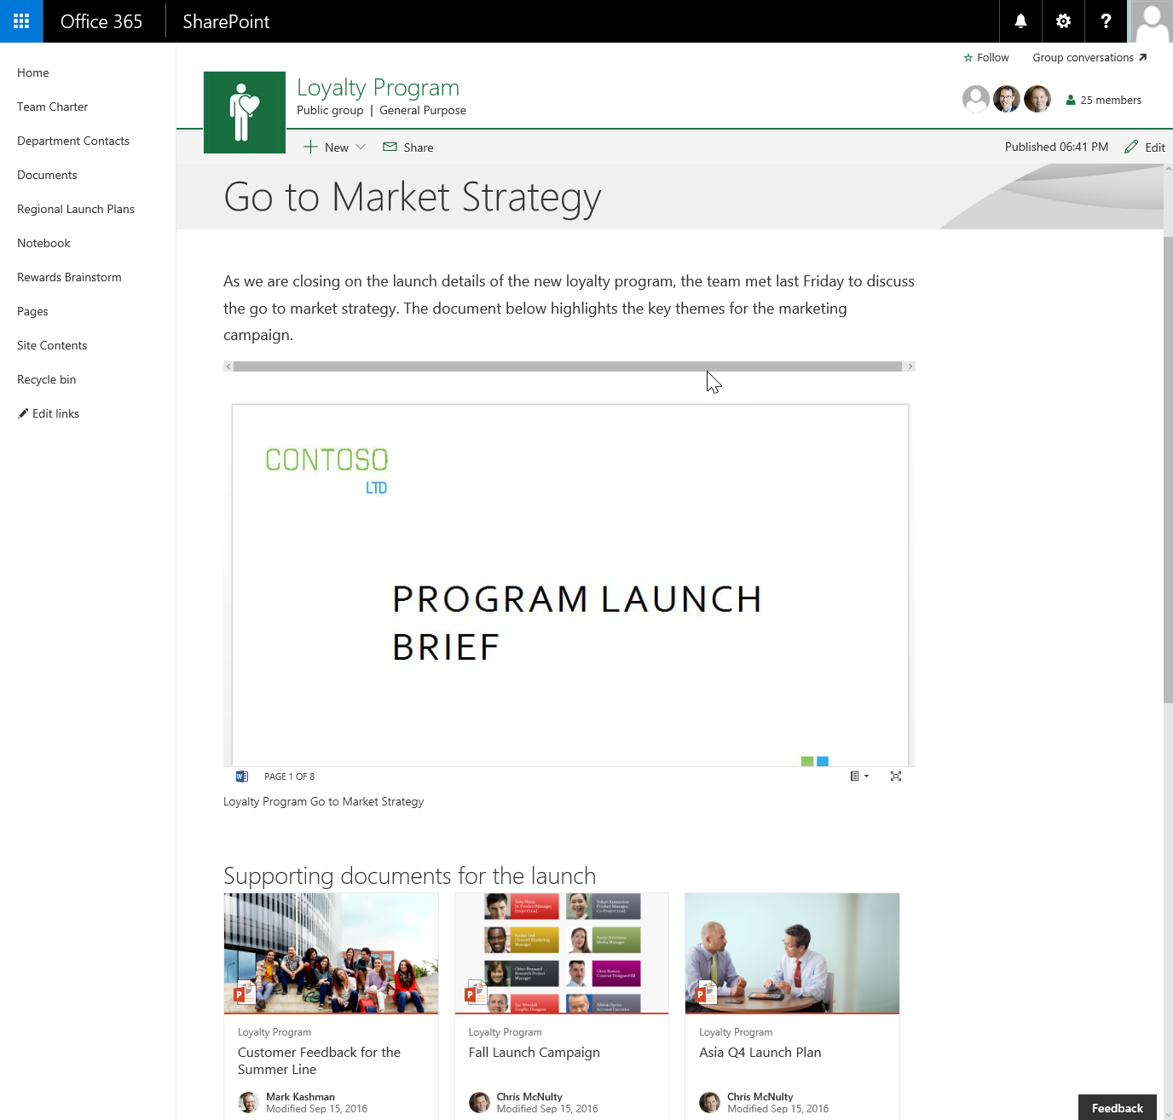

Client-side web parts
They are still web parts!
Built for the modern, JavaScript-driven web
Runs directly inside a SharePoint Page
Notes:
Experienced SharePoint developers who are familiar with server-side web parts developed and deployed using SharePoint features and solutions will find client-side web parts to be familiar. They are just web parts!
The only difference from a server-side web part is client-side web parts are rendered in the browser, not on the server.
Client-side web parts are build for the modern, JavaScript-driven web just as the modern SharePoint experience.

Slide 5
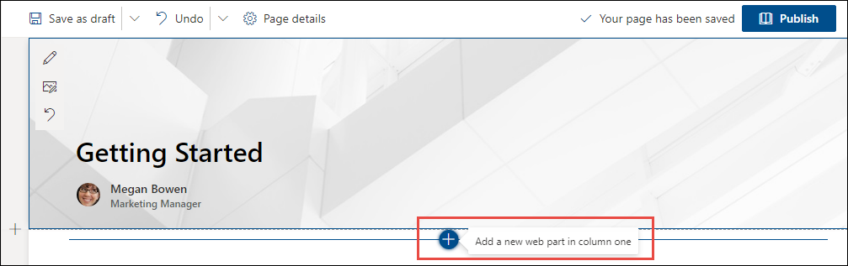
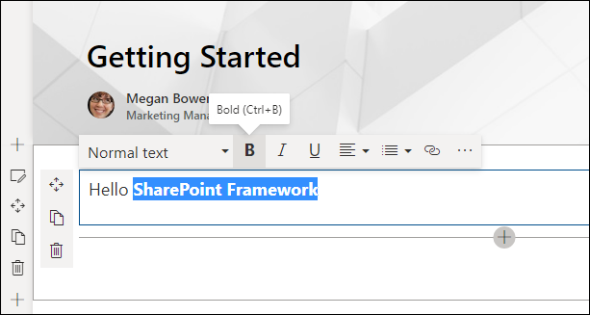
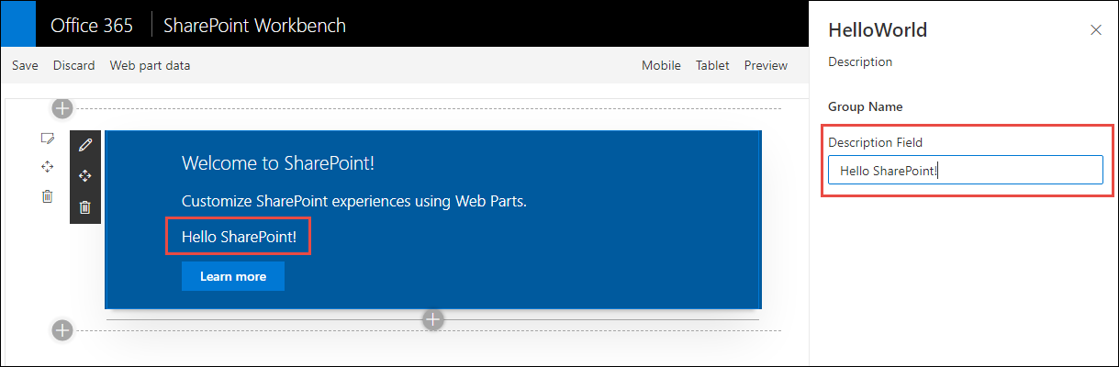
Adding SPFx web parts to pages
Once a page is in edit mode, add via web part toolbox
Select a web part and edit inline or using the property pane
Notes:
Unlike classic pages, when a page is in edit mode, any web parts on the page are also in edit mode. Compared to classic pages where the web part has a different edit mode from the page's edit mode.
To add a web part to a modern page, first put the page in edit mode and then select the **+** icon to open the toolbox. Select a web part from the toolbox to add it to the page.
You can edit the web part by opening the property pane with the edit icon to the left of the web part. By default, any changes made in the property page are immediately reflected in the web part.

Slide 6
Demo Interact with SPFx Client-Side Web Parts in Modern Sites

Slide 7
Validate local SPFx development configuration
Install required runtimes & tools:
Node.js & NPM (included with Node.js)
Yeoman, SPFx Yeoman generator
Gulp
Create first project with Yeoman & SPFx generator
Build & run web part in the workbench
yo @microsoft/sharepoint
gulp serve --nobrowser

Slide 8
Demo Creating & Running Your First SPFx Project

Slide 9

Summary
Adding client-side web parts to modern pages
Introducing the new reactive property pane
Validating local SPFx development environment

Slide 10
Thank you.

