Slide 1



Predicting Solar Power Output Using Linear Regression
Presented by: Sunkeswaram Venkata Lakshman
Under the Guidance of : M S Raghunandan Sir

Slide 2

Learning Objectives
1. Understanding and Preparing the Dataset
✔ Learn how to load a dataset using pandas and inspect its structure using:
df.head(), df.tail(), df.shape, df.describe(), df.info()
✔ Identify missing values using df.isnull().sum() and handle them appropriately.
✔ Detect duplicate values using df.duplicated().sum().
✔ Understand dataset features using df.columns.
2. Feature Engineering & Preprocessing
✔ Understand feature selection by identifying relevant independent variables (X = df.drop('generated_power_kw', axis=1)).
✔ Use data normalization (StandardScaler()) to scale numerical features.
GOAL
Source :
https://github.com/SVLakshman287/Week1.git

Slide 3
3. Exploratory Data Analysis (EDA) & Visualization
✔ Learn how to visualize data distributions using:
Histograms: sns.histplot() for visualizing the distribution of generated_power_kw.
Scatter plots: plt.scatter() to analyze the relationship between each feature and power generation.
Box plots: sns.boxplot() to detect outliers in the dataset.
4. Machine Learning Model Training
✔Learn how to split data into training and testing sets using train_test_split().
✔Implement Linear Regression using LinearRegression() from sklearn.
✔Train the model on scaled features and fit it to the dataset using model.fit().
5. Model Evaluation & Performance Metrics
✔ Make predictions using model.predict(X_test_scaled).
✔ Evaluate the model using:
Mean Absolute Error (MAE): Measures how far predictions are from actual values.
Compare training vs. testing performance to check for overfitting.
6. Practical Applications
✔ Learn how solar power prediction models can help in:
Optimizing energy production.
Improving solar panel efficiency.
Managing electricity grids effectively.

Slide 4
Tools and Technology used
Category | Technology Used
Programming Language | Python
Data Handling | Pandas, NumPy
Visualization | Matplotlib, Seaborn
Machine Learning | Scikit-Learn (Linear Regression, Train-Test Split, StandardScaler)
Model Evaluation | Mean Absolute Error (MAE)

Slide 5
Why These Tools?
Tool/Metric | Why It’s Used?
Python & Pandas | Efficient for data handling, processing large datasets, and performing transformations.
Seaborn & Matplotlib | Helps in data visualization (distributions, correlations, scatter plots).
Scikit-Learn | Provides train-test split, feature scaling, ML models, and evaluation metrics.
Mean Absolute Error (MAE) | Measures how far predictions are from actual values, used to evaluate model accuracy.

Slide 6
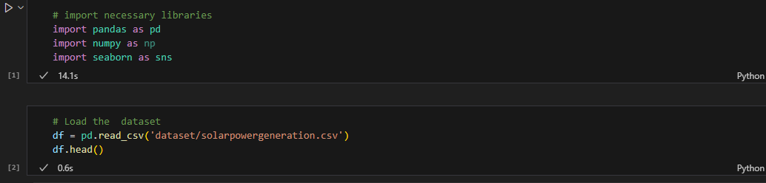
1. Programming Language & Environment
✔ Python → Used for data manipulation, visualization, and machine learning.
✔ Jupyter Notebook / IDEs (VS Code, PyCharm, etc.) → Used for writing and running the code.
2. Libraries & Packages Used
📌 Data Handling & Processing
🔹 pandas → For data loading, cleaning, and manipulation.
🔹 numpy → For numerical computations and handling arrays.
🔹 seaborn → For statistical data visualization (histograms, heatmaps, etc.).

Slide 7
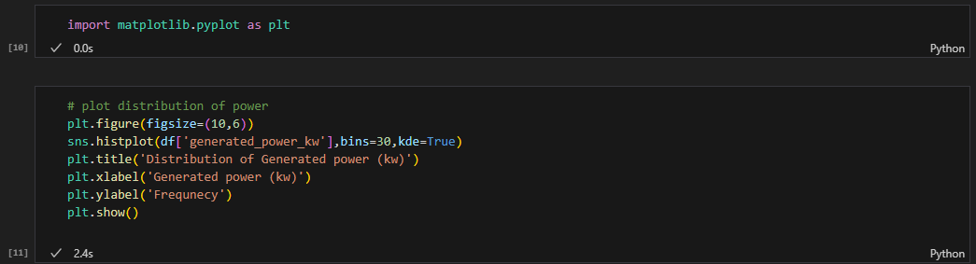
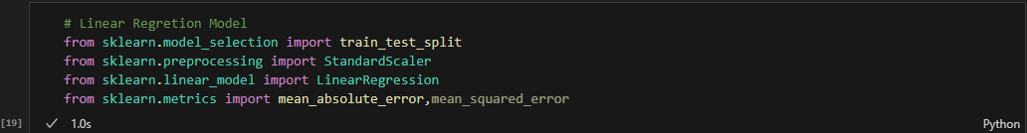
📌 Why Matplotlib?
The most widely used library for plotting graphs and charts in Python.
Supports customization of plots with labels, colors, and grid options.
Example used in your code:
📌 Why Scikit-Learn?
One of the most popular machine learning libraries in Python.
Provides pre-built ML models, data preprocessing tools, and evaluation metrics.
Supports train-test splitting, scaling, and regression/classification models.

Slide 8
Methodology
Methodology for Solar Power Prediction using a Linear Regression Model.
Below is the step-by-step breakdown of how the project is implemented:
📌 Step 1: Data Collection & Loading
✔ The dataset is loaded using Pandas from a CSV file.
✔ The first few rows and dataset structure are displayed to understand the data.
📌 Step 2: Data Preprocessing (Cleaning & Preparation)
✔Check for missing values and handle them.
✔ Identify and remove duplicate values.
✔ Extract column names and structure of the dataset.
📌 Step 3: Exploratory Data Analysis (EDA)
EDA helps understand the distribution of data and relationships between features.
✔ Univariate Analysis (Single Variable Distribution)
Histograms and KDE plots visualize the distribution of solar power generation.
✔ Multivariate Analysis (Relationships Between Features)
Scatter plots help identify correlations between input features and target values.

Slide 9
📌 Step 4: Feature Engineering & Selection
✔ Identify relevant features that affect power generation.
✔ Remove unnecessary columns to improve model efficiency.
✔ Feature Scaling
📌 Step 5: Splitting the Data for Training & Testing
✔ Divide the dataset into 80% training data and 20% test data to evaluate model performance.
📌 Step 6: Machine Learning Model Training (Linear Regression)
✔ Train a Linear Regression model using Scikit-Learn.
✔ Fit the model on scaled training data.
📌 Step 7: Model Evaluation & Performance Metrics
✔ Predict solar power generation on test data.
✔ Evaluate model accuracy using Mean Absolute Error (MAE).
✔ Compare performance on the training set to check for overfitting.
📌 Step 8: Interpretation & Future Improvements
✔If MAE is low, the model is performing well.
✔If the test error is much higher than training error, the model might be overfitting.
✔Possible improvements include:
✔ Using more advanced models like Random Forest, XGBoost, Neural Networks.
✔ Adding real-time weather data to improve predictions.
✔ Using time-series forecasting techniques.

Slide 10
🔹 Summary of the Methodology
Step | Process
1. Data Collection | Load dataset using Pandas
2. Data Preprocessing | Handle missing values, remove duplicates
3. Exploratory Data Analysis (EDA) | Analyze distributions, visualize correlations, detect outliers
4. Feature Engineering | Select relevant features, scale data
5. Data Splitting | Train-test split (80%-20%)
6. Model Training | Apply Linear Regression
7. Model Evaluation | Use Mean Absolute Error (MAE) to assess performance
8. Future Improvements | Consider advanced ML techniques & real-time data integration
🔹 This methodology follows a structured approach from data cleaning to model evaluation.
🔹 The Linear Regression model provides a simple yet effective way to predict solar power generation.
🔹 Future enhancements can involve more complex ML algorithms for improved accuracy.

Slide 11
Problem Statement:
🔹The goal of this project is to develop a machine learning model that can predict solar power generation based on historical environmental data.
✔ The dataset contains multiple input features related to weather conditions.
✔ The target variable is "generated_power_kw" (amount of solar power generated).
✔ A Linear Regression model is used to learn from past data and predict future power output.
🔹 Challenges in Solar Power Prediction
✔Variability in Weather Conditions → Sudden changes in sunlight or temperature impact power generation.
✔Data Preprocessing Requirements → The dataset may contain missing values,duplicate records,or outliers.
✔Feature Selection Complexity → Identifying which environmental factors are most important for predictions.
✔Model Accuracy & Evaluation → Ensuring that the model provides reliable predictions.
🔹 How the Code Solves the Problem
✔Loads the dataset and performs data cleaning (handling missing values, duplicates).
✔ Explores data relationships using histograms, scatter plots, and correlation heatmaps.
✔Trains a Linear Regression model to predict solar power output based on environmental factors.
✔ Evaluates model performance using Mean Absolute Error (MAE) to measure prediction accuracy.

Slide 12
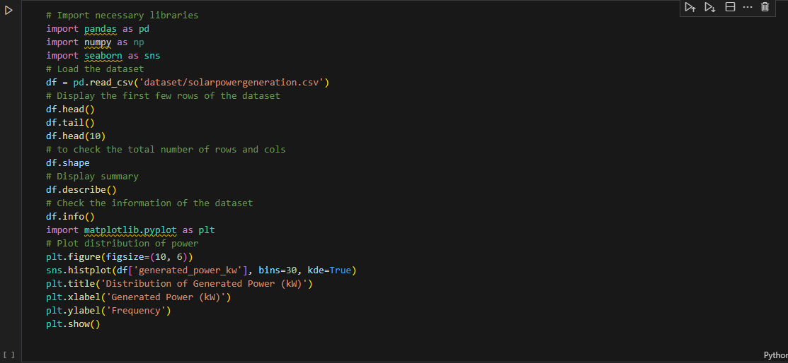
Solution: Step-by-Step Solution Implemented in the Code
1.Data Collection & Preprocessing
✔Load the dataset using pandas from a CSV file.
✔Check for missing values and handle duplicates to
ensure clean data.
2. Exploratory Data Analysis (EDA)
✔Understand data distribution using histograms and KDE plots.
✔Analyze relationships between features using scatter plots and correlation heatmaps.
✔Detect outliers using box plots.
Notes:
I just take the entire code at one place please dont consider the red lines in the code

Slide 13
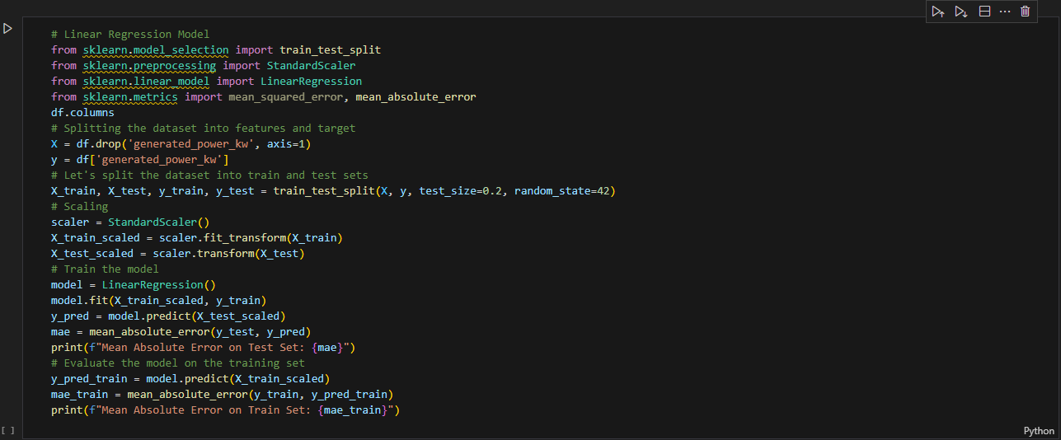
3.Train-Test Split & Feature Scaling
✔Split the dataset into 80% training and 20% testing sets.
✔Normalize the input data using StandardScaler to ensure consistent feature scaling.
4.Machine Learning Model Training (Linear Regression)
✔Train a Linear Regression model on the training dataset.
✔Fit the model to learn the relationship between input features and power generation.
5.Model Evaluation & Performance Metrics
✔Predict solar power generation on test data.
✔Evaluate model accuracy using Mean Absolute Error (MAE).

Slide 14
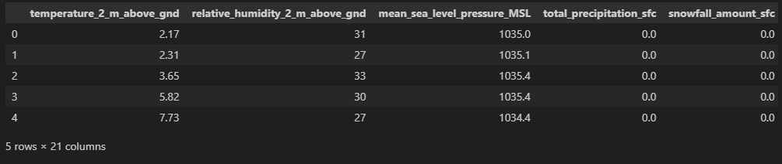
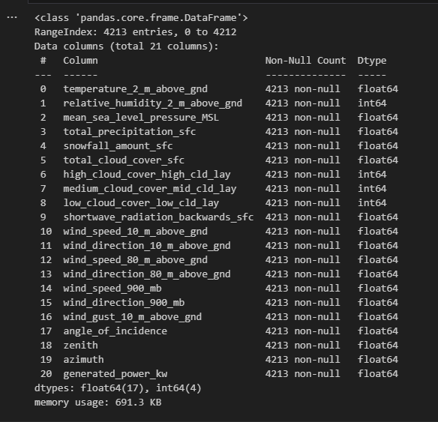
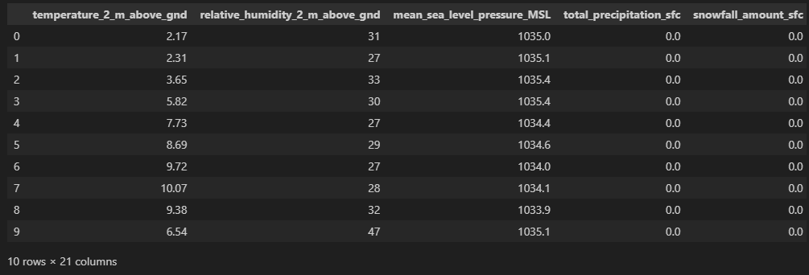
Screenshot of Output:

Slide 15
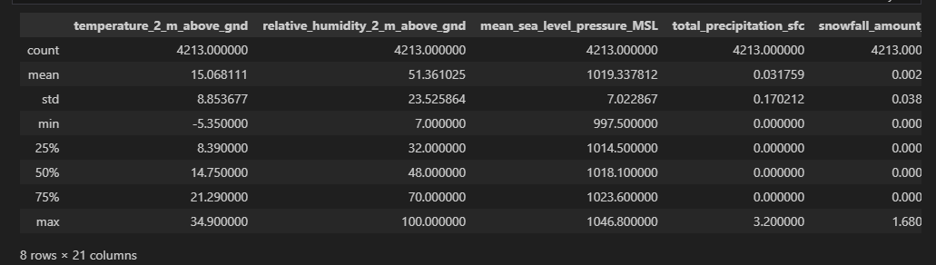
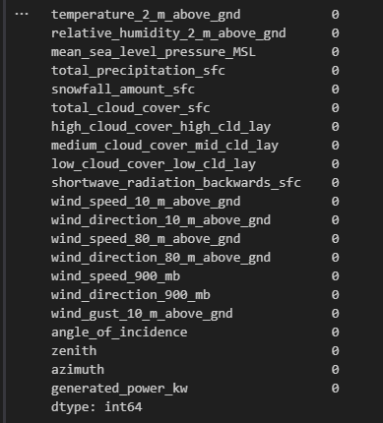
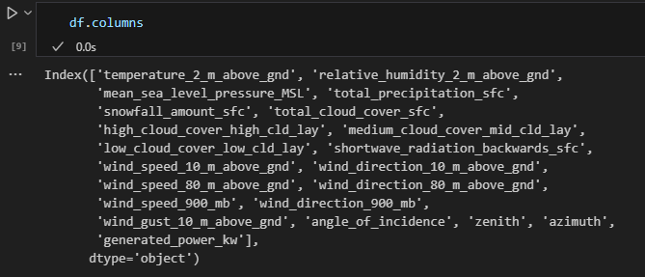

Slide 16
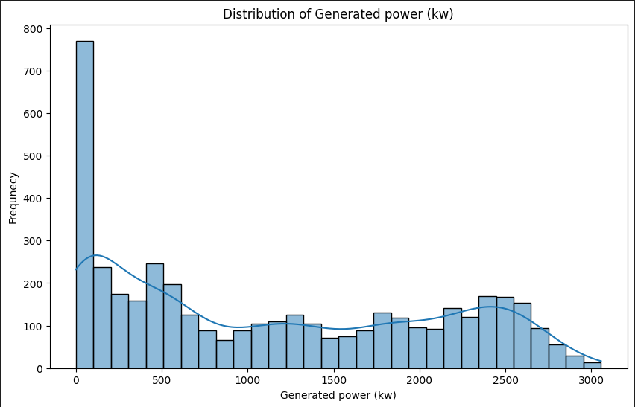
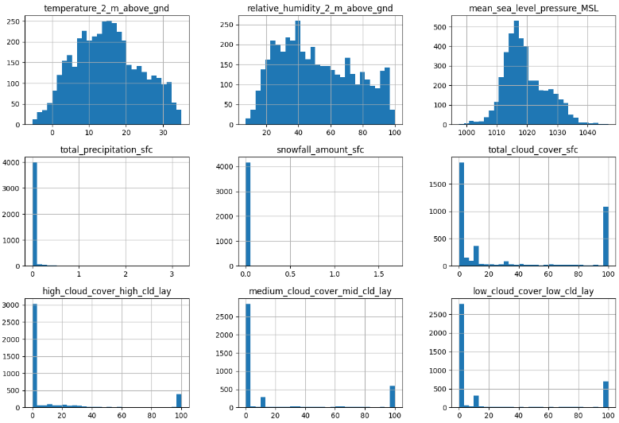
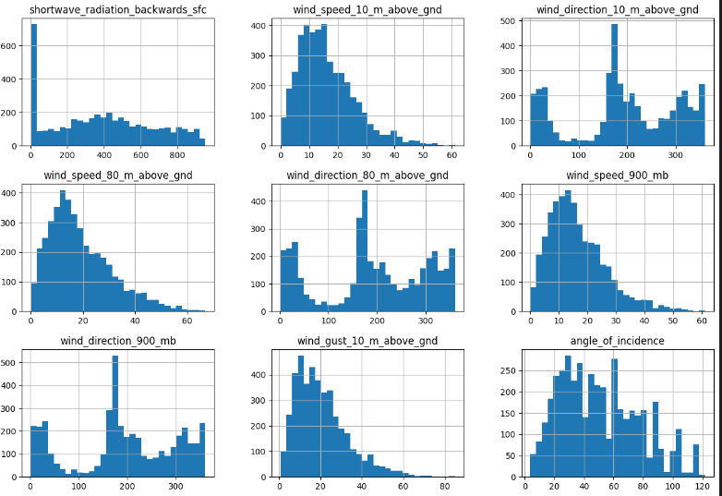
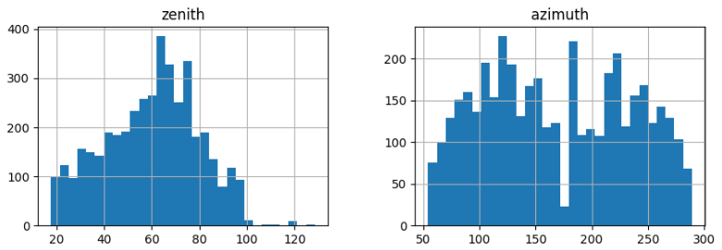

Slide 17
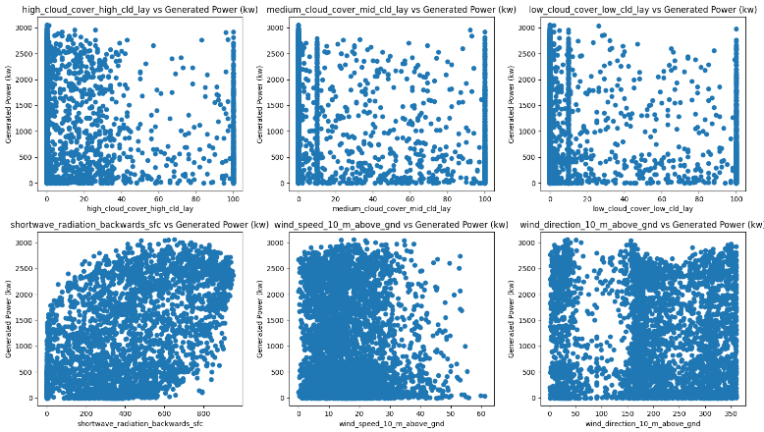
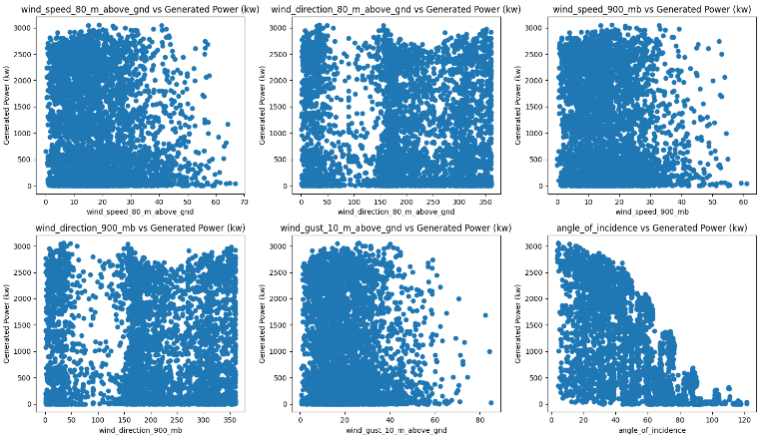
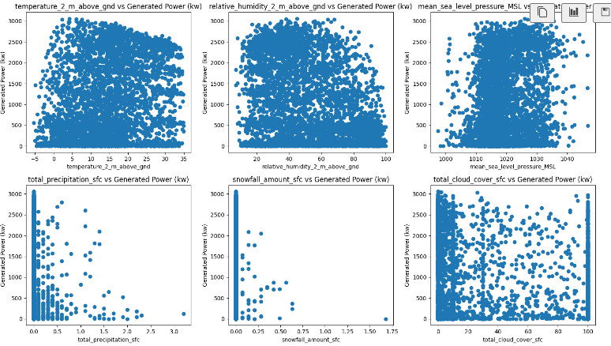
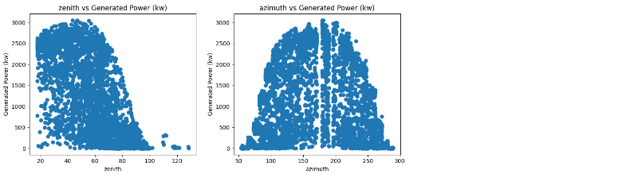

Slide 18
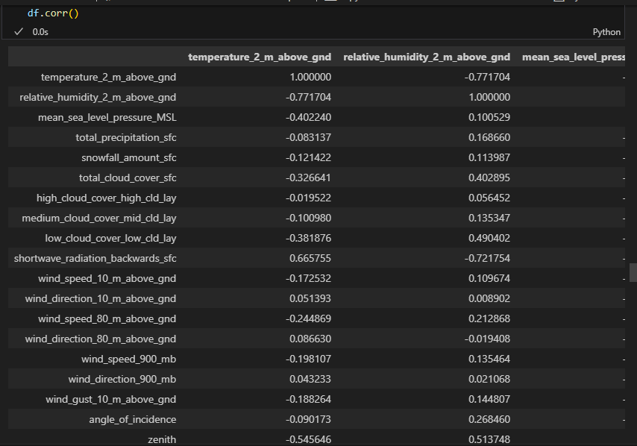
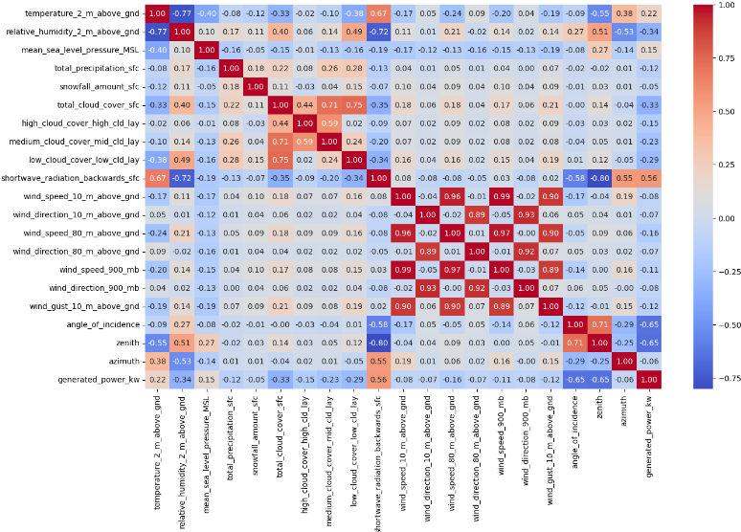
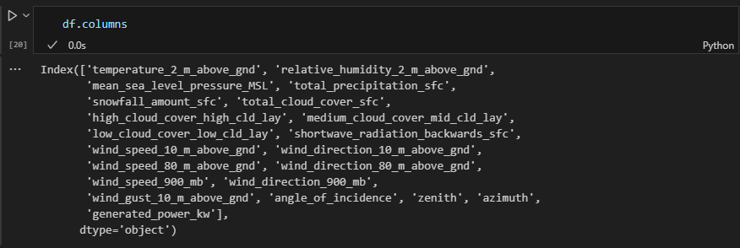

Slide 19
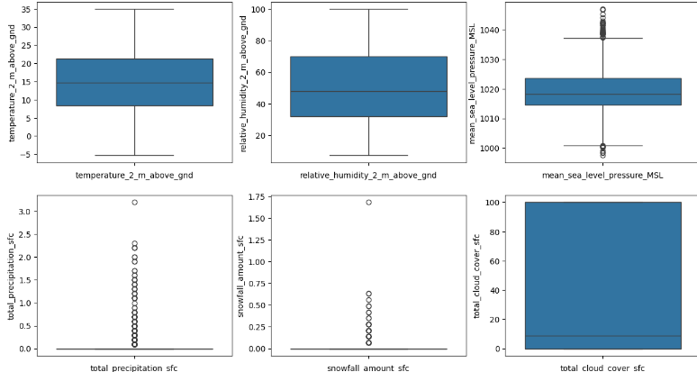
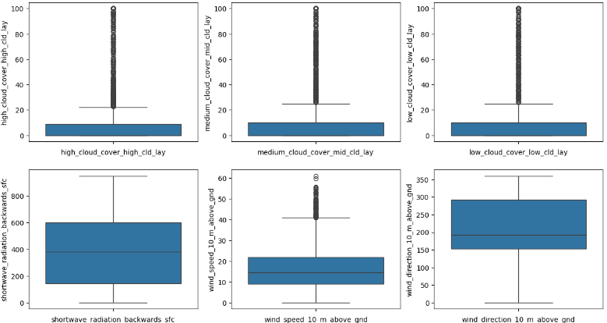
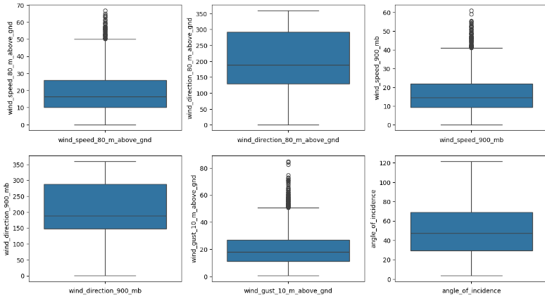
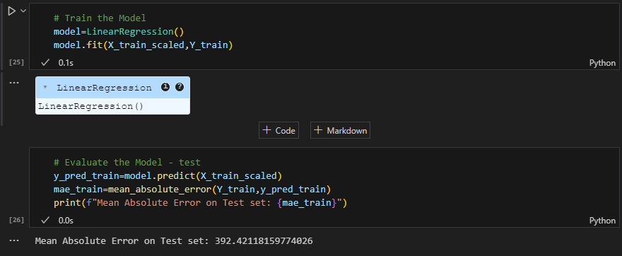

Slide 20
Conclusion:
The project successfully builds a machine learning model to predict solar power generation based on historical environmental data. The linear regression model was trained on a dataset containing various input features, and its performance was evaluated using metrics such as Mean Absolute Error (MAE).The implementation follows a structured approach, from data preprocessing to model training and evaluation.
🔹 Final Insights
✔ The model provides valuable insights into solar energy trends, helping optimize energy production.
✔ The Linear Regression model works well for this dataset.
✔ Incorporating real-time weather data could enhance predictions and make the model more robust.
✔ The project demonstrates how machine learning can be used for sustainable energy planning and better solar power management.

Slide 21


