Slide 1
Research Topic: Monitoring Air Quality and its Impact on Urban Environment of Pune City Using Geospatial Techniques
Research centre:
Postgraduate Teaching and Research Centre,
Department of Geography, S. P. College, Pune
Name of the Researcher: Kshitij S. Bairagi
Research Guide: Dr. Nitin N. Mundhe (Associate Professor)
Department of Geography, S. P. College, Pune

Slide 2
INTRODUCTION
The global significance of Declining Air quality is underscored by evidence that approximately 91% of the world’s population inhabits regions where air pollution exceeds the World Health Organization’s recommended thresholds (WHO, 2021).
Urban agglomeration in western India, serves as a key case study for examining these dynamics. As one of India’s most rapidly expanding metropolitan areas, Pune has experienced a population surge of over 20% between 2011 and 2021, reaching an estimated 7.4 million residents.
A sharp increase in vehicular density, with registered vehicles surpassing 4.4 million by 2022 (RTO Pune, 2022).

Slide 3
PM2.5 concentrations often range from 60–80 μg/m³, far exceeding the WHO’s guideline of 15 μg/m³. These pollutants contribute to health risks and environmental degradation.
Research has documented temperature anomalies in PMR’s urban core, with average temperatures rising 2–3°C above those in surrounding rural areas during peak summer months (IMD, 2020).
Addressing the intricate interplay between air quality and Environmental degradation in Pune city demands a data-driven and interdisciplinary approach.
By analysing spatial and temporal variations in air quality parameters, pinpointing primary pollutant sources, and exploring their interactions with climatic factors, this study seeks to formulate actionable strategies to mitigate environmental risks.

Slide 4
REVIEW OF LITERATURE
GLOBAL
Kumar and Maharana (2020) underline the direct link between rapid urbanization and deteriorating air quality, advocating the use of GIS and remote sensing to identify pollution hotspots and support urban environmental planning.
Ilyas et al. (2010) similarly demonstrate that pollution levels in urban centers have significant health implications, particularly respiratory illnesses, and highlight how spatial monitoring enhances the understanding of pollutant dispersion.
Dadhich et al. (2017) analyse the impact of urban sprawl on air quality using satellite imagery, establishing a clear relationship between land use changes and elevated PM and NO₂ levels.
Nejadkoorki et al. (2011) present a spatiotemporal framework for optimizing air quality monitoring networks, arguing that strategic placement of stations based on pollution variability improves data coverage and monitoring efficiency.
Liang et al. (2023) push the boundaries by integrating low-cost sensors, satellite data, and geospatial artificial intelligence (GeoAI), enabling high-resolution intra-urban pollution mapping and real-time analysis, especially valuable for urban areas with limited monitoring infrastructure.

Slide 5
Narashid and Mohd (2010) highlight the potential of remote sensing and GIS as cost-effective methods for monitoring air quality over large areas, capable of capturing both spatial extent and seasonal trends.
Jumaah et al. (2019) utilize Inverse Distance Weighting (IDW) and Ordinary Least Squares (OLS) regression within a GIS framework to predict AQI and identify pollution patterns, proving useful in data-scarce environments.
Zhalehdoost and Taleai (2022) provide an extensive review of machine learning applications in geospatial air pollution analysis, showing how AI models, when integrated with spatial data, enhance the predictive accuracy of pollution trends.
Denby et al. (2005) recommend hybrid interpolation-assimilation methods that combine observational data with atmospheric modelling to improve the spatial reliability of large-scale air quality assessments.
Collins et al. (1995) study reinforce the critical role of geospatial analysis, statistical modelling, and emerging technologies in capturing the spatial and temporal dimensions of air pollution.

Slide 6
REVIEW OF LITERATURE
REGIONAL
Kaur and Pandey (2021) reviewed the critical connections between air pollution, climate change, and health in Indian cities. They detailed how rising temperatures and altered weather patterns intensify air pollution’s health impacts.
Sharma et al. (2019) analyzed air pollution trends across Delhi, Bengaluru, and Chennai between 2015 and 2018, It categorized pollution levels into critically polluted (CP), highly polluted (HP), moderately polluted (MP), and low polluted (LP) zones.
Biswas et al. (2011) evaluated 24-hour, 8-hour, and 1-hour averages of criteria pollutants (PM2.5, SO₂, NO₂, PM10, and CO) across various sites in Delhi. Their findings were complemented by Kumar and Goyal (2011a, 2011b), who developed predictive models for air quality indices (AQI) in Delhi.
Dorage et al. (2021) analyzed Pune City’s Air Quality Index (AQI) using machine learning and time series forecasting. The study highlighted the growing environmental and health risks posed by air pollution in Pune.

Slide 7
Mundhe et al. (2014) in the article titled, “Impact of urbanization on land use/land covers change using Geo-spatial techniques” found that, the decreasing area under water bodies, vegetation, fallow land and agricultural land etc. directly or indirectly causing ain degradation of environment.
Gadekar (2020) reviewed Pune’s air pollution trends, emphasizing high levels of respirable suspended particulate matter (RSPM) exceeding permissible limits. Vehicular emissions were identified as the primary source, with hotspots like Nal Stop and Swargate experiencing severe traffic-related pollution. Industrial activities in areas such as Bhosari and Pimpri-Chinchwad further contributed to particulate emissions.

Slide 8
Rationale of the Study
Rising vehicle emissions, industrial activity, and ongoing construction contribute to deteriorating air quality, making it a growing environmental concern.
There is a need to systematically assess the spatial distribution of air pollutants and their impacts on the urban environment to enable effective policy decisions and mitigation strategies.
The application of geospatial techniques allows for a detailed, area-specific analysis of air quality, identifying hotspots and vulnerable zones within the city.
By integrating Air Quality Index data with geographic information, this study aims to provide valuable insight into the current air pollution scenario in Pune, guiding stakeholders in framing strategies for improving air quality and protecting the health of future generations.

Slide 9
IDENTIFICATION OF RESEARCH GAP
Lack of integrated air quality and climate models
Limited temporal and spatial data analysis
Ineffective assessment of existing policies
Overlooked Environment specific approach

Slide 10
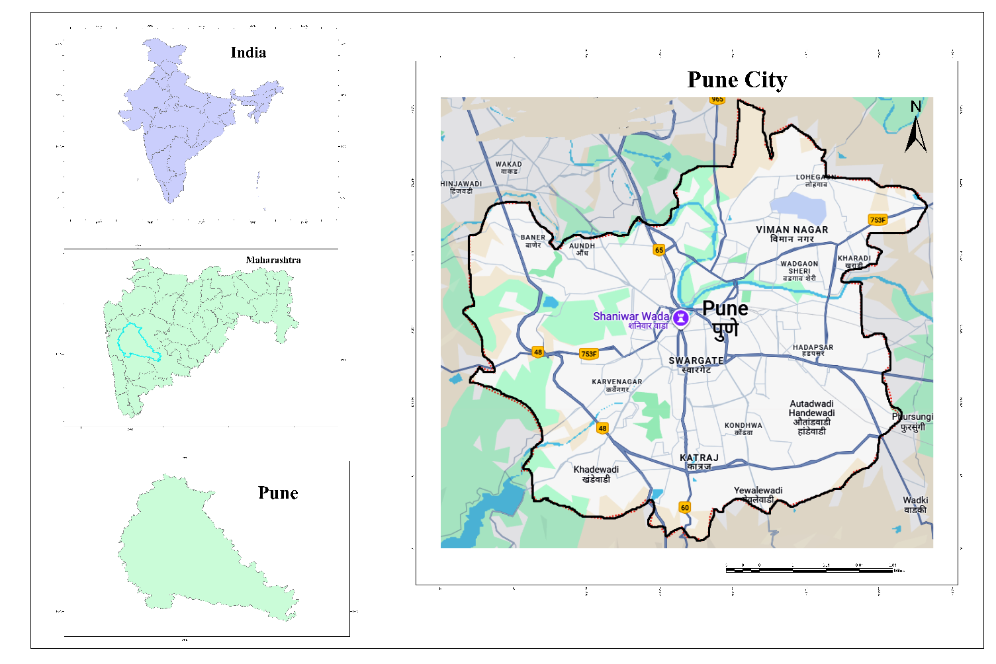
STUDY AREA
Pune city lies between latitudes 18° 25'N and 18° 37'N and longitudes between73° 44'E and 73° 57’E.
The geographical area is around 243.84 Sq.Km with a population of around 3.1 million composed of 76 general electoral wards.
The density of the city was 12,777 persons/ Sq.Km.
Pune is a plateau city situated near the western margin of the Deccan Plateau.
It is situated at an altitude of 560 m above the mean sea level. Two more rivers, Pavana and Indrayani cross the northwestern outskirts of urban area. (Figure.1)
Figure.1

Slide 11
OBJECTIVES
1.To analyze spatio-temporal variations in Air Quality Index (AQI) across Pune city.
3.To investigate the interrelationship between air pollution and urban environment with a focus on vulnerable urban zones.
4.To suggest sustainable ways to improve air quality and urban climate using spatial tools.
2.To examine the influence of changing climatic parameters on the concentration, dispersion and persistence of air pollutants.

Slide 12
What are the spatio-temporal patterns of the Air Quality Index (AQI) in Pune city, and how does the integration of ground-based monitoring data with satellite observations enhance the understanding of these patterns?
How can spatial decision support systems be utilized to develop and prioritize sustainable mitigation strategies and planning interventions for improving air quality and urban climate resilience in Pune city?
How do air pollution and urban climate resilience influence each other in Pune city, and what are the consequences for vulnerable areas and population exposure?
What is the relationship between key climatic variables and the behaviour of air pollutants in terms of their concentration, dispersion, and persistence in the urban environment of Pune?
1.
2.
RESEARCH QUESTIONS
3.
4.

Slide 13
DATA ACQUISITION
A. Air Quality
B. Satellite and Geospatial Data
Landsat 8/9 or Sentinel-2 satellite images from USGS Earth Explorer or Copernicus Open Access Hub for multi-year analysis
DEM data (from SRTM) for topography. Administrative shapefiles and road/industry layers(from SOI)
C. Meteorological Data
IMD DSP
NASA POWER
CPCB, MPCB continuous air monitoring stations (CAMS)
SAFAR Pune
Daily or monthly pollutant data (PM2.5, PM10, NO₂, SO₂, CO, O₃) for 3–5 years from

Slide 14
Air Quality Index Calculation
Perform AQI calculation in Excel or Python for each monitoring station
LULC Mapping
Perform supervised classification Validate classification using Google Earth
Geospatial Analysis
Interpolate AQI data using IDW or Kriging method
Classify AQI values into categories (Good, Moderate, Poor.)
Compare LULC for different years to identify urban expansion.
Overlay LULC maps and AQI maps
Buffer analysis
Impact Assessment
zonal statistics
NDVI, NDBI, NDWI
Analyse and assess the indices results
Visualization and Interpretation (Thematic maps)
AQI distribution
LULC change
Pollution hotspots
AQI vs NDVI/NDBI overlays
Create charts/tables for pollutant trends, LULC statistics, and AQI category distribution
Conclusion and Strategy Recommendation
METHODOLOGY

Slide 15
Tools and Techniques
Remote sensing and GIS techniques
Environmental impacts assessment
Validation
Statistical and Modelling Approaches

Slide 16
EXPECTED OUTCOMES
This study aims to provide a comprehensive analysis of air quality index (AQI) variations across different locations and timeframes within the Pune metropolitan area.
It will offer detailed insights into specific hotspots and patterns of air pollution influenced by seasons, times of day, and geographic zones.
It will establish a robust database of AQI trends to support future research and policymaking.
It will seek to quantify the relationship between climatic factors such as temperature and rainfall with the concentration of key pollutants.
Predictive models will be developed to forecast pollutant behaviour under various future climate scenarios, enabling better preparedness.

Slide 17
EXPECTED OUTCOMES
The study will also provide an evidence-based understanding of the combined impacts of air pollution and climate change on identifying vulnerable species in environment and regions most affected.
The research will propose targeted strategies and actionable solutions to enhance air quality in Pune's urban areas,
These guidelines aim to inform urban planning and policymaking for sustainable and effective air quality management and environmental sustainability .

Slide 18
CONCLUSION
This research provides a focused understanding of air quality challenges in the Pune metropolitan area.
By studying how air quality varies across locations and timeframes, and identifying hotspots of pollution, it offers a foundation for addressing these issues more effectively.
The exploration of how climatic factors like temperature and rainfall influence pollutant levels adds valuable insight into how changing environmental conditions might worsen or alleviate air pollution.
the findings emphasize the link between air pollution, climate change, particularly highlighting the risks to environment.
The development of predictive models and actionable strategies aims to guide future planning and policymaking, specifically in improving urban air quality and resilience.
While there is still much to learn, this study serves as a small but meaningful step toward better understanding and addressing the pressing environmental and urban pollution challenges faced by the Pune region.

Slide 19
REFERENCES
Biswas, P., Kumar, S., & Aggarwal, S. (2011). Criteria pollutants’ analysis across urban sites in Delhi. Journal of Environmental Studies, 34(2), 123-135. https://doi.org/10.1016/j.jenvs.2011.02.001
Central Pollution Control Board (CPCB). (2022). National Ambient Air Quality Standards (NAAQS) monitoring report. Retrieved from https://cpcb.nic.in
Collins, S., Smallbone, K., & Briggs, D. (1995). A GIS approach to modelling small area variations in air pollution within a complex urban environment. Innovations in GIS, 2, 245-253.
Dadhich, A. P., Goyal, R., & Dadhich, P. N. (2017). An assessment of urban space expansion and its impact on air quality using geospatial approach. Journal of Urban and Environmental Engineering, 11(1), 79-87.
Denby, B., Horálek, J., Walker, S. E., Eben, K., & Fiala, J. (2005). Interpolation and assimilation methods for European scale air quality assessment and mapping. Part I: Review and Recommendations. European Topic Centre on Air and Climate Change Technical Paper, 7.
Dorage, A. K., Kulkarni, S., & Patil, P. (2021). Machine learning-based AQI analysis for Pune: A comparative study. Environmental Science and Pollution Research, 28(10), 12840-12855. https://doi.org/10.1007/s11356-021-12577-3
Gadekar, S. R. (2020). Air pollution in Pune: A case study on RSPM levels and vehicular emissions. Environmental Monitoring, 18(3), 45-60.
Ilyas, S. Z., Khattak, A. I., Nasir, S. M., Qurashi, T., & Durrani, R. (2010). Air pollution assessment in urban areas and its impact on human health in the city of Quetta, Pakistan. Clean Technologies and Environmental Policy, 12, 291-299.

Slide 20
India Meteorological Department (IMD). (2020). Urban heat island effect observations and analysis. Retrieved from https://mausam.imd.gov.in
IPCC. (2007). Climate Change 2007: Impacts, Adaptation, and Vulnerability. Contribution of Working Group II to the Fourth Assessment Report of the Intergovernmental Panel on Climate Change. Cambridge University Press.
Jumaah, H. J., Ameen, M. H., Kalantar, B., Rizeei, H. M., & Jumaah, S. J. (2019). Air quality index prediction using IDW geostatistical technique and OLS-based GIS technique in Kuala Lumpur, Malaysia. Geomatics, Natural Hazards and Risk, 10(1), 2185-2199.
Kaur, H., & Pandey, P. (2021). Air pollution, climate change, and human health in Indian cities: A review. Environmental Pollution, 283, 117070. https://doi.org/10.1016/j.envpol.2021.117070
Kumar, A., & Goyal, P. (2011a). Forecasting daily air quality indices using principal component regression: A case study in Delhi. Atmospheric Environment, 45(21), 3593-3602. https://doi.org/10.1016/j.atmosenv.2011.03.049
Kumar, A., & Goyal, P. (2011b). Air quality index estimation for Delhi using SO2, NO2, RSPM, and SPM. Journal of Air Pollution Studies, 20(4), 201-213.
Kumar, S., & Maharana, P. (2020). Air quality and its impact on urban environment. In Urban Ecology (pp. 185-200). Elsevier.
Liang, L., Daniels, J., Bailey, C., Hu, L., Phillips, R., & South, J. (2023). Integrating low-cost sensor monitoring, satellite mapping, and geospatial artificial intelligence for intra-urban air pollution predictions. Environmental Pollution, 331, 121832.

Slide 21
Mundhe, N. N., & Jaybhaye, R. G. (2014). Impact of urbanization on land use/land covers change using Geo-spatial techniques. International journal of geomatics and geosciences, 5(1), 50-60.
Narashid, R. H., & Mohd, W. M. N. W. (2010, December). Air quality monitoring using remote sensing and GIS technologies. In 2010 International Conference on Science and Social Research (CSSR 2010) (pp. 1186-1191). IEEE.
Nejadkoorki, F., Nicholson, K., & Hadad, K. (2011). The design of long-term air quality monitoring networks in urban areas using a spatiotemporal approach. Environmental monitoring and assessment, 172, 215-223.
Pune Municipal Corporation (PMC) Health Department. (2022). Annual health statistics report: Respiratory and cardiovascular diseases in Pune. Pune Municipal Corporation.
RTO Pune. (2022). Vehicle registration statistics for Pune region. Regional Transport Office, Pune.
Sharma, M., Dikshit, A. K., & Prasad, R. K. (2019). Air pollution trends and challenges in India: A comparative study of Delhi, Bengaluru, and Chennai. Environmental Monitoring and Assessment, 191(11), 679. https://doi.org/10.1007/s10661-019-7795-4
World Health Organization. (2021). Air pollution levels and health impacts. Retrieved from https://www.who.int
Zhalehdoost, A., & Taleai, M. (2022). A review of the application of machine learning and geospatial analysis methods in air pollution prediction. Pollution, 8(3), 904-933.

Slide 22
THANK YOU

