Slide 1
Final Project Azure Machine Learning
Vaithilingam, Sudha
Deep Azure@McKesson
Dr. Zoran B. Djordjević

Slide 2
Problem Statement
For companies to stay profitable it is important to have a strategy focusing not only on winning new customers but retaining existing customers. If companies can predict which customers are at a risk of leaving (churn), which customers are good candidates for add-ons (upselling) and new products/services (appetency), it would help them optimize their customer relationship and sales/marketing effort and dollars. In this project, I have used Azure Machine Learning to build a Customer Relationship Prediction model to predict churn, appetency and upselling using datasets modeled from KDD Cup 2009.

Slide 3
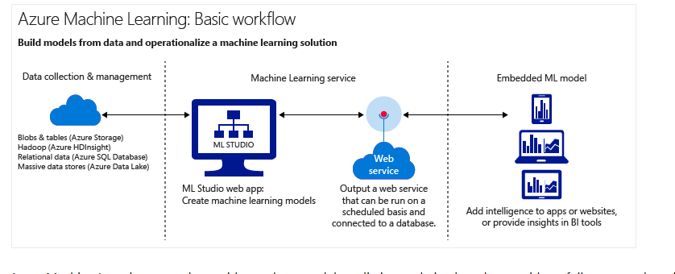
Technology
Azure Machine Learning is a cloud predictive analytics service that makes it possible to quickly create and deploy predictive models as analytics solutions.

Slide 4
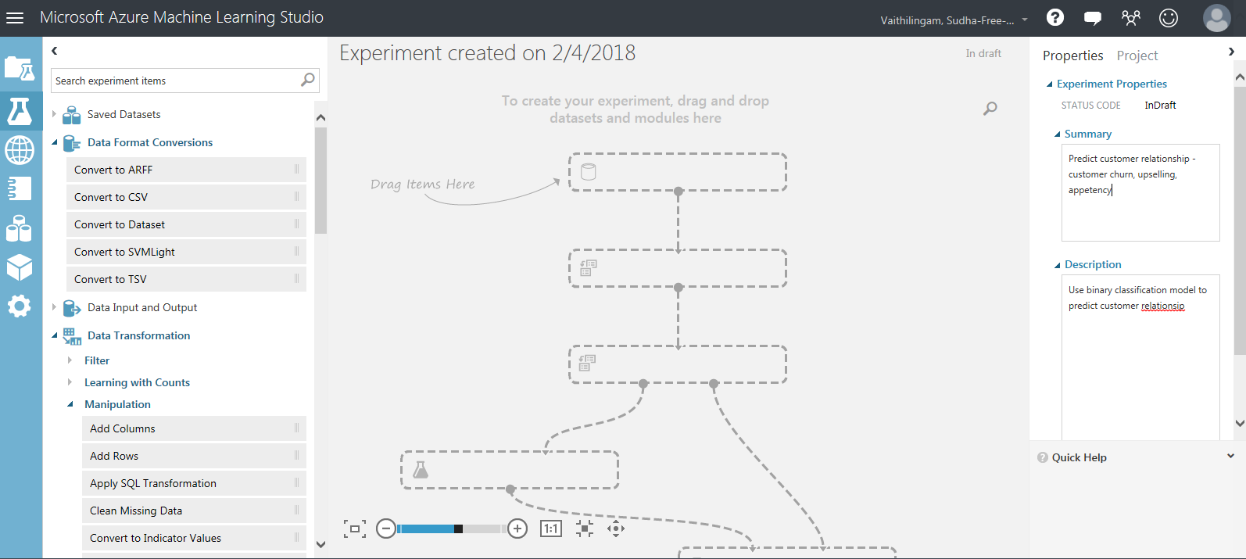
Technology
Azure Machine Learning Studio is a browser-based, visual drag-and-drop authoring environment which requires no coding.
Access Azure Machine Learning Studio at https://studio.azureml.net
Sign-in with your Microsoft Azure account. A free workspace is created in your name.
You can create and run machine learning experiments in the studio before deploying it as a predictive analytics web service.

Slide 5
Dataset
4 CRM datasets under Sample datasets in Azure Machine Learning Studio modeled from http://www.kdd.org/kdd-cup/view/kdd-cup-2009/Data
CRM Dataset from the French Telecom company Orange
CRM dataset Shared, Size:25 MB, Format: GenericTSV
CRM upselling Labels Shared, Size:192KB, Format: GenericTSVNoHeader
CRM Appetency Labels Shared, Size:194KB, Format: GenericTSVNoHeader
CRM Churn Labels Shared, Size:192KB, Format: GenericTSVNoHeader

Slide 6
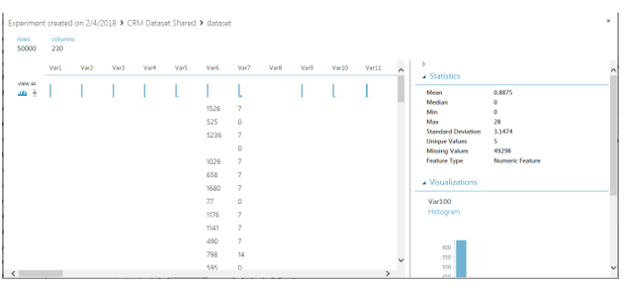
Dataset
CRM dataset Shared
Rows: 50,000, columns: 230
190 columns – numerical, 40 columns – categorical, Lot of missing values

Slide 7
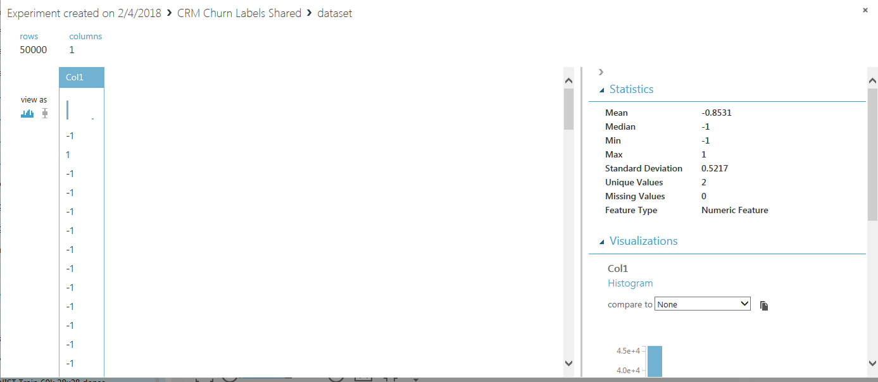
Dataset
CRM upselling Labels Shared
Rows: 50,000, columns:1, Value: -1 or 1, No Missing values
CRM Appetency Labels Shared
Rows: 50,000, columns:1, Value: -1 or 1, No Missing values
CRM Churn Labels Shared, Size
Rows: 50,000, columns:1, Value: -1 or 1, No Missing values

Slide 8
Implementation Steps
1. Create a new project in Azure Machine Learning Studio https://studio.azureml.net
2. Create a New Experiment. Drag and drop modules to canvas
Select CRM shared datasets
Clean the dataset. Combine the CRM and labels into one dataset
Split the dataset into training dataset and test dataset
Choose a machine learning algorithm - Two class Decision Forest
Train Model using the dataset
Score Model to generate predictions based on the trained model
Evaluate Model to measure the accuracy of the model
3. Run the experiment
4. Evaluate the results
5. Create new experiments or update experiment to improve accuracy of the model
5. Deploy model as a webservice

Slide 9
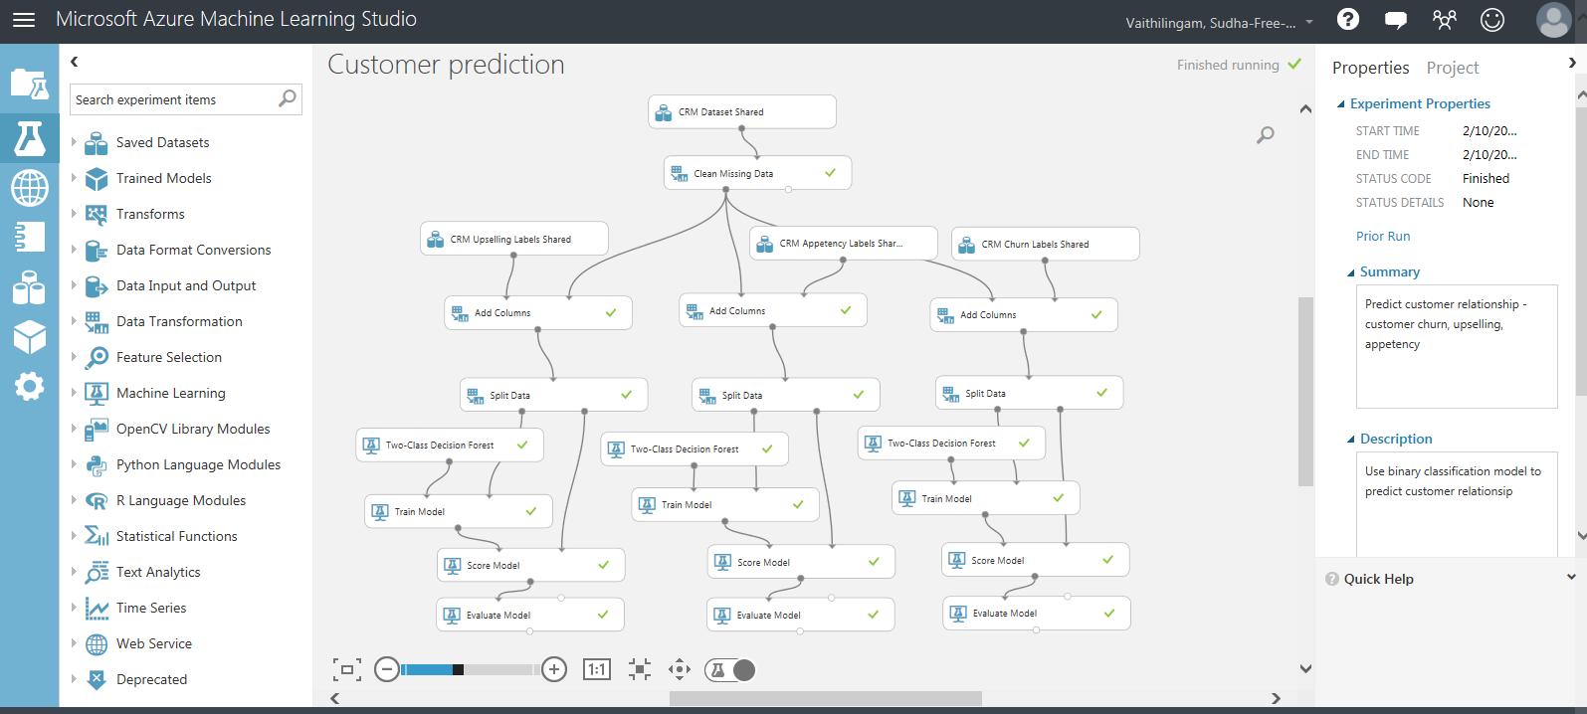
Customer Prediction Model
The Customer Prediction Model after it is built with all the modules
Algorithm used – Two class Decision Forest

Slide 10
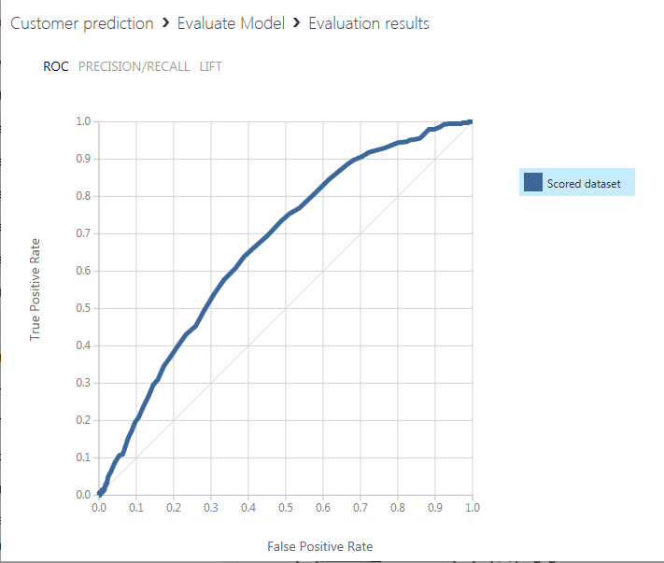
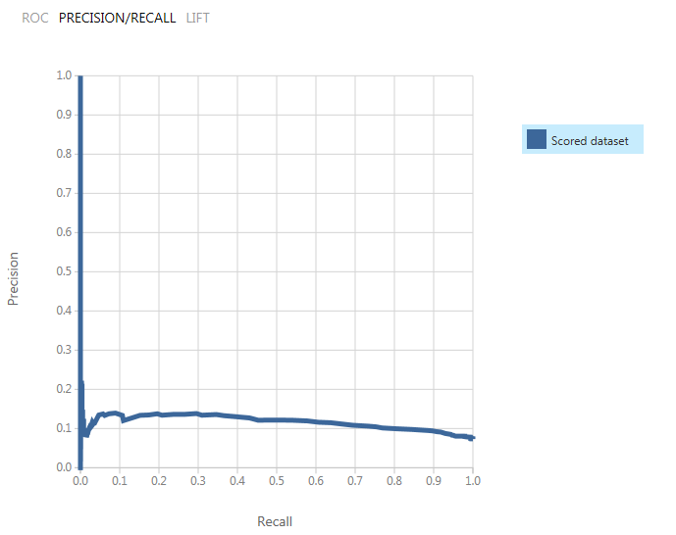
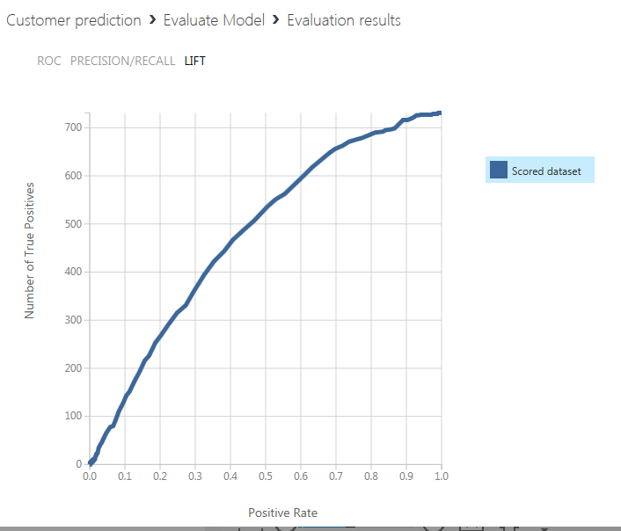
Evaluate Model Results – CRM Upselling

Slide 11
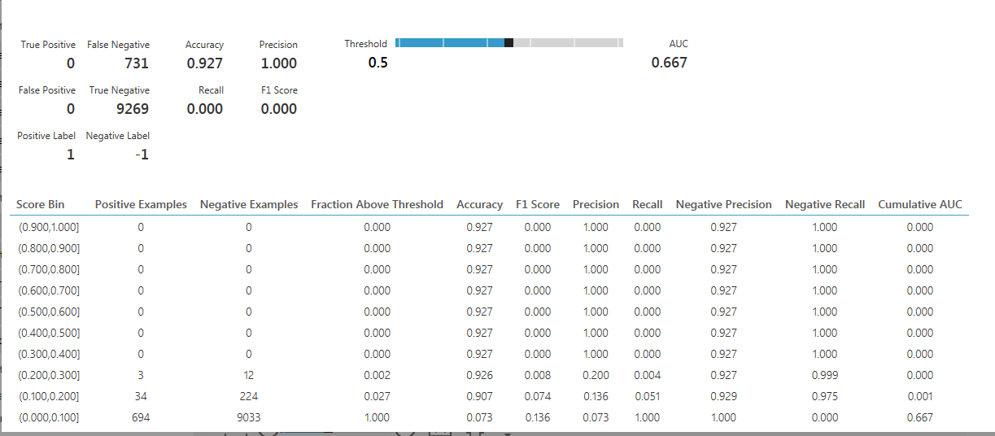
Evaluate Model Results – CRM Upselling

Slide 12
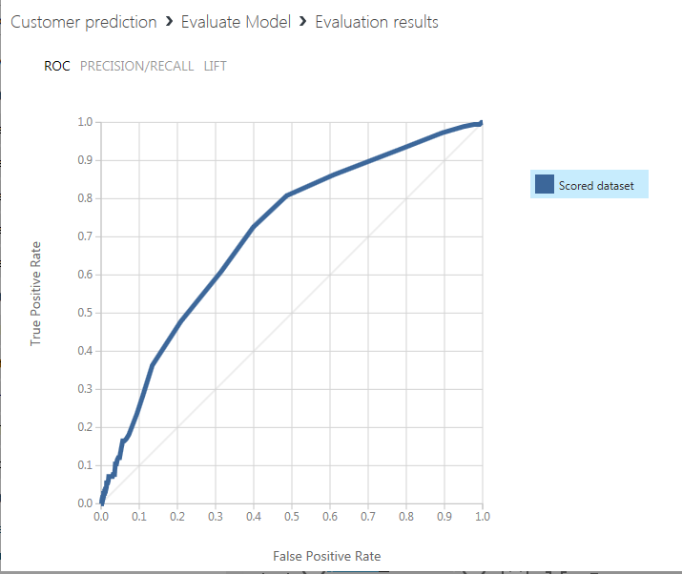
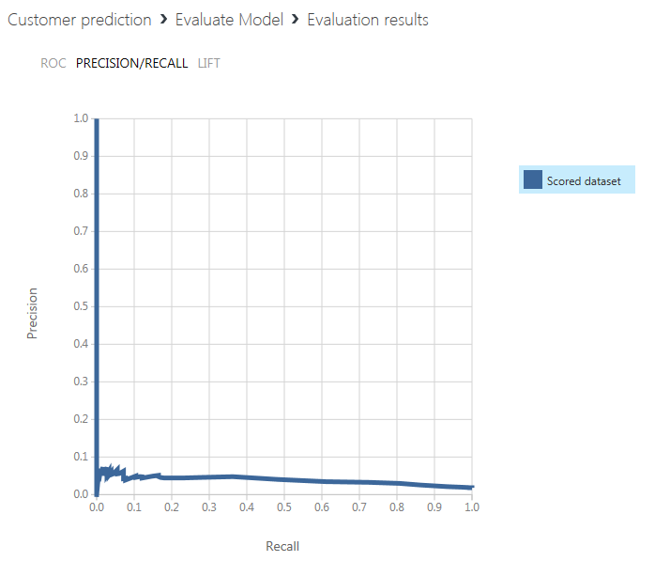
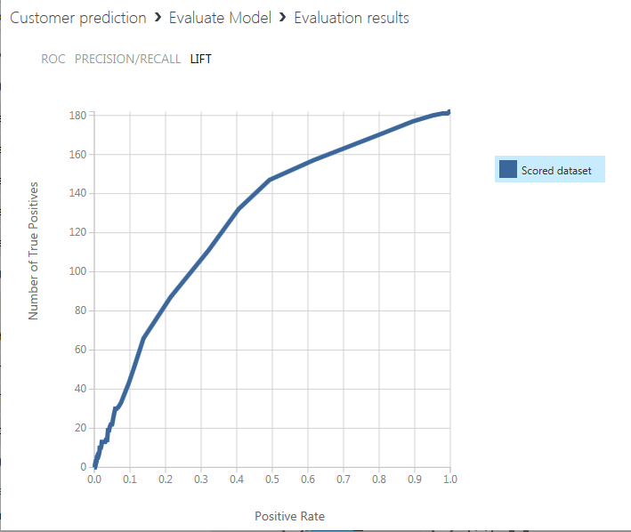
Evaluate Model Results – CRM Appetency

Slide 13
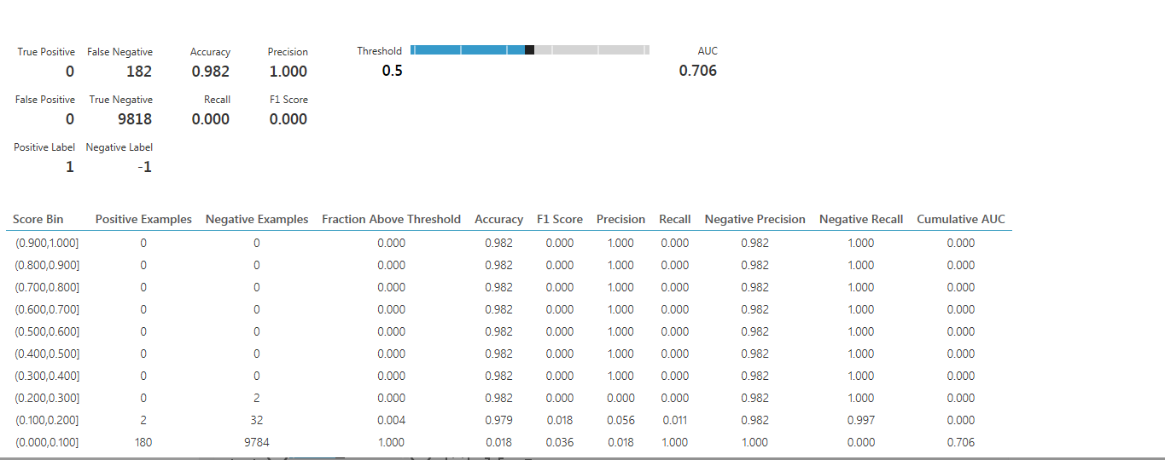
Evaluate Model Results – CRM Appetency

Slide 14
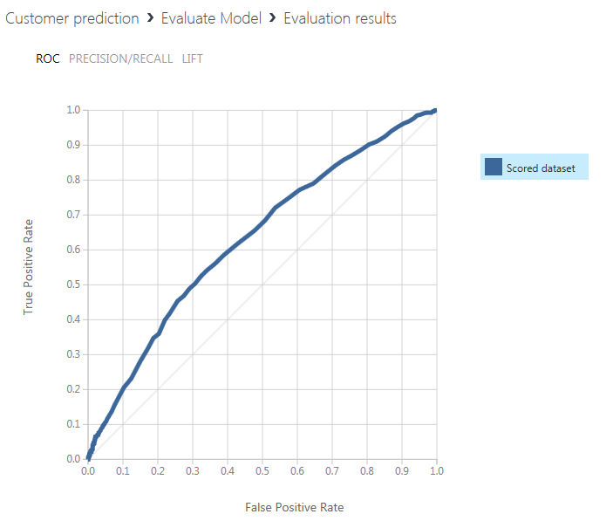
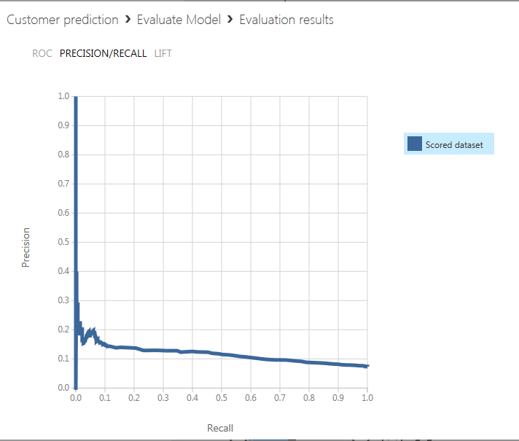
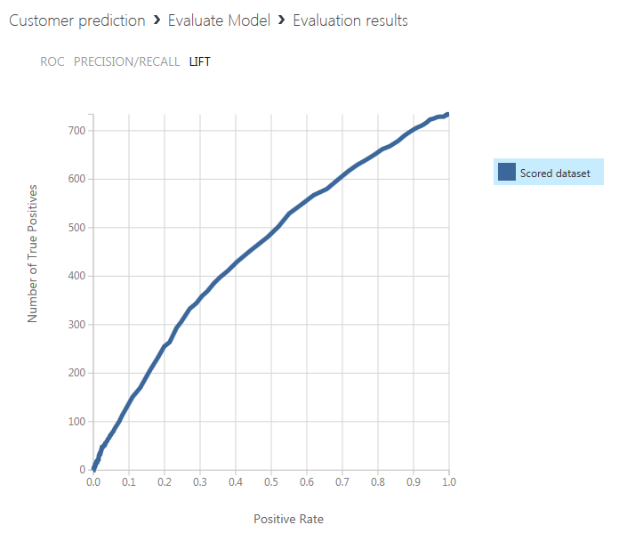
Evaluate Model Results – CRM Churn

Slide 15
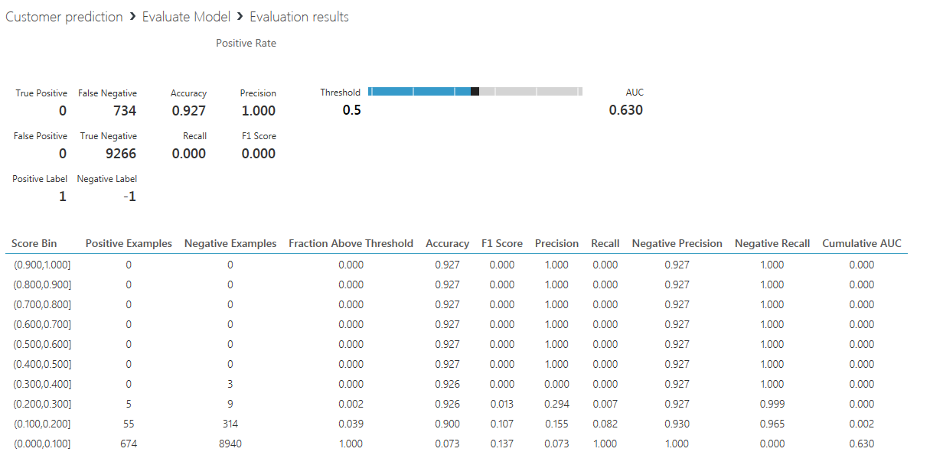
Evaluate Model Results – CRM Churn

Slide 16
Lessons Learned
I was able to create a Customer Relationship Prediction model successfully using Azure Machine Learning studio.
Pros:
Easy to use UI – drag drop modules to canvas. No coding required.
Several modules available - data transform, machine learning, evaluate model
Run experiments fast
Good tool for beginners in Machine Learning
Good tool for data scientists who are not technologists
Cons:
Modules are a black box
Deploying trained model as a web service did not work as I expected

Slide 17
Next Steps
Deploy my predictive model as a web service. The Customer Prediction web service will take customer profile as input and using the predictive model that I have built will predict customer churn (Yes or No), upselling (Yes or No) and Appetency (Yes or No)

Slide 18
YouTube URLs, GitHub URL, Last Page
Two minute (short):
15 minutes (long):
GitHub Repository with all artifacts:

