Slide 1
Open a new shopping mall in Kuala Lumpur
Capstone IBM Project Data Science
By VAMSI SANAPATHI

Slide 2
Business Problem
To analyze and recommend best location in Kuala Lumpur City for opening a new shopping mall to the Property Developers and Real Estate Investors.
Business Question – In the city of Kuala Lumpur which is the best neighborhood for opening a new shopping mall ?

Slide 3
Data
List of neighborhoods in Kuala Lumpur City.
Latitude and Longitude coordinates for each of the neighborhoods.
Venue data i.e. shopping malls.
Source of the data –
This Wikipedia page (https://en.wikipedia.org/wiki/Category:Suburbs_in_Kuala_Lumpur)
Foursquare API data for venue data (shopping malls).

Slide 4
Methodology
Web scraping of Wikipedia page for neighborhoods list.
Get latitude and longitude values using Geocoder package.
Use Foursquare API data for venue data (shopping malls).
Group data by neighborhoods and taking the mean of frequency of occurrence of each venue category.
Filter venue data by shopping malls.
Perform K-Means Clustering.
Visualize clusters in maps using folium.

Slide 5
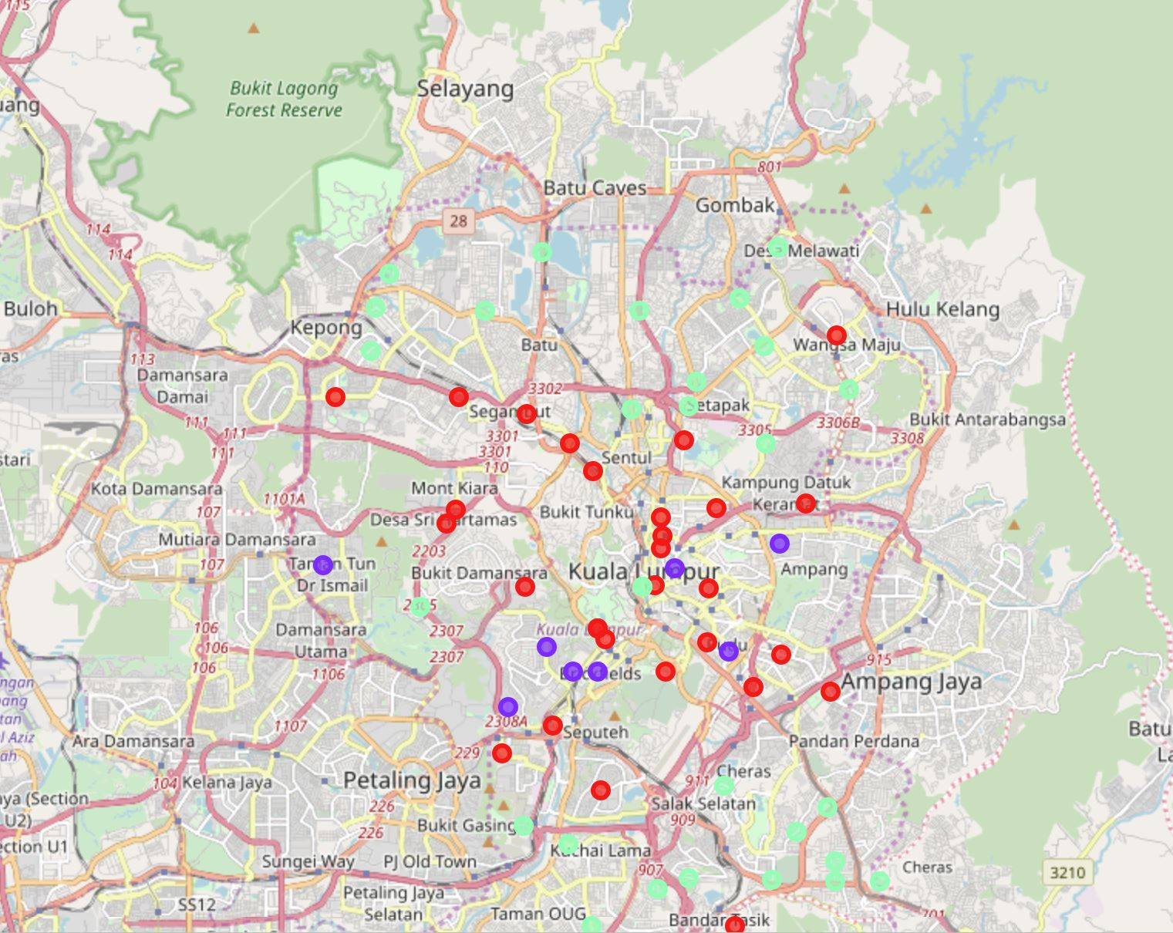
Results
Cluster 0 – Has moderate number of shopping malls.
Cluster 1 – Has highest number of shopping malls.
Cluster 2 – Has no major shopping malls.

Slide 6
Discussion
Most of the shopping malls are located in the central are of the Kuala Lumpur City.
Cluster 0 – Has moderate number of shopping malls.
Cluster 1 – Has highest number of shopping malls.
Cluster 2 – Has no major shopping malls, best neighborhood cluster for opening shopping malls.
Central city has oversupply of shopping malls. Suburbs has lesser number of shopping malls.

Slide 7
Recommendation -
Cluster 2 has no major shopping malls and hence it is the best available neighborhood cluster for opening new shopping malls because of less competition.
Cluster 0 has moderate number of shopping malls so it can be considered as second alternative for opening new shopping malls.
Cluster 1 has highest number of shopping malls so it is not recommended to open new shopping malls in this neighborhood cluster.

Slide 8
Conclusion
Cluster 2 has is the best available neighborhood cluster for opening new shopping malls because of less competition.

