Slide 1


MACHINE LEARNING | 25CS2107E
Hospital Readmission Prediction
Using Elastic Net Regularized Logistic Regression
S. Vennela (2520080018) | Krishna Sree (252008009)
Team 23 | Section 13 | A.Y. 2026-2027
Guide: Mrs. Ch. Anitha, Assistant Professor, CS&IT
Hyderabad - 500090, Telangana, India

Slide 2
Background: why readmissions matter
A hospital readmission is when a patient returns for further treatment after discharge. Frequent readmissions raise costs, hurt care quality and strain hospital resources.
Domain
The model
Why it is needed
Machine Learning, Healthcare Analytics and Predictive Modeling, supporting clinical decision-making.
Logistic Regression predicts readmitted or not. Elastic Net blends L1 and L2 penalties to cut overfitting and drop irrelevant features.
Flag high-risk patients early, plan follow-up care, reduce preventable readmissions and lower healthcare costs.

Slide 3
Problem statement
Existing problem
Challenges
Who is affected
Hospitals struggle to identify patients likely to return after discharge
Traditional methods miss high-risk patients
Higher treatment costs and workload
Missing or incorrect data
Imbalanced patient records
Choosing important features
Overfitting and prediction errors
Patient data privacy
Patients: extra treatment and expense
Doctors: hard to spot high risk
Hospitals: workload and cost
Families: more caregiving
Insurers: higher medical expense

Slide 4
Motivation
1
Why this project
2
Real-world need
3
Research motivation
Use machine learning to predict readmissions, spot high-risk patients early and apply Elastic Net to real healthcare data.
Early risk identification lets doctors plan follow-up, monitor recovery, cut avoidable visits and manage resources better.
Healthcare analytics is growing. Elastic Net selects features and limits overfitting, showing how ML can support clinical decisions.

Slide 5
Objectives
MAIN OBJECTIVE Build an Elastic Net Logistic Regression model that predicts hospital readmission risk and helps staff plan better follow-up care.
1
2
3
4
5
Data collection
Feature selection
Model development
Model evaluation
Healthcare planning
Gather patient data; fix missing, duplicate and inconsistent values
Find the factors that drive readmission
Logistic Regression with Elastic Net regularization
Accuracy, precision, recall, F1 and ROC-AUC
Use predictions to prioritise follow-up and treatment

Slide 6
Existing system vs proposed system
Existing system
Proposed system
Relies on clinical assessment, medical history, EHR records and basic statistical models.
Elastic Net Logistic Regression on patient data (age, history, prior visits) predicts whether a patient will be readmitted.
Limited accuracy on high-risk patients
Slow manual review of large data
Hard to find the key factors
Overfitting on new patients
Varies across hospitals
Learns patterns tied to readmission
Automates the analysis
L1 picks key features
L1 + L2 reduce overfitting
Risk scores guide follow-up

Slide 7
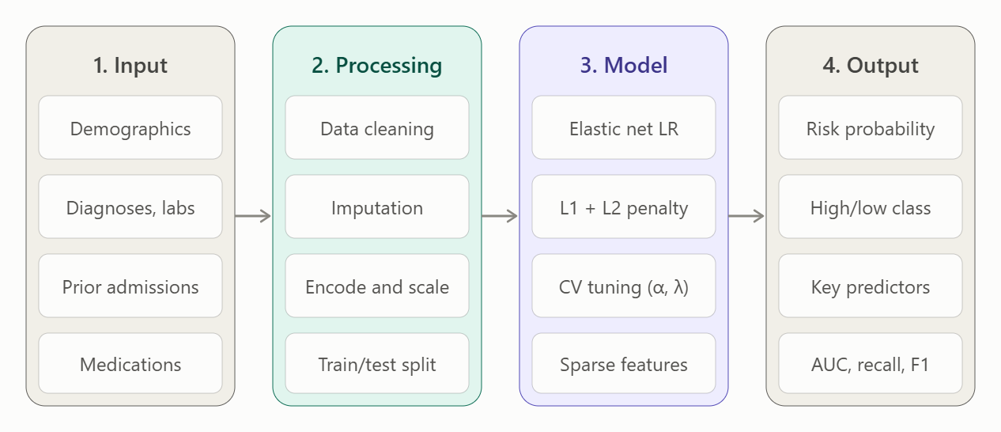
System architecture
Input
EHR records and a 30-day readmission label
Processing
Clean, impute, encode, scale, split
Model
L1 + L2 logistic regression, CV tuned
Output
Probability, risk class, key predictors

Slide 8
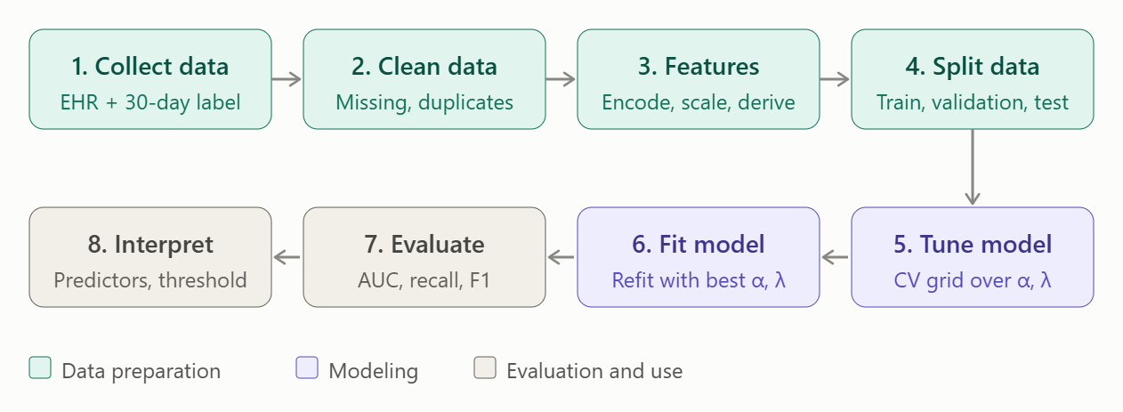
Methodology and workflow
Imputation and scaling are fitted on the training set only to prevent leakage. Cross-validated AUC selects the mixing ratio and penalty strength.

Slide 9
Technology stack
Languages
Python 3.11, SQL, R (optional, glmnet check)
Frameworks
scikit-learn (LogisticRegression, elasticnet, saga); Flask / FastAPI; Streamlit
Libraries
pandas, NumPy, imbalanced-learn, SHAP / statsmodels, matplotlib, seaborn, joblib
Data
PostgreSQL / SQLite; MIMIC-IV or UCI Diabetes 130-US hospitals
Dev tools
Jupyter / VS Code, Git and GitHub
Hardware and cloud
Standard laptop (8-16 GB, no GPU); Colab, SageMaker or Azure ML; Docker

Slide 10
System modules
User interface
Data collection
Preprocessing
Core ML
Enter or upload patient data, view risk scores
EHR or public dataset via SQL, CSV, FHIR
Impute, encode, scale and split
Elastic Net LR with cross-validated tuning
Prediction
Visualisation
Database
Security
30-day probability and risk threshold
ROC, calibration, odds-ratio charts
Raw and clean data, model versions, logs
Role-based access, encryption, audit logs

Slide 11
Dataset
608
600
16
333 / 267
original records
after removing 8 duplicates
columns
readmitted / not
Hospital Readmission Dataset (Excel): demographics, admission details, medical history, clinical information and readmission status. Target: readmitted (1) or not (0). patient_id is excluded from training.
Patient
Admission
History
Clinical
Other
Age, gender
Type, diagnosis, length of stay, discharge disposition
Prior admissions, diabetes, hypertension, heart disease
Medications, lab procedures, diagnoses
Insurance type

Slide 12
Data preprocessing
1
Remove duplicates
2
Handle missing values
3
Encode categories
8 duplicate rows dropped, leaving 600 records
Median for age and lab procedures; most frequent for gender
One-hot encoding for gender, diagnosis, admission type, discharge, insurance
4
Scale features
5
Split the data
6
Prevent leakage
Standardise numeric features to a common range
Stratified 80/20: 480 training, 120 testing records
Target and patient ID kept out of the inputs

Slide 13
Algorithm: Elastic Net Logistic Regression
Patient data
Preprocess
Encode + scale
Elastic Net LR
Probability
Predicted class
Why it fits
Parameters (preliminary run)
Built for two outcomes: readmitted or not
L1 shrinks weak features; L2 handles correlated ones
Regularization limits overfitting on a small dataset
Interpretable, with a probability for each patient
Penalty
Elastic Net
Solver
SAGA
C
1.0
l1_ratio
0.5
Max iterations
5000
Threshold
0.5
Random state
42

Slide 14
Results: model performance
Confusion matrix
Predicted: No
Predicted: Yes
Actual: No
41
True negative
13
False positive
Actual: Yes
10
False negative
56
True positive
Recall of about 85% means most real readmissions were caught. Preliminary result from a single 80/20 split, not clinical proof.

Slide 15

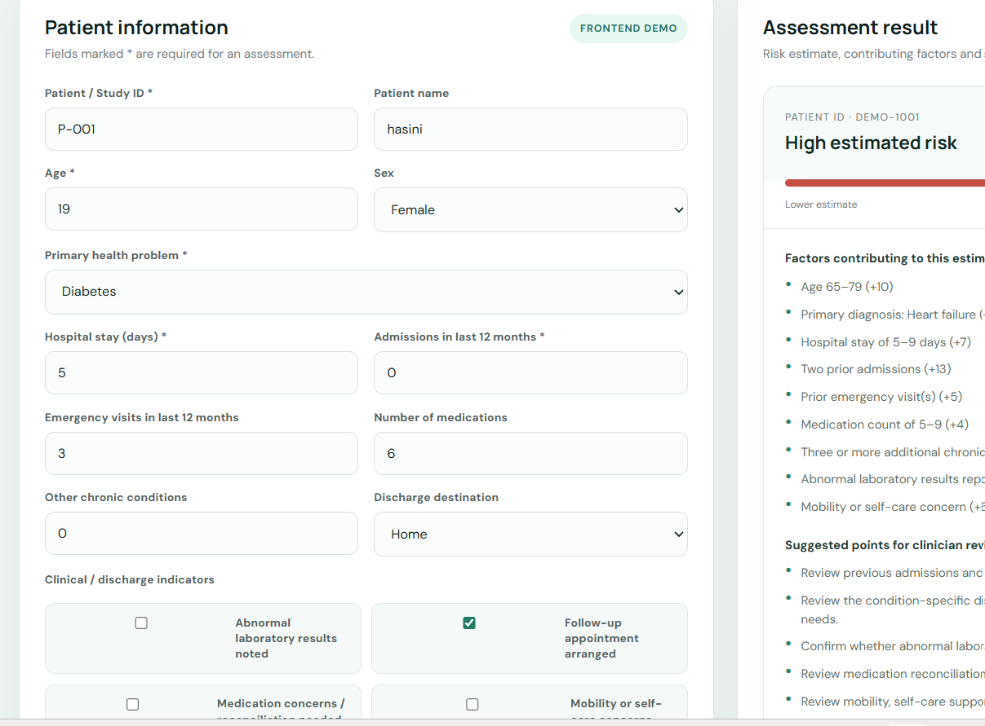
Demo: home page and patient input
Home page
Input screen
Users enter patient details such as age, diagnosis, hospital stay, prior admissions and medications to request an assessment.

Slide 16
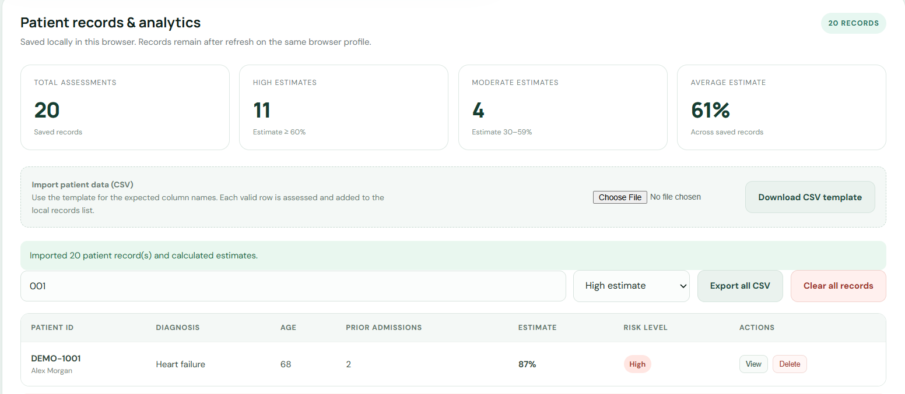
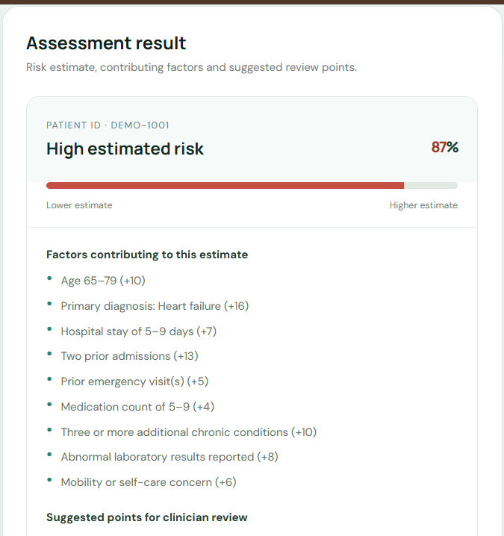
Demo: processing and risk result
Processing screen
Result screen
The result shows an estimated risk percentage, the factors contributing to it and suggested points for clinician review.

Slide 17
Advantages and applications
Advantages
Applications and users
Early identification of at-risk patients
Better follow-up and discharge planning
Less manual analysis effort
Elastic Net controls irrelevant and correlated features
Interpretable, consistent predictions
Supports hospital resource planning
Hospitals and clinics: discharge planning
Doctors: follow-up and monitoring decisions
Administrators: beds, staff and resources
Insurers: readmission and cost trends
Researchers: better prediction models
Meant to support, not replace, clinical judgment

Slide 18
Limitations and future scope
Limitations
Future scope
Prediction errors are possible
May not generalise across hospitals
Small dataset (600 records) and class imbalance
Missing data and some clinical factors not captured
Patient data privacy must be protected
No comparison with other models yet
Larger, more diverse patient datasets
Compare with standard LR and Decision Tree
Cross-validation and parameter tuning
Add medication, visit history and lifestyle factors
Connect the web UI to a live prediction API
Integrate with hospital systems at scale

Slide 19
Conclusion
Elastic Net Logistic Regression gives a simple, interpretable way to estimate hospital readmission risk.
81%
85%
0.89
accuracy on the test split
recall: most readmissions caught
ROC-AUC (88.69%)
The web interface lets users enter patient details, see estimated risk and contributing factors, and import or export CSV records. Next steps: connect a trained model, a secure database and real clinical data.

Slide 20
Thank you
S. Vennela | Krishna Sree | Team 23, Section 13 | Guide: Mrs. Ch. Anitha

