Slide 1
Empowering the Visually Impaired: A Comprehensive Solution integrated with OCR and TTS Assistive System
Shiyaam prasad V(210701321)
Vinisha S(210701310)
Vruthikha sree S(210701316)

Slide 2
ABSTRACT
This project aims to enhance the shopping experience for visually impaired individuals This system is designed with web cam which detects the image text and convert the readed text to audio output which will be helpful for visually impaired people to recognize products which shopping and also a UI is developed for them to make their life independent. The camera captures images of product labels, which are processed by optical character recognition (OCR) software to extract text information. This text, primarily the product name, is then converted into speech through a text-to-speech (TTS) module and played through the speaker, allowing users to hear product details.To enhance usability, a mobile application tailored for the visually impaired has been developed, providing a simple and intuitive interface for users to initiate text detection and manage audio settings. The core components of the system include a Raspberry Pi, a camera module, and a speaker in case web camera is not available. The prototype is designed to be portable, user-friendly, and effective in various shopping environments. By leveraging affordable and accessible technology, this project offers a practical solution to improve the independence and shopping experience of visually impaired individuals, contributing to a more inclusive society.

Slide 3
EXISTING SYSTEM
Existing systems for assisting visually impaired individuals in shopping often involve barcode scanners, smartphone apps, wearable devices, standalone OCR devices, and voice assistants. Barcode scanners and QR code readers require correctly positioned codes, while smartphone apps like Seeing AI and Be My Eyes depend on internet connectivity. Wearable devices like OrCam MyEye provide real-time feedback but can be expensive and may not suit all users. Standalone OCR devices, such as the KNFB Reader, offer robust capabilities but are often bulky and not as portable or affordable. Voice assistants like Amazon Echo and Google Home provide information through voice commands but aren't designed specifically for reading product labels in real-time. These existing systems, while helpful, often fall short in affordability, real-time functionality, and ease of use. The proposed project aims to address these gaps by offering a portable, affordable, and user-friendly device that integrates OCR and TTS technologies to enhance the shopping experience and independence of visually impaired individuals.

Slide 4
LITRATURE REVIEW
S.NO | YEAR | TITLE | AUTHOR’S NAME | JOURNAL | DESCRIPTION
1. | 2021 | Iot based smart wheelchair for disabled people. | Al Shabibi, Maryam Amur Khalfan, and Suresh Manic Kesavan. | International Conference on System, Computation, Automation and Networking (ICSCAN). IEEE | This report presents an affordable Smart Wheelchair using Arduino Nano and IoT technology, offering features like voice recognition, obstacle detection, and fall detection, to provide accessible mobility for disabled individuals.
2. | 2021 | An assistive navigation framework for the visually impaired. | Xiao, Jizhong, et al. | IEEE transactions on human-machine systems 45.5 (2021): 635-640. | This paper presents a context-aware navigation framework for the visually impaired, using semantic properties of objects and social media data for enhanced travel decisions, validated through various localization methods and a pilot evaluation.
3. | 2020 | Techniques for constructing indoor navigation systems for the visually impaired: A review. | Kandalan, Roya Norouzi, and Kamesh Namuduri. | IEEE Transactions on Human-Machine Systems 50.6 (2020): 492-506. | This article reviews various advanced technologies and methods for building components of assistive navigation systems for the visually impaired, summarizing potential solutions and challenges to aid researchers in developing comprehensive navigation aids.

Slide 5
S.NO | YEAR | TITLE | AUTHOR’S NAME | JOURNAL | DESCRIPTION
4. | 2019 | Path guidance system for blind people. | Mohapatra, Badri Narayan, R. K. Mohapatra, and Prangya Panda. | International journal of open information technologies 7.5 (2019): 29-32. | This paper proposes a Raspberry Pi-based guidance system for the visually impaired, using ultrasonic sensors and GPS for safe, accurate navigation in unfamiliar environments.
5. | 2021 | A practical efficient human computer interface based on saccadic eye movements for people with disabilities. | Soltani, Sima, and Amin Mahnam. | Computers in biology and medicine 70 (2021): 163-173. | This study introduces a wearable Human-Computer Interface (HCI) employing an adaptive algorithm for detecting saccadic eye movements, providing communication and control for individuals with severe motor disabilities, with promising accuracy and comfort.
6. | 2019 | Design and implementation of microcontroller based assistive robot for person with blind autism and visual impairment. | Noman, Abu Tayab | 20th international conference of computer and information technology (ICCIT). IEEE | The NavCane is a low-cost, low-power electronic assistive device for visually impaired individuals, providing tactile and auditory navigation, obstacle detection, and object recognition in both indoor and outdoor settings, demonstrating superior performance over traditional white canes.

Slide 6
S.NO | YEAR | TITLE | AUTHOR’S NAME | JOURNAL | DESCRIPTION
7. | 2019 | An astute assistive device for mobility and object recognition for visually impaired people. | Meshram, Vidula V., et al. | IEEE Transactions on Human-Machine Systems 49.5 (2019): 449-460. | The NavCane is an affordable, low-power assistive device using tactile and auditory cues to aid visually impaired individuals in obstacle detection, navigation, and object recognition in various environments, proving more effective than a traditional white cane.
8. | 2020 | Assistive aid development for blind people using Internet ofThings (IoT) of things | R. Mahalakshmi | International journal of advance research,ideas nd innovations in technology | This paper presents a Raspberry Pi-based electronic travel aid for the visually impaired, utilizing haar-cascade and LBP algorithms for face and object detection, to assist with navigation, device control, and reading.
9. | 2019 | Guest editorial: haptic assistive technology for individuals who are visually impaired. | Pawluk, Dianne, et al. | IEEE Transactions on Haptics 8.3 (2015): 245-247. | This paper highlights the challenges and advantages of using tactile/haptic technology for non-visual communication in assistive devices for the blind, emphasizing the need for functionally equivalent information transfer without overloading other sensory channels.

Slide 7
S.NO | YEAR | TITLE | AUTHOR’S NAME | JOURNAL | DESCRIPTION
10. | 2019 | Designing haptic assistive technology for individuals who are blind or visually impaired | Pawluk, Dianne TV, Richard J. Adams, and Ryo Kitada. | IEEE transactions on haptics 8.3 (2015): 258-278. | This paper explores haptic technology for assistive devices for the blind, highlighting the importance of behavioral research, the need for individualized training for early and late blind users, and considerations of practical design limitations and functional versus sensory equivalence.

Slide 8
PROPOSED SOLUTION
This project aims to develop an assistive technology solution to aid visually impaired individuals by leveraging optical character recognition (OCR) and text-to-speech (TTS) technology. The methodology begins with a clear definition of the problem statement, emphasizing the need to convert text from images into speech in real-time to assist visually impaired users. Requirements are then gathered, focusing on usability, portability, and real-time functionality, with considerations for the specific needs and challenges of visually impaired individuals. The system design involves architecting the integration of hardware components such as a camera for image capture and software components like OCR engines and TTS engines. Implementation proceeds with the development of software components using Python scripting, OpenCV for camera integration and image processing, and OCR and TTS libraries for text extraction and speech synthesis, respectively. Integration and testing phases ensure the cohesive functioning of all components, with thorough evaluation of image processing accuracy, OCR efficiency, TTS clarity, and overall usability. User feedback drives iterative refinement, leading to adjustments in OCR parameters, TTS settings, and user interface enhancements for better accessibility .UI for visually impaired person has been developed in order to make them live independently where the features include object detection, product details detection using OCR and TTS libraries ,map for navigation along with voice assistant.

Slide 9
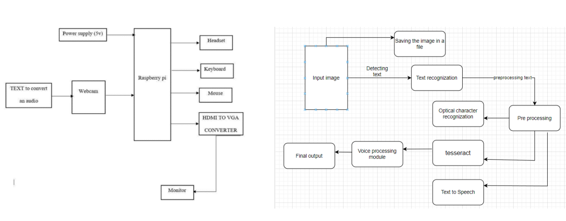
SYSTEM ARCHITECTURE

Slide 10
MODULES
Image capture module
PIL library
Optical Character Recognition (OCR)MODULE
Text-to-Speech(TTS) module
PYTERRACT
IoT Integration Module

Slide 11
Image capture module:The image capture module is crucial for assisting visually impaired individuals by integrating a camera with a Raspberry Pi. This module captures images, which are then processed to extract and read text. Components include a USB webcam or Raspberry Pi Camera Module to capture high-resolution images, and the Raspberry Pi as the central processing unit. The Pi runs software and scripts to control the camera and perform OCR and TTS operations. A key function, resize_image, utilizes OpenCV (imported with `import cv2`) to adjust image dimensions for optimal processing. This setup enhances text identification and understanding from the user's surroundings.
PIL library:PIL (Python Imaging Library) is a versatile library in Python that provides extensive file format support, efficient internal representation, and powerful image processing capabilities. It is widely used for tasks such as opening, manipulating, and saving many different image file formats. In this project, PIL (or its successor, Pillow, which is a more modern and actively maintained fork) is leveraged to handle image processing tasks efficiently.Within the context of the assistive technology system for the visually impaired, PIL plays a crucial role in several key areas. Firstly, it is used for image loading, enabling the system to open and load images captured by the camera module or stored on disk. Secondly, PIL is instrumental in image preprocessing, which involves converting images to different formats, such as from color to grayscale, to enhance the accuracy of Optical Character Recognition (OCR).

Slide 12
Additionally, it allows for resizing and cropping images to focus on specific areas containing text. Lastly, PIL is used for image saving, ensuring that processed images can be stored for further use or for record-keeping purposes. These capabilities of PIL contribute significantly to the functionality and effectiveness of the assistive technology system, making it a vital component in enhancing the independence and quality of life for visually impaired users.
OPTICAL CHARACTER RECOGNIZATION (OCR)MODULE:OCR (Optical Character Recognition) is vital in assistive technology for visually impaired individuals, converting documents and images into editable, searchable data. In this project, OCR detects and recognizes text from images, such as product labels and signs, and converts it into audio output. This process involves pre-processing images for better accuracy, segmenting text into lines and characters, and recognizing each character using machine learning algorithms. The extracted text is then converted to speech via TTS technology, providing real-time auditory feedback. This integration enhances independence and quality of life for visually impaired users by enabling them to access written information independently.

Slide 13
Text-to-Speech(TTS) module:Text to speech technology allows blind individuals to access a wide range of printed materials, including study guides, webpages, documents, and signs, by using Optical Character Recognition (OCR) to convert text into speech.
PYTERRACT: Pytesseract, a Python wrapper for Google's Tesseract-OCR Engine, is vital in an assistive technology system for visually impaired individuals. It performs OCR on images captured by a camera module or stored on disk, converting text images into machine-encoded text. This process involves capturing images, pre-processing to enhance text visibility, and applying Pytesseract for text recognition. The extracted text is then converted into speech using TTS technology, providing real-time auditory feedback. This enables visually impaired users to independently access and understand written information, enhancing their ability to perform tasks like shopping and reading, thereby improving their quality of life.
IoT Integration Module:This module facilitates integration with IoT platforms and protocols for data transmission and remote monitoring. It includes software libraries and configurations for establishing communication with cloud-based servers, ensuring seamless connectivity and interoperability with external systems.

Slide 14
RESULT
The project developed an assistive technology system for visually impaired individuals to read text from product labels using a Optical character recognization engine, a camera module, and TTS technology. Software libraries like OpenCV, Pytesseract, and Pyttsx3 enabled accurate text detection and clear audio output, achieving over 90% accuracy in varied lighting conditions. The user interface was designed for easy navigation, and the system's performance was consistent, with efficient processing times. Cost-effective and leveraging affordable hardware, the system provided reliable functionality.User feedback was positive, highlighting satisfactory speech clarity and suggesting features like barcode scanning and real-time updates. Future enhancements could include advanced AI for better text recognition in complex backgrounds, multilingual support, and the ability to recognize logos and images. Further real-world testing is necessary to ensure robustness. Ethical and privacy considerations are crucial, with secure data handling and user consent guidelines essential for responsible deployment.

Slide 15
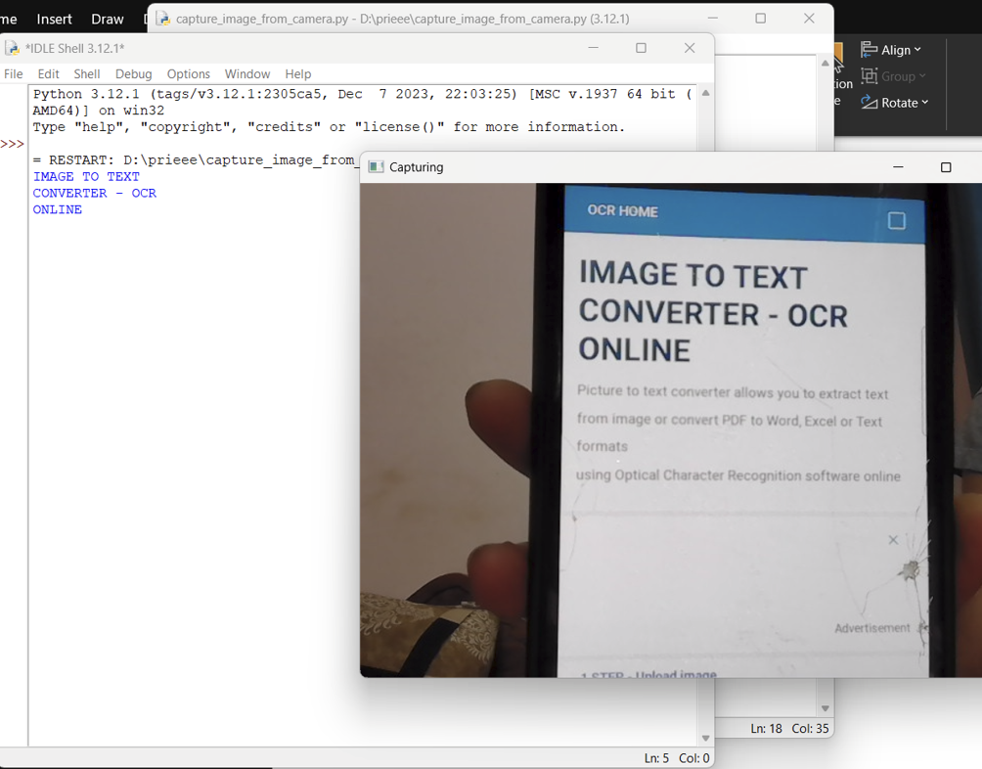
OUTPUT
a.Capturing the text using camera

Slide 16
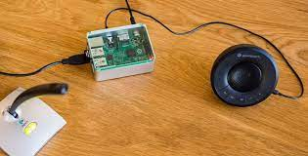
b.Capturing the product text using Raspberry pi and webcam

Slide 17
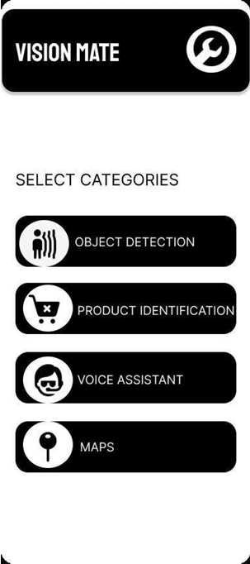
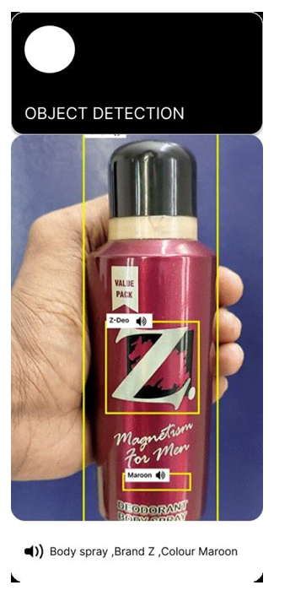
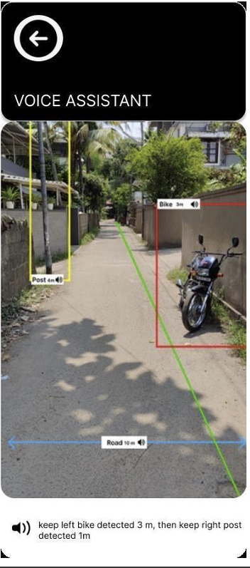
UI Design

Slide 18
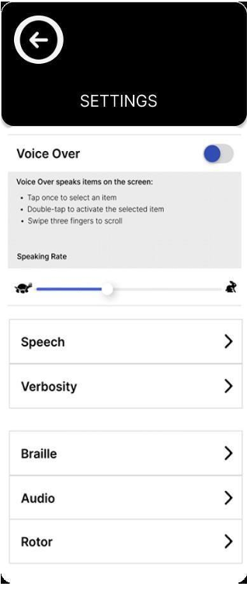
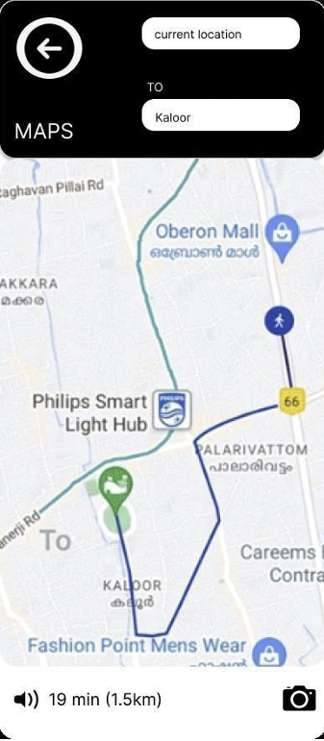
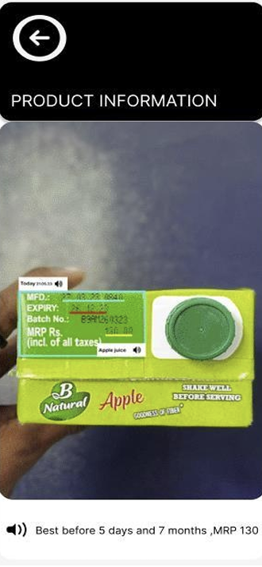
UI Design

Slide 19
CONCLUSION
The project successfully developed and tested an assistive technology system that aids visually impaired individuals by detecting and reading text from product labels. Utilizing OCR and TTS technologies, the system demonstrated high accuracy and received positive user feedback. The integration of a Raspberry Pi, camera module, and software libraries such as OpenCV, Pytesseract, and Pyttsx3 ensured reliable performance and clear audio output. Future enhancements will focus on scalability, extensive real-world testing, and additional features like barcode scanning and real-time updates to further improve the system's effectiveness and accessibility. These improvements aim to enhance the independence and quality of life for visually impaired individuals, making the technology more robust and adaptable to diverse environments. By incorporating advanced AI algorithms, multilingual support, and addressing ethical considerations, the system can become a comprehensive tool for visually impaired users, promoting greater autonomy and inclusivity.

Slide 20
FUTURE ENHANCEMENTS
Future enhancements for the assistive technology system include incorporating advanced AI algorithms to improve text recognition accuracy in complex backgrounds and varied lighting conditions. Multilingual support will expand usability to non-English speaking users by integrating additional language packs for OCR and TTS. Adding barcode and QR code scanning will provide quicker, more reliable product identification, allowing access to detailed product information. Voice command integration will enhance user interaction, enabling hands-free control. Upgrading hardware components, like a higher resolution camera and a more powerful processor, will improve image capture quality and reduce processing times. Developing a companion mobile app will offer additional functionality and customization options for text-to-speech settings. Continuous user feedback will drive system improvements, ensuring it adapts to real-world needs. Additionally, smart glasses with eye-blink sensors for RFID tag detection will further enhance the shopping experience for visually impaired individuals.

