Slide 1
Plan

Slide 2
Plan Overall Schedule
1. Requirement Specification : 9/20(W4) ~ 10/24(W8)
2. Design : 10/11(W7) ~ 10/24(W8)
3. Implement
- Component : 10/25(W9) ~ 11/14(W12)
- Integration : 11/1(W11) ~ 11/21 (W12)
4. Code Review : 11/22 ~ 11/28 (W13)
5. Testing : 11/22(W13) ~ 12/5(W14)
6. Prepare Final Presentation : 11/29 ~ 12/5(W14)
도식화
(p.20 참고)
Implement 부분은 윤소희 선배님이 말씀하신 것처럼 하나로 합쳐서 작성해도 무방할 것 같습니다.

Slide 3
Plan Process Activities
Requirement Specification : ~10/24
⇅
Unit Model Specification : ~10/24
⇅
Unit Model Development : ~11/21
&
Integration : ~11/21
↓
Verification and Validation
{Unit Testing > Integration Testing > System Testing > User Acceptance Testing} : ~12/5
도식화
(p.21-2 참고)

Slide 4
Prototype

Slide 5






Prototype Abstract Design
Library
Classroom
Hub
Exhibition Place

Slide 6
Evaluation

Slide 7
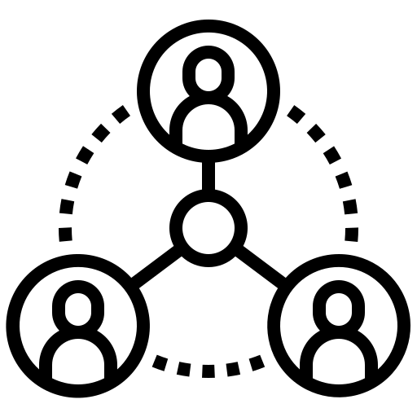


Evaluation
일단 작성하긴 했는데
이 부분이 불필요하다 생각하시면
빼도 될 것 같습니다☺
(p.23 참고)
Connectivity
How well does it connect each place interactively as a Hub?
Functionality
How well does it serve the purpose of each place?
UI/UX Design
Is it constructed with user-friendly environment in terms of design?

