Slide 1

Zantac Cloud Migration Architecture
Terraform, Ansible & Jenkins Integration

Slide 2
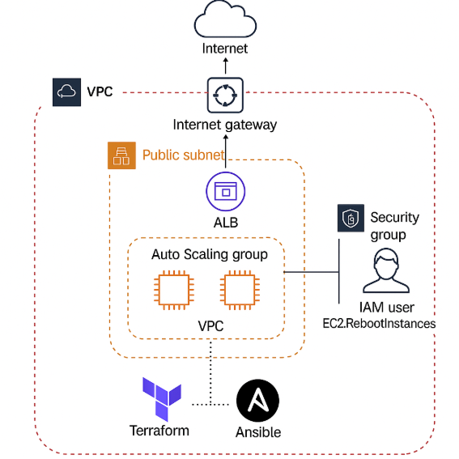
High Level Architecture

Slide 3
High-Level Architecture Overview
• VPC with Public Subnets and Internet Gateway
• Application Load Balancer (ALB)
• Auto Scaling Group with Amazon Linux 2023 EC2 instances
• Security Group for port 8080
• IAM user to allow EC2 reboot access only
• Jenkins pipeline for deployment automation

Slide 4
Terraform Modules Breakdown
• VPC: Creates networking with public subnets
• EC2_ASG: Launch Template, Auto Scaling Group, ALB
• Security: Security Group allowing inbound HTTP (8080)
• IAM: User with limited permission to restart EC2 service

Slide 5
Ansible Role for Web Server Setup
• Ansible playbook runs via bootstrap.sh in Launch Template
• Installs web server
• Configures port redirection 80 → 8080
• Ensures idempotent configuration

Slide 6
Jenkins CI/CD Pipeline
• Clones Terraform repo from GitHub
• Initializes and validates configuration
• Plan and approval-based apply
• Uses environment variables and secure credentials
• Handles terraform binary install with error checks

Slide 7
Terraform Outputs
• ALB DNS Name for application access
• Private IPs of EC2 instances
• Instance IDs for tracking and operations
• All outputs printed post apply

