Slide 1
Multiorgan Segmentation of
Abdominal CT Scans
Using 3D U-Net and the AbdomenAtlas1.0Mini Dataset
Group – 9
Deep Learning for Medical Image Analysis

Slide 2
Introduction & Overview
What is the Problem?
Our Approach
Manual organ delineation by radiologists is:
• Time-consuming & labour intensive
• Prone to inter-observer variability
• Impractical at clinical scale
Deep learning volumetric architectures have substantially closed the gap between automated and expert-level segmentation performance.
Dataset: AbdomenAtlas1.0Mini — 5,195 annotated CT volumes (100 used)
Architecture: 3D U-Net (MONAI framework)
Task: Voxel-wise segmentation of 9 abdominal organs + background
Organs: Aorta, Gallbladder, Spleen, Left & Right Kidney, Liver, Stomach, Pancreas, IVC
Metrics: DSC (primary), IoU, Precision, Recall

Slide 3
Dataset: AbdomenAtlas1.0Mini
5,195
100
9
~8 GB
Total CT Volumes
in Full Dataset
Patient Volumes
Used (Subset)
Abdominal Organs
Annotated
Post-Preprocessing
Working Set
Label Mapping
Why 100 Patients?
Index | Organ | Index | Organ
0 | Background | 5 | Right Kidney
1 | Aorta | 6 | Liver
2 | Gallbladder | 7 | Stomach
3 | Spleen | 8 | Pancreas
4 | Left Kidney | 9 | IVC
• Kaggle T4 GPU: 16 GB VRAM, ~20 GB disk
• Full dataset exceeds practical storage limit
• 100 volumes ≈ 8 GB after preprocessing
• 70 / 15 / 15 train-val-test split (seed=42)
• Lexicographic sampling ≈ random demographic draw

Slide 4
Preprocessing Pipeline
Base Transforms (All Splits)
Training Augmentations Only
Isotropic Resampling
Random Patch Sampling
1.5×1.5×1.5 mm uniform voxel spacing
Trilinear (CT) + nearest-neighbour (masks)
4 patches of 96³ voxels / volume
Pos:Neg = 1:1 balanced strategy
Intensity Normalization
Random Flipping
HU clipped to [−150, 250]
Rescaled linearly to [0.0, 1.0]
Horizontal, vertical, depth axis
p = 0.5 each
Foreground Cropping
Rotation & Intensity Shift
Removes zero-padded air regions
Reduces volume size & memory
90° axial rotation (p=0.1)
Intensity offset ±0.10 (p=0.5)

Slide 5
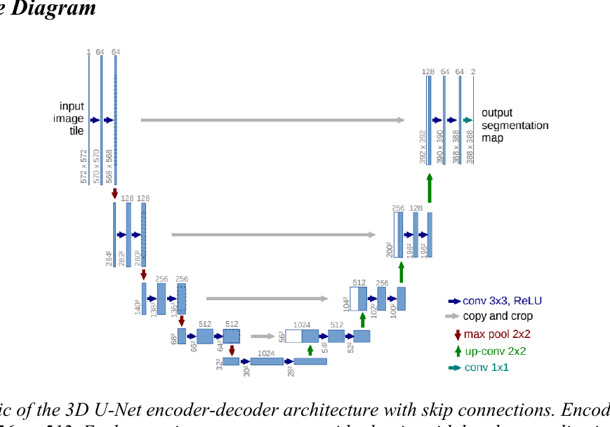
Model Architecture: 3D U-Net
Network Configuration
spatial_dims
3
in_channels
1 (single-channel CT)
out_channels
10 (9 organs + bg)
encoder channels
32→64→128→256→512
strides
(2, 2, 2, 2)
residual units
2 per stage
normalisation
Batch Norm
Schematic of the 3D U-Net encoder-decoder architecture with skip connections. Encoder channels: 32 → 64 → 128 → 256 → 512. Each stage incorporates two residual units with batch normalisation and a stride-2 convolution for downsampling.
dropout
0.1
total params
~31.2 M
Skip connections combine high-level semantic
features with fine-grained spatial detail —
crucial for adjacent structures (e.g. liver & gallbladder).

Slide 6
Training Pipeline
Loss Function
Optimiser & LR Schedule
Training Config
DiceCELoss (MONAI)
Combines soft Dice + Cross-Entropy
Background excluded from Dice component
Prevents dominant bg from overwhelming small organ gradients
Softmax activation over class dim
AdamW (lr = 1×10⁻⁴, wd = 1×10⁻⁵)
Decoupled weight decay → better L2 regularisation
Cosine Annealing: T_max=100, η_min=1×10⁻⁶
AMP (FP16 activations, FP32 gradients)
~50% VRAM reduction via Tensor Cores
Patch size: 96×96×96 voxels
4 patches per volume
Batch size: 4
Max epochs: 100
Validation every 2 epochs
Sliding-window inference (overlap=0.5)
Best checkpoint saved on val DSC

Slide 7
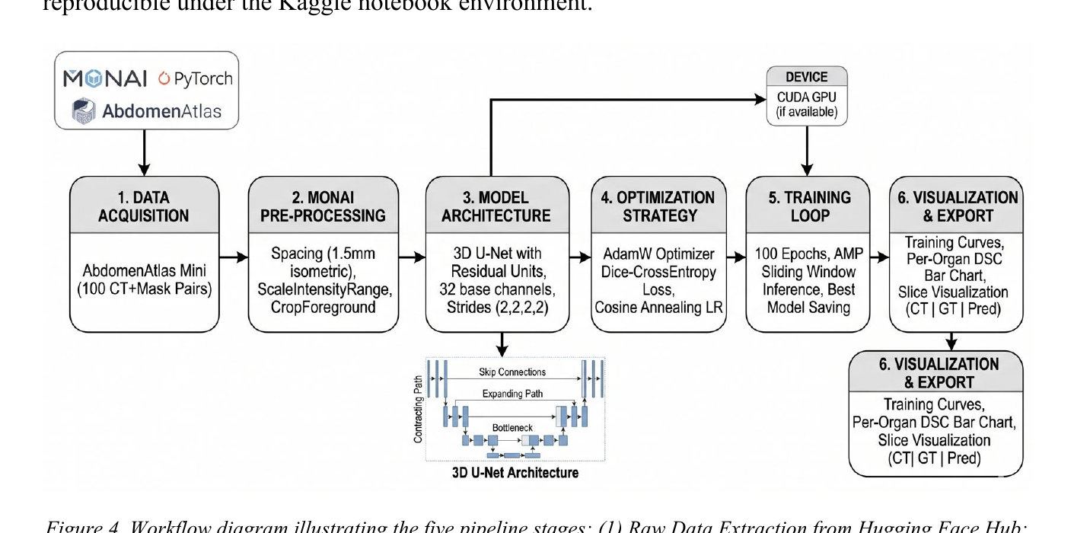
End-to-End Pipeline Workflow
Workflow diagram illustrating the five pipeline stages: (1) Raw Data Extraction from Hugging Face Hub; (2) Patient Filtering & Sampling (N = 100); (3) Preprocessing & Data Loading; (4) 3D U-Net Training with AMP; (5) Evaluation & Result Export.
Stage 1
Stage 2
Stage 3
Stage 4
Stage 5
Raw Data
Extraction
Dataset
Splitting
Preprocessing
& Loading
3D U-Net
Training
Evaluation
& Export

Slide 8
Evaluation Metrics
DSC · Dice Similarity Coefficient
PPV · Precision
2|P∩G| / (|P|+|G|)
|P∩G| / |P|
Primary metric. Harmonic mean of precision & recall. Sensitive to over- and under-segmentation.
Positive predictive value. High recall + low precision → over-segmentation.
0 (no overlap) → 1 (perfect)
Detects over-segmentation
IoU · Intersection over Union
Recall · Sensitivity / Recall
|P∩G| / |P∪G|
|P∩G| / |G|
Jaccard Index. Stricter than DSC. Monotonically related: IoU = DSC / (2−DSC).
High precision + low recall → under-segmentation. Key for small organs.
Stricter complement to DSC
Detects under-segmentation
Background voxels are excluded from all metric computations — consistent with standard multi-class medical segmentation practice.

Slide 9
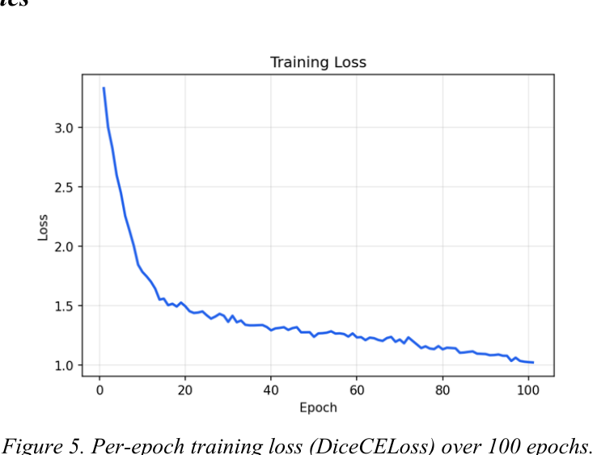
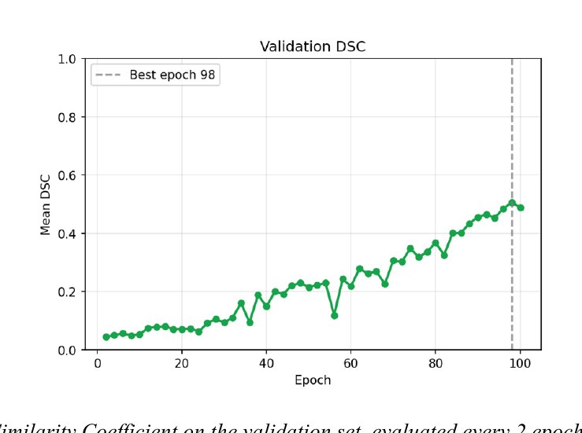
Results: Training Dynamics
Per-epoch training loss (DiceCELoss) over 100 epochs.
Mean Dice Similarity Coefficient on the validation set, evaluated every 2 epochs. Dashed vertical line marks the best-performing epoch at which the model checkpoint was saved.
Loss drops steeply from ~3.2 → ~1.0 in the first 20 epochs
Mean validation DSC steadily improves from near 0 → ~0.55
Best checkpoint saved at Epoch 98 (mean DSC ≈ 0.509 on test set)
Cosine annealing ensures smooth convergence in later epochs

Slide 10
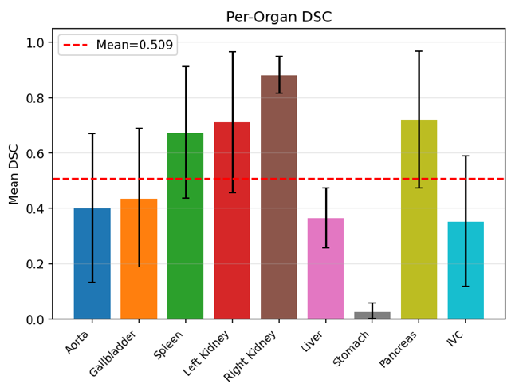
Results: Per-Organ DSC Bar Chart
Organ | DSC | IoU
Right Kidney | 0.883 | 0.797
Pancreas | 0.721 | 0.611
Left Kidney | 0.712 | 0.600
Spleen | 0.676 | 0.552
Gallbladder | 0.439 | 0.314
Aorta | 0.402 | 0.286
Liver | 0.365 | 0.229
IVC | 0.353 | 0.241
Stomach | 0.029 | 0.015
Mean | 0.509 | —
Bar chart of mean DSC (± std) per organ class on the test set. Red dashed line denotes the overall mean DSC.

Slide 11
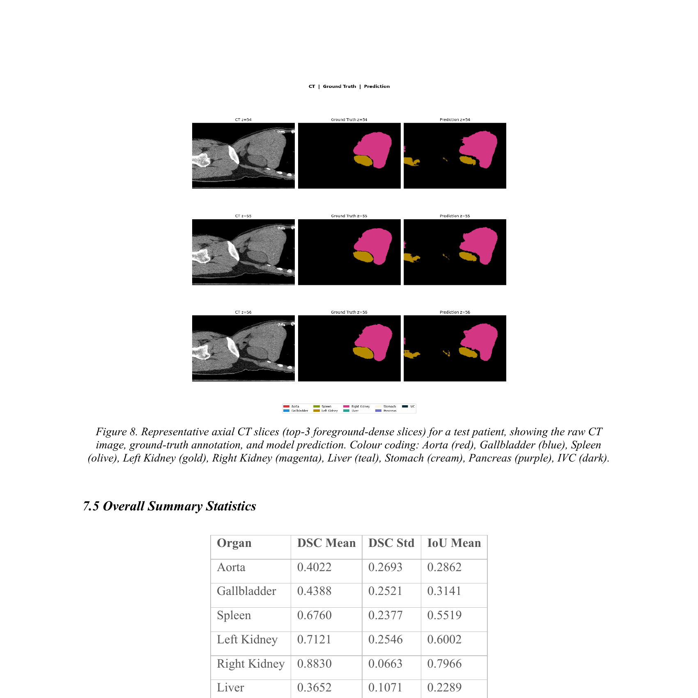
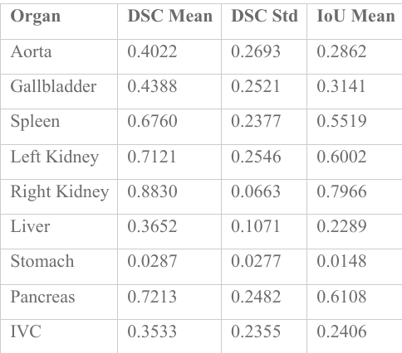
Results: Qualitative Segmentation
CT | Ground Truth | Prediction
Overall Summary Statistics
Colour Legend
Aorta
Gallbladder
Spleen
Left Kidney
Right Kidney
Liver
Representative axial CT slices (top-3 foreground-dense slices) for a test patient, showing the raw CT image, ground-truth annotation, and model prediction. Colour coding: Aorta (red), Gallbladder (blue), Spleen (olive), Left Kidney (gold), Right Kidney (magenta), Liver (teal), Stomach (cream), Pancreas (purple), IVC (dark).
Best validation DSC, test DSC, and test IoU reported from summary.json upon training completion.
Stomach
Pancreas
IVC
3 axial slices shown per test patient
(CT | Ground Truth | Model Prediction)

Slide 12
Discussion & Limitations
Strong Performers
Compute Constraints
Right Kidney (0.883), Pancreas (0.721), Left Kidney (0.712)
→ Spatially consistent, easy to distinguish in CT
Training ~10–11 hrs on Kaggle T4
Only 100/5195 patients (~1.9%) used — primary bottleneck
Weak Performers
Loss Strategy
Stomach (DSC 0.029), Liver (0.365), IVC (0.353)
→ Low contrast, high anatomical variability, insufficient patch coverage
DiceCELoss + cosine annealing insufficient for highly imbalanced classes
→ Class-weighted or focal variants recommended
High Variance
Future Work
Large std dev across organs (e.g. Aorta std=0.269)
→ Model struggles to generalise consistently across patients
Scale to 500–1,000 patients on more capable hardware
→ Expected significant improvement in DSC and stability

Slide 13
Thank You!
Group – 9
Multiorgan Segmentation of Abdominal CT Scans
Using 3D U-Net and the AbdomenAtlas1.0Mini Dataset
Questions & Discussion
Key Reference: Qu et al. (2023) AbdomenAtlas8k · Çiçek et al. (2016) 3D U-Net

