Slide 1

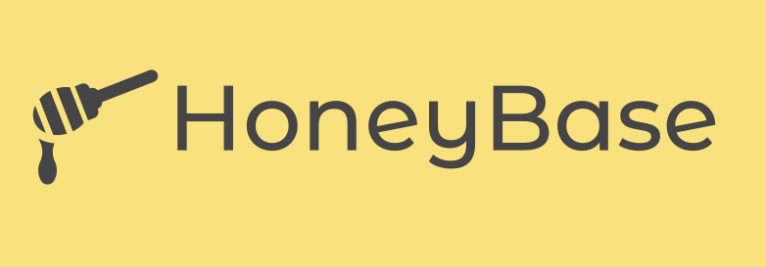
Your Decentralized Data Broker.

Slide 2


Data: The restricted gold
Small companies seek to perform data analytics using its user data but lack trust in third-party involvements and face user privacy concerns, leading to user resistant to share their data.
Due to data breaches, companies cannot share the data of the consumers to other companies because of the government regulations. It sounds good for the users but limits the potential improvements in services they can be provided.
We are now living in the era of AI revolution where data is the new gold for every business. By limiting the availability of data, we can’t bring the potential innovations that can be provided by AI.

Slide 3

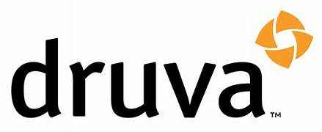
Druva and European Commission Report
The European Commission has estimated that the European Union (EU) data economy was worth €300bn in 2016, and that this will increase to €739bn in 2020.
In a 2019 survey conducted by the EU, it was revealed that around one-third of small businesses, out of nearly 1,000 surveyed, obtain data from other companies.
A survey by Druva which involves more than 700 IT leaders, indicates that-
Around 73% of IT leaders now rely more on data for business decisions, and 33% think the importance of data has gone up permanently since COVID-19 started.
Seventy percent are confident in their data utilization, yet 41% encounter difficulties accessing it promptly for decision-making.
Nearly half (47%) of respondents say their organization can only go up to four hours without access to data before causing serious harm to their business.
Considering the risks of operating a business without data access, 79% of respondents regard effective data management and protection as a competitive advantage.

Slide 4
How HoneyBase will solve this ?
Consortium Blockchain model for companies.
We shall provide our permissioned blockchain network to the companies for storing their user data as structured hashed (only the sensitive information will be hashed) blocks. These data will be made as if it only can be interpreted by AI models not by humans.
Every outside company that requires access to private data must become a member of the blockchain we've set up for the company. Additionally, the provider should arrange a voting among its users to make a decision about this.
We will be providing embedded AI tools to find only the relevant information without the need of the exact information which may include privacy.
For example, you need to find the symptoms of the corona and the age group prone to it, through the analysis of the data from various hospitals you can get the results. The data we provide will hash all the sensitive information but only the information relevant to the corona will be available.
We will provide the specific data format required by the companies and will provide in a mannered way for them to be used by AI models.

Slide 5

HoneyBase ecosystem
AI company the Service company taking service from.
User {
Data 1 (vulnerable)
Data 2
Data 3 (vulnerable)
Data 4
……
……
}
Service Company
data
user
User {
hjcsbdchjsdc323
Data 2
2378fhefkjwehfk
Data 4
……
……
}
data
data
AI company purchasing data from the company.
Employees connected to the blockchain

Slide 6
Go To Market Strategy
First, we will target the small AI startups, who require a larger set of data to train their AI system for providing services.
We plan to engage with companies possessing substantial datasets, encouraging them to securely store their information within our blockchain network. Additionally, we will offer incentives to those who are the first to store their data.
We intend to provide incentives to users of these companies whenever their data is shared with any other company, using tokens as a means of reward.
We will store the data as anonymous blocks from corporates in our blockchain system and provide relevant data formats to these AI startups for them to use for research or be mediator between the corporates and these AI companies.
After we have a certain number of clients above a threshold, we shall improve our data format generation by implementing our own AI tools that will be able analyse all the data in our blockchain and provide the relevant details to various companies without harming the privacy of the users.

Slide 7
Revenue Model
AI company
Service company
Data
user
Data
Companies are required to pay a fee in order to become part of our blockchain network.
To remain within the blockchain network, a subscription model will be implemented.
HoneyBase Tokens
HoneyBase Tokens
HoneyBase

