Slide 1
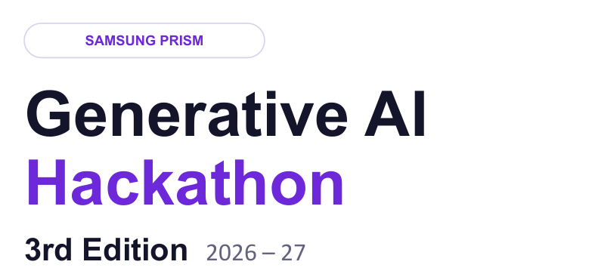


• Theme ID - 2
• Team Name - InnoVerse
• College Name - SRM Institute of Science and Technology
• Member Name & Email 1- Swarnava Sarkar & swarnava2019@gmail.com
• Member Name & Email 2 – K. Trimman Choudhary & kk0569@srmist.edu.in
• Member Name & Email 3- Utsav Singh & saxenautsav06@gmail.com
• Member Name & Email 4- Hemanth Muthyalu & mr2853@srmist.edu.in
• Submission Github link - https://github.com/SWARNAVA182006/samsung-guided-troubleshooting.git
Samsung Guided Troubleshooting Engine
Turn vague device complaints into grounded, actionable troubleshooting.
1

Slide 2

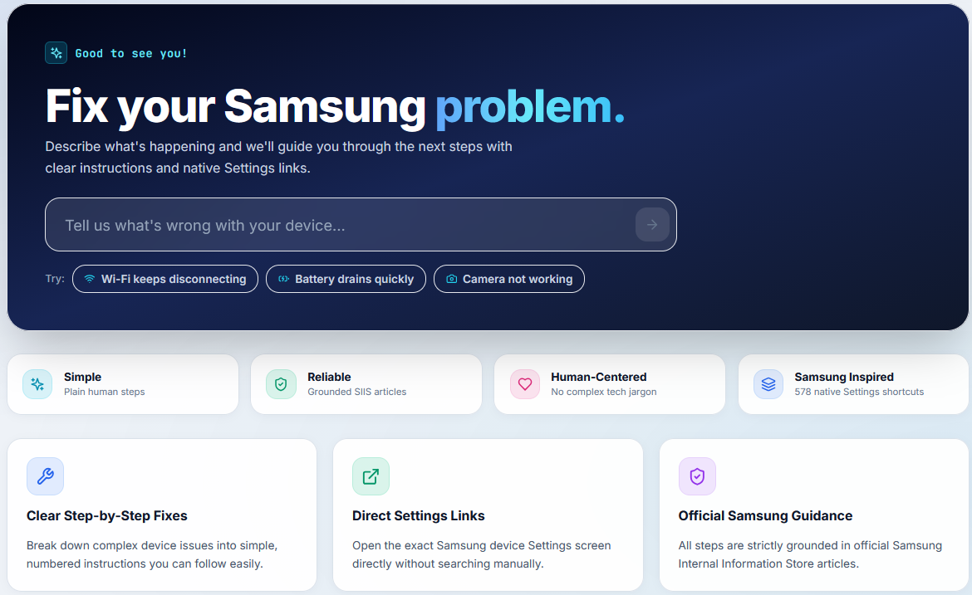
THEME 02 ( GUIDED TROUBLESHOOTING) / THE PROBLEM
Support knowledge exists. The friction is turning it into action.
Users speak naturally; support systems still make them translate the problem.
TODAY
01
Read SIIS
Find the relevant article
02
Interpret
Translate guidance into steps
03
Navigate
Find the right Settings screen
04
Explain
Tell the user what to tap
THE MISSING LAYER → guided, structured, actionable output
SAMSUNG PRISM • THEME 02
02
Notes:
The user does not speak in SIIS terms. The friction is the translation from a vague complaint to a correct action. The missing layer is a guided, structured experience.

Slide 3
Existing Solutions & Gaps
Generic AI talks. Rules break. We built for the contract.
The difference is not another chatbot — it is the verified path from language to action.
GENERIC LLM
RULE-BASED
OUR ENGINE
×
Free-form response
×
Brittle on paraphrases
✓
Official SIIS grounding
×
Weak structural guarantees
×
Manual maintenance
✓
Validated structure + deeplinks
×
No catalog-backed deeplink contract
×
Limited generalization
✓
Guided user experience
Contract protected in code.
KEY INSIGHT
Troubleshooting is not just a conversation — it is a verifiable action plan.
SAMSUNG PRISM • THEME 02
03
Notes:
The key distinction is specialization: we are not presenting a generic chatbot or brittle rules engine. We are building around the official Theme 02 contract and the need for grounded, actionable output.

Slide 4
Our Solutions & Architecture Diagram
From natural language to a verified Settings action.
An end-to-end pipeline with grounding, validation and fast-path caching.
01
02
03
04
05
06
UNDERSTAND
GROUND
STRUCTURE
MATCH
VALIDATE
GUIDE
Normalize · & enrich
Official · SIIS
Goal → Action → StepGroup
578 official · deeplinks
Schema + · safety
One step · at a time
IMPLEMENTATION
FRONTEND
React · TypeScript · Vite · Tailwind · Framer Motion
OFFICIAL CONTRACT
Complaint + SIIS
BACKEND
Node.js · Fastify 4 · session / proxy routing
Goal → Action → StepGroup
+ catalog-backed deeplink
AI GATEWAY
Python · FastAPI · Pydantic · Gemini · retrieval · cache · validation
FAST PATH • Exact + paraphrase cache
SAMSUNG PRISM • THEME 02
04
Notes:
Walk the judge through the architecture left to right: understand the complaint, ground it in official SIIS, structure the response, match the official catalog, validate it, then guide the user.

Slide 5
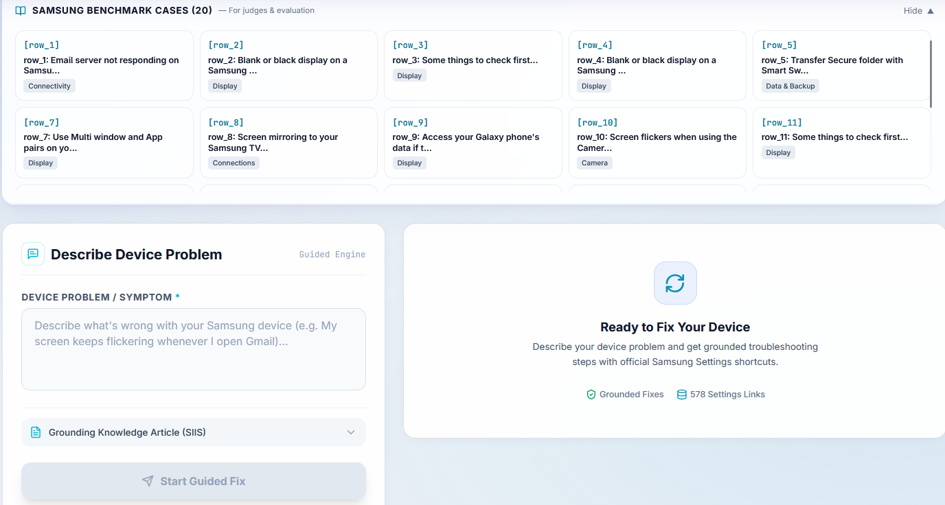
Demo & Product Walkthrough
The output is a guided journey — not a paragraph dump.
A user describes the problem once; the product carries the complexity.
S✦
1 / 4
S✦
2 / 4
Check Wi-Fi
Confirm connection
Open
Next
01 DESCRIBE
02 GUIDE
SAMSUNG PRISM • THEME 02
05
Notes:
This is the most product-oriented slide. Narrate the journey: describe, understand, guide, act, confirm. The interface hides SIIS and retrieval complexity from the user.

Slide 6
Tools and tech stack used
Purpose-built layers, not buzzwords.
Every technology shown here is tied to an actual responsibility in the system.
PRODUCT
React + TypeScript + Vite + Tailwind CSS + Framer Motion
Premium responsive UI, guided state, themes and motion
API
Node.js + Fastify
Session routing and service boundary
AI GATEWAY
Python + FastAPI + Pydantic + Gemini (optional)
Generation, grounding, validation and safe output
INTELLIGENCE
SIIS grounding + TF-IDF retrieval + deeplink matching + cache
Deterministic retrieval, catalog integrity and fast-path reuse
DESIGNED AROUND THE CONTRACT
Grounded
Structured
Catalog-backed
Validated
SAMSUNG PRISM • THEME 02
06
Notes:
Explain only the responsibilities of each layer. Avoid reading out every dependency. The point is that the stack is intentionally lightweight and tied to a real system responsibility.

Slide 7
Impact & Use case
Reduce the distance between “I have a problem” and “I know what to do.”
The same underlying engine serves users, support workflows and SIIS automation.
20
578
OFFICIAL DEEPLINK ENTRIES
0
URL LEAKS IN EVALUATED OUTPUT
OFFICIAL SIIS CASES
BEFORE
AFTER
Read → Interpret → Search → Explain → Navigate
Describe → Ground → Guide → Open → Confirm
END USERS
SUPPORT
SIIS PIPELINE
Clear steps, less Settings hunting
Structured, repeatable guidance
New articles can flow through the same API
SAMSUNG PRISM • THEME 02
07
Notes:
The strongest hard facts are the size of the official grounding sources and the zero URL-leak result. Frame the before/after as workflow simplification, not as a claim of measured business impact unless independently verified.

Slide 8
Innovation highlights, results and limitations
The model generates. The system verifies.
Measured benchmark facts are kept separate from engineering limitations.
GROUNDED
ACTIONABLE
BENCHMARK SNAPSHOT
Steps derive from supplied SIIS guidance.
Deeplinks come from the official catalog.
20 / 20
0
DETERMINISTIC
REPRODUCIBLE
Schema-valid outputs
URL leaks
Contract checks run after generation.
Evaluation is scriptable and inspectable.
146
1.68 s
Catalog-backed deeplinks
Average 20-case pipeline*
HONEST BOUNDARIES
Candidate retrieval rate ≠ semantic accuracy • Jaccard cache has limits
*Average local pipeline latency across the 20 official cases; not a p95 claim.
SAMSUNG PRISM • THEME 02
08
Notes:
Highlight the engineering safety model: official grounding, catalog-backed deeplinks, deterministic validation, reproducible evaluation. Be careful to call the 1.64-second figure an average live cold-start, not a p95.

Slide 9
What’s next
Build from a solid contract toward deeper device-aware assistance.
Current system first; future improvements are clearly separated.
CURRENT
NEXT
FUTURE
Grounded Theme 02 contract
Validated output
Catalog-backed actions
Ground-truth relevance set
Stronger retrieval evaluation
Semantic cache
Multi-turn troubleshooting
Device-aware guidance
Native Galaxy integration
01
02
03
Scale the intelligence, keep the contract.
More semantic depth without losing verification.
SAMSUNG PRISM • THEME 02
09
Notes:
Separate what exists now from what comes next. The next step is deeper semantic evaluation; the long-term direction is multi-turn and device-aware assistance.

Slide 10
Brownie points slide( differentiation)
From language to action —
THE ENGINE
with verification at every layer.
20
SIIS cases
A consumer-facing experience built on a deterministic engineering core.
AI
578
deeplink entries
CONTRACT, NOT PROMPT HOPING
VERIFIED
ACTION
01
GROUNDING FIRST
02
Official SIIS is the source of truth.
Programmatic validation protects the output.
11
validation rules
0
URL leaks
03
TEXT → ACTION
04
REAL PRODUCT UX
Catalog-backed Settings deeplinks make guidance actionable.
Guided steps, completion, history and responsive design.
Built to be
inspectable.
SAMSUNG PRISM • THEME 02
10

Slide 11
Checklist- Updated on Public GitHub
Everything important is visible, reproducible and reviewable.
Keep this slide quiet; the proof is in the checked boxes.
✓
WORKING PROTOTYPE
✓
TEST SUITE
Guided troubleshooting UI + API
pytest + Jest + frontend build
✓
PUBLIC GITHUB
✓
DEMO VIDEO
github.com/SWARNAVA182006/samsung-guided-troubleshooting
https://drive.google.com/file/d/1TwWykxGNnVJEitRnajxDy2_izLY_SLDM/view?usp=sharing
✓
REPRODUCIBLE SETUP
✓
AI DISCLOSURE
README + Docker + environment configuration
Required submission document
✓
EVALUATION OUTPUT
✓
PRESENTATION
20 official benchmark cases + reports
PPTX + PDF final deliverable
FINAL CHECK • FACT-CHECKED • RENDERED • READY FOR REVIEW
SAMSUNG PRISM • THEME 02
11
Notes:
Use this slide as a quiet checklist. Confirm the real submission artifacts and replace the demo-video line with the final link before submission.

Slide 12
SAMSUNG PRISM • THEME 02
Samsung Guided
Troubleshooting Engine
From vague complaints
to clear, actionable fixes.
20/20
official cases evaluated
578
official deeplink entries
0
URL leaks
InnoVerse • SRMIST, Kattankulathur
https://github.com/SWARNAVA182006/samsung-guided-troubleshooting.git
Thank You!
Organised by the Language AI Team and the PRISM Team, Samsung R&D Institute India
12

