Slide 1



Website of Hostel Management System
Welcome to our hostel management system website! We provide an all-in-one solution for managing hostels. Let's find out how our website can help you.
by Swarn Prabha

Slide 2
Overview of Hostel Management System
1
What is a Hostel Management System?
A software designed to streamline the hostel management process, with features that include booking management, billing, and reporting.
Advantages of Hostel Management Systems
2
Automates tasks, reduces manual labor, improves the accuracy of booking records, and enhances guest experiences
3
Why Choose our System?
We have a user-friendly interface that is accessible to all types of users and allows you to manage all aspects of your hostel with ease.

Slide 3
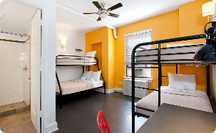



Features of Our Website
Booking Management
User-Friendly Interface
Secure Payment Processing
Manage your hostel's bookings and reservations, keep track of availability and occupancy rates, and accept online bookings via our website.
Our website is easy to navigate, with user-friendly controls, and a simple, intuitive design to help you manage your hostel efficiently.
Offer guests a secure way to pay for their bookings online, with our encrypted payment system that keeps all payment data safe and private.
Reporting and Analytics
Track your hostel's KPIs and generate reports on occupancy, revenue, and more. Analyze your data to improve your operations and drive growth.

Slide 4
User Roles and Permissions
Administrator
Manager
Can access and control all parts of the system, with the highest level of permissions.
Can manage bookings, billing, and online payments, with limited access to some system controls.
Staff
Guest
Can manage bookings and availability, but have no access to billing or other financial information.
Can view available rooms, make bookings, and receive notifications, but have no access to backend controls.

Slide 5
Booking Process
1
Guest Search and Selection
Guests search for hostels, view room information, and select a suitable room.
Booking and Reservation
2
Guests verify the booking details, agree to the terms and conditions, and pay a deposit to reserve the room.
3
Payment and Confirmation
Guests make the final payment for the booking and receive confirmation via email and SMS, with an option to cancel or modify the booking at a later time.

Slide 6

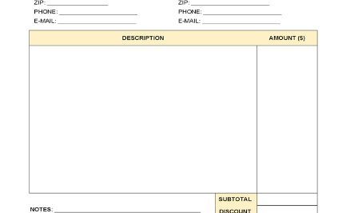

Payment and Billing
Payment Methods
Billing and Invoicing
Cash Handling Assistance
Our system supports a variety of payment methods, including credit/debit cards, PayPal, and bank transfers, to suit every guest preference.
We provide transparent billing statements and online invoices, that can be accessed and downloaded by both the management team and guests.
If you accept cash payments at your hostel, our system provides assistance in managing cash and reconciling accounts.

Slide 7
Reporting and Analytics
Booking and Occupancy Reports
Revenue and Expense Reports
Customer Feedback Reports
Get detailed reports on bookings, cancellations, and occupancy rates, to help you manage your hostel more efficiently.
Track your revenue and expenses and generate reports on profitability, expenses, and cash flow.
Get feedback from customers and generate reports on your hostel's performance, to improve customer satisfaction and loyalty.

Slide 8
Customer Support
24/7 Support Center
Personalized Service
Customer Satisfaction Guarantee
Contact us anytime for technical assistance and support, through our online booking system, email, or phone.
We provide a personalized service for guests, with assistance in booking recommendations, reservations, and additional services.
We value your satisfaction, and we guarantee a hassle-free service with no hidden costs or additional charges.

Slide 9
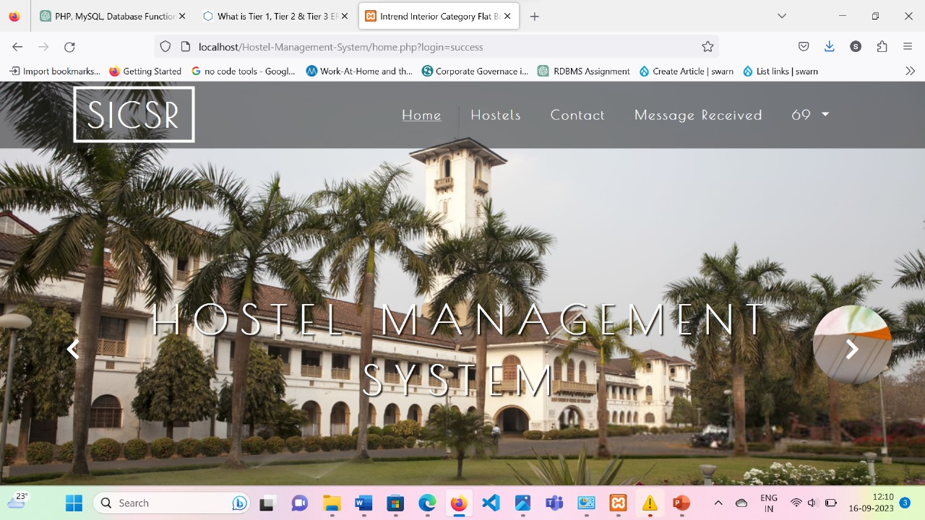
FRONT PAGE OF MY WEBSITE

Slide 10
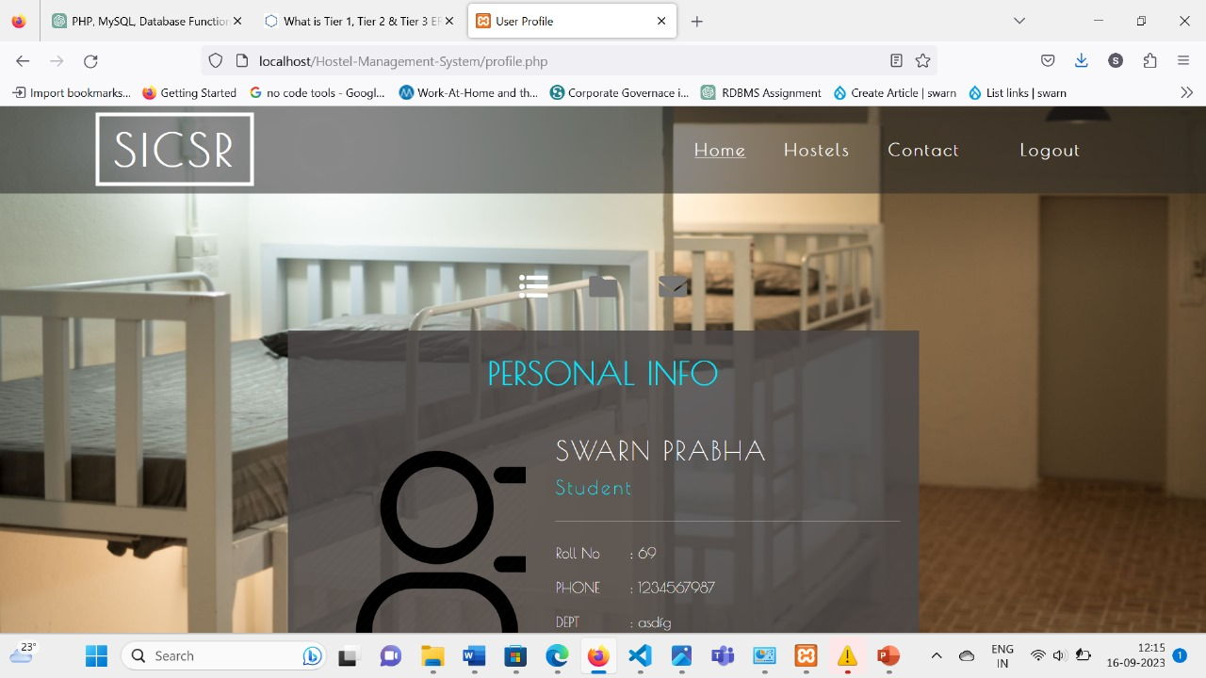
THIS IS THE USER PROFILE PAGE OF MY WEBSITE

Slide 11
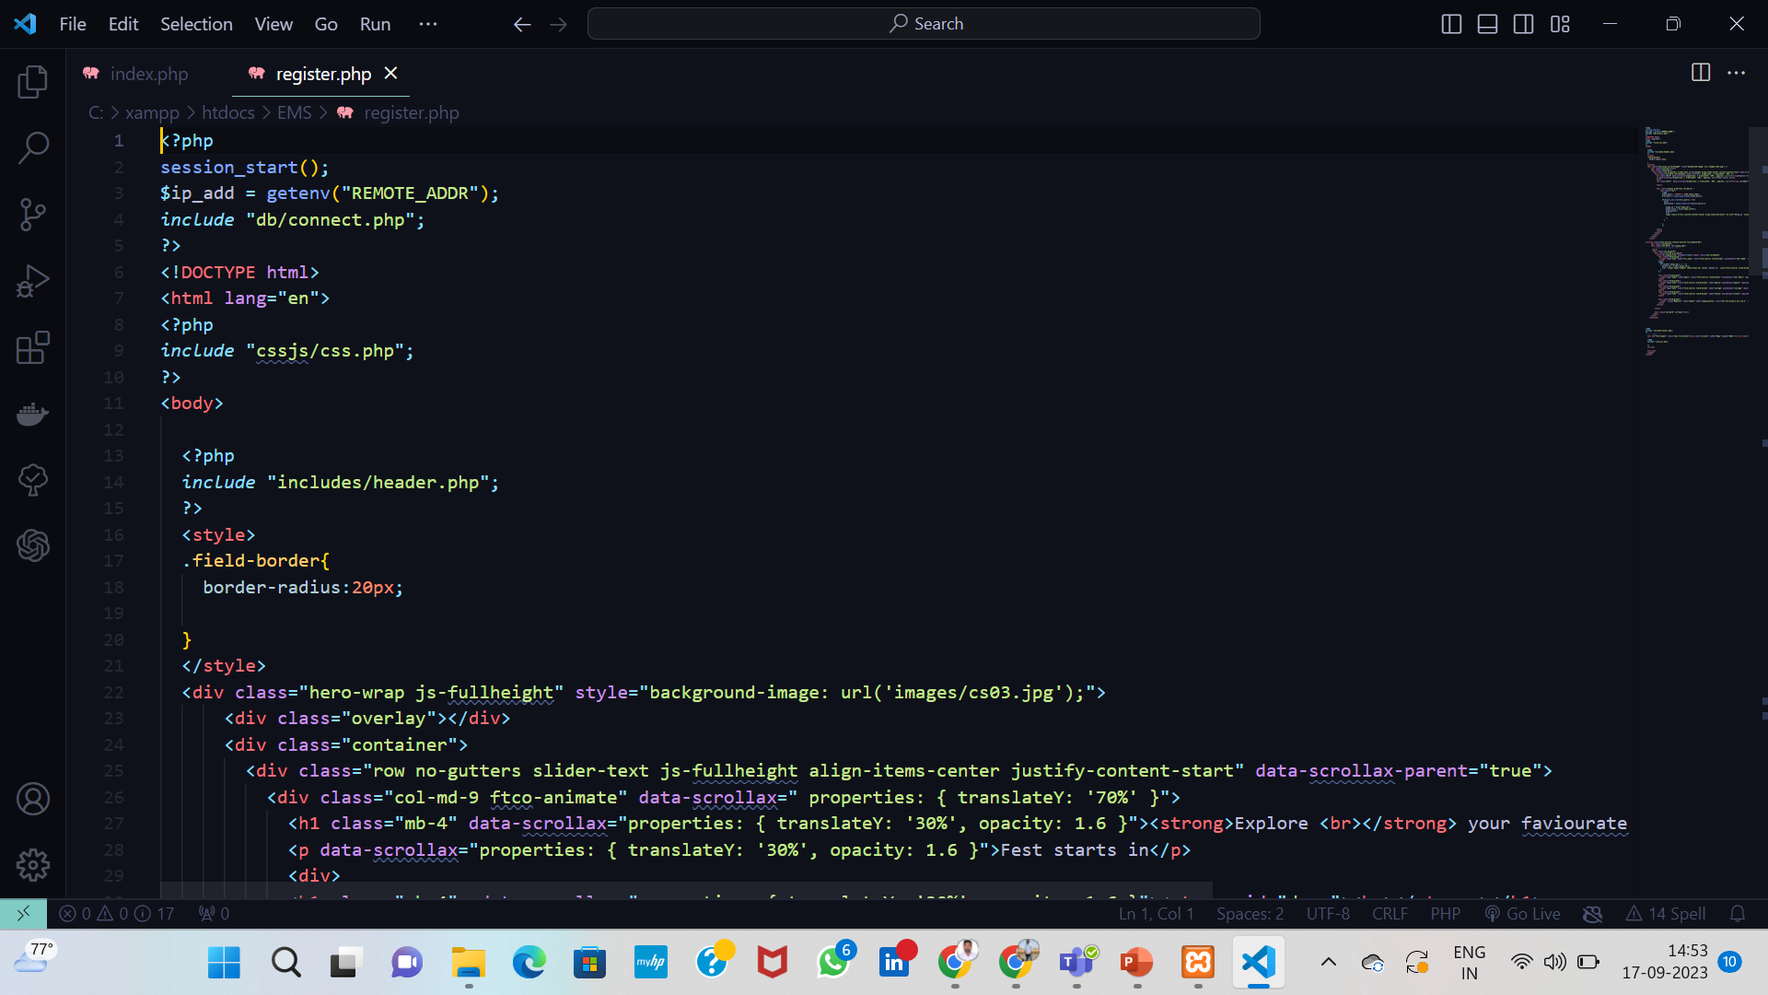
THIS IS THE CODE FOR REGISTRATION PAGE OF MY WEBSITE

Slide 12
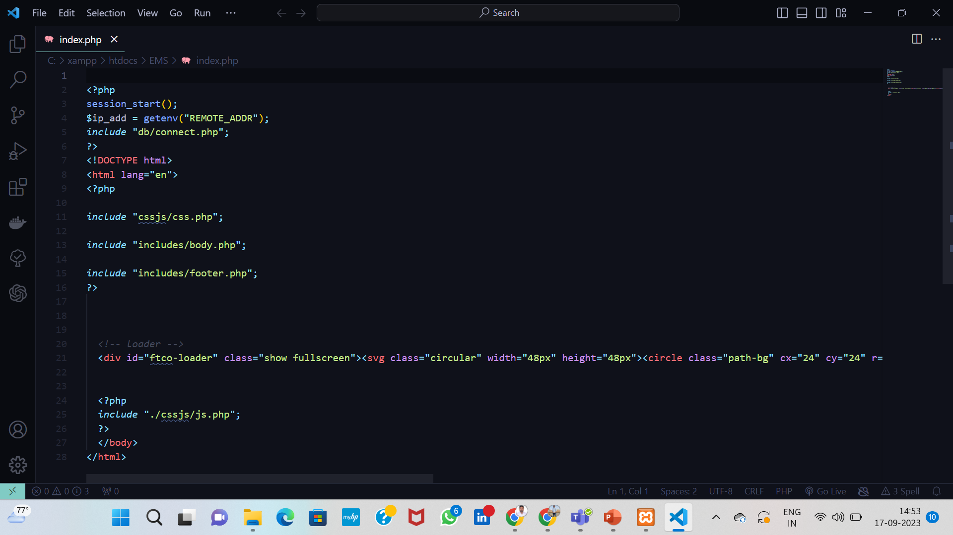
THIS IS THE CODE FOR INDEX PAGE OF MY WEBSITE

