Slide 1
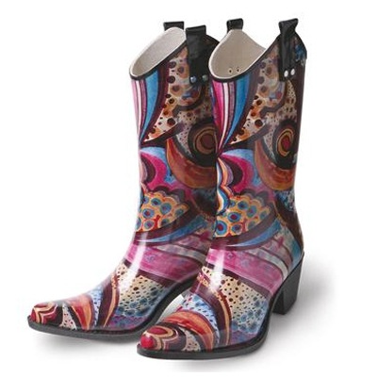
The SADI plug-in to the
IO Informatics’
Knowledge Explorer
...a quick explanation of how
we “boot-strap” semantics...

Slide 2
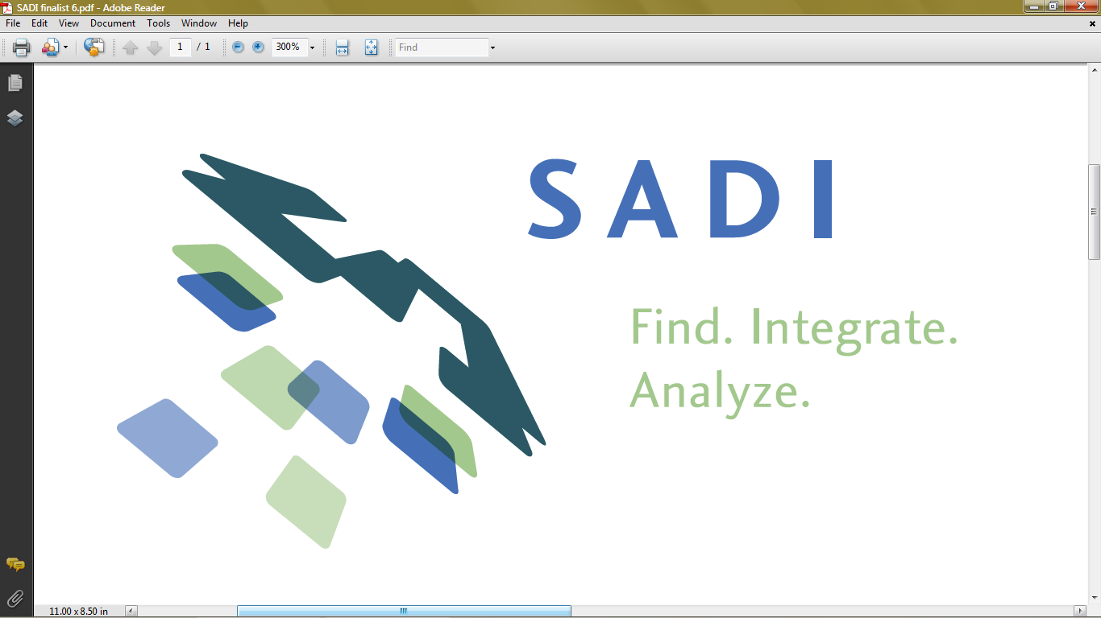
Semantic Automated Discovery and Integration
A simple set of Semantic Web Service design patterns
that result in greatly-improved interoperability and discoverability

Slide 3
SADI in a nutshell...
Service Description
INPUT OWL Class
NamedIndividual: things with
a “name” property
from “foaf” ontology
OUTPUT OWL Class
GreetedIndividual: things with
a “greeting” property
from “hello” ontology
An owl:Individual of the ServiceDescription class from the myGrid/Moby ontology

Slide 4
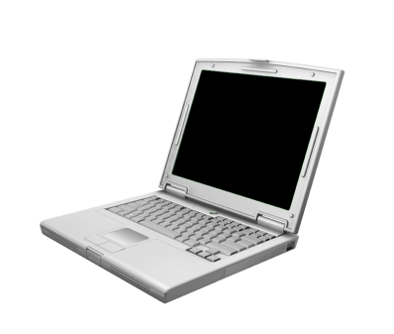

SADI in a nutshell...
POST http://example.org/myservice
person:1
Service Description
INPUT OWL Class
NamedIndividual: things with
a “name” property
from “foaf” ontology
OUTPUT OWL Class
GreetedIndividual: things with
a “greeting” property
from “hello” ontology
foaf:name
rdf:type
Guy Incognito
hello:NamedIndividual
person:1
hello:greeting
rdf:type
Hello, Guy Incognito!
hello:Greeted Individual

Slide 5
SADI in a nutshell...
Service Description
INPUT OWL Class
NamedIndividual: things with
a “name” property
from “foaf” ontology
OUTPUT OWL Class
GreetedIndividual: things with
a “greeting” property
from “hello” ontology
INDEX
The service provides a “greeting” property based on a “name” property
Registry

Slide 6

SADI in a nutshell...
Registry
I have data with
a “name” property
Service Description
INPUT OWL Class
NamedIndividual: things with
a “name” property
from “foaf” ontology
OUTPUT OWL Class
GreetedIndividual: things with
a “greeting” property
from “hello” ontology

Slide 7
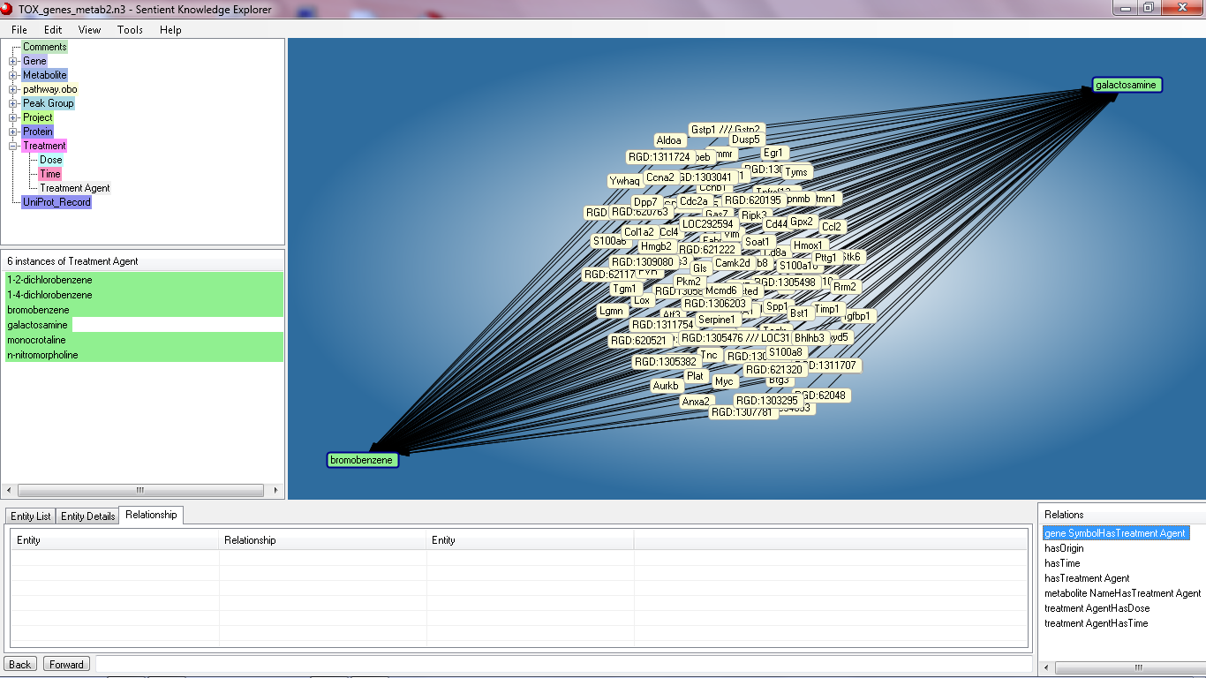
Sentient Knowledge Explorer is a retrieval, integration, visualization, query, and exploration environment for semantically rich data

Slide 8
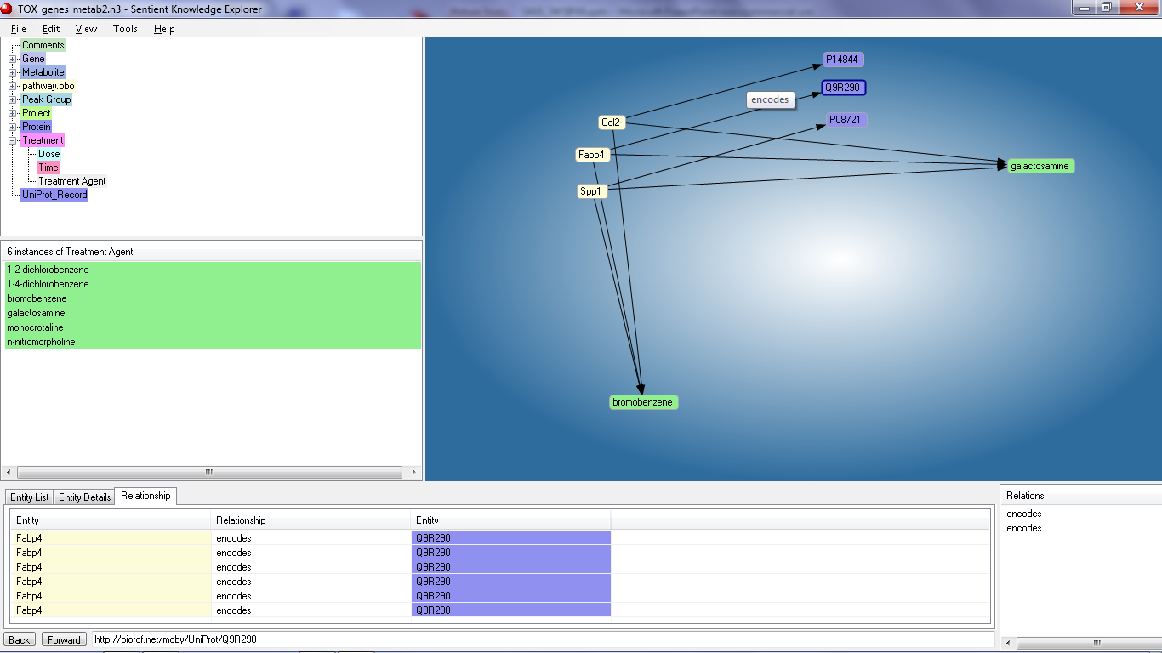
Most imported data-sets will already have properties (e.g. “encodes”)
…and the data will already be typed
(e.g. “Gene” or “Protein”)
…so finding SADI Services to consume that data is ~trivial

Slide 9


Slide 10
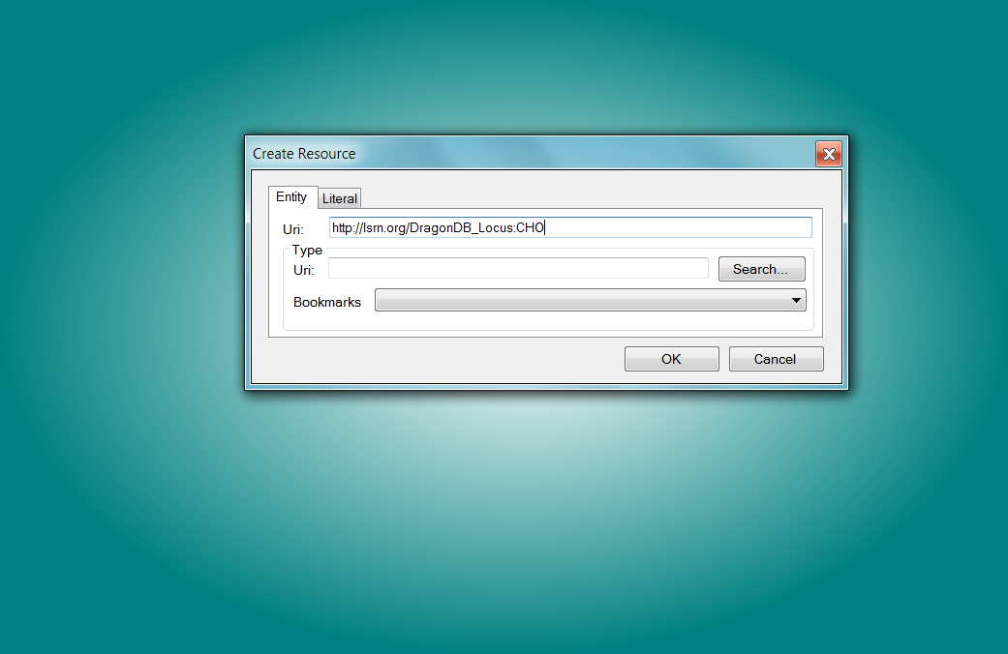

Slide 11
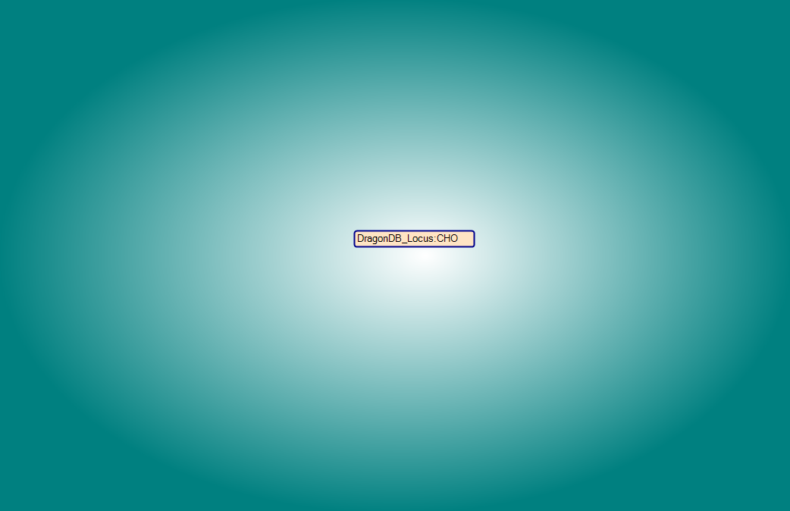

Slide 12
Now what...??
No properties...
No rdf:type...
How do I find a service using that node?
What *is* that node anyway??

Slide 13
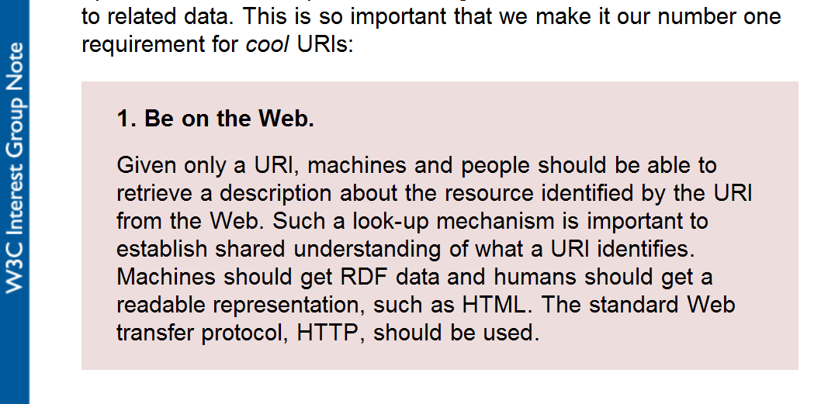

Slide 14
In the case of LSRN URIs, they resolve to:
<lsrn:DragonDB_Locus_Record rdf:about="http://lsrn.org/DragonDB_Locus:CHO">
<dc:identifier>CHO</dc:identifier>
<sio:SIO_000671> <!-- has identifier -->
<lsrn:DragonDB_Locus_Identifier>
<sio:SIO_000300>CHO</sio:SIO_000300> <!-- has value -->
</lsrn:DragonDB_Locus_Identifier>
</sio:SIO_000671>
</lsrn:DragonDB_Locus_Record>
</rdf:RDF>

Slide 15
In the case of LSRN URIs, they resolve to:
<lsrn:DragonDB_Locus_Record rdf:about="http://lsrn.org/DragonDB_Locus:CHO">
<dc:identifier>CHO</dc:identifier>
<sio:SIO_000671> <!-- has identifier -->
<lsrn:DragonDB_Locus_Identifier>
<sio:SIO_000300>CHO</sio:SIO_000300> <!-- has value -->
</lsrn:DragonDB_Locus_Identifier>
</sio:SIO_000671>
</lsrn:DragonDB_Locus_Record>
</rdf:RDF>
The Semantic Science Integrated Ontology (Dumontier) has a model for how to describe database records, including explicitly making the record identifier an attribute of that record; in our LSRN metadata, we also explicitly rdf:type both records and identifiers.

Slide 16
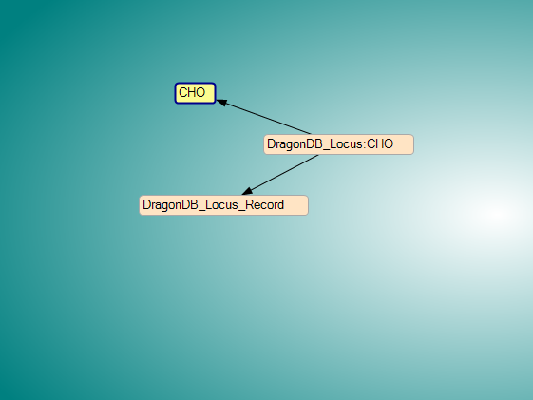
Now we have enough information to start exploring global data...

Slide 17
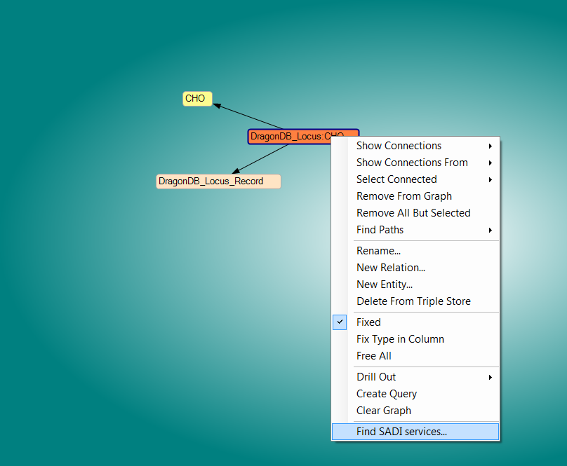
Menu option provided by the plugin

Slide 18
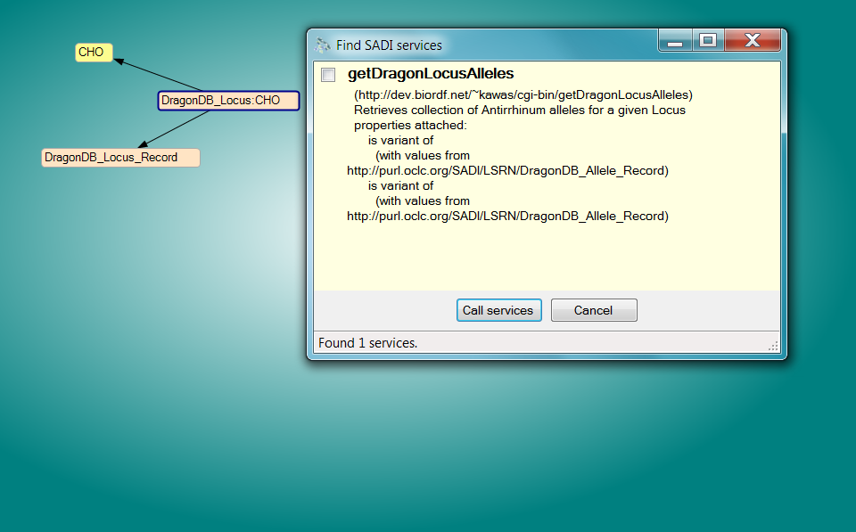
Discovered the (only)
service that consumes
these kinds of records

Slide 19
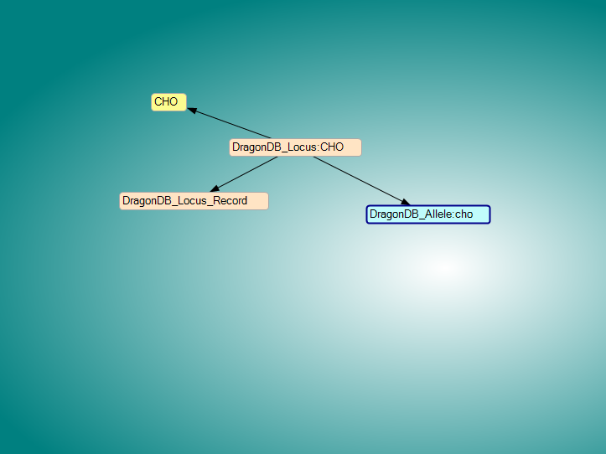
Output is added to the graph (with some extra logic to make visualization of complex data structures a bit easier)

Slide 20
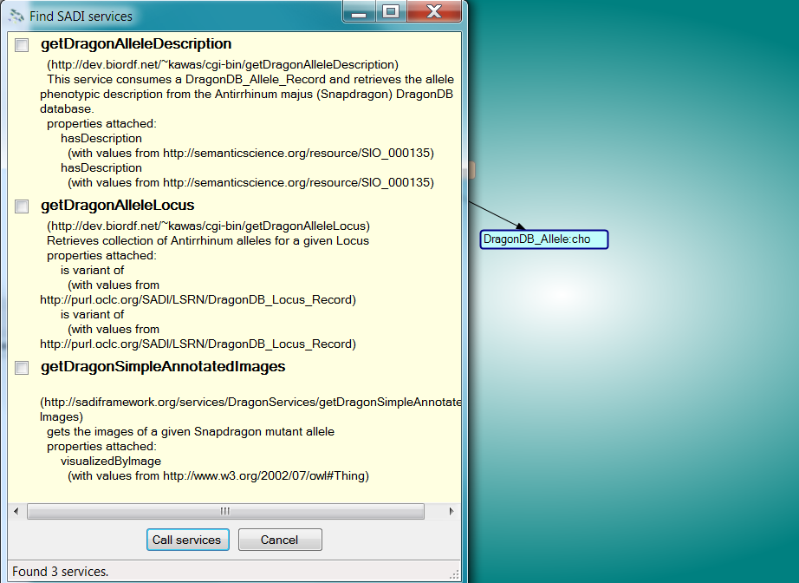
Lather, rinse, repeat...

Slide 21
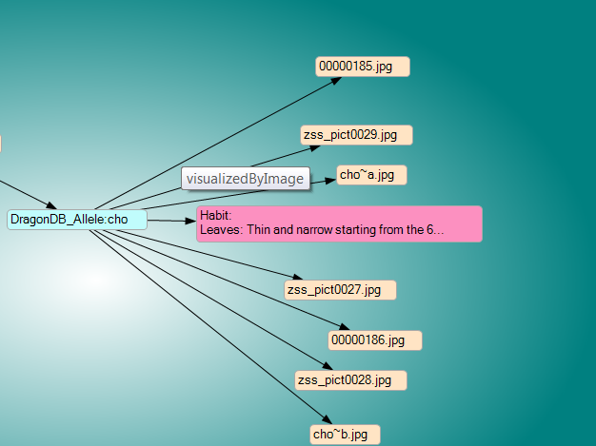
...and of course, these links are “live”

Slide 22
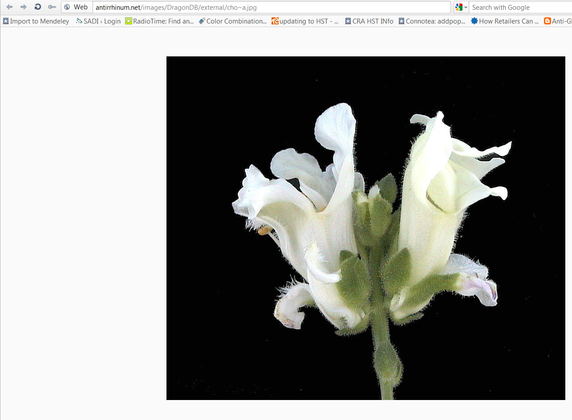

Slide 23
What about URIs other than LSRN?

Slide 24
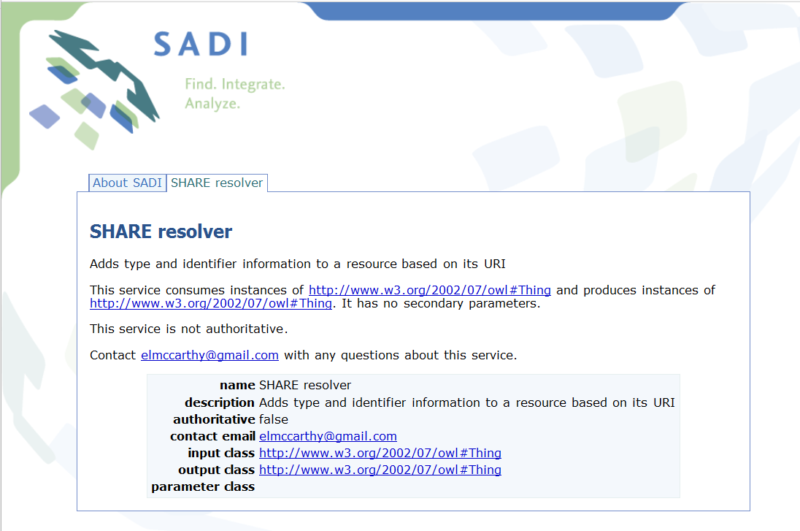

Slide 25
HTTP POST the URI to the SHARE Resolver service and it will (try to) return you SIO-compliant RDF metadata about that URI
(this is a typical SADI service)
The resolver currently recognizes a few different URI schemes (e.g. Bio2RDF) and can be updated with new patterns easily

Slide 26
Next problem:
Knowledge Explorer
and therefore the plug-in
are written in C#
All of our interfaces are described in OWL
C# reasoners are extremely limited at this time

Slide 27
This problem manifests itself in two ways:
An individual on the KE canvas has all the properties required by a Service in the registry, but is not rdf:typed as that Service’s input type → how do you discover that Service so that you can add it to the menu?
For a selected Service from the menu, how does the plug-in know which data-elements it needs to extract from KE to send to that service in order to fulfil it’s input property-restrictions?

Slide 28
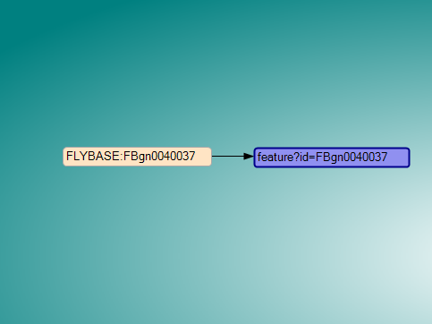
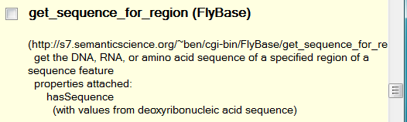
If I select a canvas node, and ask SADI to
find services, it will...

Slide 29
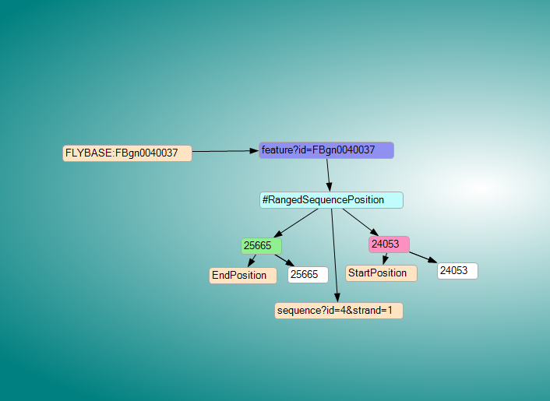
The get_sequence_for_region service
required ALL of this (hidden) information

Slide 30
Nevertheless:
The service can be discovered based on JUST this node selection
The service can be invoked based on JUST this node selection

Slide 31
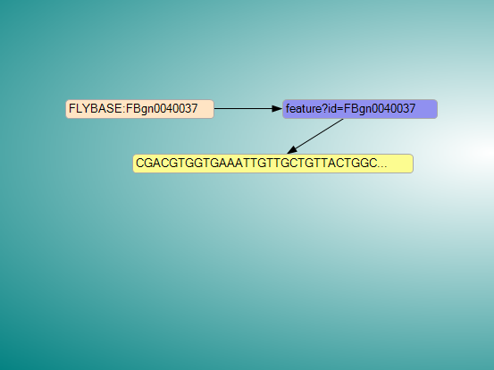
Voila!
How did the plug-in discover the service, and determine which data was required to access that service based on an OWL Class definition, without a reasoner?

Slide 32
SELECT ?x, ?y
FROM knowledge_explorer_database
WHERE {
?x foaf:name ?y
}
Convert Input OWL Class def’n
into an ~equivalent SPARQL query
Service Description
INPUT OWL Class
NamedIndividual: things with
a “name” property
from “foaf” ontology
OUTPUT OWL Class
GreetedIndividual: things with
a “greeting” property
from “hello” ontology
Store together
with index
INDEX
The service provides a “greeting” property based on a “name” property
Registry

Slide 33
Just to ensure that I don’t over-trivialize this point,
the REAL SPARQL query that extracts the input for this service is...

Slide 34
CONSTRUCT {
?input a <http://sadiframework.org/ontologies/GMOD/BiopolymerRegion.owl#BiopolymerRegion> .
?input <http://sadiframework.org/ontologies/GMOD/BiopolymerRegion.owl#position> ?position .
?position a <http://sadiframework.org/ontologies/GMOD/RangedSequencePosition.owl#RangedSequencePosition> .
?position <http://sadiframework.org/ontologies/GMOD/RangedSequencePosition.owl#coordinate> ?start .
?start a <http://sadiframework.org/ontologies/GMOD/RangedSequencePosition.owl#StartPosition> .
?start <http://semanticscience.org/resource/SIO_000300> ?startValue .
?position <http://sadiframework.org/ontologies/GMOD/RangedSequencePosition.owl#coordinate> ?end .
?end a <http://sadiframework.org/ontologies/GMOD/RangedSequencePosition.owl#EndPosition> .
?end <http://semanticscience.org/resource/SIO_000300> ?endValue .
?position <http://sadiframework.org/ontologies/GMOD/RangedSequencePosition.owl#in_relation_to> ?sequence .
?sequence <http://semanticscience.org/resource/SIO_000210> ?feature .
?feature <http://semanticscience.org/resource/SIO_000008> ?identifier .
?identifier <http://semanticscience.org/resource/SIO_000300> ?featureID .
?sequence <http://semanticscience.org/resource/SIO_000210> ?strand .
?strand <http://semanticscience.org/resource/SIO_000093> ?strandFeature .
?strandFeature a ?strandFeatureType .
?strandFeature <http://semanticscience.org/resource/SIO_000008> ?strandFeatureIdentifier .
?strandFeatureIdentifier <http://semanticscience.org/resource/SIO_000300> ?strandFeatureID .
?strand a ?strandType .
} WHERE {
?input <http://sadiframework.org/ontologies/GMOD/BiopolymerRegion.owl#position> ?position .
?position <http://sadiframework.org/ontologies/GMOD/RangedSequencePosition.owl#coordinate> ?start .
?start a <http://sadiframework.org/ontologies/GMOD/RangedSequencePosition.owl#StartPosition> .
?start <http://semanticscience.org/resource/SIO_000300> ?startValue .
?position <http://sadiframework.org/ontologies/GMOD/RangedSequencePosition.owl#coordinate> ?end .
?end a <http://sadiframework.org/ontologies/GMOD/RangedSequencePosition.owl#EndPosition> .
?end <http://semanticscience.org/resource/SIO_000300> ?endValue .
?position <http://sadiframework.org/ontologies/GMOD/RangedSequencePosition.owl#in_relation_to> ?sequence .
{
?sequence <http://semanticscience.org/resource/SIO_000210> ?feature .
?feature <http://semanticscience.org/resource/SIO_000008> ?identifier .
?identifier <http://semanticscience.org/resource/SIO_000300> ?featureID .
} UNION {
?sequence <http://semanticscience.org/resource/SIO_000210> ?strand .
?strand <http://semanticscience.org/resource/SIO_000093> ?strandFeature .
{
?strandFeature a <http://sadiframework.org/ontologies/GMOD/Feature.owl#Feature> .
} UNION {
?strandFeature <http://semanticscience.org/resource/SIO_000008> ?strandFeatureIdentifier .
?strandFeatureIdentifier <http://semanticscience.org/resource/SIO_000300> ?strandFeatureID .
} .
{
?strand a <http://sadiframework.org/ontologies/GMOD/Strand.owl#PlusStrand> .
?strand a ?strandType .
} UNION {
?strand a <http://sadiframework.org/ontologies/GMOD/Strand.owl#MinusStrand> .
?strand a ?strandType .
} .
} .
}

Slide 35
Summary
While the Knowledge Explorer plug-in has similar functionality to other tools we have built for SADI, it takes advantage of some features of the SADI Registry, and SADI in general, that are not widely-known.
We hope that the availability of these features encourages development of SADI tooling in languages that have limited access to reasoning.

Slide 36


University of British Columbia
Mark Wilkinson, Project Lead
Luke McCarthy
Lead Developer, SADI project
Benjamin VanderValk
Developer, SADI project

Slide 37






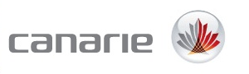
Microsoft Research
The Knowledge Explorer
Personal Edition,
and the SADI plug-in, are
freely available.

