Slide 1
Formal ontologies for the Semantic Web ?
Christine Golbreich
University of Versailles Saint-Quentin, France
cgolbrei@gmail.com
SWAT4LS, Paris 30 November 2012

Slide 2
Ontologies in 2002
… “The proposed mechanism for realising this dream is to add semantic markup to web resources describing their content and/or functionality. The vocabulary for such markup will be defined by ontologies, sets of statements which describe the structure of the domain of interest and give meaning to the terms therein”… (Horrocks, 2002)
A foundational technique of the SW
Semantic annotations facilitate the access to Web content
Ontologies give meaning to the annotations
Standardization of the OWL 2 Web Ontology Language

Slide 3
Ontologies in 2012 ?
Importance and role of formal ontologies in Life Science applications today
A number of questions
  Do applications rely on semantic annotations ?
  Do they use OWL ontologies ?
  Are OWL ontologies useful ? usable ?

Slide 4
Overview
Difference btw Ontologies and Terminologies and the added value of ontologies
Applications often ever use terminologies rather than OWL ontologies
Getting the best of them

Slide 5
Ontology
An ontology provides an explicit specification of the intended meaning of the vocabulary describing a domain of interest
Knowledge describing the concepts of a domain
Meaning to its concepts by axioms and facts
  Example (simplified)
  Class: לאָוב פון לונג
  EquivalentTo:
  Anatomical_Lobe and regional_part_of some Lung
  Lobe_of_Lung in English!

Slide 6
FMA-OWL ontology
The Foundational Model of Anatomy ontology (FMA) describes knowledge about Anatomy
OWL 2 axioms for the class Heart (extract)
Axioms

Slide 7
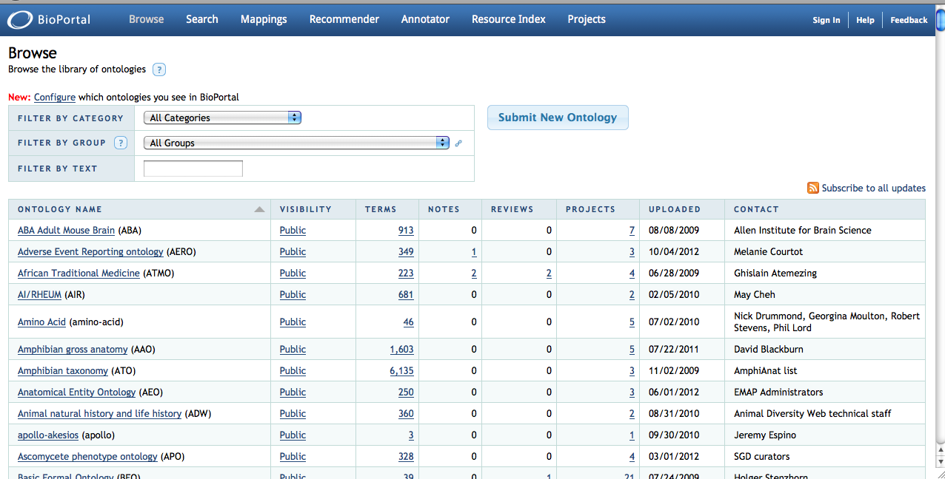
Portal of ontologies
BioPortal over 300 ontologies
  OWL, OBO, RRF (Rich Release Format)

Slide 8
Terminology
Language terms (words) used in a domain
Information (data) about them,
  preferred term, synonyms, broader, narrower terms
E.g., UMLS over 100 health terminologies
A terminology provides the system of terms belonging or peculiar to a specialized subject

Slide 9
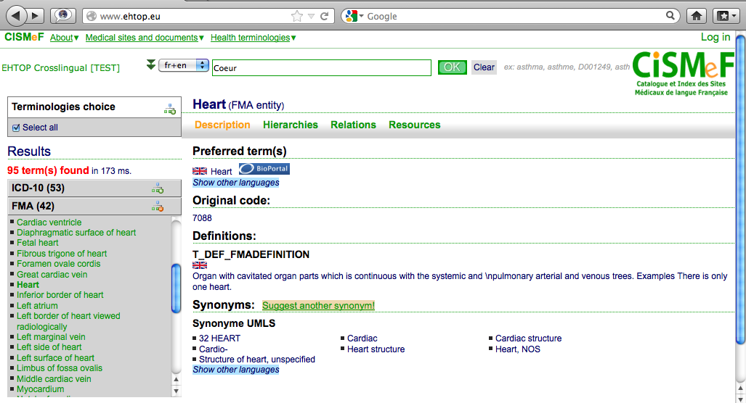
FMA terminology in EHTOP
Facts about terms

Slide 10
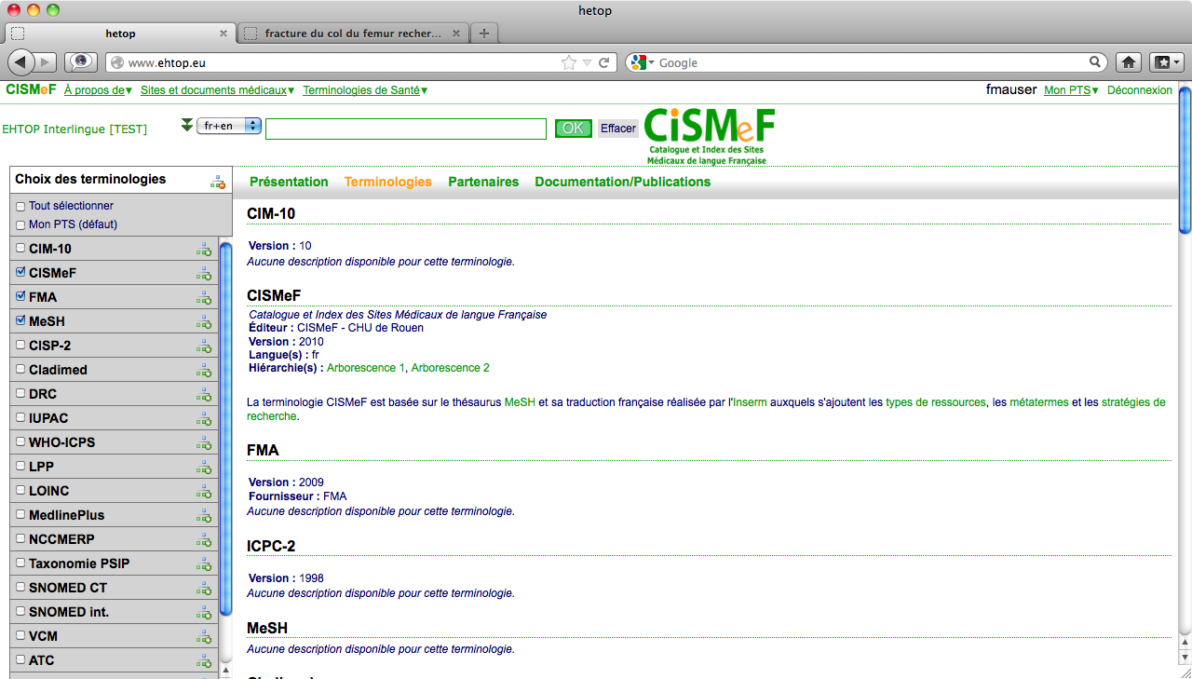
Portal of terminologies
EHTOP over 42 terminologies in French
  Developped by ROUEN hospital CISMEF team
  Aims to become a multilingual European Health Terminologies Portal
2012
Terminologies | Concepts | Synonyms | Definitions | Relations
43 | 1 570 301 | 3 683 023 | 192 815 | 4 891 423

Slide 11
But often mixed
Distinction might be blurred or the two notions may overlap
  E.g. In SNOMED-CT terminology,
  knowledge is embedded with terminology

Slide 12
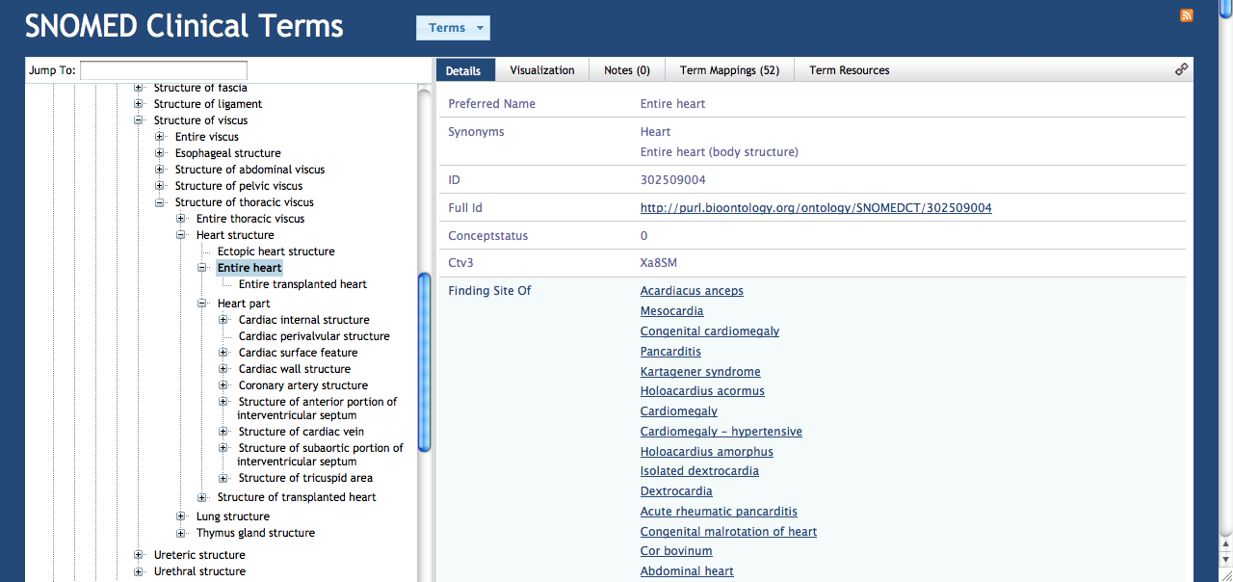
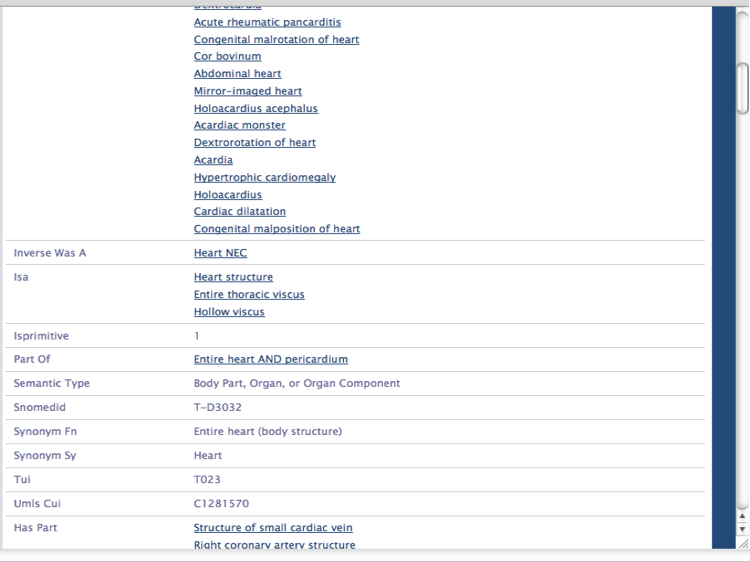
But often mixed
Terminology
Distinction might be blurred or the two notions may overlap
  E.g.
In SNOMED-CT terminology, knowledge is embedded with terminology
knowledge

Slide 13
But often mixed
Distinction might be blurred or the two notions may overlap
  E.g.,
  In SNOMED-CT terminology, knowledge is embedded with terminology
  In FMA ontology,
  terminology is embedded with knowledge

Slide 14
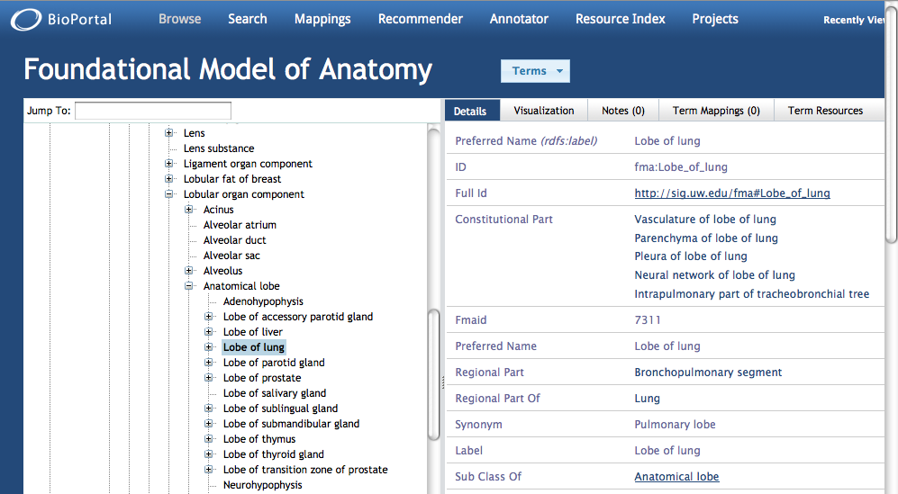
But often mixed
terminology
knowledge

Slide 15
Added value of formal ontologies
Semantics
Reasoning
Interoperability

Slide 16

Semantics
OWL 2 underlying description logic provides a precise and unambiguous semantics to terms
  OWL 2 axiom (Manchester’s syntax)
  Formalized in logic
  Meaning
  Heart is-a cavitated organ that is part of the cardiovascular system
Class: Heart
SubClassOf: CavitatedOrgan
and partOf some CardiosvascularSystem
CardiovascularSystem(y)]

Slide 17
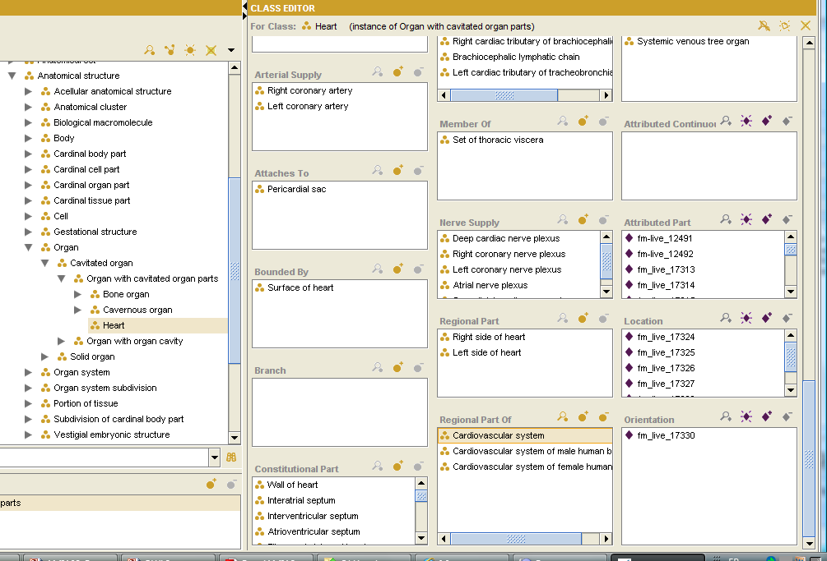
Semantics
Great! But in practice
Challenge 1
  What semantics give to a term ?
  How to formalize it in logic ?
  How to automatically generate OWL 2 definitions (axioms) for large ontologies ?

Slide 18
« Lexically Suggest, Logically Define »
Lexical techniques are not new
  E.g., in 1998 SNOMED CT’s founders to test consistency of SNOMED RT during its design [7]
  Lexical pattern for the FMA in OWL 2 [5] is a powerful and general technique
  To automatize the logical definition of classes,
  To detect errors or omissions for large ontologies
Recent study [8] to track errors in SNOMED-CT using ‘Acute’ A and ‘Chronic’ A

Slide 19
Semantics
Challenge 2
An ontology often comprises several levels:
  Metalevel specifies modeling categories.
  Domain level specifies instances of categories, i.e., conceptual entities ( Tbox )
  Instance level specifies instances of the conceptual entities ( Abox )
  Metadata level specifies data about data (instances, concepts, ontologies, assertions)

Slide 20
OWL 2 metamodelling
Metaclass
  Organ with cavitated organ parts
Class
  Heart
Metadata
  label, synonym, definition
OWL 2 Class
  Class: Organ with cavitated organ parts
Class: Heart
Individual: Heart
Types: Organ with cavitated organ parts
OWL 2 enhanced annotations
  annotation of annotations
punning

Slide 21
OWL 2 metamodelling
Preferred terms in different languages
as OWL 2 Annotations

Slide 22
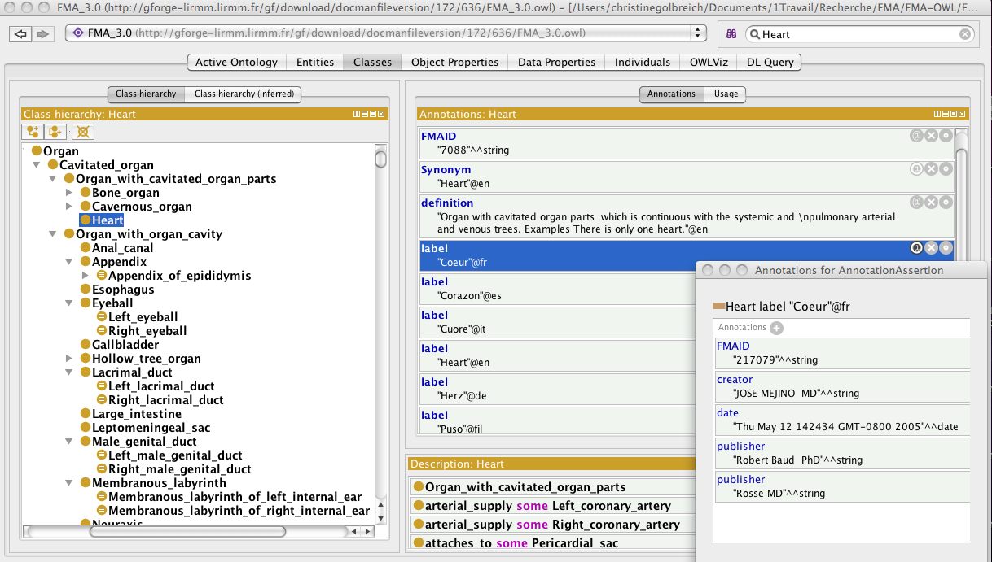
FMA-OWL
Semantics
ANNOTATION
ANNOTATION of ANNOTATION

Slide 23
« Lexically Suggest, Logically Define »
Leverage lexical patterns of names in the native FMA to formally define the classes [5]
  Pattern P_A E.g., Left_Thumb / Right_Thumb
  denoting symmetrical siblings E.g., Anterior_A / Posterior_A, Inferior_A / Superior_A,
  Pattern A _of_ B , E.g., Lobe _of_ Lung
  Class: Lobe_of_Lung
  EquivalentTo : Anatomical_Lobe
  and regional_part_of some Lung

Slide 24
FMA-OWL
Formal versions of the FMA in OWL 2
  from FMA 3.0 version 2008
Version | Size (MB) | Classes | Axioms | Expressivity
without MTC | 256 | 85005 | 263389 | SROIQ(D)
with MTC | 314 | 85005 | 261331 | SROIQ(D)

Slide 25
Added value of ontologies
Semantics
Reasoning
Interoperability

Slide 26
Logic-based reasoning
To infer implicit knowledge
  Neck of right femur part-of some Lower limb
    locatedIn o part-of → locatedIn
    = > Fracture of Neck of right femur
    SubClassOf: Fracture of Lower limb
Design and maintenance
    Consistency checking and Classification
    Modularization, Explanation
Query-answering

Slide 27
Dialysis and Transplant ontology
Following the Thesaurus of Nephrology and ICD10
  Organic disease is a disease that is associated to some lesion
  Class: OrganicDisease
  EquivalentTo: Disease
  and diseaseAssociatedLesion some Lesion
  Primary Glomerulo Nephritis With IgA Deposit is a disease that is associated to some IgA Deposit
  Class:PrimaryGlomeruloNephritisWithIgADeposit
  EquivalentTo: PrimaryGlomeruloNephritis
  and diseaseAssociatedLesion some IgADeposit

Slide 28
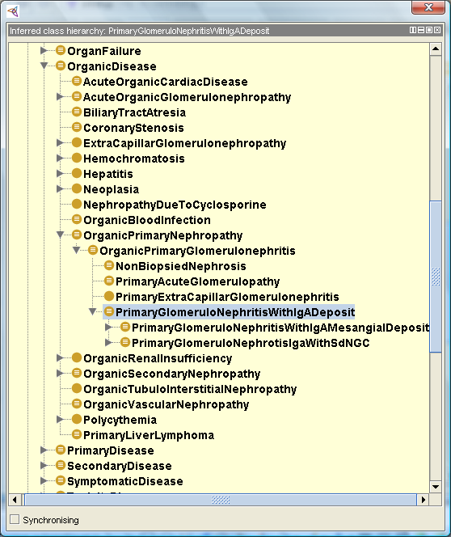
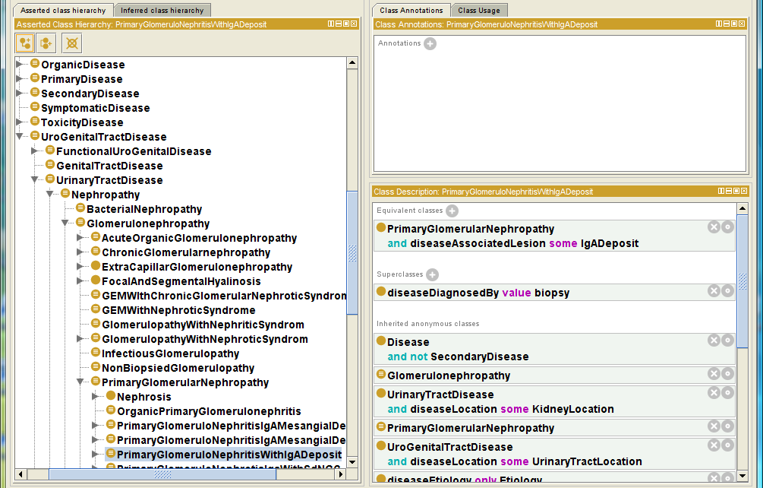
Automatic Classification

Slide 29
Reasoning
Large ontologies
  SNOMED-CT more than 400,000 classes.
  FMA 85,000 classes, 140 relationships, over 120,000 terms, and one of the most complex
Several challenges
  to reason
  to vizualize the inferred results
  to understand and repair inconsistencies

Slide 30
Reasoning with FMA-OWL
First, no reasoner could classify
Next, the special ‘core blocking’ strategy of HermiT [9] succeeded to process it in a reasonable time (1h-3h) from the command line
Impossible to run HermiT from Protégé 4.1 and to look at the inferred results

Slide 31
Modularization
(Lutz et al. 2007) (Grau et al. 2008) [6] [10] notions of conservative extension and module
Developing an ontology P, we want to reuse a set S of symbols from a “foreign” ontology Q without changing their meaning.
  to import the ontology Q in P and use P ∪ Q
When answering a query over the signature of P,
if importing a subset Q1 of Q gives exactly the same
answers as if the whole ontology Q had been imported.
Q1 is a module for P in Q
  if P does not change the meaning of the symbols S
  P ∪ Q is a conservative extension of Q

Slide 32
Incremental approach
Module extractor [Jimenez Ruiz 2008][11]
  http://www.cs.ox.ac.uk/isg/tools/ModuleExtractor/
  Logic-based tool [Grau et al. 2008]
  Extract more manageable modules
  Check inconsistencies, understand, and repair
Successful with Protégé 4.1 to see the inferred hierarchy and unsatisfiable classes within the modules
But …

Slide 33
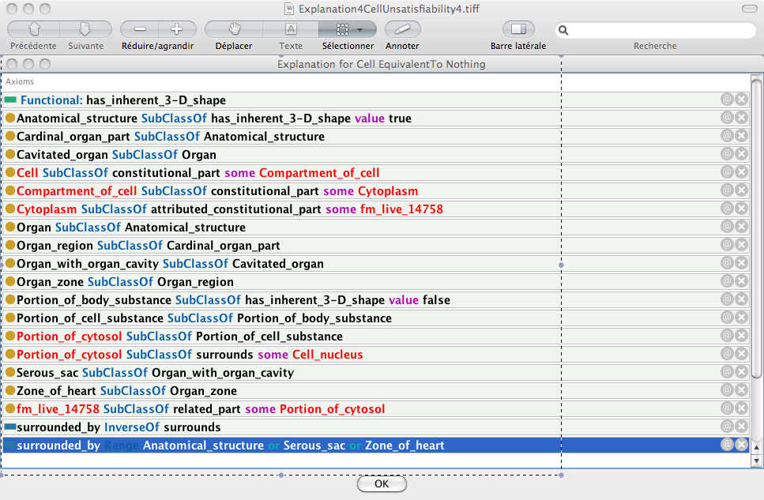
E.g., Explanation for Cell inconsistency!

Slide 34
E.g., Explanation for Cell inconsistency
Several steps of inference
Basically relies on the general inference schema related to a ‘Domain’
Finally reduces to conflicting values of the data property has_inherent_3-D_shape
A SubClassOf p some B
p Domain A'
  => A SubClassOf A’

Slide 35
Results of reasoning with FMA-OWL
Study exhibited a huge number of errors
  65,753 unsatisfiable classes out of 85,005
Identified recurrent patterns of errors
  Conflicting values from domains, from global and local ranges
  Inconsistencies propagate rapidly
But, struggling with reasoning at such scales, it was difficult, at that time, to proceed further

Slide 36
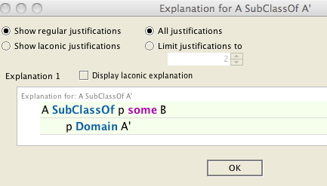
Lessons learned
Reasoning is vital for quality assurance of large reference ontologies like FMA and SNOMED-CT
Challenging, but now significant progress, highly optimised reasoners (E.g., HermiT) and friendly tools available, E.g., for explanation [12]
Possible in practice with the strategy below [5]
    Pattern-based approach
    Extract modules
    Reasoning
    Explain and repair inconsistencies

Slide 37
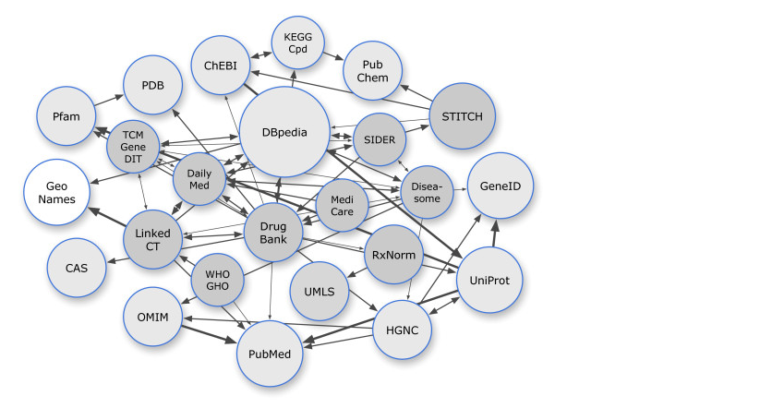
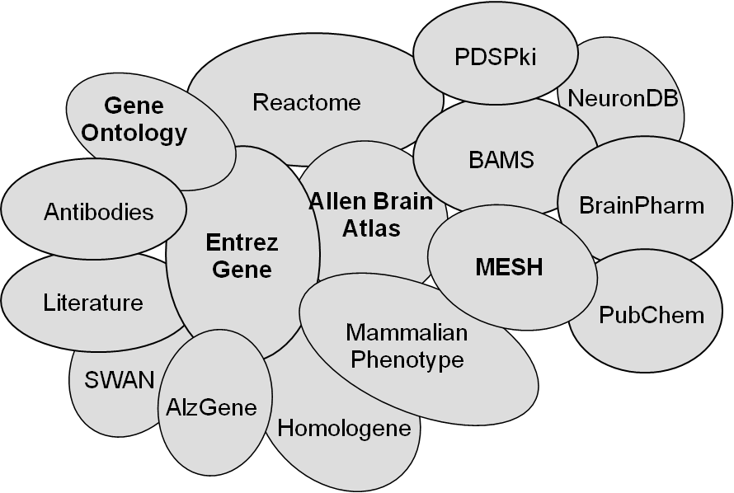
Interoperability (RDF/OWL)
Figure from Samwald et al. Journal of Cheminformatics 2011 3:19
A graph of some of the LODD datasets (dark grey), related biomedical datasets (light grey), related general-purpose datasets (white) and their interconnections.

Slide 38
Overview
Difference btw Ontologies and Terminologies and the added value of ontologies
Applications often ever use terminologies, rather than OWL ontologies
Getting the best of them

Slide 39
Use of terminologies
Numerous examples
  SNOMED-CT in clinical practice
  NCBO Annotator [1] and Resource Index [2]
  PubMed articles indexed by GoPubMed [3]
  Etc.

Slide 40
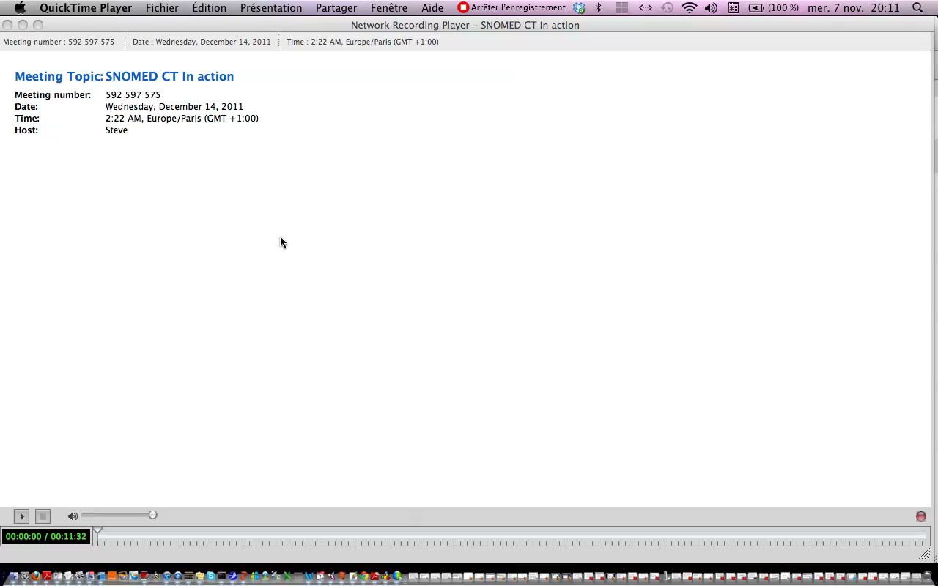
SNOMED-CT in clinical practice

Slide 41
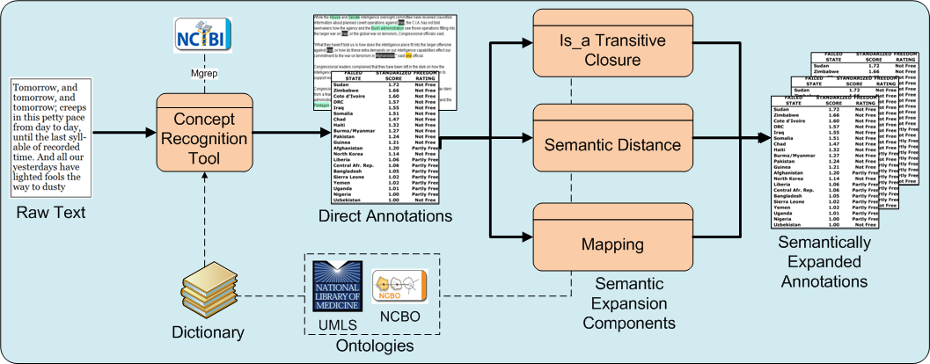
NCBO Annotator and Resource Index
NCBO Annotator (Jonquet et al. 2009) http://www.bioontology.org/wiki/index.php/Annotator_Web_service
Dictionary (lexicon) of terms
  list of strings constructed by pooling concepts names and synonyms of UMLS and (subset) BioPortal ontologies
Two steps process
  Mgrep, a recognition tool uses string matching on the dictionary to provide direct annotations
  Expansion leverages ‘is_a’ relations and mappings to extend the annotations

Slide 42
Terminology-based applications
Classical utilization of SNOMED-CT in clinical practice is to use its catalogue and codes for indexing medical records
NCBO Annotator and Resource Index use terms, synonyms, ‘hierarchies’, mappings for resources annotation
“Ontology”-based applications often only use the terms issued from the ontology, but not ontology semantics or reasoning
  Similar to terminology-based techniques, E.g, ‘Explosion’
  Searching PubMed with the MeSH term Hepatitis, Viral, Human
    query is « exploded » and retrieves resources indexed
    by its children Hepatitis A, B etc.

Slide 43
Terminology-based annotation
Efficient but sometimes suffers of
  Approximate, odd answers
  Limited flexibility and extensibility
  Incomplete results
Examples of PubMed search with MeSH terms

Slide 44
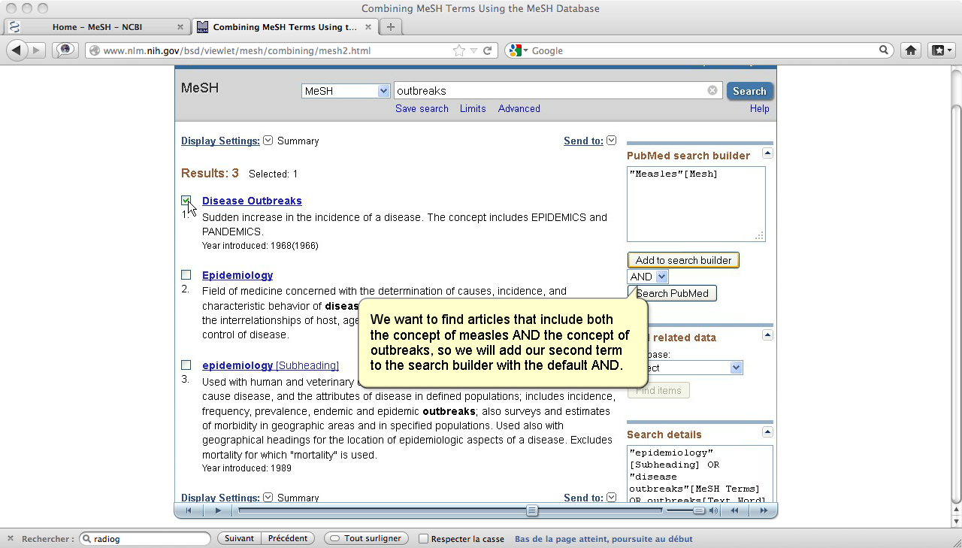
Terminology-based annotation
According to the MeSH tutorial searching PubMed for « Measles outbreaks »
  ‘AND’ query of the 2 MeSH terms
Femoral Neck Fractures ?
Search | Add to builder | Query | Items found
#1 | Add | Search "Femur Neck"[Mesh] | 4375
#2 | Add | Search "Fractures, Bone"[Mesh] | 130080
#3 | Add | Search #1 AND #2 | 1092

Slide 45
1. Approximate results
Search | Add to builder | Query | Items found
#1 | Add | Search "Femur Neck"[Mesh] | 4375
#2 | Add | Search "Fractures, Bone"[Mesh] | 130080
#3 | Add | Search #1 AND #2 | 1092
#10 | Add | Search "Femoral Neck Fractures"[Mesh] | 6949
#4 | Add | Search femoral fractures | 31890
#5 | Add | Search neck fractures | 14164
#6 | Add | Search (#4) AND #5 | 10229
#11 | Add | Search Femoral Neck Fractures | 10082

Slide 46
Approximate results
Femoral neck fractures ?
  Query "Femur Neck/injuries"[Mesh] should retrieve items indexed by "Femoral Neck Fractures"[Mesh]
Query 1 | Search "Femur Neck/injuries"[Mesh] | 88
Query 2 | Search "Femoral Neck Fractures"[Mesh] | 6949

Slide 47
2. Limited extensibility
Closed femoral neck fractures ?
  No MeSH term
Search | Add to builder | Query | Items found
#5 | Add | "Fractures, Closed"[Mesh] | 2802
#6 | Add | "Femoral Neck Fractures"[Mesh] | 6959
#7 | Add | Search (#5) AND #6 | 30
#9 | Add | Closed femoral neck fractures | 261
#11 | Add | Closed neck fractures of right femur | 2

Slide 48
3. Incomplete results
When searching for resources or images involving background knowledge, ‘Explosion’ is not enough
Even extended with parent/child, results are incomplete because they do not take into account all the inferences
  E.g., Query: search ‘’lower limb fractures’’ ?
  should include items on Closed neck fracture of right femur

Slide 49
Ontology-based query answering
To get sound and complete query answering requires to use semantic annotations and to reason over the ontology
Ontology-based indexing and query answering

Slide 50
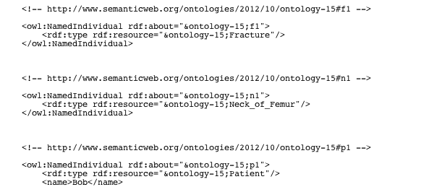

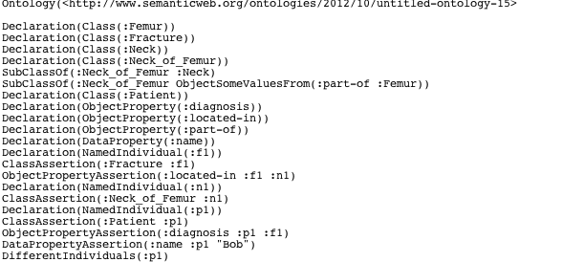
Semantic indexing
Document Input
OWL Output
Proximal femoral deformities and overcorrection of the acetabulum both can result in secondary femoroacetabular impingement and suboptimal clinical results after periacetabular osteotomy. The purpose
Proximal femoral deformities and overcorrection of the acetabulum both can result in secondary femoroacetabular impingement and suboptimal clinical results after periacetabular osteotomy. The purpose
Proximal femoral deformities and overcorrection of the acetabulum both can result in secondary femoroacetabular impingement and suboptimal clinical results after periacetabular osteotomy. The purpose
E1
E4
E2
E3
E5
E6
Ontology individuals

Slide 51
Query answering
Query answering is logical deduction
  Given a query q, the axioms and facts of an ontology O, a reasoner computes the set of individuals that satisfy the query q
  {i | O I= q(i) }
Existing reasoners, E.g., Fact ++, HermiT, Pellet, provide sound and complete query answering

Slide 52
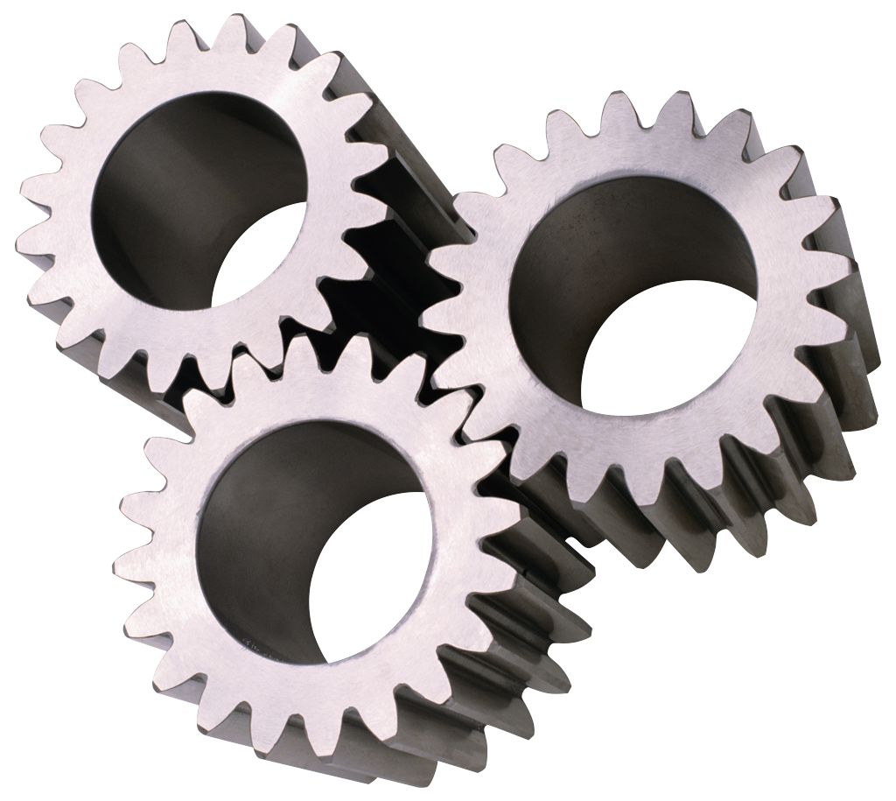
Query answering
E1
E4
E2
E3
E5
E6
Proximal femoral deformities and overcorrection of the acetabulum both can result in secondary femoroacetabular impingement and suboptimal clinical results after periacetabular osteotomy. The purpose
Query
Reasoner

Slide 53
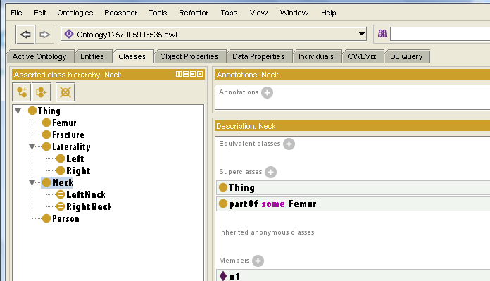
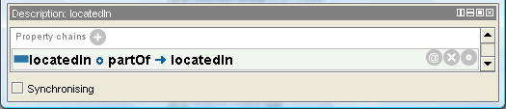
Ontology (Tiny example)
Classes and properties axioms
  A Neck of femur is a partOf some Femur
  OWL 2 property chain inclusion
  Everything located in a part is located in the whole

Slide 54
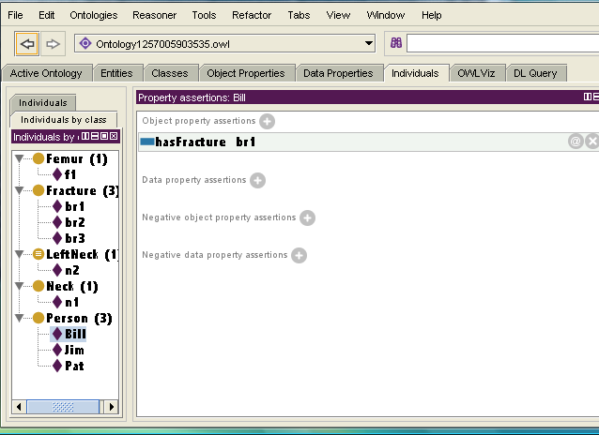
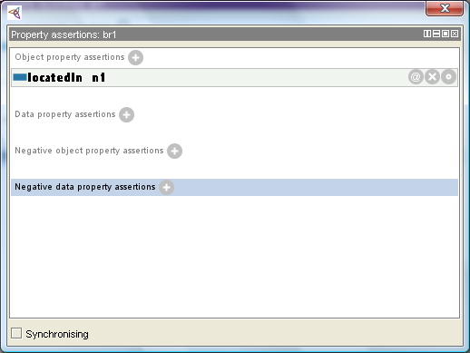
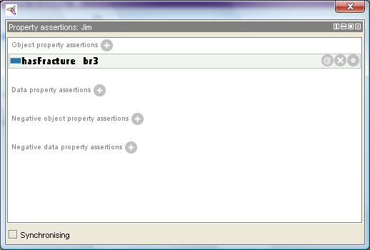
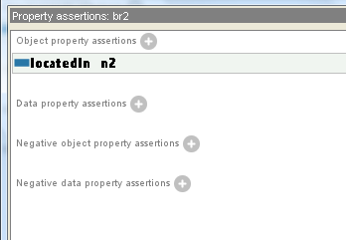

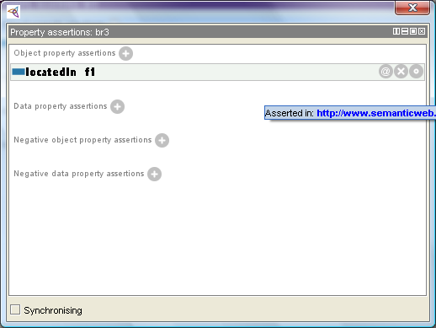
Ontology-based indexing
Let’s be 3 patients records
  Bill has a fracture (located) in the neck of femur
  Jim has a fracture (located) in the femur
  Pat has a fracture (located) in left neck of femur
Semantic annotations represented as
ontology individuals

Slide 55
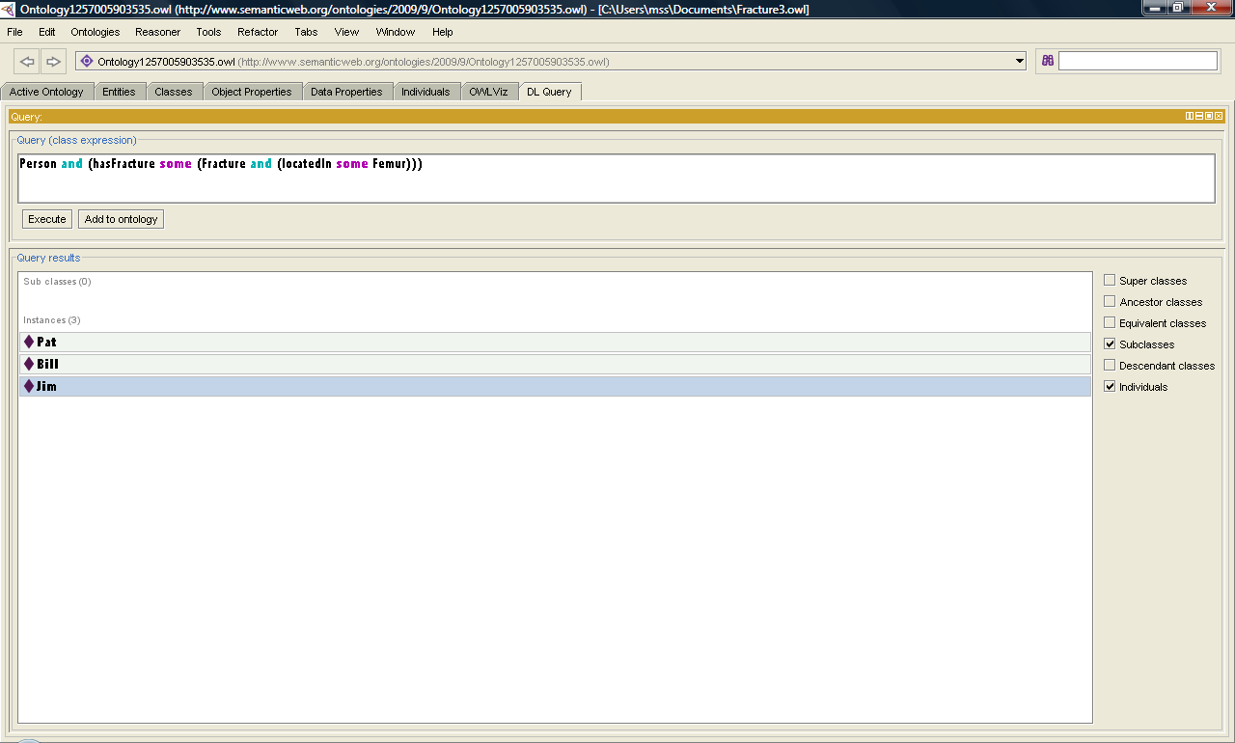
Ontology-based query answering
Query : search all records of patients having a femoral fracture ?

Slide 56
Query answering
But !
  While OWL reasoners e.g., Fact ++, HermiT, Pellet are now much highly effective for class reasoning,
  Query answering, which is concerned with individuals, is still challenging for large datasets

Slide 57
Overview
Difference btw Ontologies and Terminologies and the added value of ontologies
Applications often ever use terminologies, rather than OWL ontologies
Getting the best of them

Slide 58
Pros and Cons
Ontology
  Semantics
  Highly efficient class reasoning & other logic based tools
  Sound and complete
  query answering
But
  Scalability challenges
  for reasoning with large datasets
Terminology
  Easier to build, to understand and to deploy
  Efficient search tools
But
  (Very) little semantics
  Approximate and incomplete answering
  Scalability challenges (E.g., for annotating large datasets [4])

Slide 59
Formal ontologies in 2012 ?
Strengths and limitations of Ontologies and Terminologies
Semantics and Scalability still challenging for large datasets
Are formal ontologies usable for SWAT4LS with large datasets?
What solutions?

Slide 60
Combining different techniques
Terminology
OWL 2 DL ontology
Preprocessing step: class reasoning for quality assurance and for getting
the inferred hierarchy
Derive a terminology
Terminology for indexing
and query answering
Lightweight Ontology
OWL 2 QL ontology
Use the ontology for rewriting the query into conjunctives queries
Evaluate queries by standard DBMS
(E.g. , Requiem, Mastro, Quonto)
Materialisation approach of RDF triple-store (E.g., Sesame, OWLim, Oracle Semantic Store )
Preprocessing step: use the ontology to pre-compute & store implied facts
Evaluate queries over the augmented data set
Drawbacks.
Only OWL 2 RL
The extended dataset may be extremely large
Computing might be very long.

Slide 61
Loose integration of ontology & terminology
Approach used for EHTOP
FMA example

Slide 62
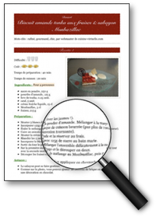
Loose integration of ontology & terminology
Ontology
(OWL 2 DL)
EHTOP Portal
Terminology (OWL SKOS)
1st step: ontology reasoning for quality assurance
2nd step: deriving a terminology
3rd step: terminology-based indexing & search

Slide 63
Loose coupling
Several advantages
  Clear organization of the knowledge
    Semantics and logics within the ontology
    Lexicon and properties within terminology
  Terminology in charge of maintaining the set of synonyms, definitions, external links etc.
  Only have to keep a link from the ontology classes to the terminology through a single annotation
  Using the best of them
    E.g., truncated, stemming, exact search modes

Slide 64
Integrated annotations
Terminology integrated within the ontology via annotations, i.e., extra-logical statements
Drawbacks
  Must synchronize ontology annotations with terminology changes about synonyms, links to external resources etc.
  Ontology can be overloaded with excessive metadata, E.g., FMA native ontology individuals

Slide 65
From ontology to terminology
Transformation of an ontology into an EHTOP terminology relies on reification
OWL Ontology
(~SKOS) Terminology
Class
Object property
SubClassOf relation
Existential restriction
preferred-name annotation
Etc.
Individual
Association (sub)class
BT-NT assertions on individuals
Property assertions on individuals
Label

Slide 66
From ontology to terminology
FMA-OWL
FMA-TERM
Class Heart
Existential restriction
Class: Heart
SubclassOf:
bounded_by some Surface_of_Heart
  ClassAssertion(:FMAEntity :FMA_7088))
  AnnotationAssertion(rdfs:label :FMA_7088 "Coeur"@fr)
  AnnotationAssertion(rdfs:label :FMA_7088 "Heart"@en)
  ClassAssertion(:FMAdelimitation :FMA_bounded_by~FMA_7088-FMA_7167)
  ObjectPropertyAssertion(:FMAlimit :FMA_bounded_by~FMA_7088-FMA_7167 :FMA_7088)
  ObjectPropertyAssertion(:FMAlimitedBy :FMA_bounded_by~FMA_7088-FMA_7167 :FMA_7167)

Slide 67
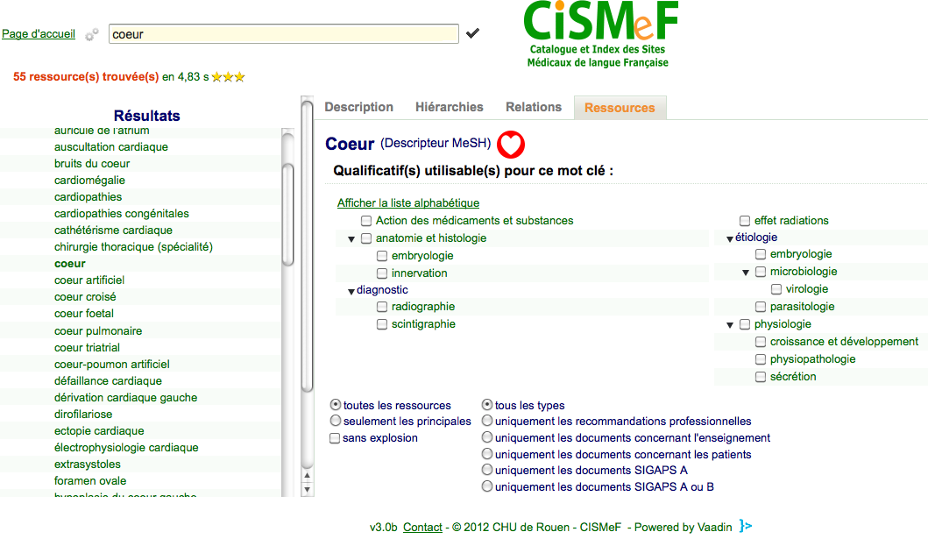
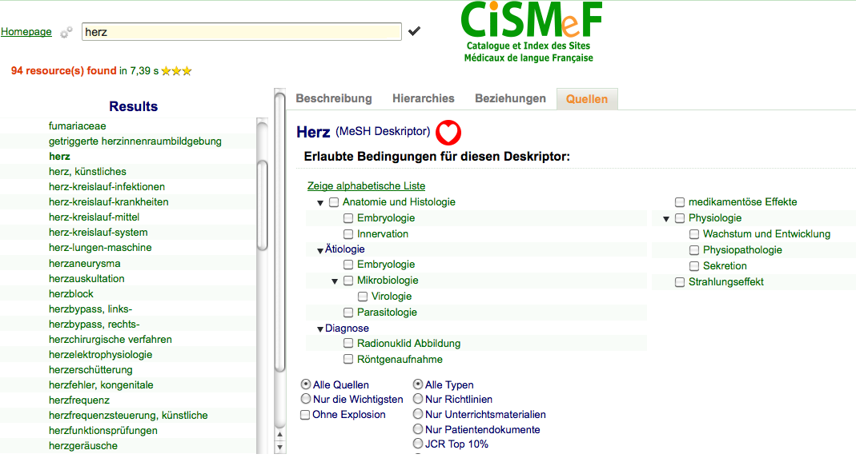
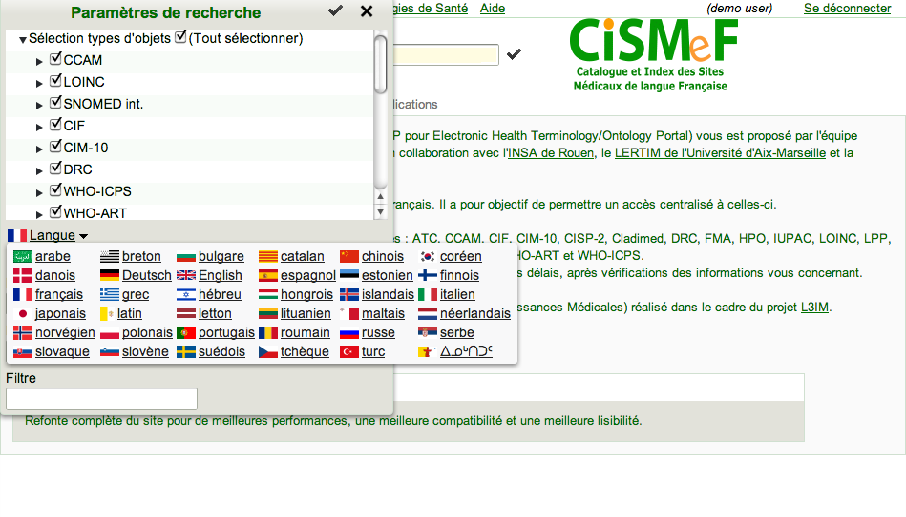
Multi-terminology & multilingual search

Slide 68
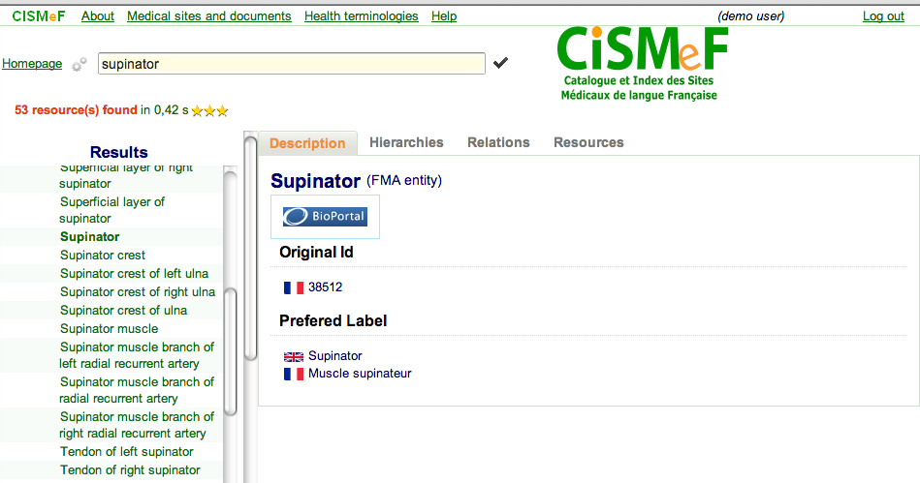
Use of the EHTOP FMA terminology
link to Bioportal
FMA ID
French translation

Slide 69
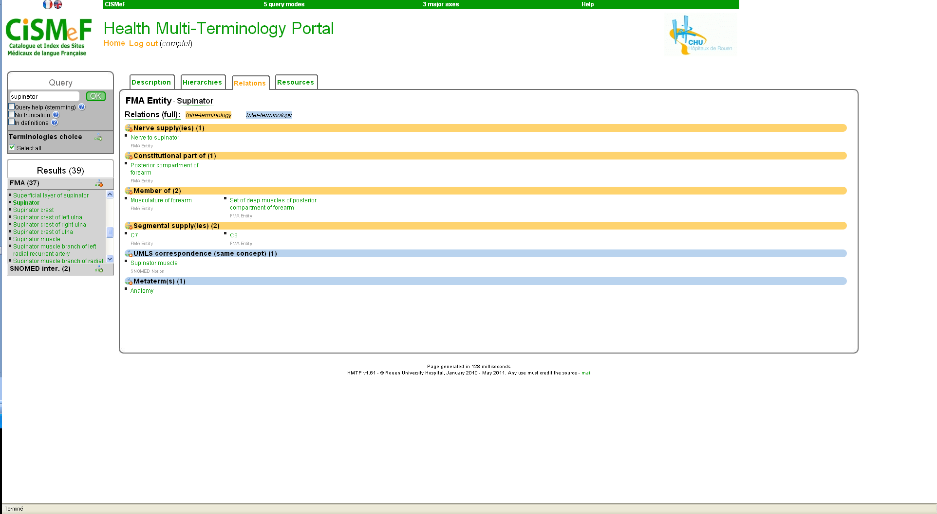
Use of the EHTOP FMA terminology
What are the other muscles of the forearm?

Slide 70
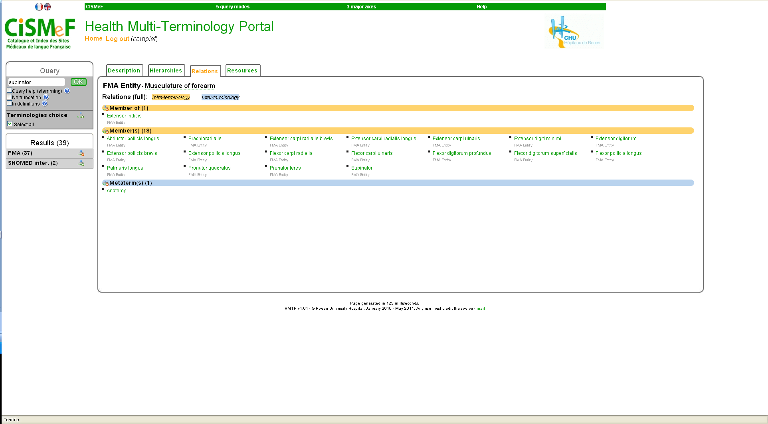
Using the FMA terminology of EHTOP
All the muscles of the forearm

Slide 71
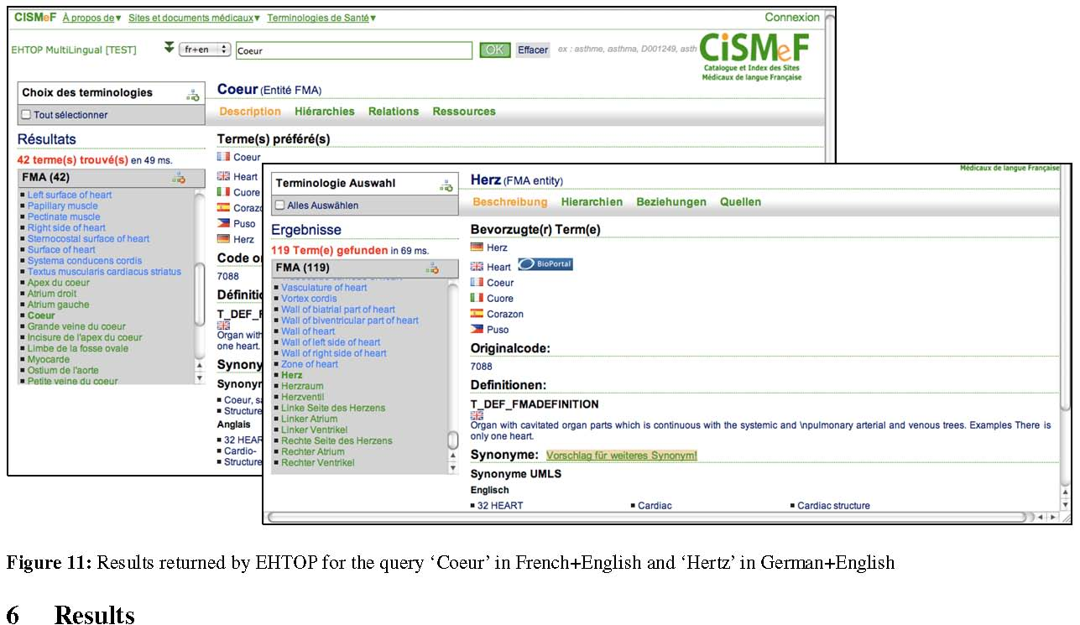
Cross-lingual navigation
French
German

Slide 72
Summary
Formal ontologies provide vocabulary and semantics for annotations
Reasoning tools are vital for ontology engineering and query answering
To date, semantic annotation and query answering still challenging for large datasets
However, some solutions are possible, using combined techniques: derived terminologies or lightweight ontologies
The ontology is rather used in a preprocessing step, for class reasoning or to materialise implied facts.

Slide 73
Optimistic conclusion
« …Given the size of this research effort, and our ever deepening understanding of both theoretical and practical issues, it is reasonable to expect that the future performance improvements in query answering systems will be even more spectacular than those achieved in the past by class reasoning systems … » (Horrocks, 2012) [13]

Slide 74
Thank you for listening
Thanks
  To Scott and organizers for inviting me today
  To CISMEF team for collaboration
  To NCBO for the past FMA meeting
  To DL people for their precious theory, tools and help
  To Protege team for very useful engineering tools and helpful interactions

Slide 75
Some references
Jonquet C, Shah NH, Musen MA. The open biomedical annotator. Summit on Translat Bioinforma. 2009 Mar 1;2009:56-60.
C Jonquet, P LePendu, S Falconer, A Coulet, NF Noy, MA Musen, NH Shah. NCBO Resource Index: Ontology-based search and mining of biomedical Journal of Web Semantics 9, 3 (2011) 316-324
A. Doms and M. Schroeder. GoPubMed: exploring PubMed with the Gene Ontology. Nucleic Acids Research, 33(Web Server issue):783–786, July 2005.
Optimize First, Buy Later: Analyzing Metrics to Ramp-up Very Large Knowledge Bases P. LePendu, N. F. Noy, C. Jonquet, P. R. Alexander, N. H. Shah, M. A. Musen 9th International Conference on Semantic Web (ISWC 2010), Shanghai, China, Springer.
Golbreich C., Grosjean J., Darmoni S., The FMA in OWL 2 and its use. Artificial Intelligence in Medicine, Elsevier Pub. Dec 2012, ((under press), extended version of AIME 2011.
B. C. Grau, I. Horrocks, Y. Kazakov, and U. Sattler, Modular reuse of ontologies: Theory and practice, J. Artificial Intelligence Research 31 (2008) 273-318 .
K. E. Campbell, M. S. Tuttle, and K. A. Spackman. A "lexically-suggested logical closure" metric for medical terminology maturity, in: C. Chute (Ed.), Proc. AMIA Fall Symposium (AMIA 1998) (1998) pp. 785-789.
Rector, A., & Iannone, L. (2011). Lexically suggest, logically define: Quality assurance of the Use of qualifiers and expected results of post-coordination in SNOMED CT. Journal of Biomedical Informatics
Birte Glimm, Ian Horrocks, and Boris Motik. Optimized Description Logic Reasoning via Core Blocking. In Jürgen Giesl and Reiner Hähnle, editors, Proc. of the 5th Int. Joint Conf. on Automated Reasoning (IJCAR 2010), volume 6173 of LNCS, pages 457-471, Edinburgh, UK, July 16-19 2010. Springer.

Slide 76
References
Bernardo Cuenca Grau, Ian Horrocks, Yevgeny Kazakov, and Ulrike Sattler. Modular reuse of ontologies: Theory and practice. J. of Artificial Intelligence Research (JAIR) , 31:273–318, 2008
E. Jimenez−Ruiz‚ B. Cuenca Grau‚ T. Schneider‚ U. Sattler and R. Berlanga. Safe and Economic reuse of ontologies: a logic−based methodology and tool support In Sean Bechhofer, Manfred Hauswirth, Jörg Hoffmann, Manolis Koubarakis (Eds.): The Semantic Web: Research and Applications, 5th European Semantic Web Conference, ESWC 2008, Tenerife, Canary Islands, Spain, June 1-5, 2008, Lecture Notes in Computer Science 5021 Springer 2008: 185–199, 2008.
Matthew Horridge http://owl.cs.manchester.ac.uk/explanation/
Ian Horrocks. Semantics ⊓ scalability ⊨ ⊥? Journal of Zhejiang University - Science C, 13(4):241-244, 2012.

