Slide 1
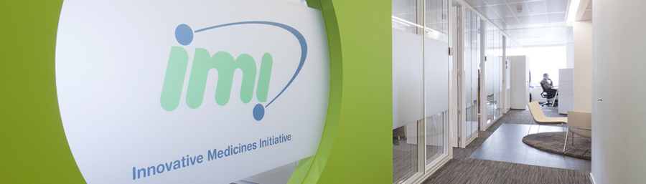

Joining Private and Public Forces to Boost Innovation in Healthcare: Knowledge Management at IMI
Ann Martin MSc
Principal Scientific Manager IMI JU

Slide 2



Innovative Medicines Initiative:
Joining Forces in the Healthcare Sector
Partnership European Commission & EFPIA
Objective:
  More efficient Drug R&D leading to better medicines
  Enhance Europe’s competitiveness in the pharmaceutical sector
2 Billion €
I Billion €
I Billion €
Public
Private
Partnership

Slide 3
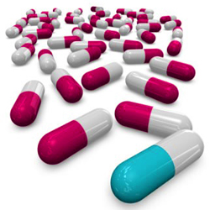
Key Hurdles in Pharma R&D
Disease heterogeneity
Lack of predictive biomarkers
for drug efficacy/ safety
Insufficient pharmacovigilance tools
Unadapted clinical designs
Societal bottlenecks
Lack of incentive for industry

Slide 4

Key Concepts
“Non-competitive” collaborative
research for EFPIA companies
Open collaboration in public-private
consortia (data sharing, wide
dissemination of results)
Competitive calls to select partners of
EFPIA companies (IMI beneficiaries)

Slide 5
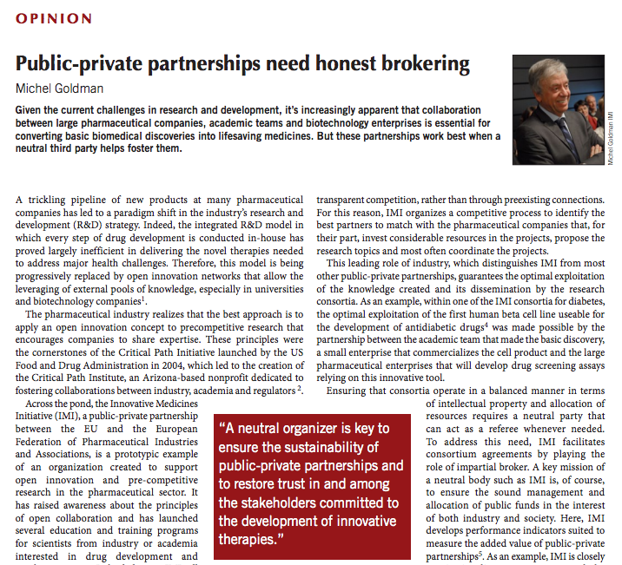
Nature Medicine
18: 341, 2012
Notes:
Message: public-private partnerships need honest brokering.

Slide 6
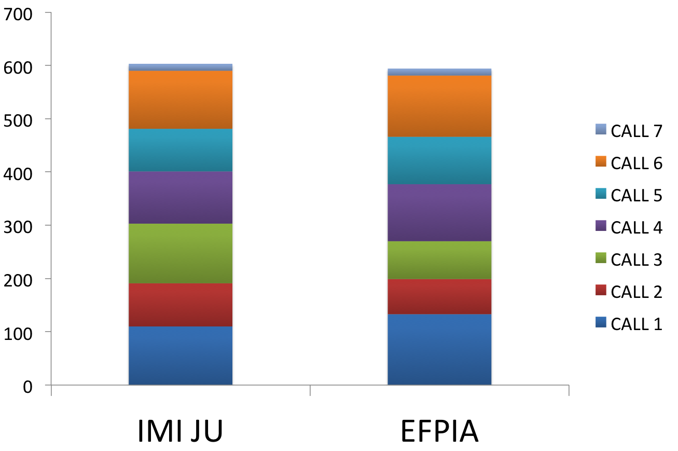
IMI JU and EFPIA commitments
as of October 2012
7 Calls launched so far
(42 projects)
1-(2) additional Call(s)
to be launched in 2012
Million Euro
Notes:
Message: many calls leading to 42 projects for a significant budget

Slide 7
Key Figures of 37 on-going Projects
347 EFPIA teams
514 Academic & research teams
91 SMEs
€600 mln
EFPIA ‘n kind
contribution
7 regulators
€ 603 mln IMI JU
cash contribution
22 patient org
~ 3500 researchers
> 240 publications
R&D Productivity Improvements
Notes:
Message: large program leading to R&D productivity improvements.

Slide 8
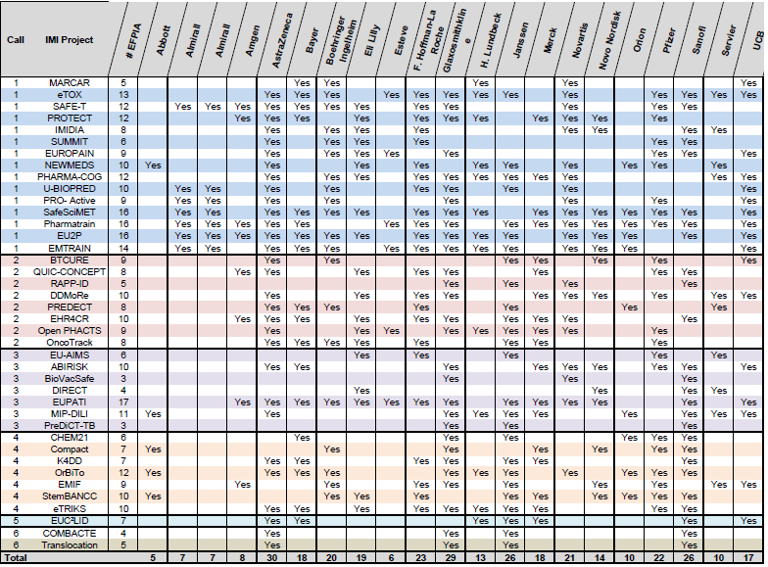
Who participates from EFPIA ?
EFPIA Partners along IMI beneficiaries
companies in > 3 projects
> half the projects include > 9 companies
> half the companies are in > 9 projects
Notes:
Message: EFPIA companies are truly working collaboratively on many topics.

Slide 9
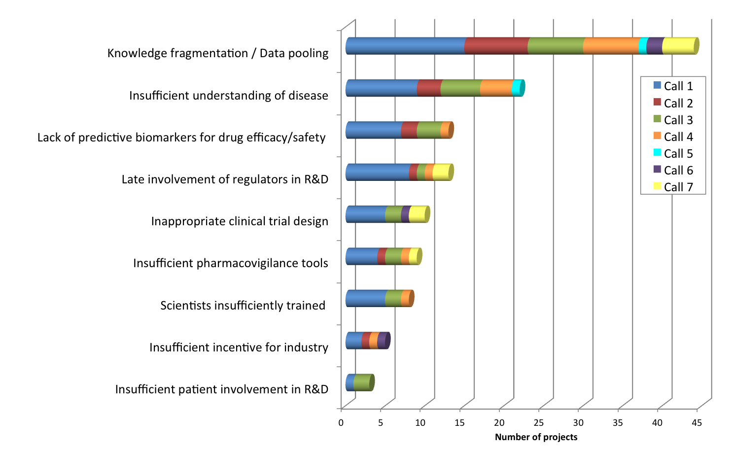
Projects Address Hurdles in R&D
Notes:
All projects are addressing the hurdles of knowledge fragmentation and data, knowledge integration.

Slide 10
IMI improving R&D productivity
Exploitation of data from multiple sources
Schizophrenia Depression
Chronic Pain
combined data analysis of 23,401 schizophrenia patients
combined genetic data analysis on 2146 DNA samples
pooled data from 43 past trials to understand the pain medicines mechanism of action and factors important in placebo response
Safety
building a toxicology information database utilising toxicology legacy reports to develop better in silico tools for toxicology prediction of new chemical entities (1274 reports extracted so far, 2092 were cleared, 3564 are planned in total)
exploited EFPIA in vivo mouse and rat toxicology studies, tissue archives and molecular profiling data for >30 reference compounds to study NGC, genotoxic carcinogens and non-hepatocarcinogen controls
Autism
sequenced 78 Icelandic parent–offspring trios, a total of 219 distinct individuals (44 autistic, 21 schizophrenic offspring) and identified 4933 de novo mutations
Knowledge Management
integrated 7 pharmacological information sources by providing a modular platform to query and analyze the linked data sources (>450 M triples) and developed 4 example applications
Notes:
Based on the midterm review (mainly Call 1)
Schizophrenia / depression (NEWMEDS)
Autism (EUAIMS)
Chroinic Pain (EUROPAIN)
Safety (eTOX, MARCAR)
KM (Open PHACTS)

Slide 11
IMI Projects’ Impact
PATIENTS
New, more effective and safer medicines faster
Personalized treatment approaches
Faster adverse effects detection and intervention
INDUSTRY
ACADEMIA
Faster and cheaper trials
Reduce late phase attrition
Facilitating regulatory approval
Better informed go/no-go decisions
Reshaping regulatory landscape
Building collaborative networks
Access to industry expertise
Access to data and samples
Focus on applied research
Reduced time to patient
Reduced cost
Decreased societal burden
Reduced use of ineffective drugs
Reduced cost due to drug adverse effects cases
More productive economies
Decreased use of animals
SOCIETY

Slide 12

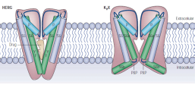
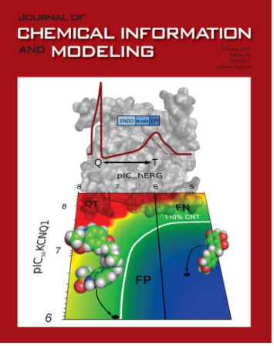
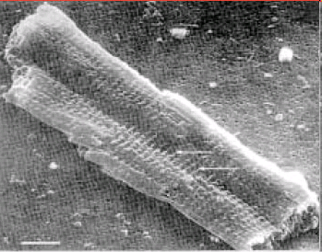
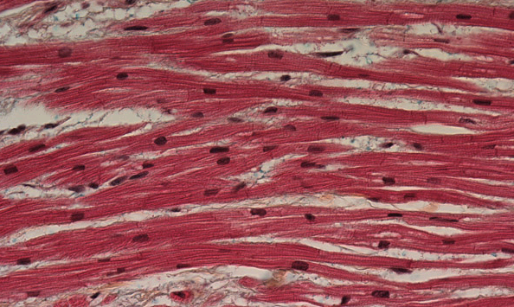
In Silico prediction of Toxicities
The Objective
Collect, extract and organise pre-clinical toxicology data into a searchable database. Built in silico predictive systems to “foresee” major side effects
Progress
Developed in silico model to predict cardiac toxicity
>3,500 reports delivered or in process
ChOX DB: 175,401 compounds annotated to 427 targets with 705,415 activities extracted from 10,000 publications
  ArrayExpress: 20, 000 microarrays from tox studies on 130 compounds, 4315 microarrays from rat liver on 344 compounds
50 models already developed
Ontology: 3917 terms and 2535 synonyms mapped and more on-going
Molecular
Cellular
Tissue
Notes:
Source Mid Term review slides

Slide 13
DDMoRe – The Vision
Standards for describing models, data and designs
Modelling
Library
Shared knowledge
Modelling
Framework
A modular platform
for integrating and
reusing models;
shortening timelines
by removing
barriers
Model
Definition
Language
System
interchange
standards
Specific
disease
models
Examples from
high priority areas
http://www.ddmore.eu
Education
Training
http://www.ddmore.eu
Notes:
13
Common ontology
Describing all components of pharmacometric and systems biology modelling
Modelling library
easily shareable among all stakeholders within pharmaceutical industry,
public bodies and SMEs;
facilitating and promoting the qualification, evaluation and application of models in a quantitative drug/development context
Specific disease models
to exemplify concept (Type II diabetes, oncology, etc.);
from high priority therapeutic areas
Modelling framework
Qualified and supported, robust, auditable, flexible and scaleable;
to effectively integrate and
reuse previous data and accurately interpret efficacy and safety findings to reduce cost and cycle time to employ “state-of-the-art” methodology;
to enable better clinical trial design by effective use of all modelling and simulation components

Slide 14
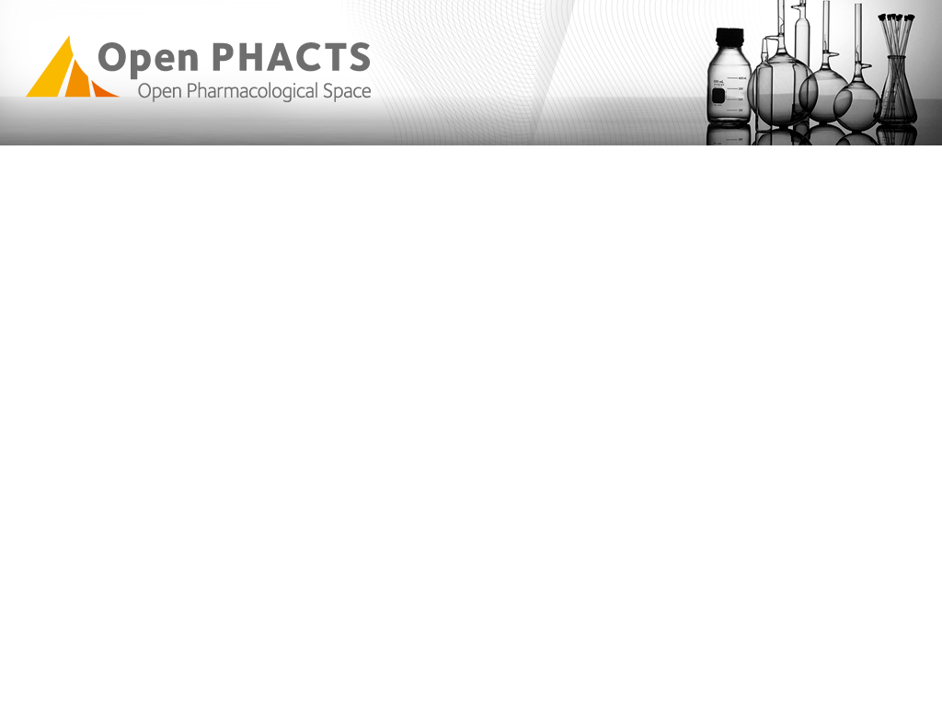
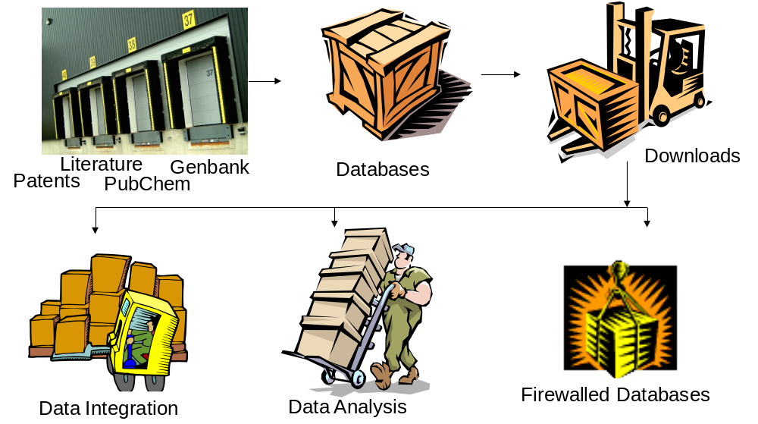
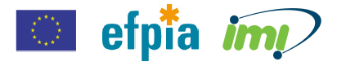
Open PHACTS: Public Domain Drug Discovery Data:
Pharma are accessing, processing, storing & re-processing
Public Domain Drug Discovery Data:
Pharma are accessing, processing, storing & re-processing
www.openphacts.org
www.openphacts.org
Notes:
3 year project 16,3 m€ start march 2011
Message: each company is accessing and integrating the information sources. Objective do it collaboratively and allow academic drug discovery teams to benefit from the knowledge integration.

Slide 15
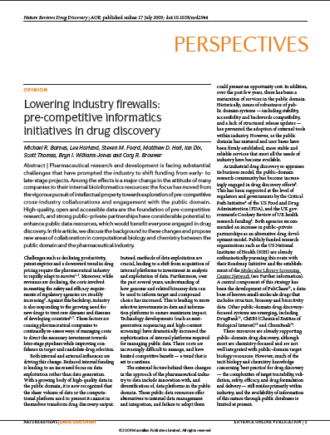

Open PHACTS
After Barnes et al Nature Review Drug Discovery 2009 doi10.1038/nrd2944
SERVICES
Application
(Knowledge)
Define needs; Design algorithms; Develop “plug-in” architectures?
Fact Visualisation
e.g. Target Dossiers;
SAR Visualisation
Assertions
Define needs; Contribute algorithms & develop tools (e.g. text mining); Enhance existing approaches
e.g. Gene-to-Disease;
Compound-to-Target; Compound-to-ADR
Standards
Support existing standards; Drive new DD-relevant ontologies; Work with publishers
Ontology/taxonomy;
Minimum information guide;
Dictionaries; Interchange mapping
Data
Defining needs; Knowledge;
Data Contribution
Targets; Chemistry; Pharmacology; Literature; Patents

Slide 16


Open PHACTS What do we need?
“What is the selectivity profile of known p38 inhibitors?”
“Let me compare MW, logP and PSA for known oxidoreductase inhibitors”
“Find me compounds that inhibit targets in NFkB pathway assayed in only functional assays with a potency <1 μM”
ChEMBL
DrugBank
Gene Ontology
Wikipathways
GeneGo
ChEBI
Uniprot
UMLS
GVKBio
ConceptWiki
ChemSpider
TrialTrove
TR Integrity
The Open PHACTS infrastructure can support many different domains & questions

Slide 17
Open PHACTS Philosophy
Open PHACTS is an Infrastructure with an open API that you can build aplications around
  Additive – we want to build on things that are already there
  Collaborative – we join the community, and develop together
  Connecting – we want to bring things together to answer key drug discovery problems
We will do boring stuff really really well, because this is big, hard and complicated
  Licensing
  Mapping
  ‘Computational plumbing’
Different users have different needs and different expectations

Slide 18
Open PHACTS Achievements
Integrated 7 information sources
> 400 M triples
Developed 4 example applications
Deployed at a professional hosting service
Testing and fine tuning ongoing
Data Licensing in review
Next: release 1.0

Slide 19
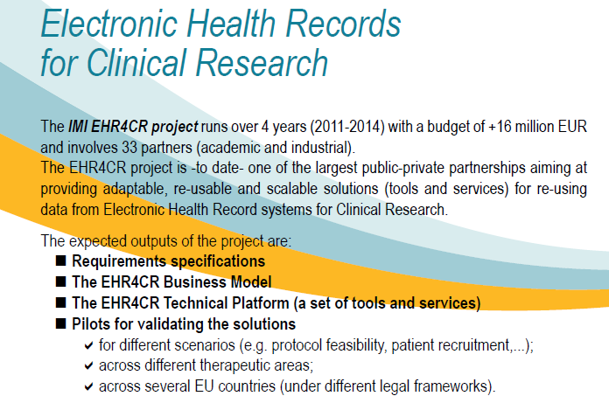
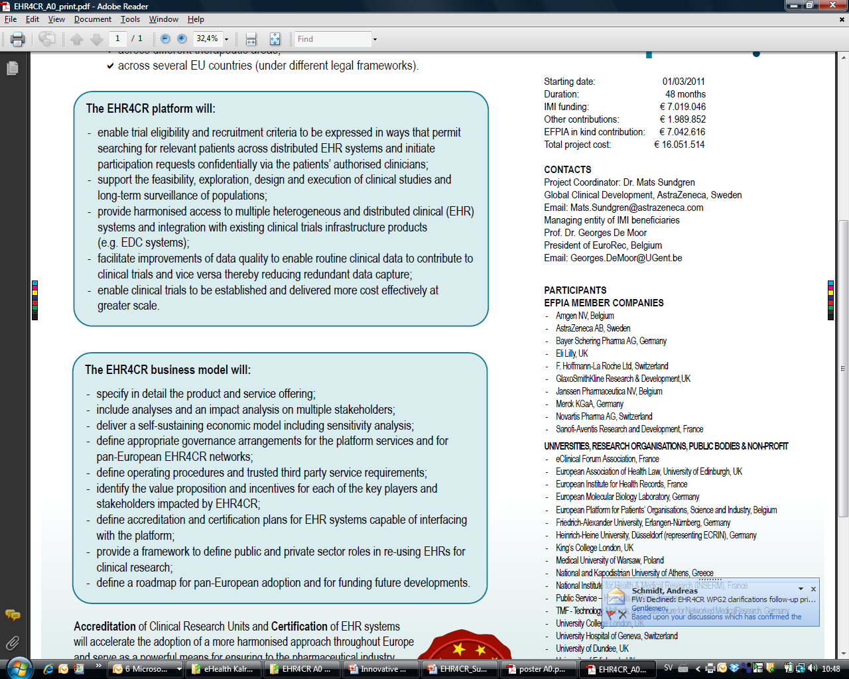

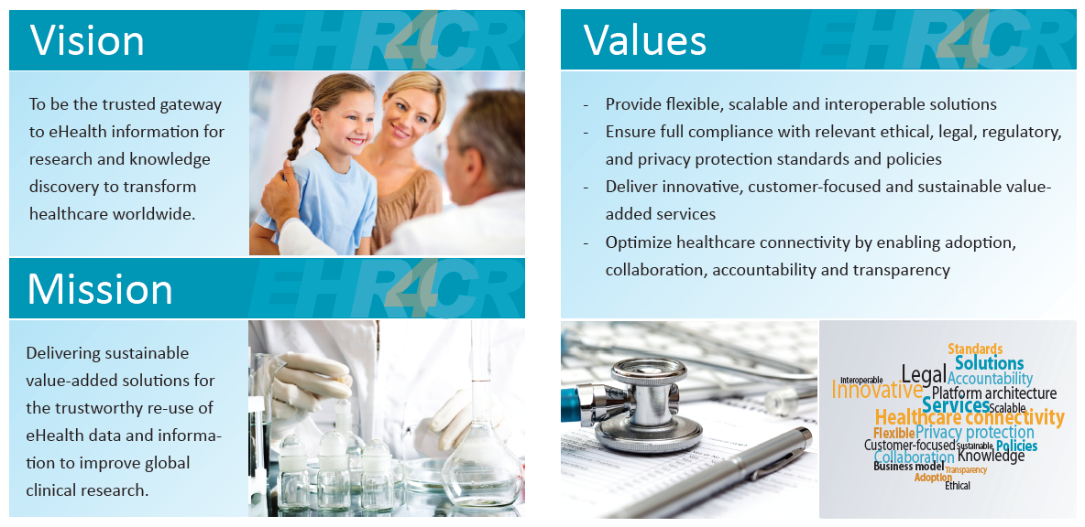
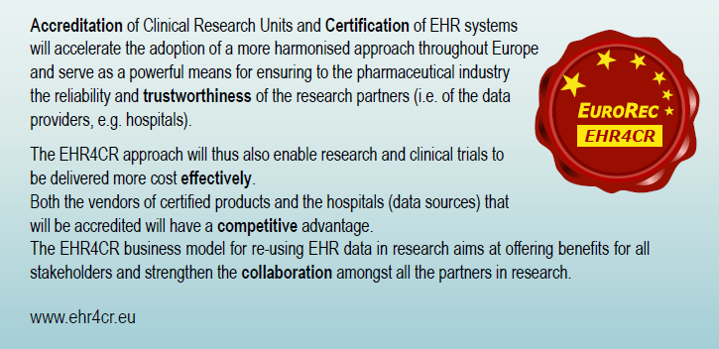

Slide 20
EMIF – European Medical Information Framework for patient level data
EMIF governance
Metabolic
Call 5
CNS
Call 5
TBD
Research Topics
EMIF - Metabolic
Patient generated data
Risk stratification
EMIF - AD
Risk factor analysis
Prevention algorithms
Predictive screening
Data Privacy
EMIF - Platform
Analytical tools
Semantic Integration
Information standards
Data access / mgmt
IMI Structure and Network
Notes:
Starting 1 january 2013 budget
Access to large pools patient level data.
Information / KM layer is intended to be reusable accross different research projects.

Slide 21
eTRIKS European Translational Information and Knowledge Services
Objective:
  Provision of a sustainable KM Platform and Service to support Private/Public Translational Research (TR) in IMI and beyond
  Single access point to standardised curated TR study information
Project:
  Built around J&J’s tranSMART open platform
  Support: Hosting, Consulting, Curation (live and historic TR trials), Software development, Training, Analytics Methodology, Standards development, Ethics consultation.
  Support of live IMI Efficacy & Safety projects: UBIOPRED, NEWMEDS, OncoTrack, PREDECT, Predict-TB, ABIRISK, ND4BB, MRC/ABPI-RA MAP.
Notes:
Starting 1 November 2012 Budget: 16M€

Slide 22
Data Intensive Sciences
Descriptive Metadata
Describe quality of the data
Use standards to ensure syntactic and semantic interoperability
(Ref e-IRG Data Management Task Force 2009)

Slide 23
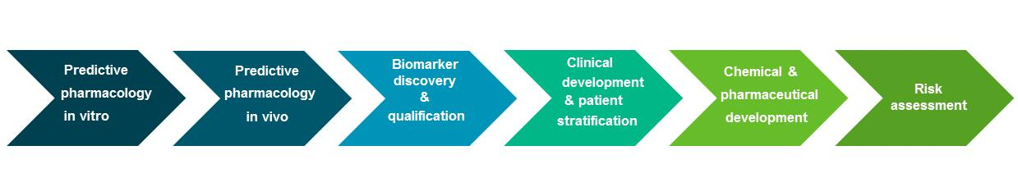
IMI and the role of Standards
CDISC –IMI
Memorandum of understanding
CDISC membership
Standards work on project basis
CDISC membership
Extends to IMI beneficiaries in IMI projects
CDISC overview course
BENEFITS
Pharma and IMI beneficiaries use same standards
Develop new standards where needed
Preventing duplication of effort and resources
CDISC project participant
EHR4CR
BIOVAC-SAFE
eTRIKS
CDISC standards used in many

Slide 24
Data Intensive Sciences
Cite standards (incl version)
Cite data ( use DOI)

Slide 25
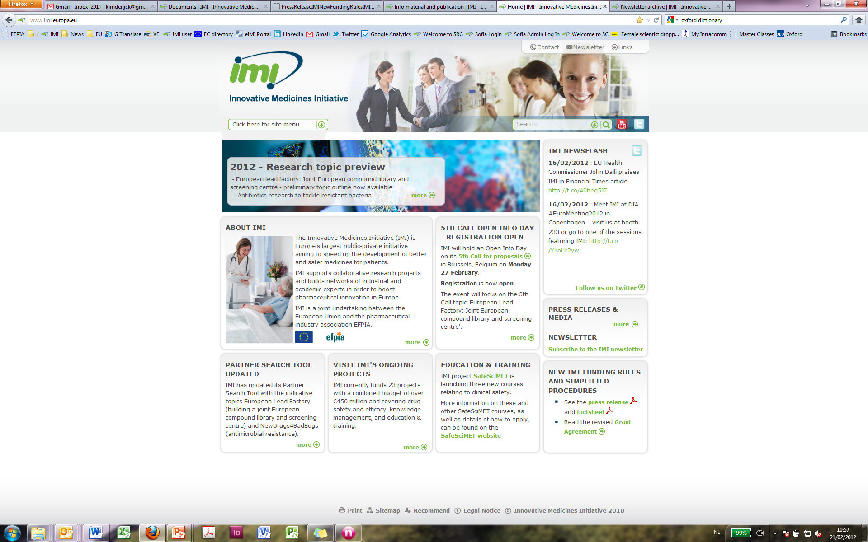
THANK YOU !
Visit www.imi.europa.eu
Sign up to the IMI Newsletter
Follow us on Twitter: @IMI_JU
Join the IMI group on LinkedIn
Questions? E-mail us: infodesk@imi.europa.eu

Slide 26

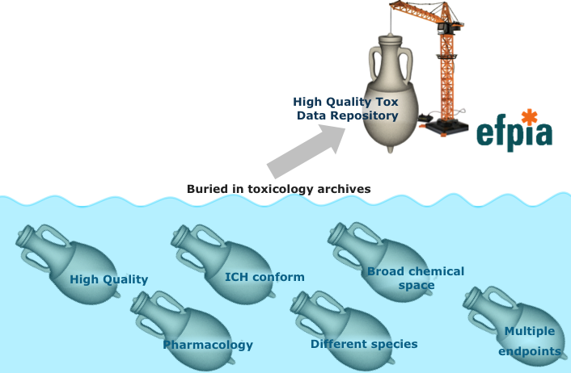
E-TOX: Opportunity for better toxicity predictions
Tremendous wealth of high quality toxicology data in the archives of the pharmaceutical companies, not yet leveraged!
www.etoxproject.eu
Notes:
About 3000 toxicity reports curate the results in a high qulaity database.

Slide 27

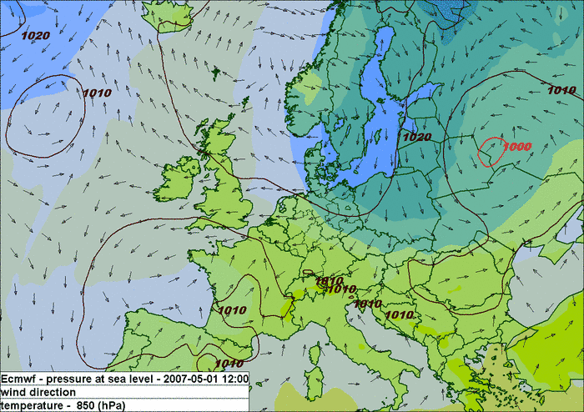
E-TOX: From mere guess to prediction→in silico prediction
Present science and technology allows the development of reliable predictive systems on the basis of a wide consideration of relevant previous experience
www.etoxproject.eu
Notes:
On the basis of the charateristics of the molecules predict the preclinical toxicities

Slide 28
eTRIKS European Translational Information and Knowledge Services
Problem: No open KM infrastructure to support pre-competitive (e.g IMI) cross-institute Translational Research IMI redundancy, in-efficiencies & data legacy challenge.
Project:
  Consortia to develop & deliver an open TR KM infrastructure & Service
  Built around J&J’s tranSMART open platform
  Support: Hosting, Consulting, Curation (live and historic TR trials), Software development, Training, Analytics Methodology, Standards development, Ethics consultation.
  Support of live IMI Efficacy & Safety projects:
    UBIOPRED, NEWMEDS, OncoTrack, PREDECT, Predict-TB, ABIRISK, ND4BB, MRC/ABPI-RA MAP.
WP6 Community Engagement and Outreach
Active Account Management of eTRIKS Service
WP1
WP2
WP3
WP4
Standards Research and Development
Analytics Research and Content Curation
Service
Delivery
Platform
Development
Technical Service
Development
Service
Standards
Service
Content Service
WP 5 Governance & Business Model
WP7 Ethics
Consortia Model & Costs:
  €23.8m / 5 year
  10 Pharma: AZ, Janssen, Sanofi, GSK, Bayer, Roche, Merck, Pfizer, Lunbeck, Lilly
  ~6 AMC/SMEs: Imperial College London, CNRS, Uni Luxembourg, CDISC, IDBS, BioSci Consulting.
Benefits:
  IMI project cost and time efficiencies
  Stable legacy: IMI TR data security
  Improved data sharing through development of standards and ethical requirements.
  Improved analytics innovation thru provision of standardised content
  Strengthened TR Ix community

Slide 29
ETOX
Elimination of inefficient pre-clinical models
in Alzheimer’s, chronic pain, schizophrenia, diabetes, asthma
Developed reliable animal models for efficacy and safety assessment
in Alzheimer’s, chronic pain, schizophrenia, diabetes, asthma
BENEFITS
Pharma and IMI beneficiaries use same standards
Develop new standards where needed
Preventing duplication of effort and resources

Slide 30

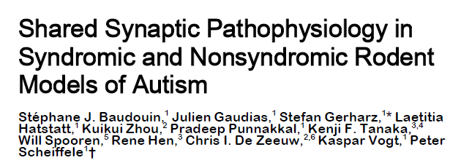
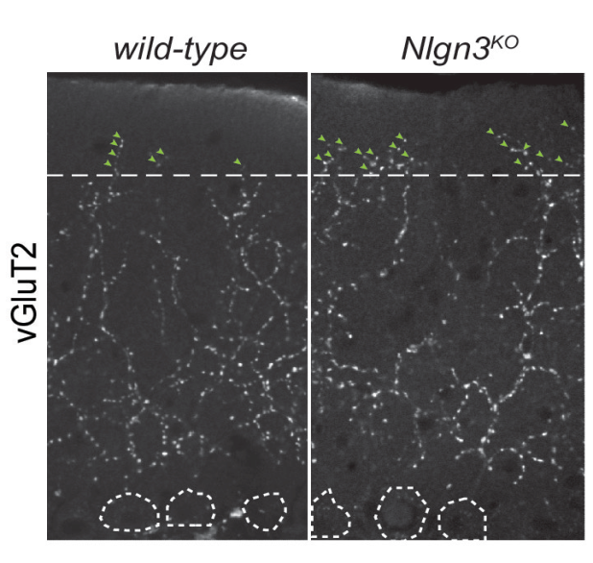
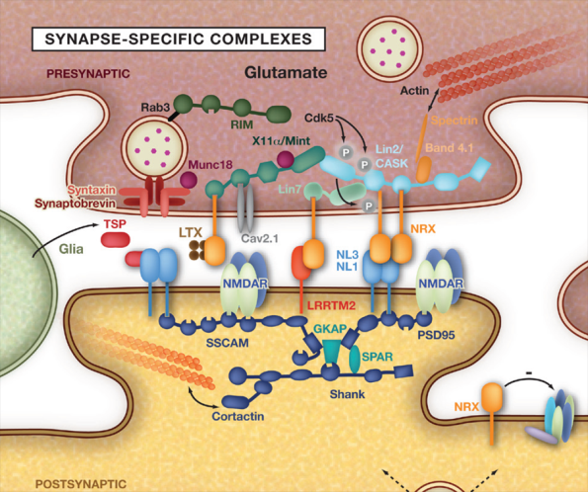
Science
October 5th 2012
The consortium has developed an animal model replicating a nonsyndromic autism
and demonstrated that the condition can be reversed with specific therapy
This new development is be of great importance for clinical development of new treatments for autism

Slide 31

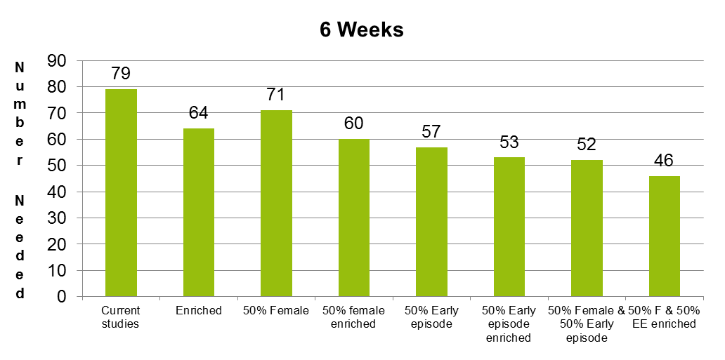
Schizophrenia trials
Average cost savings € 2,8 million
Proposed ways to reduce required numbers of patients needed for antipsychotic trials
while preserving 90% power (p<.05)
Based on resampling of data from 34 such trials (n=11,670 patients) data from Astra Zeneca, Janssen, Lilly, Lundbeck, Pfizer
Samples can be reduced from 79 to 46 patients per arm by targeting trials
In addition the trial duration can be reduced from 6 to 4 weeks
Current mix =70% female; 20% early episode; 40% enriched
Enriched=prominent positive and negative symptoms
Early episode=under 3 with 4 or more years of illness
Note: Per patient cost 6wk study $70,000-$100,000

Slide 32
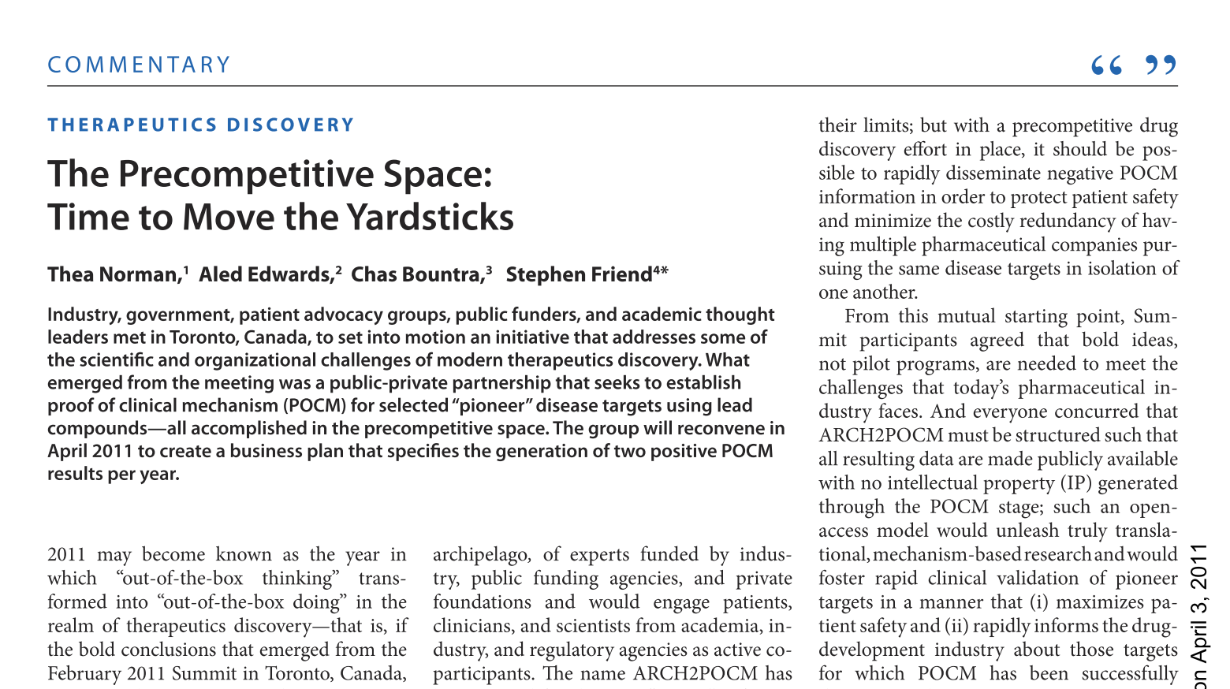
Notes:
May 2011 ARCH2POCM archipelago to proof of concept mechanism.
in light of the 90% attrition rate that the so-called pioneer targets (2) experience during phase II trials (the
first point at which POCM is evaluated in humans).
with a precompetitive drug discovery effort in place, it should be possible to rapidly disseminate negative POCM information in order to protect patient safety and minimize the costly redundancy of having multiple pharmaceutical companies pursuing the same disease targets in isolation of
One another.
such that
all resulting data are made publicly available
with no intellectual property (IP) generated
through the POCM stage; such an openaccess
model would unleash truly translational,
mechanism-based research and would
foster rapid clinical validation of pioneer
targets in a manner that (i) maximizes patient
safety and (ii) rapidly informs the drugdevelopment
industry about those targets
for which POCM has been successfully
demonstrated.
􀀀 is
open-access, integrated e ort
to validate disease mechanisms
and therapeutic targets has the
potential to increase return on
investmen

Slide 33
The broad picture of the IMI
Anti-Microbial Resistance programme
As a public-private partnership aiming at removing bottlenecks
in drug development, IMI is the ideal instrument to solve
the scientific challenges, to provide the necessary incentives
for industry and to revisit the regulatory environment in order
to reinvigorate R&D on antibiotics
The 6th Call is the first Call of a series of IMI Calls
which will address additional major challenges in the near future
First clinical trials were selected according to products that are
ready to be tested in view of a rapid introduction in clinical care

Slide 34
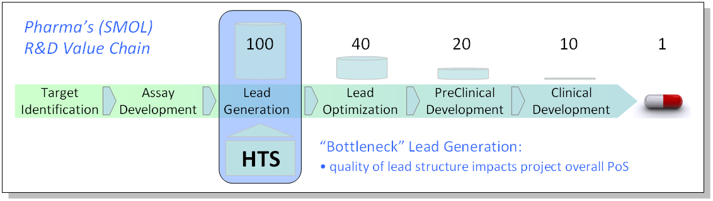
European Lead Factory
budget
forecast:
€169m
Industry partners will have access to unique high-quality Joint European Compound Library
≥ 300.000 compounds from industry partners – €60m ‘in kind’ contribution
200.000 compounds from public partners
Industry-like lead discovery platform available for public projects - focus on value generation
Addressing ‘intractable targets’
48 high throughput screening projects per anno
Support in assay development
Sustainable model for the screening centre to establish independent business entity

Slide 35
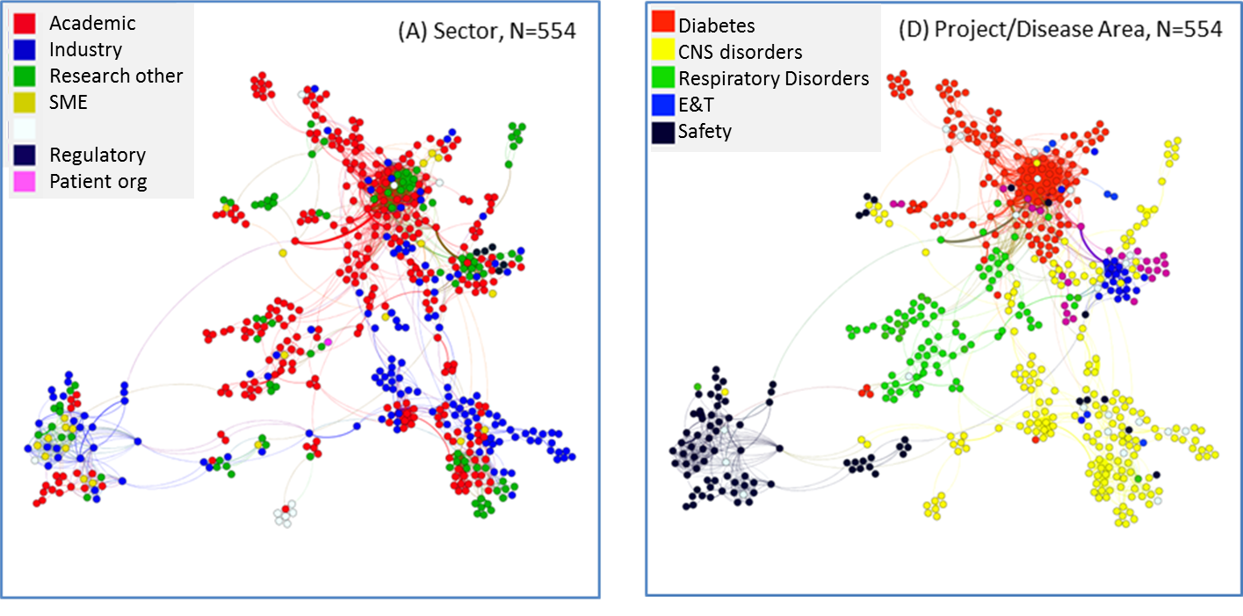
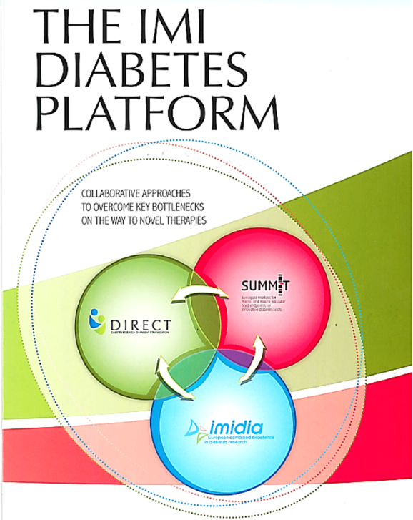
Mapping Collaborative Networks
Data & analysis: Thomson Reuters Custom Analytics & IP Solutions

Slide 36


European Patients' Academy on
Therapeutic Innovation
2012 – 2017
develop and disseminate accessible, well-structured and user-friendly information and education on medicines R&D
build competencies among well informed patients
and the public about pharmaceutical R&D
build expert capacity in patient advocates
create the leading public library on patient
information in six most common languages under public licensing
establish a widely used, sustainable infrastructure for objective, credible, correct and up-to-date knowledge
facilitate patient involvement in R&D to support industry, academia, authorities and ethics committees

Slide 37
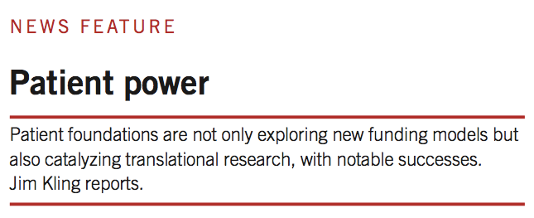
J. King, Nature Biotech 2012, 30: 818-820

