Slide 1

The “World May Be Flat”, But
“The Earth is Round”
Copyleft by C. Michael Gibson, M.S., M.D.
This material is free for anyone to copy, modify for their own purposes, and redistribute or use as they see fit, as long as the new version grants the same freedoms to others and acknowledges my original work.
Copyleft by CM Gibson
charlesmichaelgibson@gmail.com

Slide 2

Copyleft by CM Gibson
charlesmichaelgibson@gmail.com

Slide 3
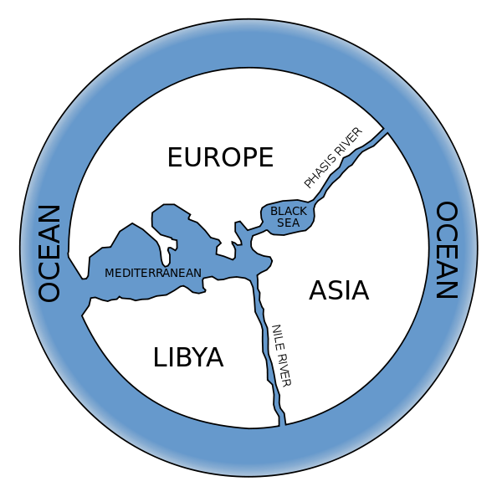
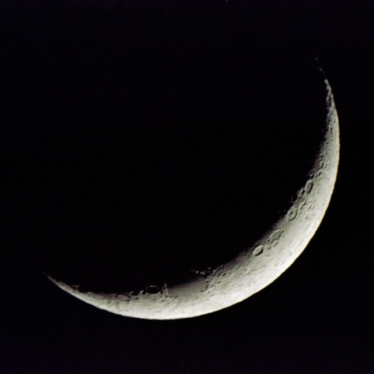
The “World May Be Flat”, But
“The Earth is Round”
One of the tenets of Friedman's "The World is Flat" is that Innovation increases as open access to information increases.
Although the “Wisdom of the Crowd” argued literally that the "World is Flat" several centuries ago, a select number of “Experts" demonstrated the world is in fact round (actually spherical).
The World is Flat:
Wisdom of the Crowd
The Earth is Spherical:
Expert Opinion
Copyleft by CM Gibson
charlesmichaelgibson@gmail.com

Slide 4
Challenges
With the vast amount of medical information on the internet, how do we harness the "Wisdom of the Crowds" yet vet it through “Experts”, and drive traffic to credible sites with the most relevant content?
How can we streamline the process so that greater numbers of individuals and websites can participate in schema.org?
Copyleft by CM Gibson
charlesmichaelgibson@gmail.com

Slide 5
Old World vs New World: Organizations
Old World
New World
Symbol: The silo
Organization: Vertical
“Command and Control”
The corner office
Symbol: The Globe
Organization: Horizontal
“Cocreation” “Collective genius” “Peering” “Online collectivism”
Cubicles at Google
Copyleft by CM Gibson
charlesmichaelgibson@gmail.com

Slide 6
Old World vs New World: Information Flow
Old World
New World
Insular and Secretive
Innovate from within
Knowledge flowed only to those at the top
Medium: Paper
Copyright
Open Source
Innovate from without
Knowledge flows to and from all
Medium: Internet
Copyleft
Copyleft by CM Gibson
charlesmichaelgibson@gmail.com

Slide 7
Old World vs New World: Competition
Old World
New World
Expensive Weapons of Mass Destruction
Inexpensive Weapons of Mass Collaboration
Copyleft by CM Gibson
charlesmichaelgibson@gmail.com

Slide 8
Old World vs New World: Collaboration
Old World
New World
John is the brightest child in kindergarten
Physician as a “individual player”
Promotion depends on first/last author publications
Publish or perish
John plays well with others in kindergarten
Physician as a “team player”
Promotion depends upon more broadly conceived contributions and collaboration
Collaborate or perish
Copyleft by CM Gibson
charlesmichaelgibson@gmail.com

Slide 9
Old World vs New World: Internet
Old World
New World
Internet 1.0
Website with one directional flow of information
Internet 2.0
Participatory community with bidirectional flow of information
Think YouTube; Facebook; Wikipedia
Copyleft by CM Gibson
charlesmichaelgibson@gmail.com

Slide 10
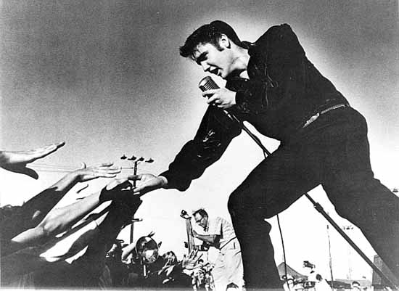

Old World vs New World: Media
Broadcast one show to millions
Broadcast millions of shows to one
Copyleft by CM Gibson
charlesmichaelgibson@gmail.com

Slide 11
Old World vs New World: The Truth Standard
Old World
New World
The professor
Diagnosis: “In my experience …”
Auscultates murmur
Eminence based therapy: “In my experience …”
Consensus & guidelines
Registry experience of many physicians
ECHO
Evidence based therapy: “In the GUSTO, TIMI experience …”
Copyleft by CM Gibson
charlesmichaelgibson@gmail.com

Slide 12
Old World vs New World: Medical Information
Old World
New World
Private
Good
Public
Good
Business Model:
Author, publisher, journal personally profit by selling medical information to those who can and will pay for it via either purchase or subscription
Copyrighted protection of journal or publisher
No Business Model:
Medical information is now ubiquitous
No entity should individually profit by selling medical information
Copyleft distribution to society
Copyleft by CM Gibson
charlesmichaelgibson@gmail.com

Slide 13
Limitations to Current Methods of Disseminating Medical Information
Textbooks
Journals
Websites
Shouldn’t all three be brought together?
Copyleft by CM Gibson
charlesmichaelgibson@gmail.com

Slide 14
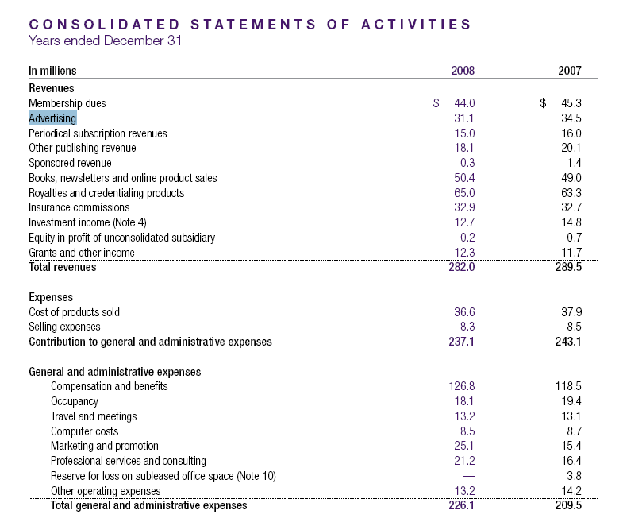
AMA / JAMA Advertising Revenue
Copyleft by CM Gibson
http://www.ama-assn.org/ama1/pub/upload/mm/37/2008-annual-report.pdf

Slide 15
Median reprint orders for the seven journals ranged from 3,000 to 126,350. Papers with high reprint orders were more likely to be funded by the pharmaceutical industry than were control papers (odds ratio 8.64, 95% confidence interval 5.09 to 14.68)
There is “the potential for future reprint orders influences decisions to publish particular articles.”
Up to 40% of revenues at a journal (example Lancet) come from reprint sales
Copyleft by CM Gibson
BMJ 2012;344:e4212

Slide 16
Clinical Research as Experimercials
"Indeed, medical journals have become an important but underrecognized obstacle to scientific truth-telling. Journals have devolved into information-laundering operations for the pharmaceutical industry."
Richard Horton, editor of the British medical journal, The Lancet
Copyleft by CM Gibson
http://www.nybooks.com/articles/archives/2004/mar/11/the-dawn-of-mcscience/

Slide 17
Current Model: Textbooks
Paper format
Outdated before it is printed
Represents views of selected authors
Broad community peer review lacking
Text based: No video, no audio, non-interactive, one way flow of information
Copyleft by CM Gibson
charlesmichaelgibson@gmail.com

Slide 18
The Textbook Business Model
Material is copyrighted: It is owned by the publisher, it cannot be broadly disseminated, it cannot be repurposed
Access limited to those who can afford textbook
Copyleft by CM Gibson
charlesmichaelgibson@gmail.com

Slide 19
Retail Price of Cardiovascular Textbooks in US Dollars
Braunwald's Heart Disease 8th Edition | Hurst's The Heart 12th Edition | Textbook of Cardiovascular Medicine, Topol 3rd Edition
$157 - 190 | $170 - 225 | $217 - 229
Copyleft by CM Gibson
charlesmichaelgibson@gmail.com

Slide 20
General Practitioner and Specialist’s Income
Country | GDP per capita USD ($) | Population (million) | GP's Monthly Salary (USD $) | Specialist's Monthly Salary (USD $)
Tajikistan | 1300 | 7.1 | 35 | 50
India | 3800 | 1128.2 | 637 | 1274
Azerbaijan | 7500 | 8.5 | 130 | 155
China | 7800 | 1323.6 | 133 - 160 | 170 - 230
Russia | 12200 | 142.3 | 210 | 290 - 320
Poland | 14400 | 38.2 | 580 | 750
United States | 43800 | 301.1
Copyleft by CM Gibson
Fact Book 2008

Slide 21
What is Copyleft?
Copyleft is a legal principle which safeguards against information being controlled by any one person, and ensures that it remains freely accessible forever.
All of the information in a copyleft document is free for anyone to copy, modify for their own purposes, and redistribute or use as they see fit, as long as the new version grants the same freedoms to others and acknowledges the authors of the original article (a credit or backlink to the original article is sufficient for this).
Copyleft by CM Gibson
charlesmichaelgibson@gmail.com

Slide 22
What is a Wiki?
A Wiki is an open source program that allows multiple authors to co-create a webpage.
The authors do not need to know how to program in HTML.
Copyleft by CM Gibson
charlesmichaelgibson@gmail.com

Slide 23

MediaWiki: The Wiki Software
What if someone makes a mistake or vandalizes the site?
  A Wiki is a database, and any page can be restored to an older version.
Can there be a discussion about the content?
  Yes. Click on the Discussion tab and there is a forum.
How do you know when a change has been made to a page?
  You can receive an email notifying you a change was made.
Copyleft by CM Gibson
charlesmichaelgibson@gmail.com

Slide 24
Wiki’s May Be Less Biased
Because articles are written based upon consensus, a Wiki is less susceptible to retaining bias, a Wiki is very hard for any group to censor, and a Wiki may be more rapidly responsive to new information.
Copyleft by CM Gibson
charlesmichaelgibson@gmail.com

Slide 25

Internet encyclopaedias go head to head
In order to test its reliability, Nature conducted a peer review of scientific entries on Wikipedia and the well-established Encyclopedia Britannica.
Reviewers were blinded to the source of information and were asked to check for errors in 50 articles matched for length.
Reviewers were asked to look for three types of inaccuracy: factual errors, critical omissions and misleading statements
"Only eight serious errors, such as misinterpretations of important concepts, were detected in the pairs of articles reviewed, four from each encyclopedia," reported Nature.
Copyleft by CM Gibson
Nature 438, 900-901; 2005

Slide 26
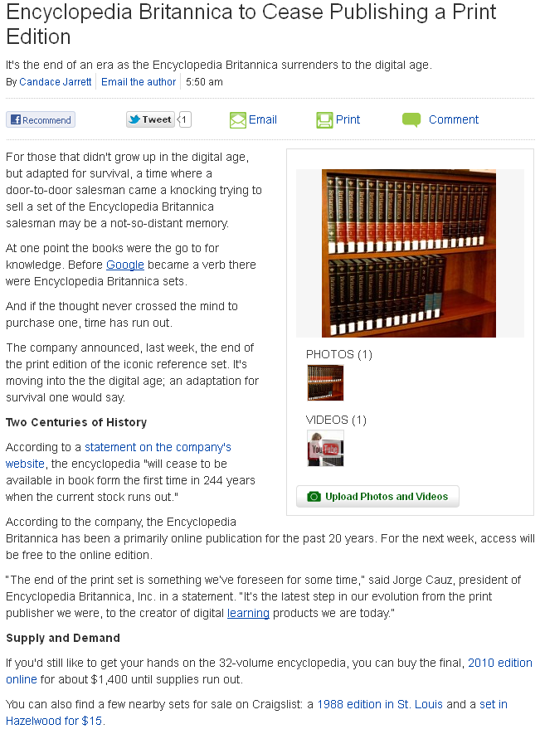
Copyleft by CM Gibson
charlesmichaelgibson@gmail.com

Slide 27
The World's First Medical Wiki: WikiDoc
Created by C. Michael Gibson, M.S., M.D. in 2005
WikiDoc is the world's first medical wiki which is a living textbook of medicine that everyone can edit and contribute to.
Uses same software as Wikipedia, but is confined to medical topics.
> 6900 registered authors are contributing at present.
501C3 Foundation
Mission statement: “Healthcare is enriched when medical knowledge flows freely.”
Copyleft by CM Gibson
charlesmichaelgibson@gmail.com

Slide 28
WikiDoc: Overview
Free, no required registration to view site
No pharmaceutical or device company support
World’s largest medical textbook
Video, audio can be inserted into medical textbook
Living guidelines (polling and suggested edits to guidelines)
Thousands of free downloadable “copyleft” images
Copyleft by CM Gibson
charlesmichaelgibson@gmail.com

Slide 29
WikiDoc’s Business Model
There is no business model
WikiDoc accepts no financial support from the pharmaceutical or device industry
There are no advertisements
A 501C3 non profit foundation has been created
NPR model: Viewer supported, philanthropy, volunteer efforts
Current bandwidth costs: $24,000 per year
Copyleft by CM Gibson
charlesmichaelgibson@gmail.com

Slide 30
WikiPatient, WikiPedia, WikiDoc
Bidirectional flow of information, complimentary
WikiPatient | WikiPedia | WikiDoc
Targeted at 8th grade level of comprehension | Too sophisticated for patients, often not sophisticated enough for a specialist in a field | Targeted at Healthcare Professionals
Editors |  | Editors
 |  | Expanded images (pathology, videos)
 |  | Expanded differential diagnosis
 |  | Board Review Questions
Toolbar shows related searches |  | Toolbar shows related searches
Copyleft by CM Gibson
charlesmichaelgibson@gmail.com

Slide 31
WikiDoc Content
Over 188,000 chapters of content
>660,000 edits to the pages
Over 6,900 registered authors
Over 23,000 copyleft images
150 million views each year
Copyleft by CM Gibson
charlesmichaelgibson@gmail.com

Slide 32
WikiDoc: The Team
Role of WikiDoc Team
  20+ dedicated full time volunteers
  Hotline / Help Desk
  Train physicians other volunteers
  Upload content to the site for those who need help
  Convert Echos and other media for use on the site
  Supervise volunteer efforts
  Police the site for vandalism
  Create a consistent structure on the site
Copyleft by CM Gibson
charlesmichaelgibson@gmail.com

Slide 33
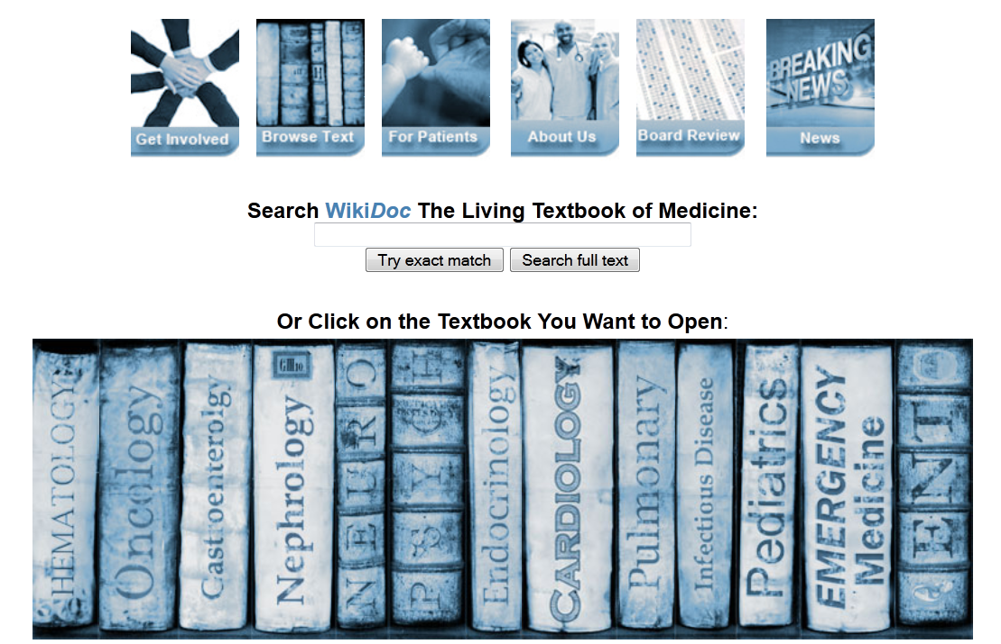
WikiDoc Home Page
Over 188,000 chapters of content
>660,000 edits to the pages
Over 6,900 registered authors
Over 23,000 copyleft images
150 million views each year
Copyleft by CM Gibson

Slide 34
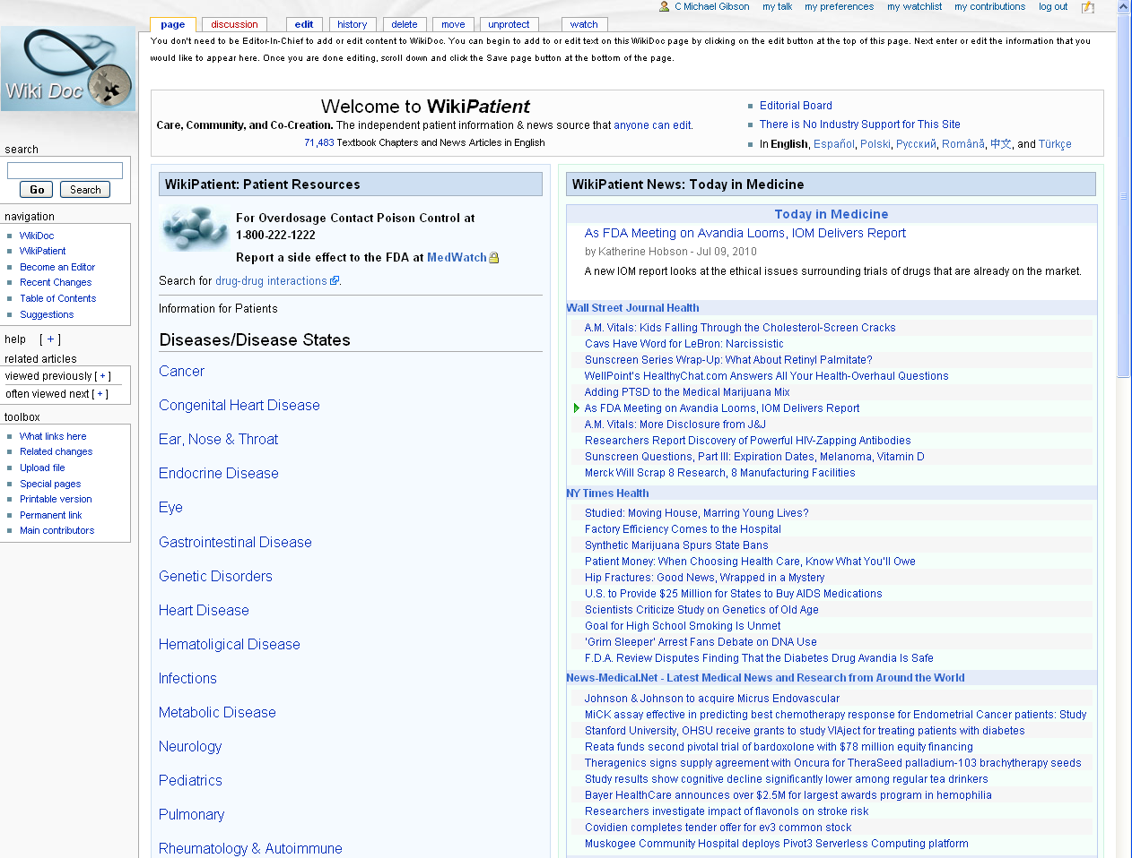
WikiPatient: Thousands of Chapters Now
Copyleft by CM Gibson
charlesmichaelgibson@gmail.com

Slide 35
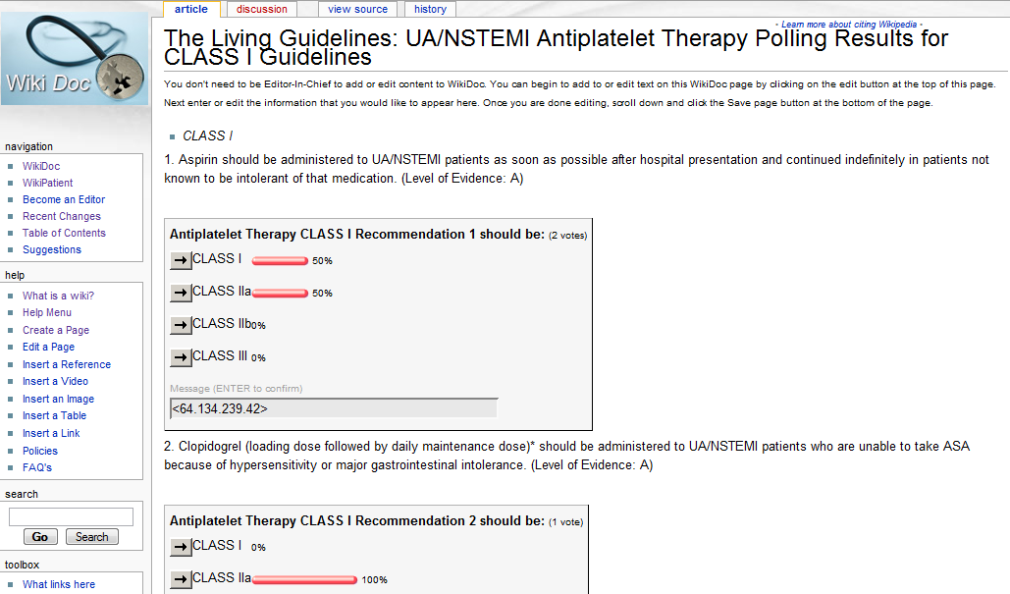
WikiDoc: The Living Guidelines
Copyleft by CM Gibson
charlesmichaelgibson@gmail.com

Slide 36
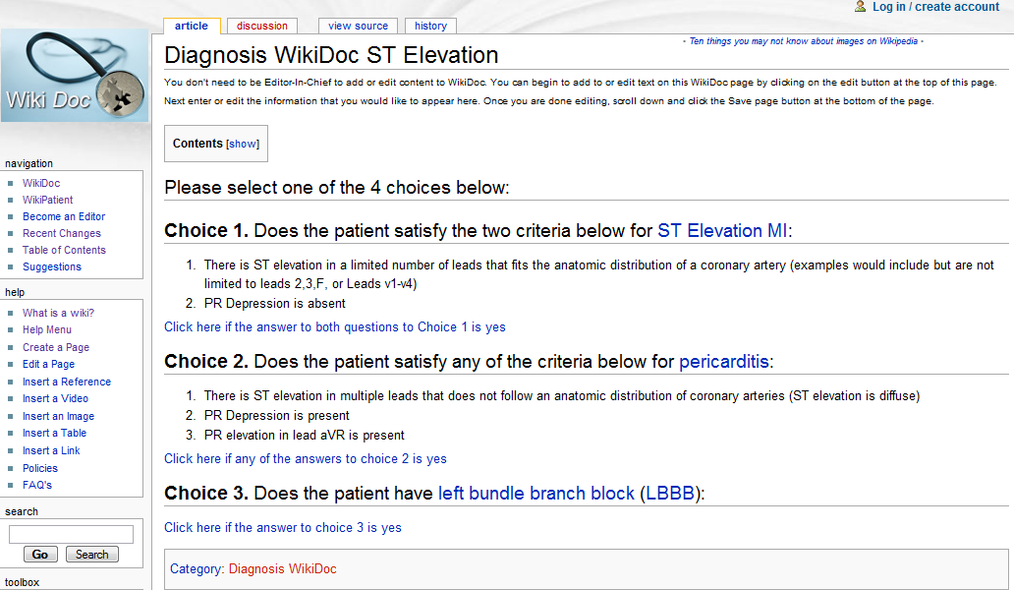
WikiDoc: Expert Algorithms
Copyleft by CM Gibson
charlesmichaelgibson@gmail.com

Slide 37
WikiDoc as a Research Tool:
WikiDoc now searches itself to find associations between symptoms, physical exam findings and disease states.
Copyleft by CM Gibson
charlesmichaelgibson@gmail.com

Slide 38
Example of WikiDoc Searching Itself to Create a Full Differential Diagnosis of the Causes of Headache
WikiDoc searches 190,000 chapters to find all pages with the word Headache in them
WikiDoc identifies >2,000 chapters associated with Headache
Physician reviews 2,000 chapters to ensure that only those Diseases truly associated with Headache are included in database
(Excludes treatments of Headache, other symptoms associated with Headache etc.)
Hundreds of diseases associated with Headache classified by organ system, and published in a table in WikiDoc
WikiDoc continues to search for any new reference to Headache and adds this to the database

Slide 39
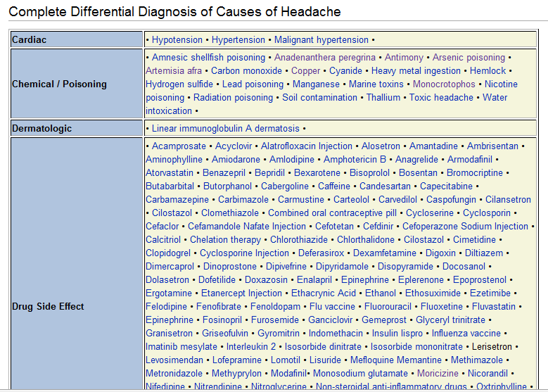
Differential Diagnosis of Headache
Copyleft by CM Gibson
charlesmichaelgibson@gmail.com

Slide 40
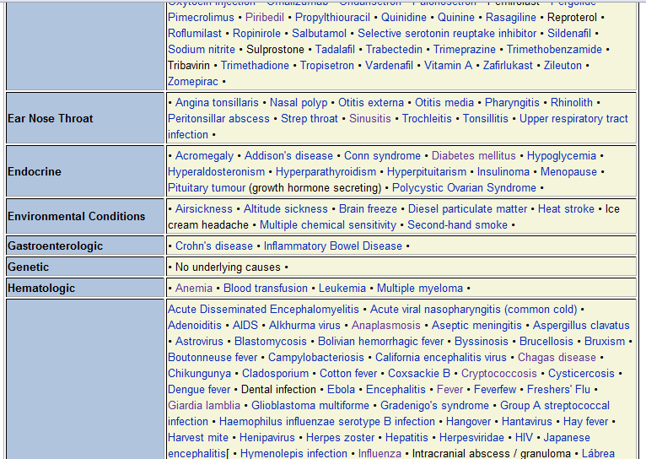
Differential Diagnosis of Headache (cont.)
Copyleft by CM Gibson
charlesmichaelgibson@gmail.com

Slide 41
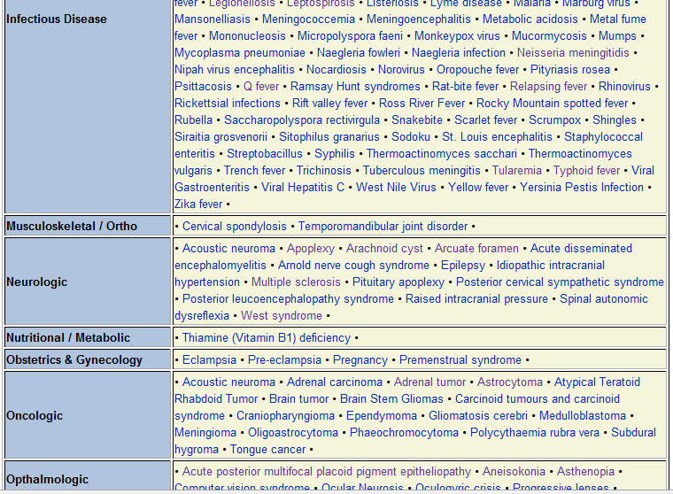
Differential Diagnosis of Headache (cont.)
Copyleft by CM Gibson
charlesmichaelgibson@gmail.com

Slide 42
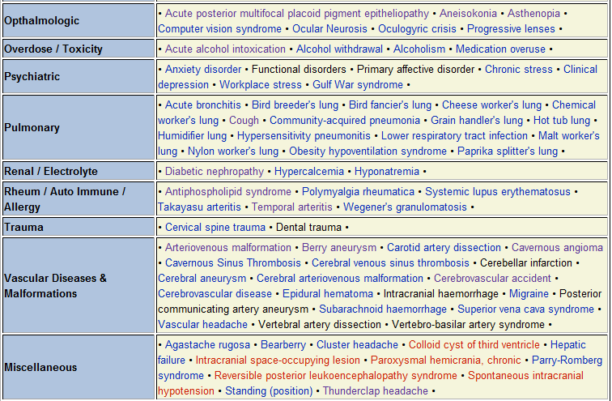
Differential Diagnosis of Headache (cont.)
Copyleft by CM Gibson
charlesmichaelgibson@gmail.com

Slide 43
WikiDoc: Successes
Large and growing viewership
Growing full time volunteer force of 20 – 28 dedicated individuals
Growing collaborations with internship and residency programs
Copyleft by CM Gibson
charlesmichaelgibson@gmail.com

Slide 44
WikiDoc Ongoing Challenges
WikiDoc content does not appear very high on search results
Vastly greater number of viewers than contributors
Initial implementation of a semantic coding system met with pushback from contributors due to its complexity
Copyleft by CM Gibson
charlesmichaelgibson@gmail.com

Slide 45
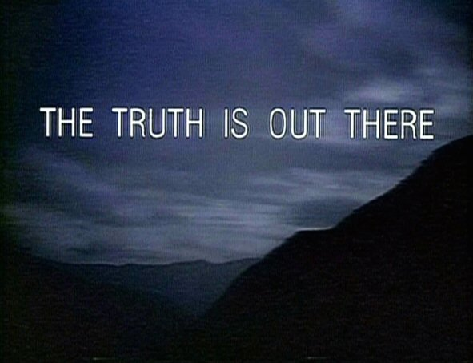
We Just Can’t Find it
Copyleft by CM Gibson
charlesmichaelgibson@gmail.com

Slide 46
Limitations of Search Algorithms
A societal goal is to discover new knowledge, particularly in a field such as medicine
An optimal search algorithm would identify not only well vetted static knowledge but would also identify new knowledge that would replace older inaccurate static knowledge
Copyleft by CM Gibson
charlesmichaelgibson@gmail.com

Slide 47
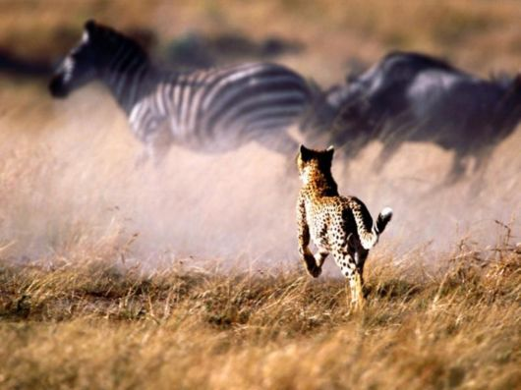
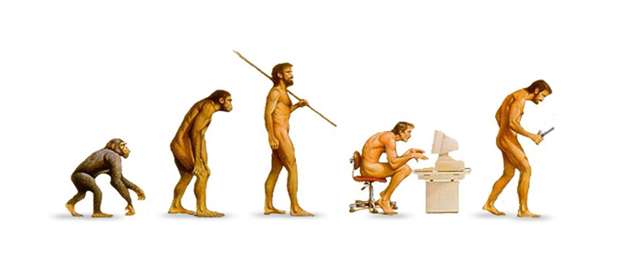
Limitations of Search Algorithms
Do current search algorithms provide effective “evolutionary pressure” to promote the “survival of the fittest” knowledge?
Copyleft by CM Gibson

Slide 48
Limitations of Search Algorithms
Older, highly linked to static knowledge rises to the top of search results
There is a positive feedback loop that promotes the survival of popular static knowledge and does not display and thereby promote rapidly evolving more credible knowledge from content experts
Copyleft by CM Gibson
charlesmichaelgibson@gmail.com

Slide 49
Limitations of Search Algorithms
The number of links is viewed as a surrogate for quality, “truth” or the fitness of knowledge
“Popularity” prevails over “credibility” in characterizing the “fitness” of knowledge
Copyleft by CM Gibson
charlesmichaelgibson@gmail.com

Slide 50

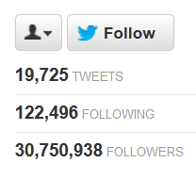
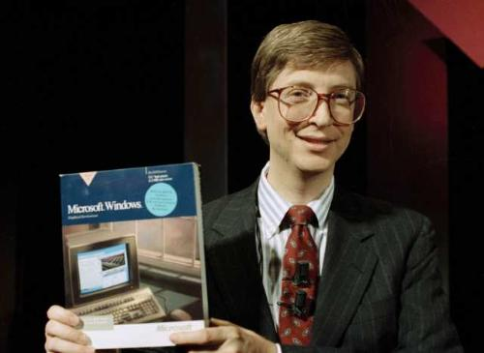
He may be popular …
But
Copyleft by CM Gibson
He may have a good idea …

Slide 51
Limitations of Search Algorithms
Forums, membership-only and subscription-only sites (lime many medical information sites) are not indexed
Sites that are slow to load may not be highly ranked
Copyleft by CM Gibson
charlesmichaelgibson@gmail.com

Slide 52
Limitations of Search Algorithms
Search algorithms currently do not adequately account for new knowledge that may be more accurate and has not yet been highly linked to by other sites
While collaborative authoring tools like a Wiki allow for the creation of new knowledge and the potential for rapid paradigm shifts, current search algorithms do not adequately identify paradigm shifts in so far as they elevate older static knowledge
Copyleft by CM Gibson
charlesmichaelgibson@gmail.com

Slide 53
Limitations of Search Algorithms
Search algorithms characterize the “quality” of the entire site and attribute that “quality” to a single page
The “quality” of content relating to older static knowledge may be excellent on a site, but the “quality” of rapidly changing knowledge on a single page may not be as good
Copyleft by CM Gibson
charlesmichaelgibson@gmail.com

Slide 54

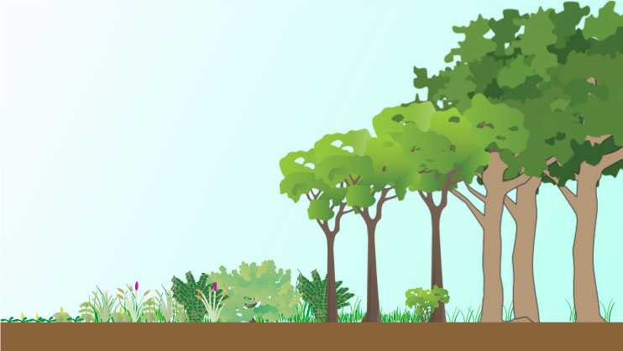
Limitations of Search Algorithms
Sites with “original content” may rise to the top of search results as well
However, in a copyleft world, new content created on one site (e.g. WikiDoc) that is assimilated into an already highly linked to site (Wikipedia) does not get viewed on WikiDoc but rather on Wikipedia
It is assumed that a highly linked to site such as Wikipedia is the creator of “original content” which may not be the case if there is bidirectional flow of content between two sites
The older, more highly linked to site prevails over the younger site
Copyleft by CM Gibson

Slide 55
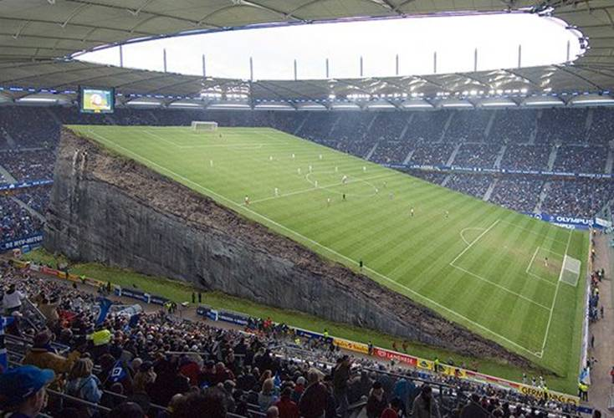
Limitations of Search Algorithms
Small organizations with good content but without the budget for search engine optimization may not be able to effectively compete with highly resourced sites in a field such as medicine
Copyleft by CM Gibson
charlesmichaelgibson@gmail.com

Slide 56
Improving Search Algorithms
Have an option to display
  What is most linked to
  What is new
  What is trending
Copyleft by CM Gibson
charlesmichaelgibson@gmail.com

Slide 57
Improving Search Algorithms:
Assessing Credibility of Medical Content
Is there an identifiable author who can be contacted?
What is the h index of the author? (a scholar with an index of h has published h papers each of which has been cited in other papers at least h times)
What is the h index of the affiliated institution?
Are there references to primary peer reviewed literature?
What is the impact factor of the journals cited?
How often has the authors work been cited?
On a wiki, how often has the content of the author been revised relative to other authors?
What is the Klout score of the author?
Are they a Castle Connolly top doctor or other peer recognition?
Are there numerous grammatical errors, typos?
Copyleft by CM Gibson
charlesmichaelgibson@gmail.com

Slide 58
Improving Search Algorithms:
Assessing Credibility of Medical Content
Is there evidence of “linkrot”?
Is there a webmaster and contact information?
Nature of the site:
  Credible:
    Journal site
    Professional society site
    Personal home page: may or may not be a content expert
    News and Journalistic site: if the article has an ISSN number (International Standard Serial Number), it will probably have more credibility
  Less credible:
    Special interest site: often biased
    Commercial site: often biased regarding products which are monetized
Copyleft by CM Gibson
charlesmichaelgibson@gmail.com

Slide 59
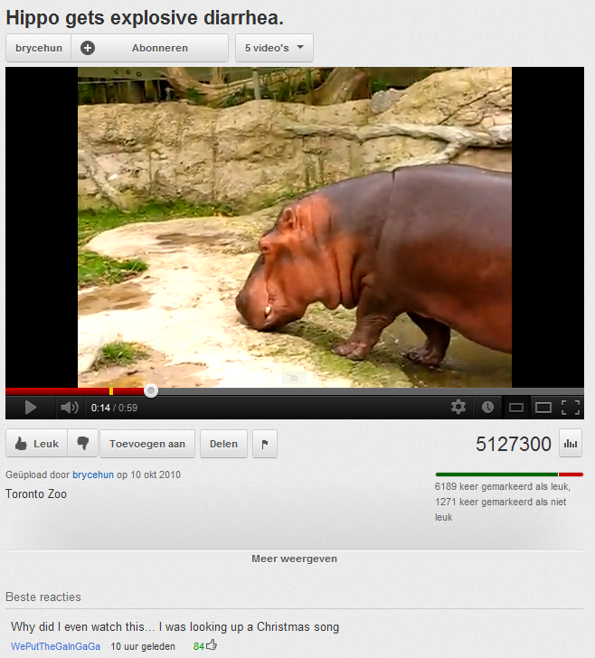
Improving the Specificity of Search
charlesmichaelgibson@gmail.com

Slide 60
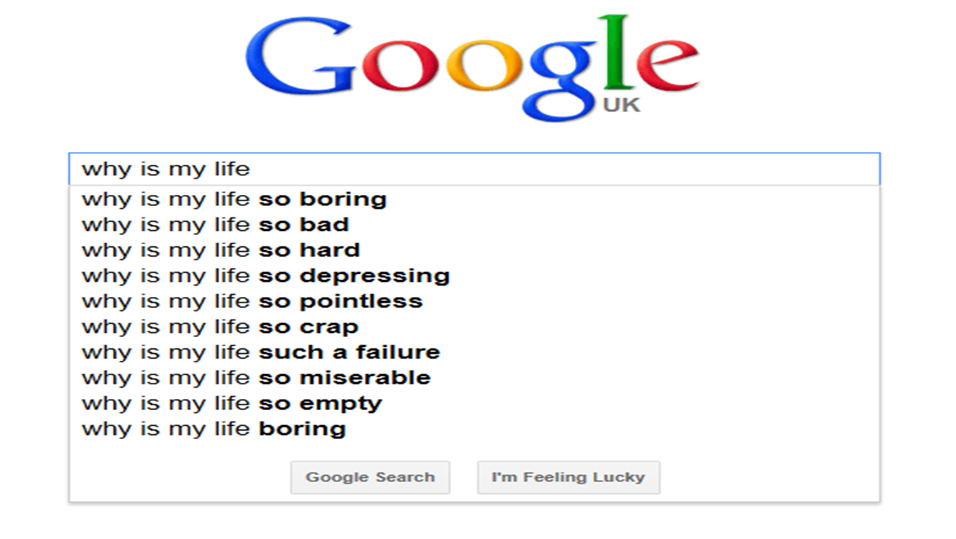

Slide 61
WikiDoc’s Role in Improving Search Results
Dr. Gibson and WikiDoc successfuly partnered with Google, Microsoft and Yahoo in a joint effort to create a hierarchical scheme to organize / tag medical content to make search results more content rich using the structure of www.schema.org
The new hierarchy was released to the public on June 27, 2012
Copyleft by CM Gibson
charlesmichaelgibson@gmail.com

Slide 62
The Open Source Journal of Medicine
This Week In Medicine:
Improving Medical Search.
By CM Gibson et al
WikiDoc: An Open Source Textbook of Medicine.
By CM Gibson et al
Editorial Board
RSS Feed
Instructions for submission
Original submission
Review #1
Review #2
Editors correspondence
Revised submission
Re review #1
Re review #2
Final article
Figures
Download data
Editorial
Forum Comments
Slides
Video
Podcast
Twitter
Articles citing this article
Content from article to insert in textbooks

Slide 63
WikiDoc: Vision
Primary Data Published in
Literature or WikiDoc’s Open Source Journal Of Medicine
WikiDoc News
(links to textbook chapters)
WikiDoc Living Guidelines Polling related to published guidelines
WikiDoc Polls
WikiDoc Discussion
WikiDoc Textbook Chapters Revised
Copyleft by CM Gibson
charlesmichaelgibson@gmail.com

Slide 64
How Could You Help?
Simplify end user coding of schema contents
Develop system to quantitate quality of contributions on WikiDoc: Proportion of a contributors content that is edited
Create coding for the Open Source Journal of Medicine
Create coding for bots to incorporate clinicaltrials.gov content on wikidoc
Help with SEO
Copyleft by CM Gibson
charlesmichaelgibson@gmail.com

Slide 65
How Could You Help?
The credibility of medical content should be characterized
Create a system whereby a unique identifier is provided to participating content providers to quantitate credibility (h index, number of citations, impact factor of journals they publish in, Klout score, peer review results, age adjusted)
Copyleft by CM Gibson
charlesmichaelgibson@gmail.com

