Slide 1
NCBO SPARQL Endpoint
Trish Whetzel
Outreach Coordinator

Slide 2
Outline
NCBO Overview
BioPortal Web and Web services
BioPortal SPARQL Endpoint
BioPortal Metadata Ontology
SPARQL Examples

Slide 3
Links of Interest
http://www.bioontology.org/wiki/index.php/SWAT4LS2012_Tutorial

Slide 4
National Center for
Biomedical Ontology
Mission
  To create software for the application of ontologies in biomedical science and clinical care
NCBO Partners
  Stanford University - Dr. Mark A. Musen
  Mayo Clinic - Dr. Christopher G. Chute
  University at Buffalo - Dr. Barry Smith
  University of Victoria - Dr. Margaret-Anne Storey

Slide 5
NCBO Key Activities
We create and maintain a library of biomedical ontologies
We build tools and Web services to enable the use of ontologies
We collaborate with scientific communities that develop and use ontologies

Slide 6
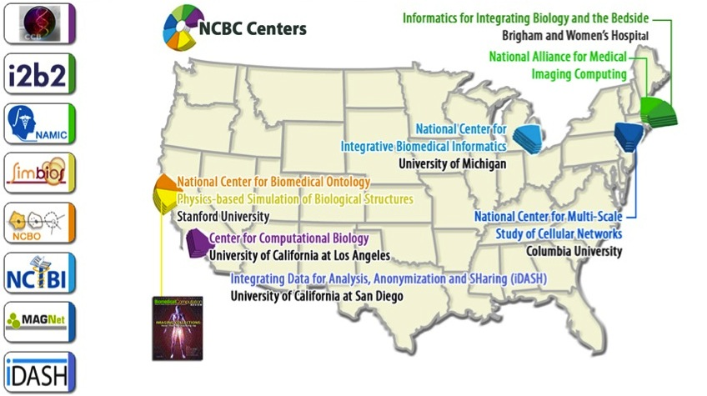
National Centers for Biomedical Computing
(http://www.ncbcs.org)

Slide 7
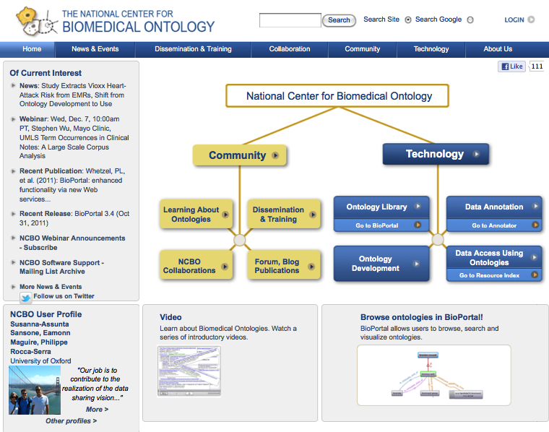
www.bioontology.org

Slide 8
Outline
NCBO Overview
BioPortal Web and Web services
BioPortal SPARQL Endpoint
BioPortal Metadata Ontology
SPARQL Examples

Slide 9
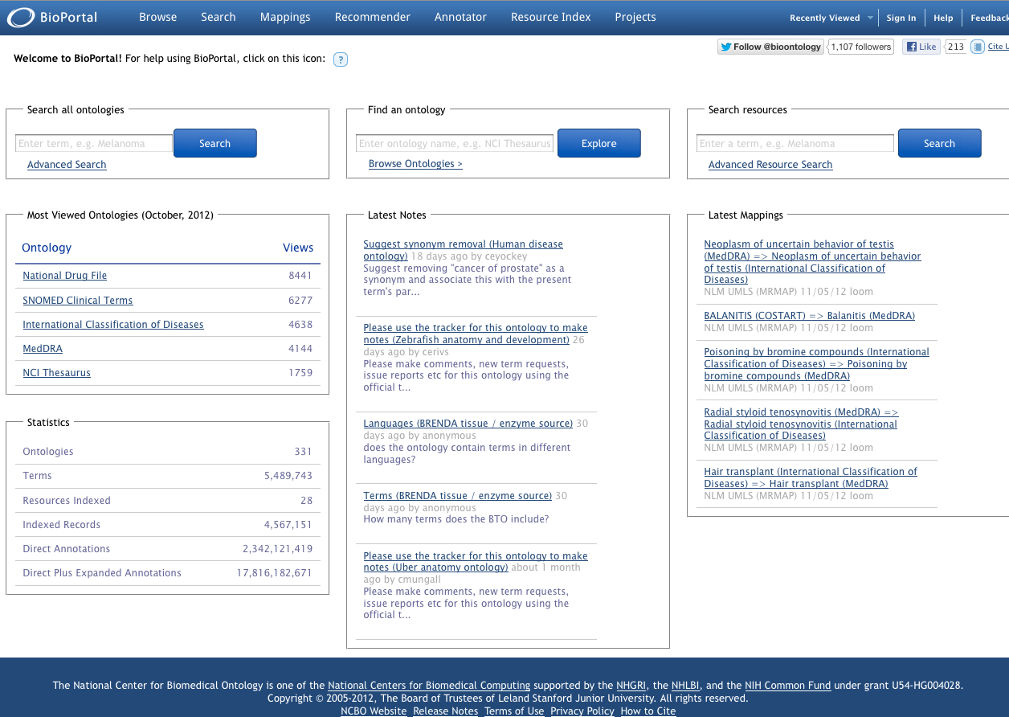
bioportal.bioontology.org

Slide 10
BioPortal
Repository of biomedical ontologies
Infrastructure is domain independent
Stores ontologies developed in OWL, Protégé frames, OBO format, and Rich Release Format
Access to ontologies via Web interface, Web services, and SPARQL
Access control for private ontologies
Supports subsets/views of ontologies

Slide 11
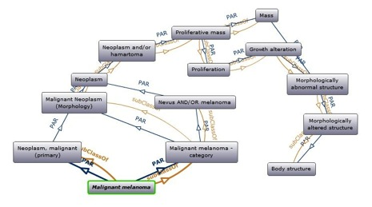
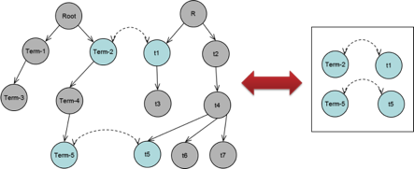
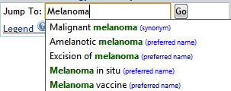
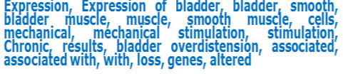
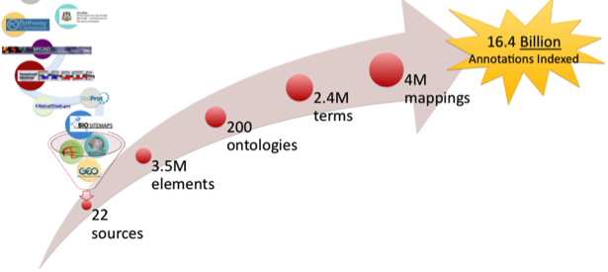
Search
Traverse
Comment
Download
Ontology Services
Mapping Services
Create
Upload
Download
http://rest.bioontology.org
Tree-view
Auto-complete
Graph-view
Widgets
Annotation
Term recognition
Search “data” annotated with a given term
Data Access
http://bioportal.bioontology.org

Slide 12






































Virtual Appliance Installations
Notes:
These are the groups that have a local BioPortal installation
As you can see, this includes both academic and industry, including large and small pharma companies
Increase in number from earth sciences
-OpenClinica – used by over 350 clinical research institutions and has over 12,000 community members

Slide 13














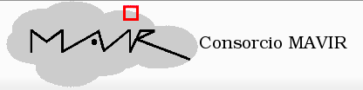












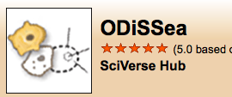





























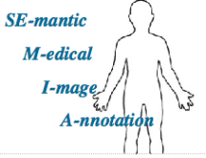















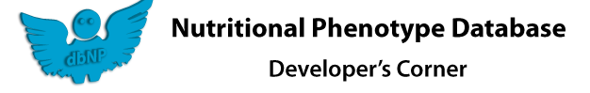






































Who is using NCBO technology?
Notes:
Now, in moving on to who is using our Web services.. There are a number of applications that have been developed that incorporate the Web services.

Slide 14
Outline
NCBO Overview
BioPortal Web and Web services
BioPortal SPARQL Endpoint
BioPortal Metadata Ontology
SPARQL Examples

Slide 15
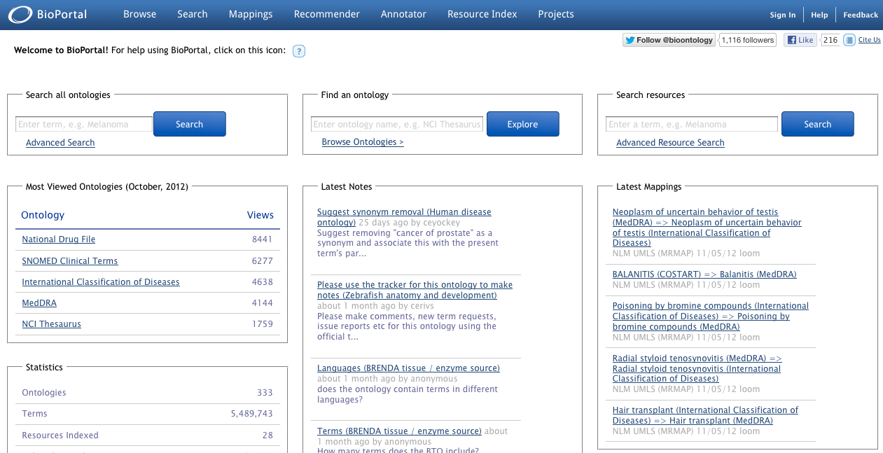
BioPortal Architecture
Third party
applications
Ruby on Rails
Tomcat
Restlet
SPARQL
Access
Spring Framework
Hibernate ORM
RDF
Protégé DB
LexEVS
OWL, RDF,
Protégé frames
OBO format, UMLS RRF, LexGrid XML

Slide 16
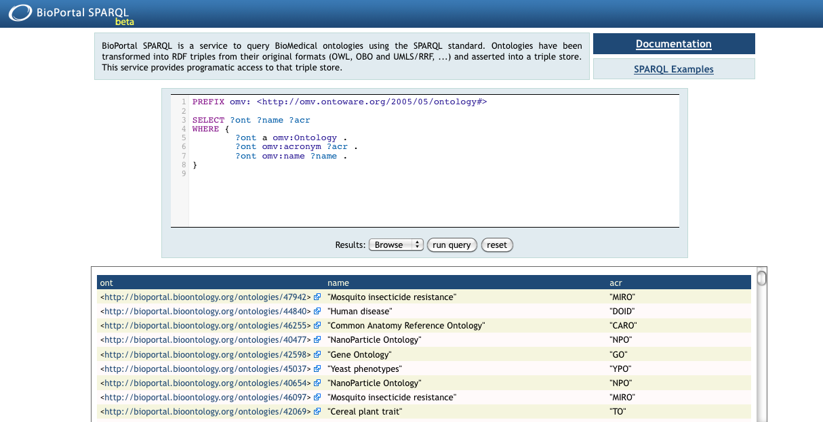
http://sparql.bioontology.org/

Slide 17
BioPortal SPARQL Data
Ontology Content
Ontology Metadata
Mapping Data

Slide 18
BioPortal SPARQL Data cont.
All ontologies from BioPortal
  Original ontology format transformed into RDF
    OBO and OWL converted via OWL API
    RRF converted via UMLS2RDF custom code
  Latest version only
Statistics
  415 ontologies
  4.2M terms
  2419 different predicates
  80M triples

Slide 19
Outline
NCBO Overview
BioPortal Web and Web services
BioPortal SPARQL Endpoint
BioPortal Metadata Ontology
SPARQL Examples

Slide 20
BioPortal Metadata Ontology
Virtual Ontology
  Virtual ontology identifier provides a stable identifier across all versions of the ontology
  All versions of an ontology are linked via this ID
Ontology
  Ontology version identifier is unique for each version of an ontology
  Most metadata linked directly to the ontology version

Slide 21
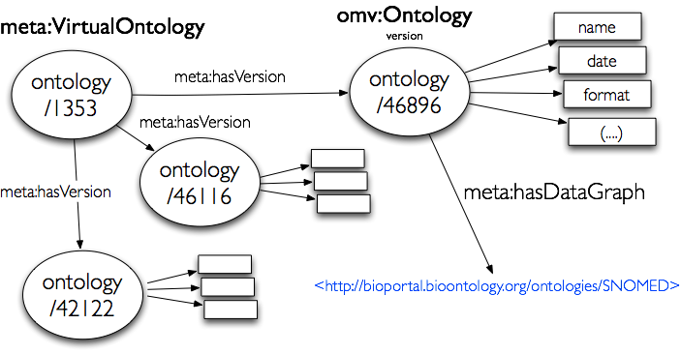
BioPortal Ontology Metadata
Notes:
For the ontology metadata we extend the OMV Ontology metadata vocabulary. Whenever is possible we always use OMV predicates and classes and in other places we define our own.

Slide 22
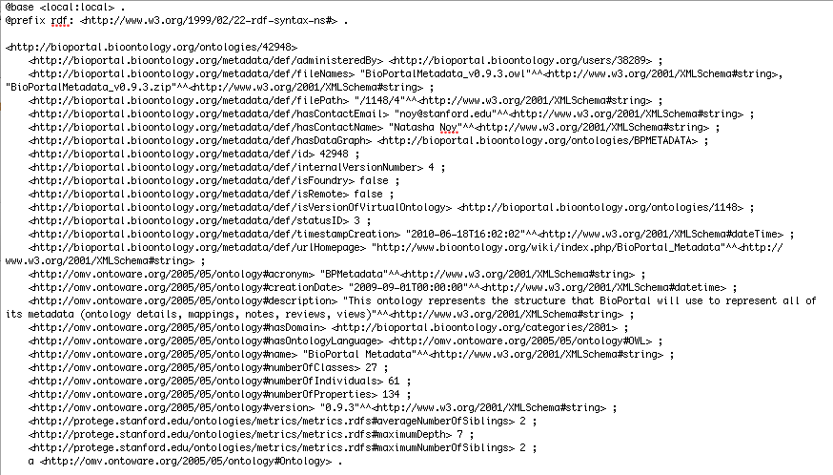
BioPortal Metadata Ontology

Slide 23
Outline
NCBO Overview
BioPortal Web and Web services
BioPortal SPARQL Endpoint
BioPortal Metadata Ontology
SPARQL Examples

Slide 24
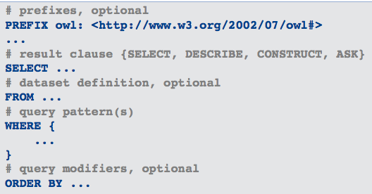
SPARQL Basics
  W3C standard query language for RDF

Slide 25
Prefixes of Interest
meta: http://bioportal.bioontology.org/metadata/def/
omv: http://omv.ontoware.org/2005/05/ontology#
map: http://protege.stanford.edu/ontologies/mappings/mappings.rdfs#
owl: http://www.w3.org/2002/07/owl#
skos: http://www.w3.org/2004/02/skos/core#
rdfs: http://www.w3.org/2000/01/rdf-schema#
rdf: http://www.w3.org/1999/02/22-rdf-syntax-ns#
xsd: http://www.w3.org/2001/XMLSchema#

Slide 26
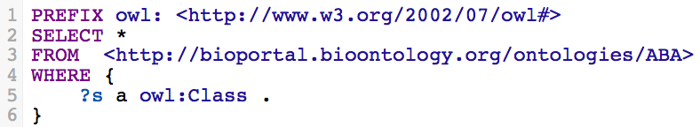
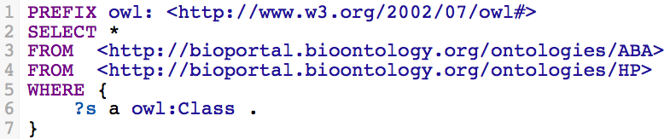

Ontology Content in Named Graphs
No named graph is the same as the union of all graphs.
Notes:
Query 1 – select all term URIs from ABA ontology
Query 2 – select all term URIs from ABA and EFO ontologies
Query 3 – select ?p ?o from all graphs where DOID_8545 is the ?s or subject in the graph
Run count(*) queries to demo differences in results returned
Documentation - http://www.bioontology.org/wiki/index.php/SPARQL_BioPortal#Database_Named_Graph_Structure
ABA Adult Mouse Brain (ABA)
Human Phenotype Ontology (HP)
DOID_8545 malignant hyperthermia

Slide 27
Globals
Provides rdfs:subPropertyOf reasoning to enable querying over multiple ontologies while using the same predicate
  http://bioportal.bioontology.org/ontologies/globals
Implemented for:
  Preferred name – skos:prefLabel
  Synonyms – skos:altLabel
  Term definition – skos:definition
  Term author – dc:author
Notes:
Documentation at http://www.bioontology.org/wiki/index.php/SPARQL_BioPortal#Preferred_Label.2C_Synonyms_and_other_common_predicates

Slide 28
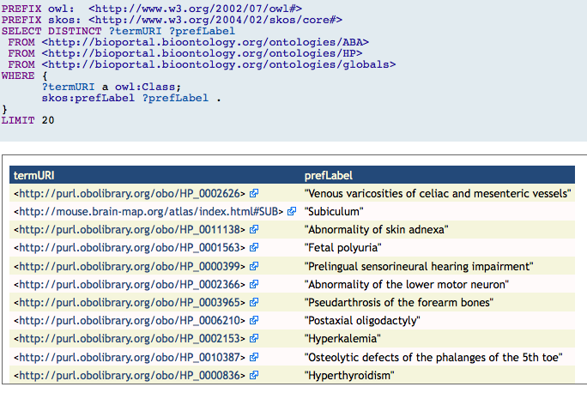
Query including globals

Slide 29
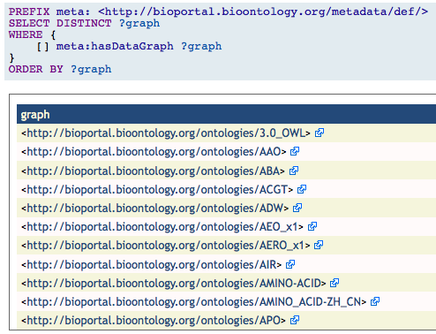
Select all ontology graphs

Slide 30
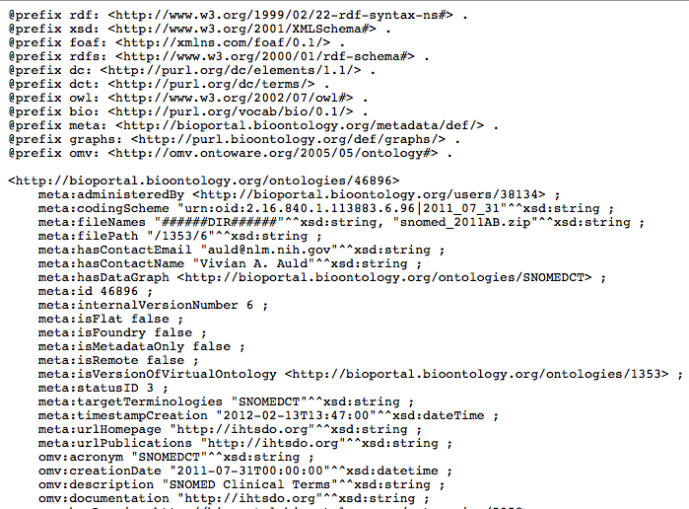
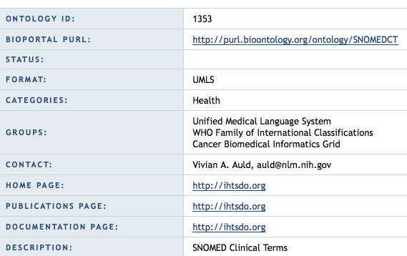

Slide 31
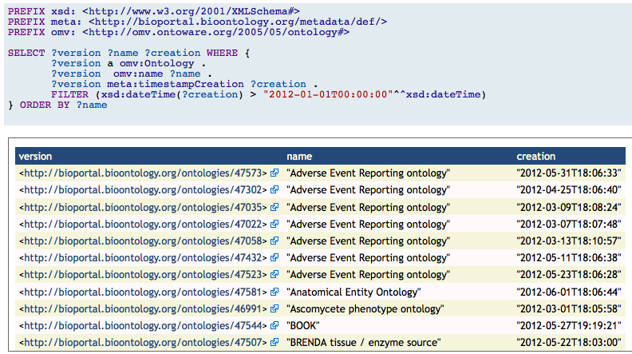
All ontologies updated since DATE

Slide 32
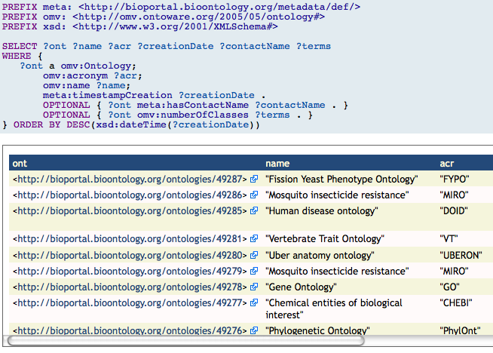
List latest ontologies

Slide 33
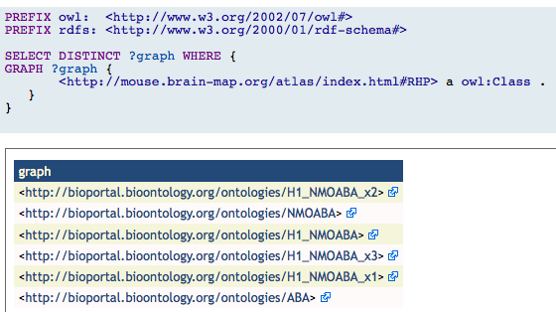
Find term in all ontologies
Notes:
We can use an unbound GRAPH to find in which ontology a pattern is satisfied.

Slide 34
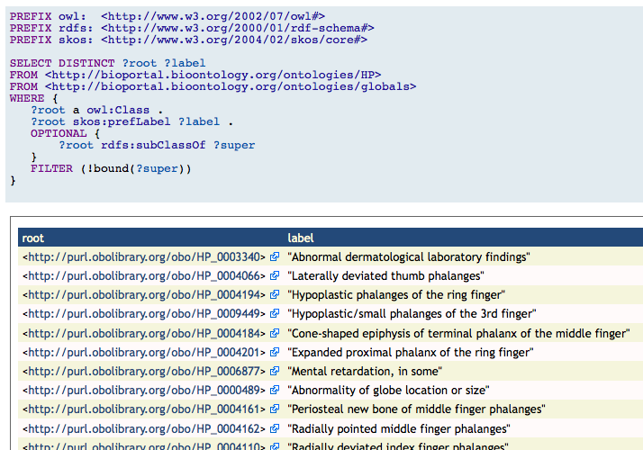
Get all root terms

Slide 35
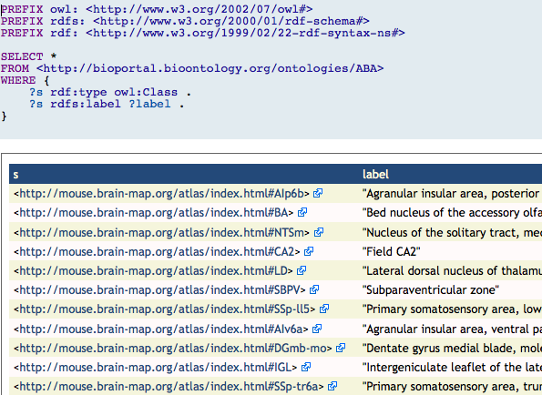
  Select all terms from the
  ABA Adult Mouse Anatomy

Slide 36
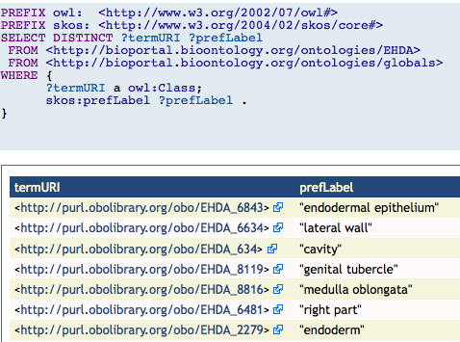
Select URI and preferred label from all terms
Notes:
Our backend has subPropertyOf reasoning to help to retrieve preferable labels, synomyns and definitions.
Use skos:prefLabel for preferable labels, skos:altLabel for synonyms and skos:definition for definitions.

Slide 37
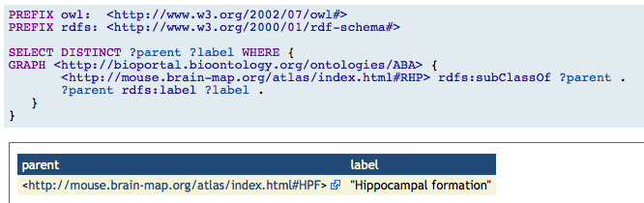
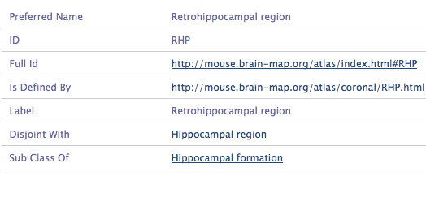
Get parent of given term

Slide 38
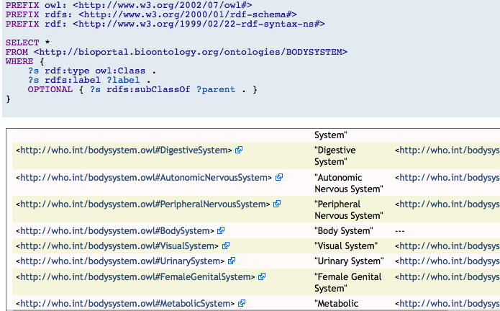
  Select all terms and their parent
Notes:
One can think of optional as a left outer join.
The pattern in the optional will be matched if possible or empty slot will be returned.

Slide 39
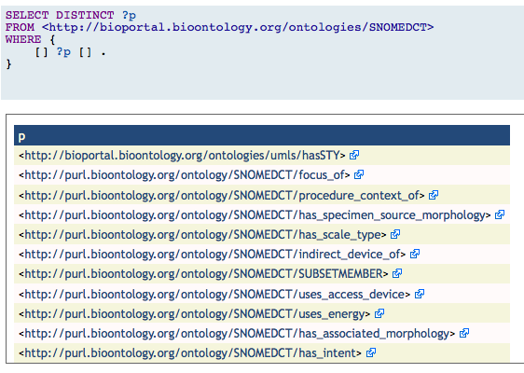
Select distinct properties from an ontology

Slide 40
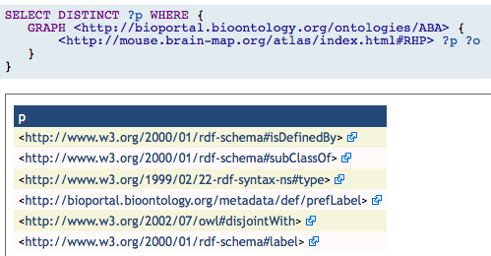
Select properties for term

Slide 41
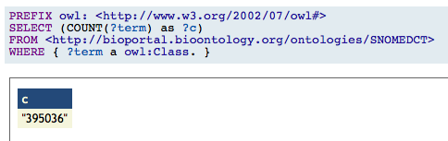
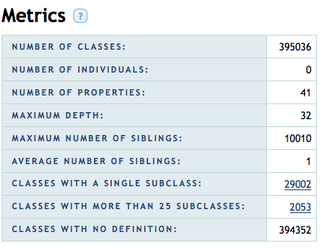
Get count of terms in SNOMED

Slide 42
Mapping Access
Get a list of mappings for an ontology to all other ontologies
Get a list of mappings between two ontologies
Get a list of mappings for a single term
Get a list of mappings between two terms

Slide 43
Mapping Data Sources
Loom - lexical mappings
REST - user submitted mappings
UMLS-CUI - CUI based mappings
OBO-XREF - Mappings for terms with same xref attribute
URI-MATCH - Mappings that for terms that in different ontologies are represented by the same URI
http://www.bioontology.org/wiki/index.php/SPARQL_BioPortal#Mappings

Slide 44
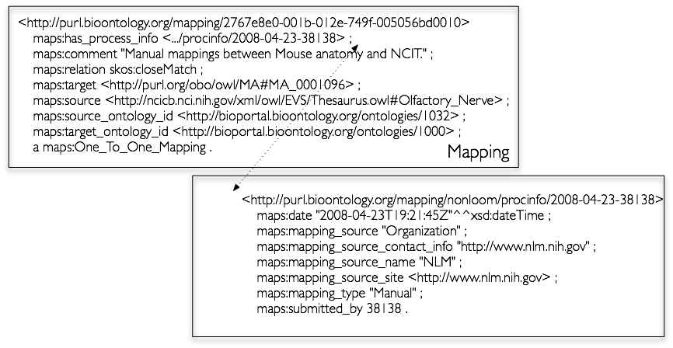
RDF Representation of Mappings
Noy, N.F., Griffith, N., Musen, M.A.: Collecting community-based mappings in an ontology repository. In: International Semantic Web Conference. pp. 371–386 (2008)
Notes:
9M.
reified object to represent the mapping not just a ground triple because we need to record provenance information among other things.
olfatory nerve in NCI thesaurus and Mouse adult gross anatomy

Slide 45
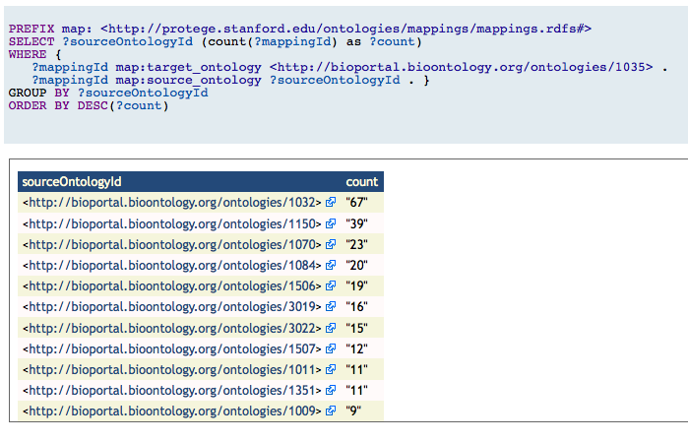
Get mapping statistics for an ontology

Slide 46
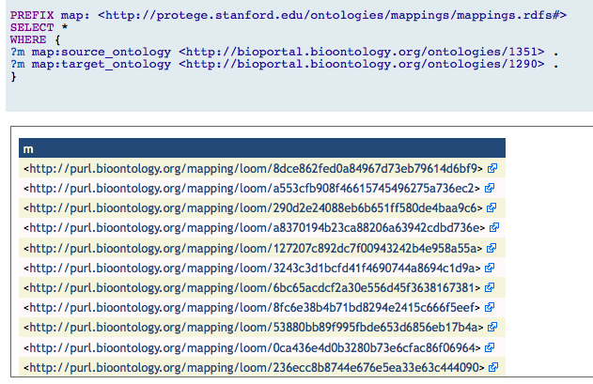
Get all mappings between two ontologies
Notes:
If you want bidirectional mappings you can use a UNION:
PREFIX map: <http://protege.stanford.edu/ontologies/mappings/mappings.rdfs#>
SELECT * WHERE {{
?m map:source_ontology <http://bioportal.bioontology.org/ontologies/1351> .
?m map:target_ontology <http://bioportal.bioontology.org/ontologies/1290> .
}
UNION {
?m map:target_ontology <http://bioportal.bioontology.org/ontologies/1351> .
?m map:source_ontology <http://bioportal.bioontology.org/ontologies/1290> .
}
}

Slide 47
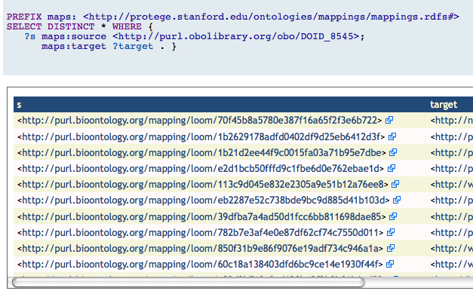
Get all mappings for a given term

Slide 48
Performance Tips and Tricks
  Completely unbound patterns (?g ?s ?p ?o) are not allowed
  To optimize queries, use UNIONS instead of FILTERS
  If using FILTER on literals it is better if the filter is not applied to millions of rows
  To prevent combinatorial explosions of results, consider use CONSTRUCT or DESCRIBE (any M-N relationship can provoke this)
Notes:
Our backend relies on predicate indexing mostly.
and most likely queries with unbound ?p will run slow.

Slide 49
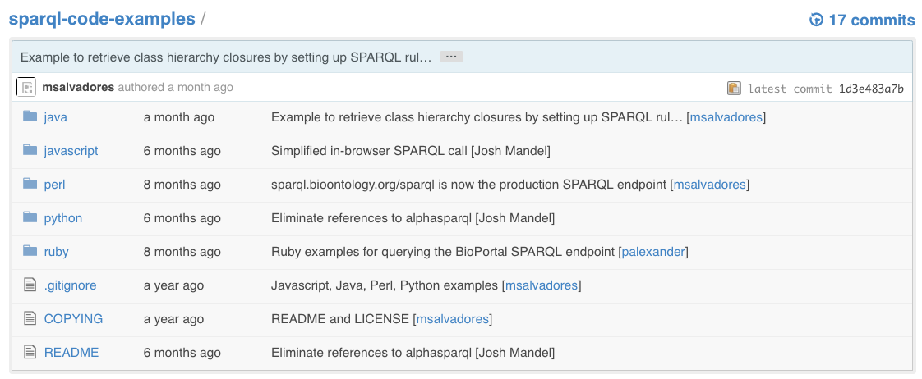
SPARQL Code Repository
https://github.com/ncbo/sparql-code-examples

Slide 50
Thank you!
BioPortal SPARQL documentation:
  http://www.bioontology.org/wiki/index.php/SPARQL_BioPortal
Keep in touch
  Software support: support@bioontology.org
  Twitter: @bioontology
  Facebook: http://on.fb.me/bioontology
  LinkedIn: http://linkd.in/ncbo-group

Slide 51
BioPortal SPARQL Endpoint Info
Documentation: http://www.bioontology.org/wiki/index.php/SPARQL_BioPortal
Query interface: http://sparql.bioontology.org/
Example queries: http://sparql.bioontology.org/examples
Sample code: https://github.com/ncbo/sparql-code-examples

