Slide 2
Introduction
Ontologies
  A specification of a conceptualization (Gruber, 1993)
  Design:
    Subjective
    Depends on the purpose they serve, the aspect(s) they cover
Ontologies Mismatches
  Different Types:
    Conceptualization (e.g., scope, granularity, coverage)
    Explication (e.g., data structure, paradigm)
  Especially in the case of healthcare entities and their data sources:
    Different Classification Systems
      (e.g., vocabularies for laboratory examinations)
    Different Schemas
      (e.g., different parameters to represent hematological examination outcomes)

Slide 3




Ontology-based DB Access
SPARQL
Mediator
SPARQL
D2R
Server
SQL
User / System
XML/RDF
XML/RDF
Tuples
Query & Results
Rewriting
Query Translation
Domain
Global
EHR
Ontology
Local
EHR
Ontology
HealthEntity
EHR
Schema
DB
EDOAL
File
D2RQ
File
Structural & Semantic
Heterogeneity
Syntactic
Heterogeneity
Healthcare
Entity
Mapping
Tool
D2RQ
Platform

Slide 4
Mapping Rules & Ontology Patterns
Mapping Rule Data
  Entities 1 and 2 → Ontology Pattern Instances
    An existing element (e.g., an OWL class)
    An element with narrower meaning (e.g., a Property with Restricted Domain)
    A combinations of existing elements (e.g., union of OWL classes)
  Relation (e.g., Equivalent Terms)
  Data Transformation (if required)
  Direction (e.g., From Ontology 1 to Ontology 2)
Mapping Rule Metadata
  Origin ( Manually / Automatically )
  Confidence Value
  Comments

Slide 5
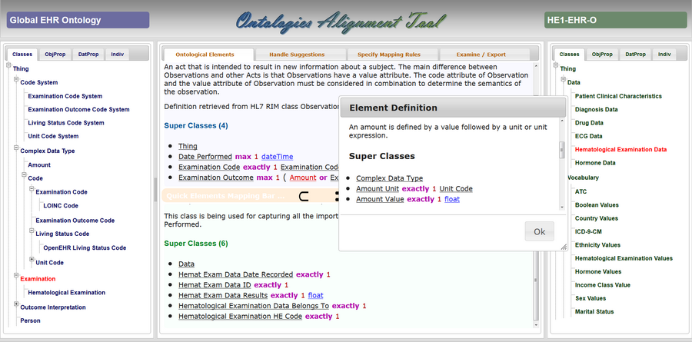
Functionality provided by OAT
LOAD
ONTOLOGY
A
LOAD
ONTOLOGY
B
Explore Ontological Elements
Handle Candidate Mapping Rules
Specify Mapping Rules missing
Save/Export Mapping Rules

Slide 6


System Architecture
Client Side
Server Side
Web Interface
Requests
Handler
Ontologies
Handler
Upload Ontologies
Get Available Terms
Get Element Definition
Get Suggestions
Mappings
Handler
Upload Mappings
Export Mappings

Slide 7



Interaction among Components (1/2)
Web Interface
Requests
Handler
Ontologies
Handler
Mappings
Handler
Upload Ontology (File|URL)
Store Onto File (File|URL)
Store
Provide
Ontology
ID &
Imports
Read
Imports
Json Data
Upload (List<URL,File|URL>)
Store Onto File (File|URL)
Store
Read
Imports
Resolve
Dependencies
Json Data
OntoJson
& Type
Get Elements (Onto, Type)
get Elements Tree (ID, Type)
Load Ontology
(first time)
Get
Ontological
Elements
Update Panel
Json Data
Get Elements

Slide 8

Interaction among Components (2/2)
Web Interface
Requests
Handler
Ontologies
Handler
Mappings
Handler
OntoJson & ElemURI
get Element Def (Onto, URI)
get Element File (Onto, File)
Get
Element
Definition
UI
Update
Json Data
Update Panel
Ontos & Mappings
get Suggestions (Ontos,Maps)
Get
Suggestions
find Suggestions ( … )
UI
Update
Json Data
Update Panel
OntoJson & Mappings
Export (Ontos, Maps, Format)
Export
Mappings
create Mappings File ( … )

Slide 9
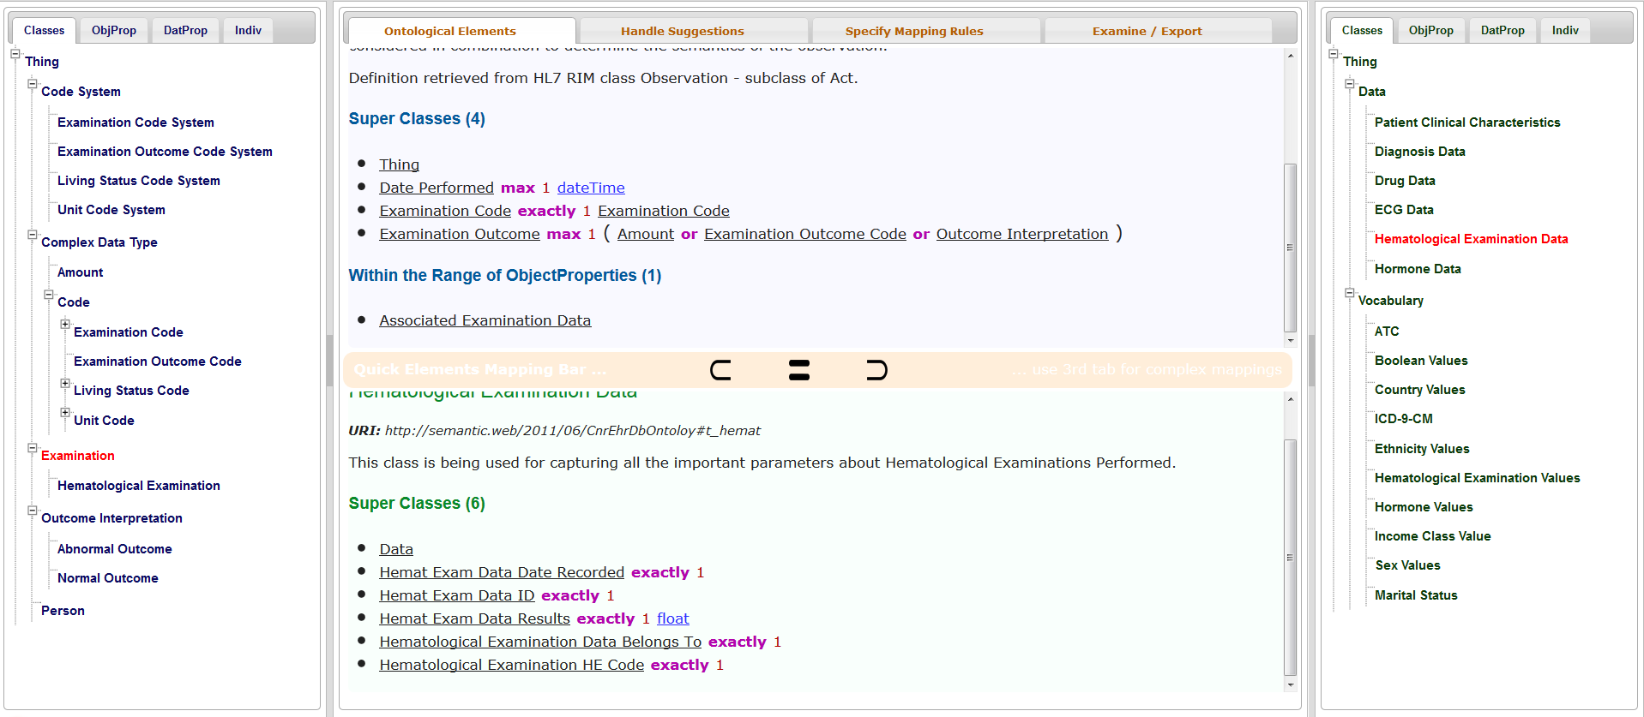
Interaction with the End Users (1/4)
  Examine Ontological Elements
  Quickly Define 1:1 Correspondences

Slide 10
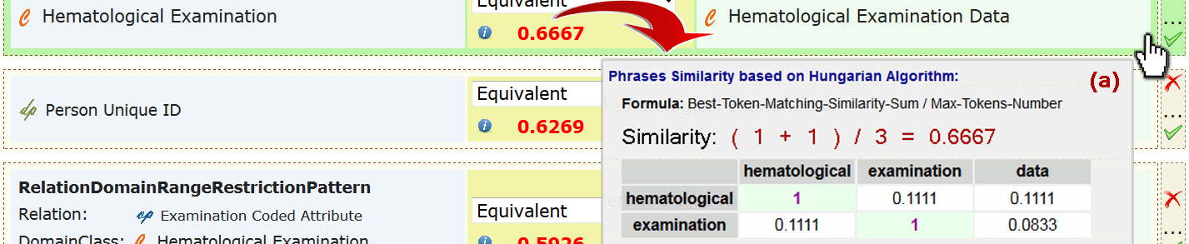
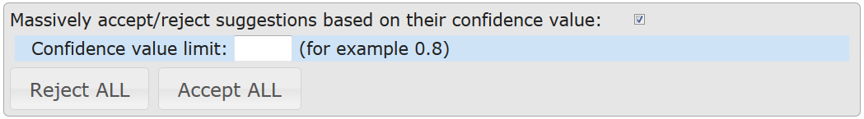
Interaction with the End Users (2/4)
  Handle Suggestions
                Accept /
      Reject
  Massively Accept / Reject based on the Confidence Value
  Reload or Export Suggestions

Slide 11
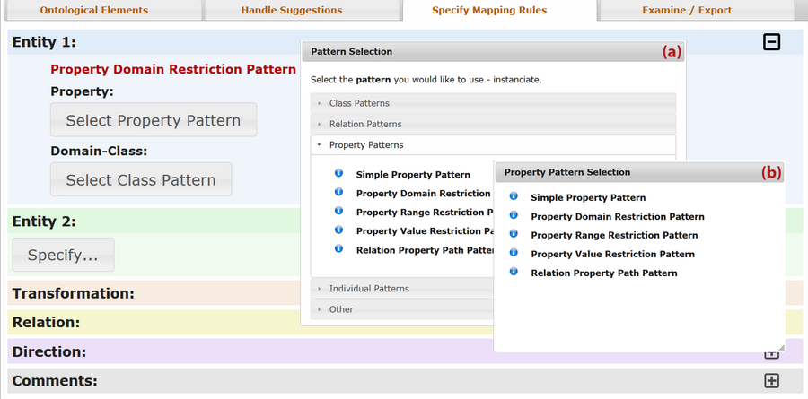
Interaction with the End Users (3/4)
  Manually Specify Mapping Rules – Ontology Pattern Instantiations

Slide 12
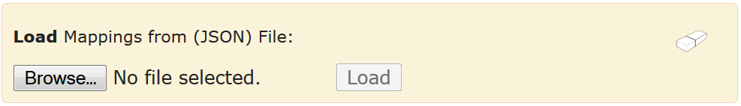
Interaction with the End Users (4/4)
  Load Mapping Rules
    JSON Format
  Save/Export Mapping Rules
    JSON / XML (EDOAL) / HTML

Slide 13
Live Demo
Use the Ontologies Alignment Tool for specifying the mappings between:
  Global EHR Ontology
    Designed in close collaboration with clinical experts
  Healthcare Entity EHR Ontology
    Automatically generated based on DB schema
Goal
  Precisely determine correspondence among them
    Intend to use mappings for SPARQL query rewriting

Slide 14
Conclusion and Next Steps
The Ontologies Alignment Tool covers all process driven requirements
  Weaknesses:
    Improve the quality of suggested mapping rules
    Visualization of suggestions and mapping rules
Next Steps:
  Update Site
    Tool Architecture
    Source Code
  Update The Ontologies Alignment Tool
    Fix errors/weaknesses

Slide 15

Thank you !
Questions ?

Slide 16

Backup Slides

Slide 17
Manually specifying a Mapping Rule
Web Interface
Requests
Handler
Ontologies
Handler
Mappings
Handler
Mapping Rules Repository and Panel Initialize / Update
Handle
Mapping
Rules
Rules specified are stored on client side.
Mapping Rule
Change ...
Accept / Reject
Manually
Specify a
Mapping Rule
Tab 2 ...
For manually specifying a mapping rule, none server side component is being used.
( in the current version of OAT )
Update Panel
Json
Mapping Rules
Parameters
Manually
Specify a
Mapping Rule
Tab 3 ...
Ontology Pattern(s)
Instantiation
Json

Slide 18
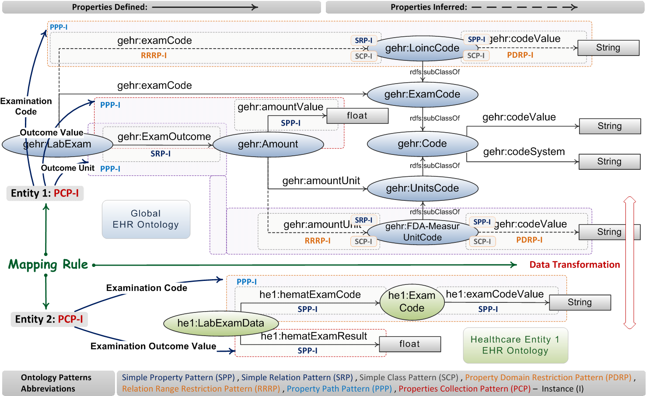
Example: Examination Outcome

