Slide 1
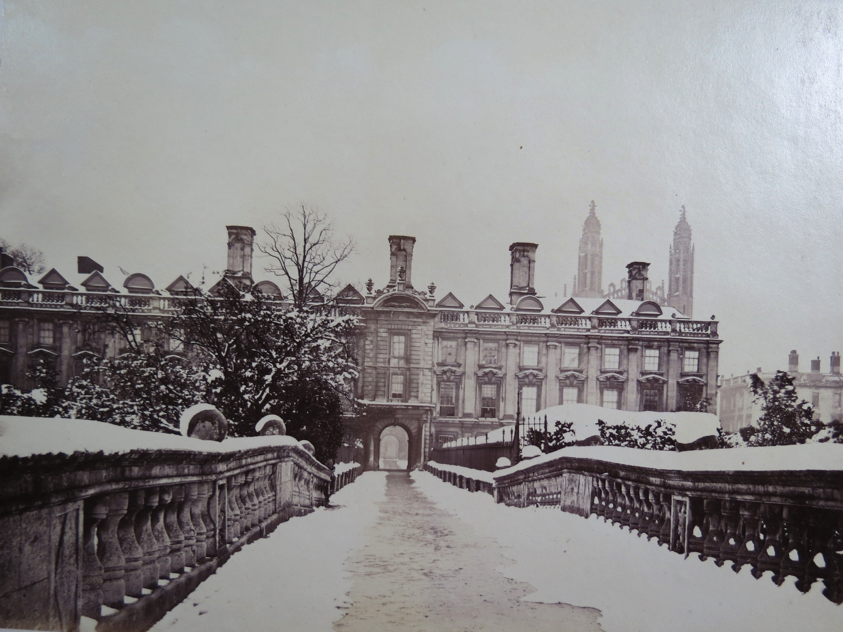


Semantic Web Applications and Tools for Life Sciences 2015
#swat4ls

Slide 2





Sponsors & Supporters
NCBO
Neo4J
EBI
FactBio

Slide 3
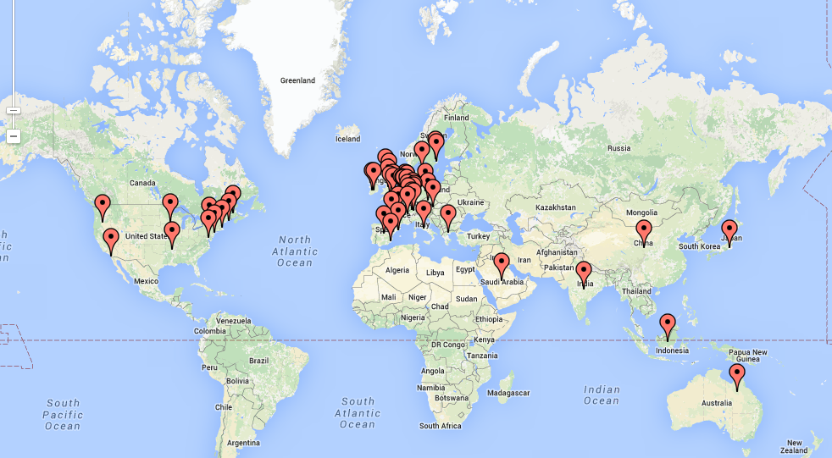
Truly International

Slide 4
SWAT4LS this Year
First time as a two day conference.
Attenders:
  100 at the conference;
  66 at the tutorials;
    59 at the Hackathon.
    submissions:
      52 papers and demos
      33 Posters
      54% acceptance rate for papers.
Thanks to the PC and the authors
If you don’t intend to go to dinner can you tell us (email james@factbio.com or tell him)

Slide 5
Hackathon
There is a hackathon Thursday organised by Simon Jupp jupp@ebi.ac.uk
Bus leaves at 8:30am sharp outside entrance to Clare College Conferencing (here)
If you have ideas, topics you want to work on or data please see: https://goo.gl/X9ltHR
Or the main swat4ls hackathon webpage: http://www.swat4ls.org/workshops/cambridge2015/programme/hackathon/

Slide 6
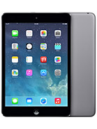
Prizes!
A best paper prize – iPad mini first author (or other presenter) & certificate
A best poster prize – similarly iPad mini & certificate
Final judging during the conference
Announced at closing ceremony

Slide 7
The Organisers
General Chair: Andrea Splendiani
Scientific Chairs: James Malone and Robert Stevens
Local Chair: James Malone
Industry Chair: Kerstin Forsberg
Tutorial Chair: M Scott Marshall
Hackathon Chair: Simon Jupp

Slide 8
Thanks go to…
Authors and attenders at the various SWAT4LS events
Our sponsors
Our PC
The EBI and FactBio
Clare College
The SWAT4LS team
Especially James Malone for being local organiser

