Slide 1
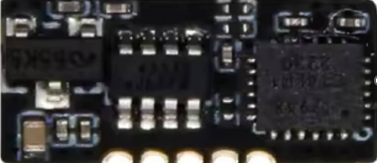
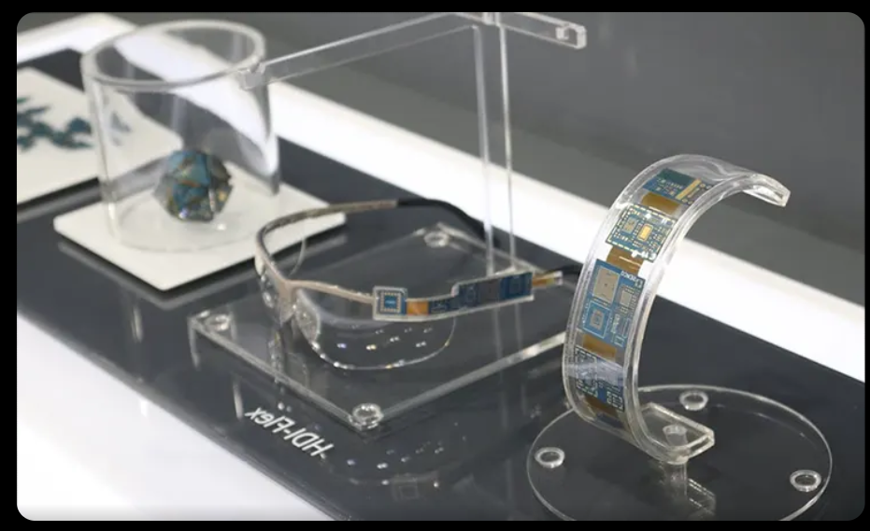
VLS 603 — ELECTRONIC SYSTEMS PACKAGING
WEARABLE ASSISTIVE TECH
Navigator Band
◉
Haptic Obstacle Guidance for the Visually Impaired
Swayam Kotecha | ESP32-S3 · 4 Sensors · Dual Haptic Motors
ESP32-S3 · I2C · BLE
SLIDE 1 / 8

Slide 2
THE PROBLEM
253 million visually impaired people worldwide
CURRENT SOLUTIONS
OUR SOLUTION
White cane
no real-time obstacle alerts
Wristband form factor
socially invisible, always with you
Phone audio
phone must stay out of pocket
Haptic + audio output
no visual needed, phone stays pocketed
Chest devices
bulky, socially very visible
Fully self-contained
no phone, no app, no internet required
SLIDE 2 / 8

Slide 3
SYSTEM ARCHITECTURE
Four functional blocks on one PCB
POWER BLOCK
MCU BLOCK
SENSOR BLOCK
FEEDBACK BLOCK
USB-C
ESP32-S3
VL53L1X (ToF)
DRV2605L(Haptic)
MCP73831
BLE 5.0
ICM-42688 (IMU)
2× LRA Motors
XC6206 LDO
I2C Master
VEML7700 (Light)
MAX98357 Amp
LiPo 400mAh
I2S Audio
MAX30205 (Temp)
Micro Speaker
3.3V rail
3.3V logic
I2C bus shared
Haptic + Audio
SLIDE 3 / 8

Slide 4
SENSOR SUITE
Four sensors, four purposes
①
VL53L1X — Time of Flight
Fires infrared laser 50×/sec · measures distance 0–4m · primary obstacle sensor
②
MPU9250 — IMU
Accelerometer + gyroscope · corrects ToF readings for wrist tilt · counts footsteps
③
VEML7700 — Ambient Light
Measures lux level · switches polling rate indoors vs outdoors · saves battery
④
MAX30205 — Skin Temperature
Reads skin surface temp · detects if device is worn · triggers deep sleep when removed
SLIDE 4 / 8

Slide 5
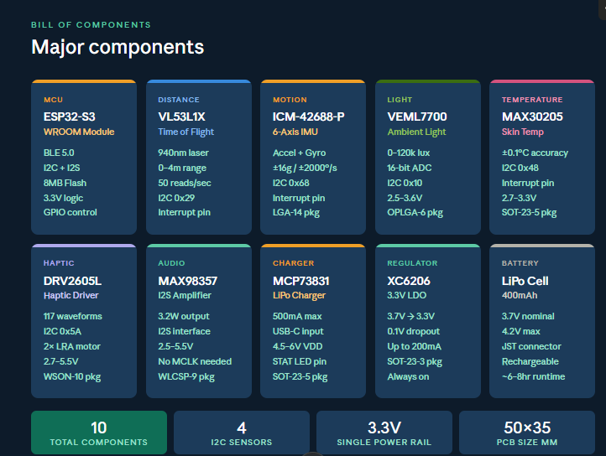
40X36

Slide 6
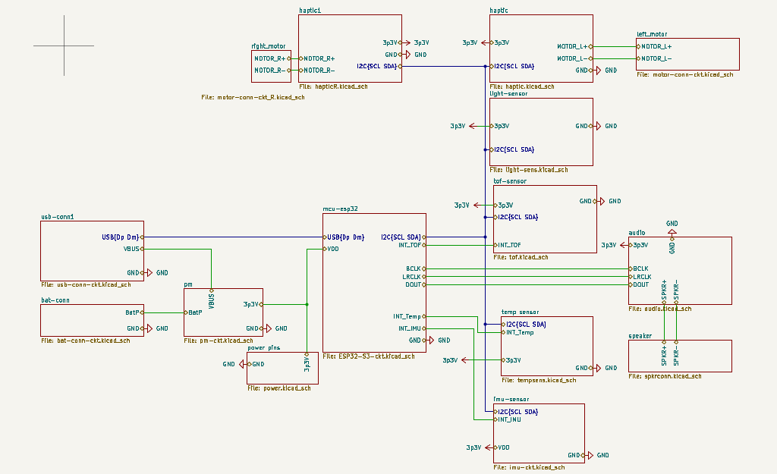

Slide 7
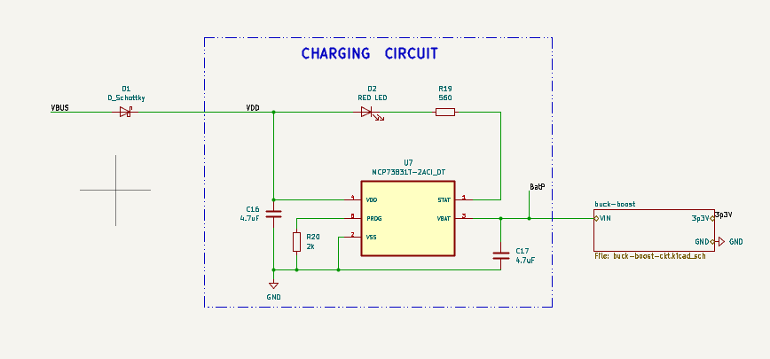
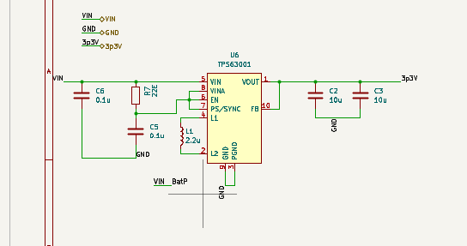
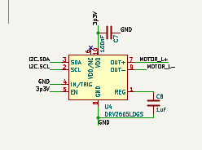
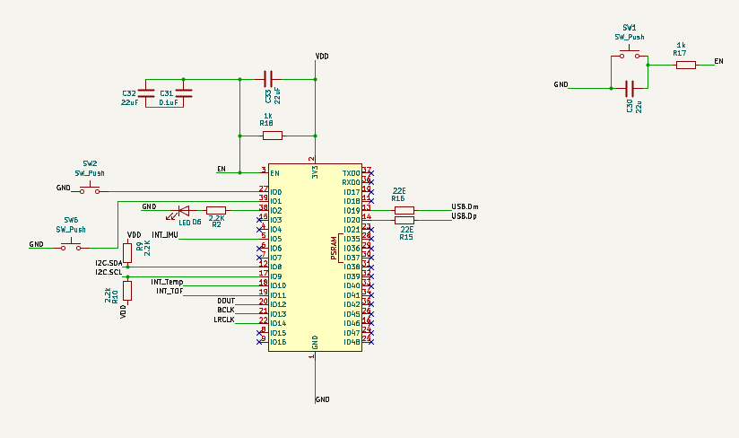
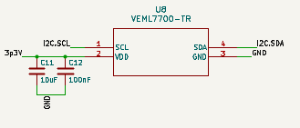
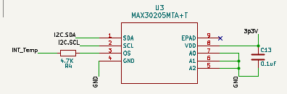
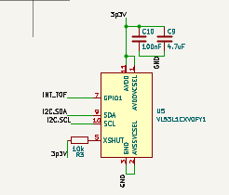
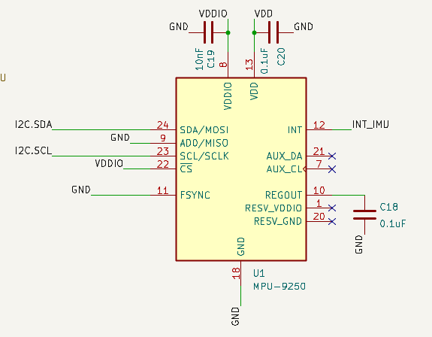
Power manag
Lin reg(3.7->3.3)
Haptic
ESP-32
Temp
Light sensor
IMU sensor
Tof

Slide 8
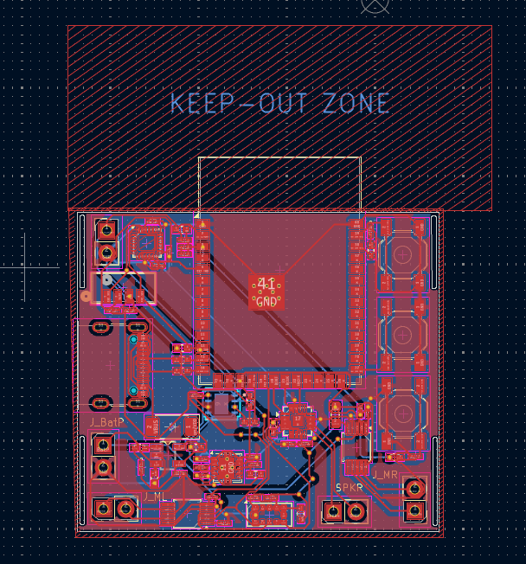
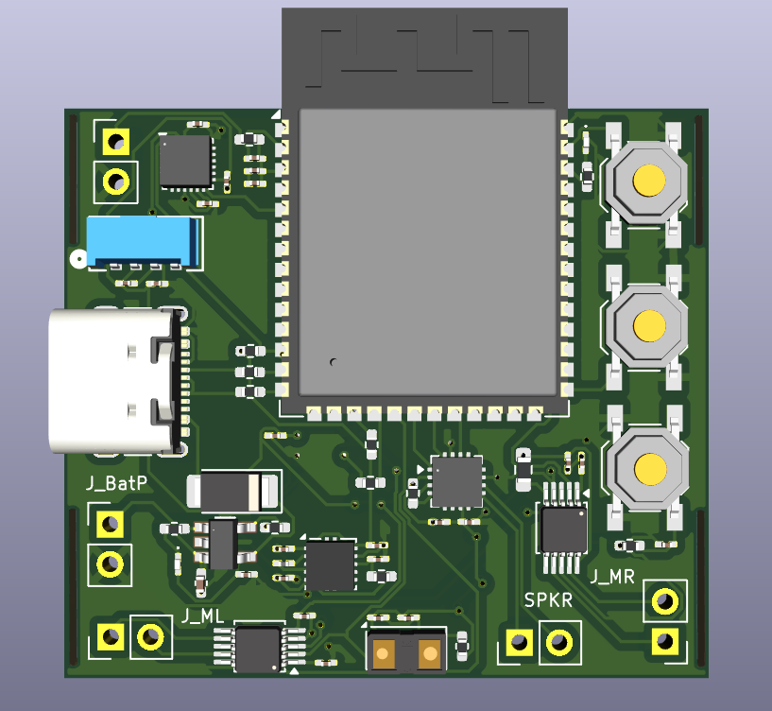
IMU
Light sensor
ESP-32
Haptic
ToF sensor
audio

Slide 9
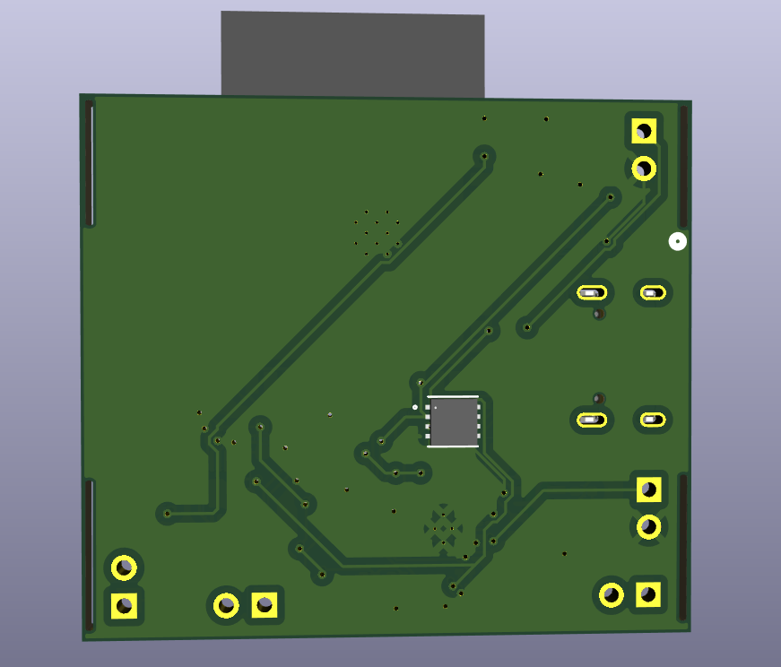
Body Temp sensor(in contact with skin)

Slide 10
HOW IT WORKS
Step-by-step obstacle response pipeline
Boot
ToF Fires
IMU Check
Alert Level
Feedback
Skin temp check 3 buzz startup All sensors init
Laser pulse sent Distance measured 50 times/sec
Wrist angle verified Ignore if pointing at floor
<50cm strong buzz <100cm double pulse <150cm slow pulse
Haptic motors fire Audio: Move right Left/right motors differ
→
→
→
→
SLIDE 5 / 8

Slide 11
FEEDBACK DESIGN
Haptic grammar + pre-loaded audio cues
VIBRATION PATTERNS — DRV2605L
AUDIO CUES — MAX98357 + SPEAKER
> 150 cm
No vibration — clear path
left.wav
"Turn Left"
Obstacle detected on the right side
80–150 cm
Slow single pulse — caution
right.wav
"Turn Right"
30–80 cm
Fast double pulse — slow down
Obstacle detected on the left side
stop.wav
< 30 cm
Strong continuous buzz — STOP
"Stop!"
Obstacle closer than 30 cm — halt
All clips stored in ESP32-S3 flash memory · ~20 KB each · fully offline
SLIDE 7 / 8

Slide 12
POWER ARCHITECTURE
USB-C charging · single clean 3.3V rail
INPUT
Skin temp drops → device removed → full system enters deep sleep
Skin temp drops → device removed → full system enters deep sleep
USB-C — 5V
↓
CHARGER IC
MCP73831
↓
STORAGE
LiPo 400mAh (3.7V nominal)
↓
REGULATOR
XC6206 LDO → 3.3V
3.3V Rail → ESP32-S3 · All 4 Sensors · DRV2605L · MAX98357
SLIDE 6 / 8

Slide 13
KICAD DELIVERABLES
What we design and submit
PCB LAYOUT — 2 LAYER · 40x36 mm
01
Power
Ground plane
USB-C, MCP73831, XC6206 LDO, LiPo connector
Full bottom copper pour, all GND nets connected
02
MCU
ERC clean
ESP32-S3 module, all pin labels, decoupling caps
Zero errors · Zero Warnings
03
Sensors
DRC clean
All 4 sensor ICs, I2C bus, 4.7kΩ pull-up resistors
Zero errors · 3D view generated · Gerbers exported
04
Feedback
Bill of Materials
DRV2605L haptic driver, MAX98357 amp, connectors
Part numbers, package sizes, footprints all listed
Self-contained · No app · No GPS · Fully demonstrable in classroom
VLS 603 · Navigator Band
SLIDE 8 / 8

