Slide 1

Real-Time-Voice-Activated-Emergency Detection System for Smart Factories

Slide 2
Introduction
This project introduces a real-time voice-controlled emergency detection system designed for smart factory environments.
Using TinyML deployed on a Raspberry Pi 4, the system continuously listens for the keyword “STOP” through a connected microphone.
Upon detecting the word, the Pi triggers an Arduino-based response unit that activates visual and audible alerts.
The model, trained and quantized with TensorFlow Lite for efficient edge inference, ensures low-latency performance and offline functionality.
This system demonstrates how edge AI and embedded voice recognition can enhance workplace safety through immediate and automated emergency response.

Slide 3
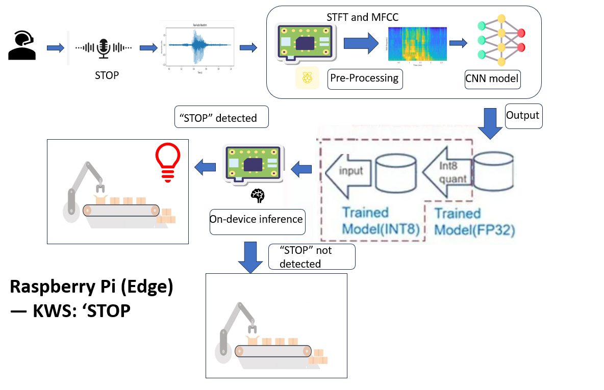
System Architecture

Slide 4
Advantages
Fully on-device Edge AI inference ensures real-time response with zero cloud dependency, zero latency, and uninterrupted performance.
Reliable during network failures since processing happens entirely locally
Hands-free emergency activation, useful when workers can’t reach physical switches
Complements vision-based defect detection systems, forming a multi-layer safety solution.
Context aware decision making using all other environmental and instrumental data from sensors.
Privacy-preserving (raw audio never leaves the device)
Highly customizable to different keywords, accents, or factory needs
Works in noisy industrial environments using MFCC + optimized TinyML model
Enhances Industry 4.0 workflows by combining safety, automation, and edge AI

Slide 5
Existing systems and their limitations
Physical emergency stop buttons (E-Stop)
Safety buzzer alarms
CCTV-based monitoring systems
Manual supervision by safety officers
IoT systems requiring cloud connectivity
Limitations-
Workers may not reach the E-stop button during emergencies (hands fixed, pinned, unconscious, etc.)
Not adaptive to different accents or dynamic conditions
Manual activation only, no hands-free option
IoT/cloud systems fail during network outages
Expensive industrial AI voice systems
No context aware decision making.

Slide 6
System Details-
On-device keyword spotting (“STOP”) using Raspberry Pi
Audio captured via microphone → processed locally
MFCC feature extraction for compact audio representation
TinyML model runs fully offline for real-time inference
Detects keyword and send an alert
Techniques Used-
Digital Signal Processing (MFCC extraction)
Lightweight neural network for KWS
Real-time, edge-based inference (no cloud)
Wireless microcontroller communication
TinyML optimization for low-latency response

Slide 7
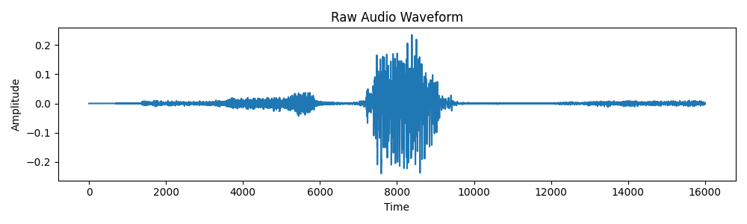
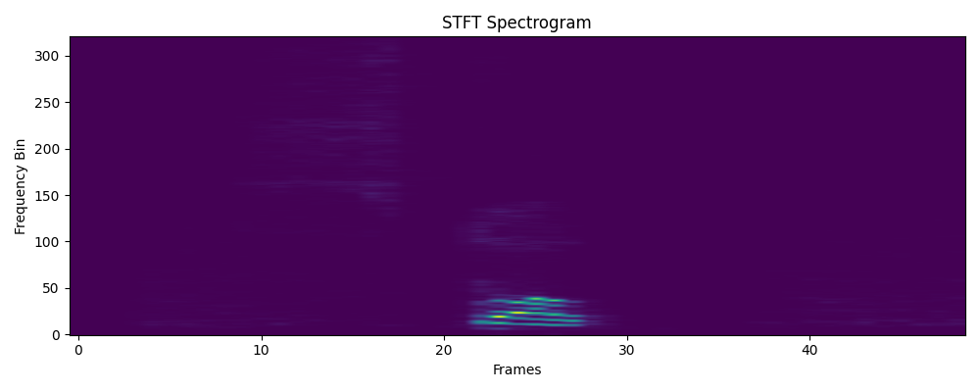


Results
🔷 Raw Audio
Shape: (16000,)
Duration: 1.00 sec
🔶 STFT Magnitude Spectrogram
STFT shape: (49, 321)
Spectrogram shape: (49, 321)
🔷 Mel Spectrogram
Mel Spectrogram shape: (49, 40)
🔶 Log-Mel Spectrogram
Log-Mel shape: (49, 40)
🔷 MFCCs (13 coefficients)
MFCC shape: (49, 13)
Model | Preprocessing Time | Inference Time | Total Latency | Model Size
TensorFlow (.h5) | 19 ms | 105 ms | 124 ms | ~2–3 MB
TFLite Quantized | 19–26 ms | 0.5 ms | 20–27 ms | 80 KB

